Slide 1
Introduction to
TAMIU’s
Dusty Works!
Presented by:
The Office of Career Services
Student Center, 114

Slide 2

What is Dusty Works!?
  Dusty Works is TAMIU’s Online Job Board that provides On-Campus Jobs and Off-Campus Jobs.
Who can use Dusty Works!?
  Current TAMIU Students and TAMIU Alumni.

Slide 3
Student Employment Program
(SEP) Application
Important:
  The Student Employment Program does not accept paper applications. Applications must be submitted through Dusty Works.
  Application must be done on a PC, not a Mac. (Apple computers tend to make applications appear blank.)
  Adobe Reader does not save any typed information on the PDF application. Adobe Acrobat Professional will allow the applications to be edited and saved.

Slide 4
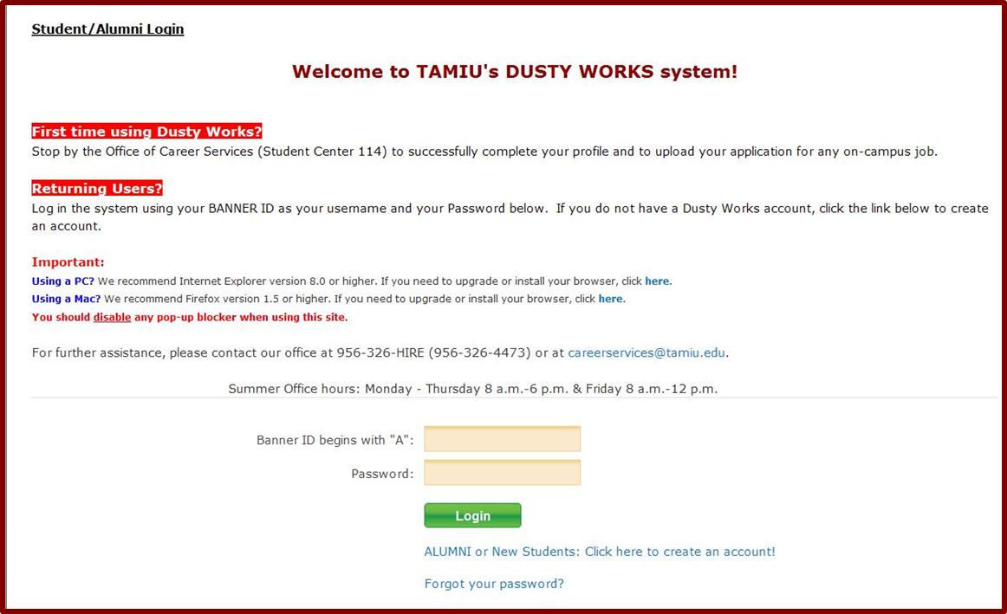
Dusty Works! Login Page
If you are a new student, you will need to set up your profile first.
Password: Your Birthday (mm/dd/yyyy) Format.

Slide 5
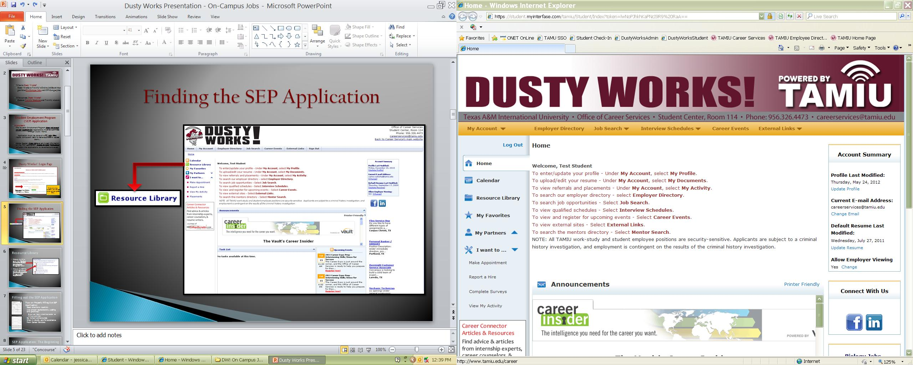
Finding the SEP Application

Slide 6
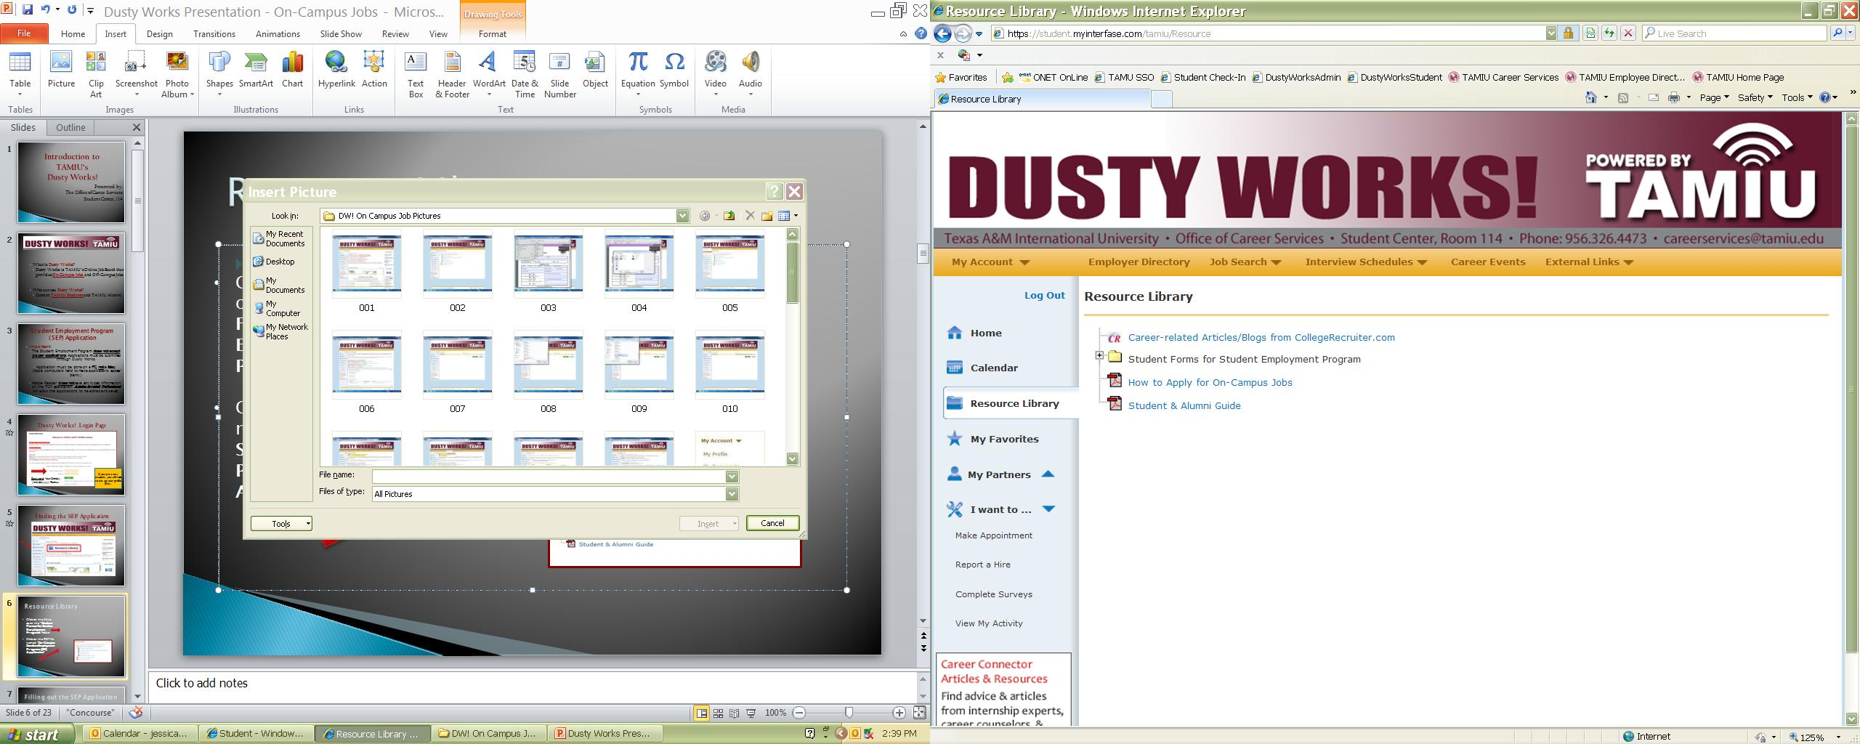
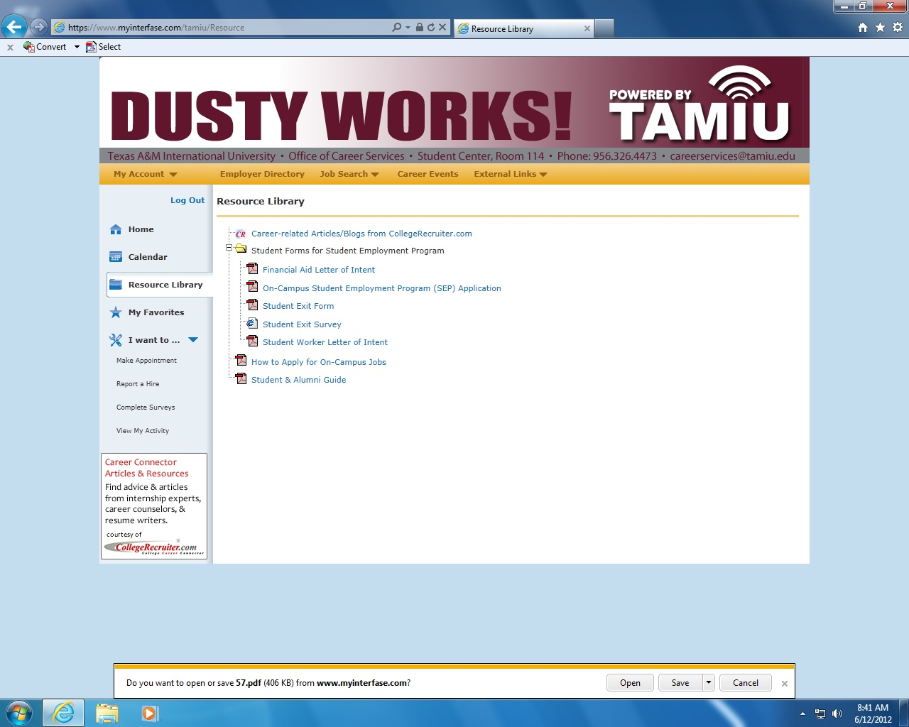
Resource Library
Click on the [+] to open the “Student Forms for Student Employment Program” Folder
Click on the PDF file named “On-Campus Student Employment Program (SEP) Application”

Slide 7
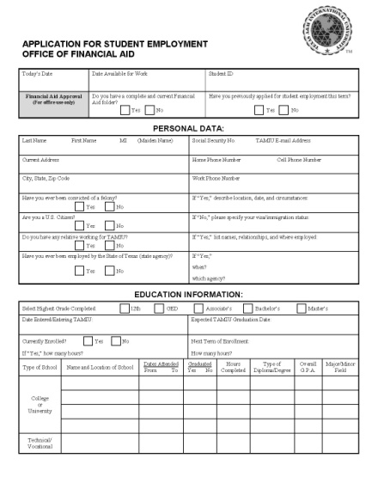
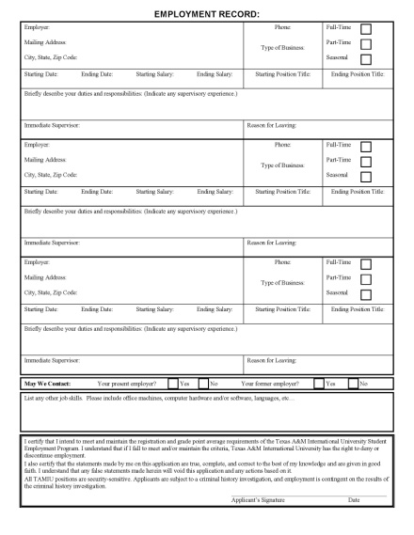
Filling out the SEP Application
Tips on Properly Filling Out SEP Application
  Read directions carefully.
  Use proper spelling and grammar.
    Errors can leave a bad impression on hiring supervisors.
  Be honest and accurate.
  When in doubt, ask for assistance from Career Services.

Slide 8

SEP Application: The Beginning
“Date Available for Work”:
List date you can begin work or type “ASAP”
(As Soon As Possible)
“Student ID”: Complete BannerID (ex. A00012345)

Slide 9
SEP Application: Personal Data
Enter your Social Security Number, or leave blank if you don’t have one.
Enter your phone number(s) and e-mail address to be contacted by employer.
Be sure to answer questions on right, depending if you answered “Yes” or “No”.

Slide 10
SEP Application: Education Information
“Date Entered/Entering TAMIU”: List semester entered TAMIU
(Example: “08/2011” or “Fall 2011”)
“Expected TAMIU Graduation Date”: List estimated semester graduating
(Example: “05/2011” or “Spring 2012”)
“Currently Enrolled?”: Depends on date application is filled out
“Next Term of Enrollment”: List the next semester you will be taking
courses at TAMIU
“College or University” and “Technical/Vocational”: Include any previous higher education experience, including TAMIU courses

Slide 11
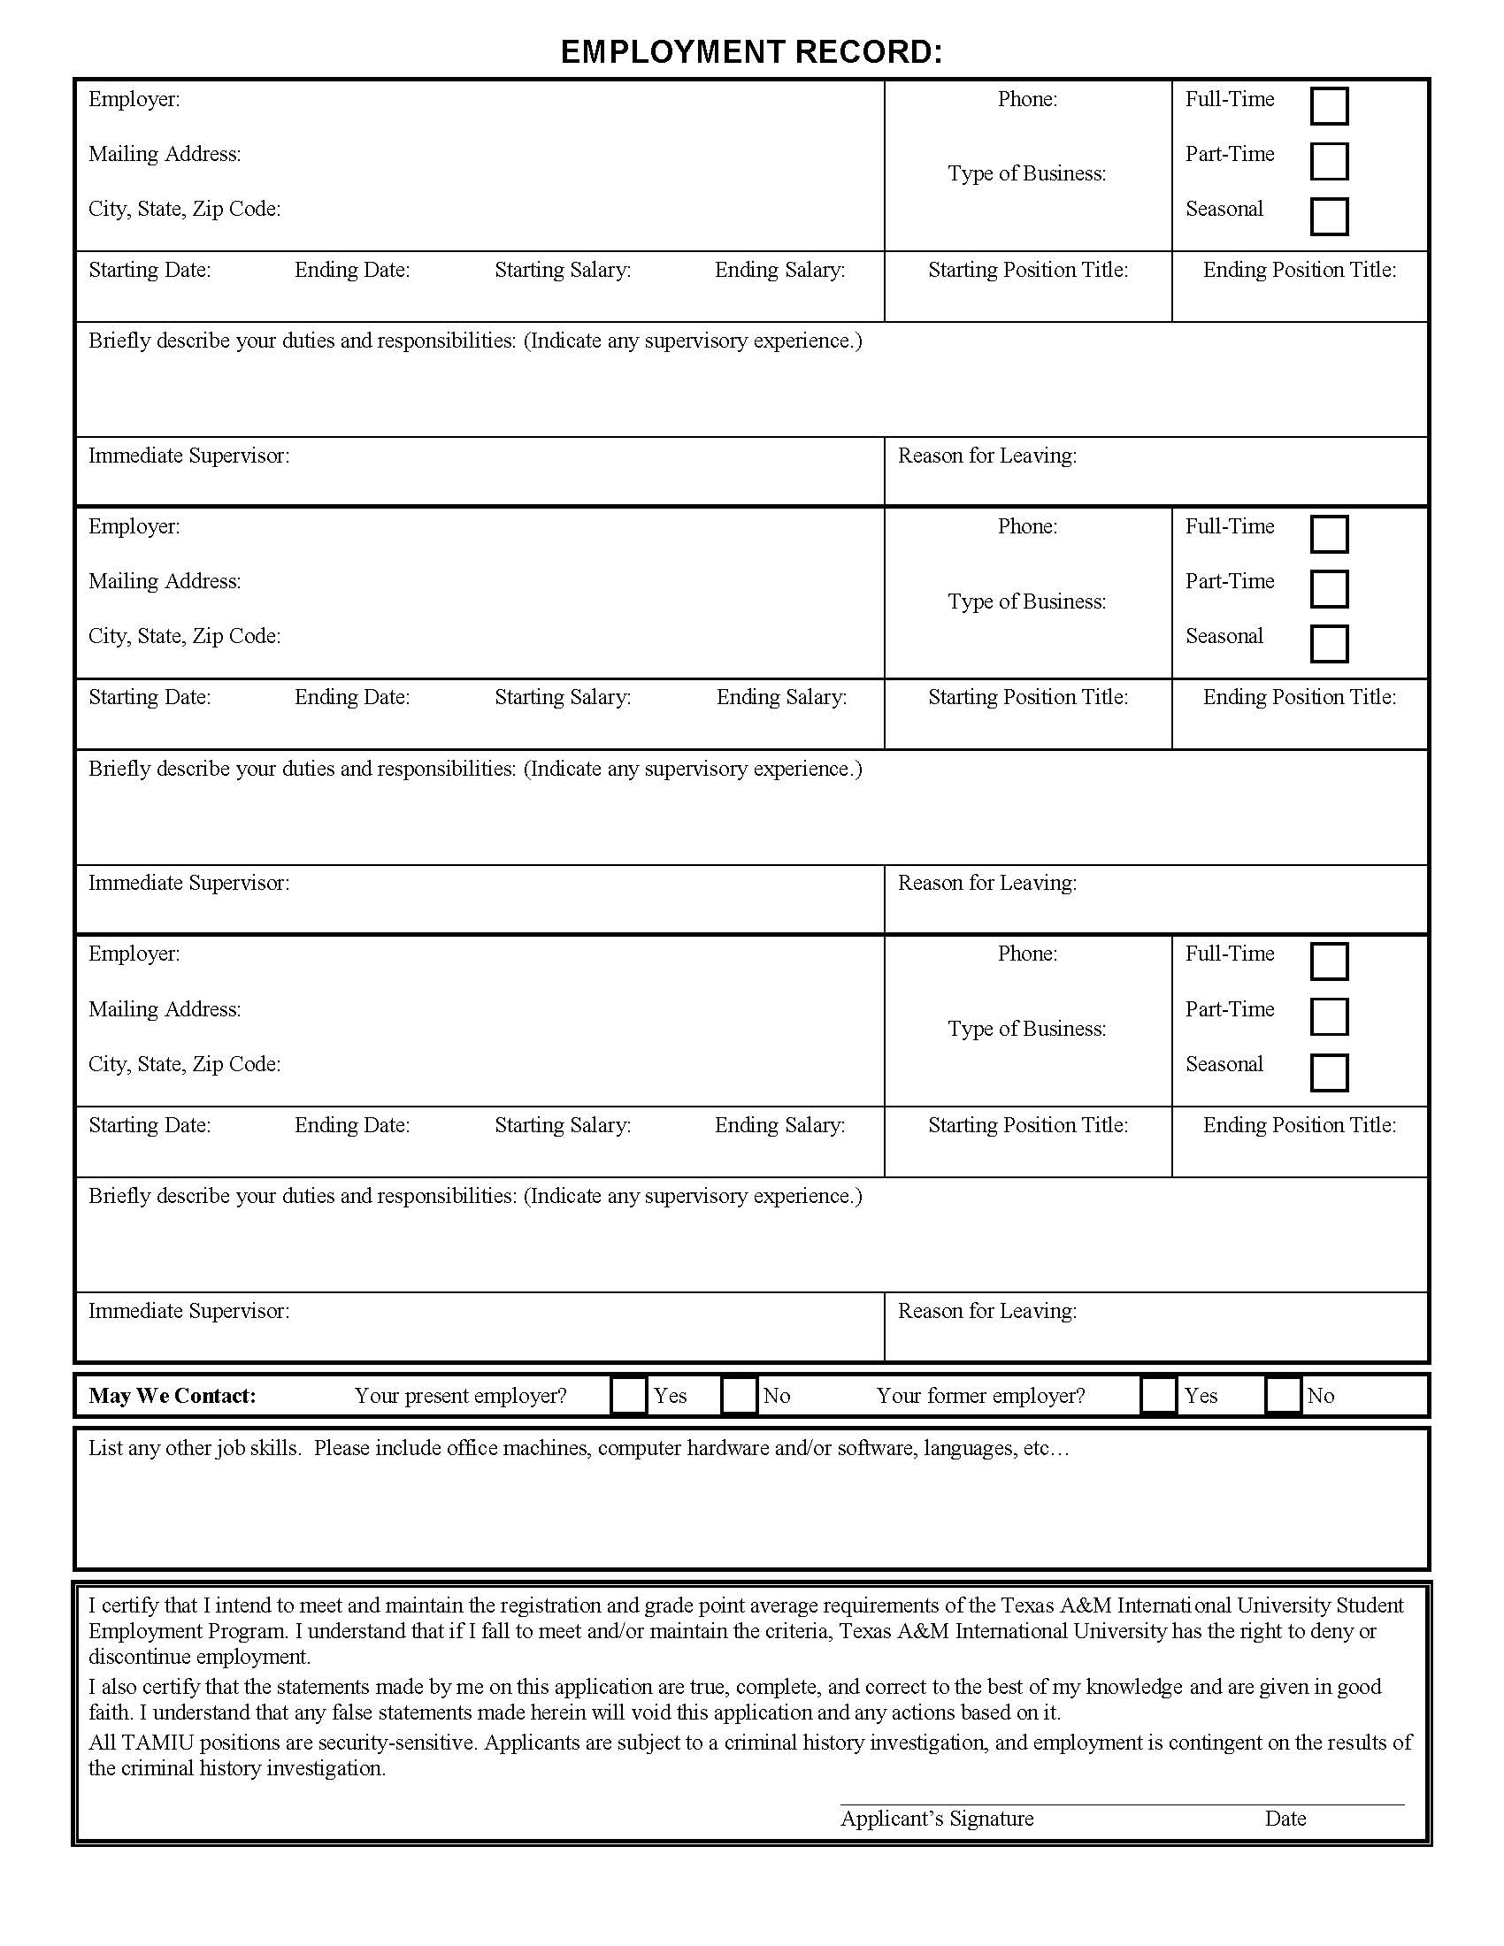
SEP Application: Employment Record
Three sections to include
previous work experience
Reverse chronological order
Fill in as much as possible
If no previous employment exists, include relevant volunteering experience

Slide 12
SEP Application: Skills & Signature
Be sure to simply list any jobs skills you have, such as software (Micosoft Excel, Word, PowerPoint, etc.), languages (English, Spanish, C++, etc.), and any knowledge on computers/machines.
Type your name in the “Applicant’s Signature” box.

Slide 13
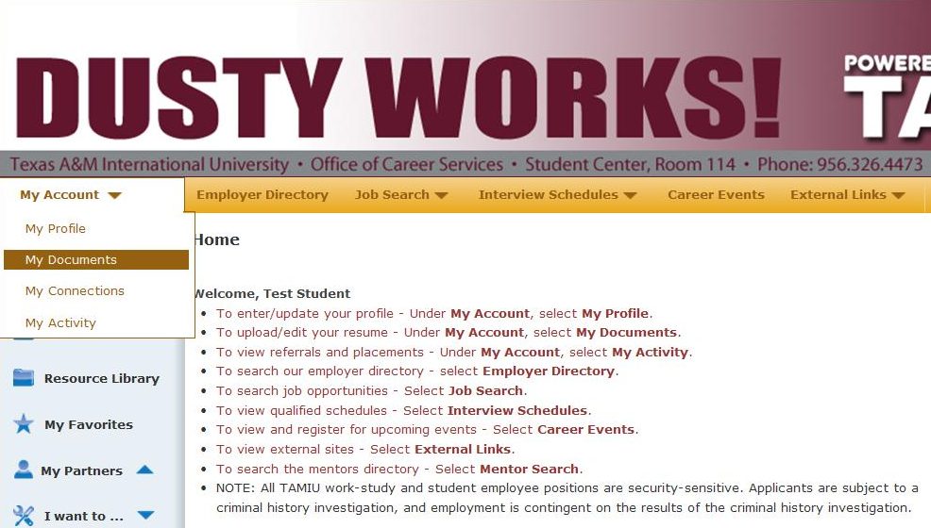
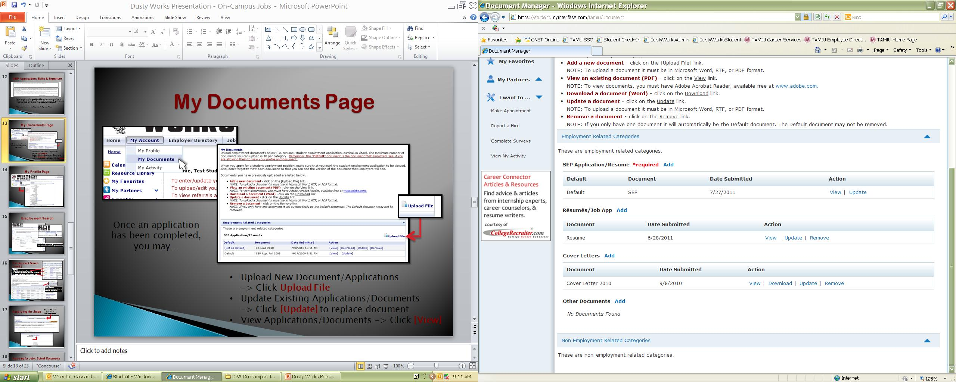
My Documents Page
Once an application has been completed, you may…
Upload New Document/Applications
-> Click Upload File
Update Existing Applications/Documents
-> Click [Update] to replace document
View Applications/Documents -> Click [View]

Slide 14
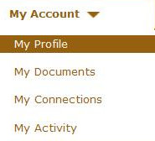
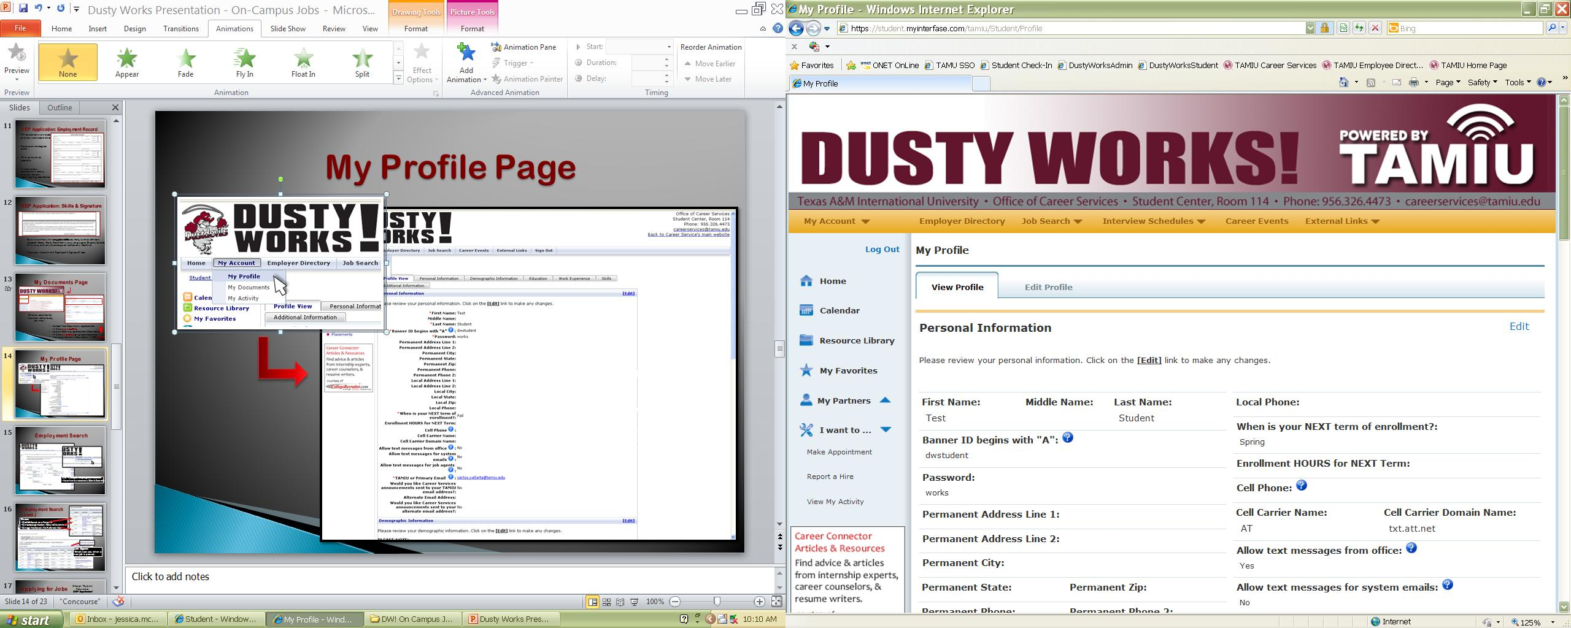
My Profile Page
Update:
Password
Background/Demographic
Information
Cell Phone for Text Service
Email(s) for Announcements
Employment/Education
History

Slide 15
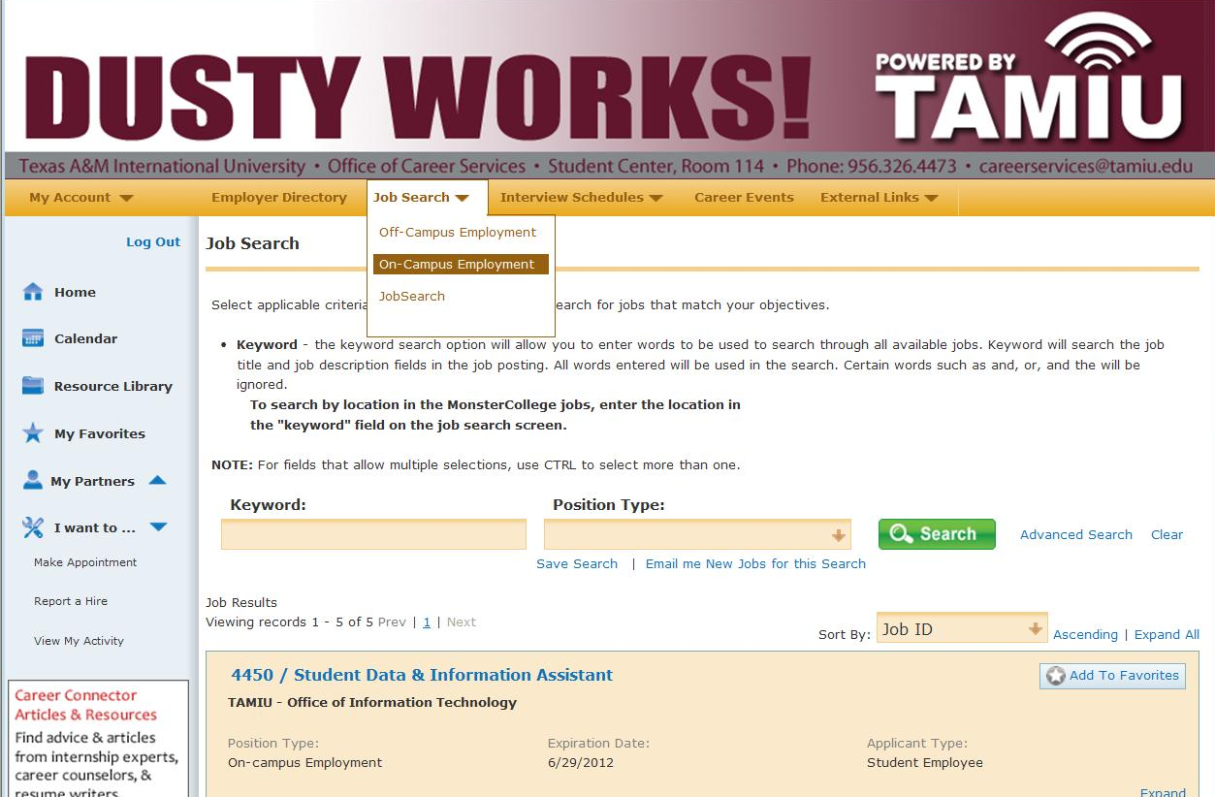
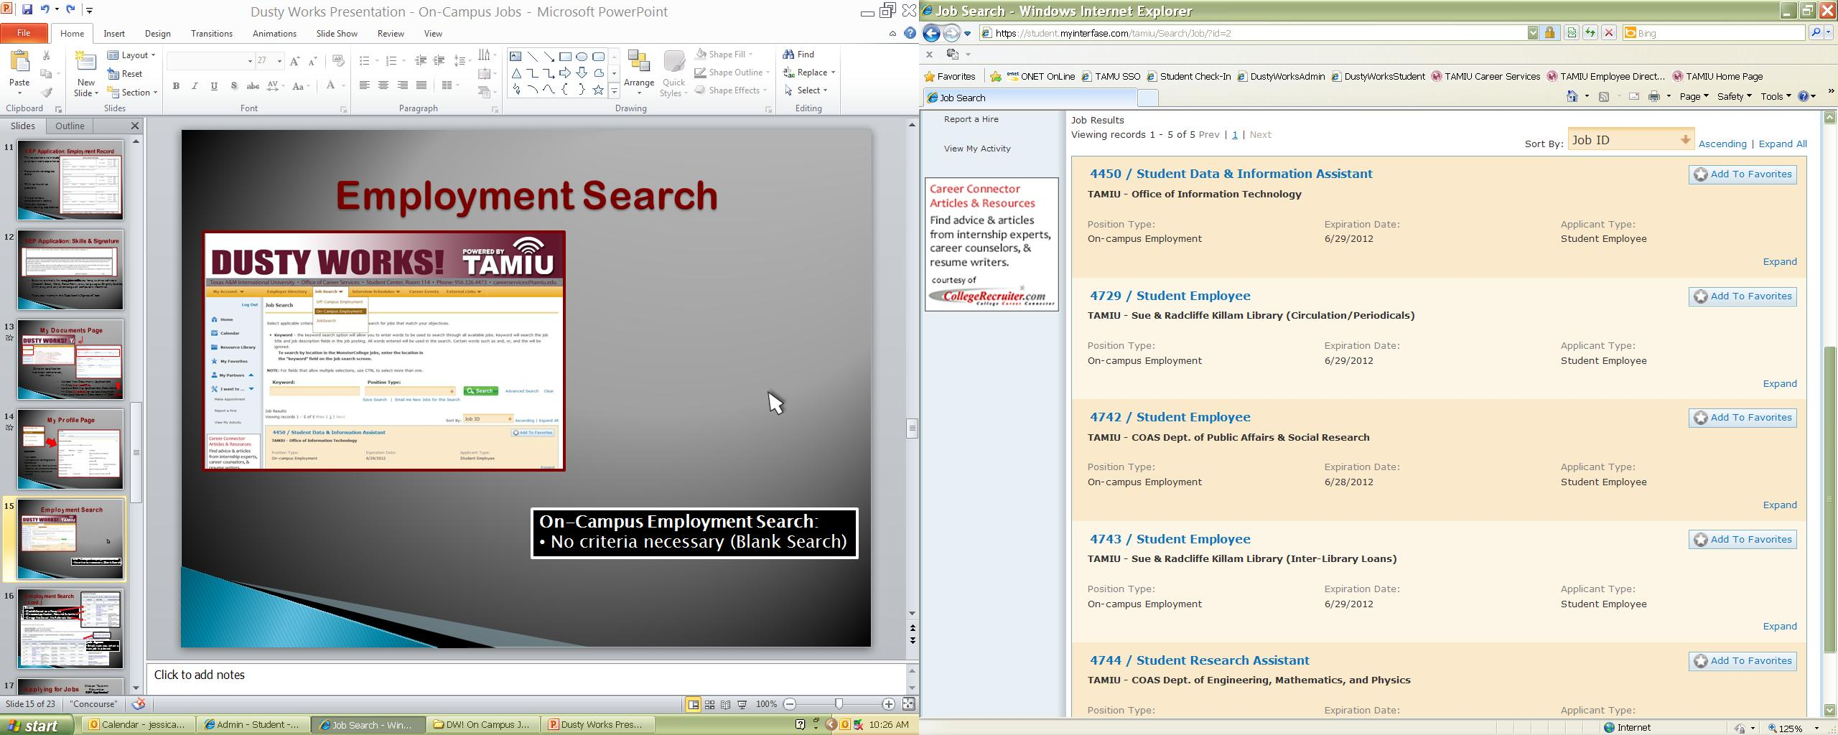
Employment Search
On-Campus Employment Search:
No criteria necessary (Blank Search)

Slide 16
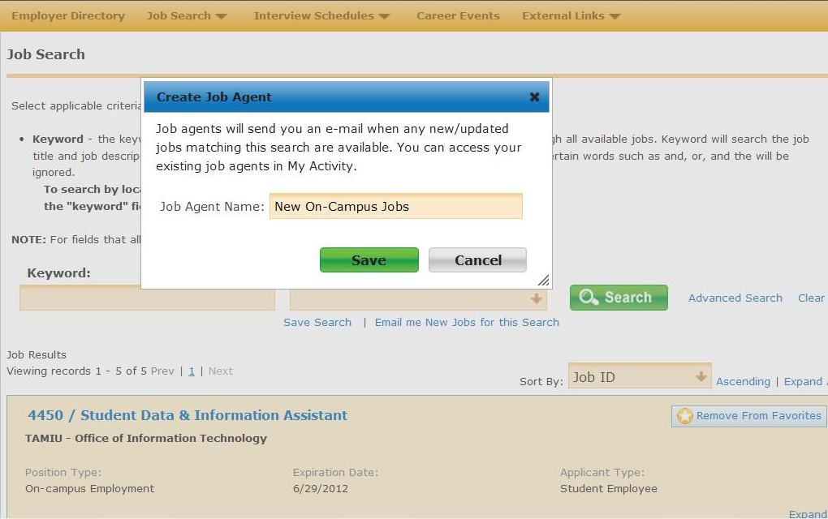

Employment Search (cont.)
Add To Favorites: You and explore jobs and save them as Favorites and return to them at a later date.
Job Agents:
(Email me New Jobs for this Search) This will allow you to be e-mailed or receive a text when a new jobs open.
Notes:
Add to Favorites
Job Agents (Email me New Jobs for this Search) Tab

Slide 17
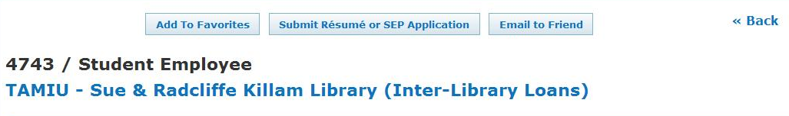

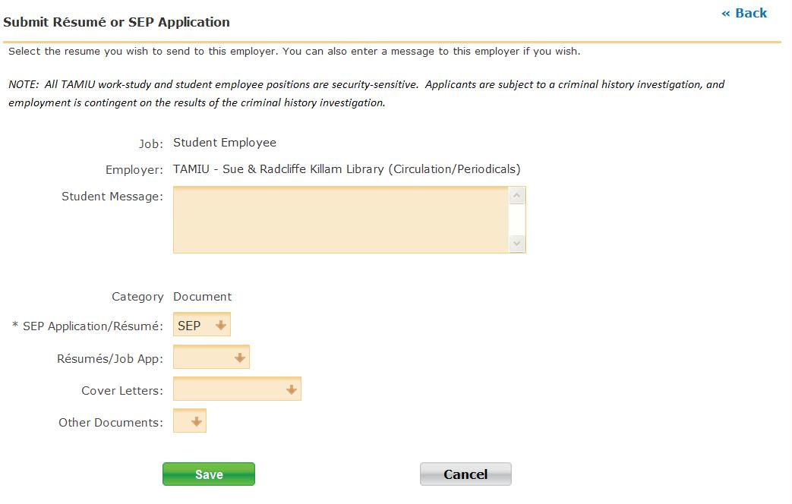
Applying for Jobs
Click on “Submit Résumé or
SEP Application”
Click on
“SEP Application/Resume”
Click on
“Save” to finish the process.

Slide 18
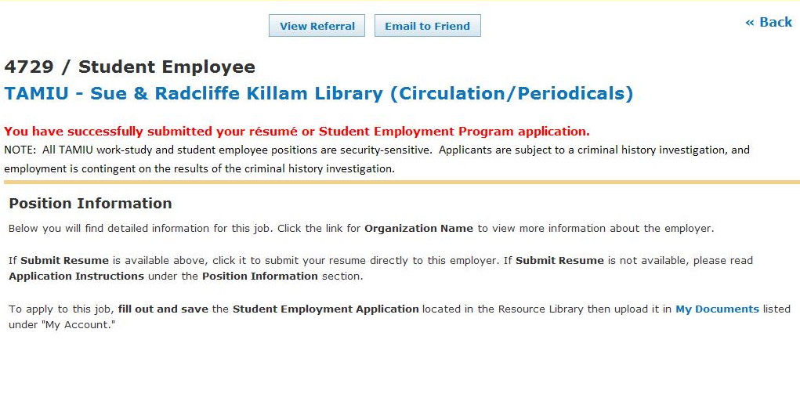
Applying for Jobs: Success!
Applying to the job is complete.
Repeat as desired for other available vacancies.

Slide 19
Preparing for an Interview
Dress Appropriately
  Examples on next slide
Arrive on Time
Prepare for Questions
  “What are your Strengths/Weaknesses?”
  “Why do you want to work for that department?”
Copy of Class Schedule (Class, Instructor, Date, Time, and Location)
Copy of Your Resume (If you were required to upload one)
Notes:
Dress Appropriately- (Insert new slide with examples)

Slide 20
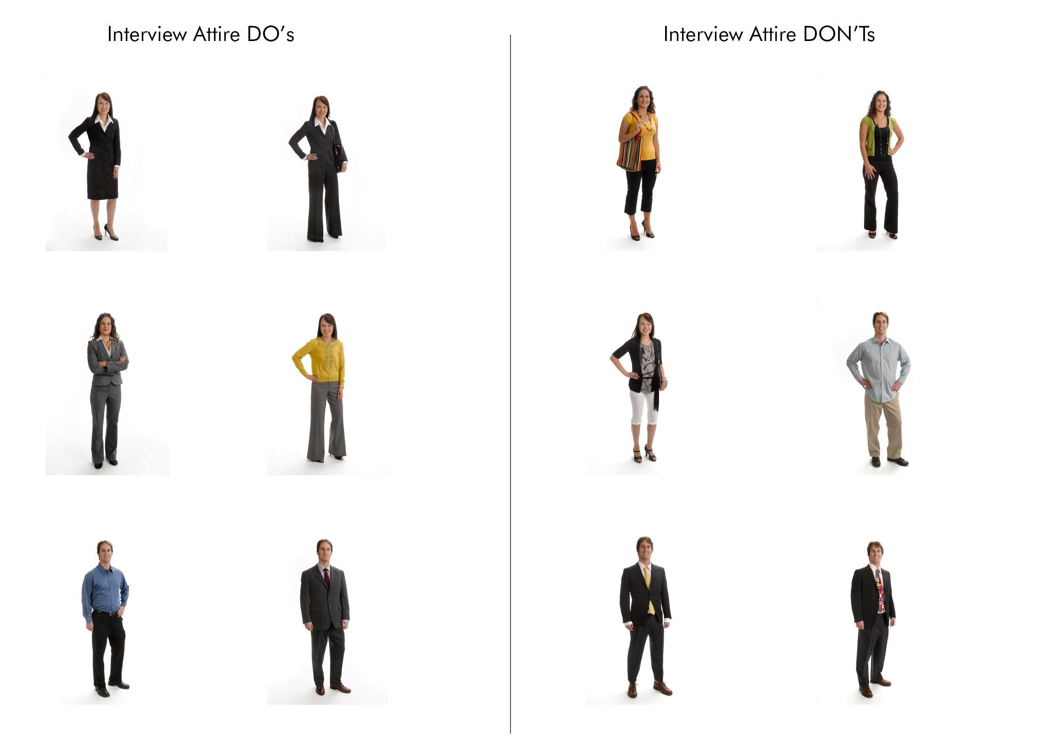
Dressing Appropriately

Slide 21
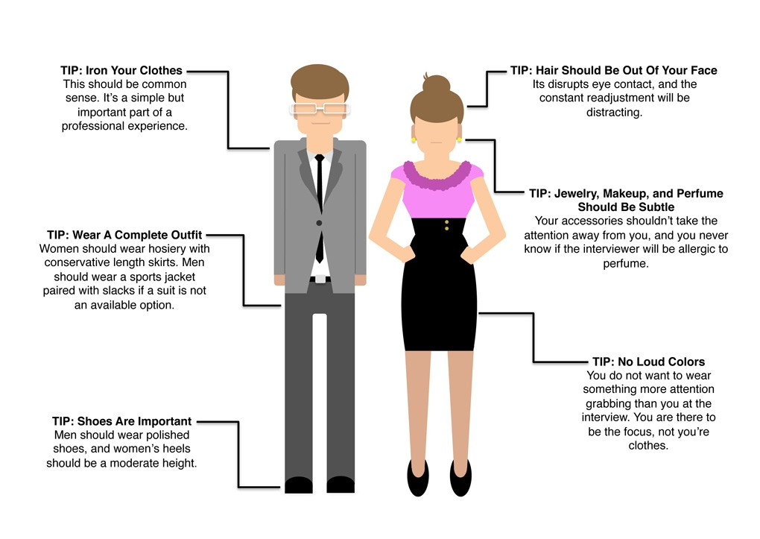
Dressing Appropriately

Slide 22
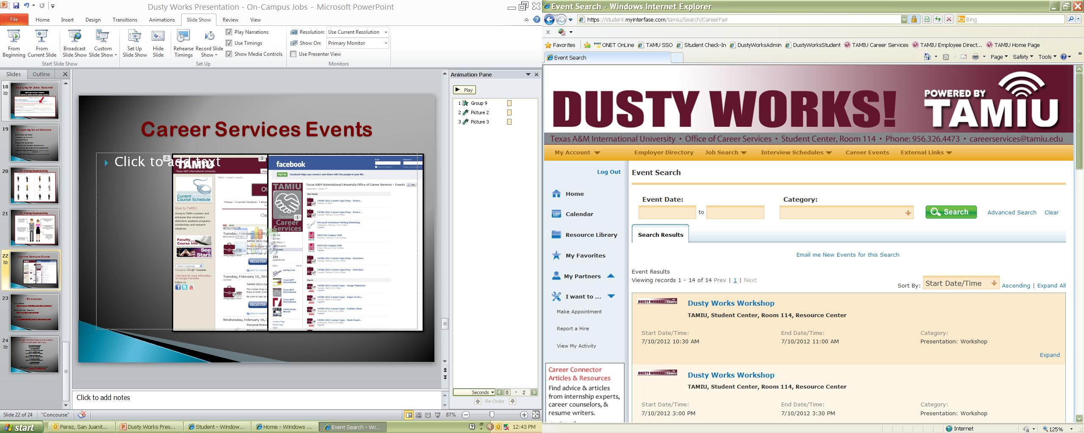
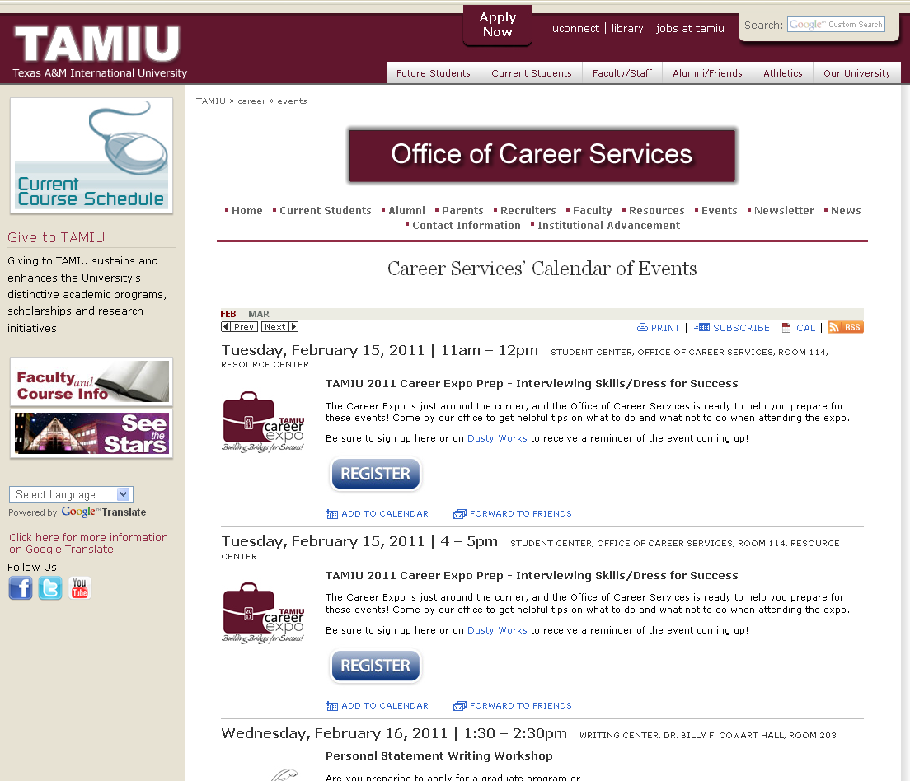
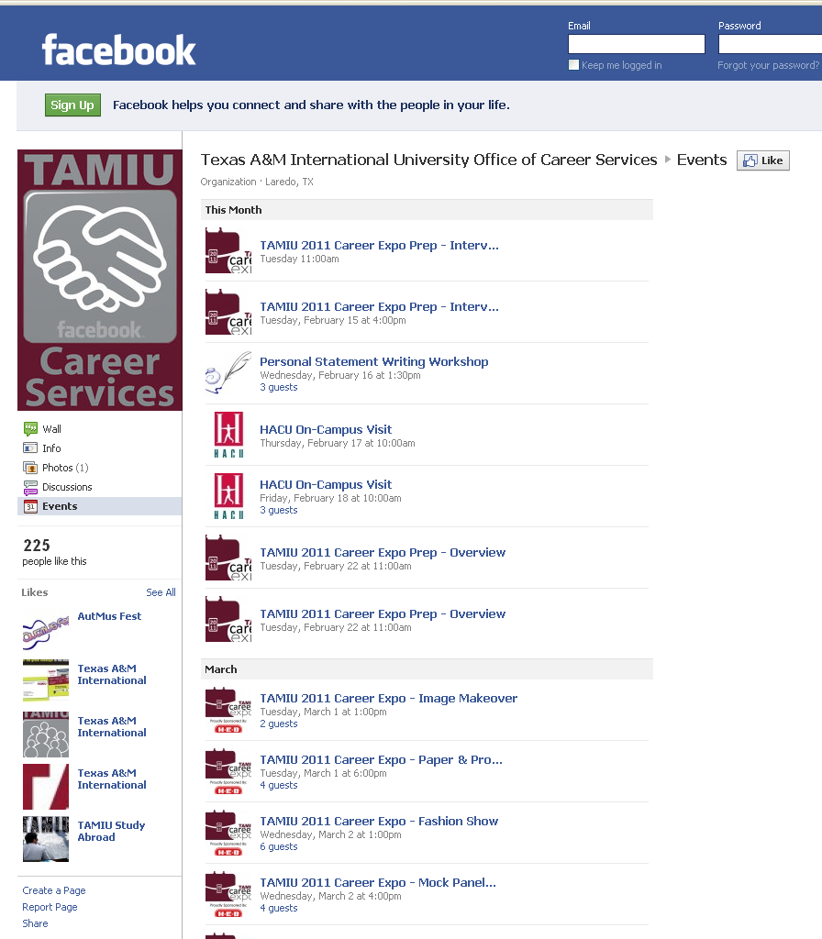

Career Services Events

Slide 23
Resources
Dusty Works: https://www.myinterfase.com/tamiu/student/
Career Services Website:
http://www.tamiu.edu/career/
Facebook: www.facebook.com/txamiu.career.services

Slide 24
TEXAS A&M INTERNATIONAL UNIVERSITY
Office of Career Services
Cassandra Wheeler
Executive Director
Laura Martinez
Director of Employer Relations
San Juanita Perez
Director of Student Relations
Jose D. Valadez, Jr.
Career Advisor (Sophomores)
Jessica McGee
Data & Information Specialist
Josefina Valle
Staff Assistant
Student Center 114 • (956) 326-HIRE (4473)
email: careerservices@tamiu.edu

