Slide 1
Camps and Programs for Minors & Volunteer
Wednesday, October 16, 2013
8:30AM-10:00AM
Student Center 236

Slide 2
TAMIU SAP- 24.01.06.L1.01
2.1 Camp or Program:
University-sponsored activity that has a participant group made up, in whole or part, of individuals under the age of 18; May or may not collect fees from participants; Held for more than one consecutive day, with or without an overnight stay, or involves overnight stays in which full supervisory duties of the minor(s) is the responsibility of the CPM or third party or a program that meets on campus on scheduled days over a period of time but may or may not meet on consecutive days.
A&M System Regulation
Programs for minors that are sponsored and operated by members of third parties using member property facilities and that are held for more than one consecutive day without an overnight stay or that involve overnight stays where full supervisory duties of the minor(s) is the member or third party responsibility. This responsibility includes providing supervision, instruction and/or recreation where the children are apart for their parent(s)/ legal guardian(s).
Camps and programs for minors sponsored and operated by members of The Texas A&M University System (system) and third-party camps and programs using member facilities shall follow this regulation.
Camps and Programs for Minors – programs for minors that are sponsored and operated by members or third parties using member property/facilities and that are held for more than one consecutive day without an overnight stay or that involve overnight stays where full supervisory duties of the minor(s) is the member or third party’s responsibility. This responsibility includes providing supervision, instruction and/or recreation where the children are apart from their parent(s)/legal guardian(s).
Contact With Minor(s) – in the context of an employment or volunteer position described in this regulation, interaction with minors that is direct and reasonably anticipated. The term does not include interaction that is merely incidental.
Department of State Health Services/ Statute
SB1414 (Must submit report to Department of State Health Services with in 5 days of the start of camp/program)
· Has more than 20 campers who are not enrolled at the institution
· Not a licensed day or youth camp
· Campers attend or temporarily reside at the camp for all or part of at least four days.
Campus program for minors--A program that:
A. is operated by or on the campus of an institution of higher education or a private or independent institution of higher education;
B. offers recreational, athletic, religious, or educational activities for at least 20 campers who:
i. are not enrolled at the institution;
ii. attend or temporarily reside at the camp for all or part of at least four days; and
C. is not a day camp or youth camp as defined by Texas Health and Safety Code, §141.002, or a facility or program required to be licensed by the Department of Family and Protective Services.
A program operator must (Office of Continuing Education has been designated the following by TAMIU):
1. submit to the department on the form provided by the department and within five days of the start of the campus program for minors verification that each employee of the campus program for minors has complied with the requirements of this section; and
2. retain in the operator's records an electronic or paper copy of the documentation required or issued in subsection (a) of this section for each employee until the second anniversary of the examination date.
Rules for Licensed Camps/ Daycares ( & Basic Good Practice)
(e) A person applying for or holding an employee position involving contact with campers at a campus program for minors must successfully complete the training and examination program on sexual abuse and child molestation during the applicable period prescribed in subsection (a) of this section.
(b) Adult supervisors. Each youth camp shall have at least one adult supervisor who is responsible for the supervision of no more than ten children in the camp. For any hazardous activity the supervisor(s) shall be in the immediate vicinity (within sight and/or hearing) of the campers. An "all camp" sedentary activity, not requiring physical activity, may require less supervision, and each camp shall establish its own guidelines, but not less than one adult supervisor to every 25 campers. The camp director shall not be included in the supervisor to camper ratio in camps serving over 50 campers at one time.

Slide 3
Information Documents
TAMIU SAP- 24.01.06.L1.01 (Not Provided)
Medical Needs and Emergency Procedures
Reporting Neglect and Abuse
Child Protection Training (Employees and Non Employees)
Safety/ Risk Management Insurance Procedures
Special Risk Accident Insurance Programs
Dusty Alert
Program Budget
Department of State Health Services
Invoices

Slide 4
TAMIU SAP- 24.01.06.L1.01
APPLICATION PROCEDURE AND APPROVAL
Before activities occur, any CPM must be reviewed and approved by the Office of Continuing Education. Violation of any terms in this SAP may result in the Office of Continuing Education/TAMIU declining the CPM to conduct activities in the future. Depending on the severity of the offense, CPM closure is viable. All documents referred to in the SAP can be found on the Continuing Education webpage at http://www.tamiu.edu/ce/CPM.shtml.
REQUIRED APPOINTMENT OF DIRECTOR OF CPM
1.5.1 A dedicated director must be appointed for each CPM. The director is responsible for the submission of paperwork, welfare of students, administration of staff, and any additional aspects of the CPM.
BACKGROUND CHECKS
2.1 If any member or participant of the CPM is a minor, background checks must be conducted on all Independent Contractor Agreements, Service Contract Agreements, TAMIU Staff hired solely for CPM, TAMIU Full Time Staff, and volunteers who will work with the CPM prior to the start of any work or volunteer service. A background check shall be conducted annually, for each camp, for each individual -- even if the individual is a current TAMIU employee and already had a background check done for their current TAMIU employment. The background check must utilize a criminal history database and sex offender registration database.
2.1.1 CPM directors are responsible for ensuring a background check has been done and cleared before allowing anyone to perform any work or volunteer services.

Slide 5
TAMIU SAP- 24.01.06.L1.01
TRAINING
3.1 System-approved sexual abuse and child molestation prevention training must be completed by all CPM employees, individuals under Independent Contractor Agreements, Service Contracts, and volunteers prior to the start of any work or volunteer service and every 2 years thereafter. …. The CPM director is responsible for submitting the transcript of completion to the Office of Continuing Education prior to the start of any work.
SAFETY AND MEDICAL CARE PROVISION
4.2 Each CPM participant must complete an online registration. The following documents will be generated and emailed to the CPM director: Registration Form, Waiver, Indemnification, and Medical Treatment Authorization Form, and a Model Release Form.
4.4 Counselor to Minor Ratio: CPM are required to report the Counselor to Minor ratio on the Camp Description form for both day and overnight CPM. Minors must be supervised by a 1 to 10 ratio for students under 10 years old and a 1 to 15 ratio for those 11 and older. Modifications to ratios may be approved by Office of Continuing Education (i.e., if students are in a classroom setting). Supervising staff must be at least 18 years of age and employed by TAMIU or a third party (i.e., TAMIU faculty or staff, individuals under Independent Contractor Agreements or Service Contract Agreements). Participants should never be alone with a volunteer on a one-to-one basis. There must be a minimum of two participants to a volunteer. A staff member must avoid being left alone with one participant in a classroom or similar setting.

Slide 6
Registration
www.TAMIU.edu/Camps
Registration
https://info.tamiu.edu/summercamps/campslist.aspx
Payment
https://secure.touchnet.com/C20208_ustores/web/store_cat.jsp?STOREID=6&CATID=7
Cash/Checks collected by CE

Slide 7
Medical Needs and Emergency Procedures
Distribution and Security of Medicine:
CPM Directors must shall evaluate medical needs of children prior to child’s attendance to camp if participant requires special attention and or medicine distribution. No medicine will be distributed at CPM. Exceptions to consider, which must be outlined in Emergency Contact Form include, but are not limited to rescue inhalers and epinephrine pens for emergencies.
Minors with Special Needs:
Camp Directors must be made aware that children with special needs may require more involvement and supervision than other children.
Emergency Plans to Consider Internally
List of emergency contacts for your camp
Possibly program a fire drill with Risk Management so that campers are aware of the proper procedures. This consideration varies with the size of the camps.
Fire Drills/ Exit Procedures per building need to be understood by staff before camp begins.
Bomb Threats/ Campus Evacuations
Bad Weather Days (i.e. Indoor activities or Camp Cancelations)
Camp Directors Enroll in Dusty Alert

Slide 8
Reporting Neglect and Abuse
Immediately report suspicion of neglect or abuse to University Police Department and/or local law enforcement.
DO NOT investigate yourself.
DO call for assistance.

Slide 9
Child Protection Training (Employees and Non Employees)
Director will ensure EVERYONE completes training
Director will submit EVERYONES transcript or certificate… including current TAMIU employees
Training is valid for two years
Non- Employees are responsible for keeping a copy and submitting to Director when requested.

Slide 10
Safety/ Risk Management Insurance Procedures & Special Risk Accident Insurance Programs
Insurance Page
Insurance Fees
Please report any accidents/incidents that occur during the camp/program to Safety/Risk Management AND Continuing Education within 24 hours or the next business day. Safety/Risk Management personnel will guide you through the claim process.
Complete Camp and Program First Aid Report when applicable.

Slide 11
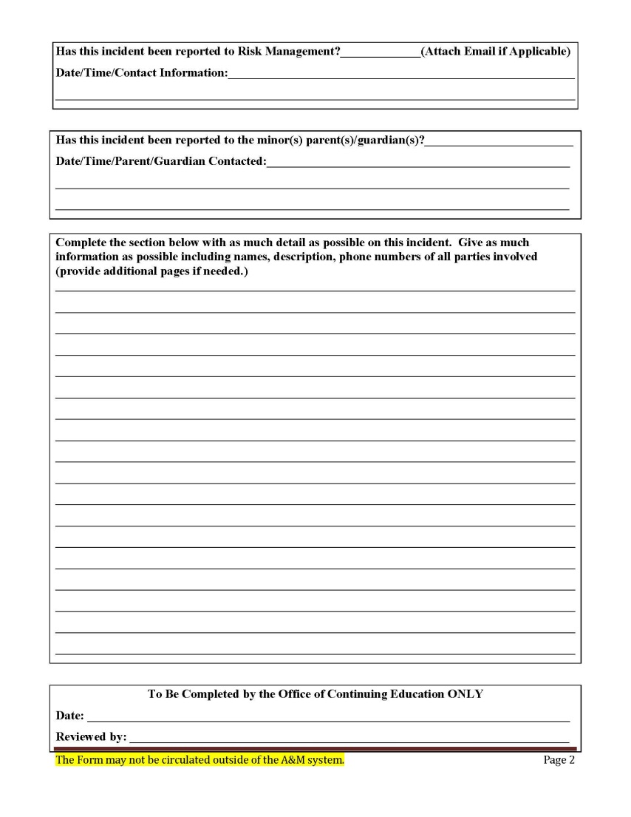
Camp and Program First Aid Report

Slide 12
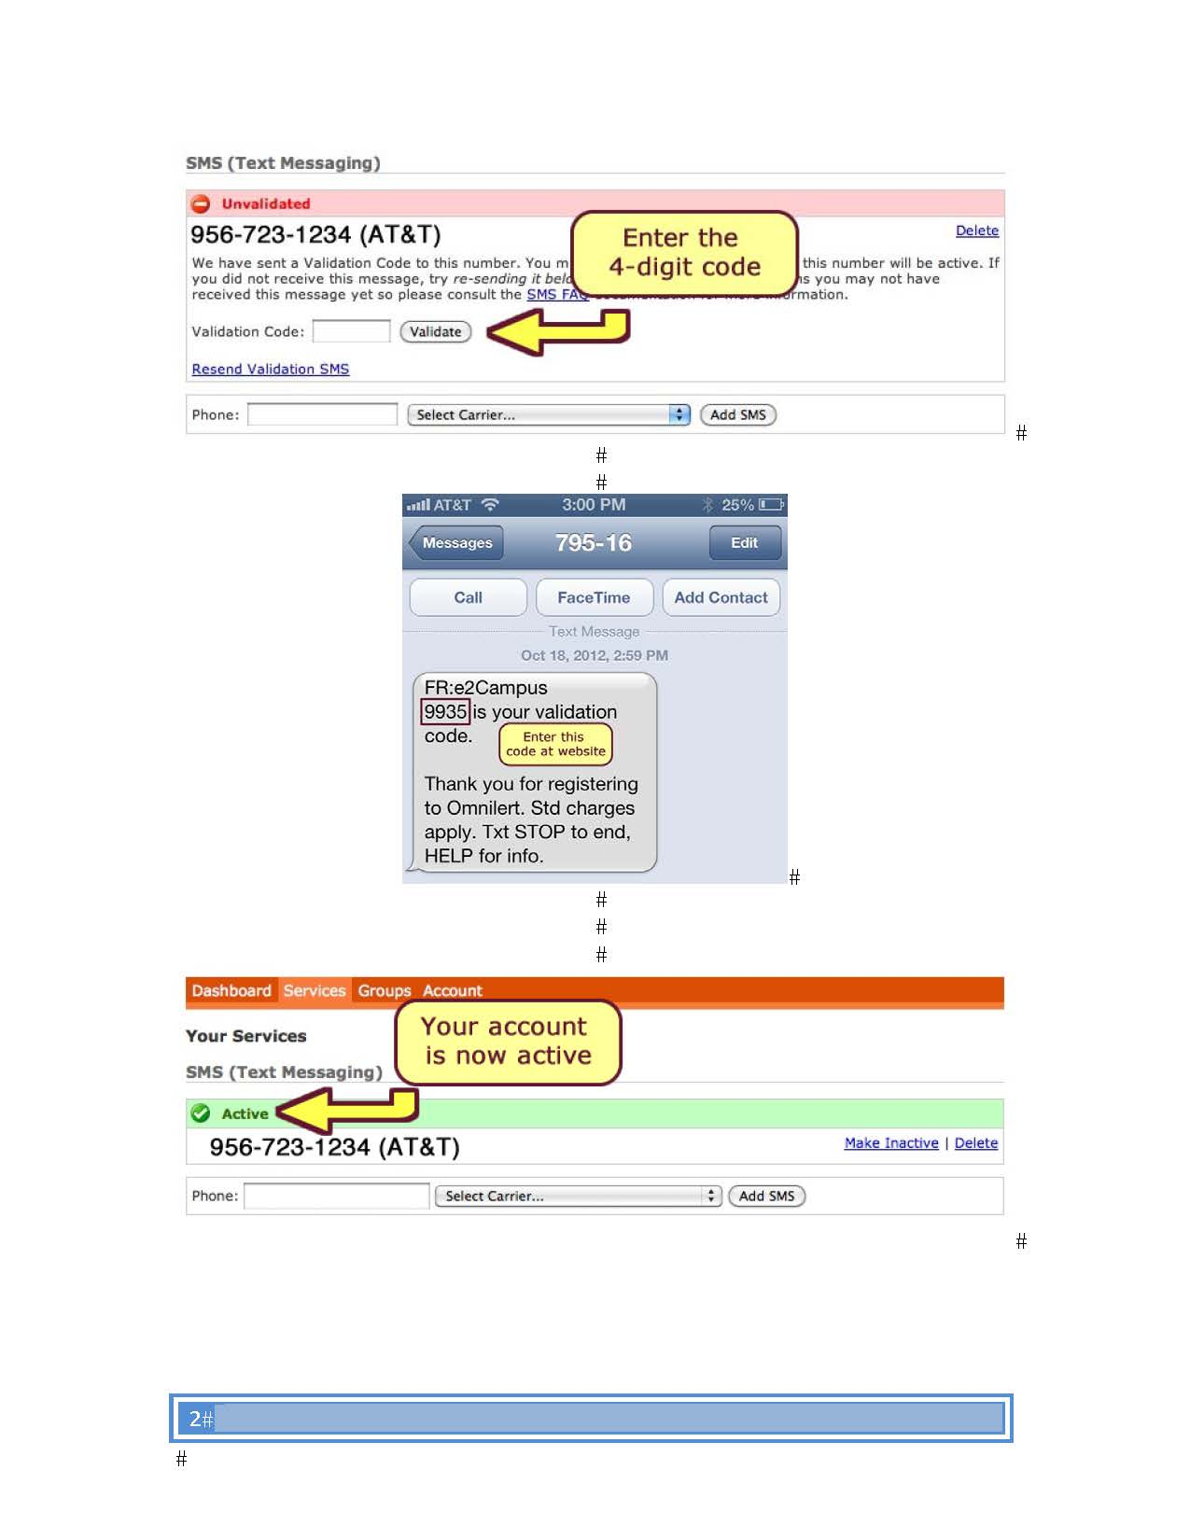
DustyAlrt
At Least 2 people at camp should have DustyAlrt

Slide 13
Program Budget
Fill in template: http://www.tamiu.edu/ce/ProgramBudgetTemplate.xltx
Provide electronic Submission of Form.
Submit to ContinuingEducation@tamiu.edu

Slide 14
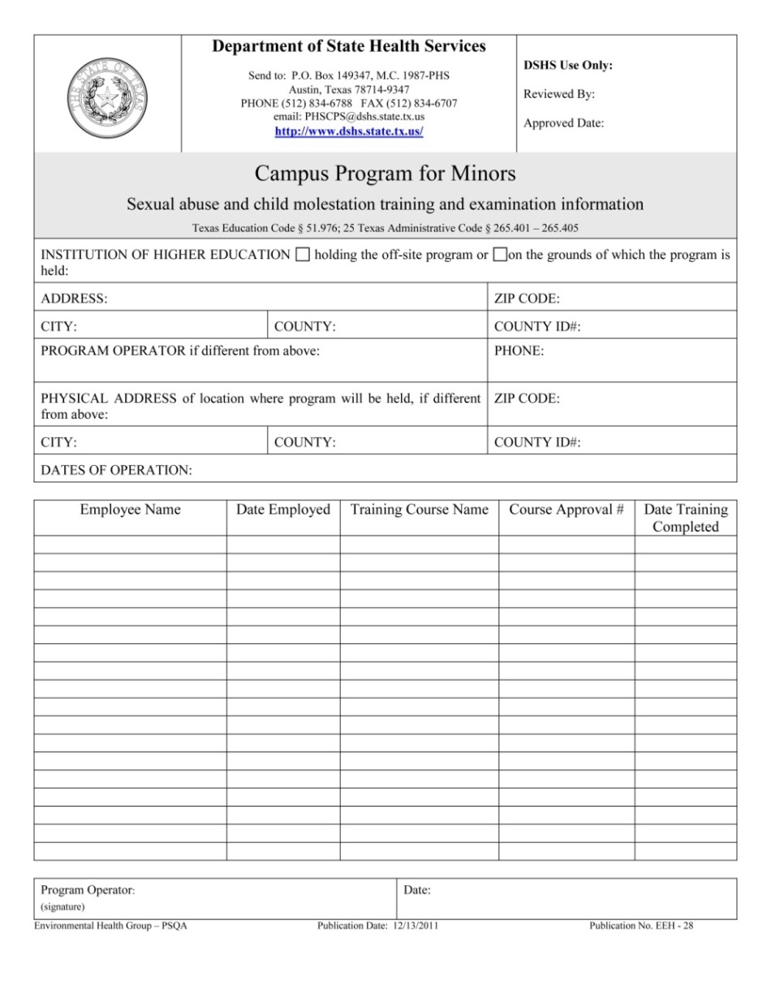
Department of State Health Services
Department of State Health Services/ Statute
SB1414 (Must submit report to Department of State Health Services with in 5 days of the start of camp/program)
· Has more than 20 campers who are not enrolled at the institution
· Not a licensed day or youth camp
· Campers attend or temporarily reside at the camp for all or part of at least four days.
Campus program for minors--A program that:
A. is operated by or on the campus of an institution of higher education or a private or independent institution of higher education;
B. offers recreational, athletic, religious, or educational activities for at least 20 campers who:
i. are not enrolled at the institution;
ii. attend or temporarily reside at the camp for all or part of at least four days; and
C. is not a day camp or youth camp as defined by Texas Health and Safety Code, §141.002, or a facility or program required to be licensed by the Department of Family and Protective Services.
A program operator must (Office of Continuing Education has been designated the following by TAMIU):
1. submit to the department on the form provided by the department and within five days of the start of the campus program for minors verification that each employee of the campus program for minors has complied with the requirements of this section; and
2. retain in the operator's records an electronic or paper copy of the documentation required or issued in subsection (a) of this section for each employee until the second anniversary of the examination date.

Slide 15
Invoices
Fees:
Administrative Base Fee…………………………………………………………………… $100
Registration Fee Per Student……………………………………………………………. $5
Registration Not Submitted Electronically, per………………………………… $3
Missing Paperwork per form for camp or participant ……………..………..$5
Late Fees:
Late Submission of Background Checks (within 2 weeks of start date), each….….……….. $10
Late Submission of Child Protection Trainings (within 2 weeks of start date), each……… $10
Reminders:
Background Checks, each………………………………………. $5
Credit Card Fee, each transaction…………………………….. 3%
Sport Type Insurance Day………………………………………... $0.40
Sport Type Insurance Overnight……………………..……..…$0.65
No Sport Type Insurance Day …………………………………...$0.20
Non Sport Type Insurance Overnight …………..…………..$0.55

Slide 16
Advertisement
www.TAMIU.edu/Camps
Brochures and Flyers
Directors are responsible for posting, distributing, and email them around town.
Laredo Morning Times Prior to March 1st
Laredo Morning Times in April
Lared0 Summer Leisure (Camp Insert)

Slide 17
Summer Camp ID Cards
-List of Campers needs to be submitted at least 2 weeks before camp begins via email to onecard@tamiu.edu.
File format should be in excel. If updates are done to the list of participants please keep us informed via email.
Example:
-Cost $5.00 per summer camp card, a roster will be provide to each department of all students issued out a card for your records. At the end of the summer an invoice will be sent of the total due, the department will then provide an account number so we may charge total amount via Central Stores system.
-Dusty Dollars
Debit/Credit Card via the following link http://www.tamiu.edu/onecard/SummerCampsDustyDollars.shtml or at Card Services ZSC 131. Please provide the parent with this web link so they may load up funds into the students card from home.
Cash- at Cash to Card Machine located in the Food Court, Library 1st floor and 2nd floor or at the Bursars Office ZSC 137. Instructions on how to add funds to the id card are on top of the cash to card machines.
(Note: Parents are advised to calculate their child’s spending on a weekly basis so funds are not left over in the card, left over funds are non refundable via cash.)
-Arrangements in advance need to be made with Card Services office to determine dates and times to bring in students for picture taking.
Contact information
Card Services
ZSC room 131
onecard@tamiu.edu
956-326-2877 or 956-326-2878

Slide 18
Documents to Submit
Paperwork to Submit (January 31)
Event Application
Risk Assessment
Things to Remember
Paperwork to Submit (February 15)
Camps and Programs for Minors Information
Emergency Plan
Program Budget
CPM Worker Status Form

Slide 19
Event Application & Risk Assessment

Slide 20
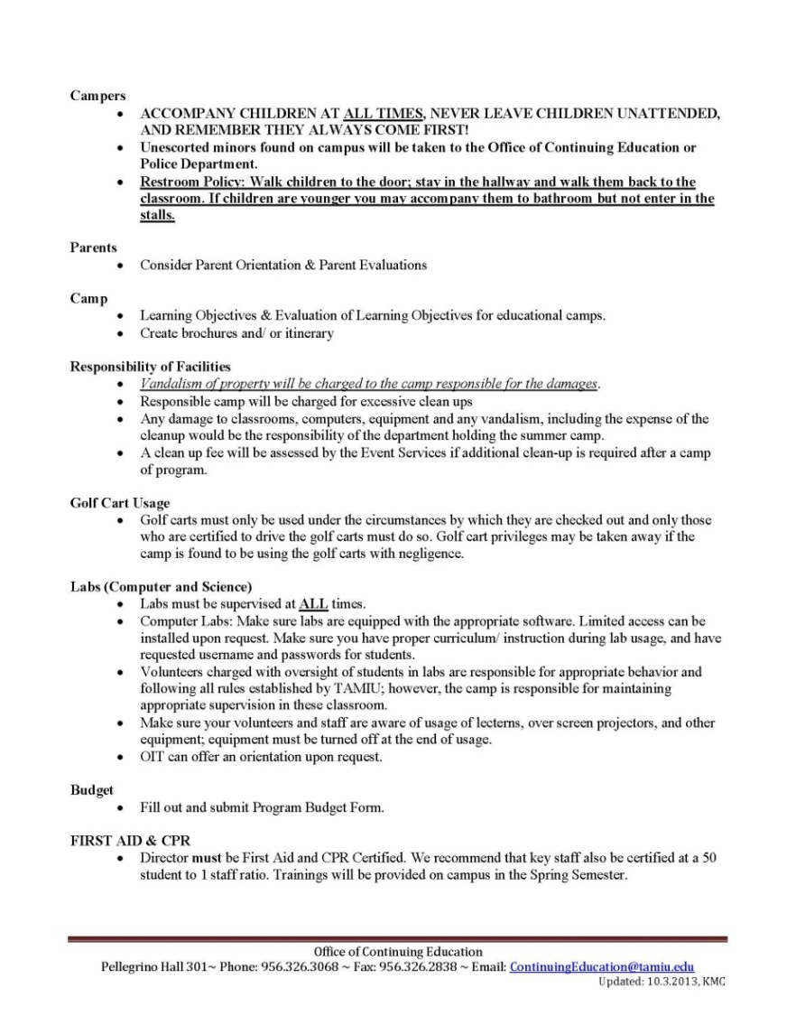
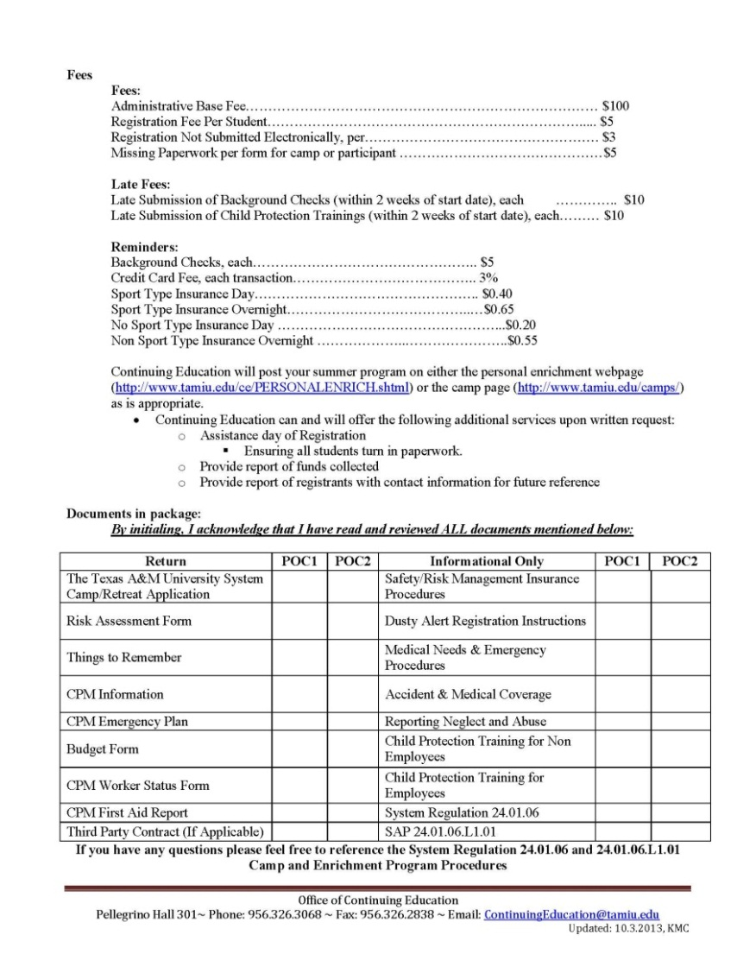
Things to Remember

Slide 21
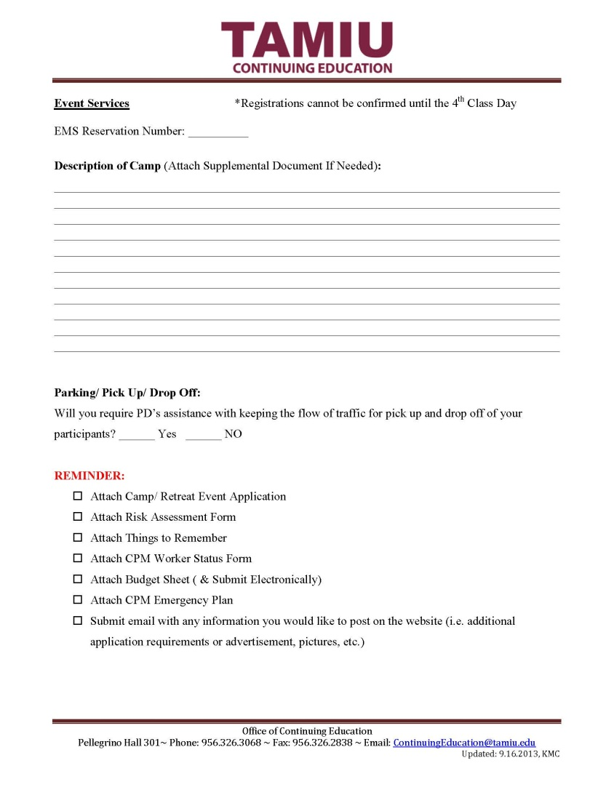
Camps and Programs for Minors Information

Slide 22
How Do I Pay Individuals Working for My Program?
Office of Budget, Payroll and Fiscal Analysis
Rocio Garcia
Fred Juarez
Christy Martinez

Slide 23
Service Contract, Independent Contract, or EPA?
Service Contracts
Service Contracts can only be submitted for active employees.
All payments made via a Service Contract are considered supplemental wages and subject to 25% federal income tax (as well as social security, Medicare, and retirement, if applicable).
What do I need to submit with a Service Contract?
Contract must state date(s) and time(s) the services were completed
Back-up Documentation

Slide 24
Service Contract, Independent Contract, or EPA?
Independent Contracts
Independent Contractors must meet the criteria of the “checklist”. Otherwise, they cannot be classified as an Independent Contractor.
Checklist must be completed before individual provides services to determine if the person meets the eligibility criteria.
Basic criteria includes the following:
Individual provides same/similar services to other entities or to the general public as part of a trade or business.
Individual has special skills/expertise that will be used to provide services, rather than the department providing him or her with specific instructions.
Individual sets own prep time, does not have continuous work schedule set by TAMIU, is not required to report hours worked and is not paid by the hour.

Slide 25
Service Contract, Independent Contract, or EPA?
Independent Contracts, cont.
What do I need to submit to process an Independent Contract?
If contractor is a foreign national, a “Foreign Independent Contractor/Visiting Scholar Initial Request” form must be submitted and approved prior to start of services.
Submit form with signatures to BPFA (KL 168) for final signature. BPFA will contact department to advise if form was approved/denied. Once approved, proceed with next item.
Form W-9 (for U.S. persons) or Certificate of Foreign Status (for foreign nationals) should be submitted to Account Payable to set up vendor.

Slide 26
Service Contract, Independent Contract, or EPA?
Independent Contracts, cont.
Completed 1099 – Misc. Income Agreement
Employee/Independent Contractor Classification Checklist
Back up documentation proving services were completed
If payment will be made via limited document (L), FAMIS screens 241 and 914 (with final approval) are required, no screens required if payment made via requisition (R)
Vendor Direct Deposit Authorization form (optional)

Slide 27
Service Contract, Independent Contract, or EPA?
EPA
If the individual is not currently employed by TAMIU and does not meet the eligibility criteria of an Independent Contractor, the individual must be hired through Human Resources and cannot begin working until the hiring process is complete.
Forms are available at the following websites:
http://www.tamiu.edu/adminis/payroll/forms.shtml
http://www.tamiu.edu/adminis/comptroler/AccountsPayable.shtml

Slide 28
New Hires
If your worker is classified as an “employee” (paid from the payroll), submit a TAMIUWorks Action called “Create New Position.”
Use title code 7611 Temporary Camp Worker.
Submit TAMIUWorks action at least 2 months before the start of the camp. If you wish to get a head start, generate the action now and HR can hold it until you are ready to advertise.
Once you make your selection(s) for hire and update applicant statuses on TAMIUWorks, generate an EPA for the hire(s).
When HR receives the EPA, Gracy will run a background check for the individual.
Once all of the above is done, Gracy will coordinate with the camp director and schedule a special new hire orientation just for Temporary Camp Workers.
Prior to starting any form of work, the Temporary Camp Worker must complete all required online trainings, which they will be informed of at new hire orientation.

Slide 29
Food Services/ Aramark

Slide 30
Room Reservations
All Reservations MUST be submitted through EMS and reported on Camps and Programs for Minors Information.
Room Reservations are not approved until the 12th class day.

Slide 31
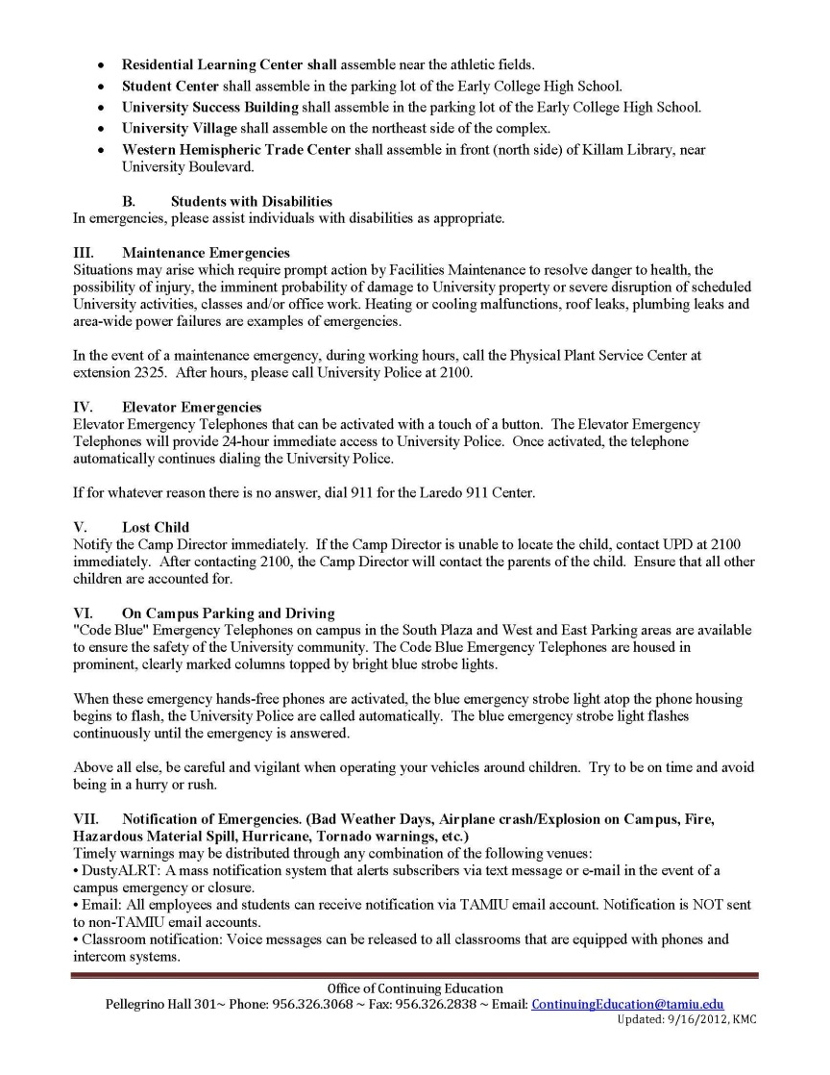
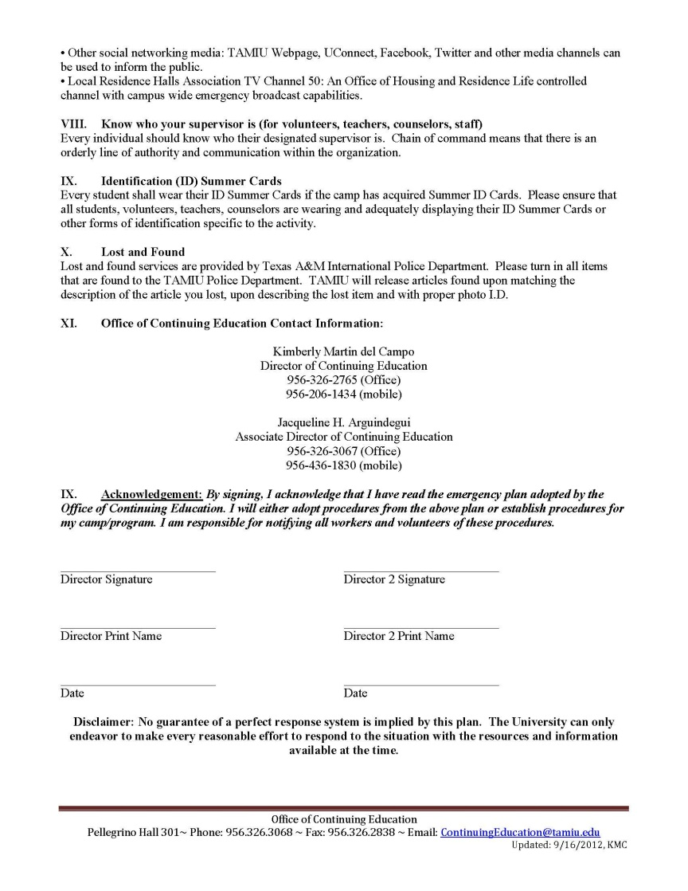
Emergency Plan

Slide 32
Program Budget
Fill in template: http://www.tamiu.edu/ce/ProgramBudgetTemplate.xltx
Provide electronic Submission of Form.
Submit to ContinuingEducation@tamiu.edu

Slide 33
CPM Worker Status Form

Slide 34
Camp and Program First Aid Report

Slide 35
Residential Learning Community
Overnight Stays

Slide 36
Volunteers
Camps and Programs for Minor Volunteer
Student Volunteer
Community Volunteer

Slide 37
Volunteer Paperwork
Background Check with BC DPS Form
Child Protection Training for Non-Employees
Staff and Volunteer Contract
Model Release for Minors/ Model Release for Adults
Waiver, Indemnification, Assumption of Risk and Medical Treatment Authorization
System Volunteer Waiver Form

Slide 38
Background Check with BC DPS Form

Slide 39
Child Protection Training for Non-Employees
Password changes every three months, so check the website for the newest password available.

Slide 40
Staff and Volunteer Contract

Slide 41
Model Release for Minors/ Model Release for Adults

Slide 42
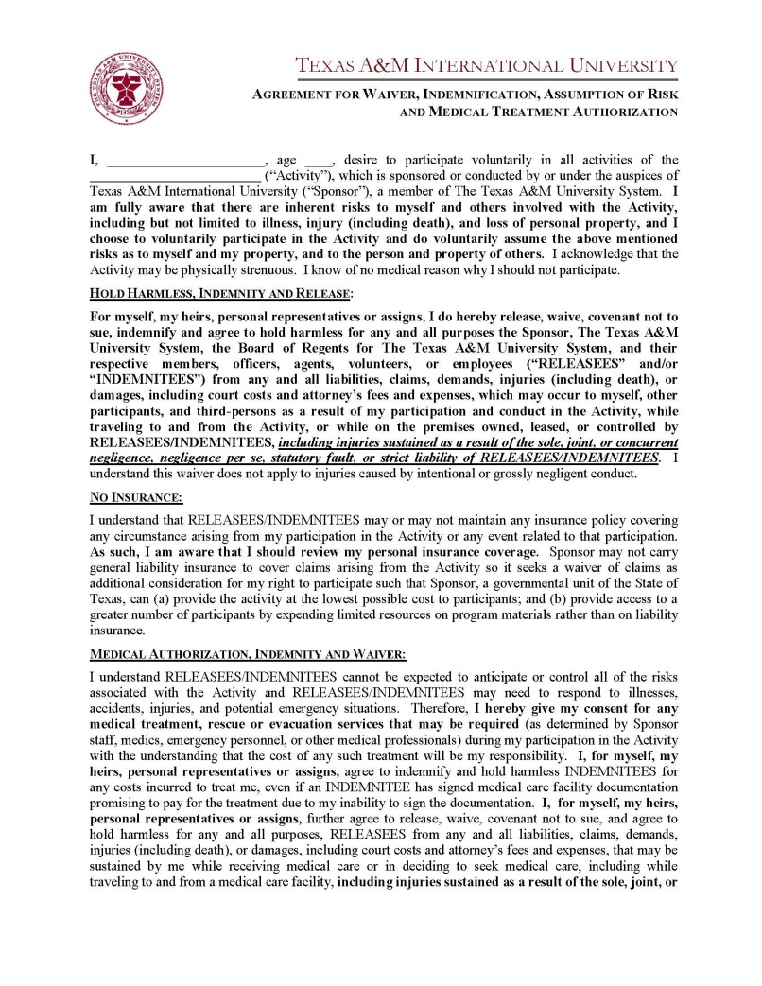
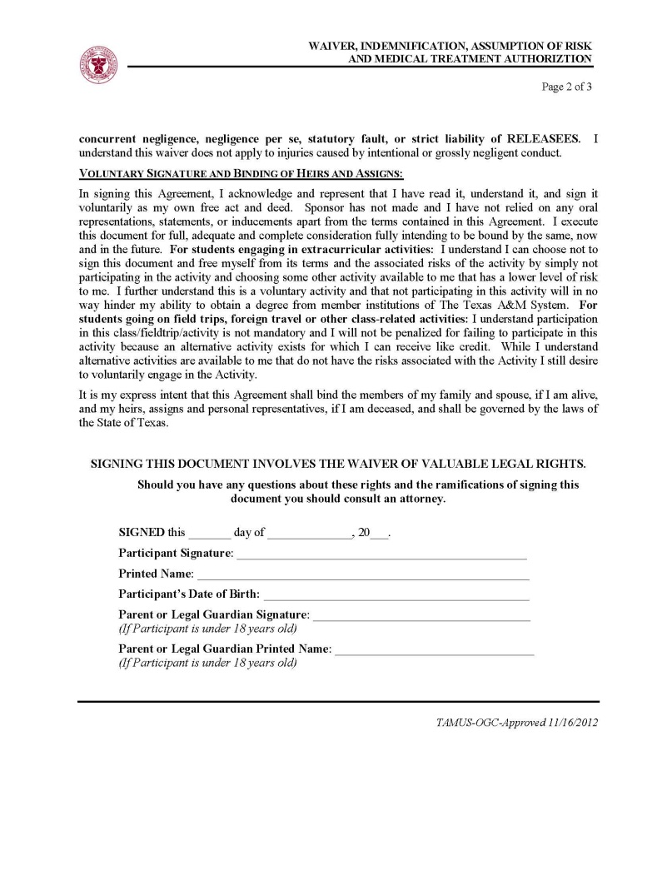
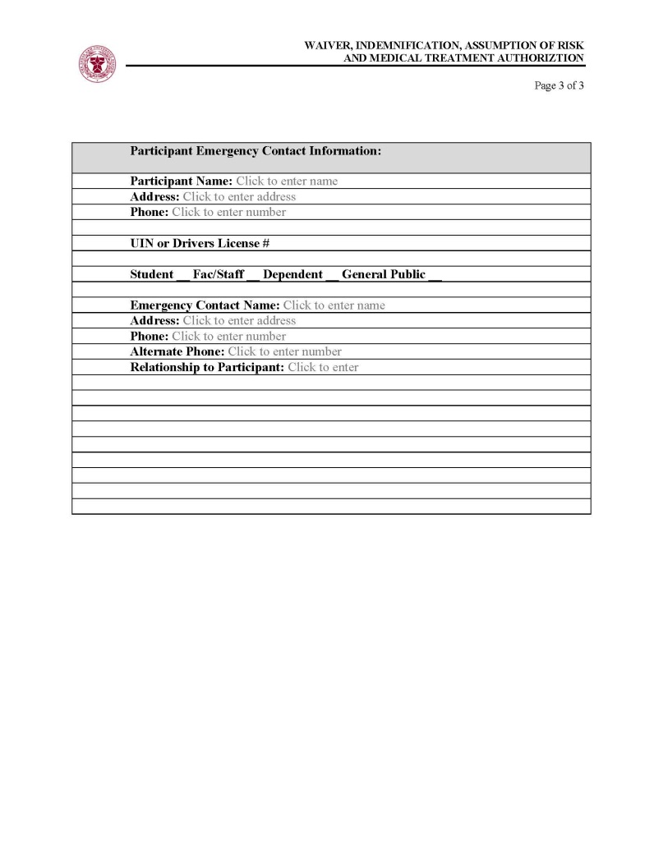
Waiver, Indemnification, Assumption of Risk and Medical Treatment Authorization

Slide 43
System Volunteer Waiver Form

Slide 44
Volunteer Log

Slide 45
Thank you…
Any questions?

