Slide 1
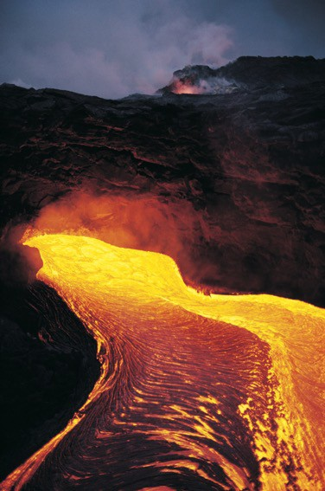
Volcanoes and Volcanic Hazards

Slide 2
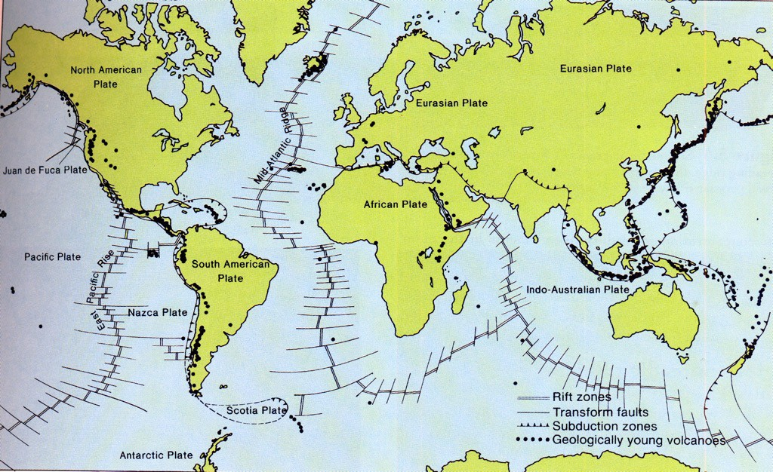
Volcanoes and Plate Tectonics

Slide 3
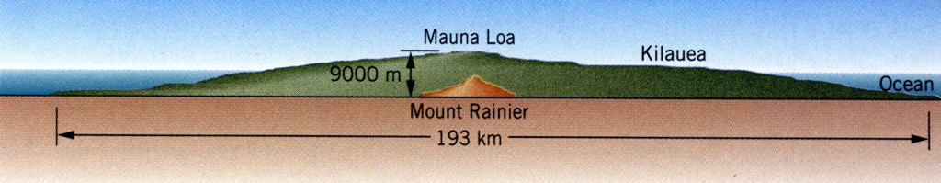
Oceanic Basalt Shield Cones

Slide 4
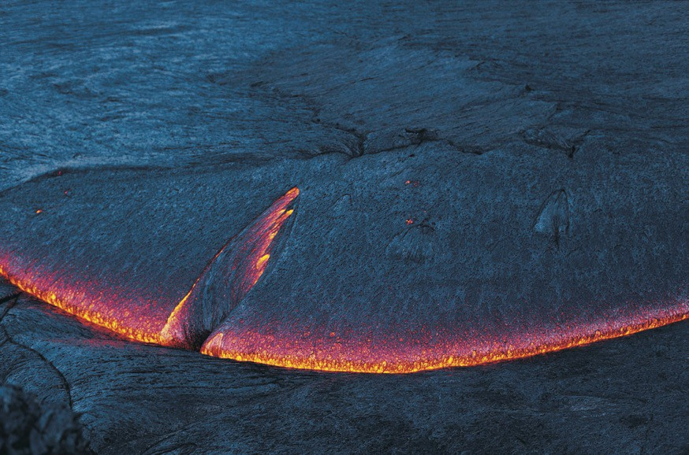
Thin, Dense, HOT, Basalt Lava

Slide 5
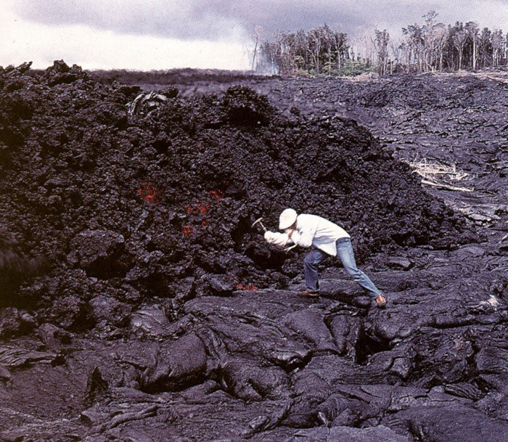
Aa and Pahoehoe

Slide 6
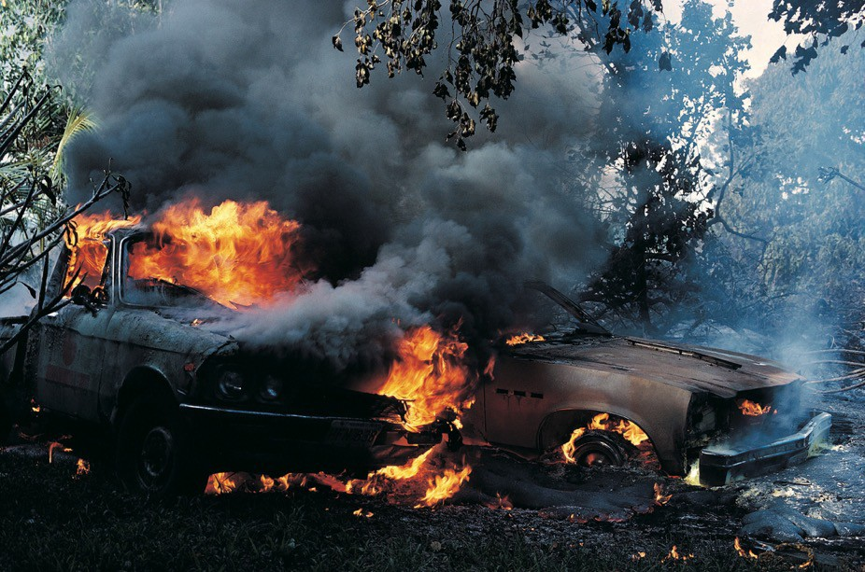
Hot basalt will melt almost anything….

Slide 7
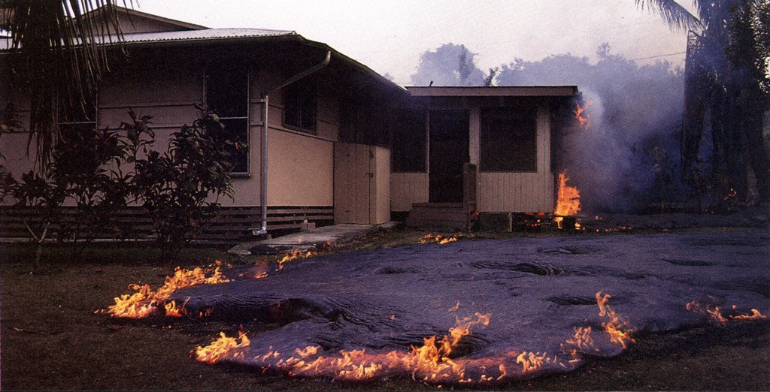
…or burn anything !

Slide 8
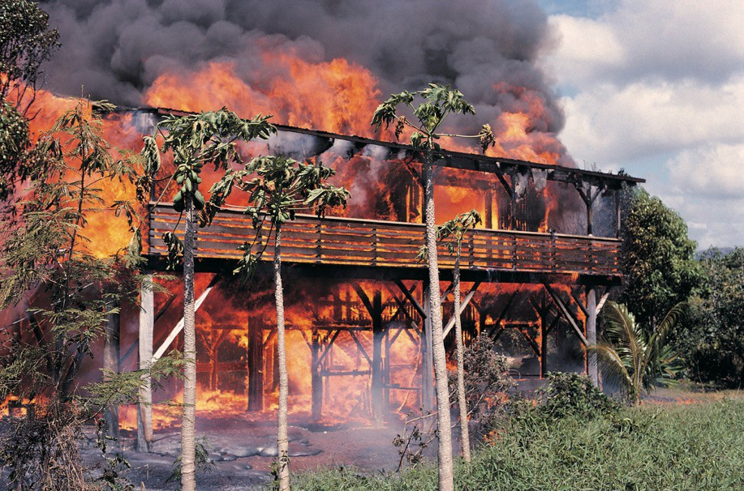
repeat….anything !

Slide 9
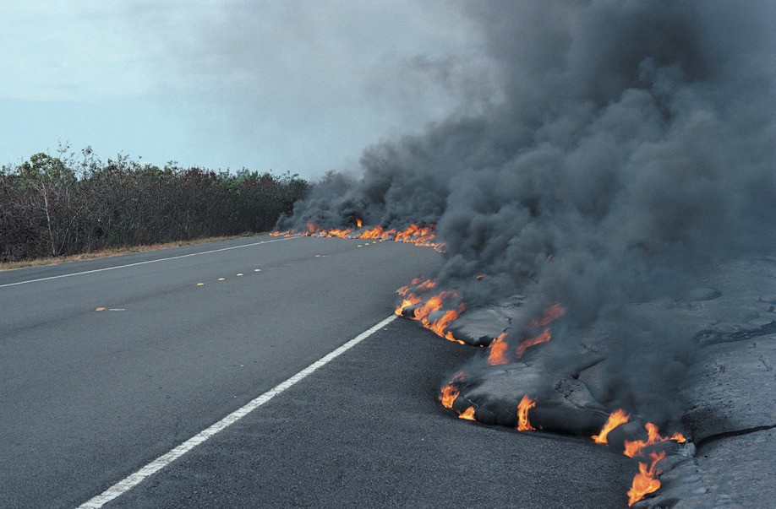
And bury what it does not burn.

Slide 10
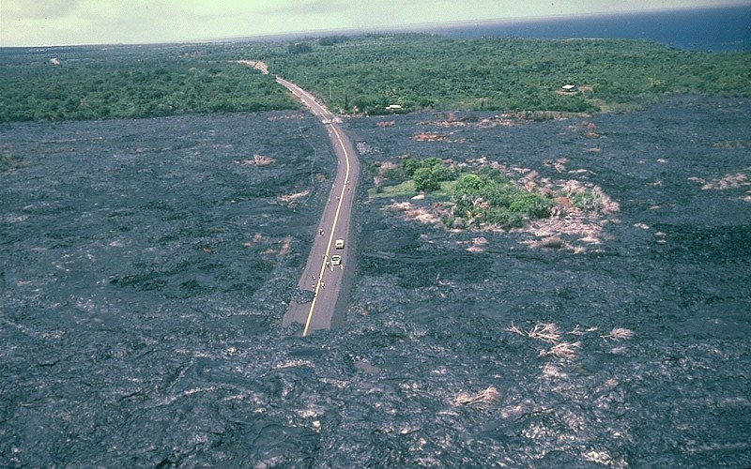
Basalt over the road (and everything else)

Slide 11
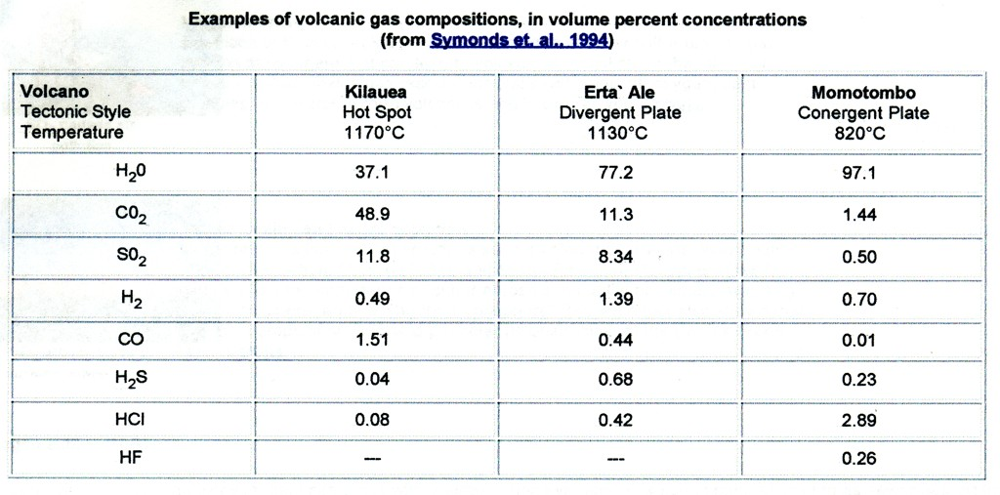
All lavas contain volatiles

Slide 12
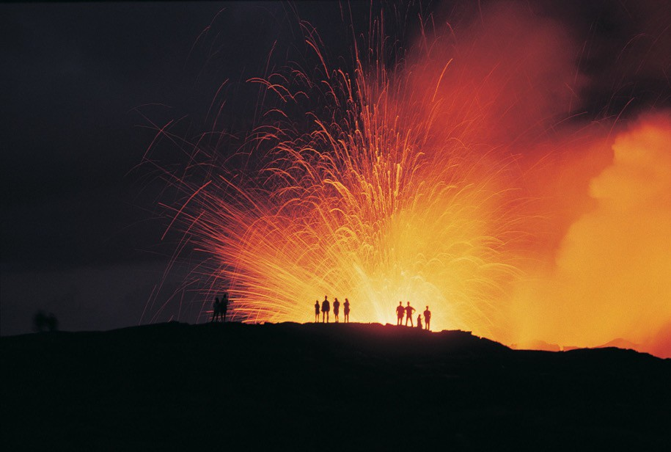
Basalt Fire Fountain

Slide 13
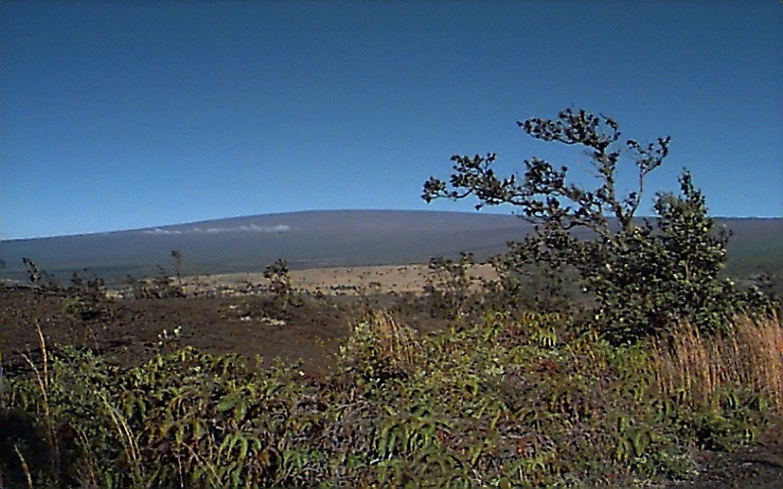
Mauna Loa on a normal day

Slide 14
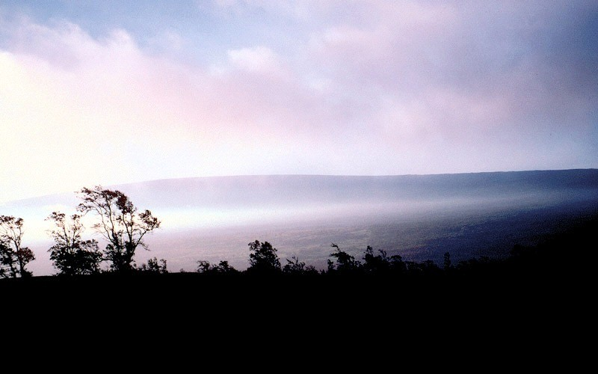
Mauna Loa VOG

Slide 15
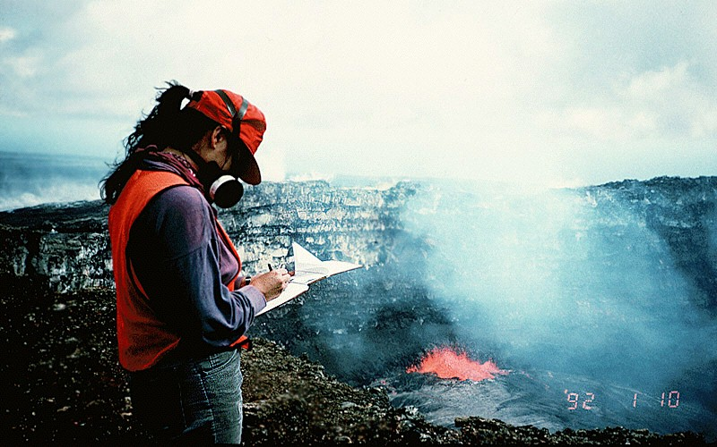
Acid Haze or LAZE from Kilauea

Slide 16
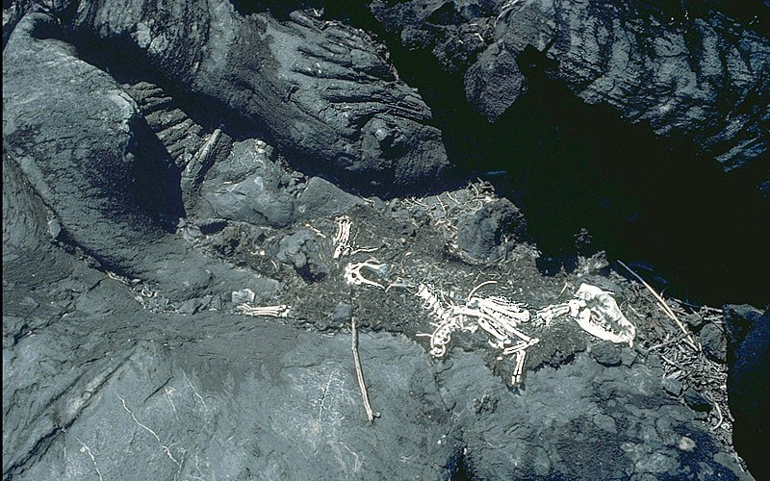
CO2 asphyxiation

Slide 17
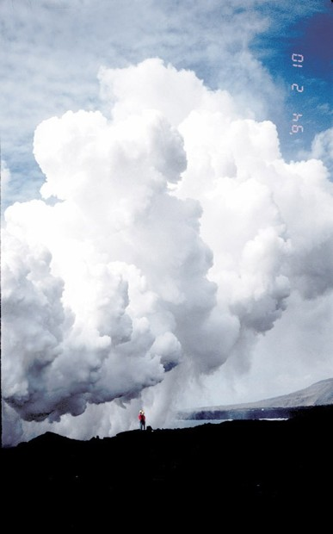
LAZE

Slide 18
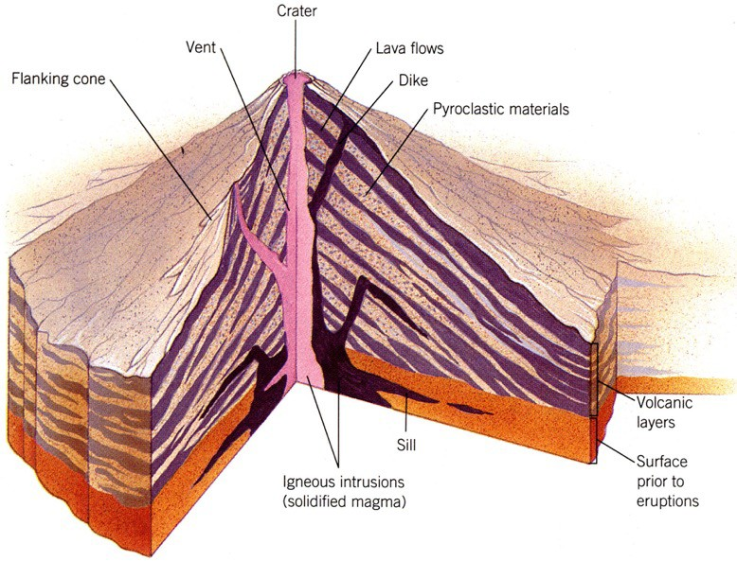
Composite Cone Anatomy

Slide 19
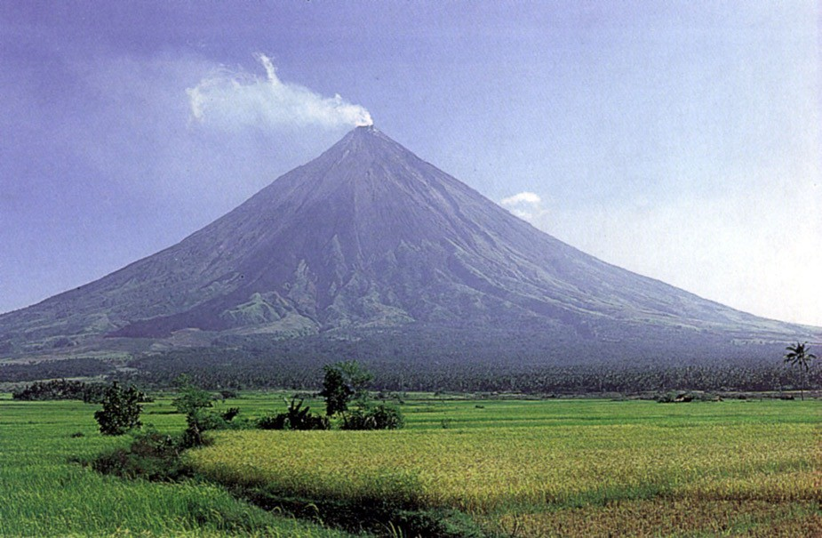
Mount Mayon Volcano in the Philippines

Slide 20
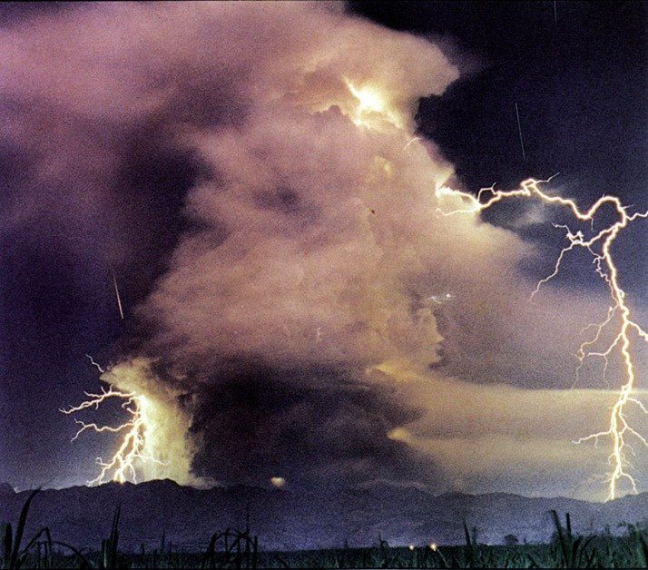
Mount Pinatubo in the Philippines on June 15, 1991

Slide 21
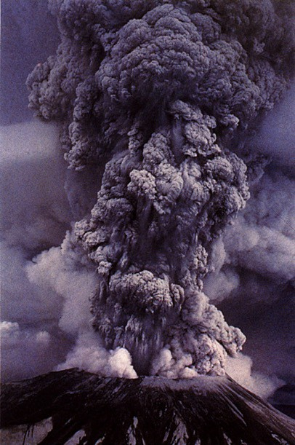
May 18, 1980 Eruption of Mount St. Helens

Slide 22
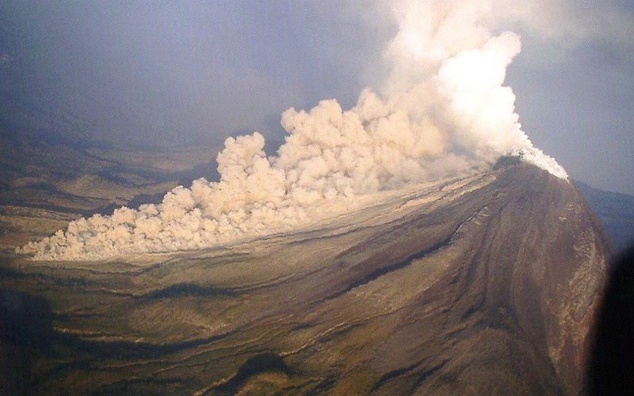
Collapsing Lava Dome

Slide 23
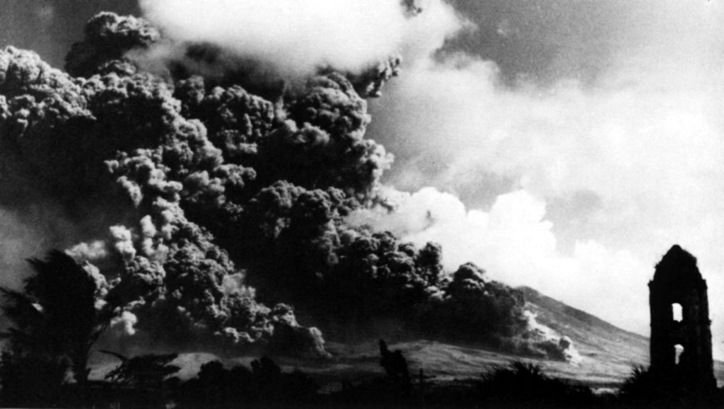
Mount Pelée, Martinique (Caribbeans), May 1902

Slide 24
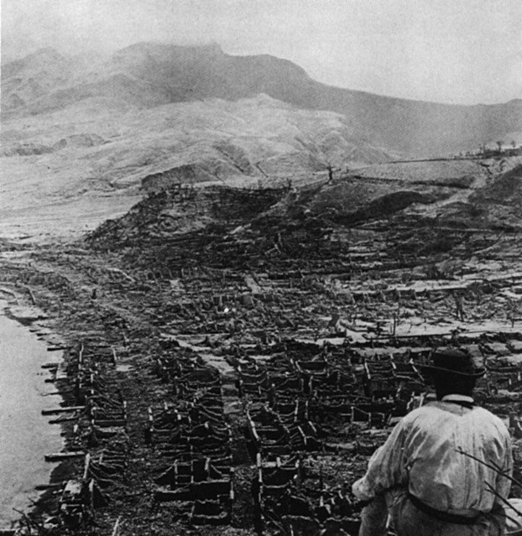
Fiery Cloud

Slide 25
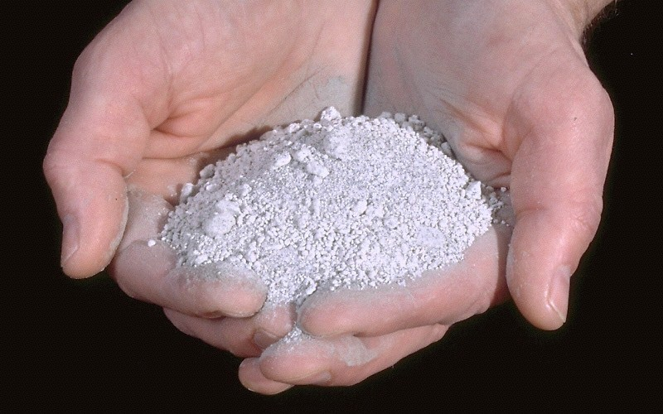
Tephra - Volcanic Ash

Slide 26
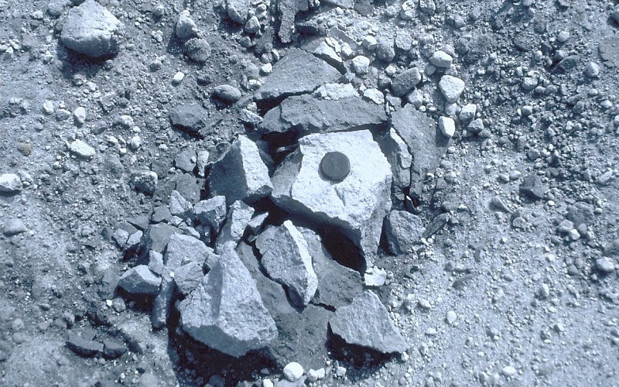
Tephra - Volcanic Blocks

Slide 27
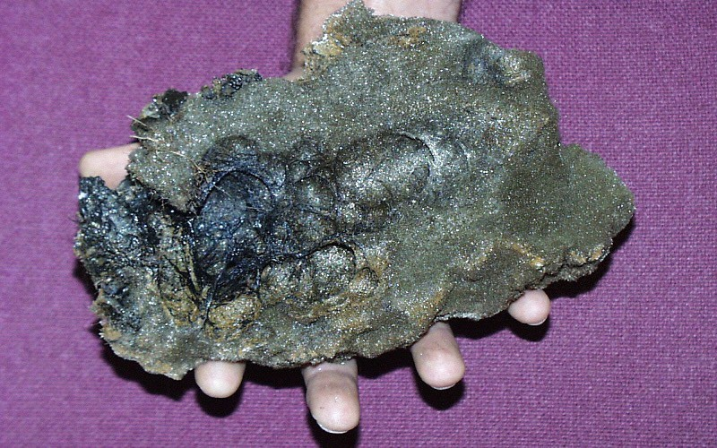
Tephra - Volcanic Bombs

Slide 28
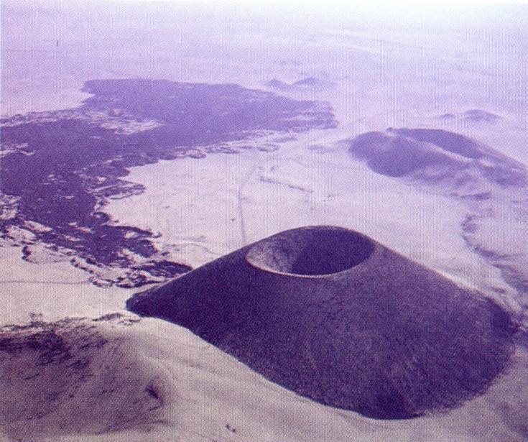
Cinder Cone

Slide 29
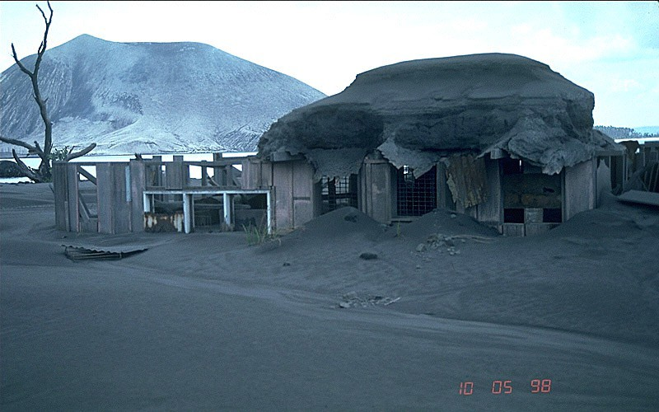
Structures Collapse and/or are Buried

Slide 30
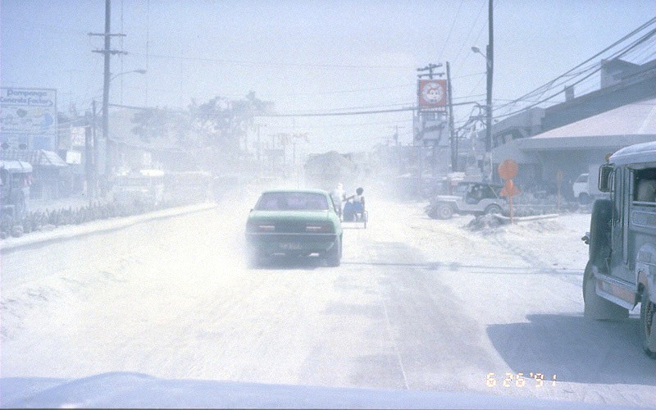
Machinary Abraded

Slide 31
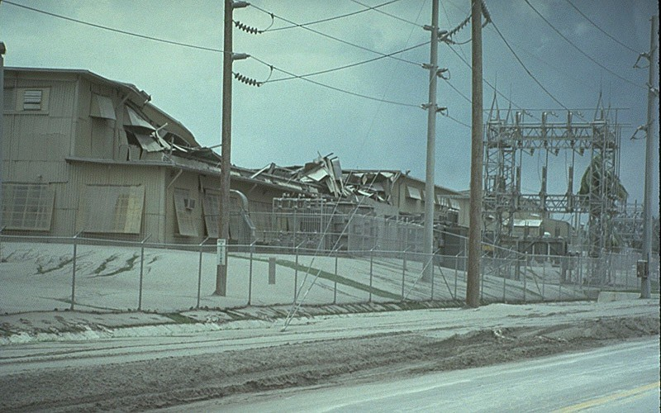
Power Systems Destroyed

Slide 32
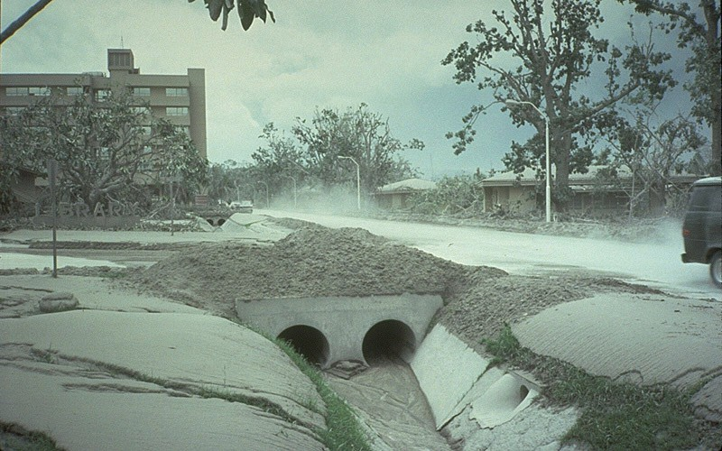
Water Systems and Waste Water Drainage Clogged

Slide 33
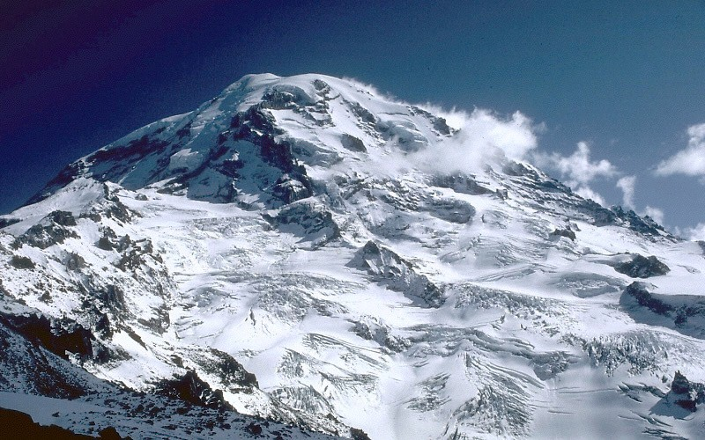
Mount Rainer WA - the beginning of a Lahar

Slide 34
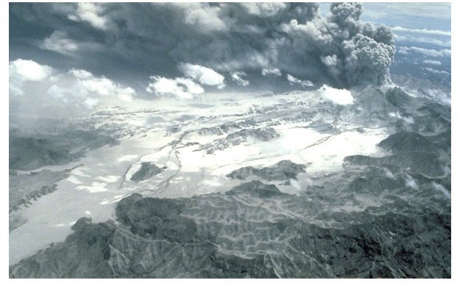
Add Rain = Lahar

Slide 35
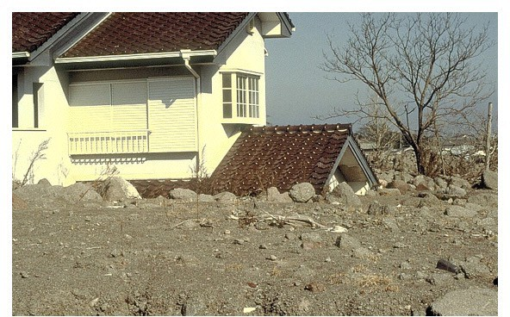
Buries Homes

Slide 36
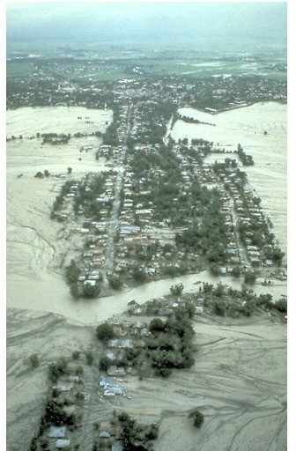
Buries Whole Communities

Slide 37
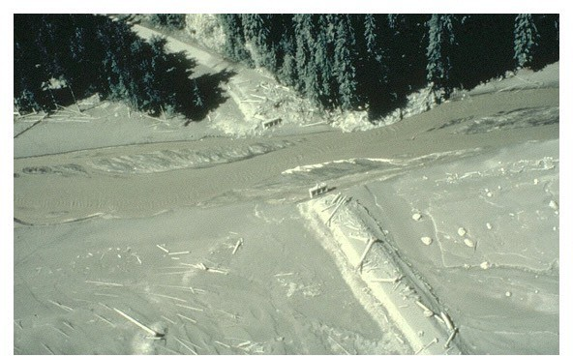
Clogs Waterways

Slide 38
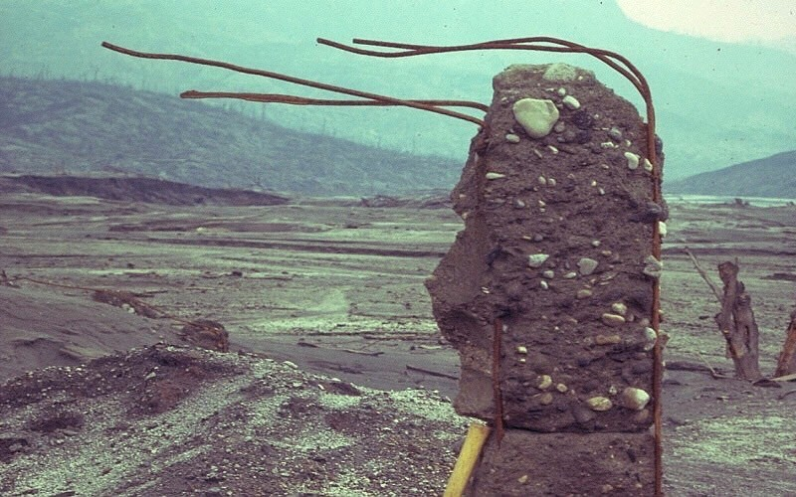
Impact Flatten Structure

Slide 39
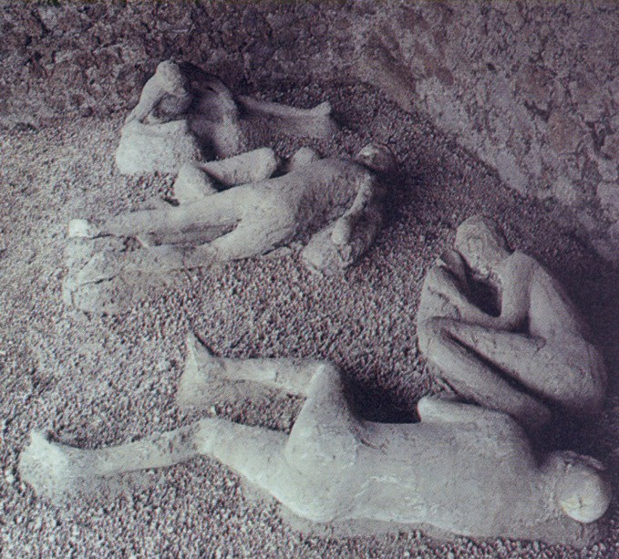
Mt Vesuvius, Italy - Pompeii, a Hot Lahar

