Slide 1
DROUGHT AS A GEOHAZARD
Lecture Outline
The Hard Truth about South Texas Climate
Drought Definition – In the Eye of the Beholder
3. What Makes Drought Unique as a Geohazard
4. Specific Drought Risks
5. Coping with Drought

Slide 2
1. The Hard Truth about South Texas Climate
Climatically, South Texas is defined as having a semi-arid climate
The definition of a semi-arid climate is:
(a) A location where PET > P
(b) Where average annual rainfall is less than 10 in /yr
Rainfall in Laredo historically varies between 5 to 50 in /yr
Needless to say that in most years South Texas experiences a chronic shortage of rainfall – Drought is our constant companion

Slide 3
2. Drought Definition – In the Eye of the Beholder
A basic definition is an extreme environmental condition that is characterized by an absence of precipitation in the local and regional water cycle as a consequence of the physical interactions of elements of the atmosphere, hydrosphere, and lithosphere.
There are several different types of drought:
Meteorological Drought - Below normal rainfall (shorter-term)
Agricultural Drought - lack of soil moisture to support ag activities (shorter-term drought)
Hydrologic Drought - lack of surface and subsurface water resources (longer-term drought)

Slide 4
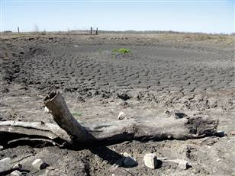
Drought in Texas - 2011

Slide 5
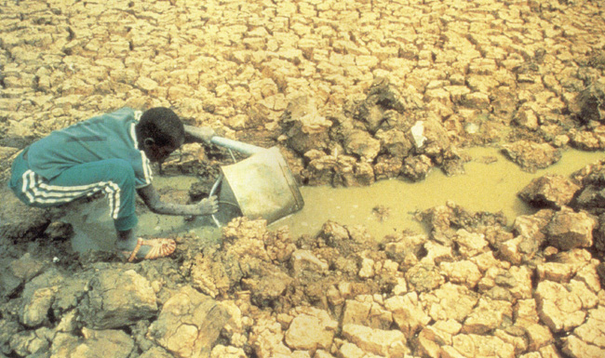
3. What Makes Drought Unique as a Geohazard
SLOW ONSET
DIVERSE IN LOCATION &
DURATION
DIFFICULT TO MEASURE
THE SOCIETAL IMPACTS

Slide 6
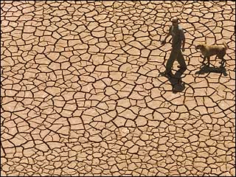
4. Specific Drought Risks
Direct Meteorological & Hydrological Impacts
HIGH TEMPERATURES
VERY LOW HUMIDITY
LOSS OF SOIL MOISTURE
VANISHING STREAMS, LAKES, AND WATER TABLES

Slide 7
4. Specific Drought Risks – Indirect Impacts
Drought is typically linked to wildfires, loss of water quantity and quality, and famine (sometimes).
These linkages can lead to major loss of life of people and animals, loss of livelihoods, and loss of habitats.
Loss of agricultural land (e.g., from desertification)
Reductions in water quantity and quality

Slide 8
CAUSES OF RISK
PROLONGED LACK OF PRECIPITATION
LOSS OF SOIL MOSTURE
LOSS OF AGRICULTURAL PRODUCTIVITY
DROUGHTS
DEPLETION/POLLUTION OF GROUND WATER
LOSS OF VEGETATION
INSECT INFESTATION
LOSS OF AG. LAND FROM DESERTIFICATION

Slide 9
5. Coping with Drought
In terms of facing future droughts there are four public policy options:
MONITORING
PREPAREDNESS
ADAPTATION
MITIGATION

Slide 10
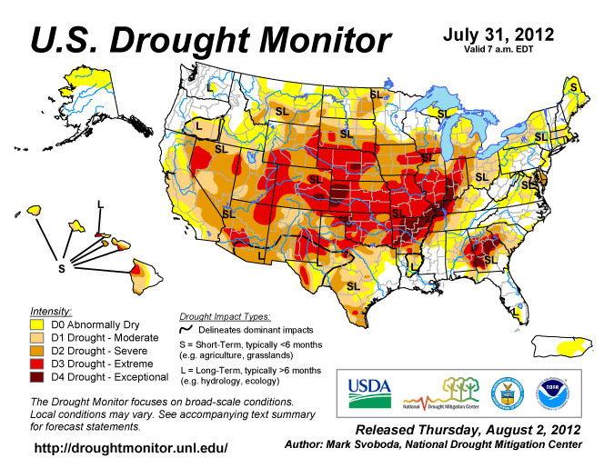
5. Coping with Drought - Monitoring
LONG RANGE
WEATHER FORECASTS
MONITORING
TECHNOLOGIES
(E.G., REMOTE
SENSING)
ANALYSIS OF PAST
DROUGHTS

Slide 11
5. Coping with Drought – Adaption / Preparedness
Another proactive option for dealing with drought is to increase the public’s general awareness of this issue.
Augmenting water supplies
- Next Friday’s Lecture
b. Promote water conservation (Need Public Buy-in)
- Low Flow Toilets
- Making the Choice to Use Less Water
- Rainfall Harvesting. ??

Slide 12
5. Coping with Drought – Mitigation
Here are some reactive strategies to minimize drought impacts
Conversation Credits Less Severe
Restricting Specific Uses
Outright Prohibiting Specific Uses
Rationing Water
Service Outage (We all move to SA) Most Severe

Slide 13
Summary
1. “Drought” is here to stay in South Texas.
2. We need a proactive strategy to wisely manage our
limited water resources
3. Must have buy-in from public to be successful

