Slide 1
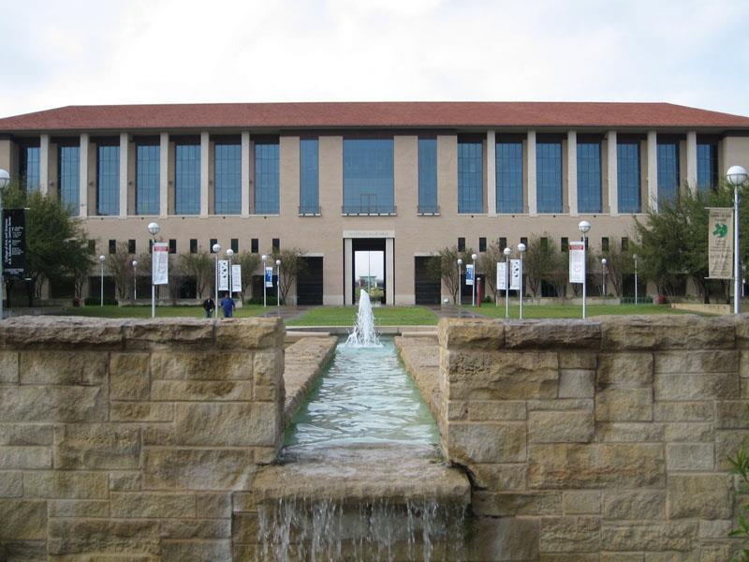
The Texas Academy of International and STEM Studies
Texas A&M International University

Slide 2
What is The Texas Academy of International and STEM Studies?
A program for high school-aged students who are academically focused and highly motivated. (11th and 12th graders)
Students take classes with current TAMIU students and enjoy full university experience.
The academy offers students the opportunity to complete two years of college concurrently with the last two years of high school.

Slide 3
History of the Academy
Located on the Texas A&M International University (TAMIU) campus, the Texas Academy of International Studies was authored by State Senator Judith Zaffirini and authorized by the 79th Texas Legislature in 2005.
The Academy focuses on STEM and International Studies.

Slide 4
Mission and Goal
The mission of the Texas Academy of International and STEM Studies is to offer an innovative and accelerated curriculum for motivated Texas high school students.
The goal is to provide a learning environment to enhance knowledge and understanding for each student far beyond where they are when they arrive.
It is our desire for students to explore ideas and feelings and serve their community.

Slide 5
Partnership
The Texas Academy of International and STEM Studies will also partner with the UT Health Science Center in San Antonio (UTHSC)
(Laredo, Texas Extension)
Research Opportunities
Summer Camps
Internships
Mentors

Slide 6
Benefits for Students
Free tuition, fees, and books
Advanced and engaging university courses
Full participation in college life
Safe and respectful campus environment
Strong administrative and counseling support
Collaborative educational opportunities

Slide 7
Other Opportunities for Students
Ability to pursue degrees in any area
Research opportunities with renowned professors
Collaborative learning, peer mentoring and tutoring
High school diploma will be earned concurrently with college credits

Slide 8
Enrollment
Fall 2014 – 35 -50 high school “rising juniors”
Additional 50 students will be admitted the following year
Projected Enrollment
Total: 100 students
by the end of 2015

Slide 9
Requirements to Apply
Academy students will be required to comply with all enrollment pre-requisites, specifically:
Resident of the state of Texas
Competitive Preliminary Scholastic Aptitude Test (PSAT)
Official transcript for 9th and 10th grades, including STAAR, EOC and other test scores
Algebra I and II and Geometry courses completed before entering the academy
Meet TSI College Readiness Standards in all 3 areas (math, reading, and writing)
Completed application packet
*Application, student essay, three recommendation letters (school administrator, counselor, teacher)

Slide 10
Application
Application is online
www.tamiu.edu/coas/theacademy
Upload files
- PSAT/TSI Scores
-Transcripts
-Reference Letters

Slide 11
Involvement
Please list activities, awards, organizations, in the order from recent to past
If additional space is needed, a resume may be included
Short answer paragraphs:
Answer separately and attach
Parent/guardian statement: short statement on your viewpoint about child’s decision

Slide 12
Essay
Essay must be completed by student
Focus on why you wish to join academy, what you hope to contribute and gain from the experience

Slide 13
Additional Information
Three recommendation letters (assistant principal, counselor, and teacher)
Please review to make sure all questions are answered and papers are signed
Please provide us with as much information on this page as possible

Slide 14
The Texas Academy of International and STEM Studies Application Process Deadline to apply: June 15, 2014

Slide 15
For more information please contact…
Dr. Patricia E.Uribe
Academy Director
Email: puribe@tamiu.edu
Phone: (956) 326-2860

