Slide 1
MISS MANNERS

Slide 2
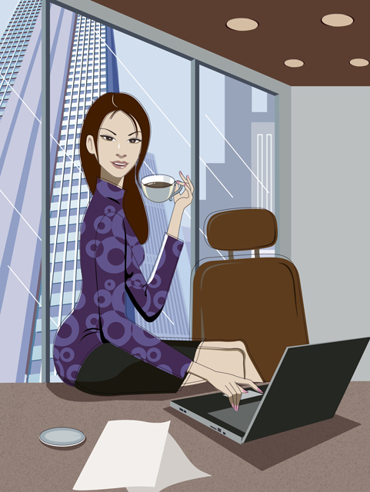
Office hours
Dress attire
Work Area
Noise pollution
Email
Telephone
Visitors
Do’s and Don’ts

Slide 3
Business Presence

Slide 4

Office Hours
Expectations

Slide 5

DRESS FOR SUCCESS

Slide 6

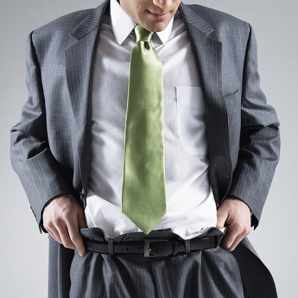
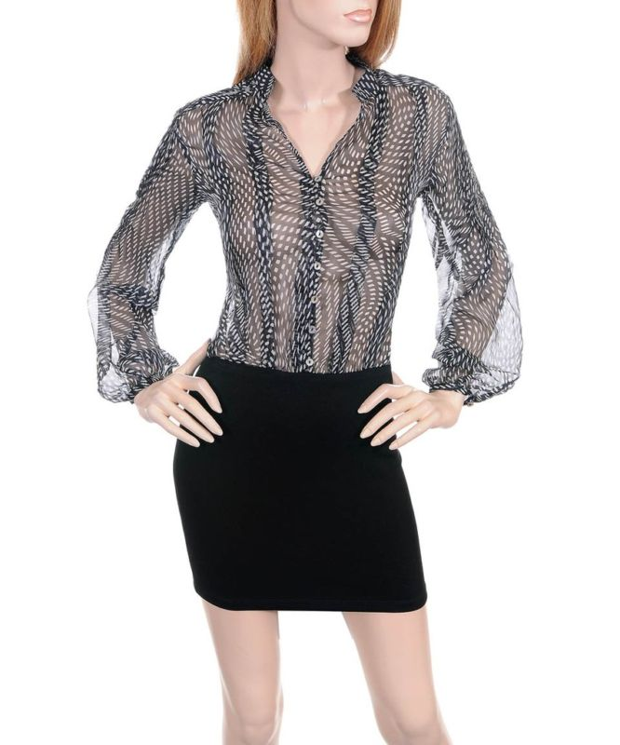

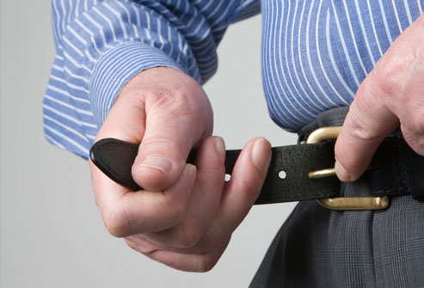
What do these messages convey?

Slide 7

Work Area
Phone
Message Pads
Calendar
Computer
Folders
Note Pad
Reference materials

Slide 8
Noise
Pollution

Slide 9
E-MAIL APPROPRIATNESS
Watch Your Tone
Be Concise
Be Professional
Use Correct spelling and
Proper grammar
Ask before sending attachments
Wait to fill in the “TO”
Proofread email

Slide 10
Telephone
Etiquette

Slide 11
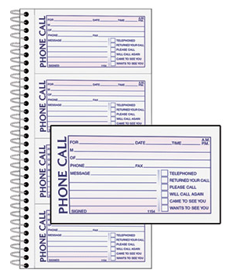
Taking
Messages

Slide 12
Personal Visitors

Slide 13
MISS MANNERS

