Slide 1
Using AEFIS for Linking an Assignment
Texas A&M International University
Office of Institutional Assessment, Research & Planning

Slide 2
Logging into AEFIS
Website: Tamiu.aefis.net
Make sure and have Duo Connect to login.

Slide 3
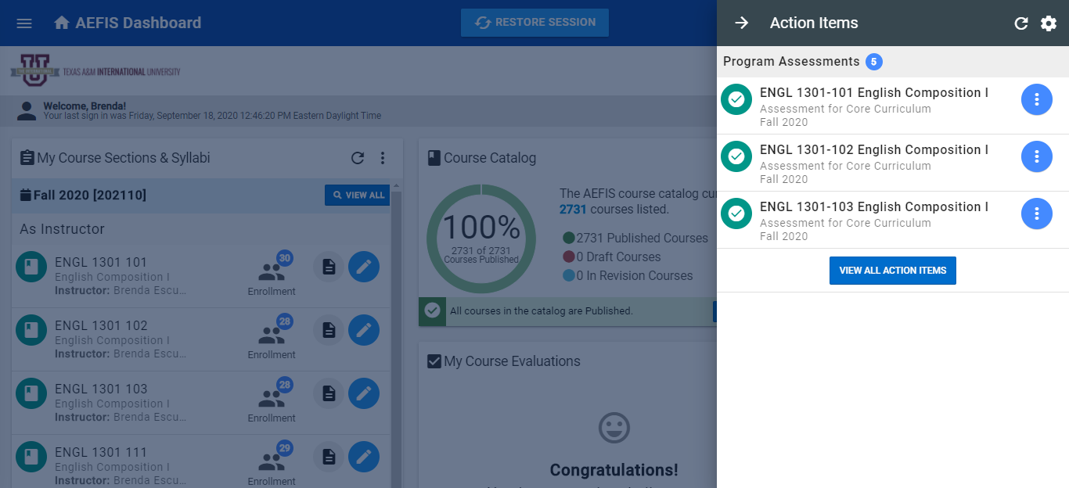
AEFIS Homepage

Slide 4
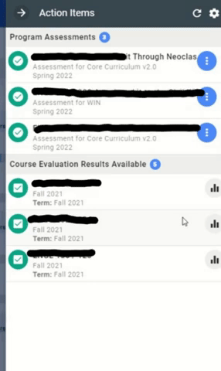
Entering Course Home
Hover your mouse over the three dots of the course section you wish to enter.
Click on the house icon to enter the main page of your course section.

Slide 5
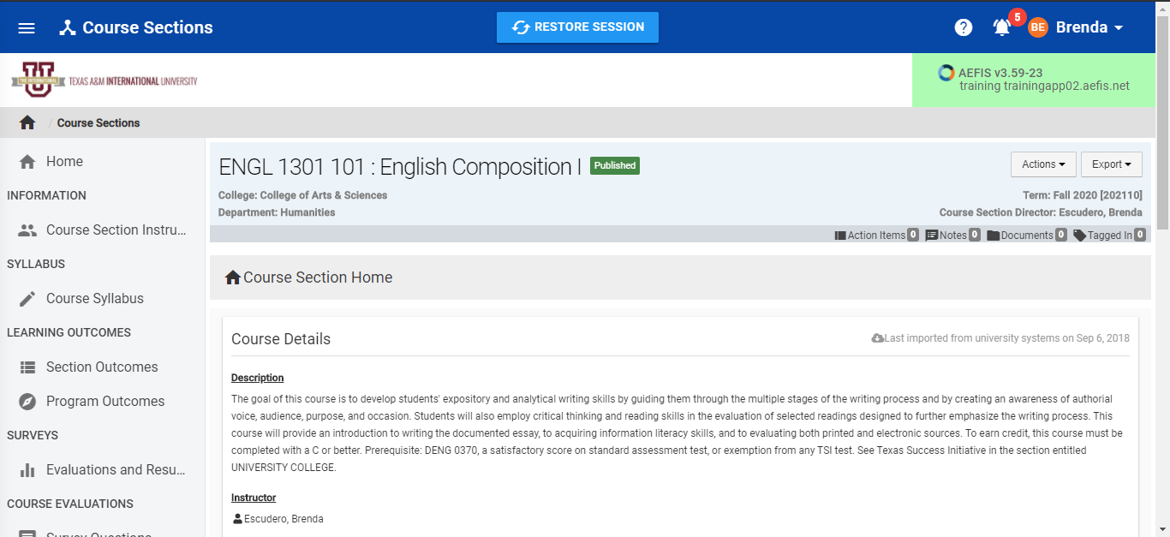
Course Section Page

Slide 6
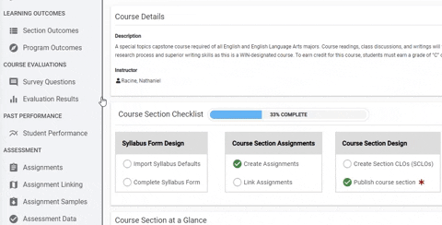
Assignments
On the left-hand menu, select the menu item “Assignments Linking”:

Slide 7
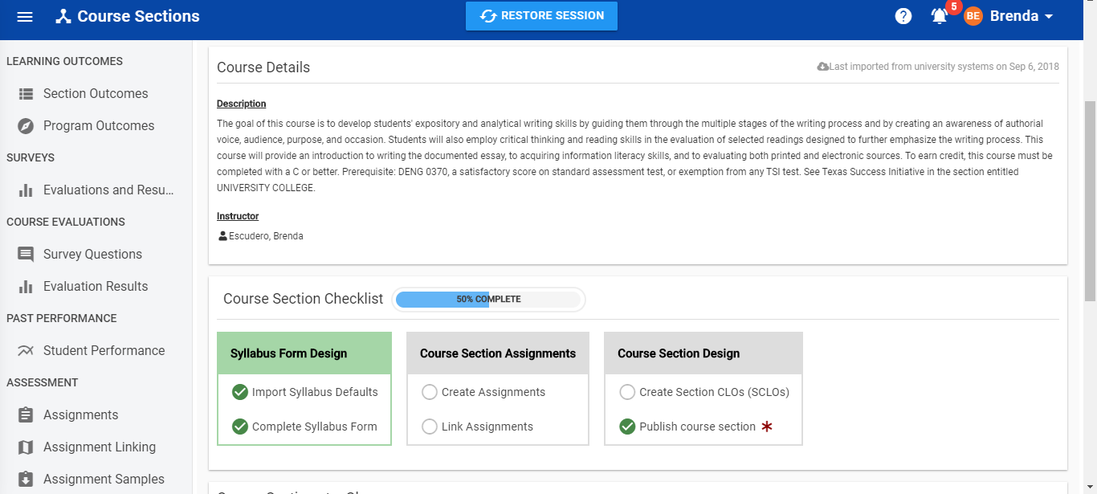
Assignments Linking Page
You are now on your assignments linking page. Your preselected outcomes are displayed here.

Slide 8
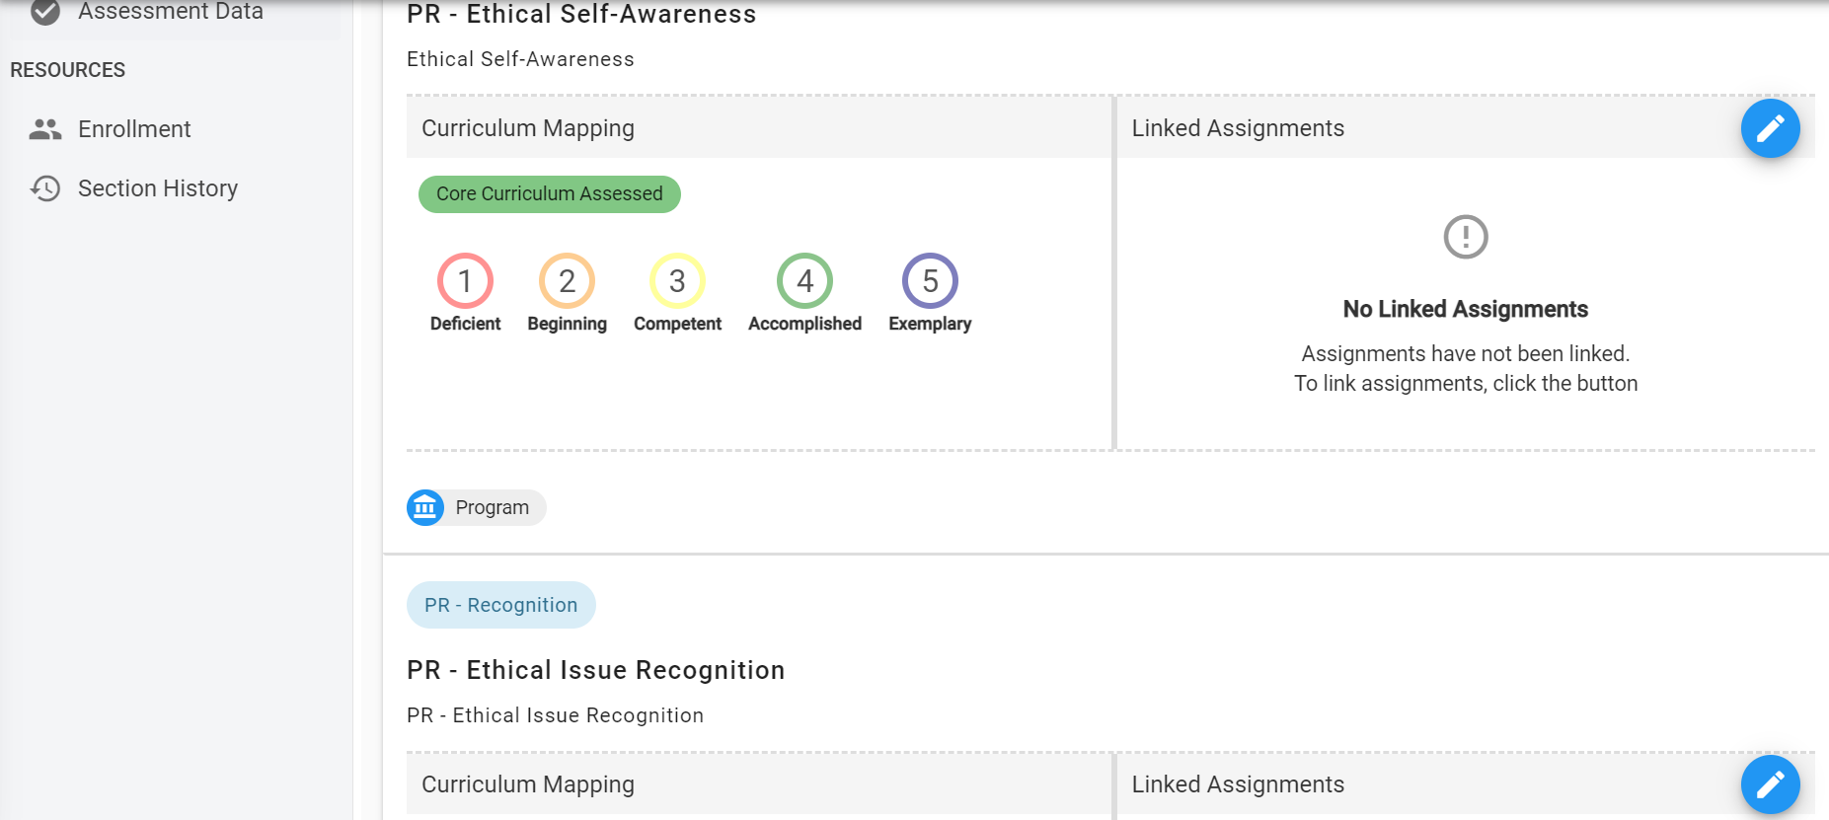
Linking Assignments
To link your assignment to the corresponding outcome, click the blue pencil in the corner of that outcome.

Slide 9
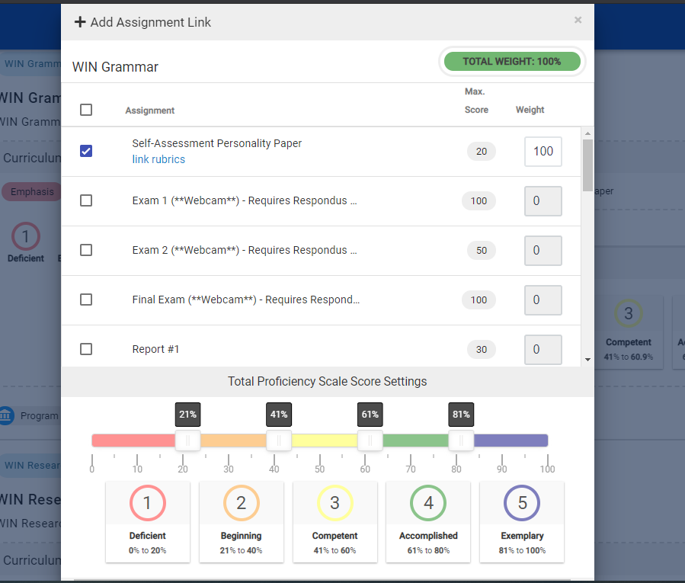
Linking Assignments
A new selection box will appear with your assignments. You must select the hyperlink “Link Rubrics” to select the appropriate rubric domain.
**Special Note**
If you do not see “Link Rubrics” you did not set up the scoring criteria correctly. Please return to converting or creating assignment to add the scoring criteria

Slide 10
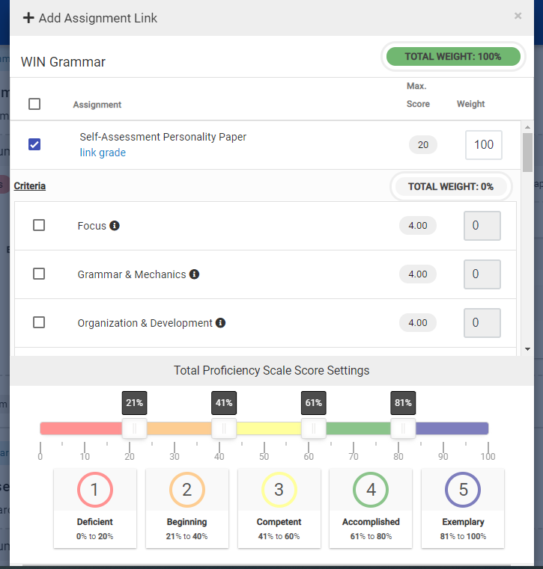
Linking the Appropriate Rubrics
The criteria will appear below the assignment.
Select the proper criteria for the outcome being tested. (e.g., Testing WIN Grammar as in this image only the “Grammar & Mechanics” criteria should be selected)

Slide 11
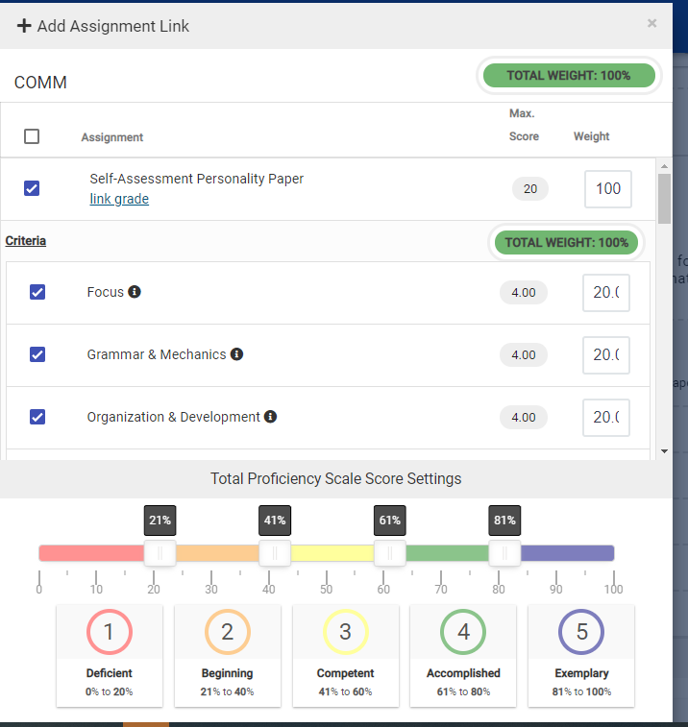
Linking the Appropriate Rubrics
When you’re linking the assignment to the overall outcome, select all rubric domains appropriate to that outcome.
Common Mistake: If you’re testing two outcomes with one assignment. Make sure and select ONLY those rubric domains that pertain to that outcome.

Slide 12
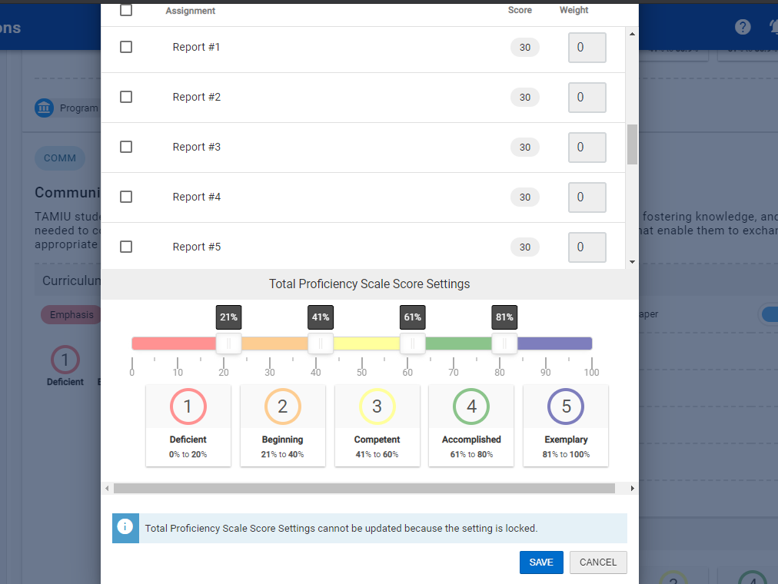
Linking Assignments
After selecting all criteria necessary click “Save” at the bottom.
**Do not change Total Score Rubric Settings. This is set at the institutional level.**

Slide 13
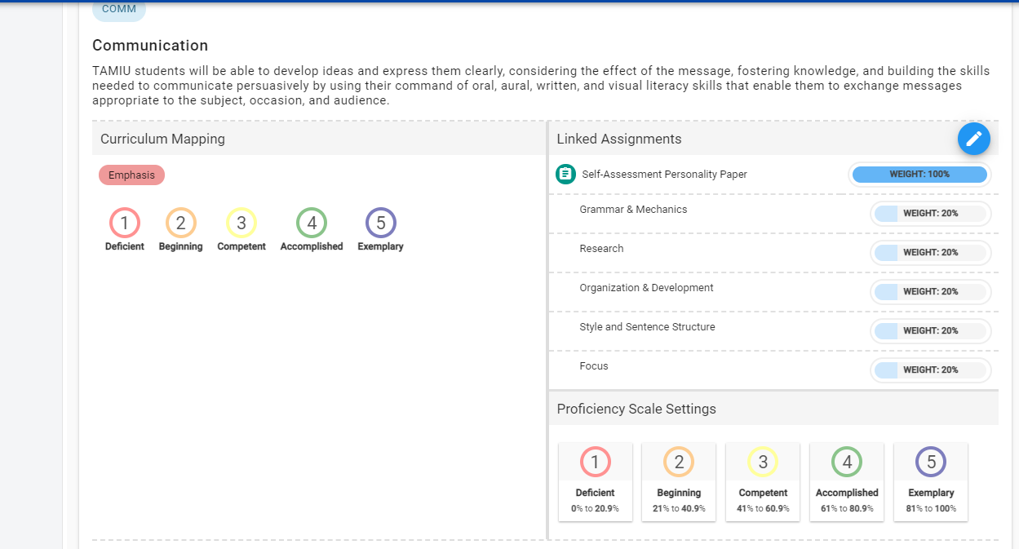
Linking Assignments
Once you are finished linking you will see your linked assignments below the outcome. You are now finished linking your assignments

Slide 14
You have finished linking an assignment!
The following step in the process may still be necessary:
Scoring your Assignment
Please reach out to our office if you need any additional assistance or if you have any questions. We are here to help! Feel free to visit our website for other helpful tips and tutorials https://www.tamiu.edu/adminis/ie/Assessment.shtml#WINAssessment

