Slide 1

Using AEFIS for Step 5 of Administrative Educational Support (AES) Units
Assessment Process
Texas A&M International University
Office of Intuitional Assessment, Research, & Planning
Assessment Specialist – Vanessa Martinez

Slide 2
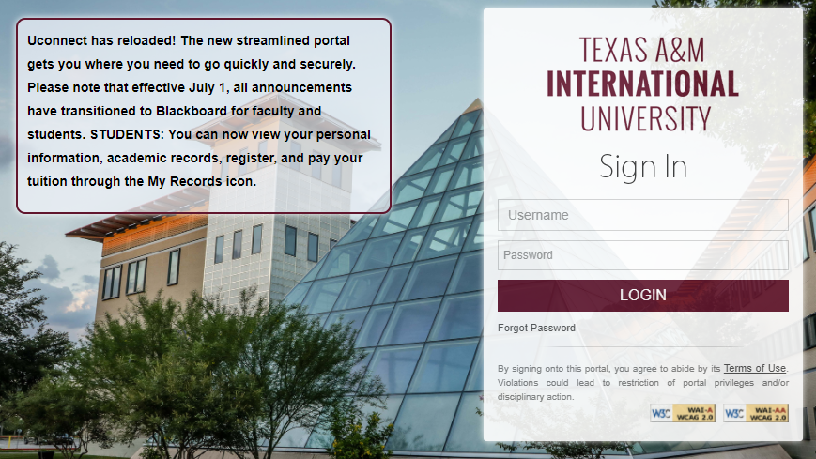
Logging into AEFIS
Website: Tamiu.aefis.net
Make sure to have Duo Connect to login.

Slide 3
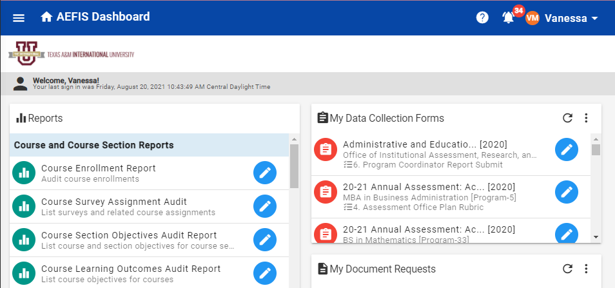
AEFIS Homepage – Once Entered
This screen shot may have more items presented than yours will when you login.

Slide 4
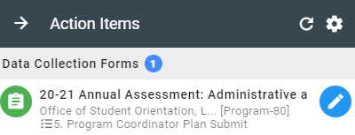
Entering your Assessment Plan
When you first enter into AEFIS, your “Action Items” will display on the right side of your screen. To enter your assessment plan click on the blue pencil.
This step should be entitled “5. Program Coordinator Plan Submit.”
If the step is not on 5 then it can mean multiple things, and we encourage you to reach out to our assessment office for clarification.

Slide 5
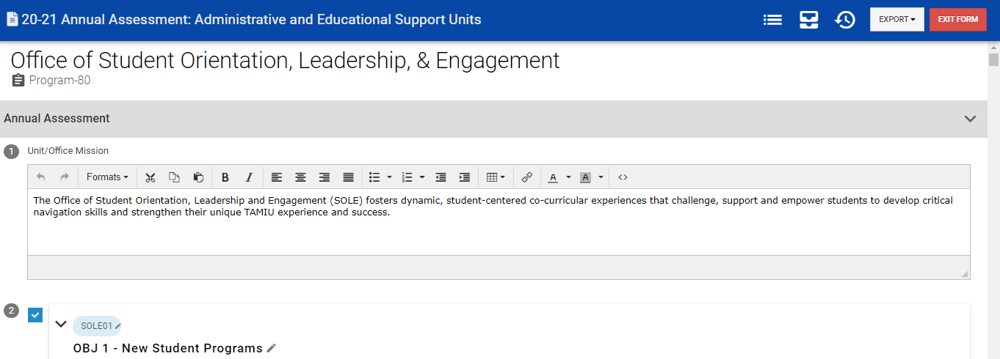
Assessment Plan Page
When you enter into your Assessment Plan you should see your office’s name under the blue banner.

Slide 6


Reading your Assessment Feedback
Step 5 allows you to review feedback provided throughout the document:
  1 – Your Department Chair: Below Plan Entitled “Assessment Plan Checklist”
  2 – The Assessment Office Below the Checklist Entitled “Assessment Plan Rubric”
  Comments from an IARP Assessment Specialist and the Overall Plan Score can be found at the bottom most portion of the page.

Slide 7
Editing Based on Comments
The assessment plan is now available to edit based on commentary provided to you by the assessment office.
**Please Note** This is your FINAL time to edit your mission, measures, and benchmarks. After this submission you will no longer be able to edit these sections.

Slide 8
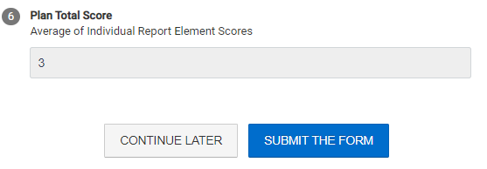
Submitting your Plan to Enter Reporting Stage
Once you are ready to start your Assessment Report simply click “I’m Finished, Submit.” This will officially move the Assessment Plan into Reporting Stages of the Assessment Cycle.

Slide 9
Thank you!
Please reach out to our office if you need any additional assistance or if you have any questions. We are here to help!
Feel free to visit our website for other helpful tips and tutorials: https://www.tamiu.edu/adminis/ie/Assessment.shtml#AAssessment

