Slide 1
Using AEFIS for Creating an Assignment
Texas A&M International University
Office of Institutional Assessment, Research & Planning

Slide 2
Logging into AEFIS
Website: Tamiu.aefis.net
Make sure and have Duo Connect to login.

Slide 3
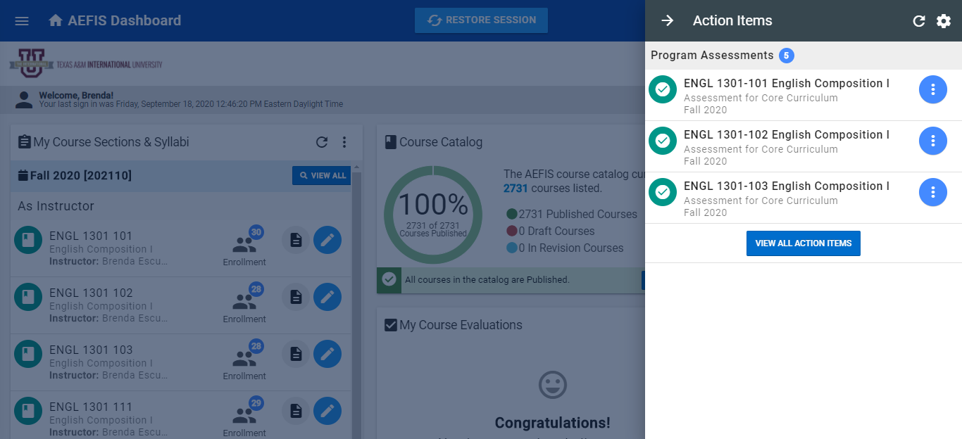
AEFIS Homepage

Slide 4
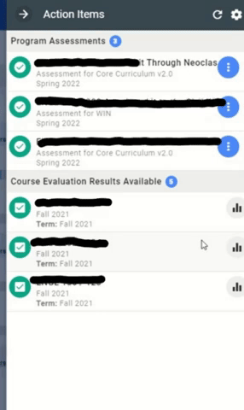
Entering Course Home
Hover your mouse over the three dots of the course section you wish to enter.
Click on the house icon to enter the main page of your course section.

Slide 5
Course Section Page

Slide 6
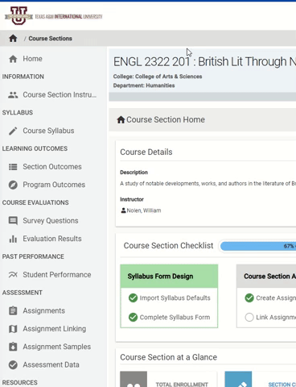
Assignments
On the left-hand menu, select the menu item “Assignments”:

Slide 7
Assignments Homepage
You are now on your assignments page. Your assignments from Blackboard should be displayed here.

Slide 8
Creating a New Assignment to Link
If you will be creating a new assignment to link to the assessment process, click the blue +ADD ASSIGNMENT button.

Slide 9
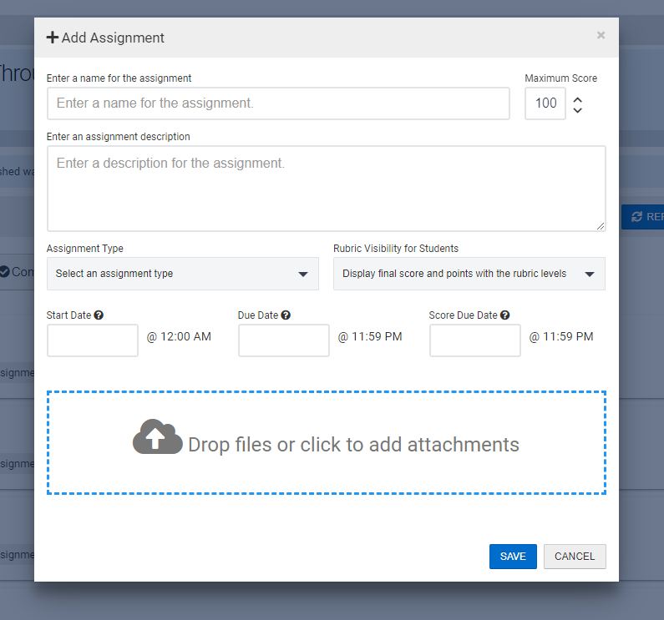
Creating a New Assignment to Link
The New Assignment Box will appear. You will fill out the following:
Name of Assignment
Maximum Score dependent on Rubric Criteria:
Social Responsibility = 16
Teamwork = 20
Communication for Dance, Art, Theatre Composition = 12
Communication = 20
Critical Thinking = 16
Empirical & Quantitative = 24
Personal Responsibility = 16
Assignment Description: Re-enter your title

Slide 10
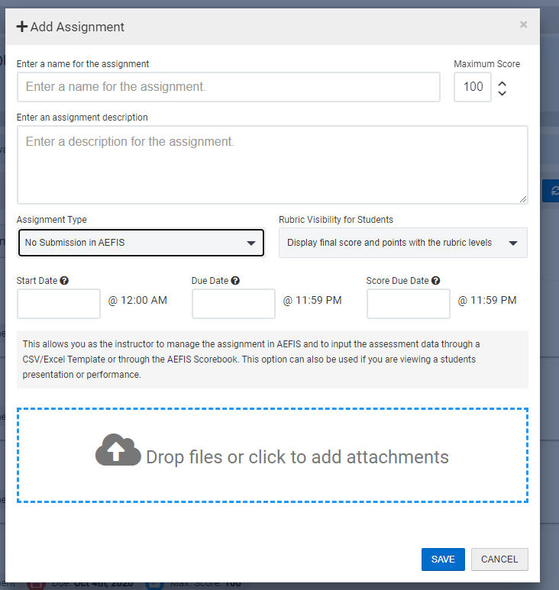
Creating a New Assignment to Link
The New Assignment Box will appear. You will fill out the following:
Assignment Type = No Submission in AEFIS
Rubric Visibility for students = Display final score and points with the rubric levels
Start Date: Select today’s date
Due Date: Select tomorrow’s date
Grading Due Date: Last day of submission
Once you have finished click Save

Slide 11
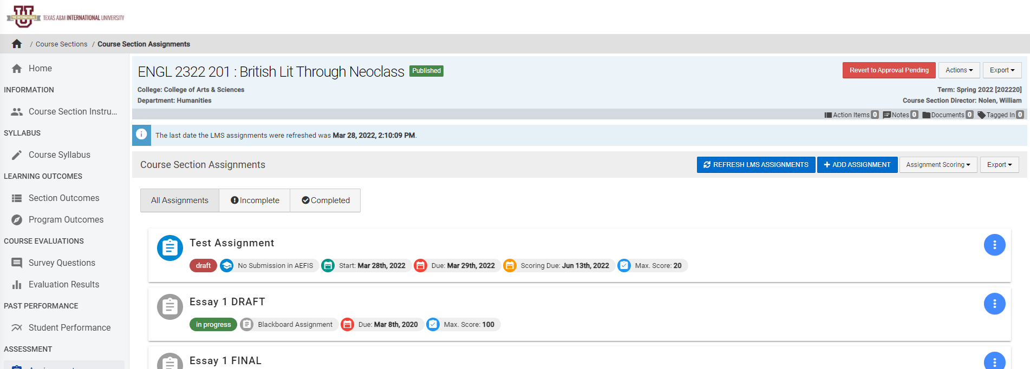
Creating a New Assignment to Link
This will take you back to your Assignment Homepage. Find the new assignment you have created.

Slide 12
Adding Rubric to your created Assignment

Slide 13
Adding Rubric
Hover over the Blue button with three white vertical dots and select the Home Image “Go to Assignment Home”

Slide 14
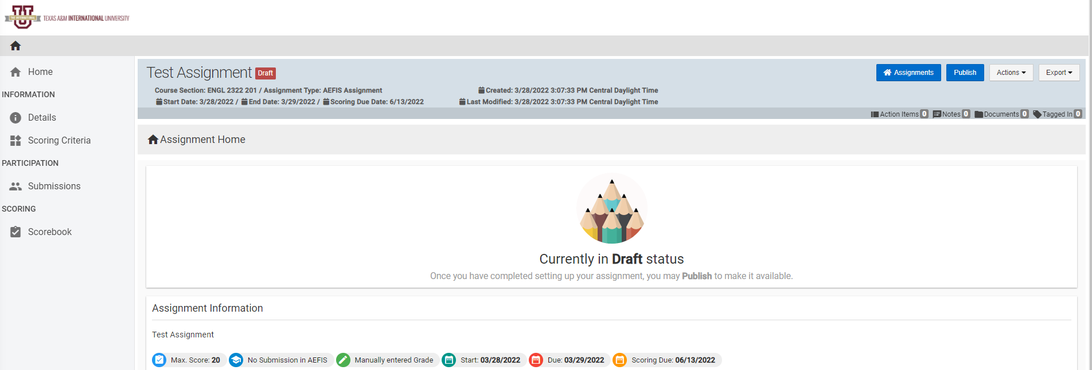
Adding Rubric
Select “Scoring Criteria” on the left menu.

Slide 15
Adding Rubric
Click the edit button to select the appropriate rubric.

Slide 16
Adding Rubric
Click the “+ADD RUBRIC CRITERIA” button

Slide 17
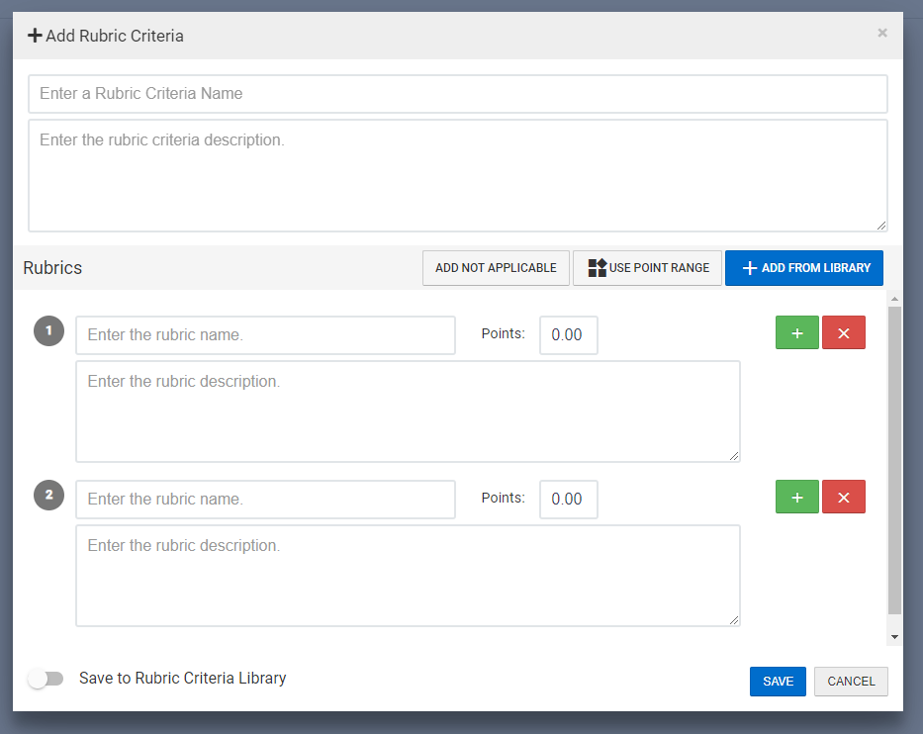
Adding Rubric
Click the “+ADD FROM LIBRARY” button

Slide 18
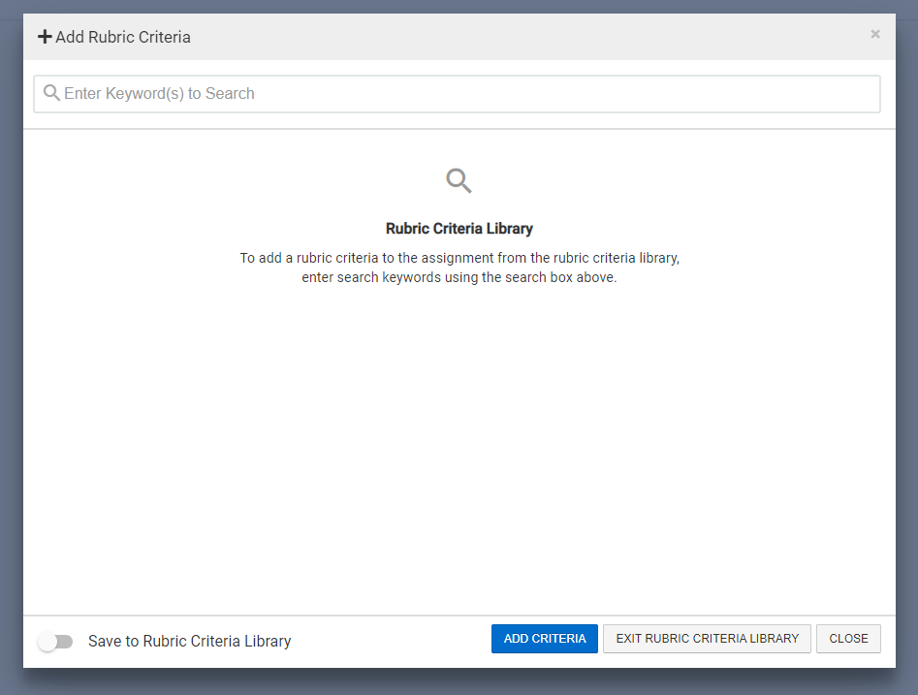
Adding Rubric
Use the “Keyword Search” to locate your outcome domains (e.g. type CC: Communication)

Slide 19
Adding Rubric
This keyword will bring about the Core Curriculum Rubric entered in the system. Please select every domain as appropriate for the rubric. If you are unaware of what those are, you must reference the rubric. Once you have selected all the appropriate rubric areas scroll to the bottom and click the blue button “ADD CRITERIA” and then after added notification appears Click “CLOSE”

Slide 20
Adding Rubric
Special Note:
If you are using one assignment to score multiple outcomes. You must add rubric criteria one by one. But all rubric can be assigned to this one assignment.

Slide 21
Adding Rubric
At this point your assignment now has the proper rubric for scoring assessment. Click “EXIT” (top right) to return to assignment home. You must now publish your assignment to grade it.

Slide 22
Publish & start your Assignment

Slide 23
Publishing your Assignment
Now that we have selected the proper rubric, we are ready to publish the assignment. Click the Blue “Publish” button

Slide 24
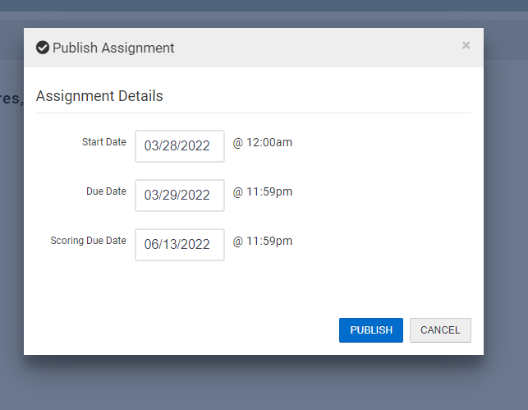
Publishing your Assignment
Double check the start, due, and grading due dates for the assignment/ Click “Publish” again.

Slide 25
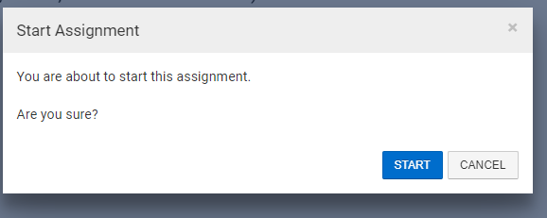
Starting your Assignment
Click the Green “Start” button
Click “Start”

Slide 26
You have finished creating an assignment!
The following steps in the process may still be necessary:
Linking your assignment to all outcomes
Scoring your Assignment
Please reach out to our office if you need any additional assistance or if you have any questions. We are here to help! Feel free to visit our website for other helpful tips and tutorials https://www.tamiu.edu/adminis/ie/Assessment.shtml#GECAssessment

