Slide 1
Using AEFIS for Scoring an Assignment
Texas A&M International University
Office of Institutional Assessment, Research & Planning

Slide 2
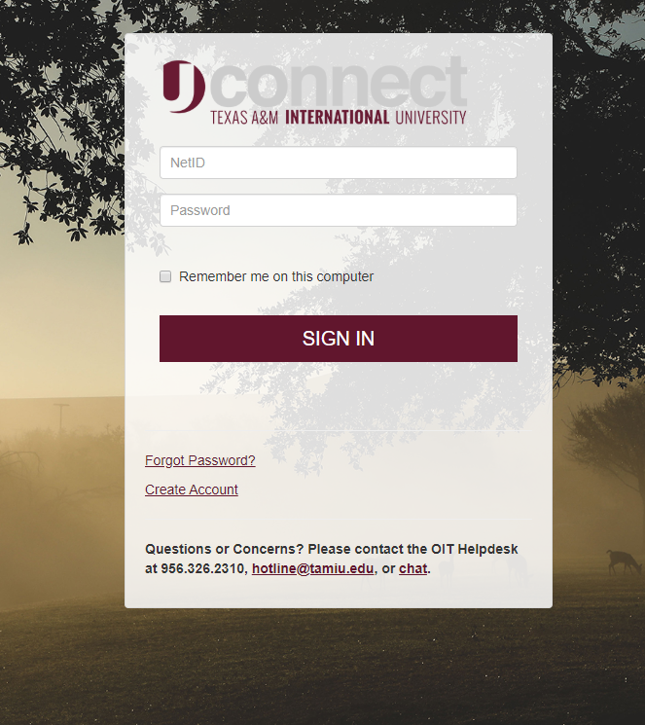
Logging into AEFIS
Website: Tamiu.aefis.net
Make sure and have Duo Connect to login.

Slide 3
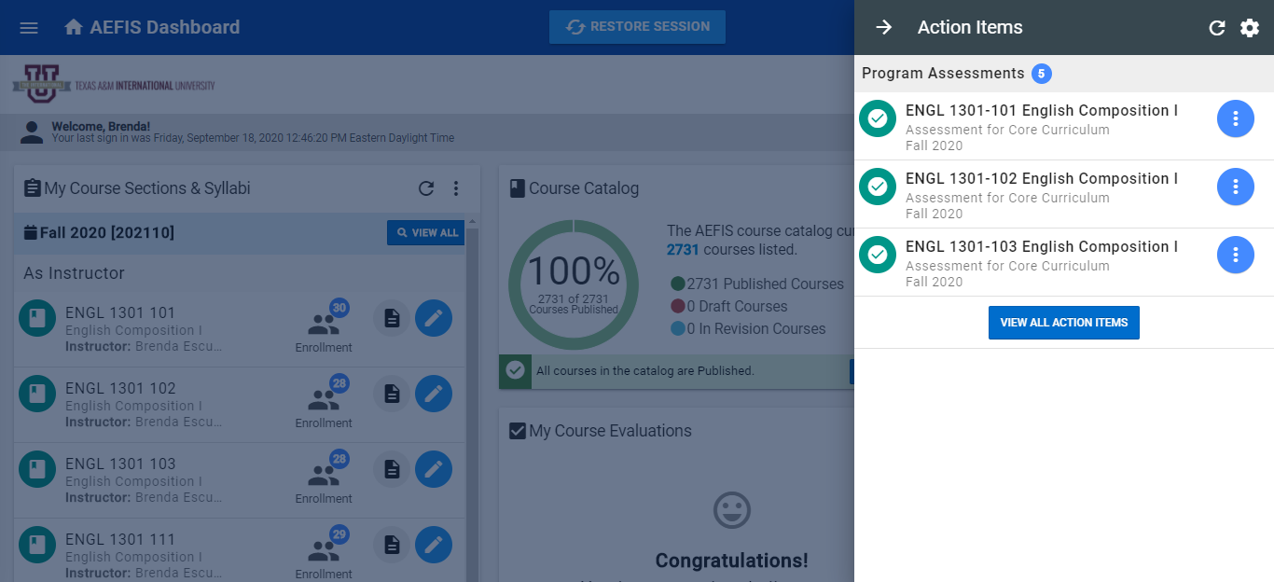
AEFIS Homepage

Slide 4
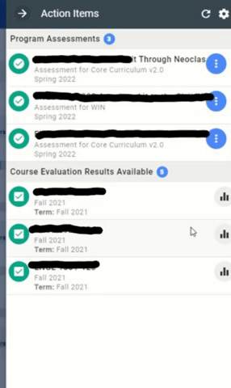
Entering Course Home
Hover your mouse over the three dots of the course section you wish to enter.
Click on the house icon to enter the main page of your course section.

Slide 5
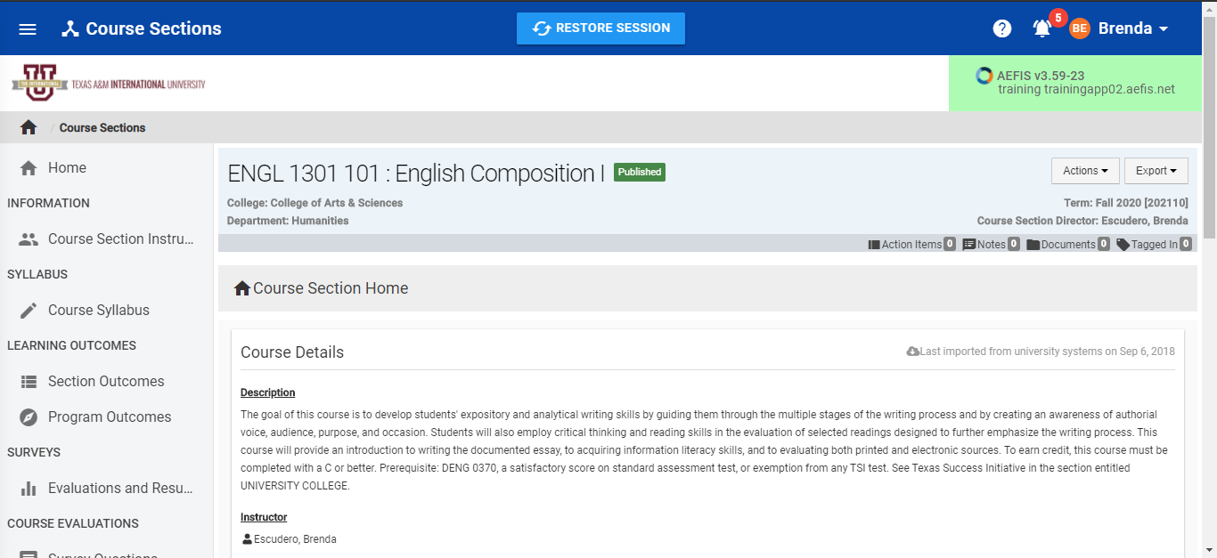
Course Section Page

Slide 6
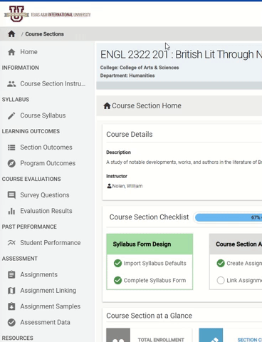
Assignments
On the left-hand menu, select the menu item “Assignments”:

Slide 7
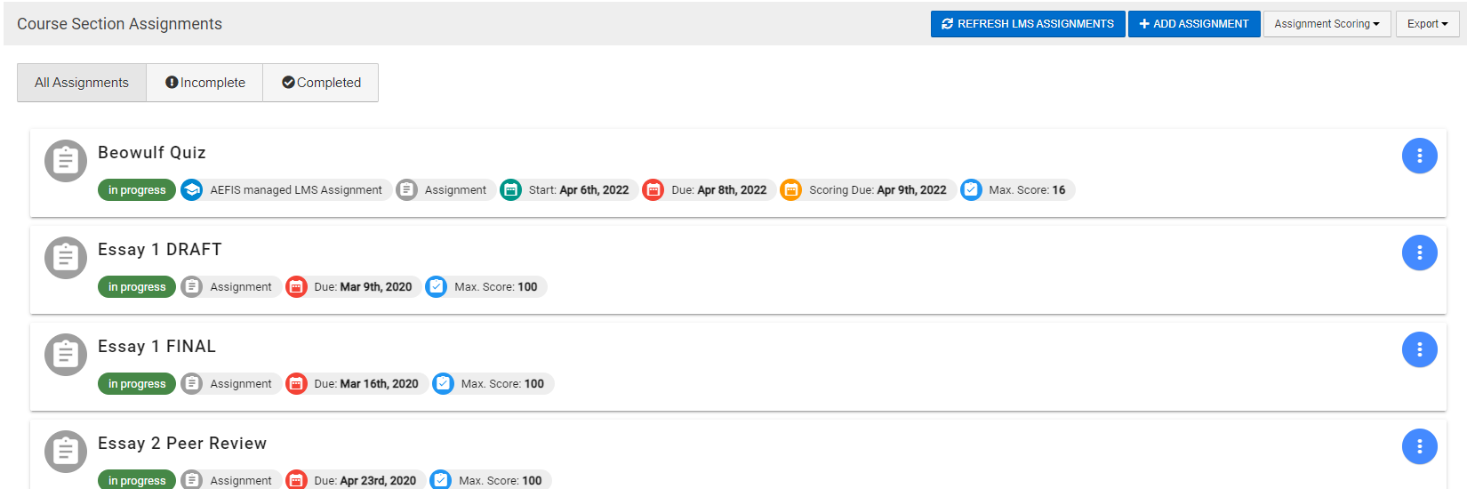

Scoring an Assignment
This will take you back to your Assignment Homepage. Find the assignment you wish to score.

Slide 8
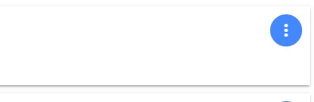
Going to Scorebook
Hover over the Blue button with three white vertical dots and select the Checkmark Image “Go to Gradebook”

Slide 9
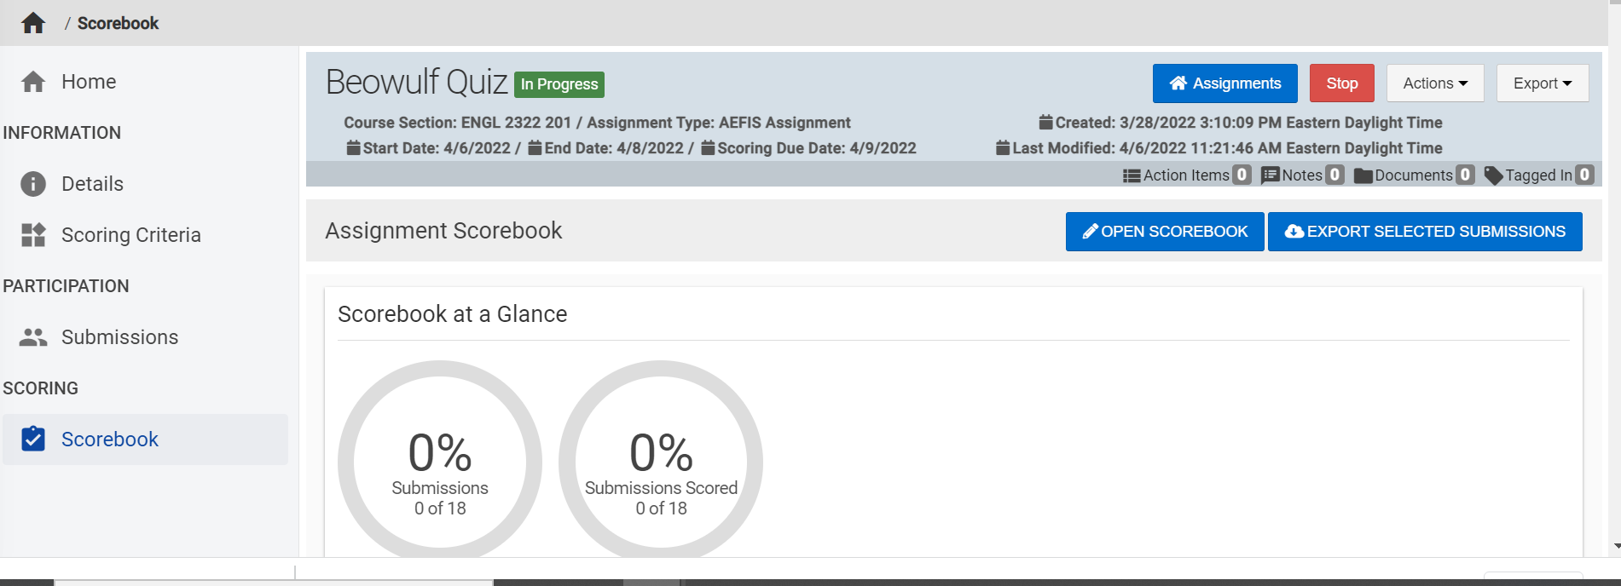

Going to Scorebook
Select “Open Scorebook” the blue button on the right side of the screen.

Slide 10
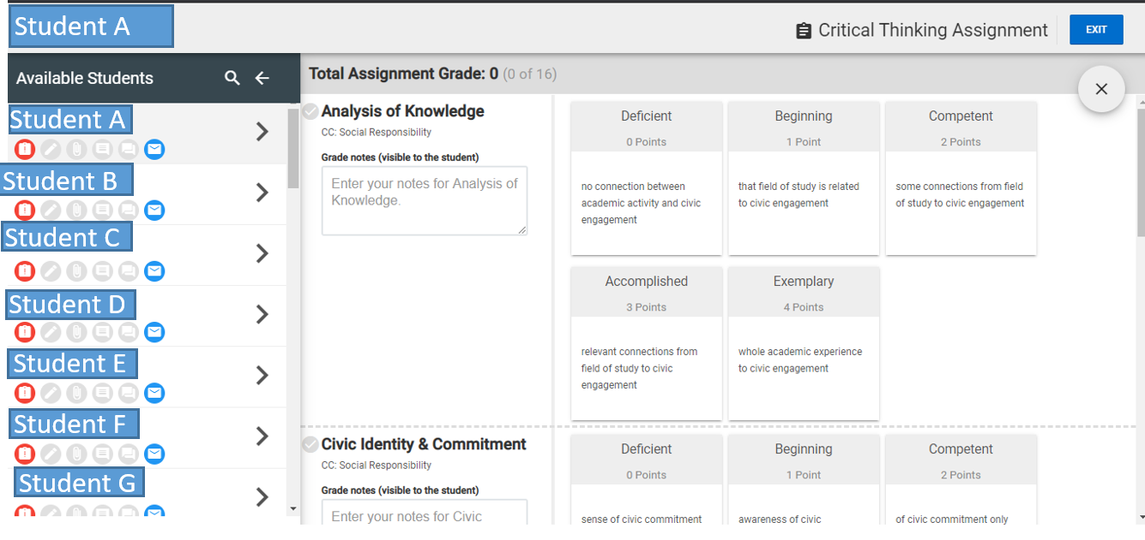
Scoring Assessments
You will now be in the scorebook for the assignment. Click on the student you wish to score. The rubric will populate for you to score the assessment. To score click on the rubric square that coincides with the student’s score.

Slide 11
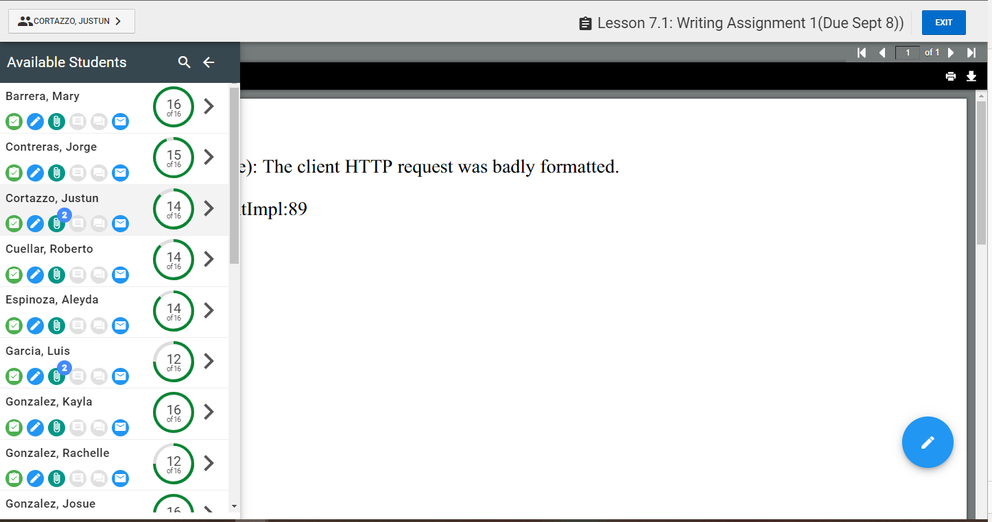
Scoring Assessments – Error Page
Student F
Student A
Student B
Student C
Student D
If you receive this error page, please click the blue pencil in the bottom right corner to get to the rubric.
Student E
Student F
Student G
Student H
Student I

Slide 12
Scoring Assessments
If at any point you need to exit and come back later just click the exit button. When you’re done you will also click the exit button.

Slide 13
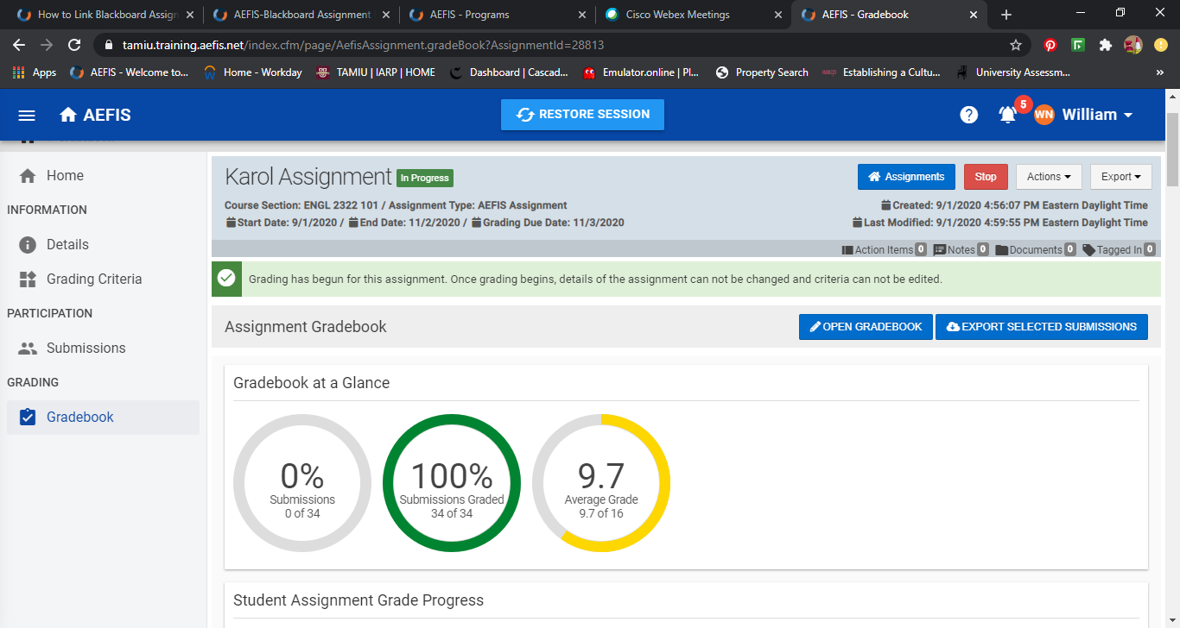
Scoring Assessments
Your scorebook page will update with the percent graded updated as well as the average score of all the students. Below that you will see the individual student scores. And you are finished scoring.

Slide 14
You have finished converting an assignment!
The following steps in the process may still be necessary:
  Linking your assignment to all outcomes
Please reach out to our office if you need any additional assistance or if you have any questions. We are here to help!
Feel free to visit our website for other helpful tips and tutorials https://www.tamiu.edu/adminis/ie/Assessment.shtml#GECAssessment

