Slide 1

New Faculty
Orientation - Payroll
Daniel Salazar
Payroll Administrator IV
Office of Budget, Payroll, & Fiscal Analysis
Notes:
Welcome new faculty. This session is meant to prevent surprises around the 9-month pay schedule, Save for Summer, W-2 access, and what to do if a paycheck looks wrong.

Slide 2


What we will cover today
A quick payroll introduction for 9-month faculty.
1
Your 9-month pay schedule
What is paid, when, and why September and June look different.
2
Save for Summer (S4S)
How deductions and summer disbursements help smooth your cash flow.
3
W-2 distribution
How to elect electronic delivery and where to find tax documents.
4
Accessing your payslip
Where to find it, and how to read it.
5
Reviewing payroll
How to catch errors early and avoid repayment surprises.
Office of Budget, Payroll & Fiscal Analysis
01
Notes:
Frame the presentation as practical: employees should know when to expect pay, how to plan for summer, how W-2 delivery works, and why reviewing payslips each month matters.

Slide 3
9-month pay at a glance
Your academic appointment and payroll calendar do not line up as one simple January–December year.
9
8
2
months of academic salary
Regular full month pay checks
half-month payments
Aug 16
Sep 1
Oct–May
May 15
Jun 1
First check
Half-month pay; no insurance or S4S deduction
Full-month payments
Academic term for payroll purposes ends
Academic term for payroll purposes begins
Last check for academic year
Half-month pay
Important Information
September and June are half month checks.
Academic Term for payroll purposes starts August 16th and ends May 15th.
Office of Budget, Payroll & Fiscal Analysis
02
Notes:
Explain that 9-month faculty are paid through the academic year pattern: a half-month payment at the beginning, full payments during the main academic months, and a half-month payment at the end. Use the timeline to emphasize the difference between the work period and pay dates.

Slide 4
Why September and June can look “off”
The first and last academic-year checks are half-month payments, so the totals and deductions can look different.
September Payroll
Half-month payrolls do not behave like regular full-month checks.
June Payroll
Covers the beginning of the academic work period (August 16th through August 31st.
Expect half-month pay.
September 1st payroll has no insurance or S4S deduction.
June 1st payroll might have inflated benefit deductions based on your elections and S4S might be deducted
Covers the end of the academic work period (May 1st through May 15th).
Expect half-month pay.
Aug. 16
Full months
May 15
Office of Budget, Payroll & Fiscal Analysis
03
Notes:
Spend time here because this is the common confusion point. September and June checks may look smaller because they are half-month payments. Do not use them as the baseline for monthly pay comparison.

Slide 5
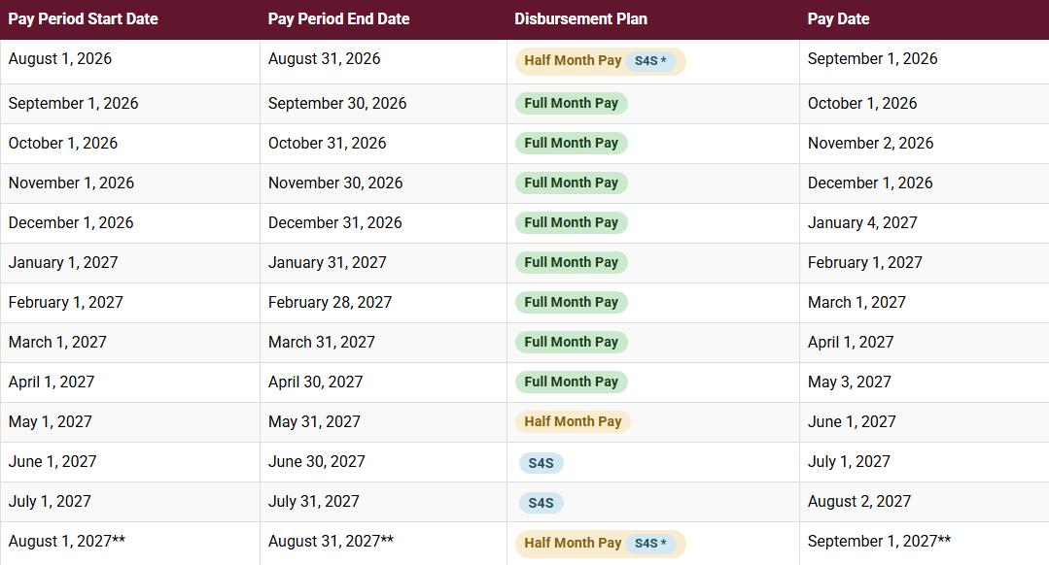
AY 2026-2027 Pay Schedule – 9 Month Faculty
Office of Budget, Payroll & Fiscal Analysis
04
Notes:
Source: TAMIU Payroll Schedules & Deadlines, FY 2027 Monthly Payroll Pay Schedule for 9-Month Faculty. Mention that dates are updated each fiscal year, so faculty should rely on the Payroll Schedules page for current dates.

Slide 6

Save for Summer (S4S)
Optional program for faculty who work less than 12 months and want summer disbursements.
How it works
You elect a specific amount to be withheld from your 9-month net pay.
The withheld total is disbursed in three equal summer installments: June, July, and August.
Forms for enrollment, changes, or cancellation go to the Office of Budget, Payroll & Fiscal Analysis.
Enrollment form must be submitted to budgetandpayroll@tamiu.edu by September 14th, 2026, to account for full academic year.
Reminders: no interest earnings, automatic re-enrollment each fiscal year, no catch-up for expired portions of the fiscal year.
Office of Budget, Payroll & Fiscal Analysis
05
Notes:
Source: TAMIU Save for Summer page. S4S extends pay over 12 months by withholding a chosen amount from 9-month net pay and disbursing the total in three equal installments during June, July, and August.

Slide 7

W-2 distribution
The Form W-2 is issued by January 31 of the following calendar year.
Electronic delivery
Update the Tax Forms Printing Election to receive year-end tax documents electronically.
Sign in through SSO and open Workday.
Go to the Benefits & Pay application and select Pay then Tax.
Paper delivery
If electronic delivery is not elected, the paper Form W-2 is mailed to the address on file on January 31.
Former employees have SSO/Workday access for up to 18 months after the last date of employment.
Office of Budget, Payroll & Fiscal Analysis
06
Notes:
Source: TAMIU Form W-2 page. Employees receive W-2s by January 31. Electronic delivery is elected in Workday under Pay > My Tax Documents > Printing Election.

Slide 8
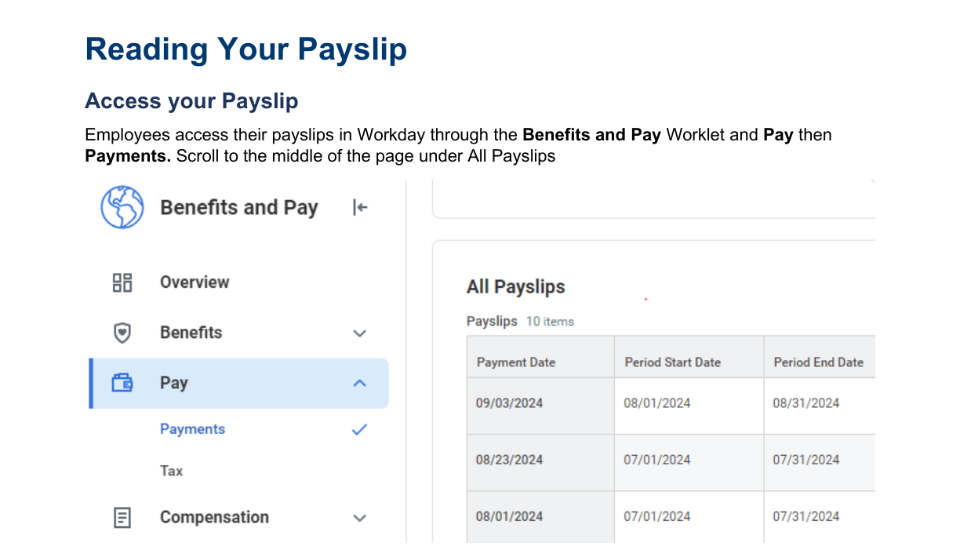
How to access your Workday payslip
Faculty can review current and prior payslips directly in Workday.
Navigation path
Benefits and Pay → Pay → Payments → All Payslips
Payslips display in chronological order, with the most recent at the top.
Select View next to the payslip you want to review.
Review the payslip when payroll processes so questions can be addressed early.
Office of Budget, Payroll & Fiscal Analysis
07
Notes:
Source: TAMIU Form W-2 page. Employees receive W-2s by January 31. Electronic delivery is elected in Workday under Pay > My Tax Documents > Printing Election.

Slide 9

Review your payslip every month
Who knows what pay you should be paid better than yourself?
What to check
Is the gross pay what you expected for this month’s schedule?
Do deductions and taxes look reasonable?
Did direct deposit, tax withholding, or S4S changes process as expected?
Are you comparing a half-month check to another half-month check?
When in doubt, email us. A quick question can prevent a bigger correction later.
Office of Budget, Payroll & Fiscal Analysis
08
Notes:
Encourage faculty to make payslip review a monthly habit. Emphasize that not every difference is an error—September and June are expected to look different—but Payroll wants to know when something seems wrong.

Slide 10
Key takeaways
1
September and June are half-month checks.
2
S4S can help spread 9-month pay into summer.
3
Review payslips and report concerns early.
Office of Budget, Payroll & Fiscal Analysis
Questions?
Contact Information
Email: budgetandpayroll@tamiu.edu
Phone: 956.326.2375
Location: KLM 435
Notes:
Close by reinforcing the practical asks: know the pay pattern, consider S4S, and review pay early.

