Slide 1
Texas A&M International University Procurement Card Training
http://www.tamiu.edu/adminis//purchasing/purchasingcard.shtml

Slide 2
Cardholder Information
Keep your card safe and secure, do not lend it out to anyone and Use card for business purposes only.
Making tax exempt purchases.
Follow up with vendors & check received orders; contact vendor in case of return
Make sure only purchases you made are charged on your card. If there are any problems:
1- Try to resolve situation with vendor 2- Contact Citibank and follow dispute procedures
Search for and use HUB vendors
Set up your PDME/Shred-it account information (if applicable)
PDME- 1-800-723-3345
Noncompliance will be reported to appropriate VP
Keeping your card is subject to proper usage and compliance
Cards must be returned to Program Administrator upon exiting the University

Slide 3
Credit Limit
$5,000 per month
Request to raise: in writing (dept. manager)
approval from VP/Dean
Freight and installation charges must fall within the card limit.
Payments may not be split.

Slide 4
Vendor Selection
State restricted vendors
TAMUS Policy Every employee is responsible for making a good faith effort of ensuring that HUBs are afforded an equitable opportunity to compete for all procurement and contracting activities of the University.
No discrimination

Slide 5
HUB
HUB = Historically Underutilized Businesses
Businesses owned, in majority, by: -American Women Hispanic Americans Black Americans Native Americans Asian Pacific Americans and that have been acknowledged by the state as such
State entities must meet set goals

Slide 6
Finding a HUB
TAMIU Website:
http://www.tamiu.edu/adminis/purchasing/hubsvendor.shtml
2. State Purchasing Website: https://mycpa.cpa.state.tx.us/tpasscmblsearch/index.jsp
a. Search for CMBL/HUB vendors
(right side, blue box)
→ select: ALL VENDORS
b. NIGP Commodity Book (left top section)
→”Search the Commodity Book Alpha Index’

Slide 7
Examples of Acceptable Purchases
Office, educational & cleaning supplies;
Books;
Toners and kits for printers/copiers;
Fabrics and linens w/o text/graphics;
Business meals (local)*; catering and food purchases;
Registration fees;
*Please see Food Purchasing Guidelines for a clear understanding of what is acceptable
http://www.tamiu.edu/adminis/purchasing/documents/FoodPurchasingGuidelines.pdf

Slide 8
Examples of Restricted Purchases
- Advertising
- Printing/copying
- Embroidery, screen printing
- Promotional items
- Software, licenses
- Memberships
- Travel
Alcohol
- Entertainment
Hazardous Chemicals
Food Vouchers
Gift/Gift Cards
- Controlled assets
**See online manual for a more complete list of acceptable and restricted purchases.

Slide 9
Controlled Assets
Fax machines
Stereo Systems
Cameras
Video Recorders
Televisions
Projectors
If the cost of these items is under $500 they are not controlled assets, if the cost is over $500 then they are and must be tagged as University property and purchased through a requisition.

Slide 10
How to Register on Citibank

Slide 11
Citibank Customer Service
Available 24/7
Contact for questions about your account, password resets, etc
Call immediately if your Pro Card is lost or stolen
1-800-248-4553

Slide 12
Information
Submit your Expense Report after the close of each cycle with required paperwork
Receipts
Food Purchases Form (for all/any food purchases & catering)
Missing receipts form (if applicable)
Communication with vendors (if applicable)
Incorrect Expense Reports will be returned to cardholder
Expense Reports are due to Purchasing Office by the 13th with required signatures and paperwork
If you did not have charges for the month no report is needed

Slide 13
Citi Information
REMEMBER:
Every billing cycle closes on the 3rd of every month (unless 3rd falls on a weekend or holiday)
Reconcile (by REPORTING CYCLE, not date range) by going to direct link on your profile under CitiDirect GLOBAL Card Management System
www.citimanager.com

Slide 14
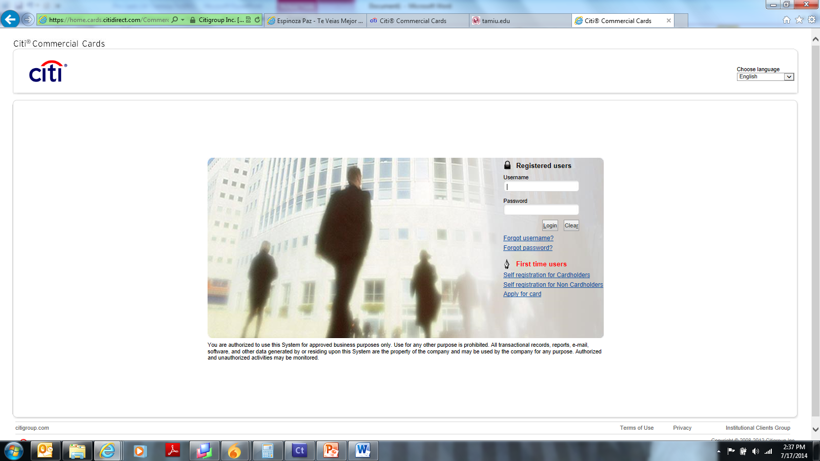
Citi Website-STEP 1
Step 1 Click on Self registration for card holders.
Select the Self Registration for Card Holders link
https://home.cards.citidirect.com/CommercialCard/Cards.html?classic=2

Slide 15
STEP 2
Step 2 Enter account information exactly as it appears in the delivery envelope. The account information marked with an asterisk identifies required fields.
Please Select the second option and press continue
***Remember that you are still responsible to call the number provided in the front of your card for activation.

Slide 16
STEP:3
Step 3 Select Continue to proceed, Cancel if you need to return to previous screen, or Clear if you need to edit the information entered. If the account information is entered incorrectly or if the information was already entered, you’ll receive an error message. “The card details provided does not exist or the card has already been registered. Please verify the details provided or contact Customer Support for further assistance.”
Fill in all the appropriate information as shown on your card

Slide 17
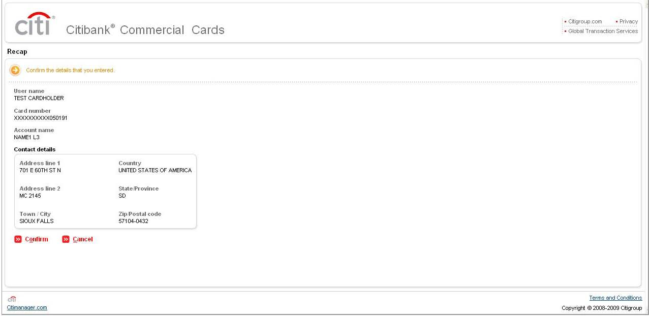
STEP:4
Once your User Name and Password has been established, you will receive a final review and confirmation screen. The final screen is a confirmation that your self-registration process is complete.
Click OK then continue with your first log in and set up your challenge questions as part of Citi’s dual authentication security procedures.

Slide 18
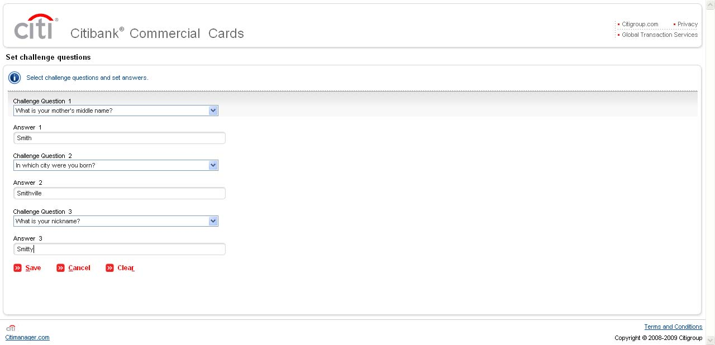
Step 5
STEP 5
Click SAVE to complete your challenge question set up and access the CitiManager Cardholder Home screen.

Slide 19
STEP:6
After you have successfully completed all of the indications previously mentioned you will have to select the following steps to gain full access to your account:
Resources tab/links
Choose Option 9
It will ask you to log in with the same username and password you have created
The system will then indicate to wait approximately 15 minutes before you gain access to your account. (This will allow you to have direct link access to a single sign on in your next login.

Slide 20
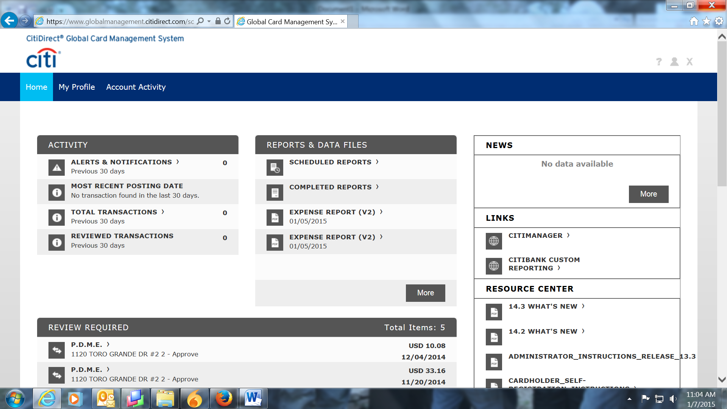
Main Screen
To logoff

Slide 21
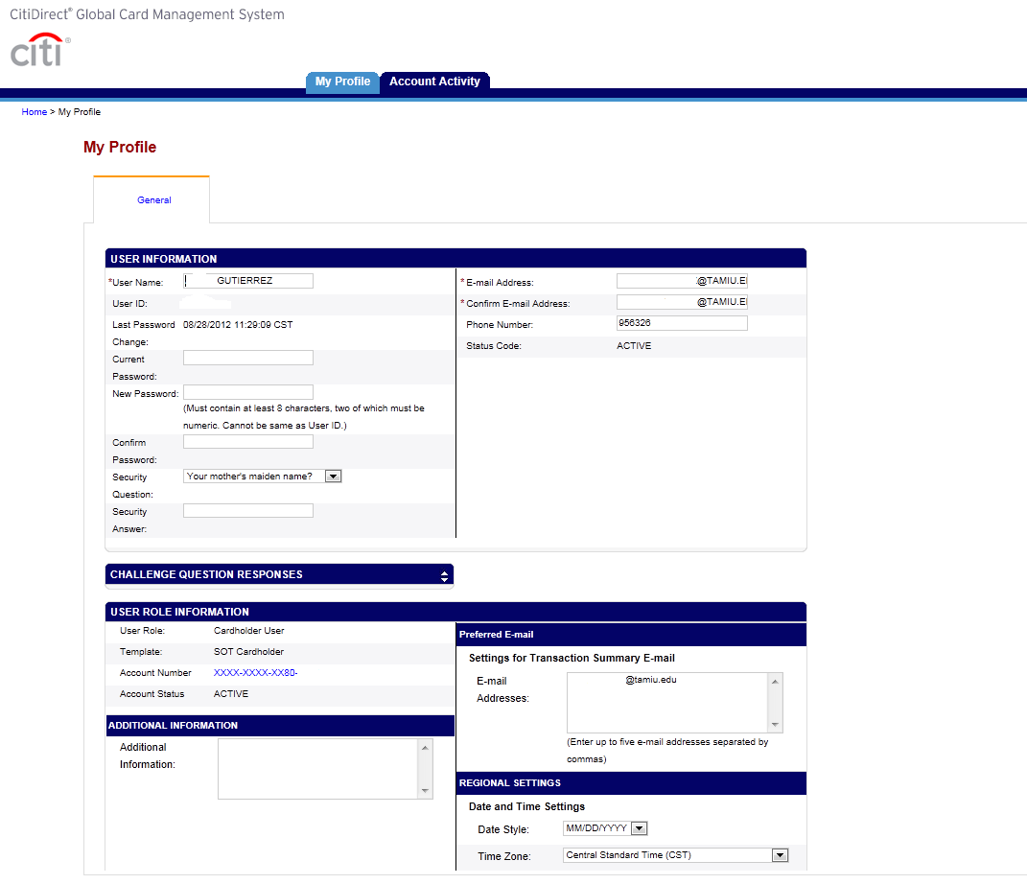
My Profile Tab
*email address, password, challenge questions can be updated

Slide 22
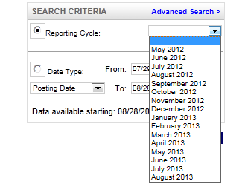
Account Activity

Slide 23
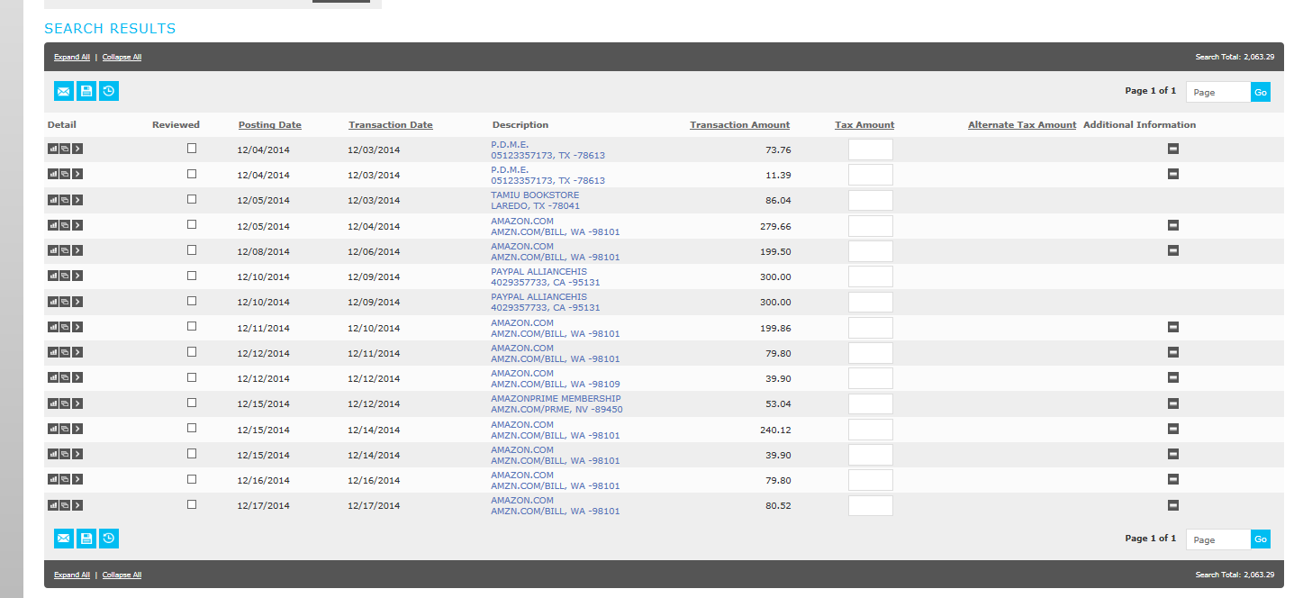
Transaction Screen
Accounting Details
Split Transaction
Clicking on the Accounting Details icon will expand your transaction to look like…

Slide 24
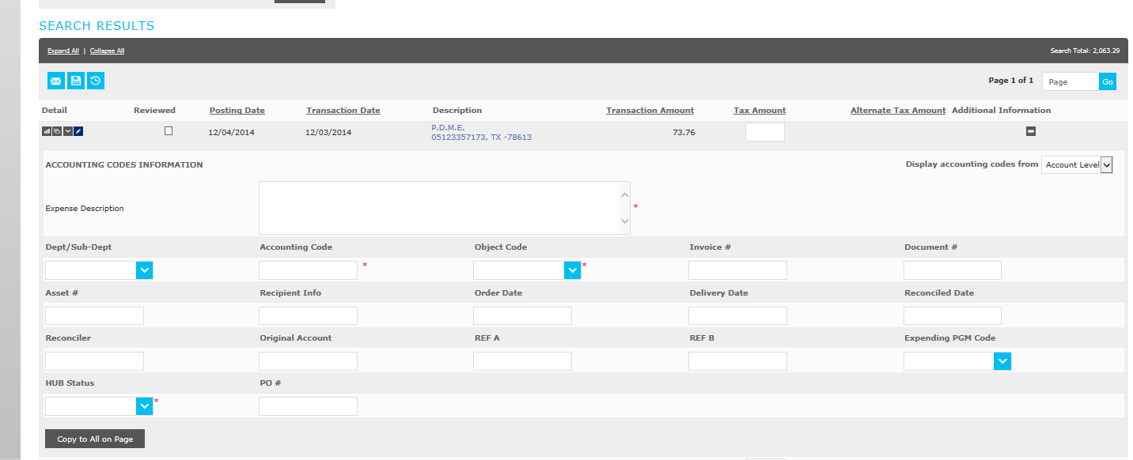
Required Fields
Your transaction information expanded so that you can enter the required fields (boxed in red).
After all of the required information has been entered please save using this icon.
You will NEED to select the ‘Reviewed’ box once all of your transaction information is inputted. Clicking this box will lock all of the information so that you will no longer be able to edit the transaction. Make sure this is selected before you begin running your report.

Slide 25
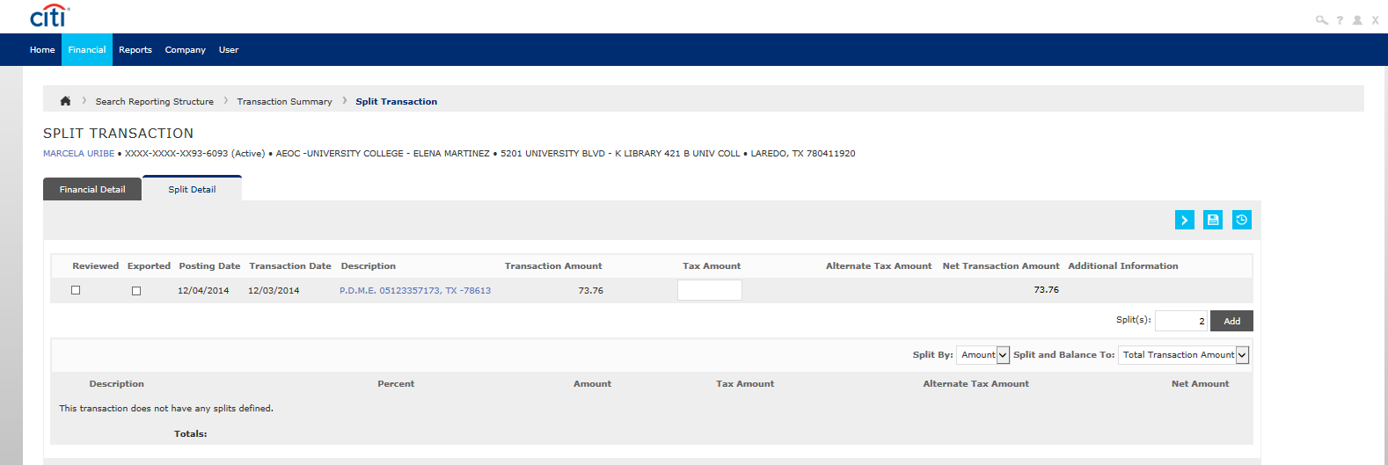
Splitting Transactions
1- When you buy items, in a single transaction, that have different object codes
2- When you are paying for items with more than one account
** The number of splits depends on the number of object codes/accounts you will be using
-Click the icon to add the splits. This will take you to the following screen, where you will enter the number of splits you need.
- After you enter the number of splits you click “Add” and …

Slide 26
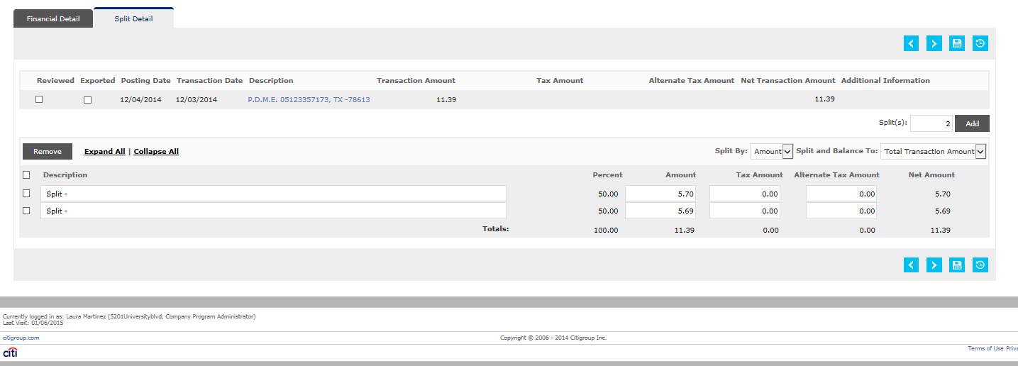
Splitting Transactions
You will see the Accounting Details icon for each split, you can then expand the transactions by clicking the icon and reconcile as you would on an unsplit transaction.
After you have completed all of the following categories save the information by using icon.

Slide 27
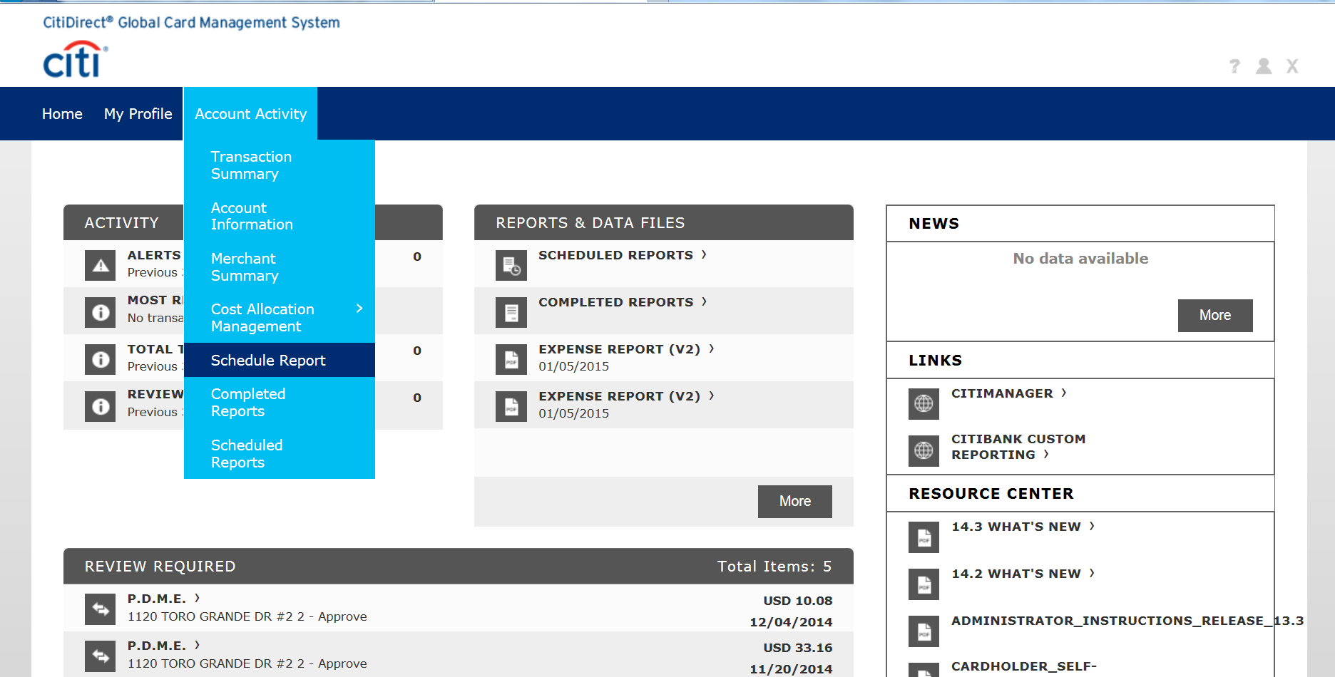
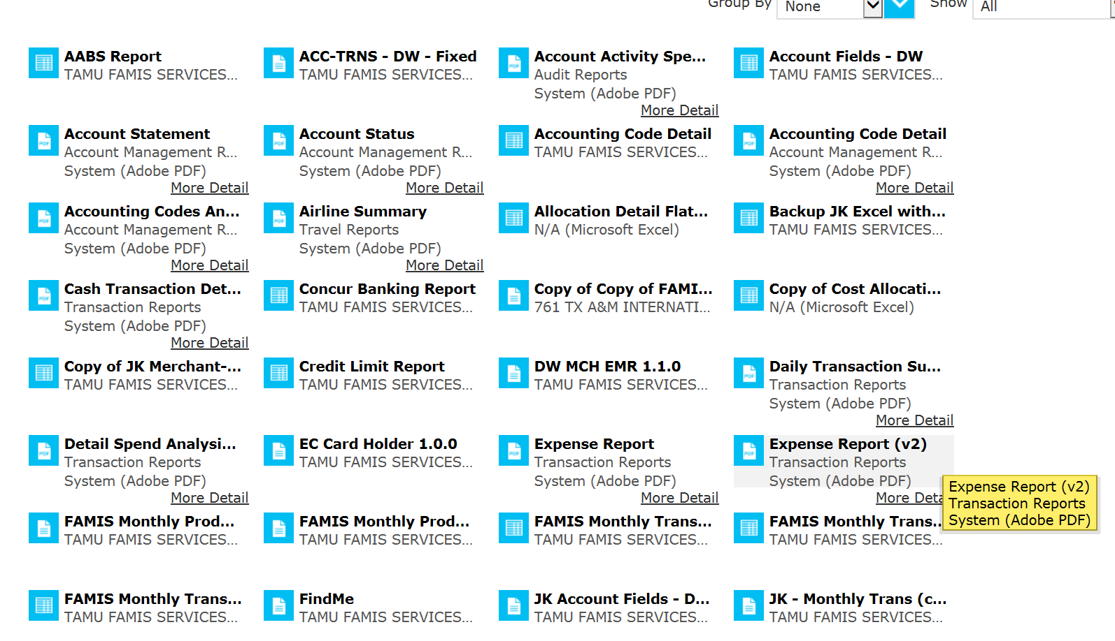
Running Reports
Account Activity tab, then select ‘Schedule Report’
Select the Expense Report

Slide 28
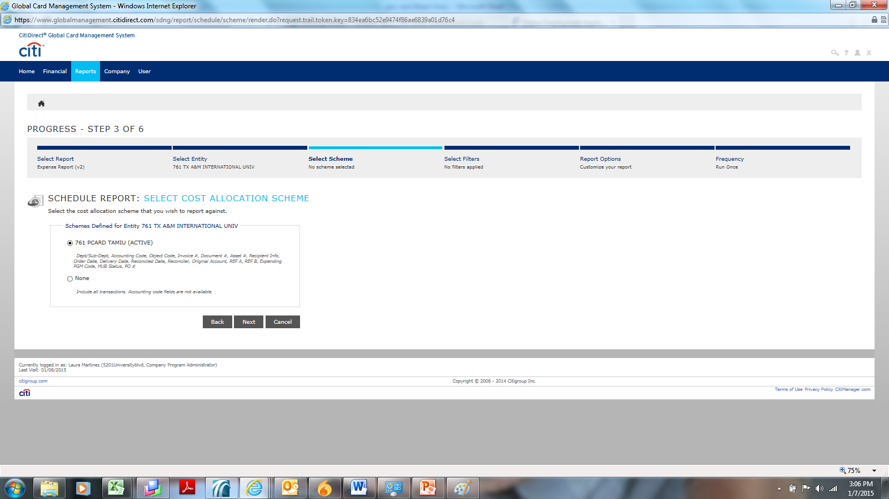
Do not change anything on this screen, just click Next

Slide 29
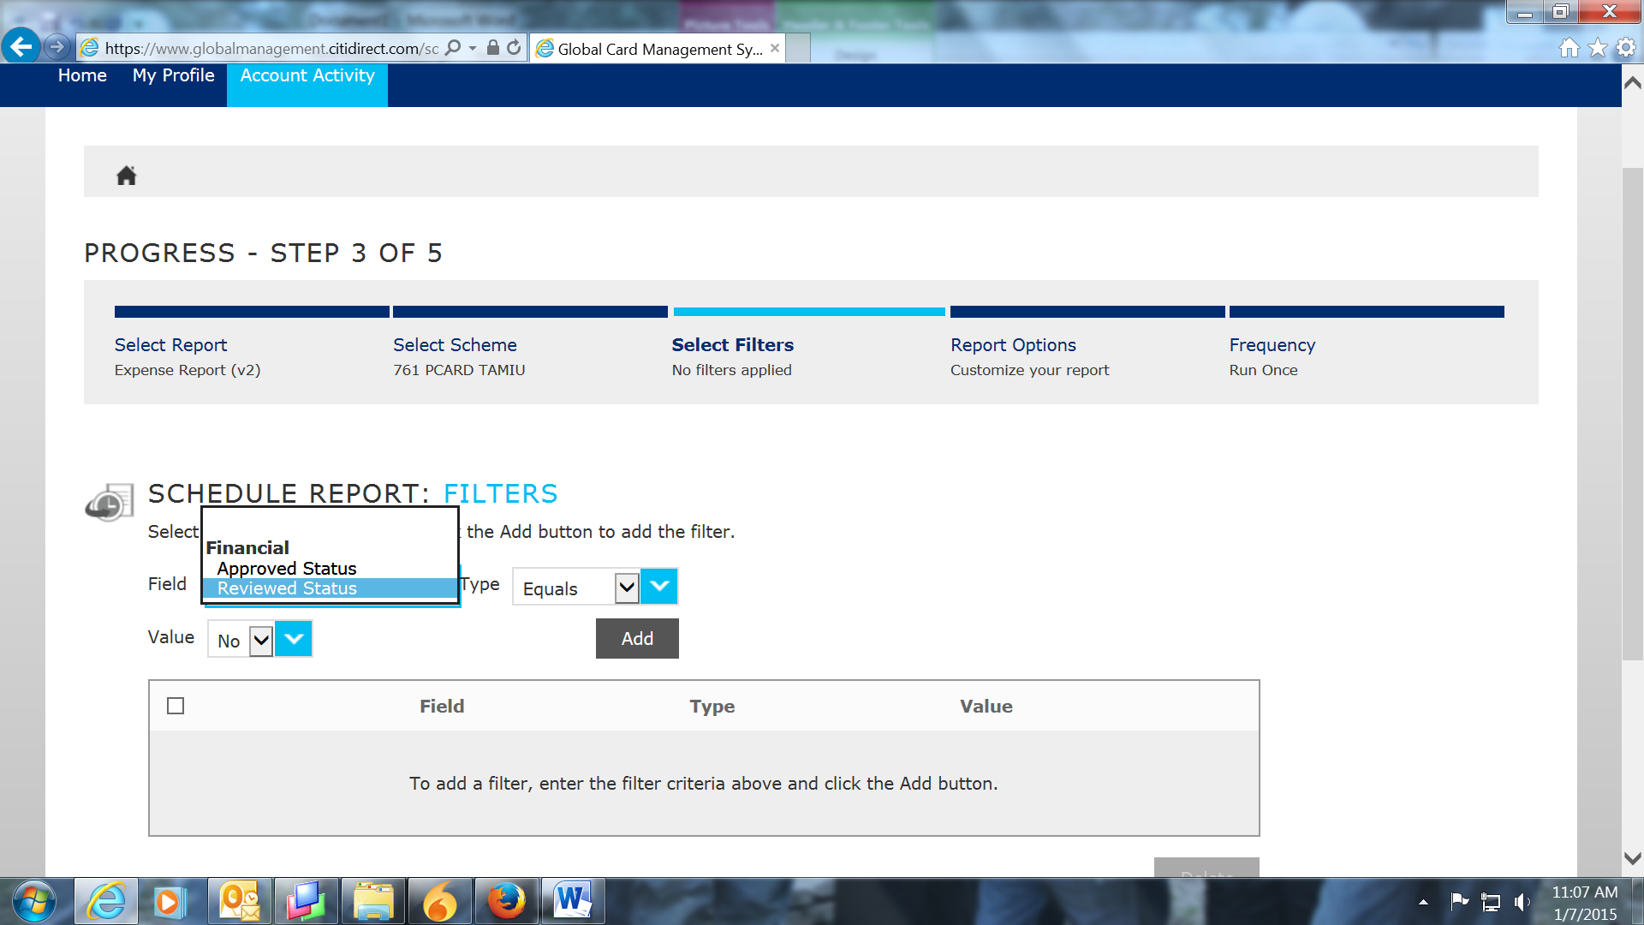
Select ‘Reviewed Status’
Always select the Review Status

Slide 30
Check Box
Entering a Description is for your information only

Slide 31
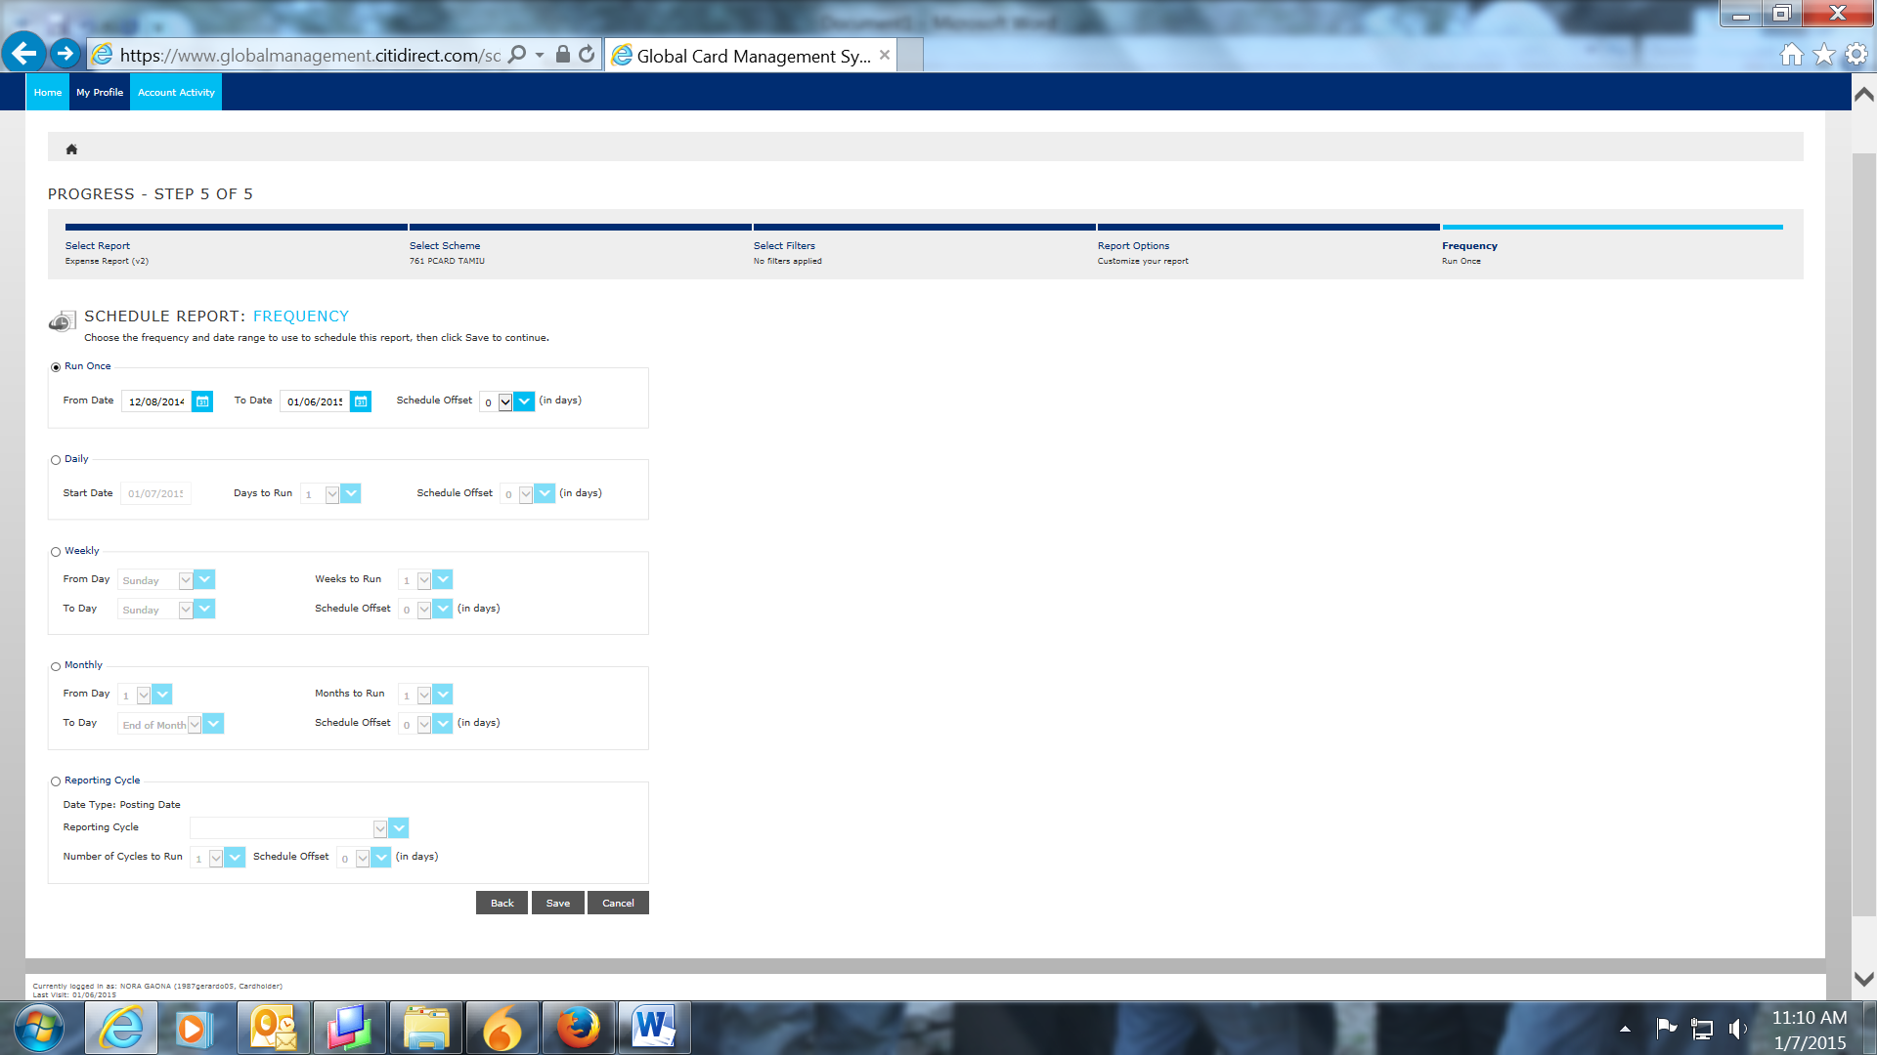
ALWAYS use the Reporting Cycle option
Make sure you change the cycle to the correct month

Slide 32
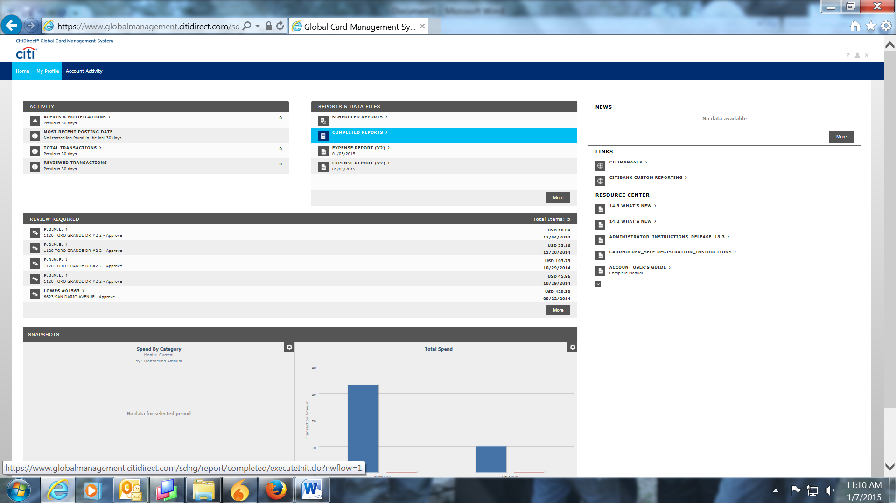
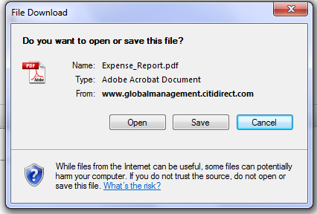
To print your report:
Click on the link to your report and either Open or Save your report.
Reports stay in your inbox for 30 days

Slide 33
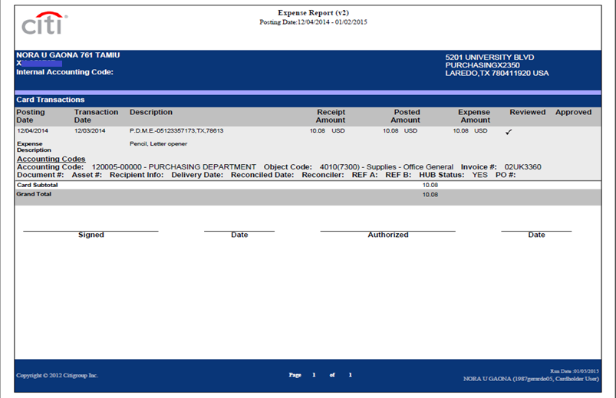
This is what your report should look like, with transaction information. Signatures are required by both the Pro Card User user and the department supervisor.

Slide 34
For questions contact:
Laura Echandy
X2343
Laura Martinez
x2351

