Slide 1

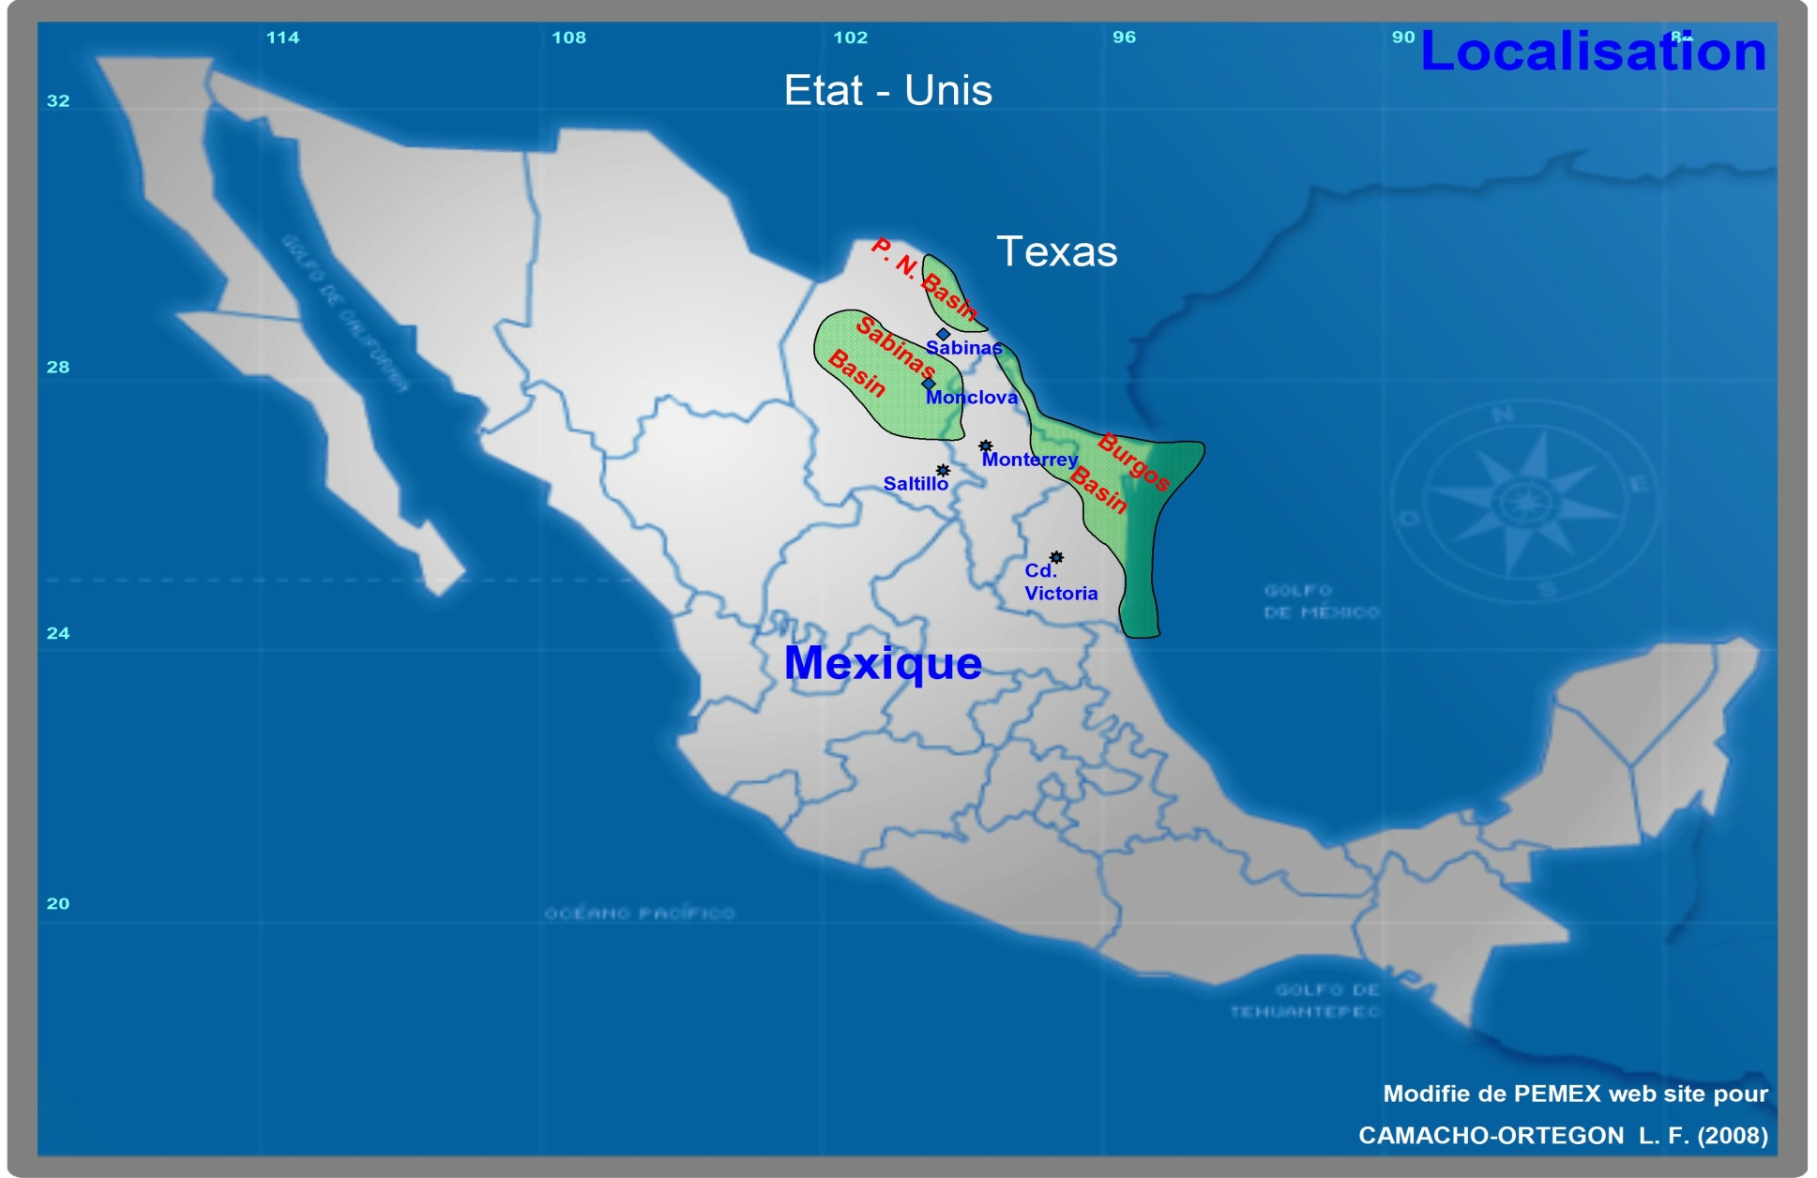
Texas A&M International University
Office of Global Initiatives/Binational Center
Topic:
Texas Eagle Ford Shale /Cuenca Burgos
Presented by:
Maria Eugenia Calderón-Porter
June 11,2014

Slide 2
Petroleum Industry at the Mexican Border
Mexico amended its Constitution 12/12/2013
to allow private and foreign Petroleum Industry
investors to participate in its oil industry.
What does this mean for the Texas/Mexico Border?
What is the new role for Pemex?

Slide 3
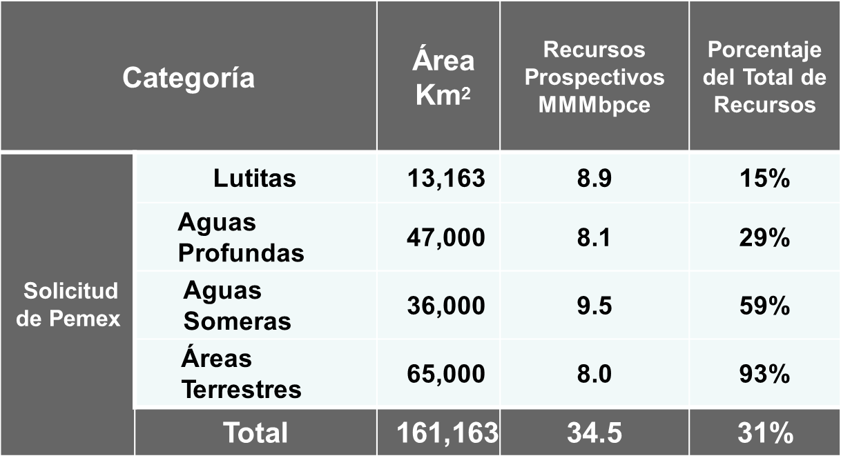
What does it mean to the Foreign Investor?
PEMEX Ronda Zero
Dr. Luis Fernando Camacho Ortegón, Univ. Autónoma de Coahuila

Slide 4
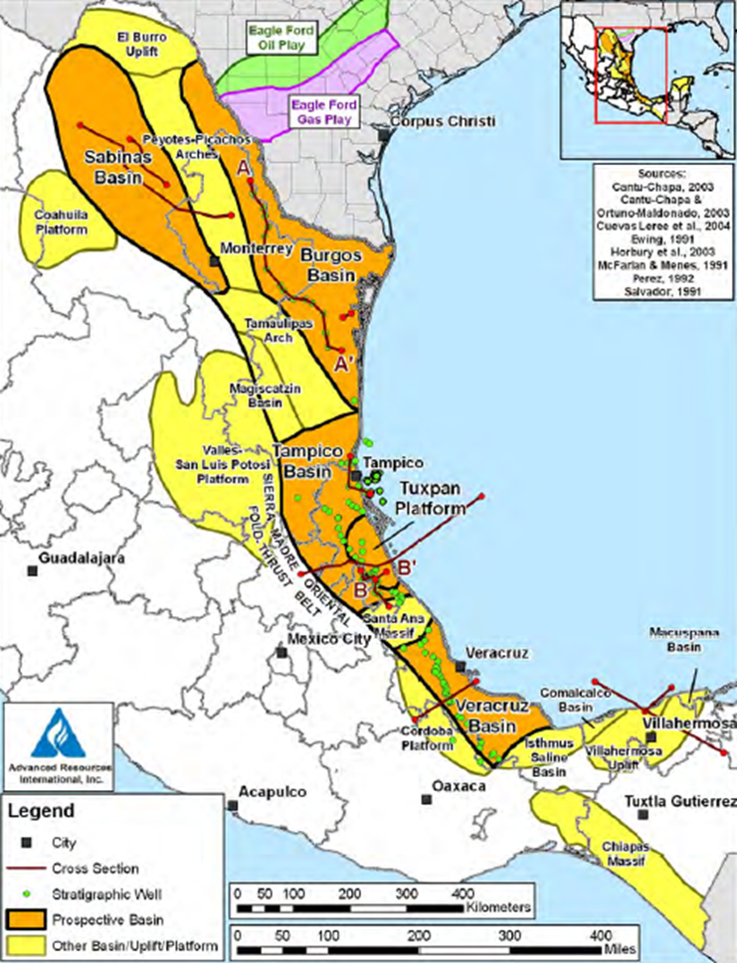
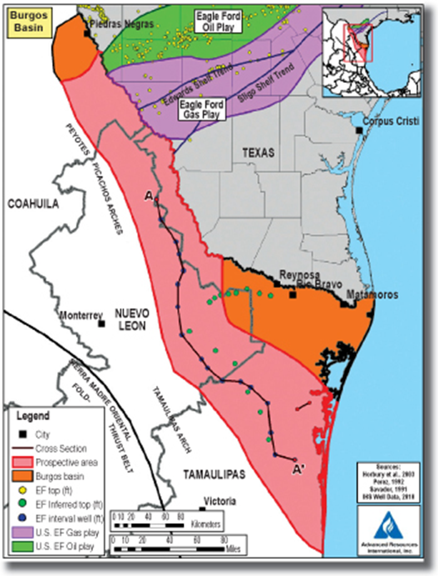
Where is it located?
Advanced Resources International, Inc.

Slide 5
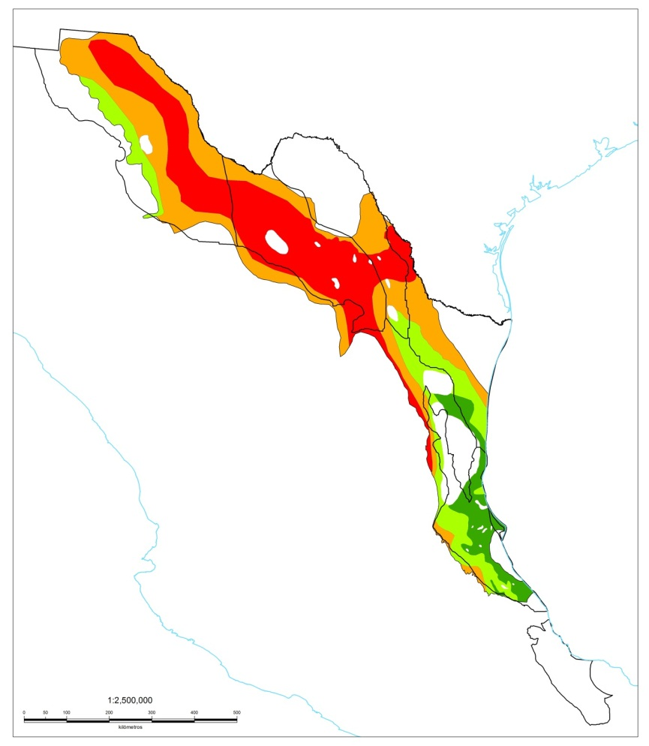
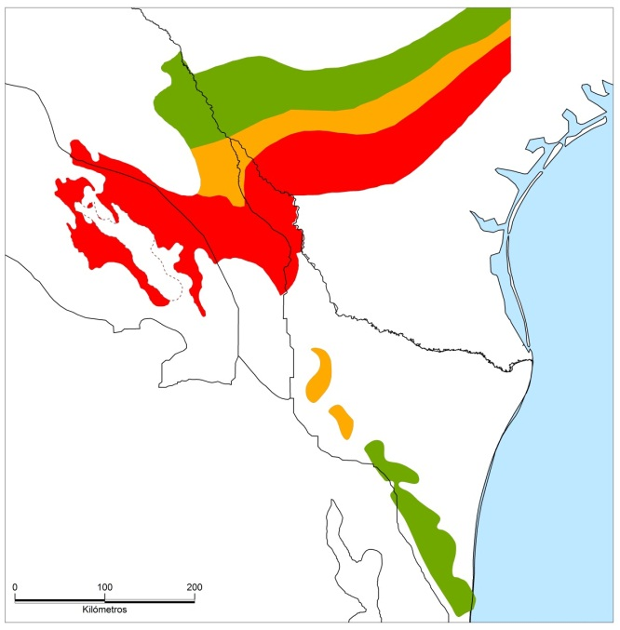

Mexico’s Shale Plays
EUA
1
Piedras Negras
Nomada-1
2
Montañés-1
Gamma-1
Habano-1
Chucla-1
Emergente-1
Percutor-1
Durián-1
Nuevo
Laredo
Distribución basada en la madurez de la RGeneradora del Tithoniano
3
Monclova
Aceite pesado
Aceite ligero
Reynosa
4
Monterrey
Gas húmedo
Gas seco
San
Fernando
Golfo de México
5
0
km
100
Ing. J. Antonio Escalera Alcocer, PEMEX Exploración y Producción

Slide 6
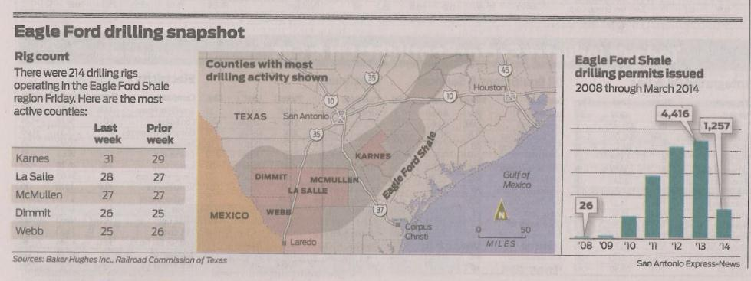
Our Border Region

Slide 7
Baseline for our Region
Reality Check
Oil Rigs in the World |  |  |  | Change |  | Change Percentage
 | January 2014 | December 2013 | January 2013 | Monthly | Annual | Monthly | Annual
Latin America | 401 | 417 | 414 | (16) | (13) | -3.8% | -3.1%
Europe | 126 | 126 | 134 | 0 | (8) | 0.0% | -6.0%
Africa | 139 | 138 | 115 | 1 | 24 | 0.7% | 20.9%
Middle East | 403 | 405 | 379 | (2) | 24 | -0.5% | 6.3%
Far East | 256 | 249 | 237 | 7 | 19 | 2.8% | 8.0%
International | 1,325 | 1,335 | 1,279 | (10) | 46 | -0.7% | 3.6%
Canada | 504 | 372 | 503 | 132 | 1 | 35.5% | 0.2%
United States | 1,769 | 1,771 | 1,757 | (2) | 12 | -0.1% | 0.7%
World | 3,598 | 3,478 | 3,539 | 120 | 59 | 3.5% | 1.7%
http://www.wtrg.com/rotaryrigs.html

Slide 8
Where is Texas Today?
The Texas average rig count as of April 17 was 882, representing about 50 percent of all active land rigs in the United States. In the last 12 months, total Texas reported production was 744 million barrels of oil and 7.8 trillion cubic feet of natural gas.
RAILROAD COMMISSION OF TEXAS NEWS RELEASE - APRIL 25, 2014

Slide 9
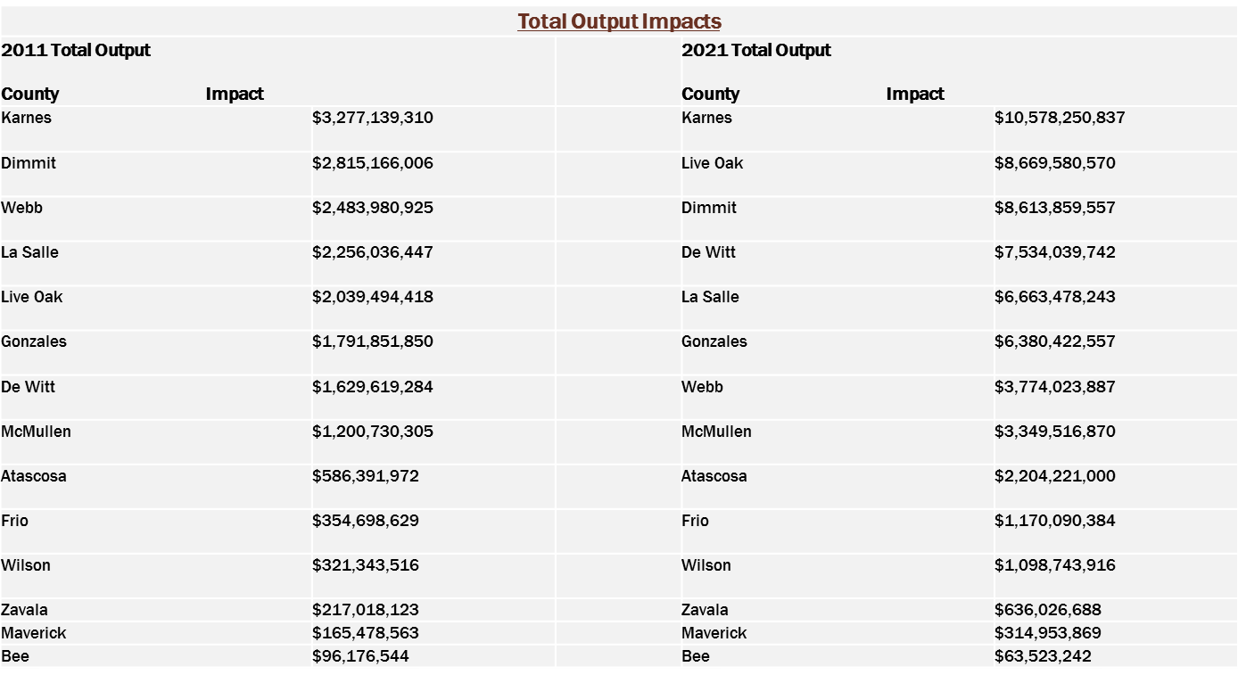
Beneficios para los Condados

Slide 10
What has Eagle Ford Shale Play done for Texas?
“Unambiguously positive” is a great way to describe the effect the current oil boom is having on the Texas economy, and it is why the state’s economy has significantly outperformed the national economy in recent years. One important thing to understand is that economists will tell you that every dollar of capital invested by the oil and gas industry in Texas has a multiplier effect of an additional $3 to $4 in associated economic activity. When the oil industry is booming, every hotel is full, every café is crowded, clothing stores can’t keep enough socks, underwear and khakis on the shelves, and local supermarkets tend to run out of milk and eggs before each day is through.”
David Blackmon, Why the Shale Miracle Has Happened in Texas Forbes Magazine, May 1, 2013

Slide 11
Moving Into Mexico
Moving into Mexico will not be that easy
Oil Rigs are tied up in Texas
Transportation via pipeline is scarce
Human Resource is scarce
Fraccing Technology is limited
Can the US/Mex Border Cities support the move south?

Slide 12
Mexico Will Benefit
The Multiplier effect in Texas as per Forbes’ comment can be expected. Opportunities are limitless for private investors in international partnerships. Who owns the mineral rights should not be a deterrent.
Need more
  Over land roads
  Rail spurs
  Pipelines
  In addition to housing, clinics, food supplies, workforce capacitation, transportation & its support systems, and the entire supply chain for the petroleum industry, etc.

Slide 13
Mexico Border Region
The future holds many opportunities for the Border Regions to develop into prosperous economic zones with the abundance of gas
Supplier to the Euorpean Market
Insures Near Shoring
These will not be without problems

Slide 14
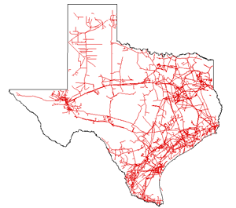
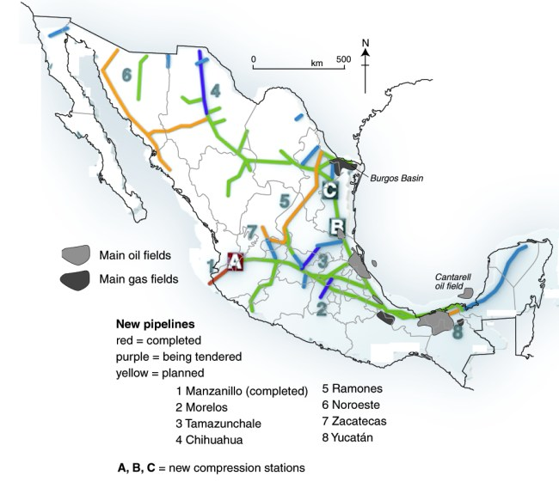
Comparable Pipeline Maps
www.eia.gov
http://geo-mexico.com/?p=5415

Slide 15
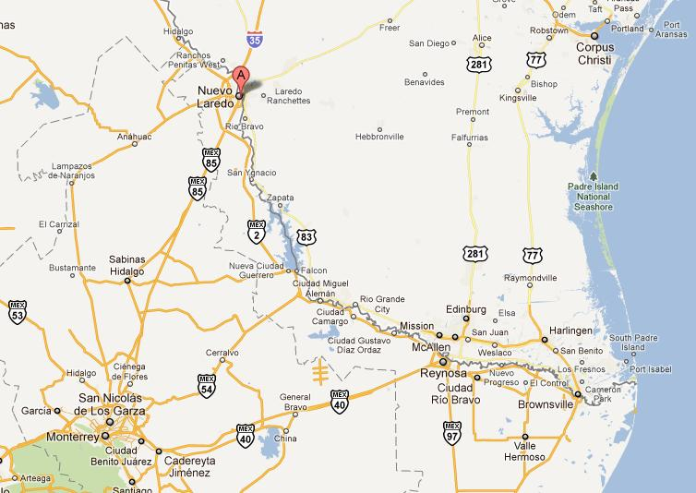
Border Urban Areas
Google Maps

Slide 16
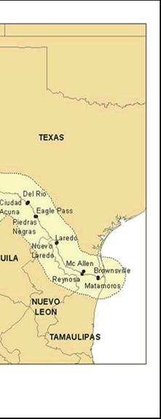
Overview
Frontera entre Estados Unidos y México, www.google.com
Advanced Resources International, Inc.

Slide 17
Population in Border Cities
Ciudad Mier, Tamaulipas | 4,762 (2010)
Total | 4,762
Donna, Texas | 16,204 (2012)
Río Bravo, Tam | 118,259 (2010)
Total | 134,463
Del Rio, Texas | 35,543 (2012)
Cd. Acuña, Coah | 136,755 (2010)
Total | 172,298
Roma, Texas | 9,873 (2012)
M. Alemán, Tam | 27,015 (2010)
Total | 36,888
Progreso, Texas | 5,715 (2012)
N. Progreso, Tam | 10,178 (2010)
Total | 15,893
Eagle Pass, TX | 27,283 (2012)
Piedras Negras, Coah. | 152,806 (2010)
Total | 180,089
Rio Grande, TX | 13,939 (2012)
Cd. Camargo, Tam | 14,933 (2010)
Total | 28,872
Valle Hermoso, Tam | 63,170 (2010)
Total | 63,170
Laredo, Texas | 244,731 (2012)
N. Laredo, Tam | 384,033 (2010)
Total | 628,764
Sullivan, Texas | 4,098 (2012)
Díaz Ordaz, Tam | 15,775 (2010)
Total | 19,873
Brownsville, Texas | 180,097 (2012)
H. Matamoros, Tam | 489,193 (2010)
Total | 669,290
Nva. Cd. Guerrero, Tamp. | 4,477 (2010)
Total | 4,447
Hidalgo, Texas | 11,711 (2012)
McAllen, Texas | 134,719 (2012)
Reynosa, Tam | 608,891 (2010)
Total | 755,321
GRAND TOTAL Border Residents | 2,714,130
INEGI / United States Census Bureau

Slide 19
Mexico’s Potential
Mexico has 545 TCF reserves and Mexico consumes about 2.5 TCF per year so the 545 TCF reserves would last approx 218 years at the current rate. It could also support some of Europe’s needs.

Slide 20
Mexico’s Potential
Excluding shale gas, Mexico has about 17 TCF of natural gas reserves. Mexico has one of the world's largest shale gas resource bases, which could support increased natural gas reserves and production. According to the U.S. Energy Information Administration's (EIA) assessment of world shale gas resources, Mexico has an estimated 545 Tcf of technically recoverable shale gas resources–the sixth largest of any country examined in the study. The figure of technically recoverable shale gas resources is far smaller than the total resource base because of the geologic complexity and discontinuity of Mexico's onshore shale zone.

Slide 21
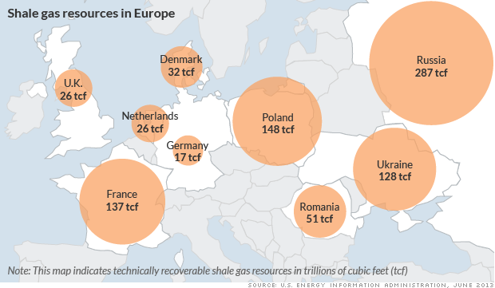
Notes:
Europe has proven shale gas resources.

Slide 22
Study:Harvard’s Belfer Center
A Comparable for Mexico
Fracking is often criticized for the amount of water it consumes, with a common figure given of 2-3 million gallons per well…or 4 per drilling pad on 351 acres….to produce the 12 million gallons of water you need 1.26 inches of rain annually
U.S. annual freshwater actually consumed (e.g. either evaporated or contaminated and stored) came to 43,800 billion gallons. With that as our baseline, total estimated 2011 water consumption for all shale wells completed that year represents about 0.3 percent of total U.S. freshwater consumption.

Slide 23
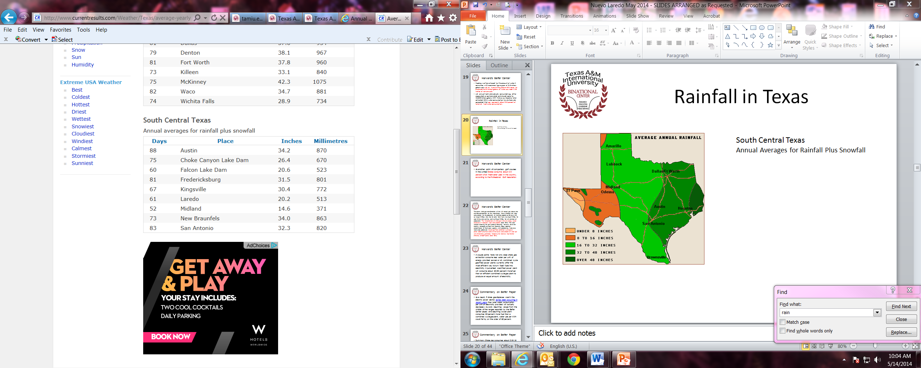
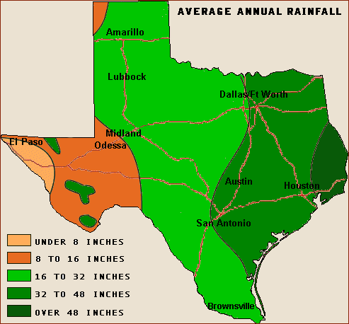
Rainfall Laredo Border
Texas Annual Rainfall
http://www.currentresults.com/Weather/Texas/average-yearly-precipitation.php
http://web2.airmail.net/danb1/annualrainfall.htm

Slide 24
Harvard’s Belfer Center
As another point of comparison, golf courses in the United States consume about 0.5 percent of all freshwater used in the country, according to the Professional Golf Association

Slide 25
Harvard’s Belfer Center
The recent shale gas transformation of the U.S. natural gas industry has also focused attention on the water-energy nexus, although the water consumption for the production of shale gas appears to be lower (0.6 to 1.8 gal/MMBtu) than that for other fossil fuels (1 to 8 gal/MMBtu for coal mining and washing, and 1 to 62 gal/MMBtu for U.S. onshore oil production). The increased role of shale gas in the U.S. energy sector could result in reduced water consumption (Chart ES-1). The water used for releasing the gas (hydraulic fracturing), however, has to be carefully managed at a local level. Concerns about potential contamination of freshwater supplies with hydrofracking fluids also need to be addressed. Natural gas-fired combined cycle power plants (CCGT) also have some of the lowest consumption of water per unit of electricity generated, helped by the relatively high thermal efficiency of CCGT plants (Chart ES-2).

Slide 26
Harvard’s Belfer Center
A couple points here: not only does shale gas extraction consume less water per unit of energy provided as coal or oil, combined cycle gas-fired power plants currently offer the most efficient way to turn fossil fuels into electricity. A pulverized coal-fired power plant will consume about 30-50 percent more fuel than an efficient combined cycle gas plant to produce an equal amount of electricity.

Slide 27
Commentary on Belfer Paper
As a result, if shale gas displaces coal in the electric power sector, as has been occurring in recent years, then total water consumption per unit of electricity provided will actually decrease – by a lot. Assuming values from the middle of the ranges reported by the Belfer Center paper, and assuming a coal plant consumes 30 percent more fuel than a combined cycle gas plant, water use per kWh could fall by on the order of 80 percent.

Slide 28
Commentary on Belfer Paper
Summary:
Shale gas consumes about 0.6-1.8 gallons of water per million BTUs of energy produced. If shale gas is used to generate electricity at a combined cycle gas plant and displace coal-fired power, the quantity of water consumed per unit of electricity generated could fall by on the order of 80 percent.

Slide 29
Commentary on Belfer Paper
The greatest driver, at this point is profit. The companies that use the water and other liquids to frack would like to get them back because it saves money. The companies pay for both, and once filtered, they can be used again. So, water usage per well should decrease.

Slide 30
Interesting Data
According to Texas Railroad Commission, there are 20,000 square miles (50X400 miles) in Eagle Ford Shale, 12,800,000 acres, 320,000 wells at 40 acres each, 960,000 miles of pipe at 3 miles per well which would be 39 times around the Earth at 24,901 miles.
  20,000 square miles in Eagle Ford
  12,800,000 acres
  320,000 wells at 40 acres each
  960,000 miles of pipe at 3 miles per well
  39 times around the Earth at 24,901 miles
R.A. Porter, Porter Engineering, Laredo, Texas

Slide 31
Interesting Data
Transportation - Every 50 miles of pipeline, 20 inches in diameter replace 1,250 truck trips
Are supplies and suppliers available in the Northern Region of Mexico?
R.A. Porter, Porter Engineering, Laredo, Texas

Slide 32
Thank you
For more information please contact:
Maria Eugenia Calderon-Porter,
Asst. Vice President Texas A&M International University
Office of Global Initiatives/Binational Center
Laredo, Texas
Telephone: 956-326-2834
Email: Mcalderon@tamiu.edu
www.tamiu.edu/binationalcenter

Slide 33
UPDATE:
RONDA I
Secretaria de Energía

Slide 34
RONDA I
En la Ronda Uno se licitarán 169 bloques, de los cuales 109 corresponden a áreas de exploración y 60 a campos de extracción.
Las reservas 2P y recursos prospectivos a licitar representan un volumen de 3,882 y 14,606 millones de barriles de petróleo crudo equivalente (MMbpce), respectivamente.
Se espera que estos proyectos representen inversiones anuales por aproximadamente $8,525 millones de dólares, entre 2015 y 2018.
La siguiente tabla muestra el volumen y número de bloques o campos a ser licitados en la Ronda Uno:

Slide 35
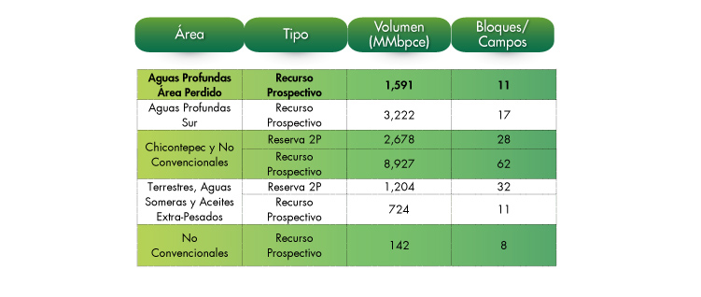

Slide 36
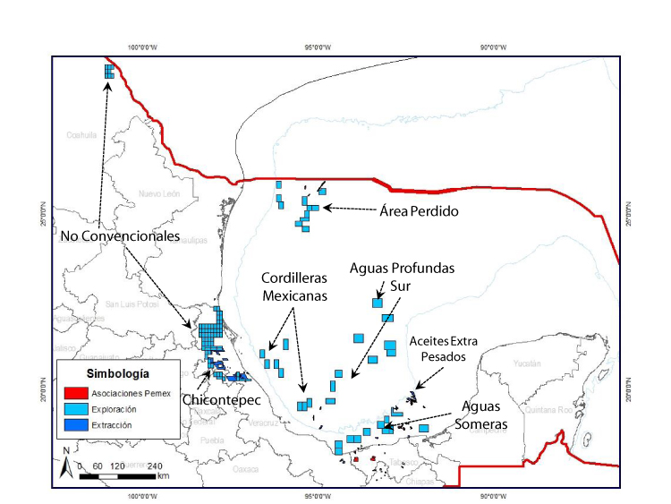
NATIONAL MAP RONDA I

Slide 37
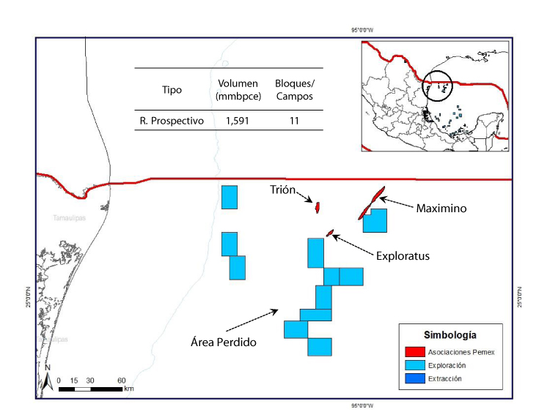
DEEP WATER

Slide 38
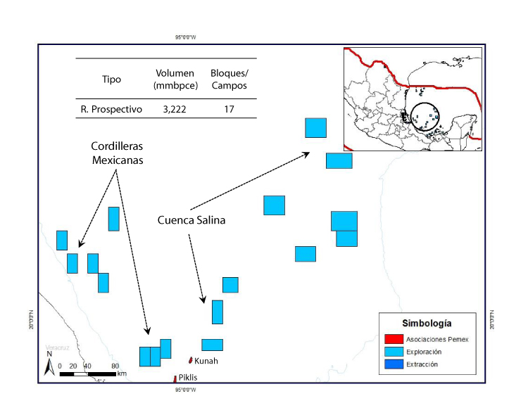
DEEP WATER SOUTH

Slide 39
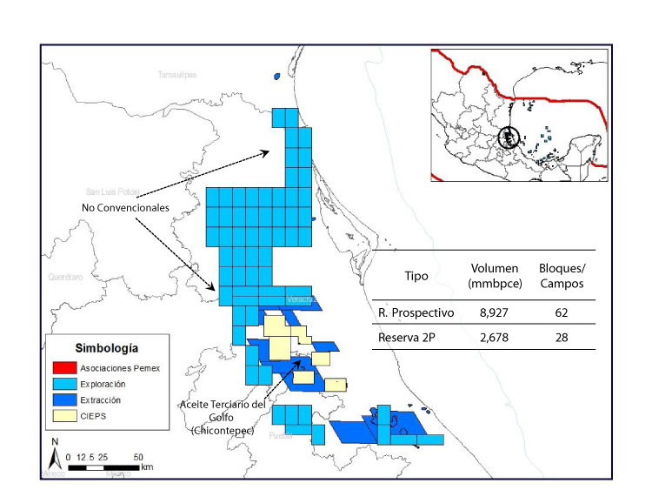
CHICONTEPEC Y NO CONVENCIONALES

Slide 40
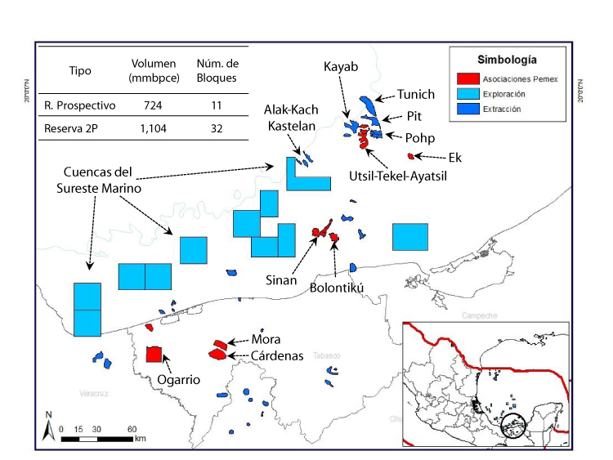
LAND / SHALLOW WATER / HEAVY CRUDE

Slide 41
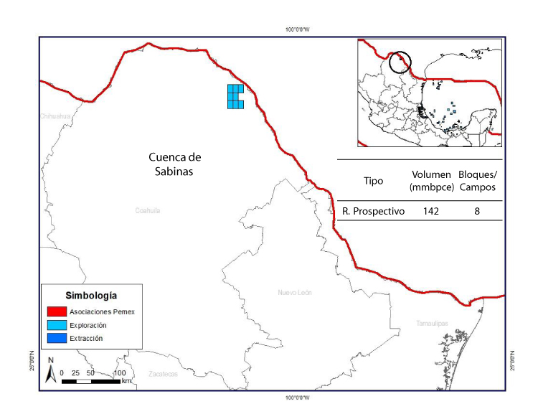
NON CONVENTIONAL

