Slide 1
Introduction to TAMIU’s Dusty Works!
Presented by:
Office of Career Services
Student Center, 114

Slide 2
What is Dusty Works!?
TAMIU’s Online Job Board that provides On-Campus Jobs and Off-Campus Jobs.
Who can use Dusty Works!?
TAMIU Students and Alumni.

Slide 3
Student Employment Program (SEP) Application
Important:
TAMIU does not accept paper applications. Applications must be submitted through Dusty Works!
Application must be done on a PC, not a Mac. (For compatibility reasons).
Only Adobe Acrobat Professional will allow the applications to be saved and edited.

Slide 4
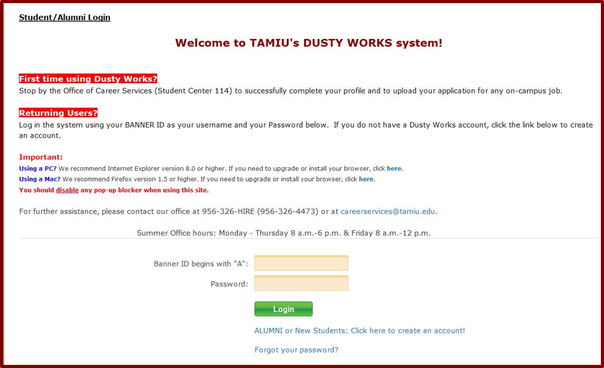
Dusty Works! Login Page
If you are a new student, you will need to set up your profile first!
Password: Your Birthday (mm/dd/yyyy) Format.

Slide 5
My Profile Page
Update:
Password
Background/Demographic Information
Cell Phone for Text Service
Email(s) for Announcements
Employment/Education History

Slide 6
Finding the SEP Application

Slide 7
Resource Library
Click on and open “On-Campus Employment for Students”
Click on open “On-Campus Student Employment Program (SEP) Application”

Slide 8
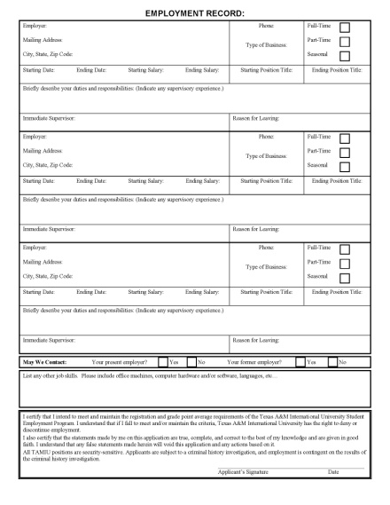
Filling out the SEP Application
Tips for SEP Application
Always Read directions carefully!
Use proper spelling and grammar.
Errors can leave a bad impression on hiring supervisors.
Be honest and accurate.
When in doubt, ask Career Services for assistance.

Slide 9
SEP Application: The Beginning
“Date Available for Work”: List date you can begin work or type “ASAP” (As Soon As Possible)
“Student ID”: Complete BannerID (ex. A00012345)

Slide 10
SEP Application: Personal Data
Enter your Social Security Number, or leave blank if you don’t have one.
Enter your phone number(s) and e-mail address to be contacted by employer.
Be sure to answer questions on right, depending if you answered “Yes” or “No”.

Slide 11
SEP Application: Education Information
“Date Entered/Entering TAMIU”: List semester entered TAMIU
“Expected TAMIU Graduation Date”: List estimated semester graduating
“Currently Enrolled?”: Depends on date application is filled out
“Next Term of Enrollment”: List the next semester you will be taking courses
“College or University” or “Technical/Vocational”: Any previous higher education experience, including TAMIU

Slide 12
SEP Application: Employment Record
Three sections to include previous work experience.
Reverse chronological order.
Fill in as much as possible.
If you have no previous employment, include relevant volunteering experience.

Slide 13
SEP Application: Skills & Signature
Be sure to simply list any jobs skills you have, such as software (Micosoft Office), languages, and any knowledge on computers/machines etc, etc.
Type your name for “Applicant’s Signature”.

Slide 14
My Documents Page
Once your application has been completed, you may…
Upload New Document/Applications -> Click [Add]
Update Existing Applications/Documents -> Click [Update] to replace document
View Applications/Documents -> Click [View]

Slide 15
Employment Search
On-Campus Employment Search:
No criteria necessary (Blank Search)

Slide 16
Employment Search (cont.)
Add To Favorites: You can explore jobs and save them as Favorites to return to at a later date.
Job Agents:
This will allow you to be e-mailed when a new jobs open.
Notes:
Add to Favorites
Job Agents (Email me New Jobs for this Search) Tab

Slide 17
Applying for Jobs
Click on “Submit Résumé or
SEP Application”.
Your selected SEP
will attach itself.
Student Message
is optional.
Click
“Save” to finish.

Slide 18
Applying for Jobs: Success!
Applying to the job is complete.
Repeat as desired for other available vacancies.

Slide 19
Preparing for an Interview
Dress Appropriately
Examples on next slide
Arrive on Time
Prepare for Questions
“What are your Strengths/Weaknesses?”
“Why do you want to work for that department?”
Copy of Class Schedule (UConnect / Class Schedule)
Copy of Your Resume (If required to upload one).
Notes:
Dress Appropriately- (Insert new slide with examples)

Slide 20
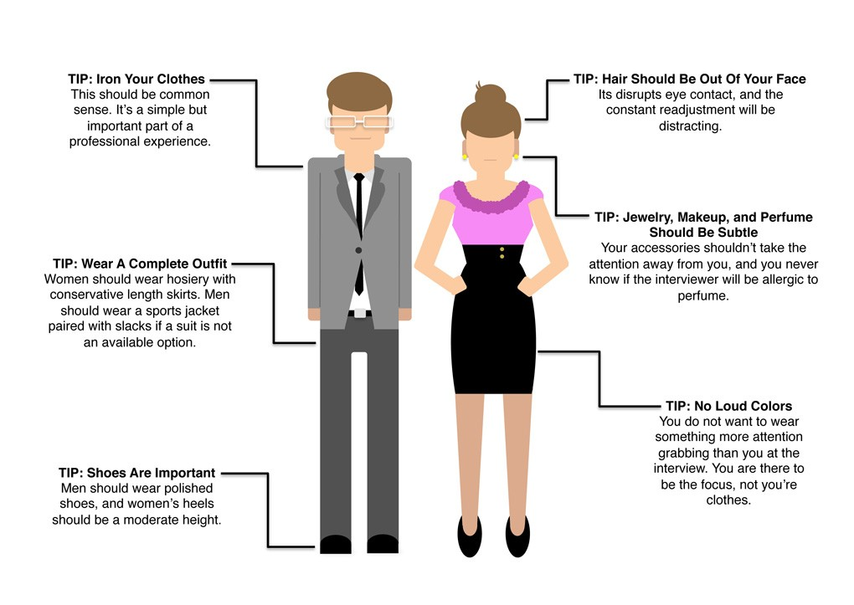
Dressing Appropriately

Slide 21
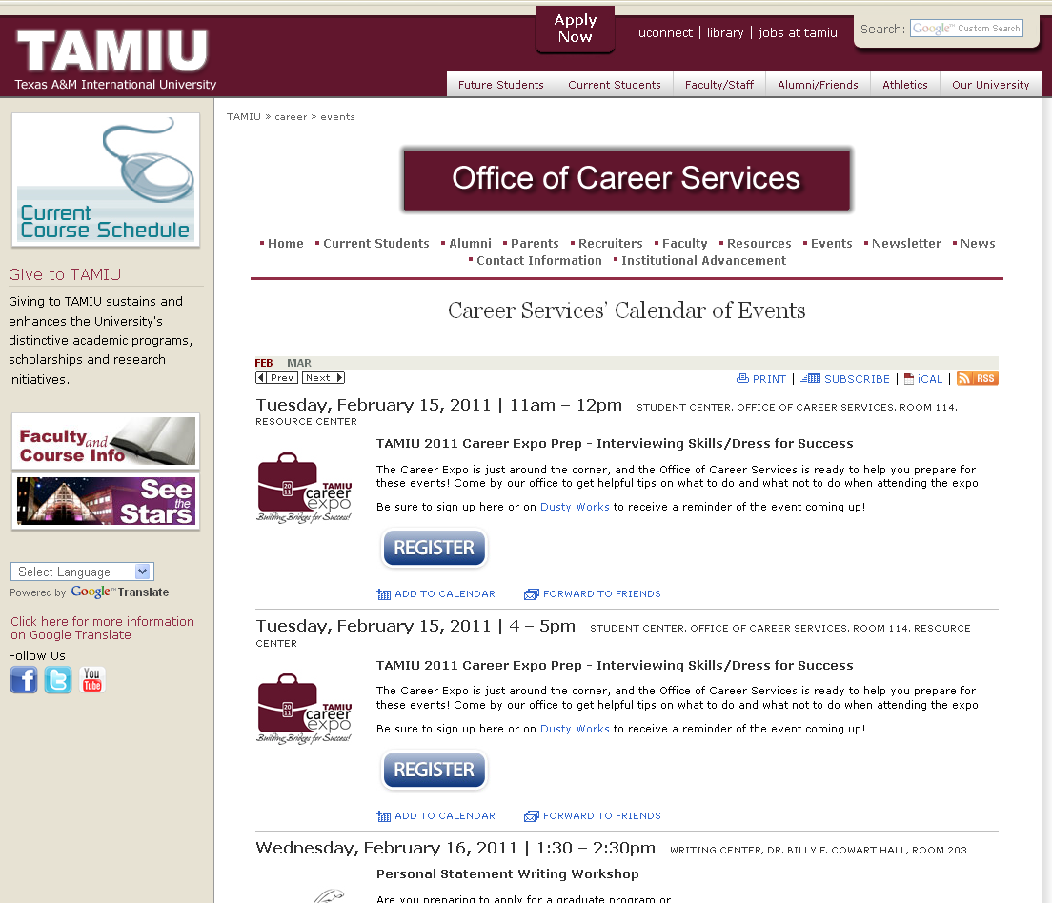
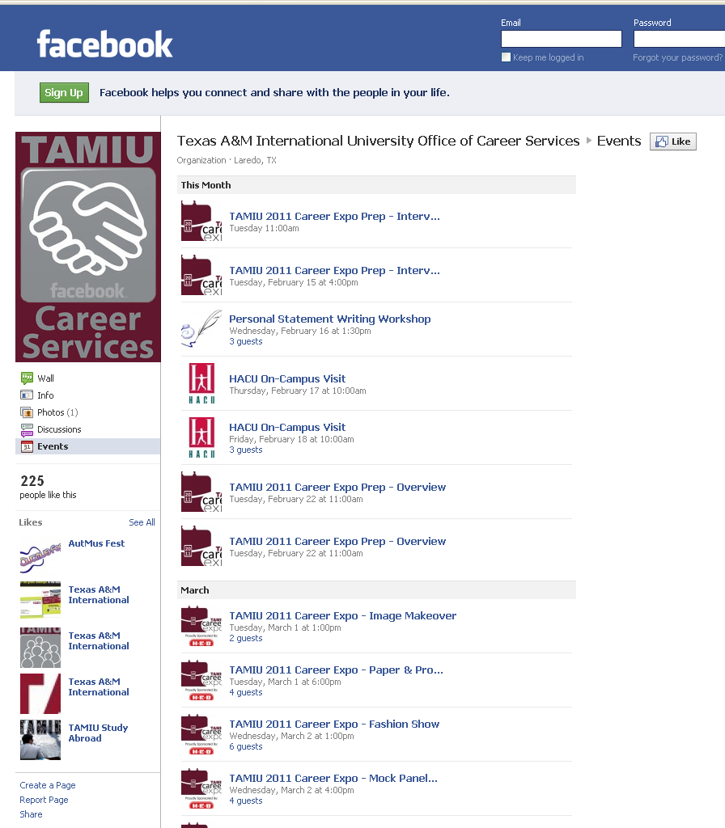
Career Services Events

Slide 22
Find Us!

Slide 23
TEXAS A&M INTERNATIONAL UNIVERSITY Office of Career Services
Cassandra Wheeler
Executive Director
Laura Martinez
Director of Employer Relations
San Juanita Perez
Director of Student Relations
Jose D. Valadez, Jr.
Career Advisor (Sophomores)
Jessica McGee
Data & Information Specialist
Josefina Valle
Staff Assistant
Student Center 114 • 956.326.4473 email: careerservices@tamiu.edu

