Slide 1
Physical Education
Continuing Education Summer Camp 2014

Slide 2
Meaning and Purpose of Physical Education
• Curriculum composed of subject, teaching strategies, and experiences designed to help each child reach his/her fullest intellectual, physical, social, and emotional potential through the medium or physical activities.

Slide 3
Objectives of Physical Education
Enhance Physical Growth and Development
• Growth and development of bone, connective tissue, and muscle tissue occur when a child receives adequate and continuous exercise.
•Lack of exercise can severely limit the potential growth of other bodily systems and organs.
Develop and Maintain Optimum Physical Fitness
•Striving for and maintaining optimum levels of strength, cardiorespiratory endurance, and other fitness components as a means of achieving optimum growth, better health, and maximum performance.
Develop Useful Physical Skills
•Assist each child in developing and perfecting a wide variety of motor skills that will be used in everyday activities and in future leisure pursuits.

Slide 4
Objectives of Physical Education Cont’d
Develop in Socially Useful Ways
• Physical Education through team games and other group activities can foster desirable social behavior.
Develop Creative Talents
• In Physical education creativity is defined in terms of the way in which a movement or series of movements is performed or by the degree of inventiveness of a movement.
Enhance a Child’s Self-image
• Present activities so that each child, regardless of physical ability, can achieve

Slide 5
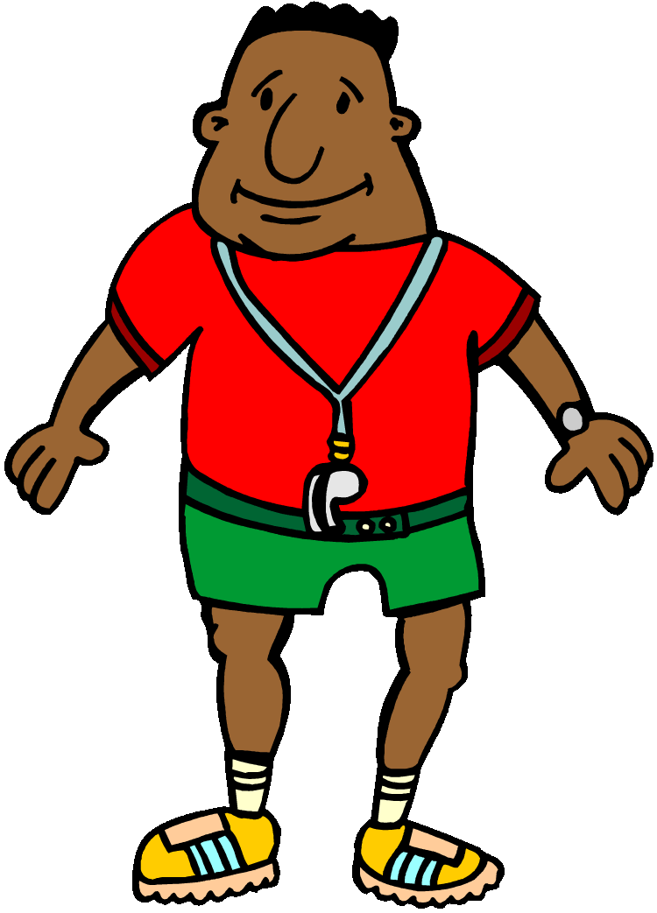
Teaching Strategies
The learner, not the subject, is the center of the curriculum.
The teacher’s genuine enthusiasm for the value of Physical education is the most critical factor in making physical education a true educational experience.
Teachers and students are jointly engaged in the search for knowledge and understanding, a mutual respect for each other’s abilities and efforts.

Slide 6
QUESTIONS?

