Slide 1
Public Speaking: Dissertation, Proposal, and Final Thesis Defense Guide
Guide for Thesis and Dissertation Students and Public Speaking
Developed by TAMIU Graduate Writing Consultant, Franco Zamora Advanced Research and Curriculum
TAMIU Graduate School
Fall 2020

Slide 2
Note:
None of these elements, behaviors, attitudes, or activities are required for the TAMIU Final Thesis/Dissertation Defense or the Proposal defense (except for the section on paperwork in the final slides).

Slide 3
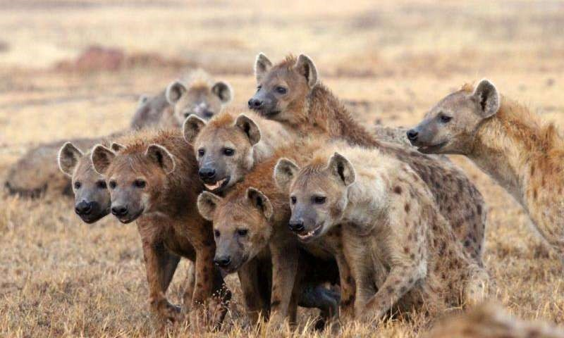
Why are people afraid of public speaking?
Physiological response
Over-thinking
Lack of experience or a bad experience
Fear of failure or judgement
Imposter syndrome
Unfamiliar audience
Not having all the answers

Slide 4
Public Speaking in General: “Do”s
Practice! Practice by yourself and with a small audience!
Make eye contact with the committee.
Dress professionally, but stay comfortable.
Speak in a clear, loud tone (use technology to your advantage)

Slide 5
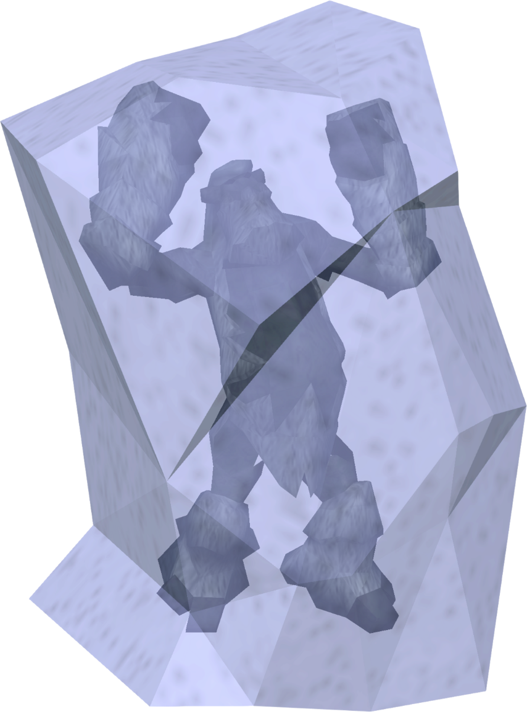
Public Speaking in General: “Don’t”s
Pace/move too much
Gesture too wildly
Look only at notes/screen
Be rude
Rush
Go too far off topic
Try to just copy someone else’s style.

Slide 6
Practice Speaking Tips
Learn your Material (The “What”)
The order - What goes first, what goes middle, what goes last?
The length (time) – Time yourself. How long is your presentation? Give yourself a hard time limit. Most adults only have an attention span of between 11 and 20 minutes. You probably want to have about 10 minutes minimum or 15 minutes maximum of prepared material.
The meaning – You need to fully understand what you are saying, in case you accidentally get lost or one of your audience members has a hard question. It is not enough to simply memorize the material.

Slide 7
Practice Speaking
Consider your Delivery (The “How”)
The volume – What is the loudest you can speak comfortably? What is the softest you can speak clearly? Use big breaths and pretend you are talking to a friend across a very crowded café.
The tone - Friendly and approachable is usually preferred, but sometimes, speeches require a range of emotions to evoke the proper audience response. How do you want your audience to react?
The pace – Be conscious of how fast you are going. Deliver your words at the same, conversational pace. If you are struggling with a word or idea that you wish to emphasize, slow down.

Slide 8
Visual Presentation Tips
Contrasting colors
Light backgrounds with dark text
Text big enough to see (know what kind of screen you’re using)
Avoid “wall of text”
Mix in visuals, when possible
A consistent or unified theme
Avoid distracting transitions.

Slide 9
“Direction”
Lighting – Bright enough to see your face
Camera placement – Centered on you, not too tight or blurry
Background – Free of distractions, neutral color (not green or blue if you can help it, unless you’re trying to use a digital background)
Noises – Headphones help reduce background noise. Send pets and family members to another room if they’re noisy.
Attire – How do you want to be seen?
Film yourself and see what you look like

Slide 10
Purpose of Thesis Defense
To inform your audience of your academic knowledge and skills demonstrated within your thesis or dissertation writing project.
Other speeches:
Entertain
Debate
Appeal to audience
Explore an idea
Always keep your purpose and your audience members in mind.

Slide 11
Advice from previous Thesis/Dissertation Defenders
“Your advisor wouldn’t have let you get this far if they didn’t believe you were ready to defend.” –M.M., 2013 Psychology M.S.
“I’ve given a hundred presentations in a hundred classes. This used the exact same set of skills.” –C.M., 2019 English M.A.
“As long as you understand the basics, everything else will fall into place.” –S.N., 2019 Education M.S.
“I was scared that I wasn’t going to pass. But my committee was much less scary when the day came than they were in my head.” –Y.S., 2020 English M.A.
“Compared to the actual work I put in writing my thesis, this was nothing. I already did the hardest part.” –A.H., 2020 English Ph.D.

Slide 12
What to Expect Before, During, and After the Defense:
1.Your Pre-Preparations 2.Set-Up and Start-Up 3.Giving the Presentation
4.Post-Defense Committee Questions 5.Revisions/Paperwork

Slide 13
1. Prep Beforehand
•
Make cue cards
– Even if you don’t use them.
•
•
Have a Roadmap
– Decide on your order ahead of time.
Write it in a familiar form – Most conference-style presentations are styled like a “research paper” version of your full text. Try bullet points, lists, images, etc.
Have a visual aid
– Detailed slides or a simple backdrop with the title of your manuscript and your name. Gives the audience something to stare at that isn’t you!
•

Slide 14
2. Set-Up and Start Up
Arrive Early –Triple check the time and place. If giving your presentation online or virtually, arrive to the “room” early and make sure all technology is operational.
Take and print all your materials ahead of time, especially handouts for the committee or notecards for yourself.
Take a bottle of water with a cap.
Thank the committee for being there first before starting.
Introduce yourself and the title of your work.

Slide 15
3. Giving the Presentation
Don’t Explain Everything
Use present tense to discuss the project - Your project is ongoing always. “I discuss” “The data suggests” “This researcher says…” “In this novel…” “This study focuses on…”
Be confident. - Avoid “I think” or “I forgot, but…”
Do. Not. Stray. - Stick to a specific order! Try not to backtrack! Do not talk about things that do not explicitly appear in the text of your work unless it is to answer a question from the committee.

Slide 16
4. After – Committee Questions
Don’t Interrupt the Committee’s Questions!!! –
Rude
Causes delays
No sense being defensive—committee just wants to help.
Be Courteous –
Thank your committee for each piece of advice or every question that they give to you.
Clarify before moving on.
Don’t assume you’re done.
Do not talk down to your committee.
Thank the committee and the audience at the end.
Be patient – Most committee deliberations are decided quickly.

Slide 17
5. Post-Defense Revisions, Policies, and Paperwork
For Successful Post-Proposal:
Committee suggests revisions
Committee Chair, Members, and Deans sign the Proposal Cover Sheet.
Chair delivers forms directly to COAS.
CHECK YOUR EMAIL.
Find TAMIU’s Proposal, Thesis, and Dissertation forms: https://www.tamiu.edu/gradschool/ThesisForms.shtml
See the TAMIU Thesis and Dissertation Manual for details on other Thesis/Dissertation Committee decisions.
For Successful Post-Final Defense:
Committee suggests revisions.
Committee chair, members, and the deans of the colleges sign either the Written Thesis or Written Dissertation Approval Form.
Chair delivers appropriate material to deans and COAS.
COAS communicates revisions to the student until satisfied. COAS passes revisions to Grad School.
Graduate School revisions to the student until completed.
Final Draft is published by the TAMIU Library.

Slide 19
Deadlines, Fall 2020
Thesis I - About the last week of the semester (most likely before December 4th, but it HIGHLY depends on your committee). Before semester ends.
Thesis II and Final Dissertation – Four Weeks Before Graduation
Final Day to Defend (more or less) – October 30th
Revised Final Drafts Due to COAS by November 13th
Revised Final Drafts Due to Graduate School by November 20th
FINAL Revisions to Graduate School By December 11th

Slide 20
Practice!

Slide 21
Other Information you Need to know
Graduate Student Resources
Writing Consultant for all writing assignment assistance (me): https://www.tamiu.edu/cees/arc/pages/consultation.shtml
Reserve Graduate Study Rooms at GSASC Pellegrino 203: https://www.tamiu.edu/cees/arc/pages/gsasc.shtml
Upcoming ARC Professional Development Workshops:
The Basics of Structural Equation Modeling (SEM) Presented by Dr. Wanzhu Shi, Assistant Professor, October 28th at 12 PM
Editing Your Thesis or Dissertation Presented by Francisco Zamora, ARC Graduate Writing Consultant & COAS's Miguel Rangel, November 6th at 11 AM.
How & Where to Publish Presented by Dr. Ken Tobin, Professor & Dr. John Kilburn, Associate Vice President, November 13th at 12 PM.

