Slide 1
Defending and Submitting your thesis workshop
Guide for Public Speaking and Microsoft OneDrive/Teams
Developed by TAMIU Graduate Writing Consultant, Franco Zamora Advanced Research and Curriculum
TAMIU Graduate School
Spring 2021

Slide 2

Note:
None of these elements, behaviors, attitudes, or activities are required for the TAMIU Final Thesis/Dissertation Defense or the Proposal defense (except for the section on paperwork in the final slides).

Slide 3
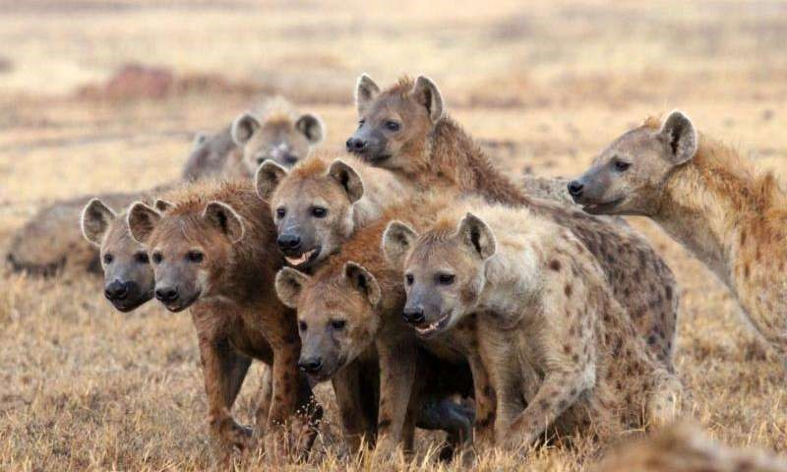
Why are people afraid of public speaking?
Physiological response
Over-thinking
Lack of experience or a bad experience
Fear of failure or judgement
Imposter syndrome
Unfamiliar audience
Not having all the answers

Slide 4

Public Speaking in General: “Do”s
Practice! Practice by yourself and with a small audience!
Make eye contact with the committee.
Dress professionally, but stay comfortable.
Speak in a clear, loud tone (use technology to your advantage)

Slide 5
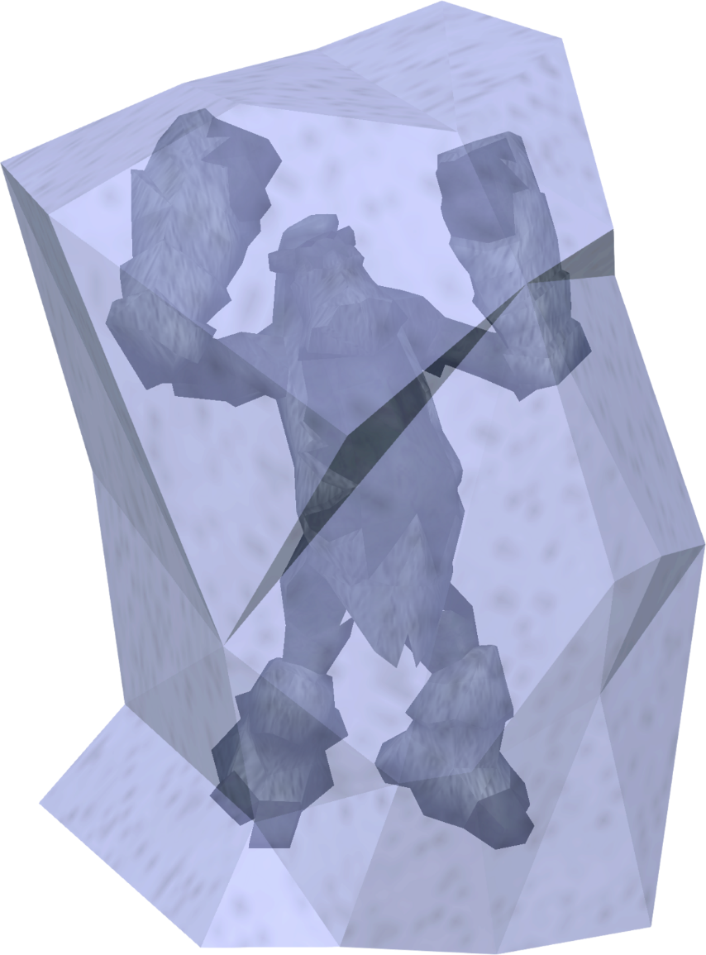
Public Speaking in General: “Don’t”s
Pace/move too much
Gesture too wildly
Look only at notes/screen
Be rude
Rush
Go too far off topic
Try to just copy someone else’s style.

Slide 6

Practice Speaking Tips
Learn your Material (The “What”)
The order - What goes first, what goes middle, what goes last?
The length (time) – Time yourself. You probably want to have about 10 minutes minimum or 15 minutes maximum of prepared material.
The meaning – It is not enough to simply memorize the material.

Slide 7
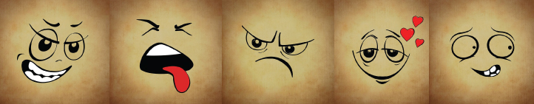
Practice Speaking
Consider your Delivery (The “How”)
The volume – What is the loudest you can speak comfortably? What is the softest you can speak clearly? Use big breaths and pretend you are talking to a friend across a very crowded café.
The tone - Friendly and approachable is usually preferred, but sometimes, speeches require a range of emotions to evoke the proper audience response. How do you want your audience to react?
The pace – Be conscious of how fast you are going. Deliver your words at the same, conversational pace. If you are struggling with a word or idea that you wish to emphasize, slow down.

Slide 8

Visual Presentation Tips
Contrasting colors
Light backgrounds with dark text
Text big enough to see (know what kind of screen you’re using)
Avoid “wall of text”
Mix in visuals, when possible
A consistent or unified theme
Avoid distracting transitions.

Slide 9

“Direction”
Lighting – Bright enough to see your face
Camera placement – Centered on you, not too tight or blurry
Background – Free of distractions, neutral color
Noises – Headphones help reduce background noise.
Attire – How do you want to be seen?
Film yourself and see what you look like

Slide 10

Purpose of Thesis Defense
To inform your audience of your academic knowledge and skills demonstrated within your thesis or dissertation writing project.
Other speeches:
Entertain
Debate
Appeal to audience
Explore an idea
Always keep your purpose and your audience members in mind.

Slide 11
Advice from previous
Thesis/Dissertation Defenders
“Your advisor wouldn’t have let you get this far if they didn’t believe you were ready to defend.” –M.M., 2013 Psychology M.S.
“I’ve given a hundred presentations in a hundred classes. This used the exact same set of skills.” –C.M., 2019 English M.A.
“As long as you understand the basics, everything else will fall into place.” –S.N., 2019 Education M.S.
“I was scared that I wasn’t going to pass. But my committee was much less scary when the day came than they were in my head.” –Y.S., 2020 English M.A.
“Compared to the actual work I put in writing my thesis, this was nothing. I already did the hardest part.” –A.H., 2020 English Ph.D.

Slide 12
What to Expect Before, During, and After the Defense:
1.Your Pre-Preparations 2.Set-Up and Start-Up 3.Giving the Presentation
4.Post-Defense Committee Questions 5.Revisions/Paperwork

Slide 13
1. Prep Beforehand
•
Make cue cards
– Even if you don’t use them.
•
•
Have a Roadmap
– Decide on your order ahead of time.
Write it in a familiar form –Try bullet points, lists, images, etc.
Have a visual aid
Slides or backdrop. Gives the audience something to stare at that isn’t you!
•

Slide 14
2. Set-Up and Start Up
Arrive Early – even “virtually”
Print all your materials, especially handouts for the committee or notecards for yourself.
Take a bottle of water with a cap.
Thank the committee for being there first before starting.
Introduce yourself and the title of your work.

Slide 15
3. Giving the Presentation
Don’t Explain Everything
Use present tense to discuss the project –
Be confident. - Avoid “I think” or “I forgot, but…”
Do. Not. Stray. - Do not talk about things that do not explicitly appear in the text of your work unless it is to answer a question from the committee.

Slide 16
4. After – Committee Questions
Don’t Interrupt the Committee’s Questions!!! –
  Rude
  Causes delays
  No sense being defensive—committee just wants to help.
Be Courteous –
Thank your committee for each piece of advice or every question that they give to you.
Clarify before moving on.
Don’t assume you’re done.
Do not talk down to your committee.
Thank the committee and the audience at the end.
Be patient – Most committee deliberations are decided quickly.

Slide 17
5. Post-Defense Revisions,
Policies, and Paperwork
For Successful Post-Proposal:
Committee suggests revisions
Committee Chair, Members, and Deans sign the Proposal Cover Sheet.
Chair delivers forms directly to COAS.
CHECK YOUR EMAIL.
Find TAMIU’s Proposal, Thesis, and Dissertation forms: https://www.tamiu.edu/gradschool/ThesisForms.shtml
See the TAMIU Thesis and Dissertation Manual for details on other Thesis/Dissertation Committee decisions.
For Successful Post-Final Defense:
Committee suggests revisions.
Committee chair, members, and the deans of the colleges sign either the Written Thesis or Written Dissertation Approval Form.
Chair delivers appropriate material to deans and COAS.
*NEW* COAS and the Graduate School deliver revisions directly to students using Teams/OneDrive virtually until thesis revisions are complete.
Registrar is informed of your completion for graduation.
Final Draft is published by the TAMIU Library.

Slide 18
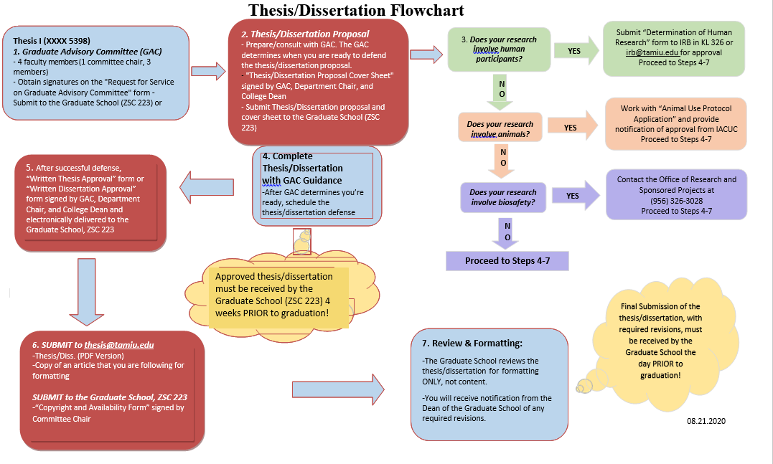

Slide 19
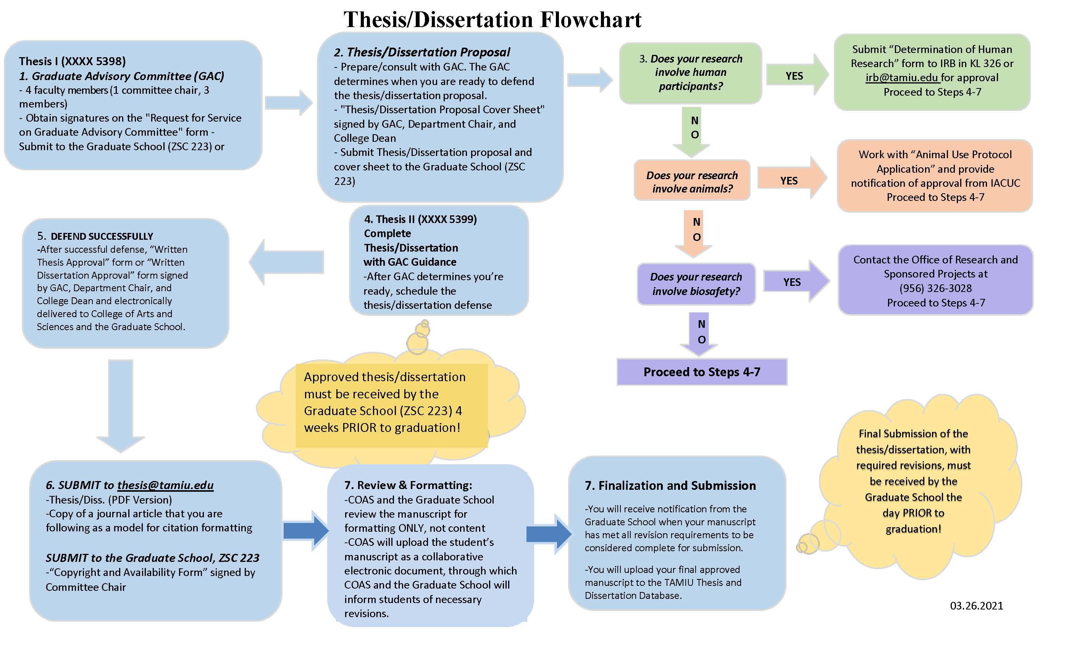

Slide 20
Deadlines, Spring 2021
Thesis I - About the last week of the semester (most likely before finals week, but it HIGHLY depends on your committee). Before semester ends.
Thesis II and Final Dissertation – Three Weeks Before Graduation (~May 14)
  Final Day to Defend (more or less) – April 23rd
  Revised Final Drafts Due to COAS/Graduate School April 30th
  FINAL Revisions Complete Before May 14th

Slide 21
Practice!

Slide 22
Other Information you Need to know
Graduate Student Resources
  Writing Consultant for all writing assignment assistance (me): https://www.tamiu.edu/cees/arc/pages/consultation.shtml
  Reserve Graduate Study Rooms at GSASC Pellegrino 203: https://www.tamiu.edu/cees/arc/pages/gsasc.shtml
Upcoming ARC Professional Development Workshops:
-SPSS Workshop with ARC SI Lesly Hernandez, April 28th, noon and 5:30 PM, LBV computer lab
-Sign up for ARC Summer Research Bootcamp II – Could receive compensation!
Contact us! writingconsultant@tamiu.edu, (956) 326-2477, Pellegrino 203

