Slide 1
Finalizing Your Thesis
With Miguel Rangel and Franco Zamora
TAMIU COAS Office of the Dean and TAMIU Graduate School Office

Slide 2
Who are we and what do we do?

Slide 3
The Thesis Approval Process

Slide 4
Required parts of the thesis
• Title Page
• Approval Page
• Abstract
• Table of Contents
• List of Tables/List of Figures (whenever there are two or more or either)
• Major Divisions (Chapter Titles)
• Bibliography/Works Cited/References
• Vita
Notes:
Miguel’s example Thesis

Slide 5
Sample Thesis

Slide 6
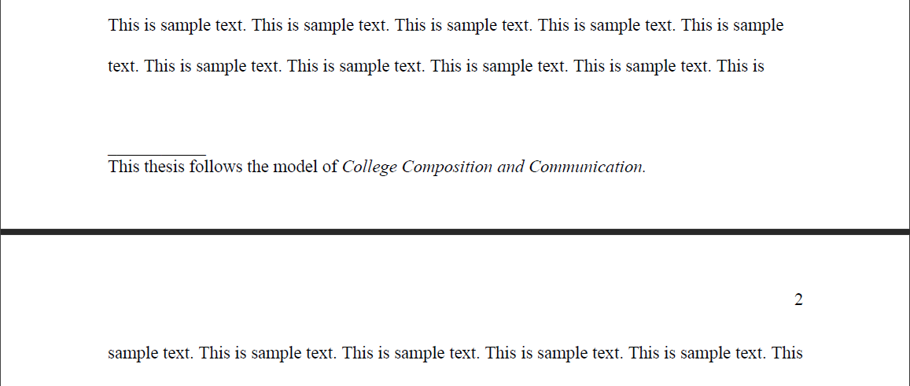
Bibliography, Citations, and Journal Model
How in-text citations are cited
• How the Bibliography is formatted
• The style and labeling for Tables and Figures.
If there are inconsistencies for formatting between the journal model and the TAMIU Thesis Manual, use the TAMIU Thesis Manual rules.
The journal model must be noted at the bottom of page 1 of the thesis or dissertation.

Slide 7
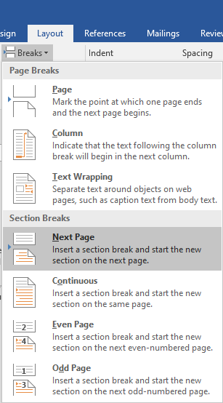
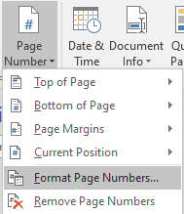
Pagination—Page numbers, Section Breaks (Demo)
Margins are always 1” all around. The only thing that should be outside of these margins are your page numbers, which, when used, are in the top left always.
(Demonstration)

Slide 8
Table of Contents (Demo)
Make sure your ToC includes all major divisions and only first-level subheadings.
Make sure every title and name matches between the ToC and the manuscript.
Demonstration:
By Hand – Make sure that all leader dots line up correctly.
Automatic – When you update the ToC, I recommend “Update Page Numbers Only”

Slide 9
Spacing
Use Single Space when:
• Using block quotes and inserted quotes
• Inserting the line that notes your Journal Model on page 1
• Using footnotes or endnotes
• Itemized or tabular materials (lists)
• Certain parts of the Approval Page, Title Page, and Table of Contents
Use Double Space when:
• Writing the body of the narrative text. (Note: You may also choose to use one and one-half space. Whichever you choose, the Abstract, List of Tables and/or List of Figures should match this.)
• Writing the title of the thesis or Chapter or Section titles within the narrative text
• Certain parts of the Approval Page, Title Page, and Table of Contents
Note: The Bibliography (References or Works Cited) may be either single-spaced with double-space between entries or double-spaced throughout.

Slide 10
Spacing (Cont’d)
If a quote is six or more lines long, it becomes a block quote
• Block quotes are single spaced
• The left margin for blocked and insert quotations is indented with two “tab” key strikes
• The paragraph that follows a blocked or insert quotation is flush left rather than indented.

Slide 11
Vita
Always Required
Always the last page in the thesis.
Has a page number
MUST Include the student’s full legal name
MUST include educational background, including schools attended, degrees earned, years earned, and the major field of specialization
MUST also list applicable professional, industry, military, business, and academic experience
SHOULD NOT include the master’s or ph.d. degree that you are currently pursuing
The typist name may be included at the bottom of the page

Slide 12
Resources
ARC Writing Consultant Page - https://www.tamiu.edu/cees/arc/pages/consultation.shtml
Thesis Guides 1-3
Thesis Template
Thesis Checklist
Past Webinar Presentations - https://www.tamiu.edu/cees/arc/professional-dev.shtml
Starting Your Thesis Video
Defending Your Thesis Video
Other Professional Development Webinars
My contact info – writingconsultant@tamiu.edu, (956) 326-2477, Monday through Friday (and Tu/Th evenings)
Miguel’s Contact Info – miguel.rangel@tamiu.edu, (956) 337-9814

Slide 13
Thanks!
Giveaway!

