Slide 1
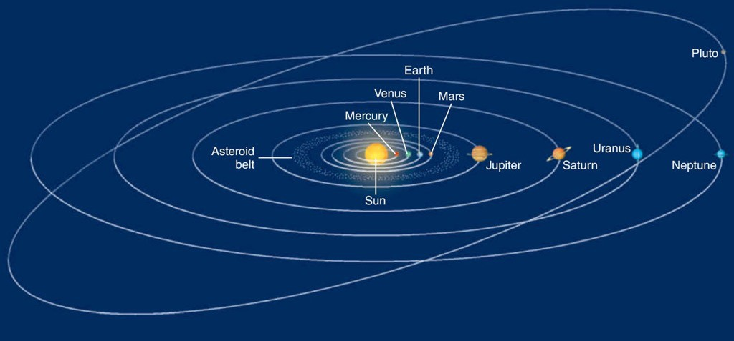
The History of the Earth

Slide 2
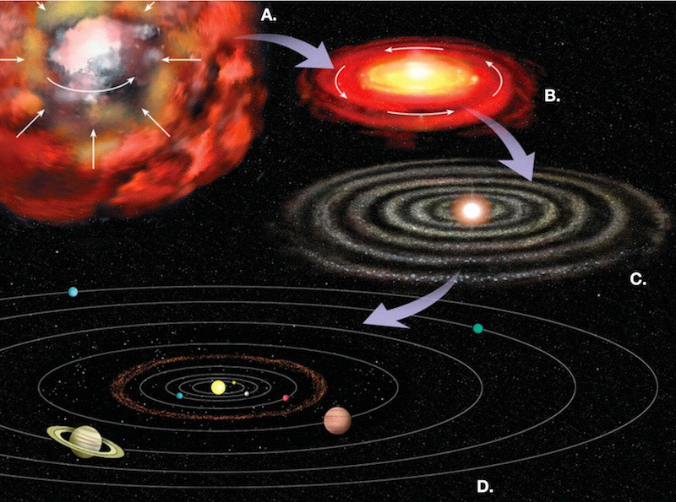
Solar Nebula Hypothesis

Slide 3
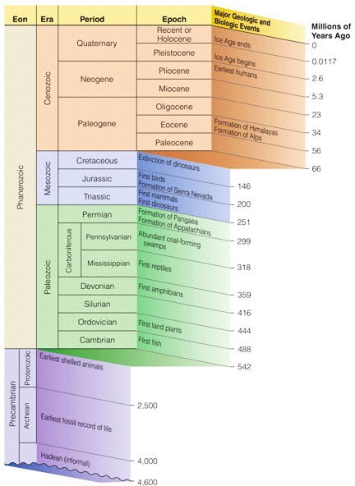
The Geologic Time Scale

Slide 4
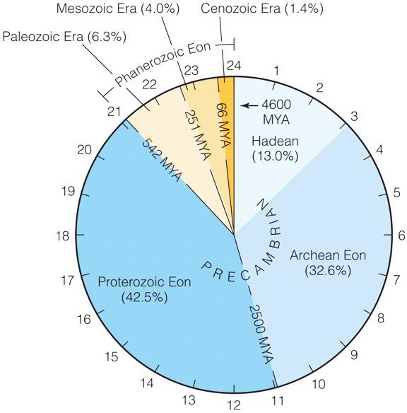
The Geologic “Clock”

Slide 5
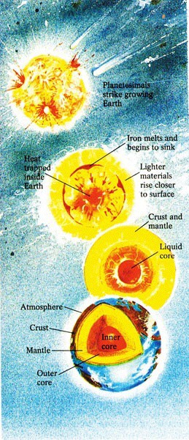
The Hadean Eon - Accretion, Melting and Differentiation

Slide 6
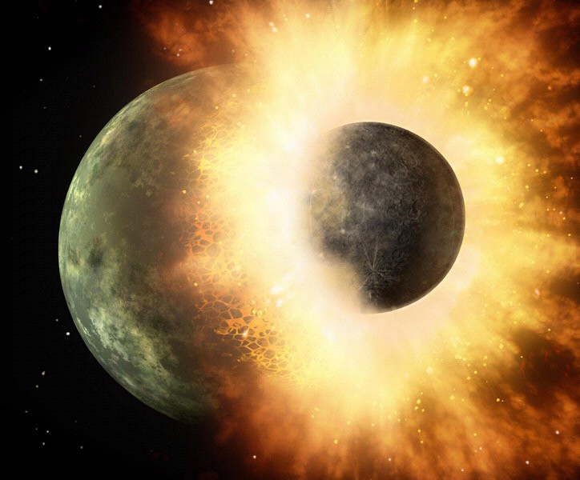
The Mars-size (Theia) Impactor Theory

Slide 7
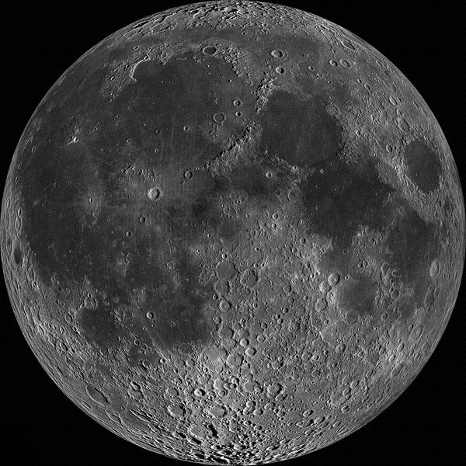
Our Moon

Slide 8
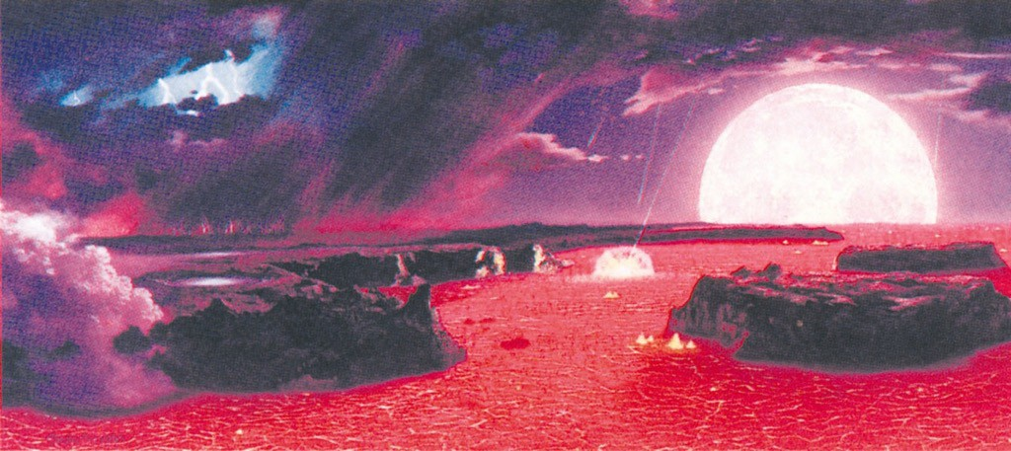
Hadean “Outgassing” to form Atmosphere and Oceans

Slide 9
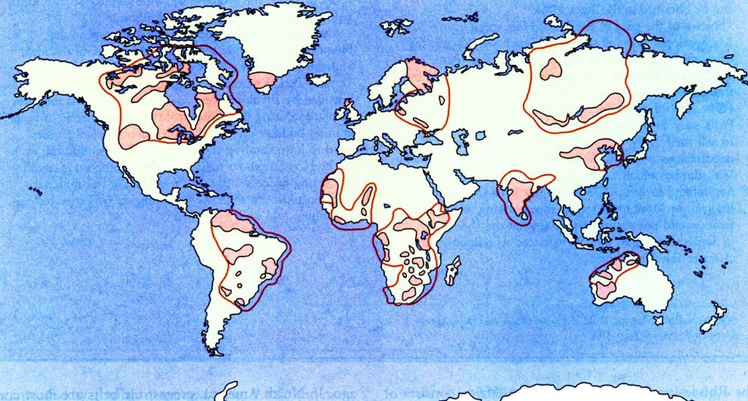
Archean Eon - the time of crust-building

Slide 10
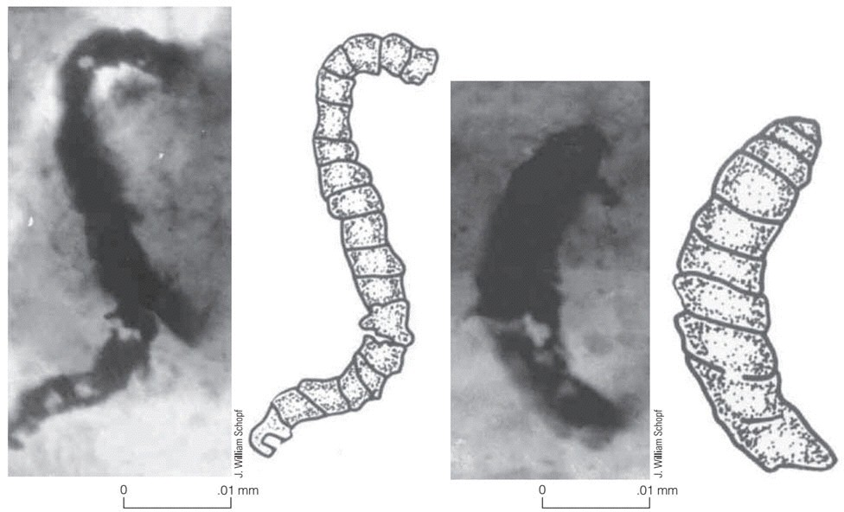
Oldest Known Fossils - 3.5 Ga Blue-green Algea

Slide 11
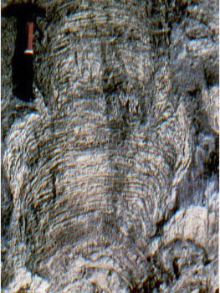
Canadian Stromatolites (3.0 Ga)

Slide 12
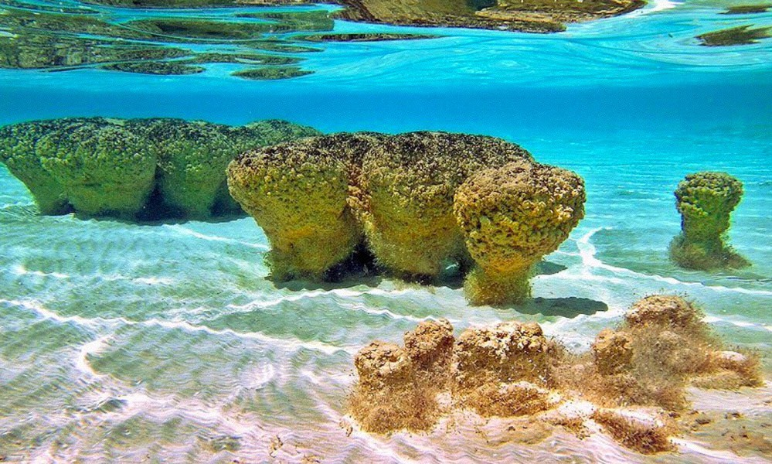
Stromatolites at Shark’s Bay, Western Australia

Slide 13
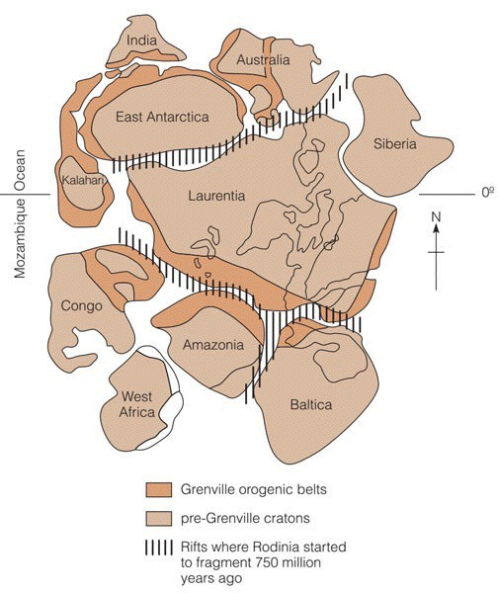
Rodinia - Late Proterozoic Super Continent

Slide 14
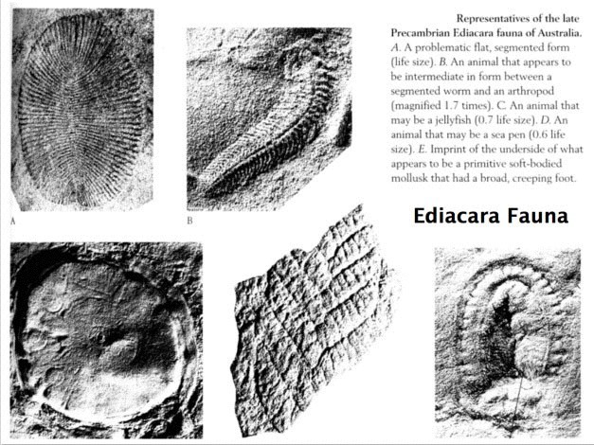
640 Ma Ediacara Fauna - Soft-bodied Metazoans

Slide 15
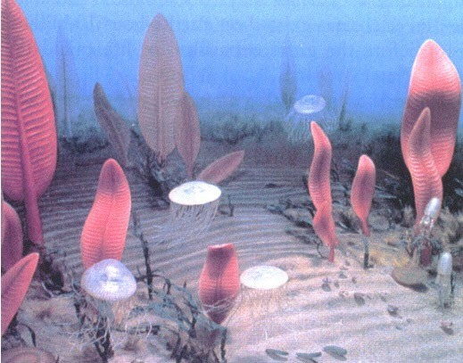
Ediacara Paleocommunity

Slide 16
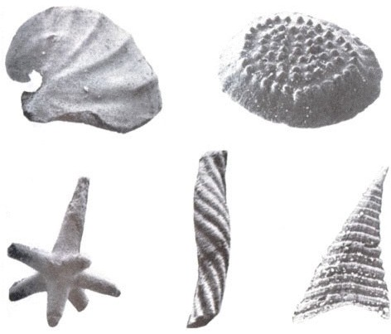
Beginning of the Phanerozoic Eon (first hard-shelled invertebrate metazoans)

Slide 17
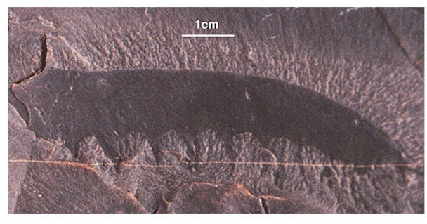
Early Phanerozoic “Anomalocaras”

Slide 18
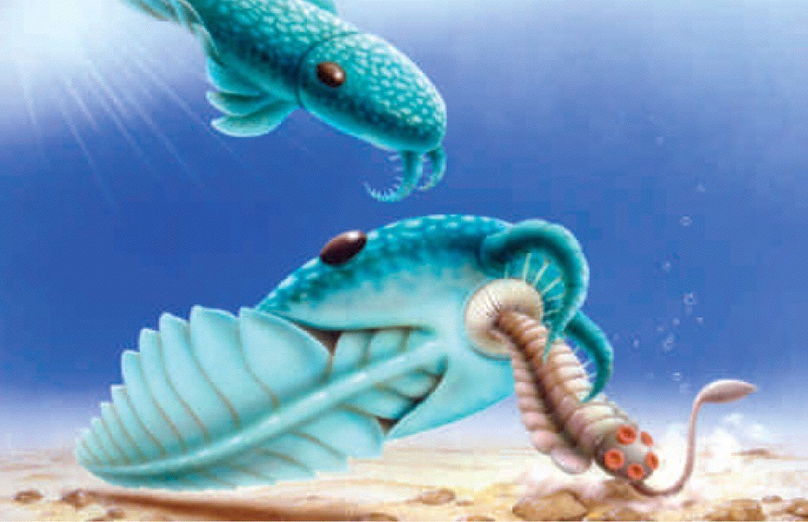
Anomalocaras - (reconstructed)

Slide 19
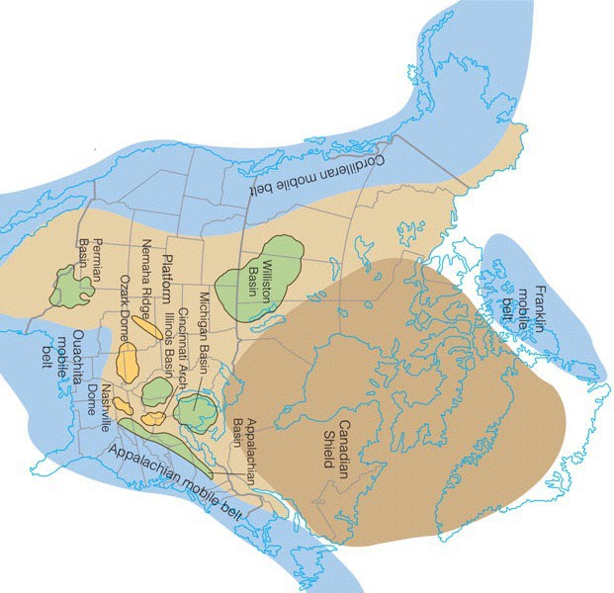
North America during the Lower Paleozoic Era

Slide 20
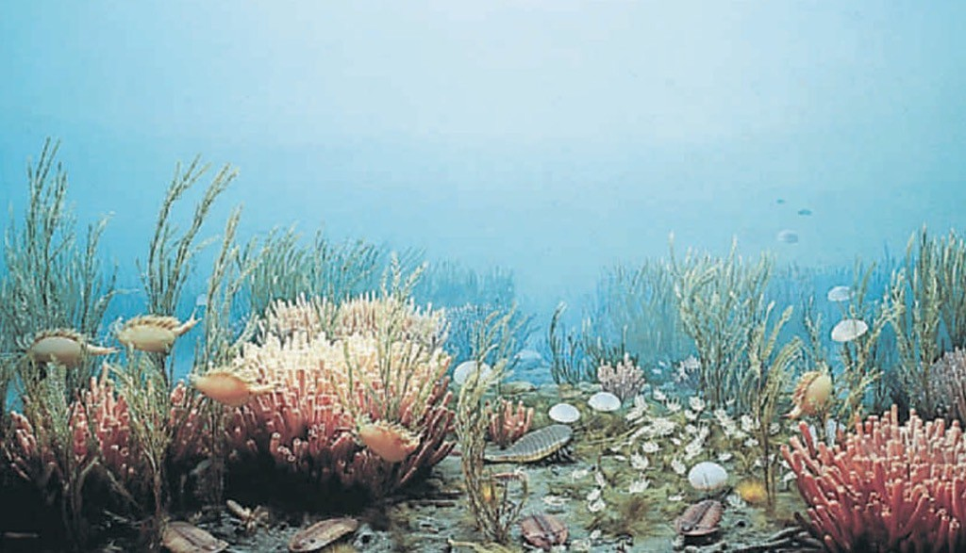
Lower Paleozoic Era - The Age of the Invertebrates

Slide 21
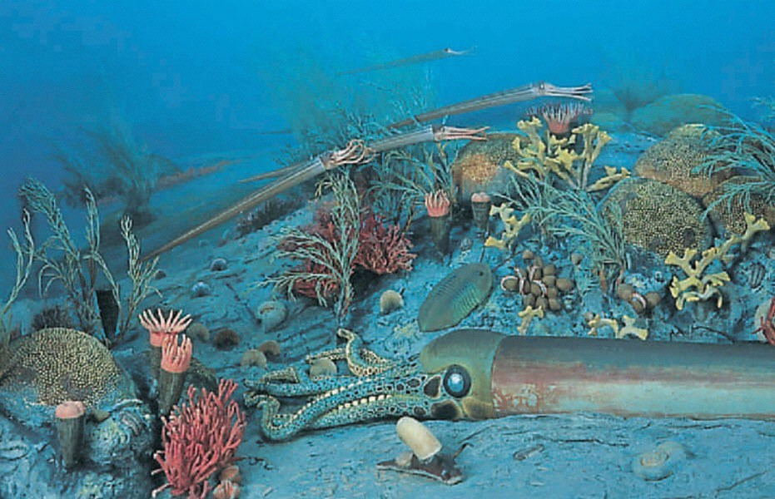
Lower Paleozoic Era Cephalopods

Slide 22
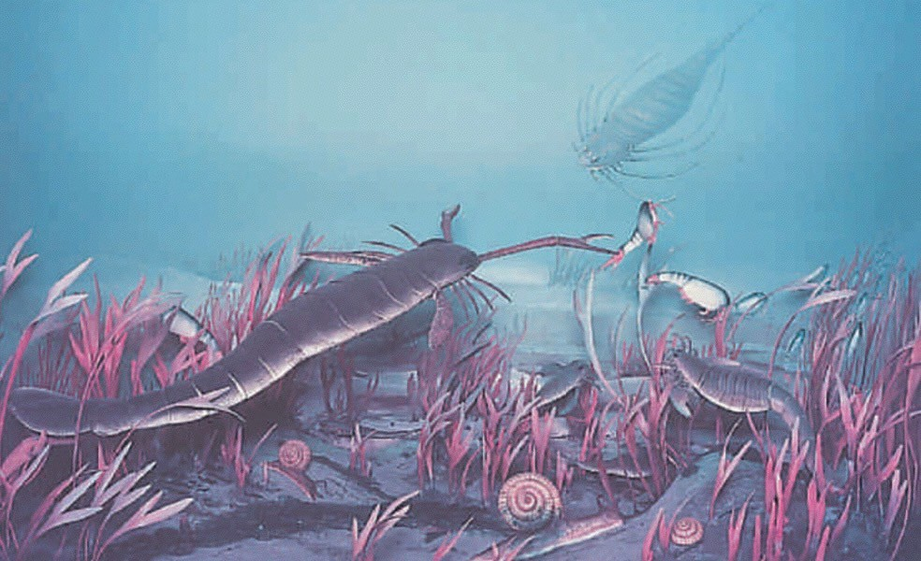
Lower Paleozoic Eurypterids - Sea Scorpions

Slide 23
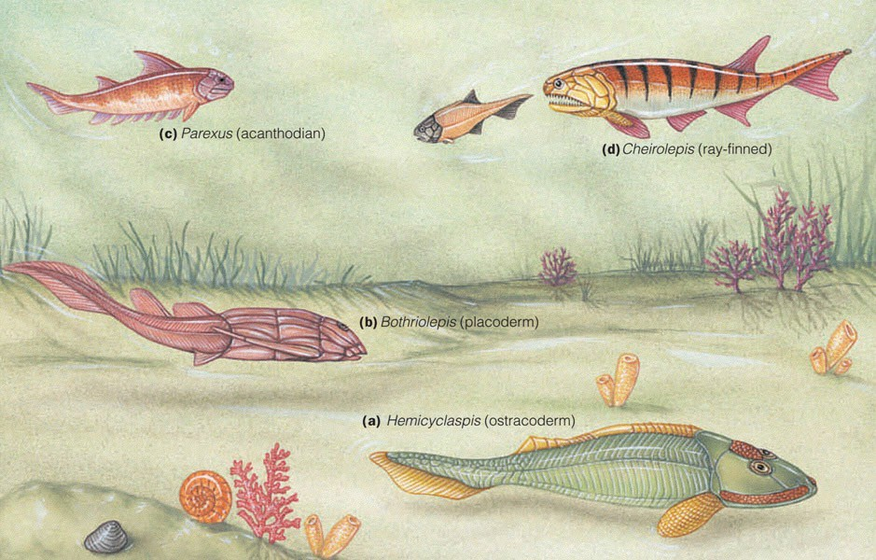
Middle Paleozoic Era - Age of the Fish

Slide 25
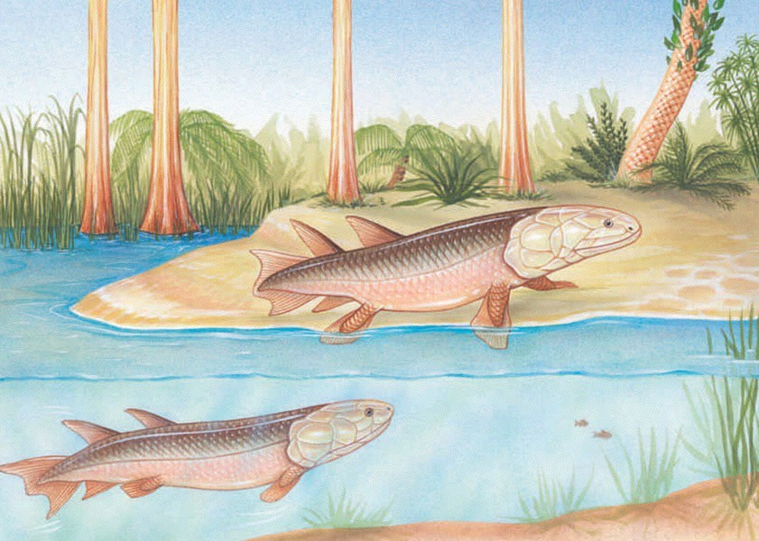
A mid-Paleozoic lobe-finned fish

Slide 26
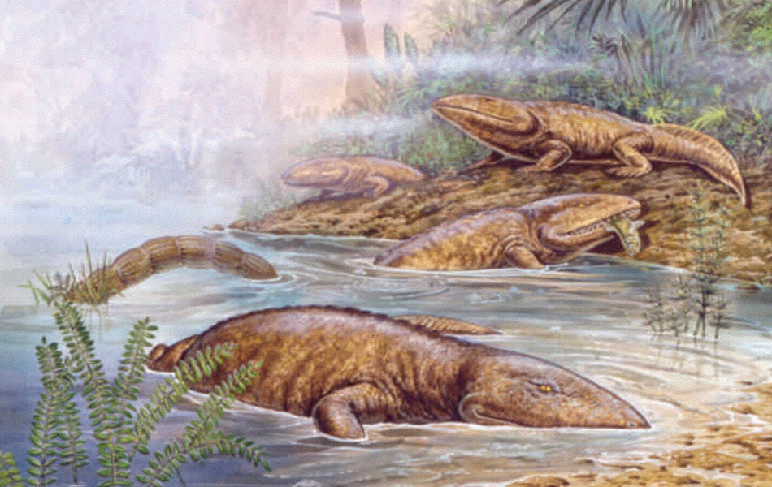
Late Paleozoic - the Age of the Amphibians

Slide 27
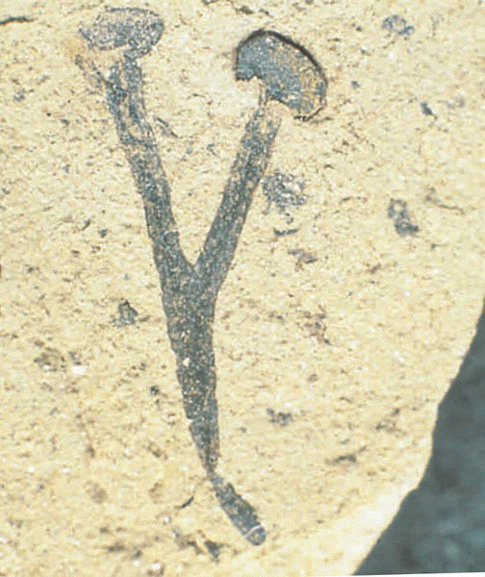
Cooksonia - one of the first land plants

Slide 28
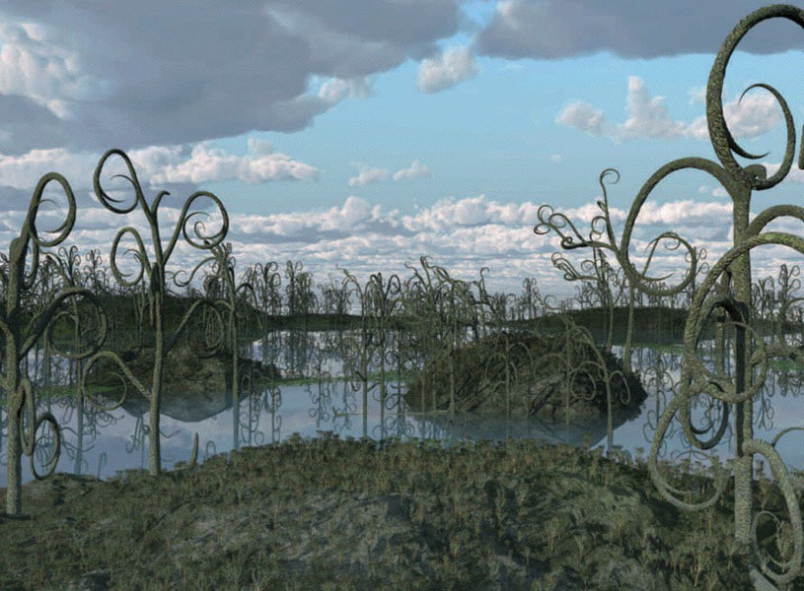
Middle Paleozoic ‘forest’

Slide 29
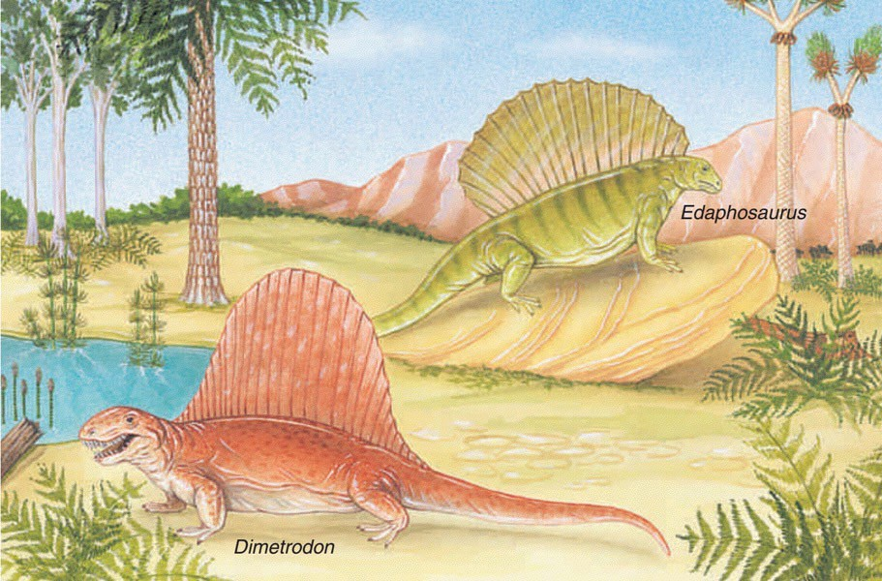
At the end of the Paleozoic - Pelycosaurs (early reptiles)

Slide 30
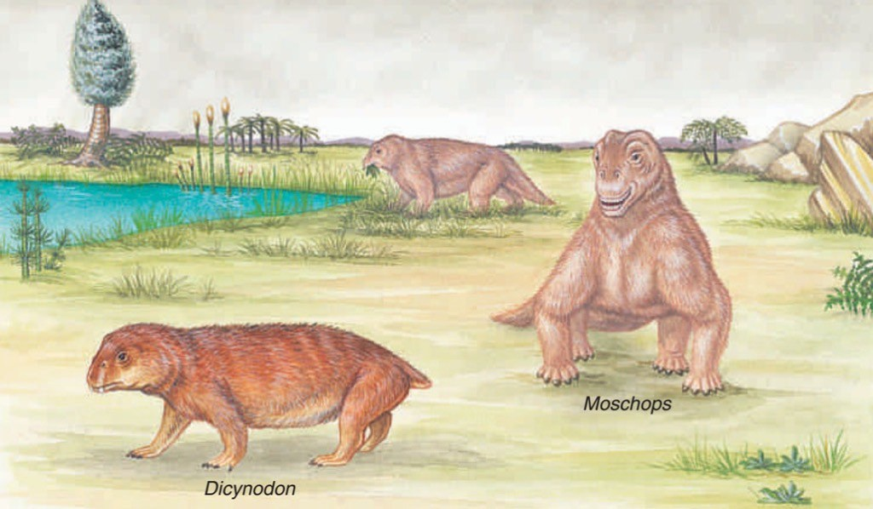
Therapsid Reptiles - ancestors to modern Mammals

Slide 31
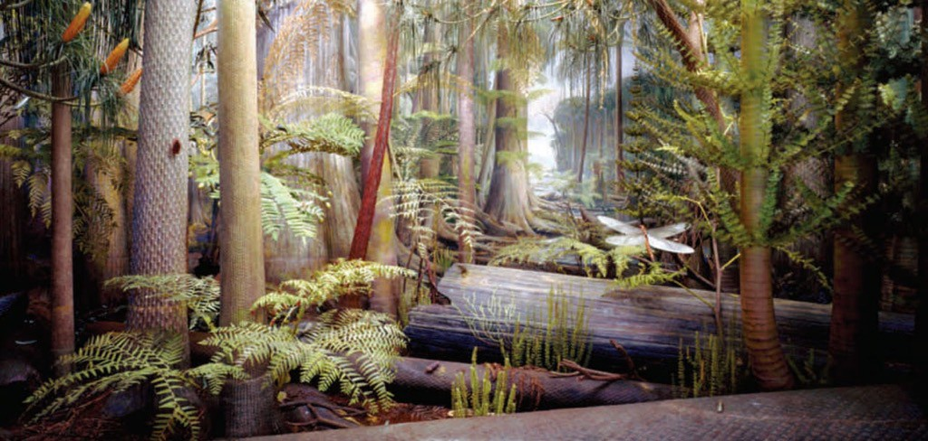
Late Paleozoic Coal Swamps

Slide 32
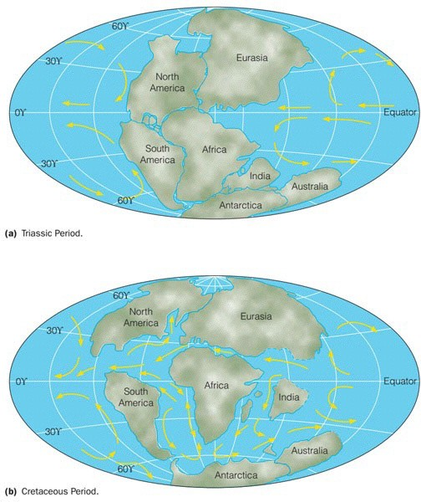
Mesozoic Era - Pangea

Slide 33
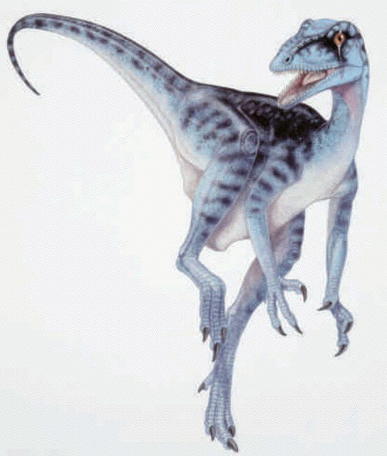
Mesozoic Era - the Age of the Reptiles

Slide 34
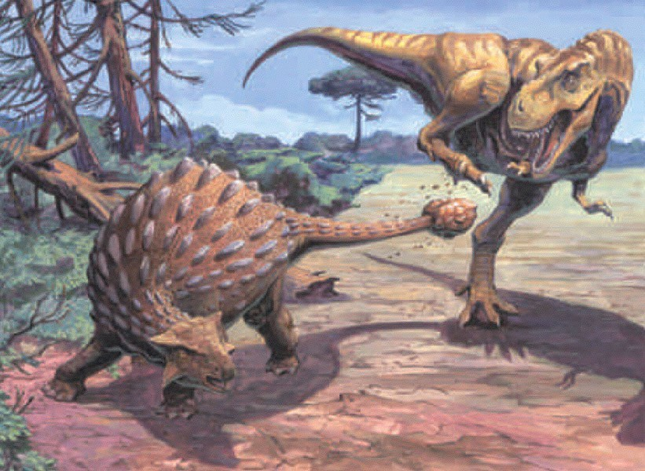
Dinosaurs ruled the land in the Mesozoic Era

Slide 35
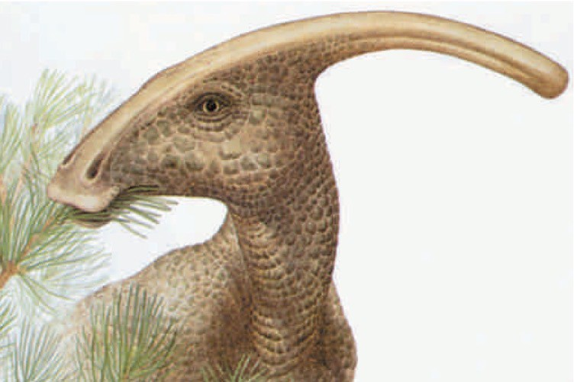
Mesozoic Duck-billed Dinosaur

Slide 36
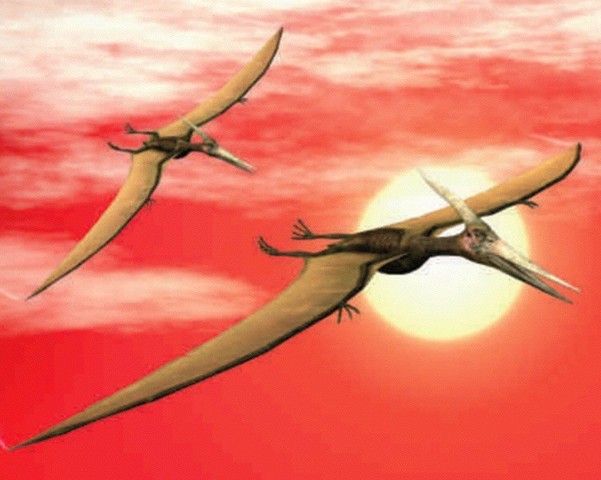
Mesozoic Pterodactyls

Slide 37
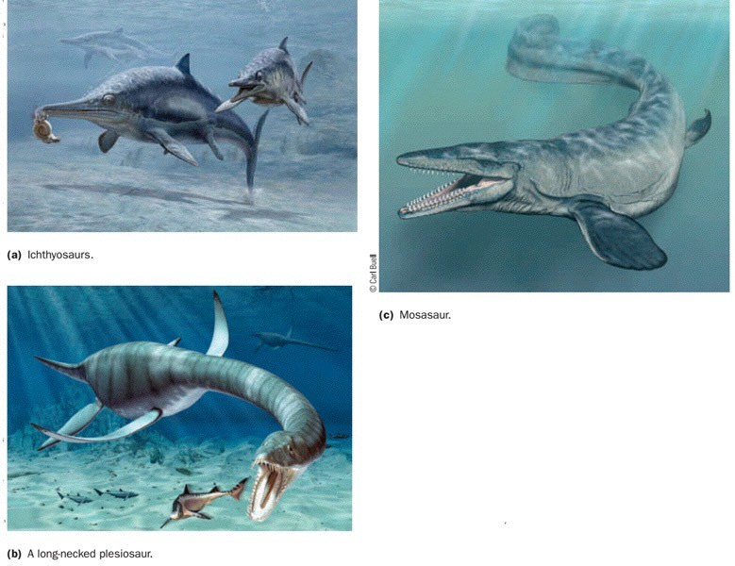
Mesozoic Marine Dinosaurs

Slide 38
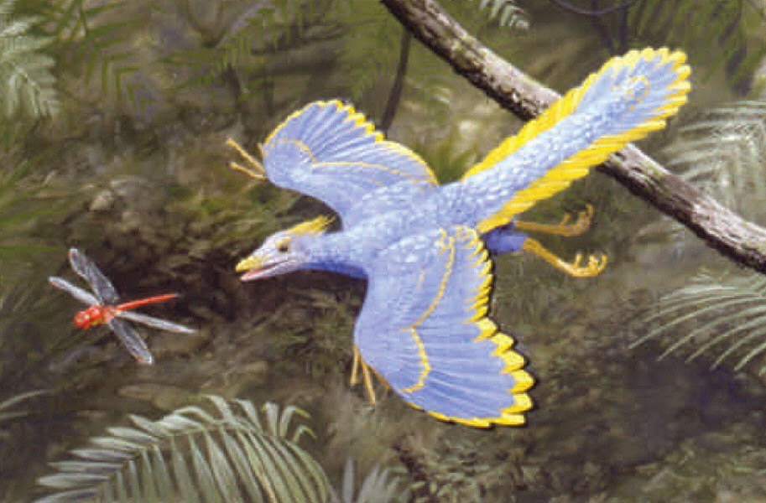
Archaeopteryx - Late Mesozoic Bird Ancestor

Slide 39
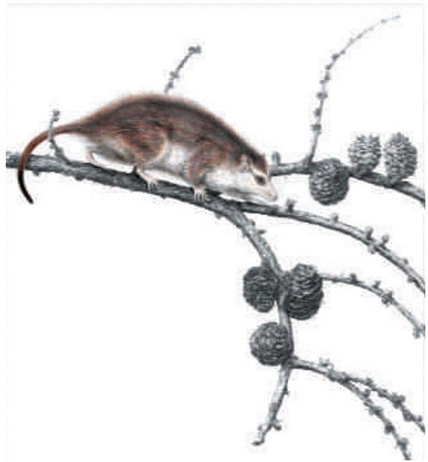
a Triconodont - Late Mesozoic Mammal

Slide 40
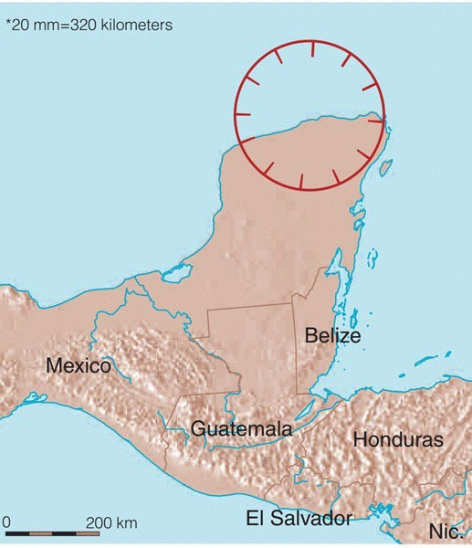
Chicxulub Impact Crater, Northern Yucatan Peninsula

Slide 41
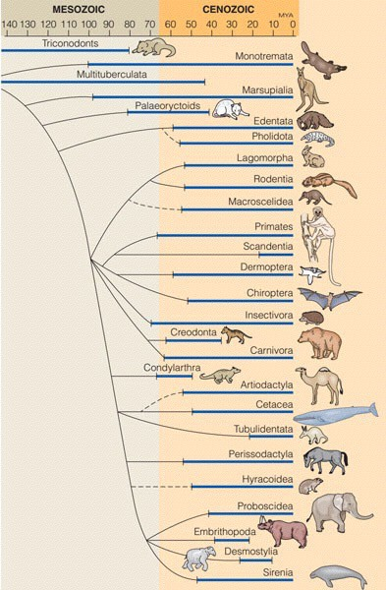
Cenozoic Era - the Age of Mammals

Slide 42
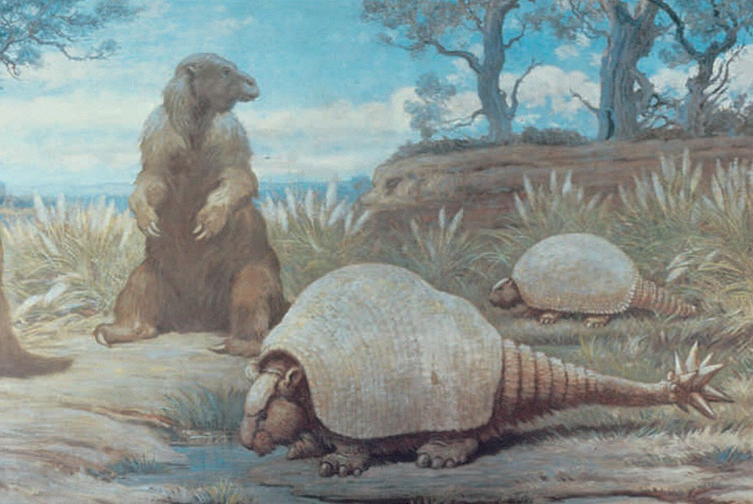
Extinct Pleistocene Epoch Mammals

Slide 43
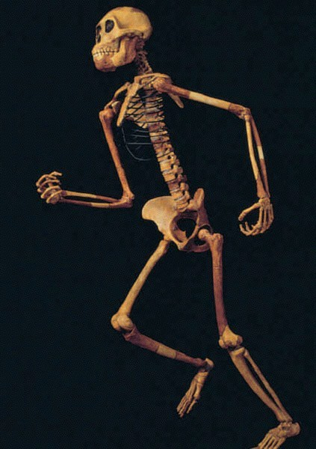
Lucy (Australopithecus afarensis) - early hominid

Slide 44
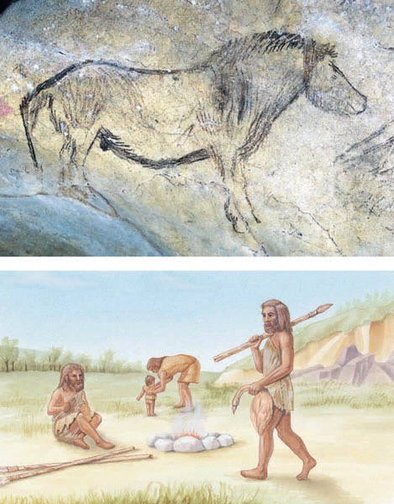
Cro-Magnon - modern hominid

