Slide 1
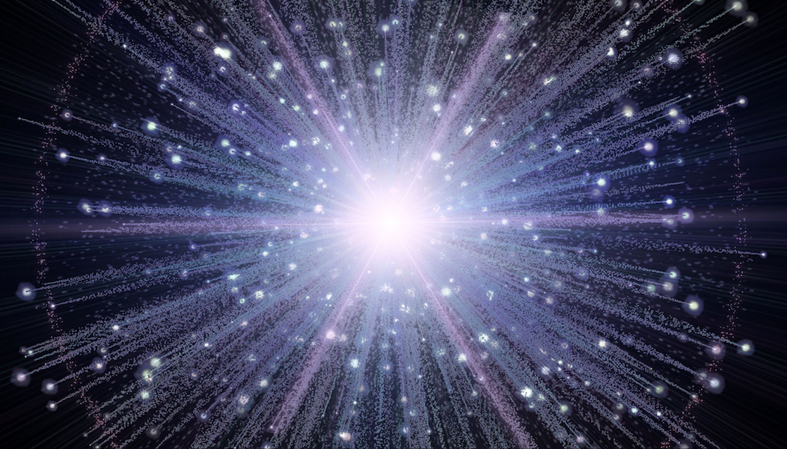
Planetary Geology

Slide 2
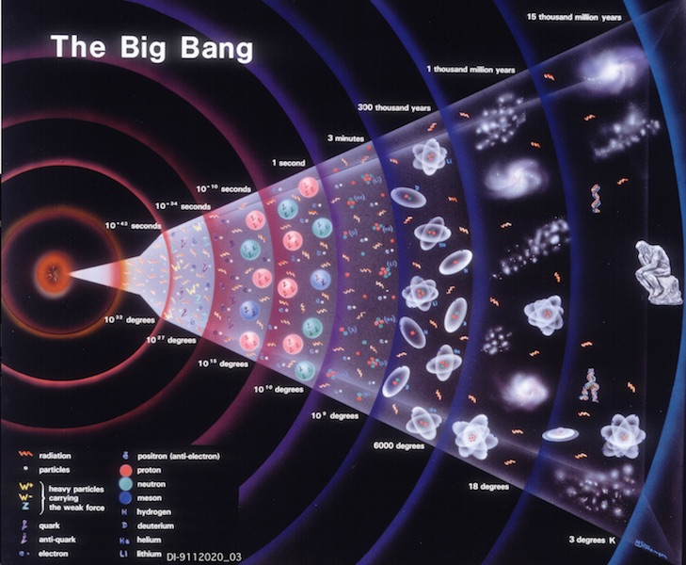
The Big Bang

Slide 3
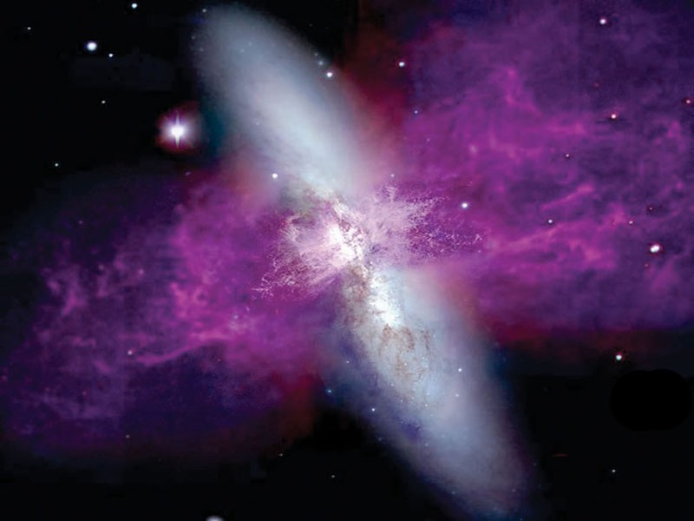
The Birth of a Star

Slide 4
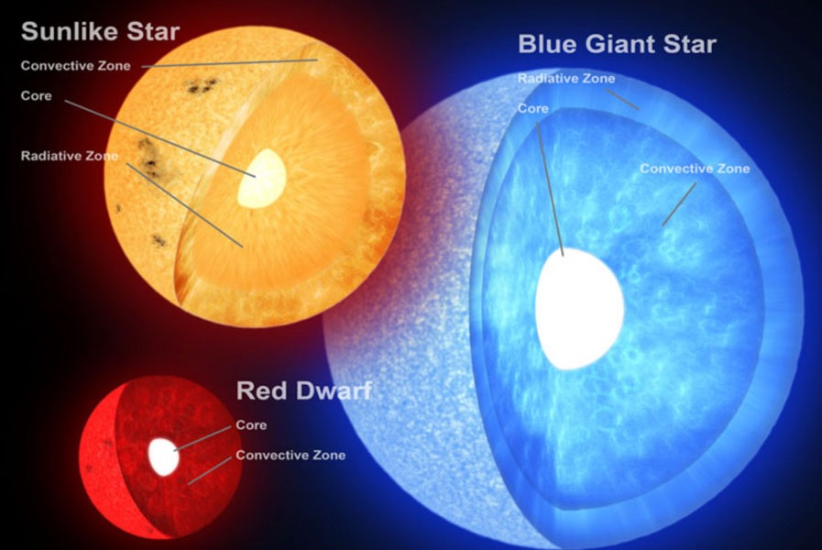
The Interior of Stars

Slide 5
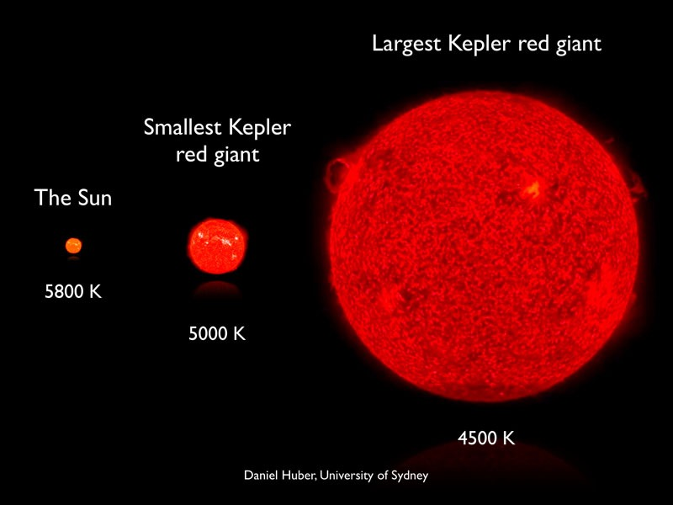
The Sun - A Red Giant ?

Slide 6
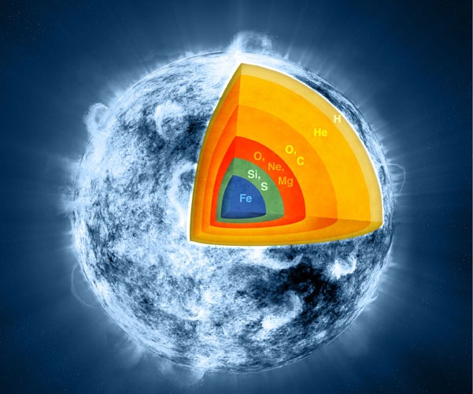
Nucleosynthesis in Massive Stars

Slide 7
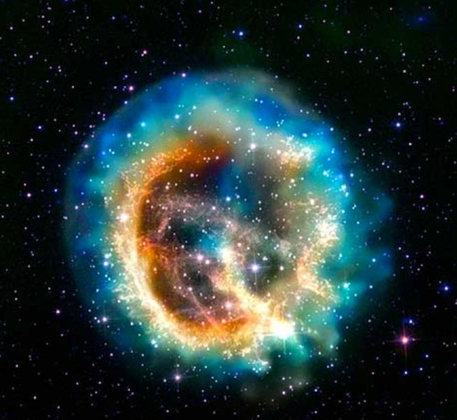
The Supernova of a Massive Star

Slide 8
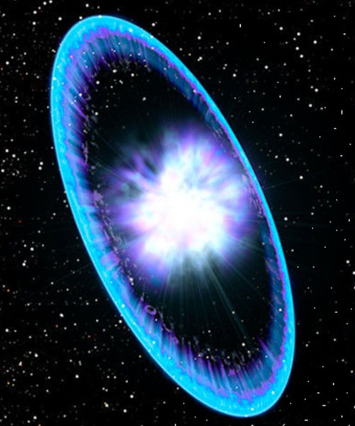
The Shockwave from a Supernova

Slide 9
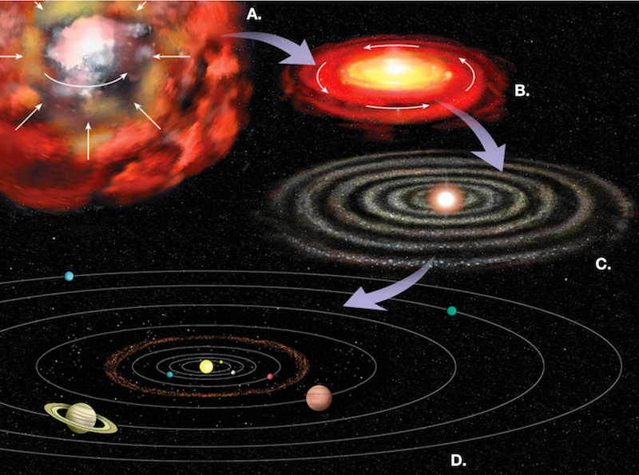
Solar Nebula Hypothosis

Slide 10
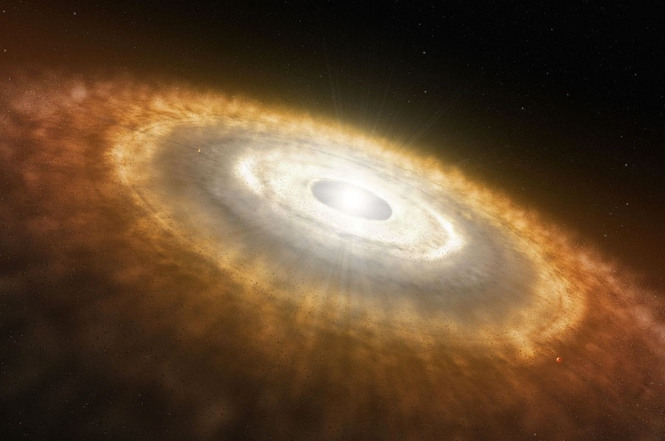
Protoplanetary Disk

Slide 11
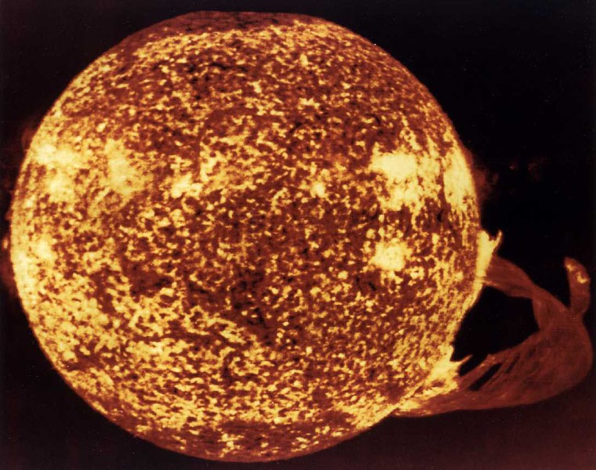
‘Sol’ - Our Sun

Slide 12
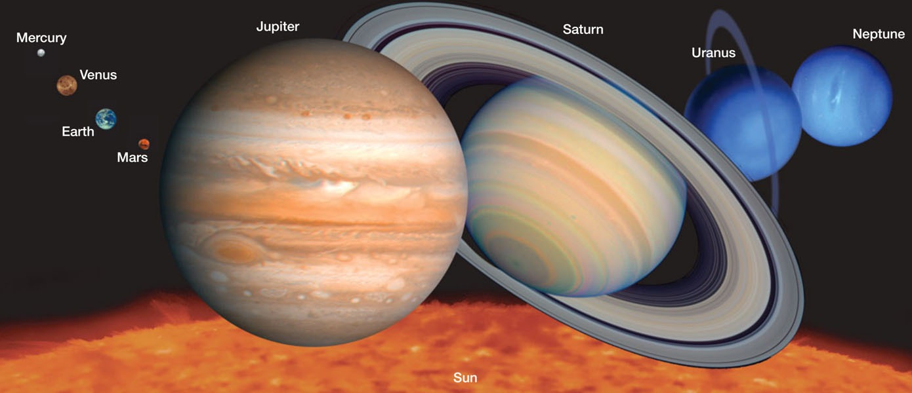
The Planets (to scale)

Slide 13
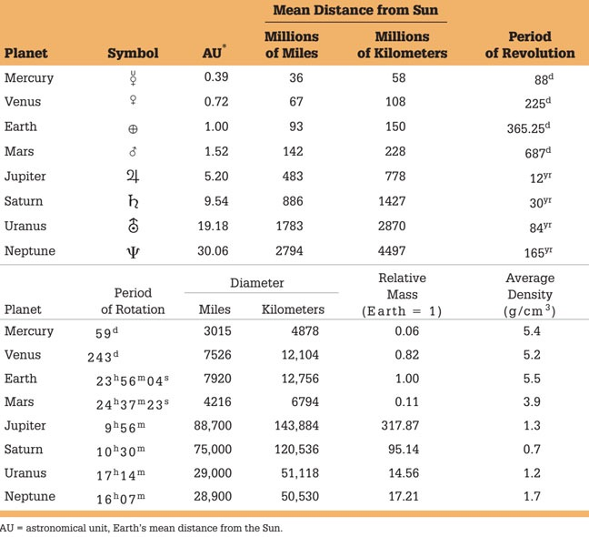
Planetary Data

Slide 14
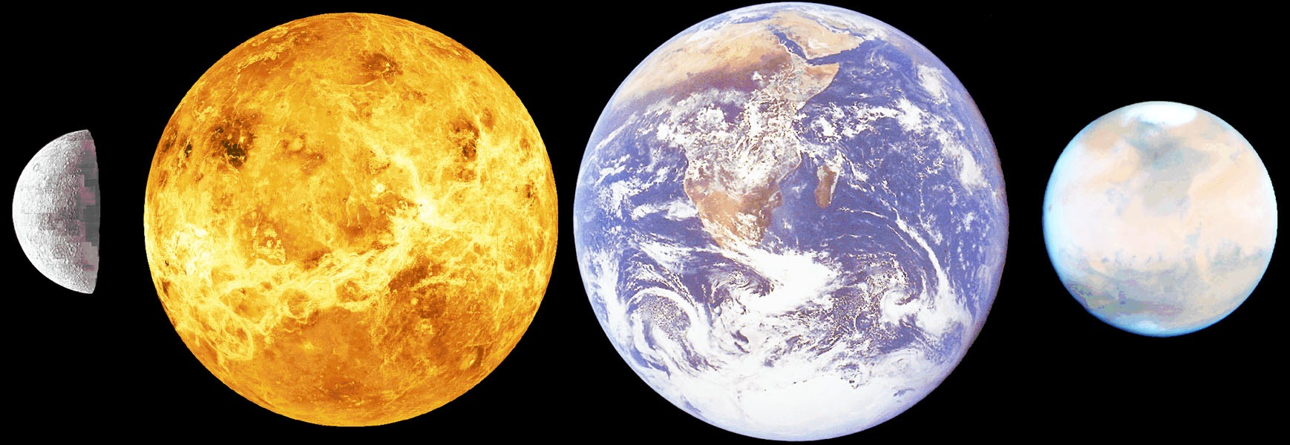
The Terrestrial Planets

Slide 15
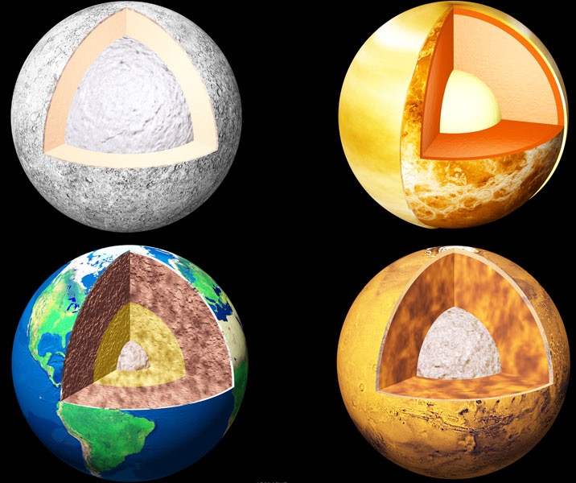
Terrestrial Planet Interiors

Slide 16
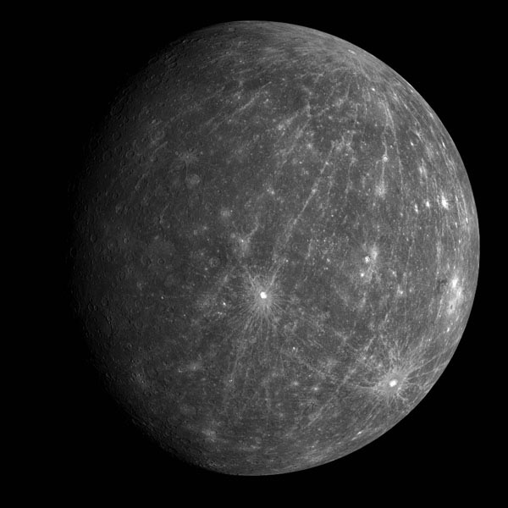
Mercury

Slide 17
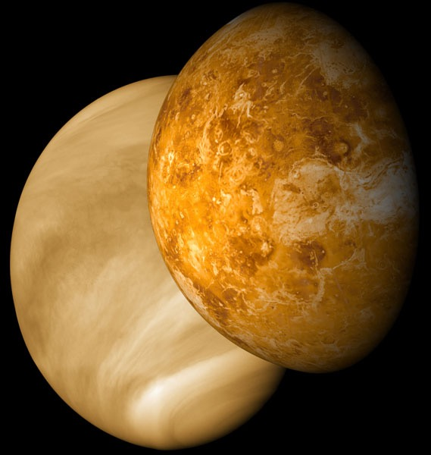
Venus (visible and radar images)

Slide 18
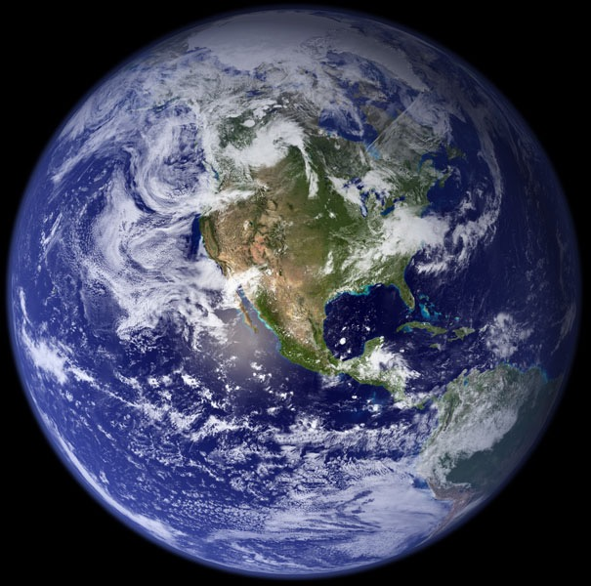
Earth - The Big Blue Ball

Slide 19
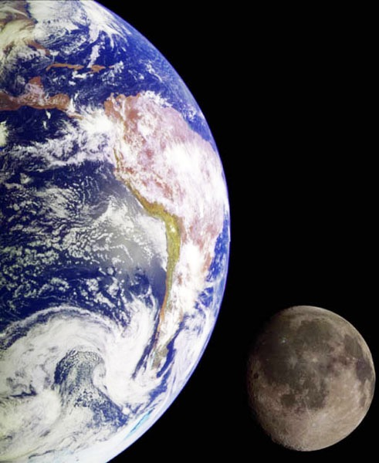
Earth - Moon System

Slide 20
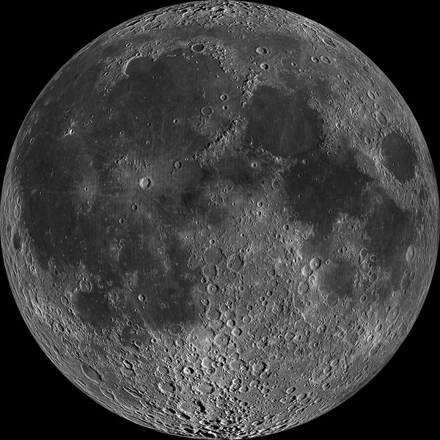
The Moon

Slide 21
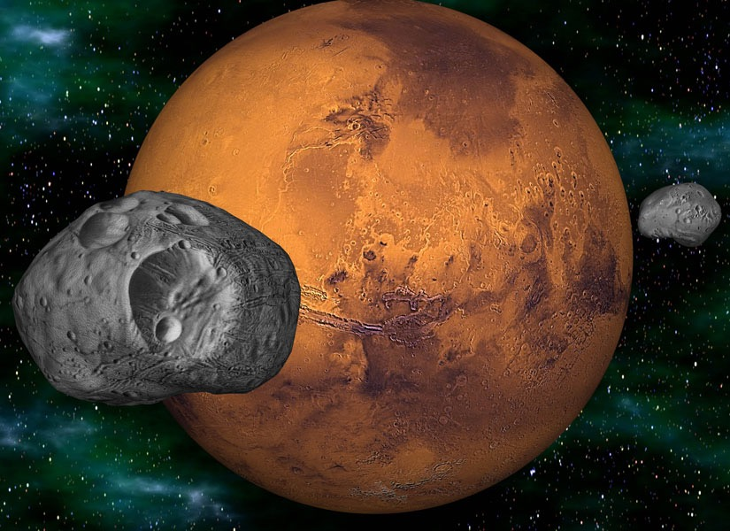
Mars with Deimos and Phobos

Slide 22
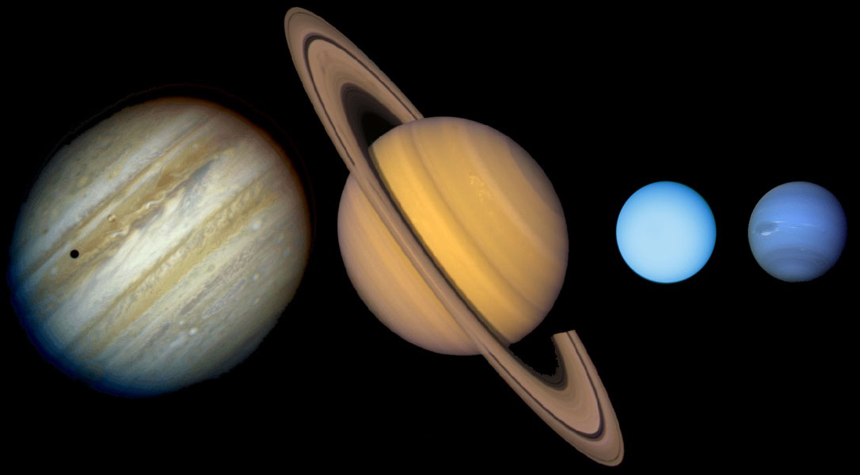
The Gas Giant (Jovian) Planets

Slide 23
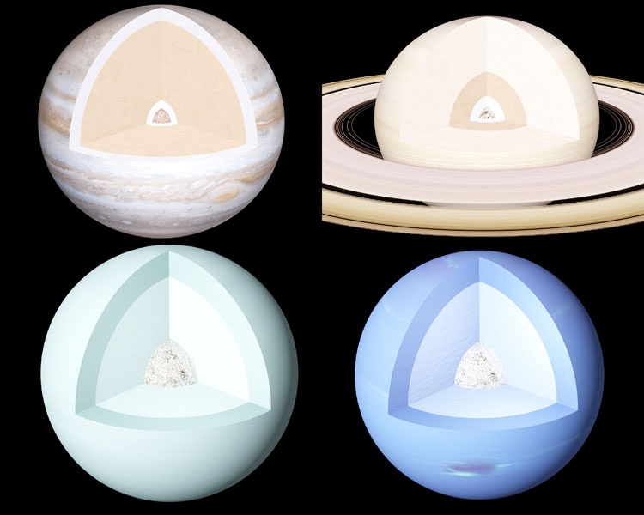
Jovian Interiors

Slide 24
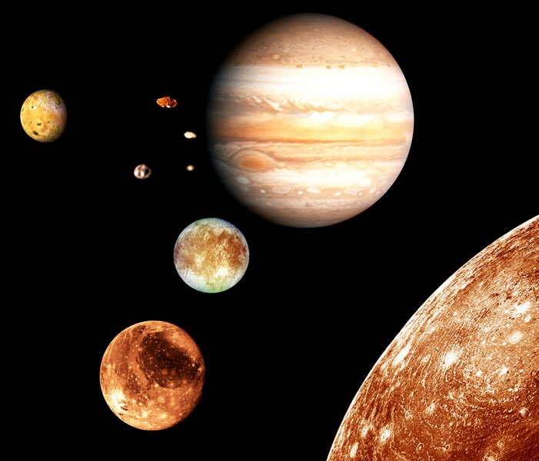
The Jupiter ‘System’

Slide 25
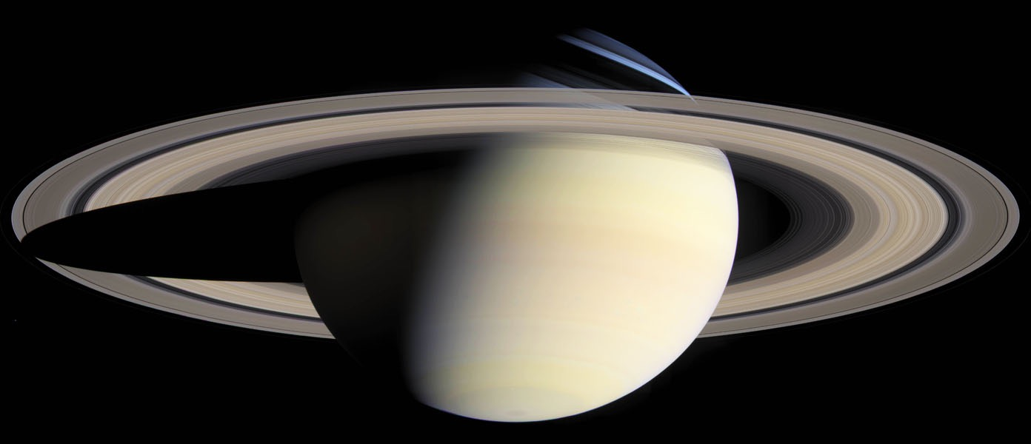
Saturn

Slide 26
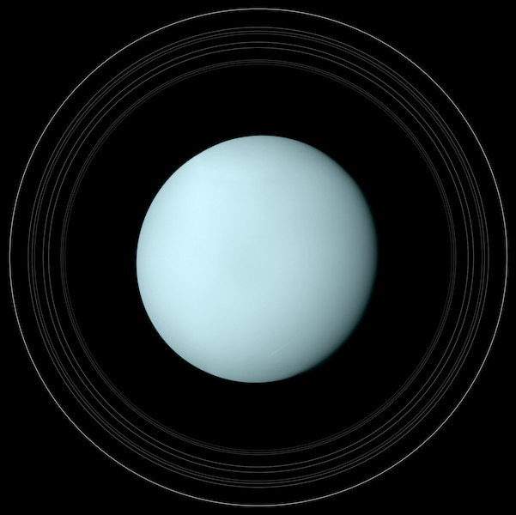
Uranus with Rings

Slide 27
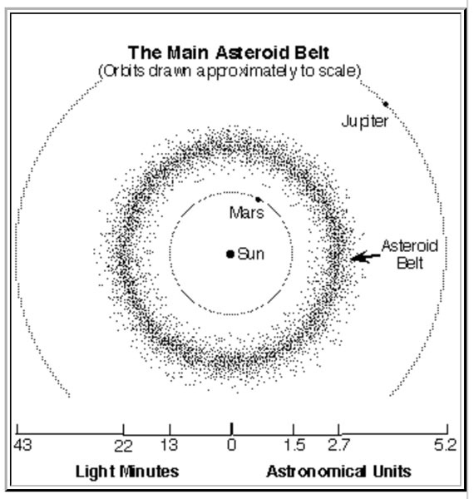
Small Solar System Bodies - the Asteroid Belt

Slide 28
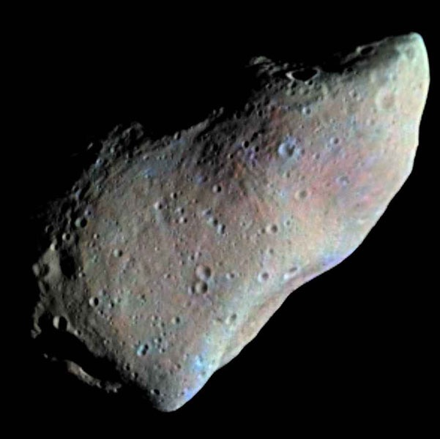
Asteroid Gaspra

Slide 29
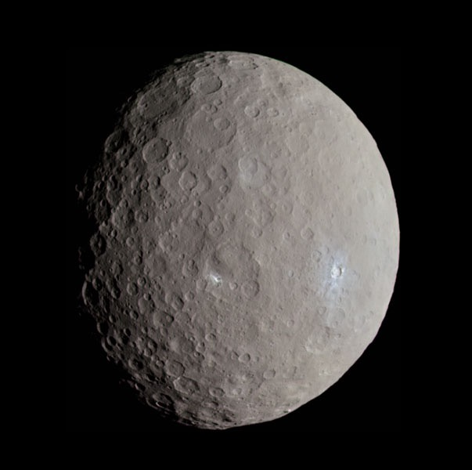
Dwarf Planet Ceres

Slide 30
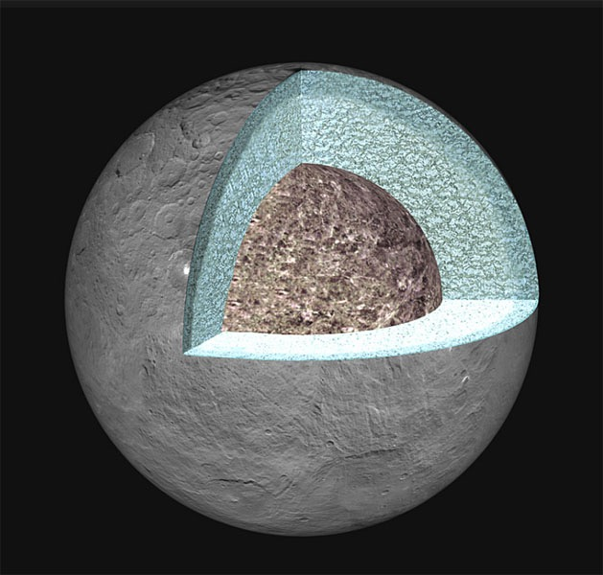
Ceres is Differentiated

Slide 31
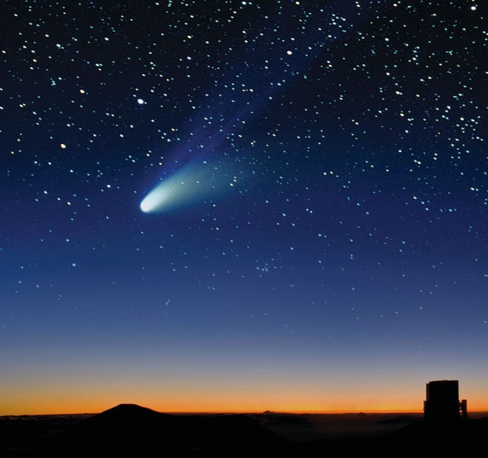
Meteors vs Meteorites

Slide 32
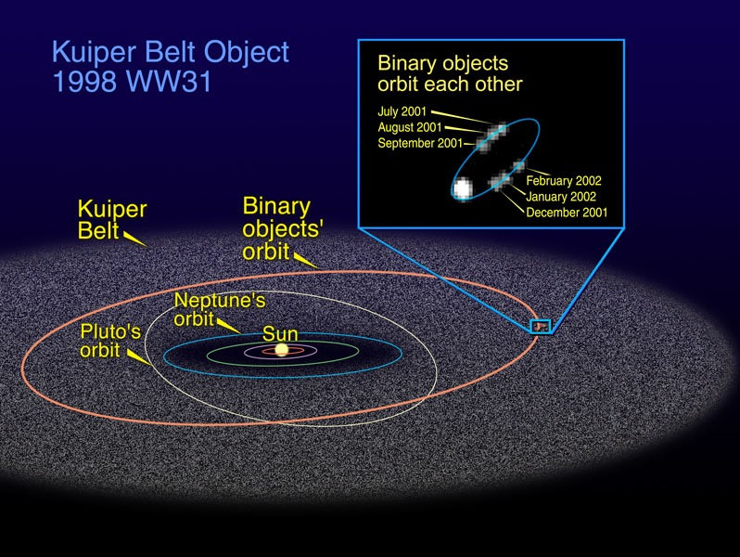
Kuiper Belt

Slide 33
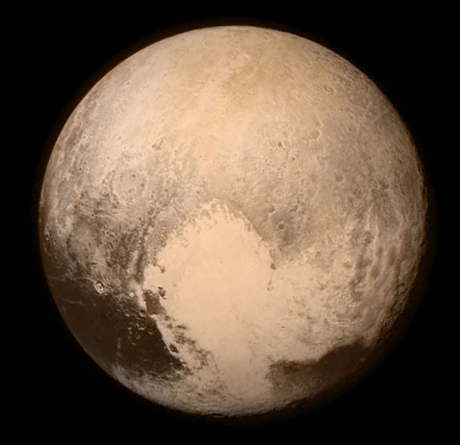
Pluto

Slide 34
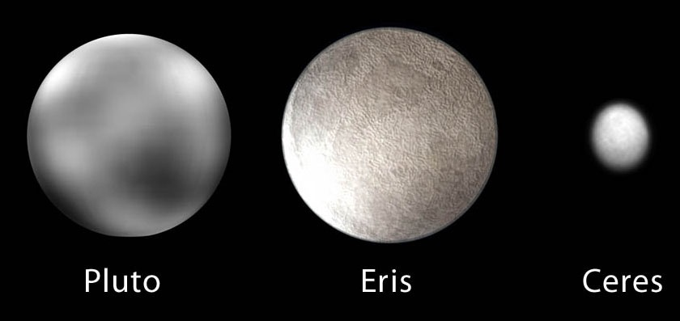
Dwarf Planets

Slide 35
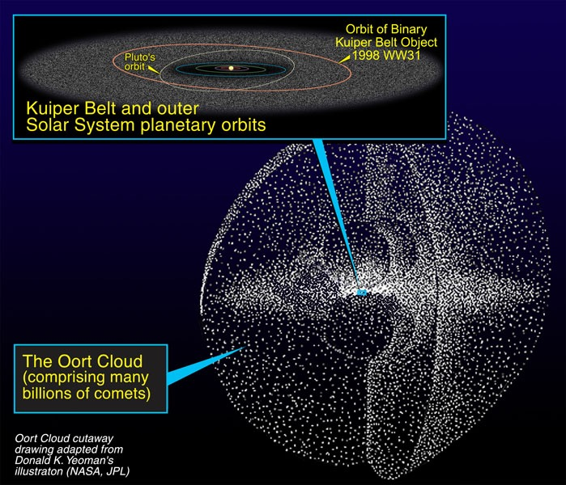
The Oort Cloud

Slide 36
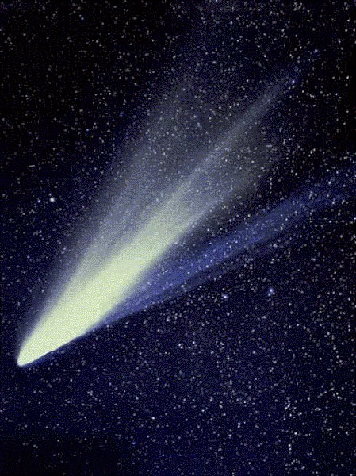
Comets

