Slide 1



Jump into RIO
Contribute your scholarship to the TAMIU institutional repository
Eva A. Hernandez
September 21, 2022
Notes:
Introduce session and speakers
Remind viewers to send a chat if they are having technical difficulties

Slide 2


Overview
What is RIO?
Purpose of RIO
Contributors/Authors
Content
Create and contribute
Website Tour
What’s next for RIO
Contact
Notes:
On our agenda this afternoon:
An introduction to RIO and its purpose, plus
information on who can contribute,
what content lives in our repository,
a tour of our repository website,
how to access materials in RIO
and a hands-on walkthrough for creating an account and contributing your own scholarly works.
At the end of our session, we’ll touch on current plans for RIO’s continued development and growth.

Slide 3
What is RIO?
Research
Information
Online
Open access institutional repository for scholarship and special collections
Notes:
RIO stands for Research Information Online and it is named in honor of Killam Library’s original online catalog. RIO is part of the Digital Commons Network, a global network of open access institutional repositories. The publications in RIO and in the wider Digital Commons network are completely open, discoverable via Google, and can be downloaded and shared without limit (unless access limits are requested by the author, but we’ll touch on that later). There are over 600 repositories involved housing over 4 million items and the network continues to grow. You do not have to be a member of digital commons to access the content.
RIO is home to TAMIU’s institutional scholarship and digitized materials from our Special Collections and Archives. Current collections include full-text electronic theses and dissertations going back to 2011, faculty publications divided by college and discipline, and digitized rare books from our Special Collections. New content is being added frequently as we harvest publications from different databases and upload digitized materials.

Slide 4

Purpose and Mission
Document scholarship of TAMIU community
Archive research efforts to build on knowledge
Notes:
RIO’s purpose and mission is to document and preserve the scholarship of our University community. Our institutional repository is also an effort to make TAMIU scholarship and collections more accessible not only to our students and faculty but connect this body of knowledge to the larger academic world.

Slide 5
Contributors/Authors
Current TAMIU faculty, staff, and students
Non-affiliated scholars if co-authored with TAMIU author
Authors submitting content via a TAMIU-sponsored event or publication
Notes:
Content contributors for RIO must be affiliated with TAMIU. Current TAMIU faculty, staff, and students can submit their works for consideration for publication through the RIO site. Scholarship that is co-authored with a TAMIU author can also be submitted for publication. Additionally, RIO can accept content that is submitted via a TAMIU-sponsored event, like a conference or call for papers.

Slide 6
Content
Masters Level Theses
Dissertations
Publications and preprints
Working papers
Teaching and learning resources
Audio and visual recordings
Open Education Resources
Datasets
White papers
Notes:
RIO accepts a wide range of content. While this is not an exhaustive list, it does represent the type of content we are currently adding to the repository. You may notice some of your own works linked in our repository already.
Beyond articles and theses, RIO will also be home to audio-visual materials such as audio recordings, video recordings, photographs, and the like.

Slide 7
Create your account &
Contribute your scholarship
Create an account
1
Upload your work
2
Share your scholarship
3
Discover new content
4
Notes:
Before we head over and visit our repository, this is our itinerary: we'll be creating an account in RIO, giving a brief tour of our collections, and show you how to contribute your own scholarship and search for new content.

Slide 8

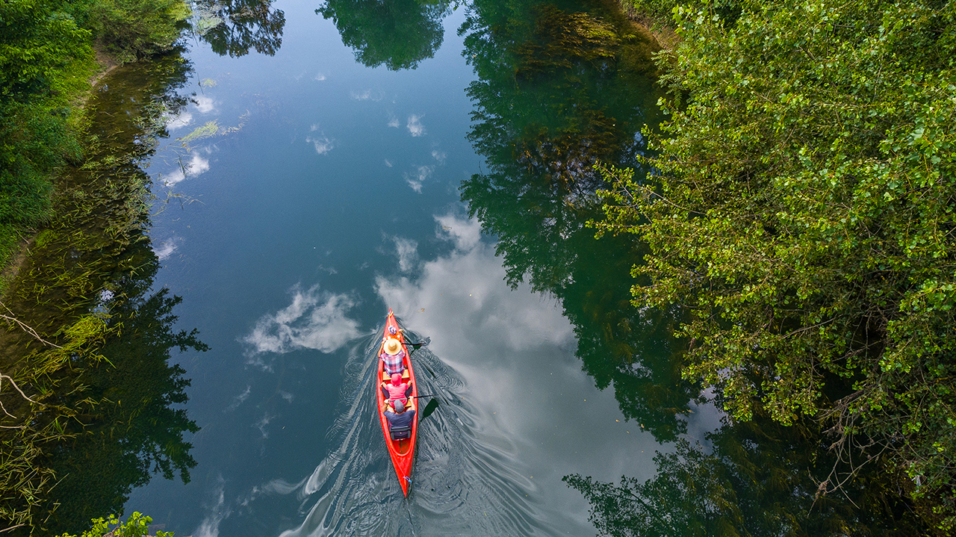
Take a tour down the RIO
https://rio.tamiu.edu
Notes:
Let’s visit our repository now and explore some of the features of RIO. The URL for our repository is easy to remember: rio.tamiu.edu
Contributing your scholarship to RIO is quick and easy. You can create an account using your email address. Your account is the same across all instances of Digital Commons; if you contribute something to another institution’s repository, you can use the same login credentials. All of your authored works are linked in your account as well.
When you’re ready to contribute your work to the repository, you can upload it via the provided form. Once submitted, we verify the metadata and RIO admins publish the work. Authors are notified when the link goes live. When the link is live, you can share your scholarship. Finally, since RIO is part of the wider Digital Commons network, it is easy to discover new content to use in your research or course.

Slide 9
What’s next for RIO
DIGITAL EXHIBITIONS
New journal
Notes:
Faculty publications
Digital exhibitions of collections

Slide 10
Contact
Eva A. Hernandez, Cataloging and Metadata Librarian
eva.hernandez@tamiu.edu

