Slide 1

How & Where to Publish
Selecting an Academic Journal to Maximize Chances for Promotion and Tenure
Dr. Kenneth Tobin
Dr. John Kilburn

Slide 2
Glenn Villenmez Scale

Slide 3
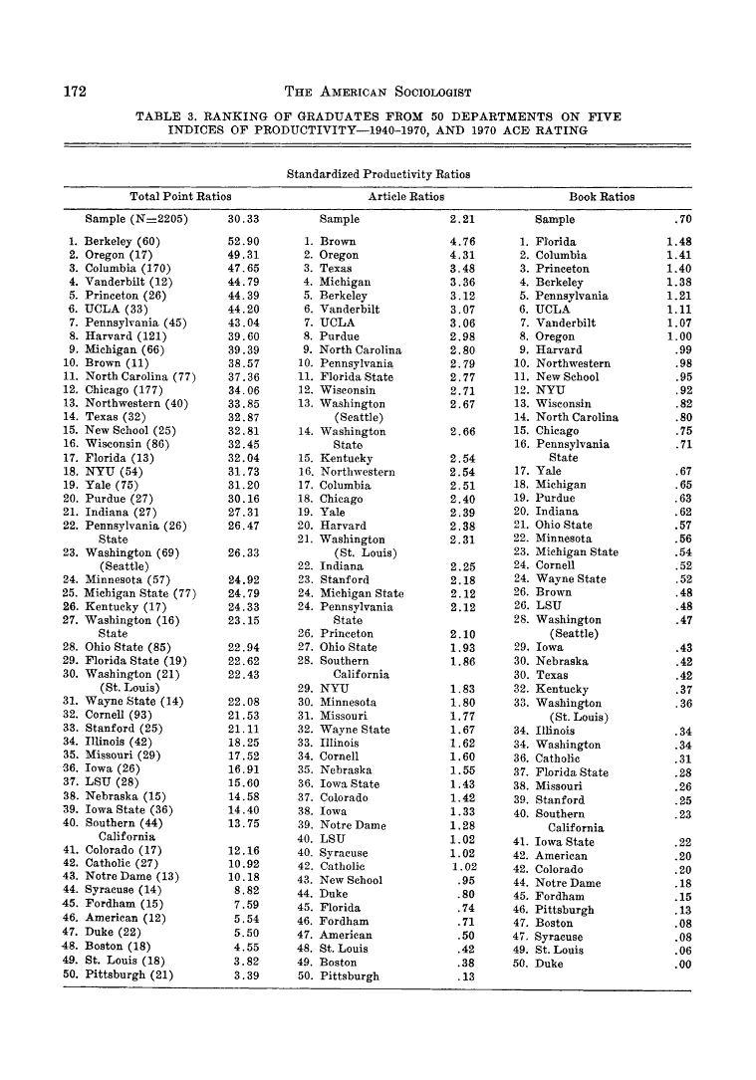
Productivity of Graduates of 50 Sociology Department https://www.jstor.org/stable/27702102?seq=4#metadata_info_tab_contents

Slide 4
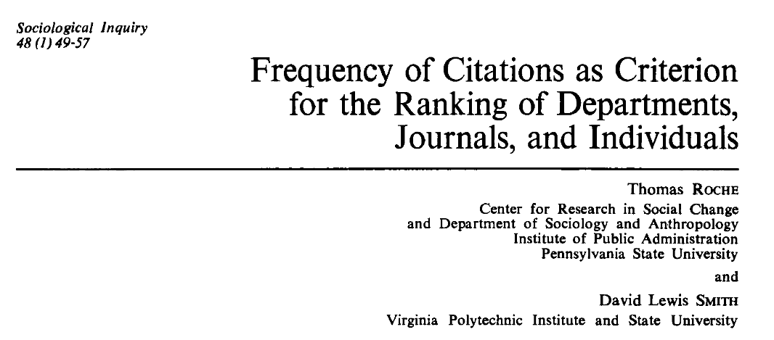

Slide 5
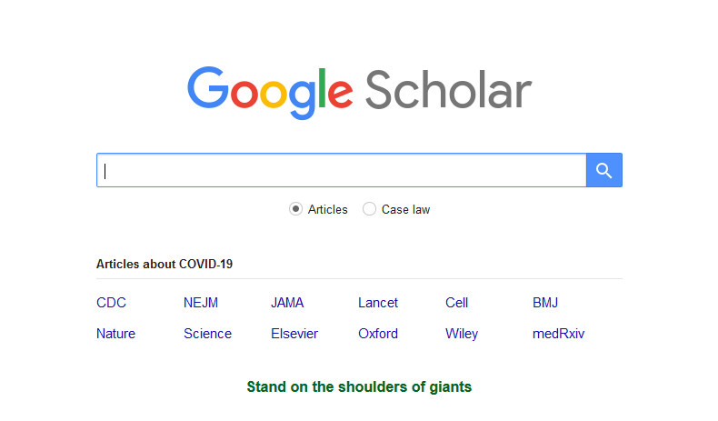

Slide 6
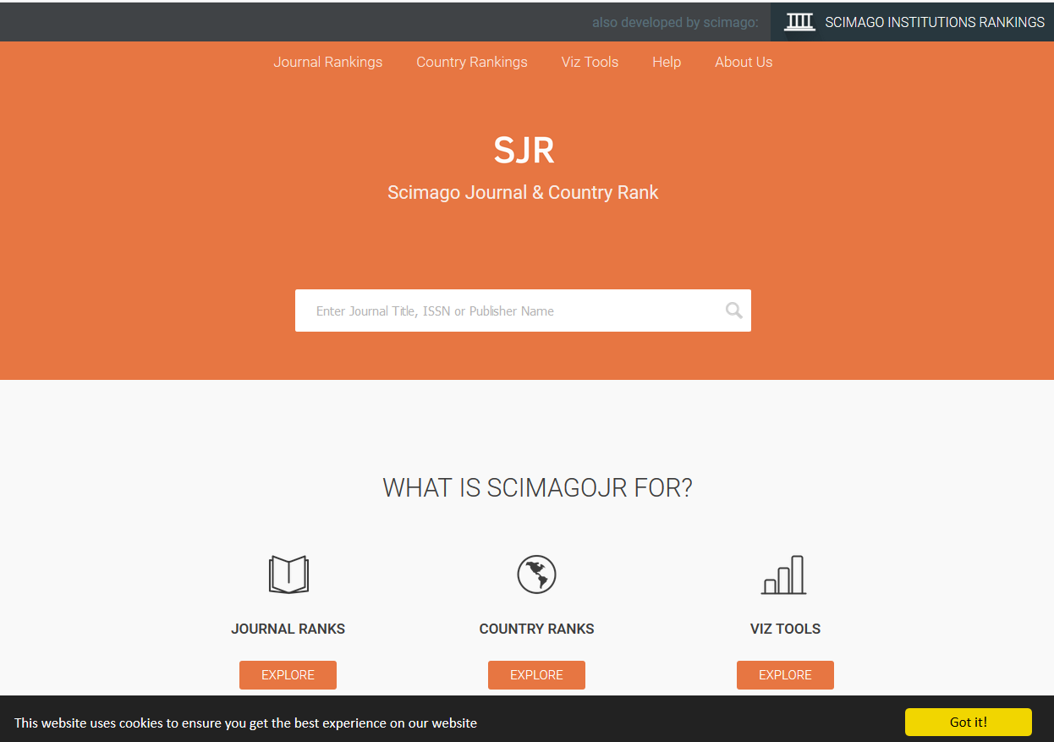

Slide 7
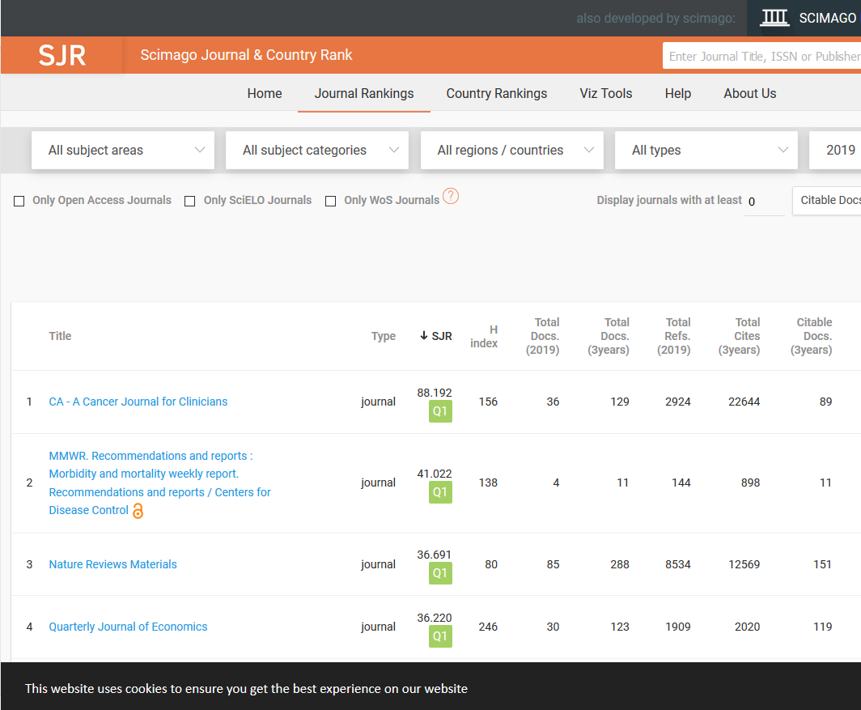
30,891 Publishing Outlets

Slide 8
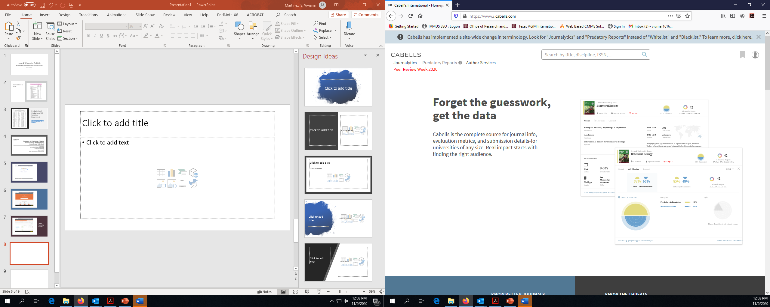
7,819 Publishing Outlets

Slide 9
Personal Comments on Faculty Evaluation (KT)
Authorship Order
  First author is generally best
  Any student authors should be clearly indicated and emphasized in any dossier or vita.
  This is supportive of the university’s QEP
  In et al. papers second and third authorship is also significant but a little less than first author works
  In et al. papers n^{th} authorship is less significant (unless it is an exceptional journal)

Slide 10
Evaluating Journals Within Your Discipline
Journal ranking within your discipline (quantile) is more important than impact factor (in my opinion - KT). Less popular fields should not be penalized.
You need to make the case that the journal you are publishing in is quality. Realize that many who are evaluating your work are probably not in your field.
Some fields publish more conferences papers. Be aware that while these conferences can be found in Scimago they tend to be more sporadically listed then conventional journals.
It always safer to publish with a well established publisher
Make sure you are publishing in a real and not fake or predatory journal

Slide 11
Journal Red Flags
By wary of publishing in new start-up journals
Look at the editorial board. Are the members well established in the field that you are publishing in.
Examine the peer review process within the journal. Is there sufficient rigor to justify this publication being called a peer review paper.
Run away from vanity journals that promise very quick publication times for a fee.
When in doubt check Scimago or a relevant journal database within you field. If the journal you are considering is not there think twice before submitting to it.

Slide 12



