Slide 1



The Soil Moisture Active/Passive (SMAP) Level 4 Surface and Root-zone Soil Moisture Product
Rolf Reichle¹, Gabrielle DeLannoy^{1,2}, and Wade Crow³
¹ NASA Goddard Space Flight Center Global Model and Assimilation Office
² University of Louvain, Louvain, Belgium
³ USDA ARS Hydrology and Remote Sensing Lab
Supported by the NASA SMAP mission and the NASA Applied Sciences Program (Water Resources)

Slide 2
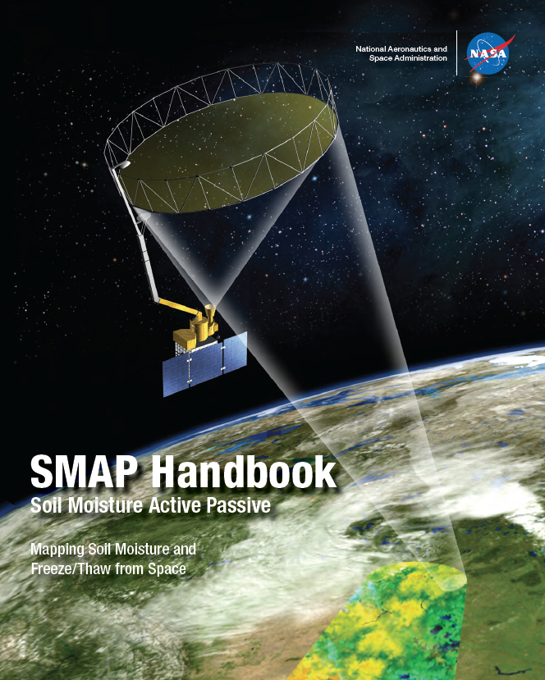
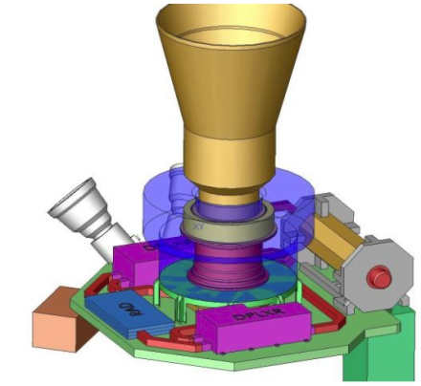
Soil Moisture Active/Passive (SMAP) Mission Concept
L-band unfocused SAR and radiometer system, offset-fed 6 m light-weight deployable mesh reflector. Shared feed for:
1.2 GHz Radar 1-3 km (30% nadir gap)
HH, VV and HV
1.4 GHz Radiometer at 40 km (-3 dB)
H, V, 3rd and 4th Stokes
Conical scan, fixed incidence angle at 40°
Contiguous 1000 km swath, 2-3 days revisit
Sun-synchronous 6am/6pm orbit (680 km)
Electronic Version at http://smap.jpl.nasa.gov/Imperative/
Print Version Available (182 Pages): smap_science@jpl.nasa.gov

Slide 3
Soil Moisture Active/Passive (SMAP) Mission Concept
L-band unfocused SAR and radiometer system, offset-fed 6 m light-weight deployable mesh reflector. Shared feed for:
1.2 GHz Radar 1-3 km (30% nadir gap)
HH, VV and HV
1.4 GHz Radiometer at 40 km (-3 dB)
H, V, 3rd and 4th Stokes
Conical scan, fixed incidence angle at 40°
Contiguous 1000 km swath, 2-3 days revisit
Sun-synchronous 6am/6pm orbit (680 km)
Electronic Version at http://smap.jpl.nasa.gov/Imperative/
Print Version Available (182 Pages): smap_science@jpl.nasa.gov

Slide 4
Soil Moisture Active/Passive (SMAP) Mission Concept
L-band unfocused SAR and radiometer system, offset-fed 6 m light-weight deployable mesh reflector. Shared feed for:
1.2 GHz Radar 1-3 km (30% nadir gap)
HH, VV and HV
1.4 GHz Radiometer at 40 km (-3 dB)
H, V, 3rd and 4th Stokes
Conical scan, fixed incidence angle at 40°
Contiguous 1000 km swath, 2-3 days revisit
Sun-synchronous 6am/6pm orbit (680 km)
Electronic Version at http://smap.jpl.nasa.gov/Imperative/
Print Version Available (182 Pages): smap_science@jpl.nasa.gov

Slide 5
Soil Moisture Active/Passive (SMAP) Mission Concept
L-band unfocused SAR and radiometer system, offset-fed 6 m light-weight deployable mesh reflector. Shared feed for:
1.2 GHz Radar 1-3 km (30% nadir gap)
HH, VV and HV
1.4 GHz Radiometer at 40 km (-3 dB)
H, V, 3rd and 4th Stokes
Conical scan, fixed incidence angle at 40°
Contiguous 1000 km swath, 2-3 days revisit
Sun-synchronous 6am/6pm orbit (680 km)
Electronic Version at http://smap.jpl.nasa.gov/Imperative/
Print Version Available (182 Pages): smap_science@jpl.nasa.gov

Slide 6

SMAP Launch: January 31, 2015

Slide 7
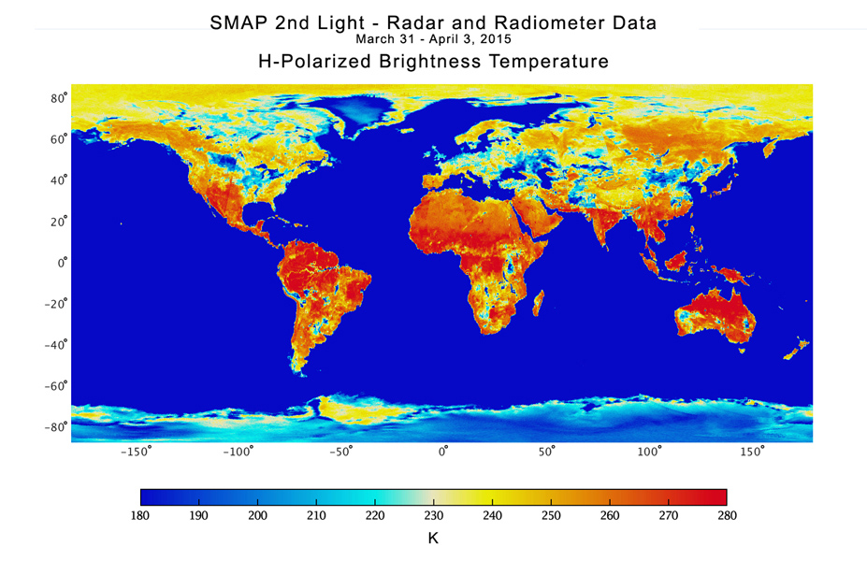
First SMAP Measurements
http://smap.jpl.nasa.gov/news/1246/

Slide 8
SMAP Data Product Table
Current SMAP Data Product Summary
Data Product | Data Product Description | Gridding/ Resolution
L1A_Radiometer | Radiometer Data in Time-Order | -
L1B_TB | Radiometer T_{B} in Time-Order | (36×47 km)
L1C_TB | Radiometer T_{B} in Half-Orbits | 36 km
L1C_TB_E | Radiometer T_{B} in Half-Orbits, Enhanced | 9 km
L2_SM_P | Soil Moisture (Radiometer) | 36 km
L2_SM_P_E | Soil Moisture (Radiometer, Enhanced) | 9 km
L2_SM_SP | Soil Moisture (Sentinel Radar + Radiometer) | 3 km
L3_FT_P | Freeze/Thaw State (Radiometer) | 36 km
L3_FT_P_E | Freeze/Thaw State (Radiometer, Enhanced) | 9 km
L3_SM_P | Soil Moisture (Radiometer) | 36 km
L3_SM_P_E | Soil Moisture (Radiometer, Enhanced) | 9 km
L4_SM | Soil Moisture (Surface and Root Zone) | 9 km
L4_C | Carbon Net Ecosystem Exchange (NEE) | 9 km

Slide 9
Background/Motivation
Soil moisture data assimilation: Updating dynamic and continuous model state predictions (dS/dt) using sporadic soil moisture observations (θ).
In its most common form:
S = Profile soil moisture and temperature states within a land surface model.
θ = Surface soil moisture retrievals from a satellite-based radar or radiometer.
Motivation:
Provides a spatially and temporally continuous soil moisture analysis.
Random errors in analysis ≤ those found in underlying model/observations.
Provides a mathematical basis for updating unobserved states.
Example system: The NASA Soil Moisture Active/Passive (SMAP) Level 4 (L4) Surface and Root-zone Soil Moisture Product.

Slide 10
Background/Motivation
Soil moisture data assimilation: Updating dynamic and continuous model state predictions (dS/dt) using sporadic soil moisture observations (θ).
In its most common form:
S = Profile soil moisture and temperature states within a land surface model.
θ = Surface soil moisture retrievals from a satellite-based radar or radiometer.
Motivation:
Provides a spatially and temporally continuous soil moisture analysis.
Random errors in analysis ≤ those found in underlying model/observations.
Provides a mathematical basis for updating unobserved states.
Example system: The NASA Soil Moisture Active/Passive (SMAP) Level 4 (L4) Surface and Root-zone Soil Moisture Product

Slide 11
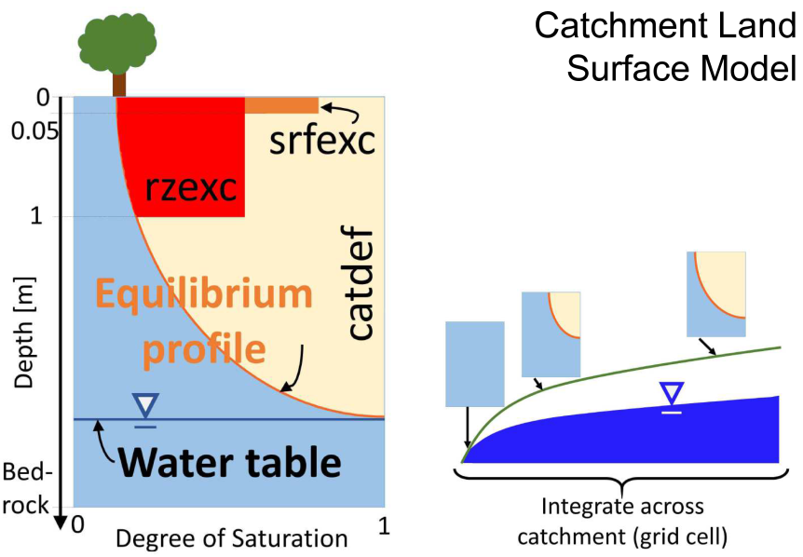
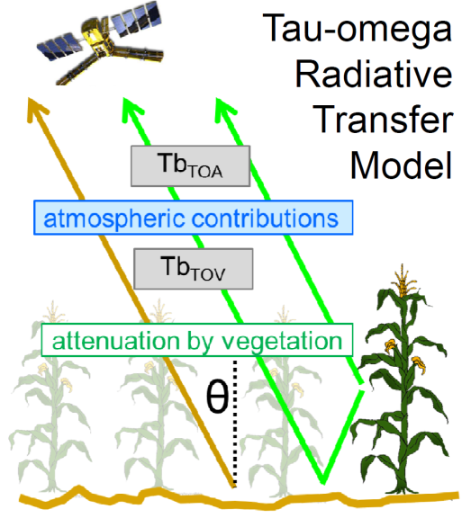
SMAP L4 Surface and Root-Zone Soil Moisture Example
Land Surface Model

Slide 12
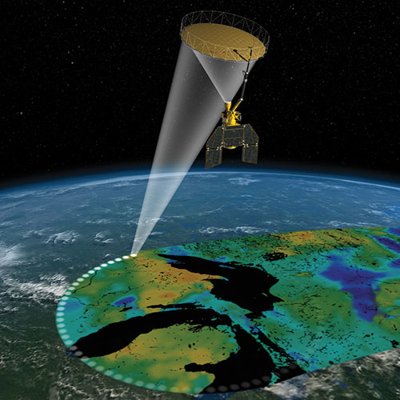
SMAP L4 Surface and Root-Zone Soil Moisture Example
Land Surface Model
SMAP Satellite
Compare

Slide 13
SMAP L4 Surface and Root-Zone Soil Moisture Example
Land Surface Model
Update all moisture and temperate states in model, not just those directly impacting SMAP measurements
Update
SMAP Satellite
Compare

Slide 14
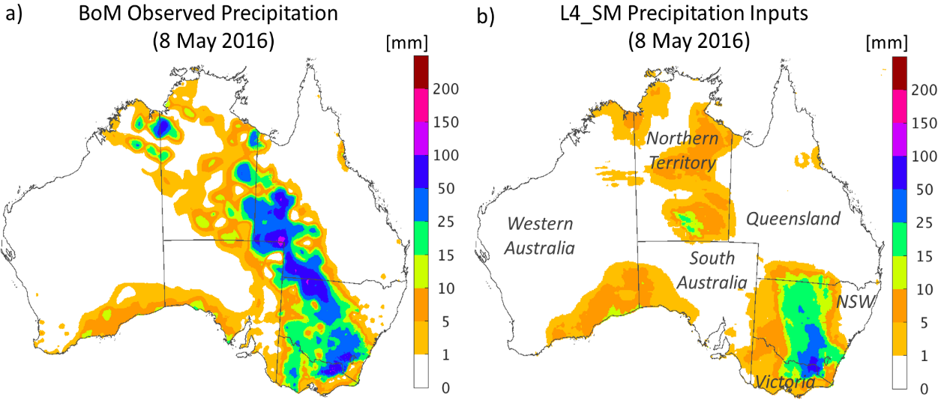
SMAP L4 Surface and Root-Zone Soil Moisture Example
Benchmark rainfall (available > 1 week later)
Near real-time rainfall

Slide 15

SMAP L4 Surface and Root-Zone Soil Moisture Example
Benchmark rainfall (available > 1 week later)
Near real-time rainfall
Brightness temperature differences (SMAP minus model)

Slide 16
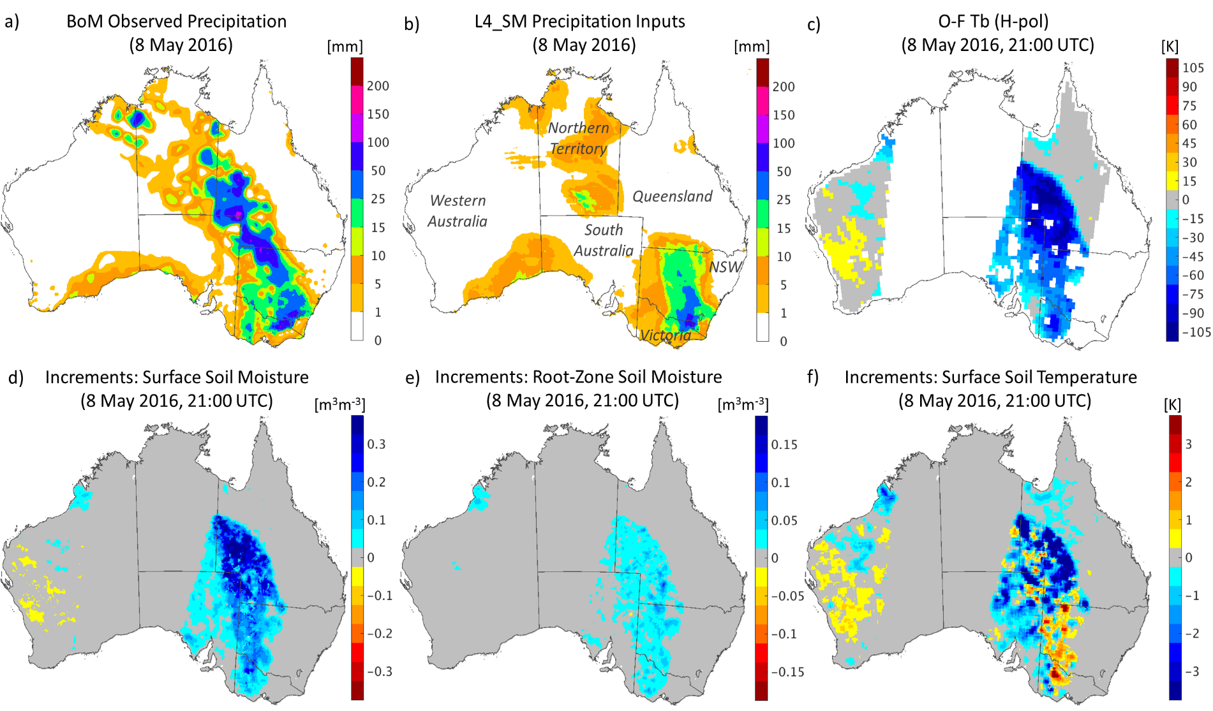
SMAP L4 Surface and Root-Zone Soil Moisture Example
Dynamic corrections to model states in response to observations

Slide 17
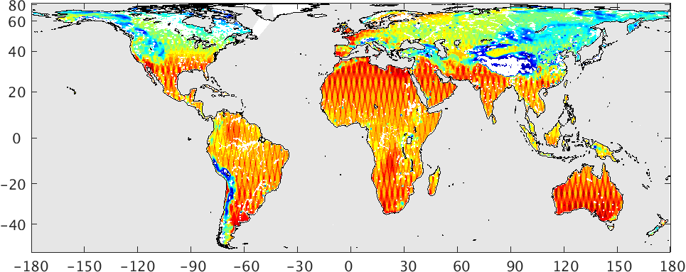
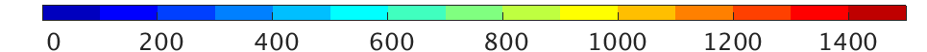
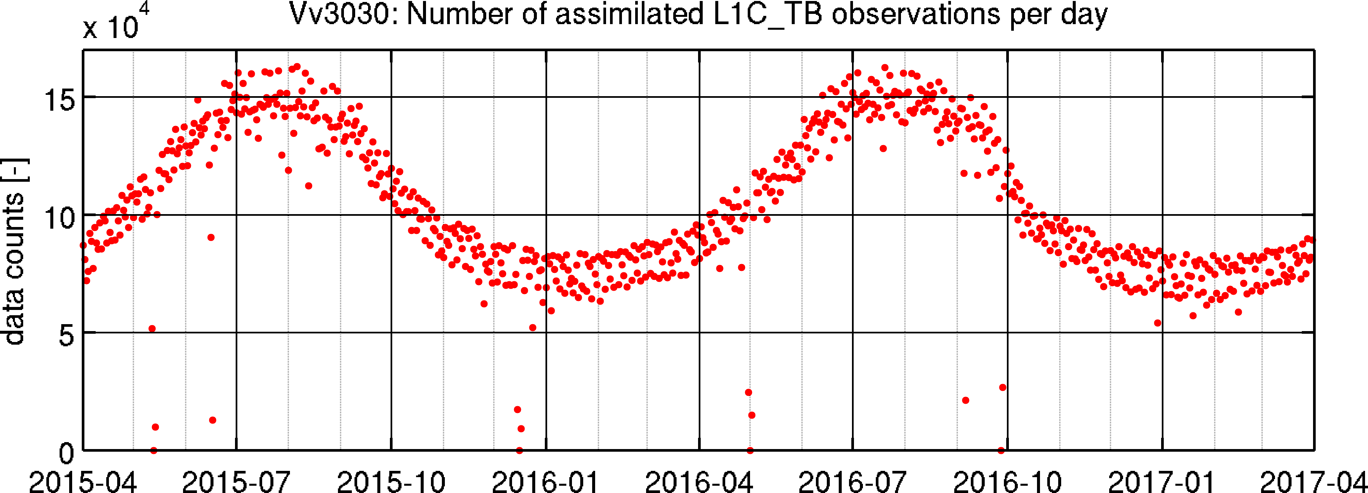
SMAP L4 Surface and Root-Zone Soil Moisture Example
  # assimilated obs. (4/2015 – 3/2017)
  Average:
  104,000 / day
9-km, hourly product, available since March 31, 2015 at ~2 to 3 day latency, output includes a wide range of land surface fluxes and states (ET, soil temperature, runoff, etc.)

Slide 18
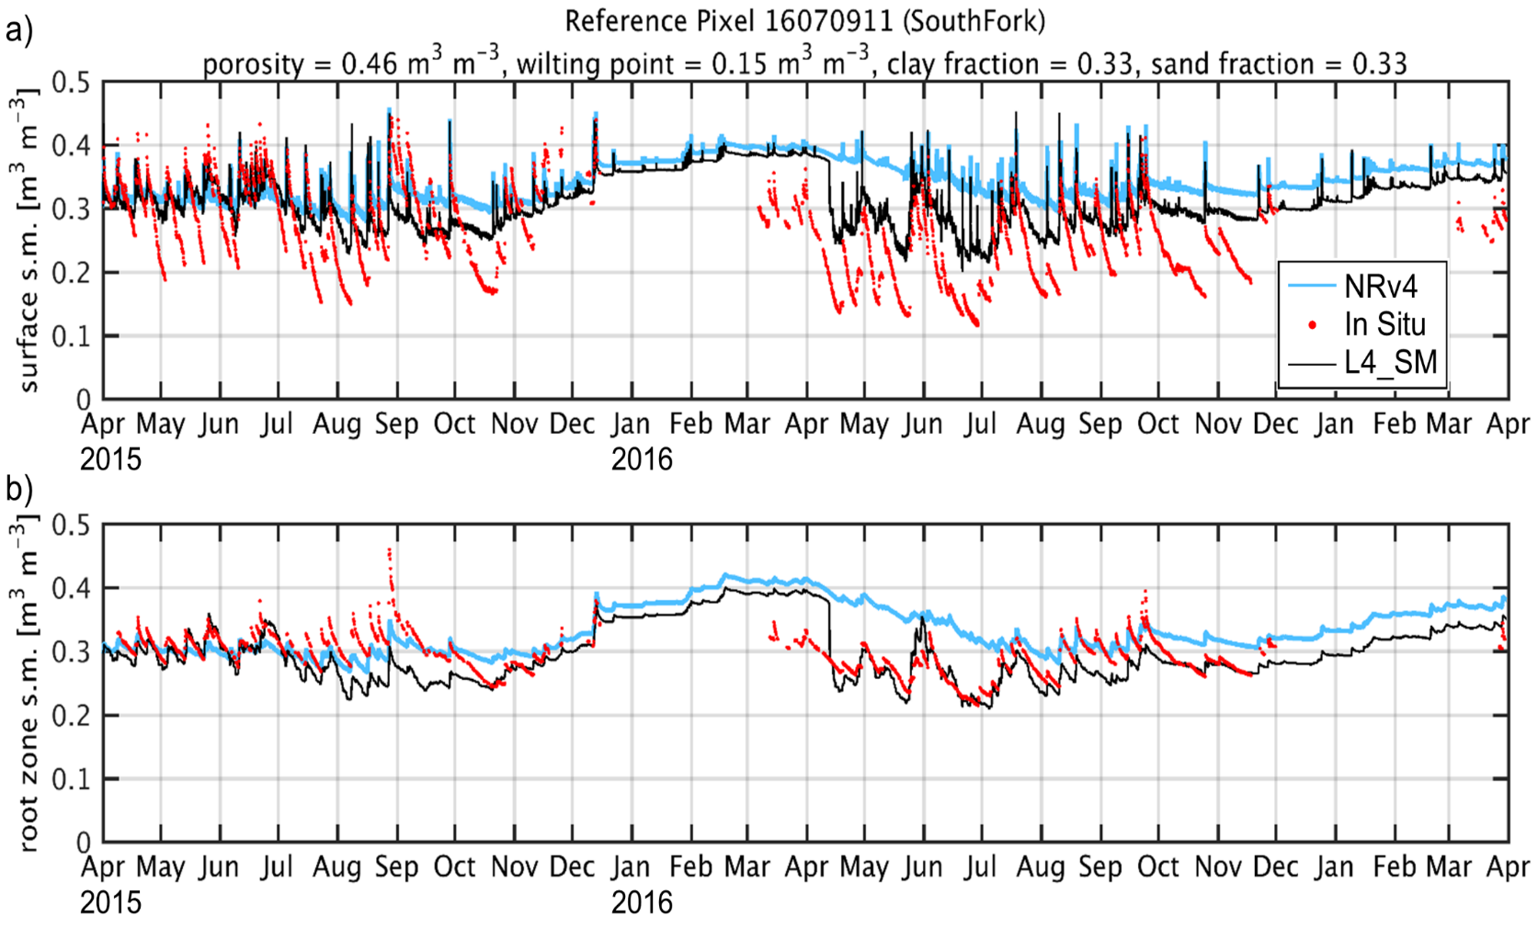
SMAP L4 Surface and Root-Zone Soil Moisture Example
Blue = Model, Red = Ground Obs., Black = SMAP L4

Slide 19
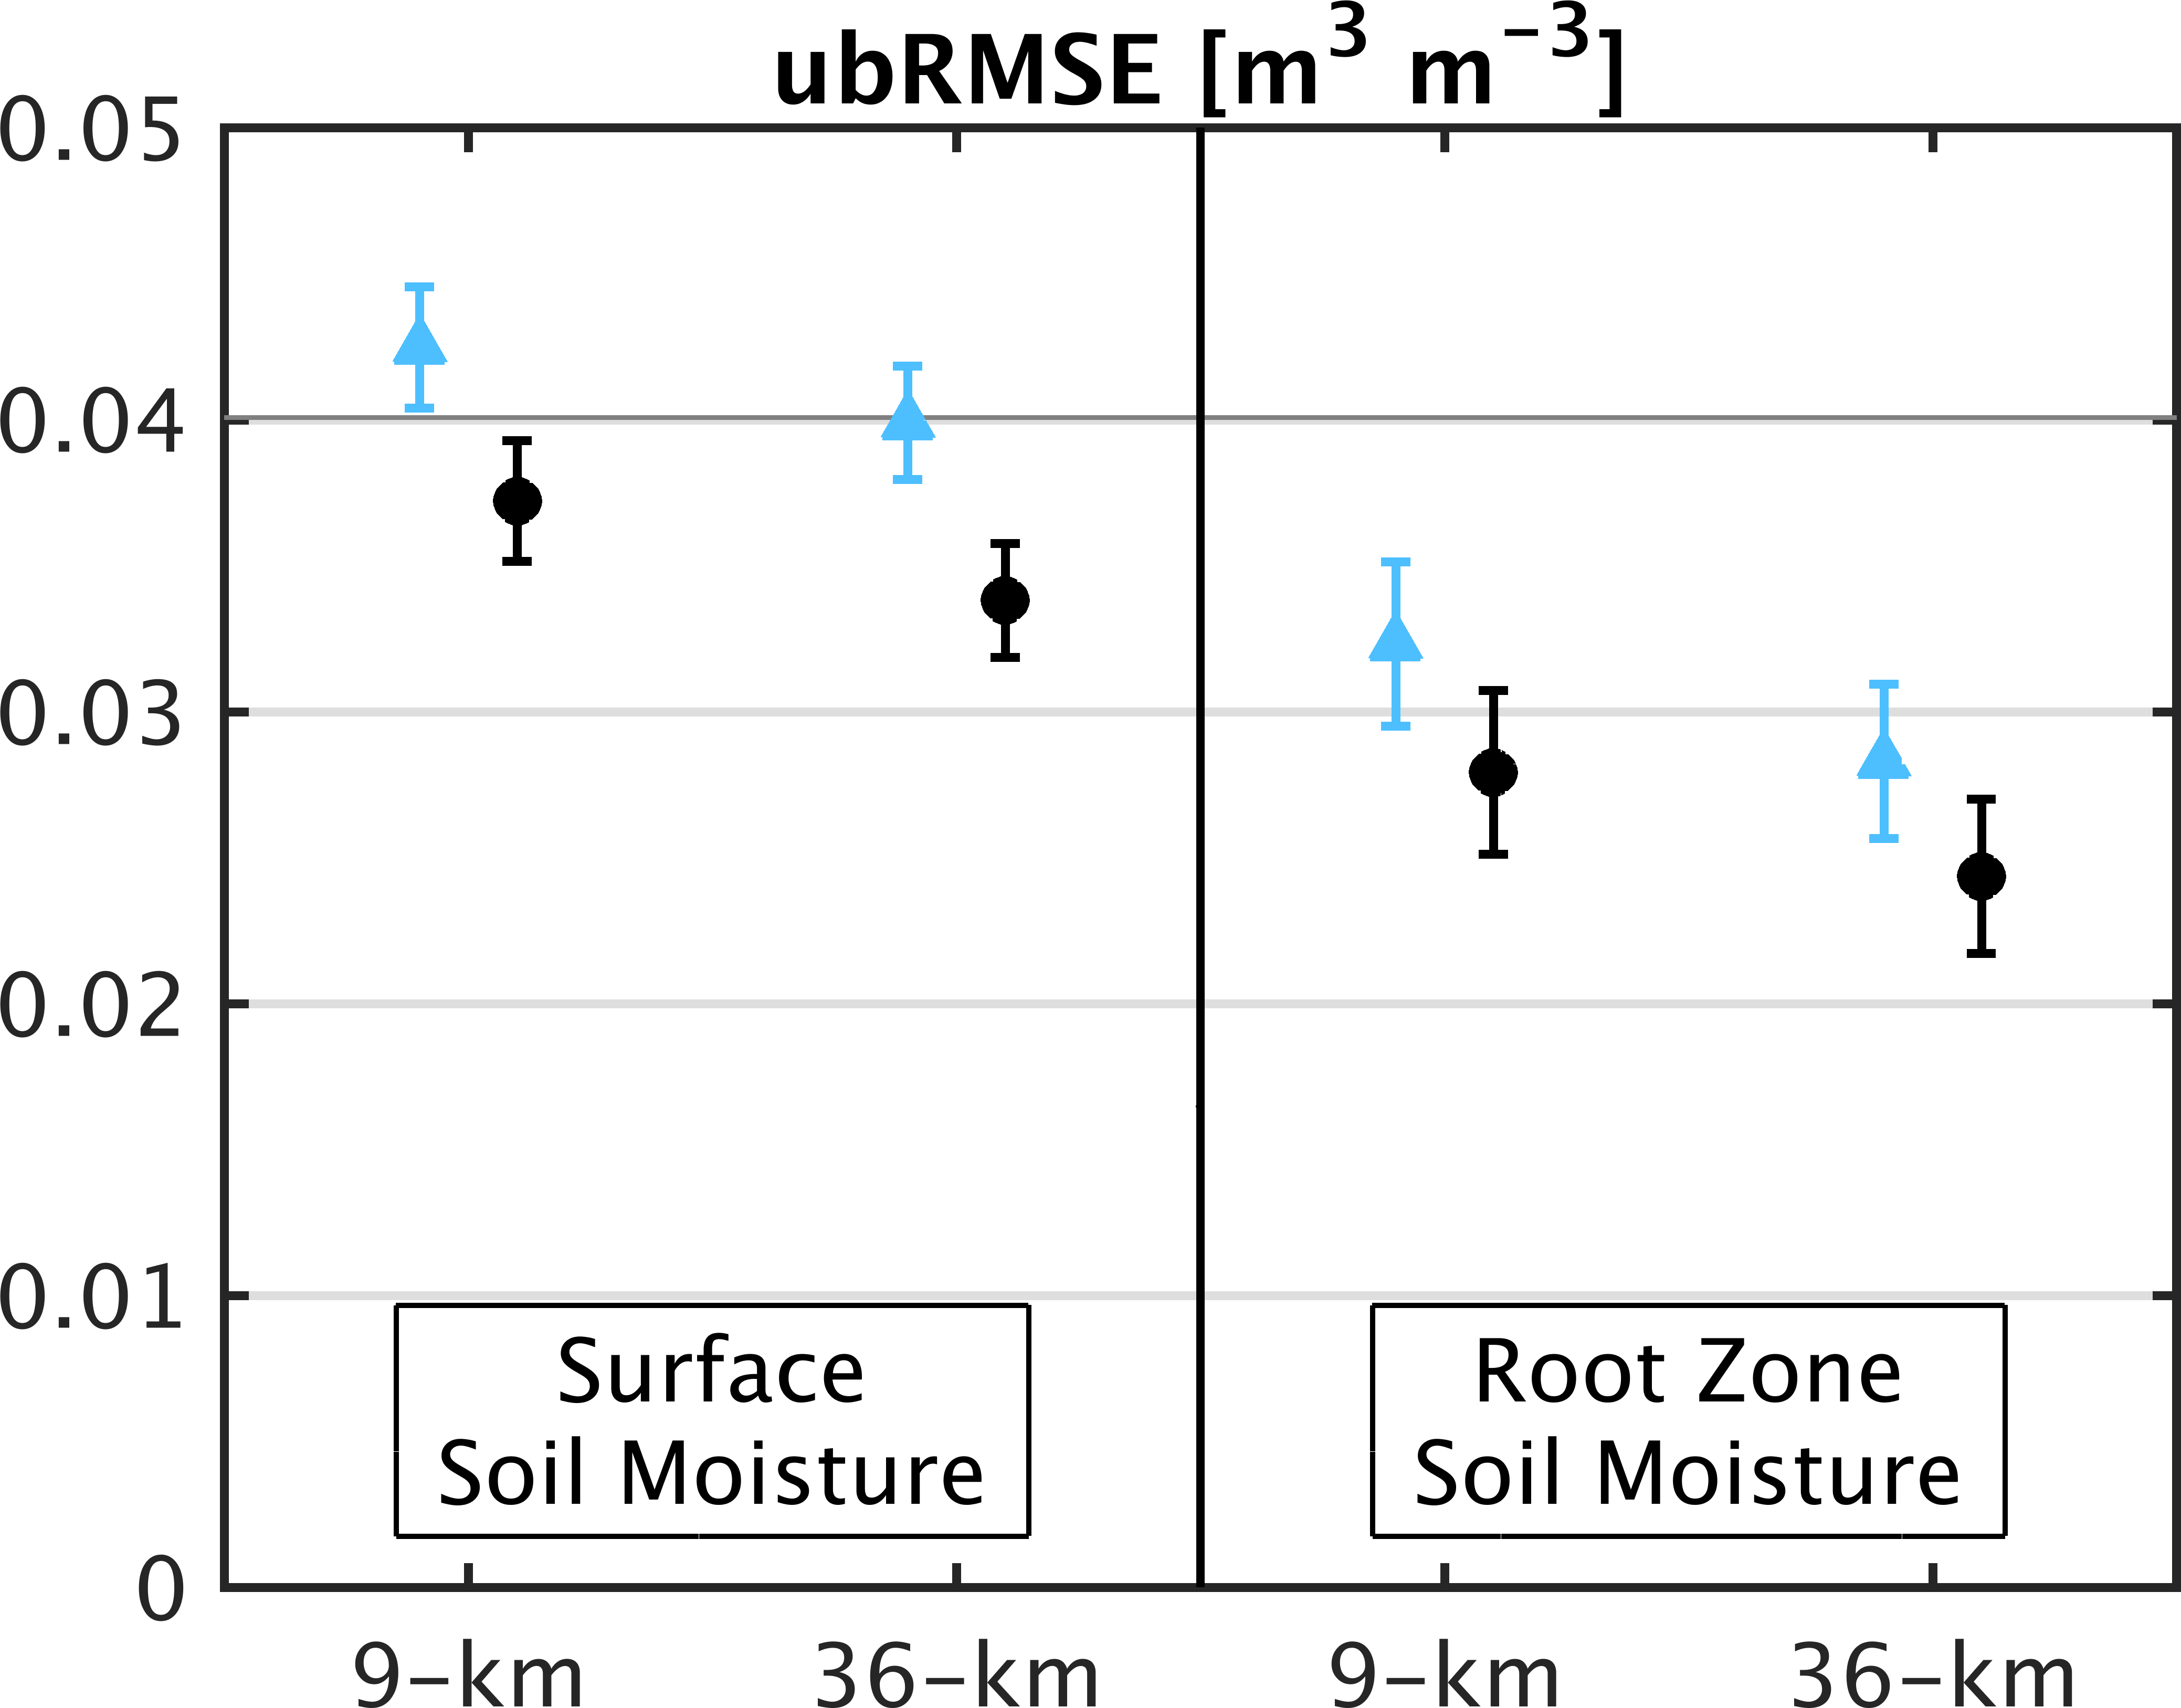
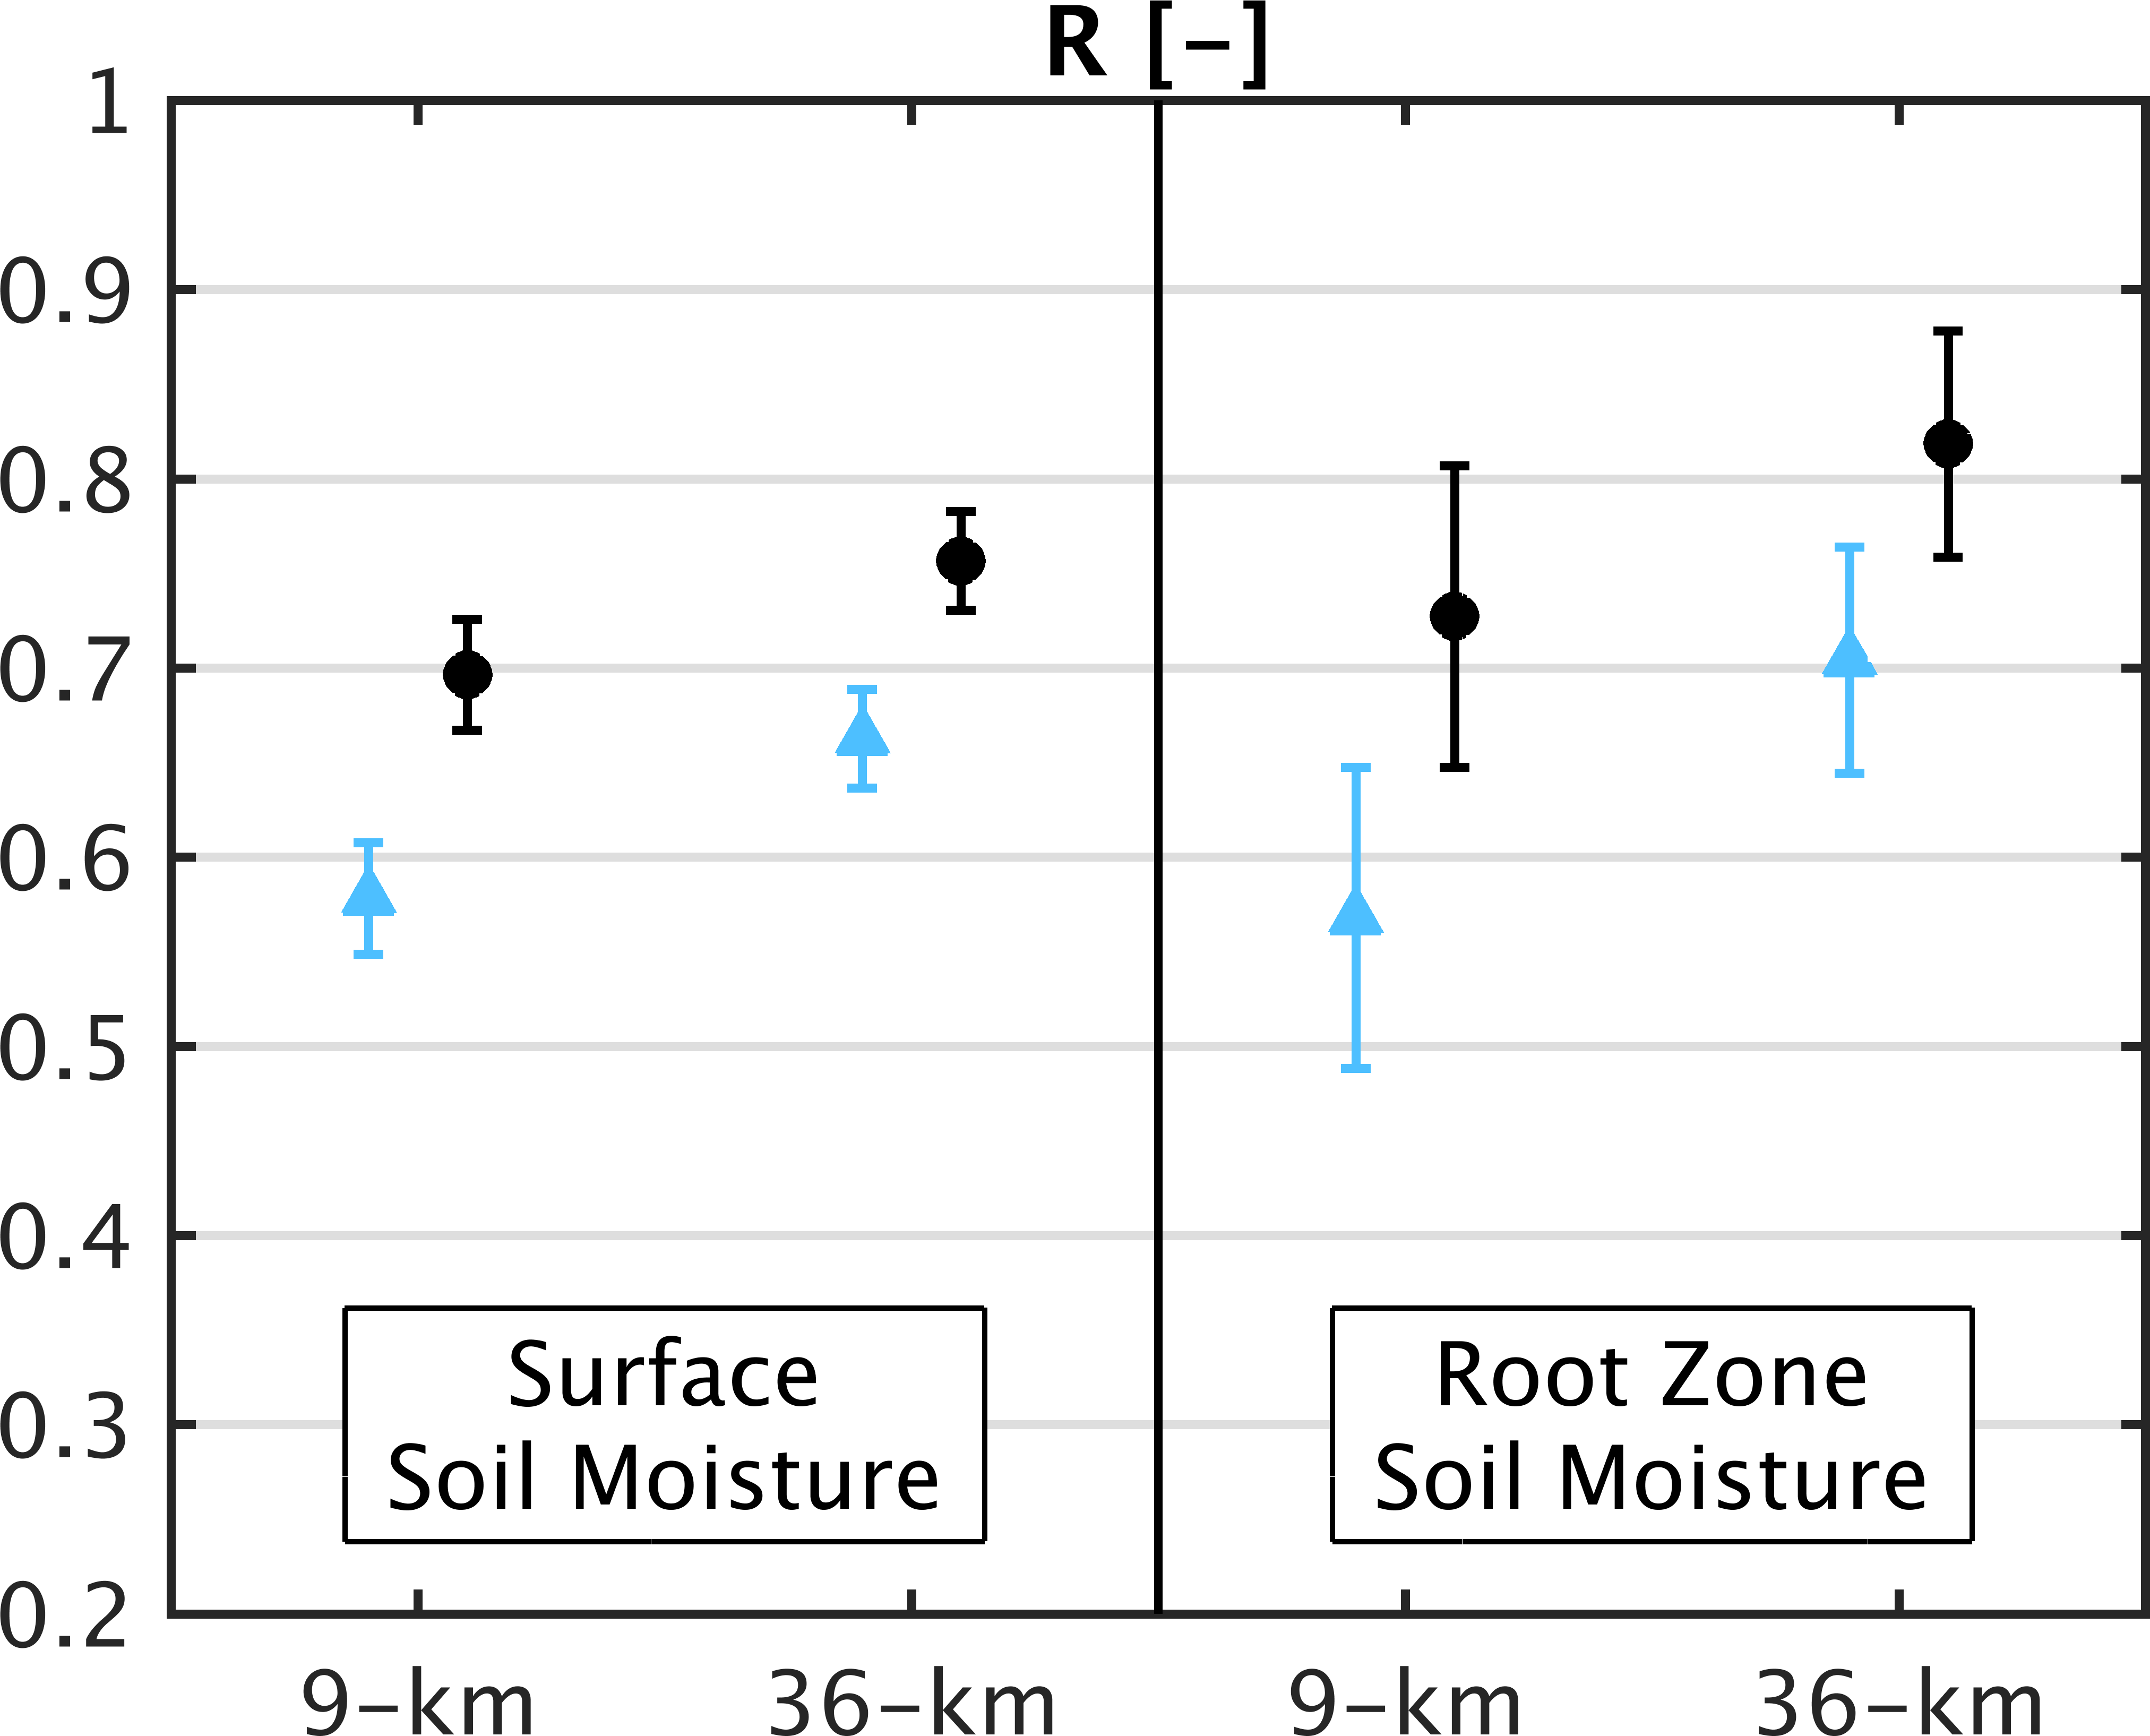
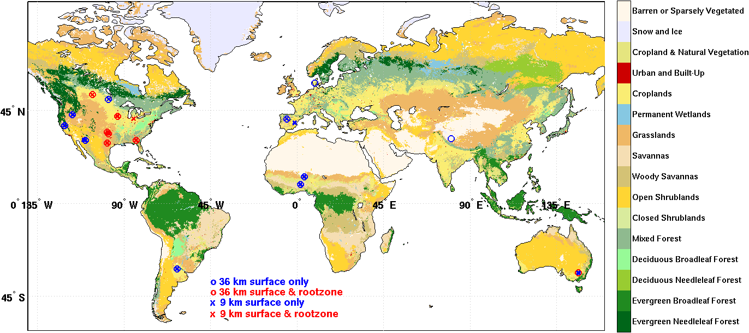
SMAP L4 Validation at SMAP Ground Core Sites
Blue = Model, Black = SMAP L4
SMAP core validation sites

Slide 20
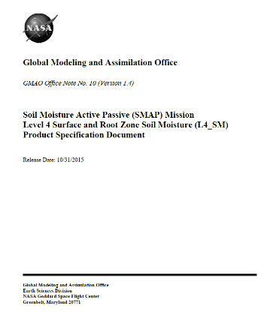
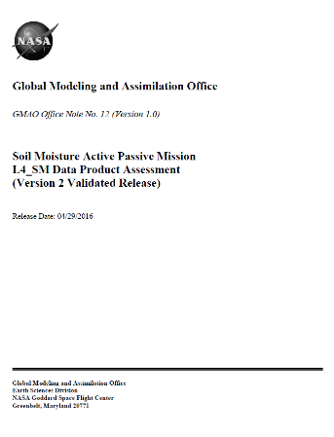
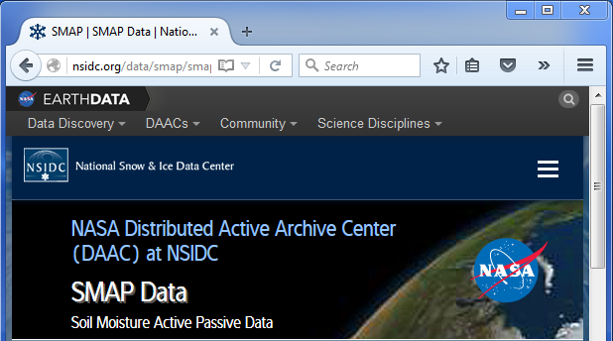
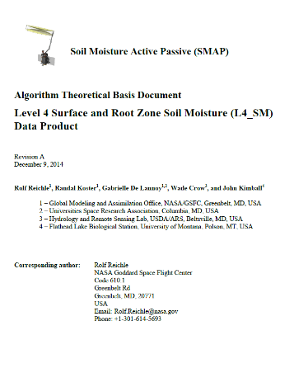
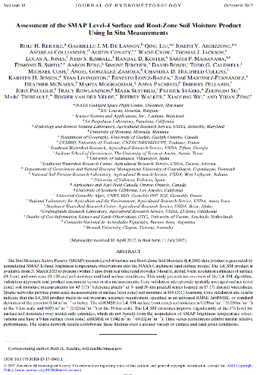
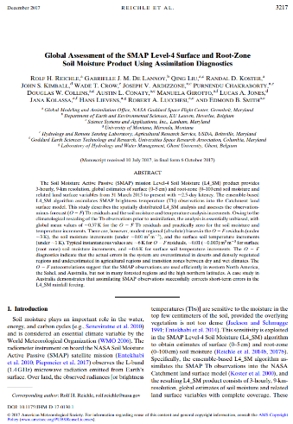
SMAP L4 Documentation
Data Archive & HTML Doc
http://nsidc.org/data/smap
Product Specification Document
Data Assessment Reports
Algorithm Document
Peer-Reviewed Papers
(J. Hydromet.)
9-km, global land hourly product available since March 31, 2015 at ~2 to 3 day latency
10.1175/JHM-D-17-0063.1
10.1175/JHM-D-17-0130.1

Slide 21
Sequential data assimilation (SMAP_L4) versus post-processing merging (SMERGE)
Sequential data assimilation:
1) Captures hourly/daily dynamics better.
2) Can estimate fluxes and states which are indirectly related to the observations.
Can horizontally-extrapolating spatially-discontinuous observations.
Computationally expensive for long-term products (1979-2015 SMERGE reprocessing would take on the order of ~1 year if run on single processor).
Labor consuming to develop and test systems (SMAP_L4 system took > 5 FTE’s to develop).
Han et al., HESS (2014) and Gruber et al., RSE (2017) argue that advantages #1 to #3 above do measurably add to the value of a root-zone soil moisture analysis for monthly agricultural drought monitoring
Therefore, SMERGE post-processing is: i) 100x faster to run, ii) 5x faster to develop and iii) likely as useful for agricultural drought applications.
SMERGE and NASA SMAP_L4 integration will be explored (once we have sufficient overlap)…

Slide 22
Thank you…
Han, E., Crow, W.T., Holmes, T. and Bolten, J.D. Benchmarking a soil moisture data assimilation system for agricultural drought monitoring. Journal of Hydrometeorology. 15:1117-1134. 10.1175/JHM-D-13-0125.1. 2014.
Gruber, A. and Crow, W.T. The potential of 2D Kalman filtering for soil moisture data assimilation, Remote Sensing of Environment. 171:137-148. 10.1016/j.rse.2015.10.019. 2015.
Reichle, R. et al. Assessment of the SMAP Level-4 Surface and Root-Zone Soil Moisture Product using in situ measurements. Journal of Hydrometeorology. 18(10):2621-2645. 10.1175/JHM-D-17-0063.1. 2017.
Reichle, R. et al. Global assessment of the SMAP Level-4 surface and root-zone soil moisture product using assimilation diagnostics. Journal of Hydrometeorology. 18(12):3217-3237. 10.1175/JHM-D-17-0130.1. 2017.

Slide 23
SMAP L4 Surface and Root-Zone Soil Moisture Example
Land Surface Model
Update all moisture and temperate states in model, not just those directly impacting SMAP measurements
Update
SMAP Satellite
Compare

Slide 24
SMAP L4 Surface and Root-Zone Soil Moisture Example
Land Surface Model
Update all moisture and temperate states in model, not just those directly impacting SMAP measurements
BAD
Update
SMAP Satellite
Compare
GOOD

Slide 25
SMAP L4 Surface and Root-Zone Soil Moisture Example
Land Surface Model
Update all moisture and temperate states in model, not just those directly impacting SMAP measurements
GOOD
Update
SMAP Satellite
Compare
BAD

