Slide 1
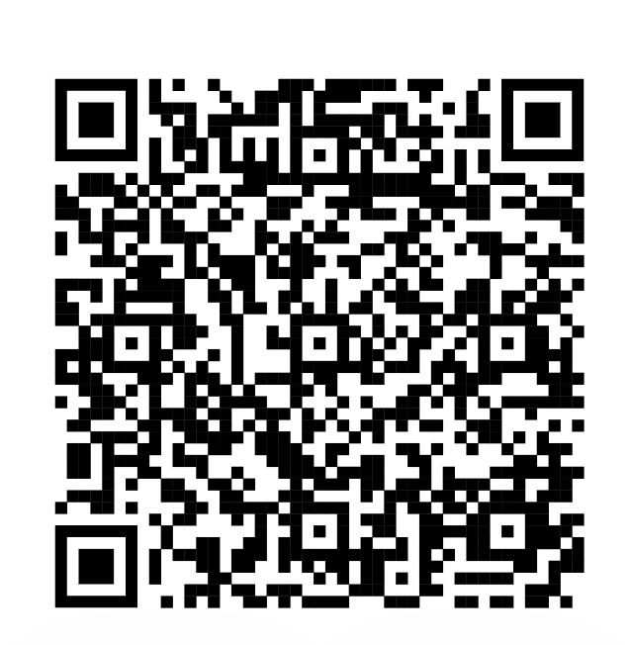

Slide 7
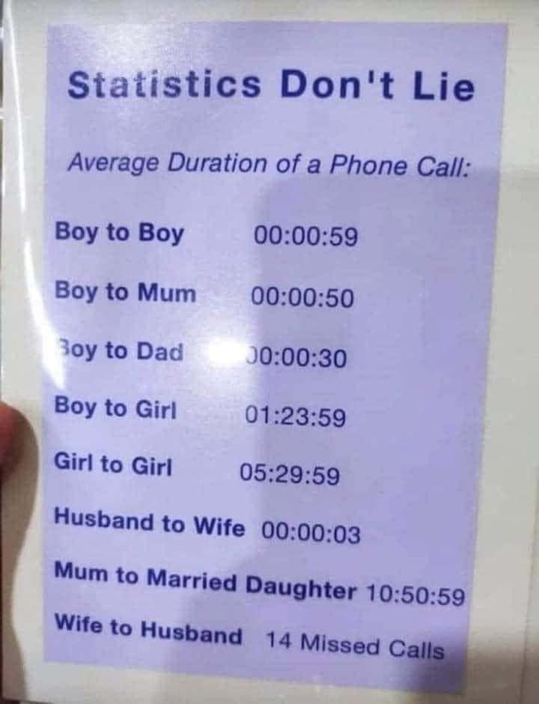

Slide 12
Statistics in the Research Process
Chapter 1

Slide 13
There are three kinds of lies:
lies, damned lies, and statistics
~ Benjamin Disraeli (1804 – 1881)

Slide 16
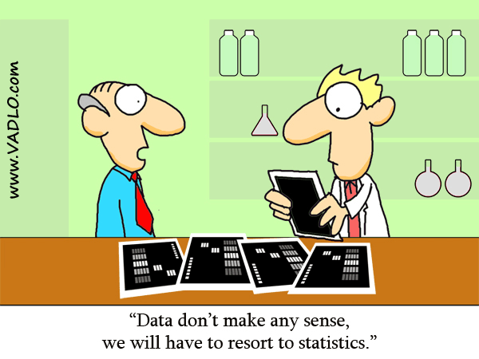

Slide 17
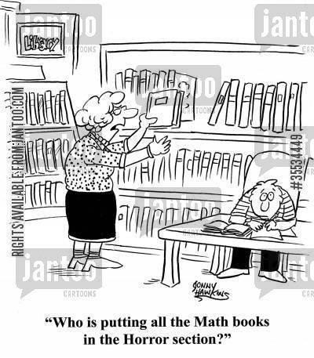

Slide 19
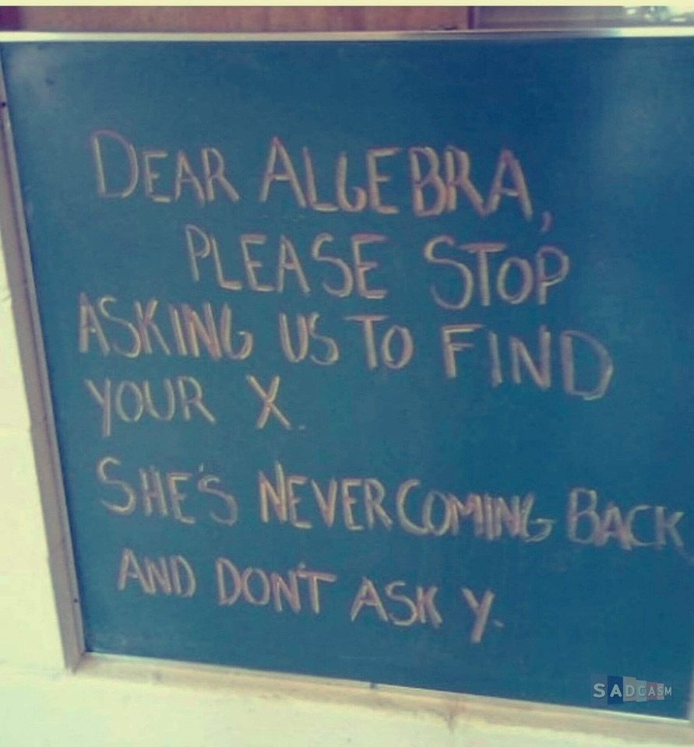

Slide 20
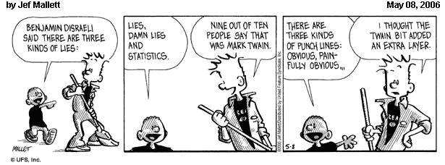

Slide 21
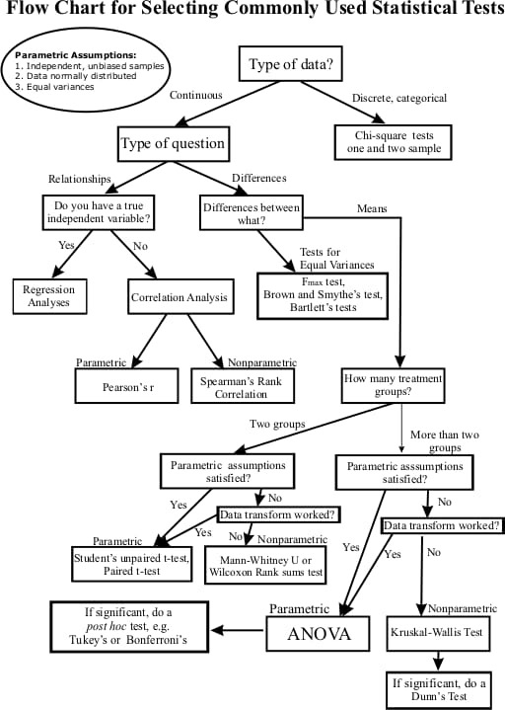

Slide 22
https://cloud.jamovi.org/ (Access jamovi from your browser)
https://www.jamovi.org/ (Access javmovi’s website)

Slide 24
Chapter Outline
What are Statistics?
Basic Concepts
Theory and Research
Statistics and Research
Kinds of Variables
Assumptions Underlying Statistical Procedures
Levels of Measurement

Slide 25
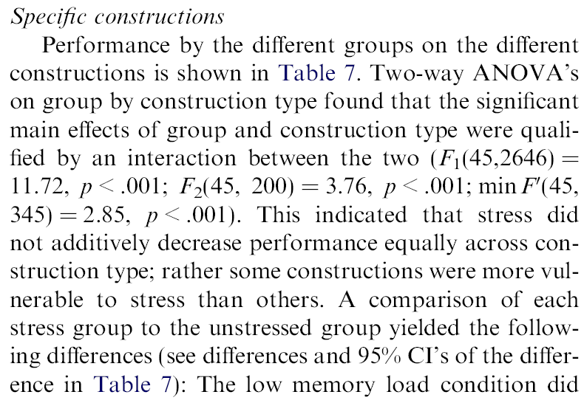
Why Learn Statistics?
Understand research articles
Help you on your own research
Improve your reasoning and intuition
Better consumer of science

Slide 26
What are Statistics?
Branch of applied mathematics focusing on the organization, analysis, and interpretation of a group of numbers or large amounts of data
Two Main Branches of Statistics
Descriptive statistics:
Summarize a group of numbers from a research study.
The numerical, graphic, and tabular descriptions or output of collected data

Slide 27
EXCELLENT
ECONOMY
BAD
ECONOMY
0 Abortions
100 Abortions

Slide 28
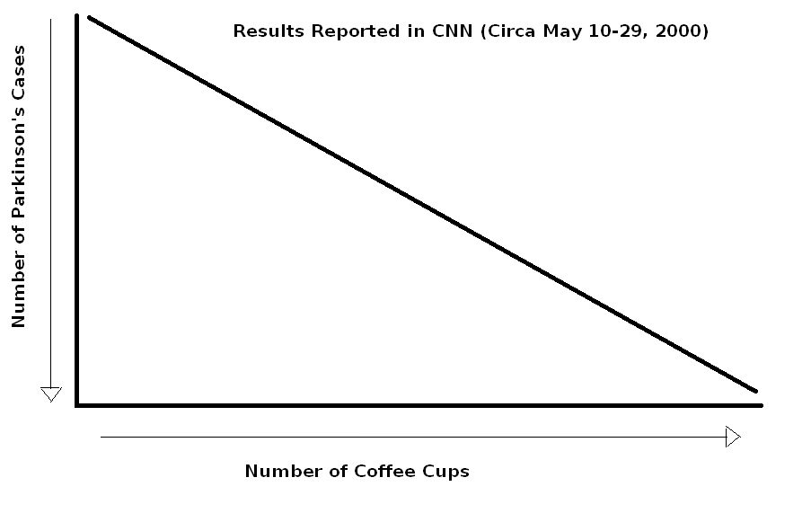

Slide 29
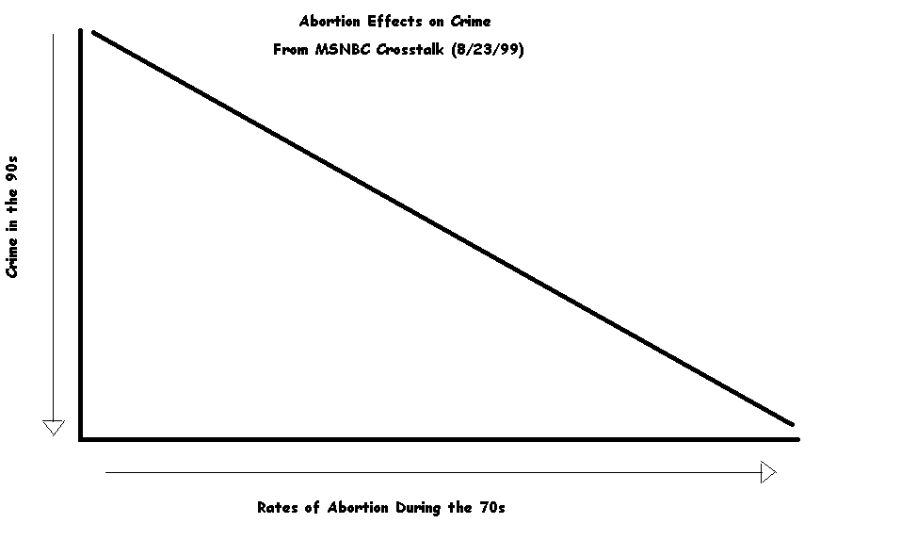

Slide 30
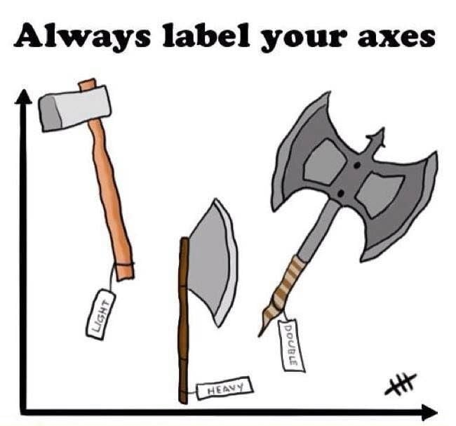

Slide 31
What are Statistics?
Inferential statistics:
Methods and procedures for drawing conclusions, make inferences based on scores collected in a research study and going beyond them
Generalize from sample to population
Samples (statistics) vs. Populations (Parameters: Unknown)
Statistics is the TESTS (t-est, Z-test) that can be used to analyze collected data.

Slide 32
Populations and Samples
Population
Total set of subjects of interest (ALL TAMIU students)
Sample
Representative subset of the population on which the study collects data
(n = 45 students chosen at random)
Population (parameters)
Sample (statistics)

Slide 33
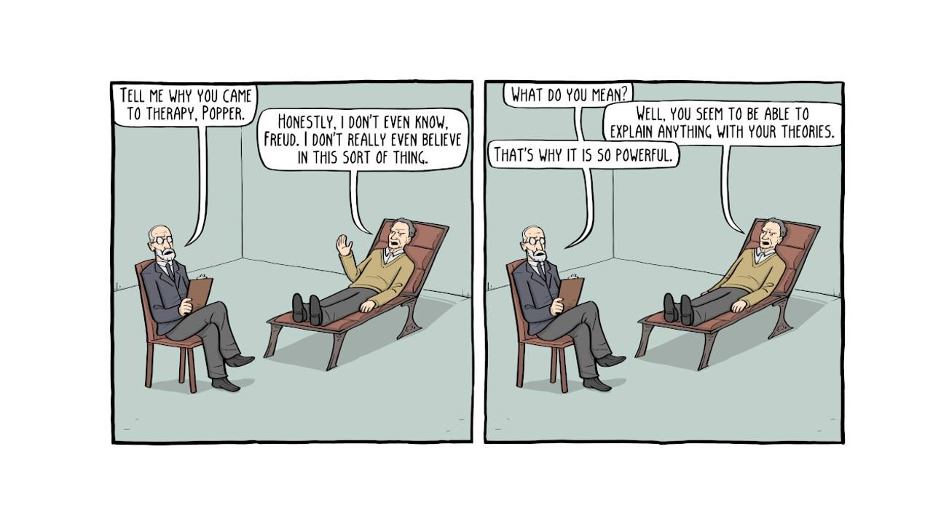
Theory and Research
Theory: Organized system of assumptions/ principles that attempts to explain certain phenomena and how they are related
Guides Research
Karl Popper: Look! Look!
Frames of Reference: Ways of looking at research questions/problems/ Motivation
Hypothesis: Prediction

Slide 34
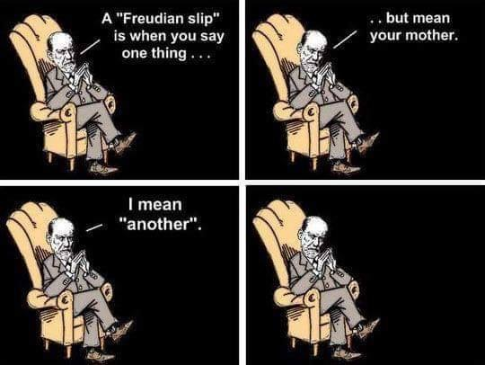

Slide 35
Variables
Variable
Characteristic/condition that can have different values
Gender, Ethnicity, Religiosity
Value
possible number or category a score can have
Rating scale: 1-10; Gender: F vs. M; F = 1 vs. M = 0
Score
A particular person’s value
e.g., values on a test, 70, 80, 90.

Slide 36
Variables
Discrete (nominal, Qualitative variable):
Fixed values (categorical, subcategories)
Religion: (Catholic, Protestant)
Political party: (Republican, Democrat, Independent)
Gender: Male, Female
Numbers no numerical value: Male = 1, Female = 2
Continuous (numeric, quantitative variable)
Infinite or unlimited values
Age: In years, 2.3 years old, 3.5 days old child

Slide 37
Discrete and Continuous Variables
Discrete and Quantitative!!!
Variables that only take on values from a set of separate numbers
Number of crimes committed
(can you have1.5 or 1.8 crimes)
Number of elections previously voted in
(Voted 1.5 times?)
Number of children
(Household = 1.5 children/family)

Slide 38
Assumptions Underlying Statistical Procedures
Randomization
Random selection
Random assignment
Sample size

Slide 39
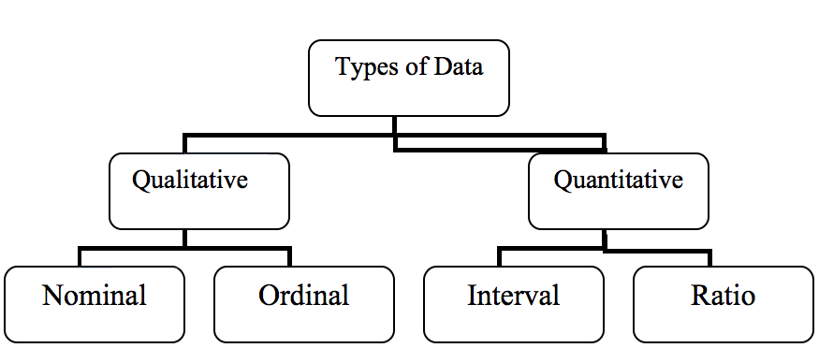
Scales or Levels Measurement
Nominal: variable in which values are categories
(e.g., gender, religion, ethnicity)
Ordinal (Rank-order): numeric values correspond to the relative position of things measured (e.g., class rank birth order)

Slide 40
https://www.usatoday.com/story/news/politics/2021/06/30/historian-ranks-trump-near-bottom-presidents-obama-rises-top-10/7795974002/

Slide 41
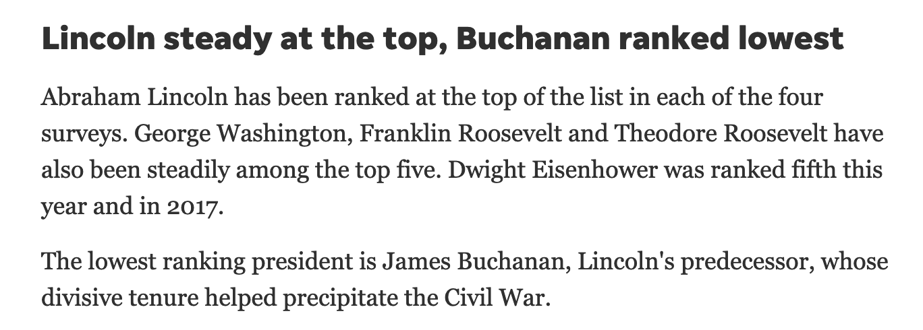

Slide 42
Scales or Levels Measurement
Interval
Numeric, quantitative and continuous
Ages: 5, 10, 15, 20, 25, 30, 35, 40, 45, 50, 55, 60, 65
Continuum of ages: Equal distance intervals
Equal unit size or interval: Units of measurements (intervals) on scale are all equal in size
Distance between 5 and 10 identical to 60 and 65
Temperatures: Difference between 30º and 40º same as differences between 80º and 90º
Ages: 5, 10, 15, 20, 30, 40
See the intervals? Not an interval scale!! Different intervals

Slide 43
Scales of Measurement
Underlying numerical information provided by a measure
Equal-interval: Numeric Variable (No absolute ZERO)
Carries identity: Days with different temps receive different scores on scale
Magnitude: (cooler days receive lower scores)
Equal unit size: differences between values correspond to differences in the underlying thing being measured (Diff. between 20º & 40º is equivalent to the difference of 50º & 70º)
e.g., pain level, stress level, ratings of mood, age

Slide 44
Scales of Measurement
Ratio
Identical to interval with one exception.
It has an absolute zero.
ZERO stands for the absence of something.
Temperature in ºK ( 0ºK = -459.67 ºF!)
ºF or ºC Temperatures can go below ZERO
Time, Weight
Income: Persons can have no money? Is it a ratio?

Slide 45
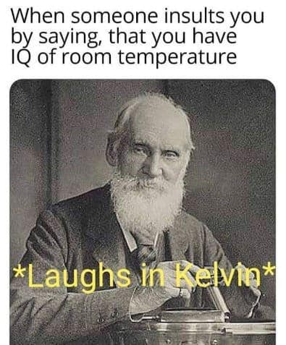
20–22 ºC
68–72 ºF
293 ºK

Slide 46
Differentiates values
Sex: Male or Female

Slide 47
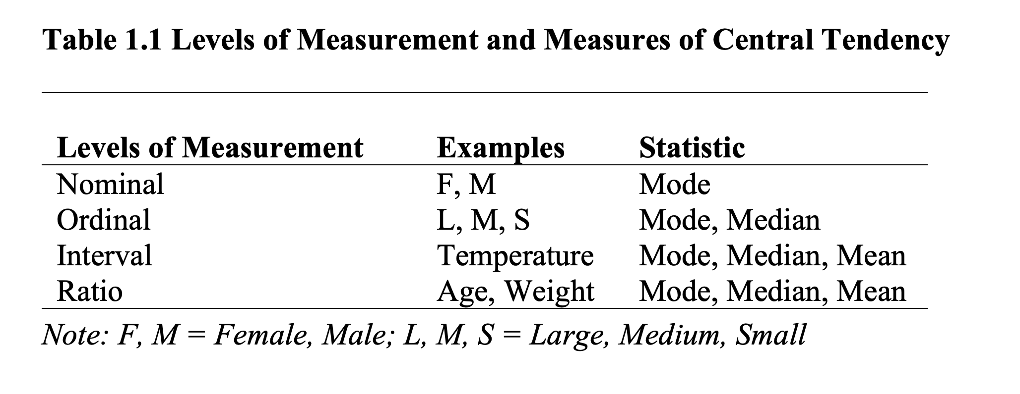
Levels of Measurement and Measures of Central Tendency

Slide 48
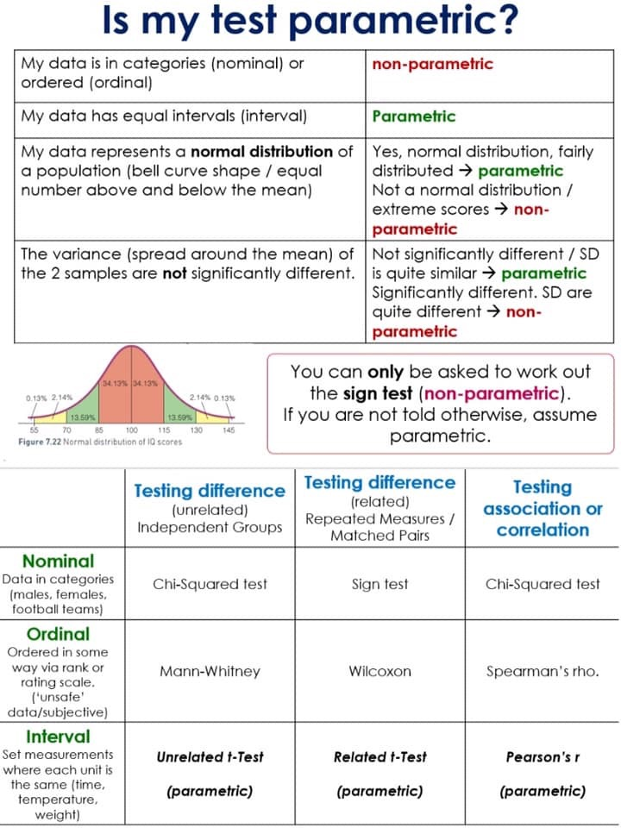

Slide 49
Comprehension Questions
You are conducting a study to evaluate how happy students are when taking a statistics test.
For this study, you ask college students to rate their level of happiness on a scale of 0 (very unhappy) – 10 (very happy)
1. What is your variable of interest?
2. Is your variable, numeric or nominal.
3. What level of measurement are you using?
a. Interval
b. Numeric
c. Nominal

Slide 50
Key Points
Descriptive statistics are used to describe and summarize a group of numbers from a research study.
A value: is a number or category; a variable is a characteristic that can have different values; a score is a particular person’s value on the variable.
Some numeric variables are rank-ordered and some variables are names or categories and not numbers.

