Slide 1
Correlation and Prediction
Chapter 10.1

Slide 2
Bivariate Regression
Prediction: Making predictions on one variable from knowledge of another
Prediction = Regression
Bivariate: Two variables

Slide 3
Prediction
Predictor Variable (X)
  variable being predicted from (e.g., Level of Education)
Criterion (PREDICTED) Variable (Y)
  variable being predicted to (e.g., INCOME)
If we expect level of education to predict income,
Predictor variable = Education
Criterion variable = Income

Slide 4
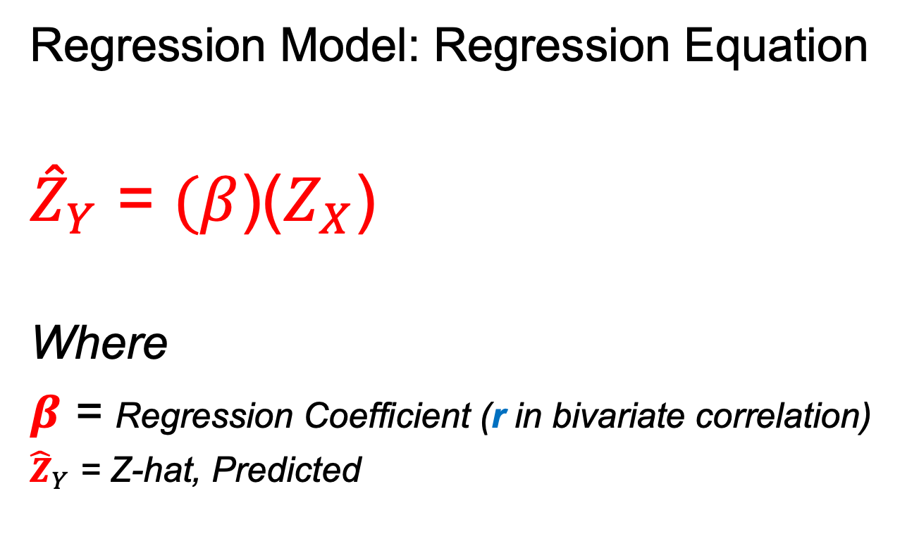
Regression Model
Regression Model: Regression Equation
${\hat{Z}}_{Y}$ = $(β$)($Z_{X}$)
Where
$β$ = Regression Coefficient (r in bivariate correlation)
${\hat{Z}}_{Y}$ = Z-hat, Predicted

Slide 5
Predicting a Person's College Grade from Knowledge of SAT Score
Given Information:
SAT µ = 800, 𝜎 = 100
COLLEGE µ = 80, 𝜎 = 20
Correlation: SAT vs. College Grades r = .70

Slide 6
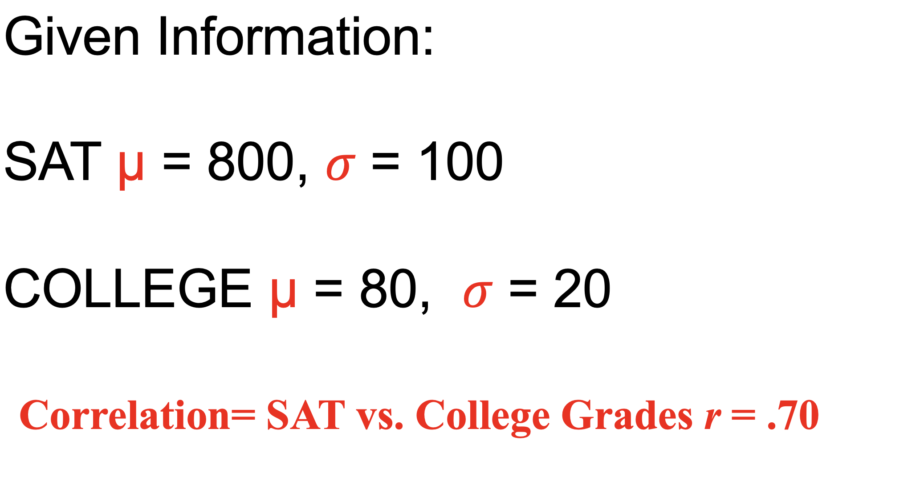
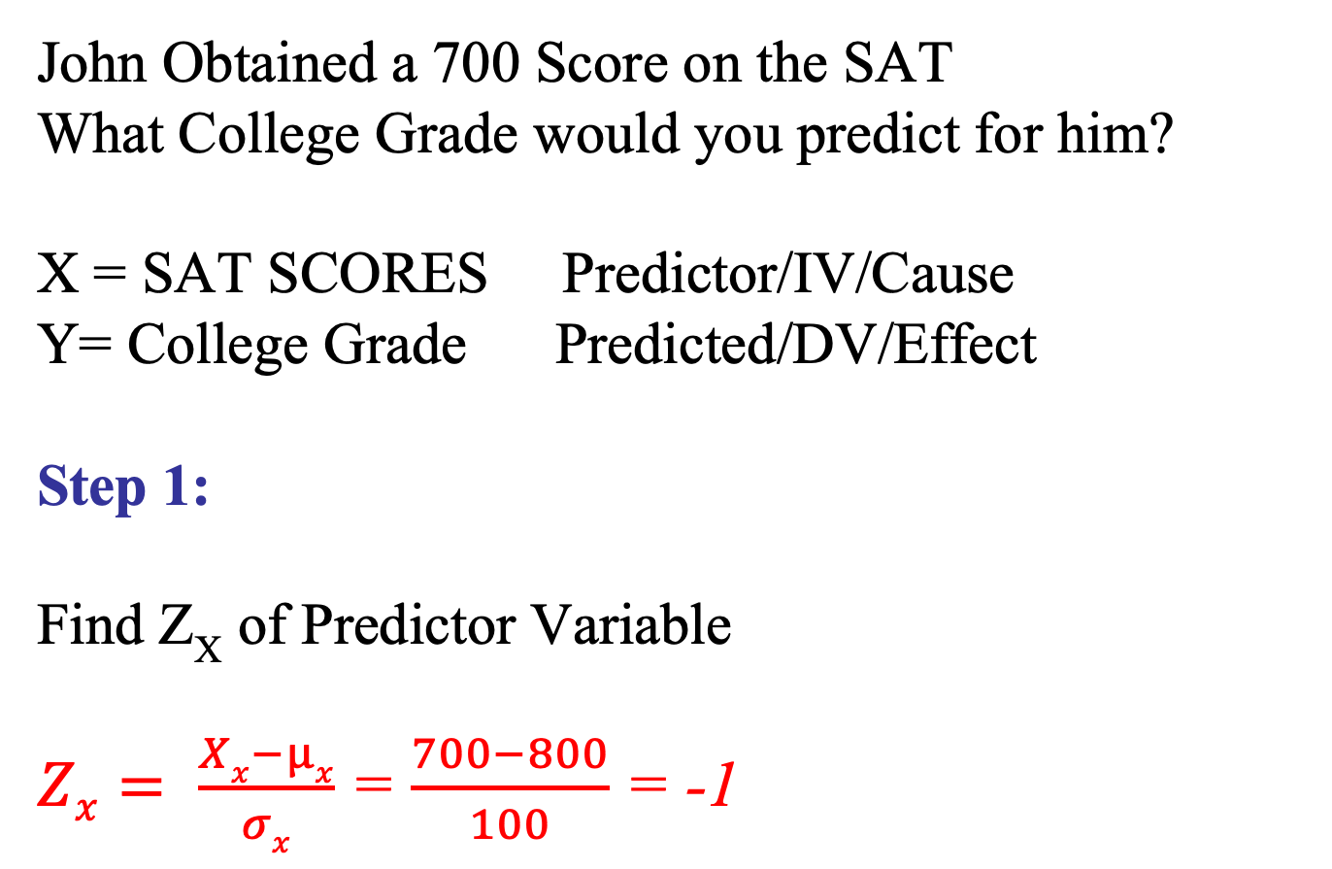
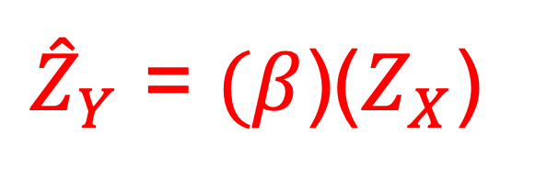
${\hat{Z}}_{Y}$ = $(β$)($Z_{X}$)
John Obtained a 700 Score on the SAT
What College Grade would you predict for him?
X = SAT SCORES Predictor/IV/Cause
Y= College Grade Predicted/DV/Effect
Step 1:
Find Z_{X} of Predictor Variable
$Zx= \frac{Xx−µx}{σx}$ = $\frac{700−800}{100}$ = -1

Slide 7
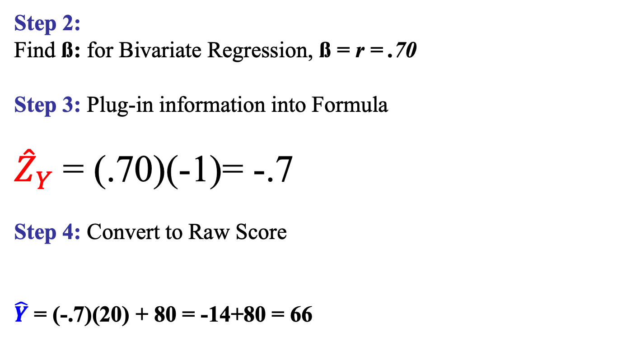
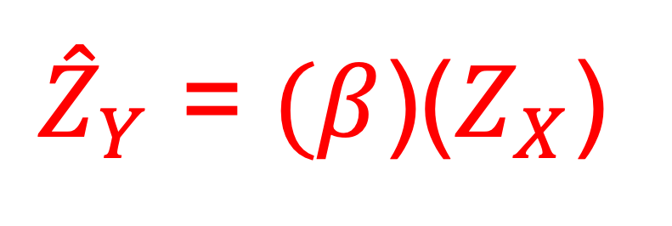
${\hat{Z}}_{Y}$ = $(β$)($Z_{X}$)
Step 2:
Find ß: for Bivariate Regression, ß = r = .70
Step 3: Plug-in information into Formula
${\hat{Z}}_{Y}$= (.70)(-1)= -.7
Step 4: Convert to Raw Score
$\hat{Y}$ = (-.7)(20) + 80 = -14+80 = 66
  $\hat{Y}$ = (𝜎_{y})(${\hat{Z}}_{Y}$) + µ_{y}

Slide 8
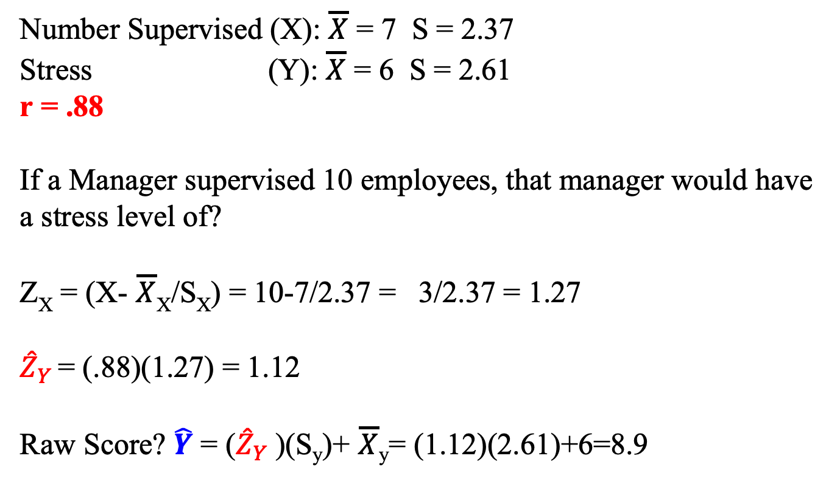

Manager's Stress Example
Number Supervised (X): $\overline{X}$ = 7 S = 2.37
Stress (Y): $\overline{X}$ = 6 S = 2.61
r = .88
If a Manager supervised 10 employees, that manager would have a stress level of?
Z_{X} = (X- $\overline{X}$_{X}/S_{X}) = 10-7/2.37 = 3/2.37 = 1.27
${\hat{Z}}_{Y}$ = (.88)(1.27) = 1.12
Raw Score? $\hat{Y}$ = (${\hat{Z}}_{Y}$)(S_{y})+ $\overline{X}$_{y}= (1.12)(2.61)+6=8.9
${\hat{Z}}_{Y}$ = $(β$)($Z_{X}$)

Slide 9
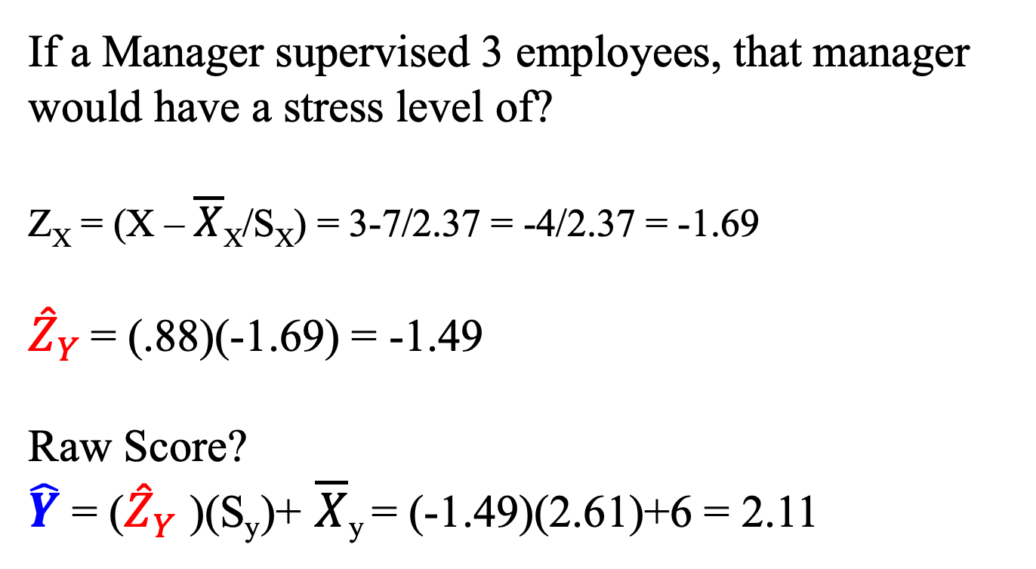

Manager's Stress Example
If a Manager supervised 3 employees, that manager would have a stress level of?
Z_{X} = (X – $\overline{X}$_{X}/S_{X}) = 3-7/2.37 = -4/2.37 = -1.69
${\hat{Z}}_{Y}$ = (.88)(-1.69) = -1.49
Raw Score?
$\hat{Y}$ = (${\hat{Z}}_{Y}$)(S_{y})+ $\overline{X}$_{y} = (-1.49)(2.61)+6 = 2.11
${\hat{Z}}_{Y}$ = $(β$)($Z_{X}$)

Slide 10
The Correlation Coefficient and the Proportion of Variance Accounted for
Proportion of variance accounted for (r²)
  To compare correlations, square correlation.
  Proportion of the total variance in one variable that can be explained by the other variable.

Slide 11
R² Proportion of Variance Accounted for
How much Stress Level (Y) is Explained by the number of
Supervised Employees (X)
How much Class Grade (Y) is explained by Levels of Stress (X)
r = .9----------> r² =.81
r = .70--------> r²=.49
Proportion of variance in the criterion (Y) accounted by the Predictor Variable (X)

Slide 12
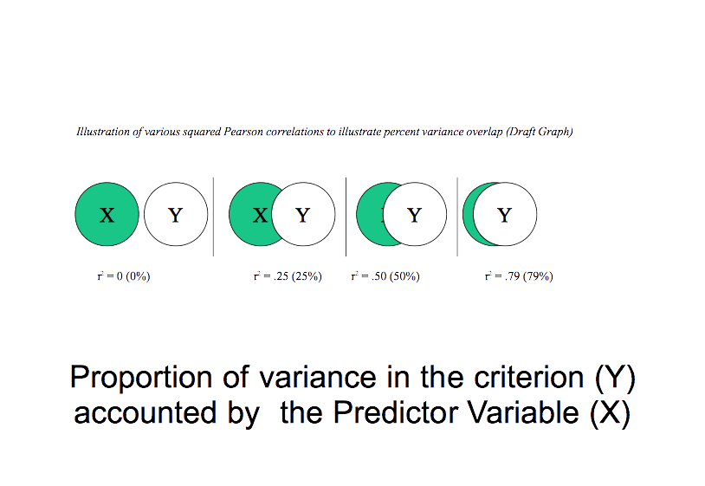

Slide 13
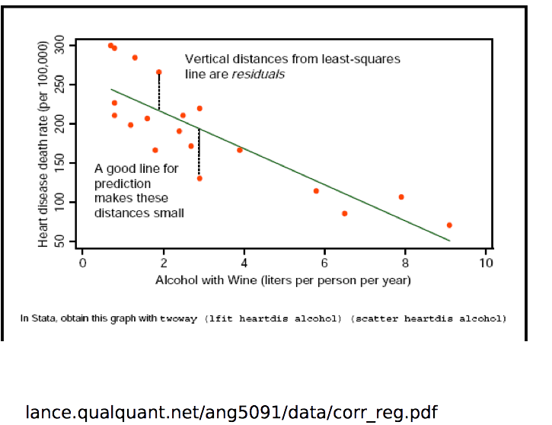

Slide 14
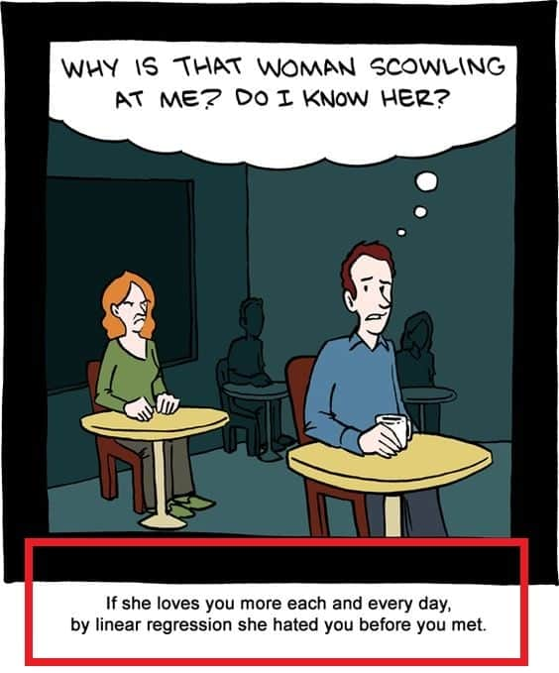
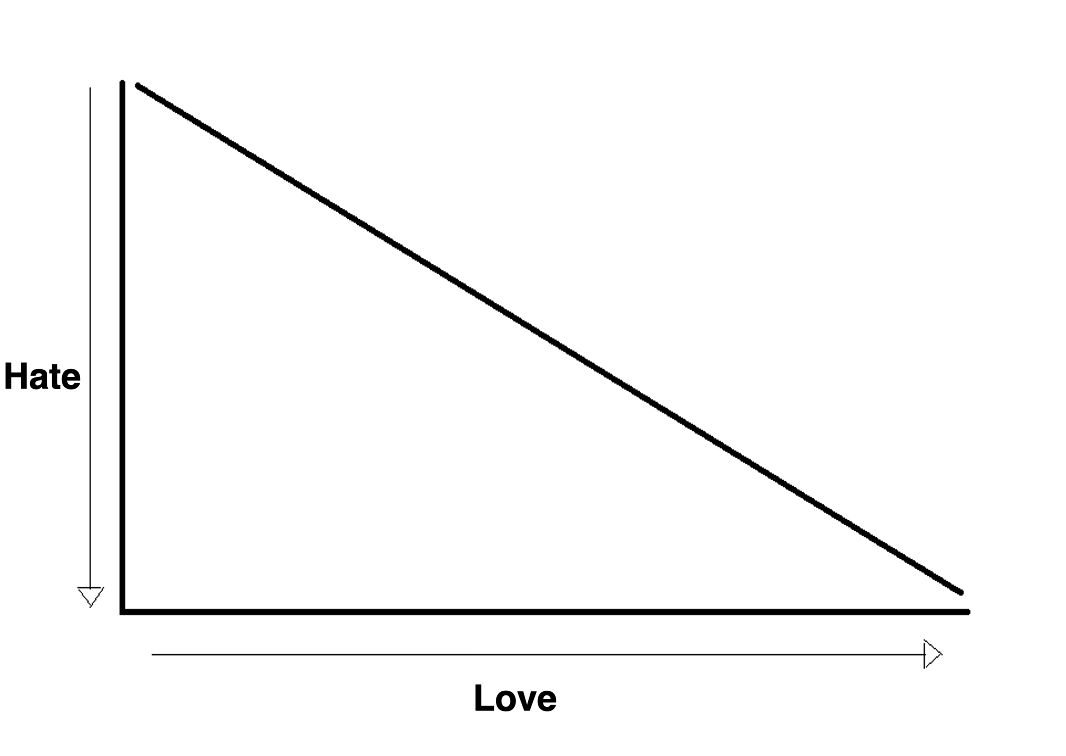

Slide 15
Regression Line
ŷ = bx + a
Where
Ŷ (y-hat) = predicted score
bx = slope of the regression line
a = y intercept

Slide 16
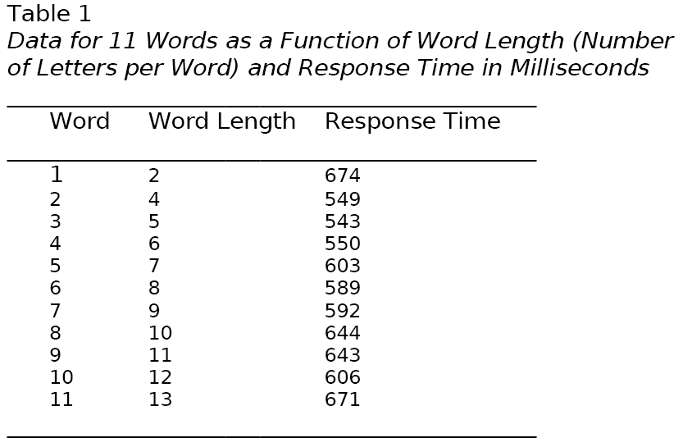

Slide 18
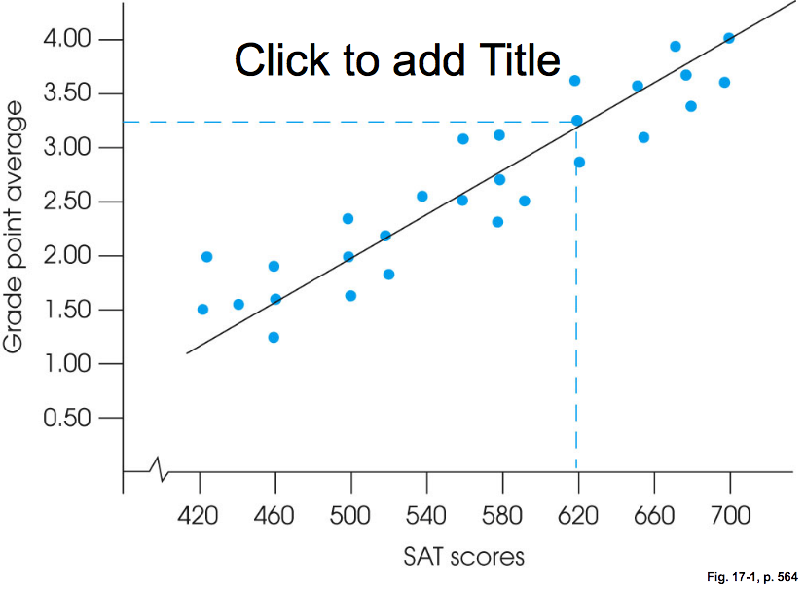

Slide 19
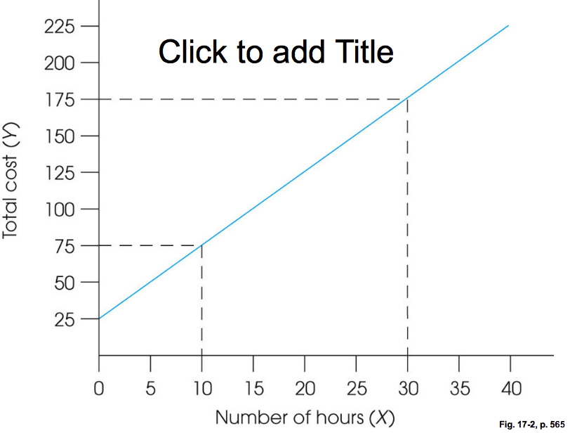

Slide 20
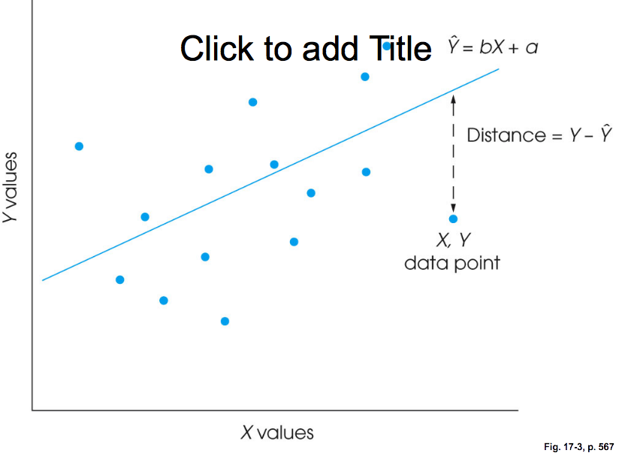

Slide 21
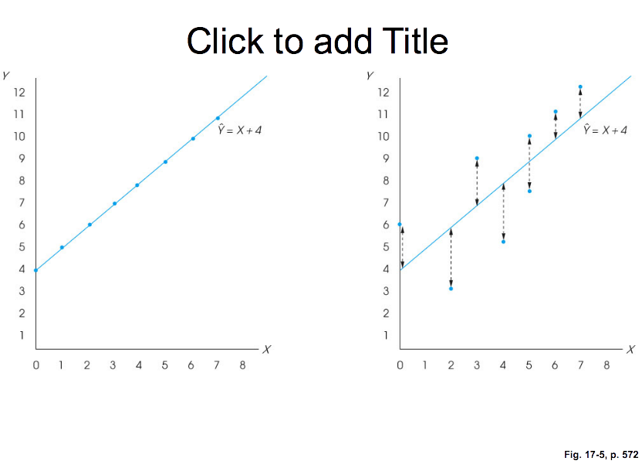

Slide 22
Correlation and Prediction in Research Articles
Scatter diagrams are sometimes found in research articles.
Correlation coefficients (r) are often found in research articles.
Correlation Matrix
  a table which displays the correlation of each pair of variables
  Each variable is listed down the side and across the top of the table.

Slide 23
Advanced Topic: Multiple Regression
Multiple Correlation
  the association between a criterion variable and two or more predictor variables
Multiple Regression
  predicting scores on a criterion variable from two or more predictor variables

Slide 24
Multiple Regression Prediction Models
Predicted Z_{y} = (β₁)(Z_{x1}) + (β₂)(Z_{x2}) + (β₃)(Z_{x3})
    predicted Z_{y} = person’s predicted score on the criterion variable
    β₁ = standardized regression coefficient for the first predictor variable
    β₂ = standardized regression coefficient for the second predictor variable
    β₃= standardized regression coefficient for the third predictor variable
    Z_{x1} = person’s Z score for the first predictor variable
    Z_{x2} = person’s Z score for the second predictor variable
    Z_{x3} = person’s Z score for the third predictor variable

Slide 25
Difference Between Multiple and Bivariate Regression
If one predictor variable (BIVARIATE), β = r.
In multiple regression, β not the same in bivariate
β describes the unique distinctive contribution of the predictor variable excluding any overlap with other predictor variables.
Multiple correlation coefficient (R)
  overall correlation between criterion variable and all predictor variables
  R is usually smaller than the sum of each individual r.
  R² = proportion of variance in the criterion variable accounted for by all of the predictor variables

Slide 26
Multiple Regression
ŷ = bx₁ + bx₂ + bx₃ + a
bx₁ = SAT
bx₂ = College Grade
bx₃ = High School GPA
ŷ = Graduate School GPA

Slide 27
Advanced Topic: Multiple Regression in Research Articles
often found in research articles
Standardized regression coefficients are commonly reported in tables.

Slide 28
Key Points
Two variables are correlated when they are associated in a clear pattern.
A scatter diagram displays the relationship between two variables.
A linear correlation is seen when the dots in a scatter diagram generally follow a straight line. In a curvilinear correlation, the dots follow a pattern that does not approximate a straight line. When there is no correlation, the dots do not follow a pattern.
In a positive correlation, the highs go with the highs, the lows with the lows, and the mediums go with the mediums. With a negative correlation, the lows go with the highs.
r is the correlation coefficient and gives you the direction and strength of a correlation. r = (∑Zx Zy )/N
The maximum positive value of r = 1 and the maximum negative value of r = -1.
The closer the correlation is to -1 or 1, the stronger the correlation.
Correlation does not tell you the direction of causation.
Prediction model using Z scores = predicted Z_{y} = (β)(Z_{x}).
Prediction model with raw scores = predicted Y = (SD_{y})(predicted Z_{y}) + M_{y.}
r² = proportion of variance accounted for and is used to compare linear correlations
Correlation coefficients are reported both in the text and in tables of research articles.

Slide 29
Key Points for the Advanced Topic
Multiple regression is when a criterion variable is predicted by multiple predictor variables.
In multiple regression, predicted Z_{y} = (β₁)(Z_{x1}) + (2)(Z_{x2}) + (β₃)(Z_{x3}).
The multiple regression coefficient squared (R²⁾ is the proportion of variance accounted for by all of the predictor variables taken together.
Multiple regression results are often reported in research articles both in the text and in tables.

Slide 30
