Slide 1
Measures of Central Tendency
Chapter 3

Slide 2
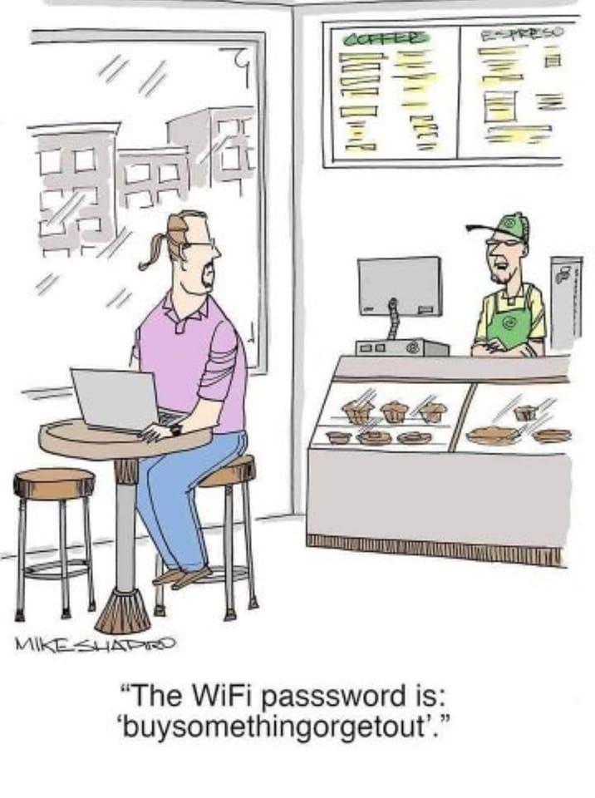

Slide 3
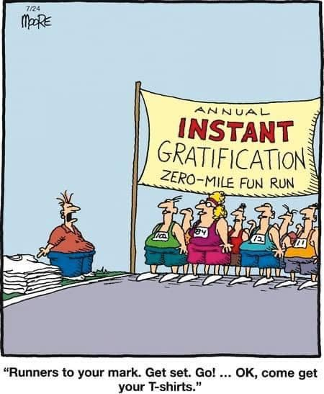

Slide 4
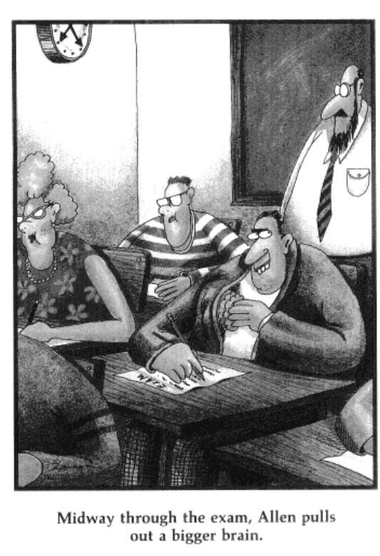

Slide 5
Chapter Outline
Representative Values
Mode
Mean
Median

Slide 6
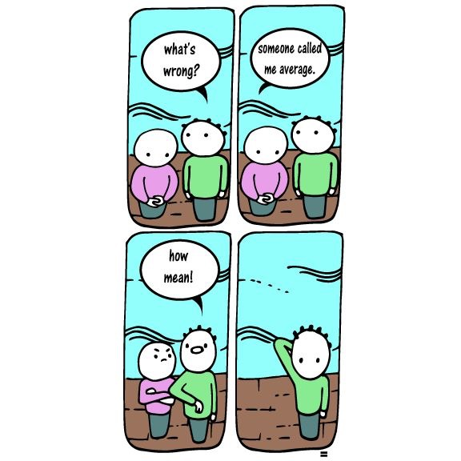

Slide 7
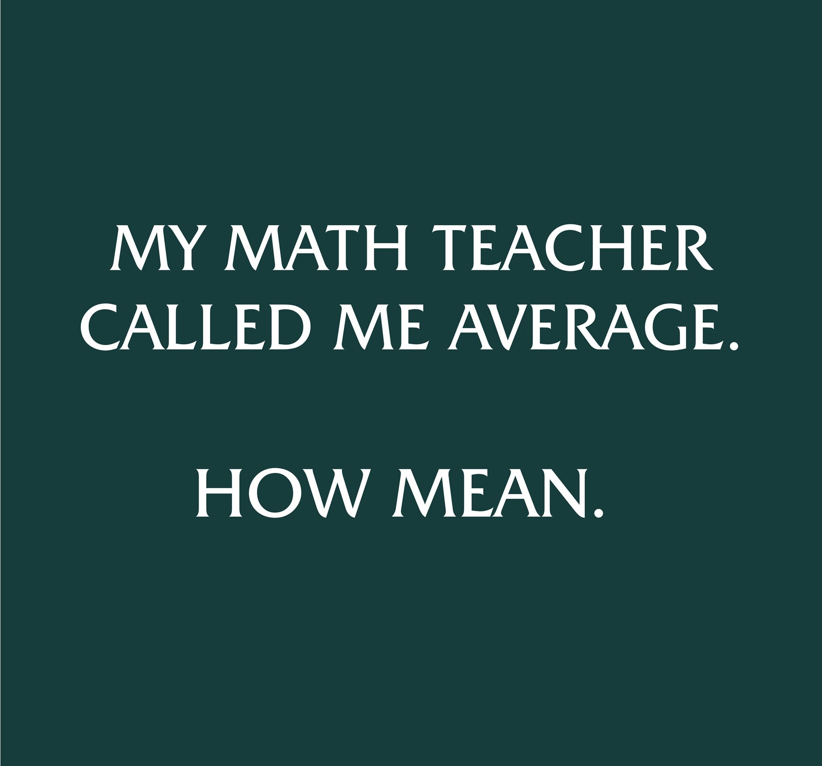

Slide 8
Representative Value
Uses a single number to describe a group of scores
Refers to the middle of the group of scores
Mode
Median
Mean

Slide 9
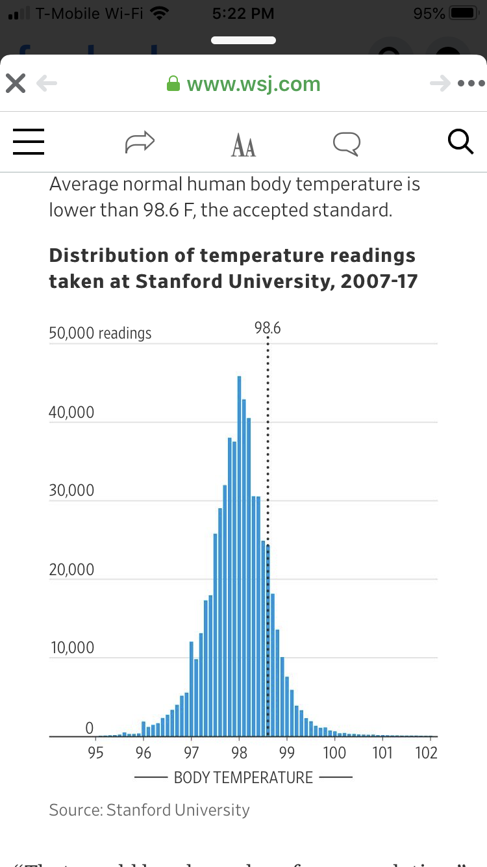
Mode
The most common/frequent single value in distribution
10, 5, 9, 8, 6, 5, 9, 8, 7, 6, 5, 6,5
5, 5, 5,5, 6, 6, 6, 7, 8, 8, 9, 9, 10
Value with largest frequency in a distribution
High point or peak of a distribution’s histogram
Distribution unimodal & symmetrical, mean = mode.
Typical way describing representative value for nominal variable
rarely used with numerical variables

Slide 10
How many modes?
2, 2, 2, 3, 3, 5, 5, 6, 6, 7, 7, 8, 8, 8, 9, 9 10
Other distribution of happiness scores:
2, 2, 3, 3, 3, 5, 6, 6, 6, 7, 7, 7, 8, 8, 8, 9, 10
Four different scores occur most frequently, or three times each.
One mode = unimodal
Two modes = bimodal
Three modes = multimodal

Slide 11
Mode for Ungrouped and Grouped Data
Consider the following distribution of happiness scores from students in a fictional statistics course, where 1 = Very Unhappy, and 10 = Very Happy:
1, 2, 3, 3, 5, 6, 6, 6, 6, 7, 7, 8, 8, 9, 9 10, 10
How many modes?
2, 2, 2, 3, 3, 5, 5, 6, 6, 7, 7, 8, 8, 8, 9, 9 10

Slide 12
Other uses of the mode
Most typical/frequent nominal characteristics
Ethnicity (Most frequent ethnic group)
Languages spoken (More frequent)
What is the Mode?
Cow, cow, horse, horse, goat, rabbit, rabbit, rabbit, deer, deer
https://boostlingo.com/2019/06/27/the-top-most-common-spoken-languages-in-the-united-states-besides-english/

Slide 14
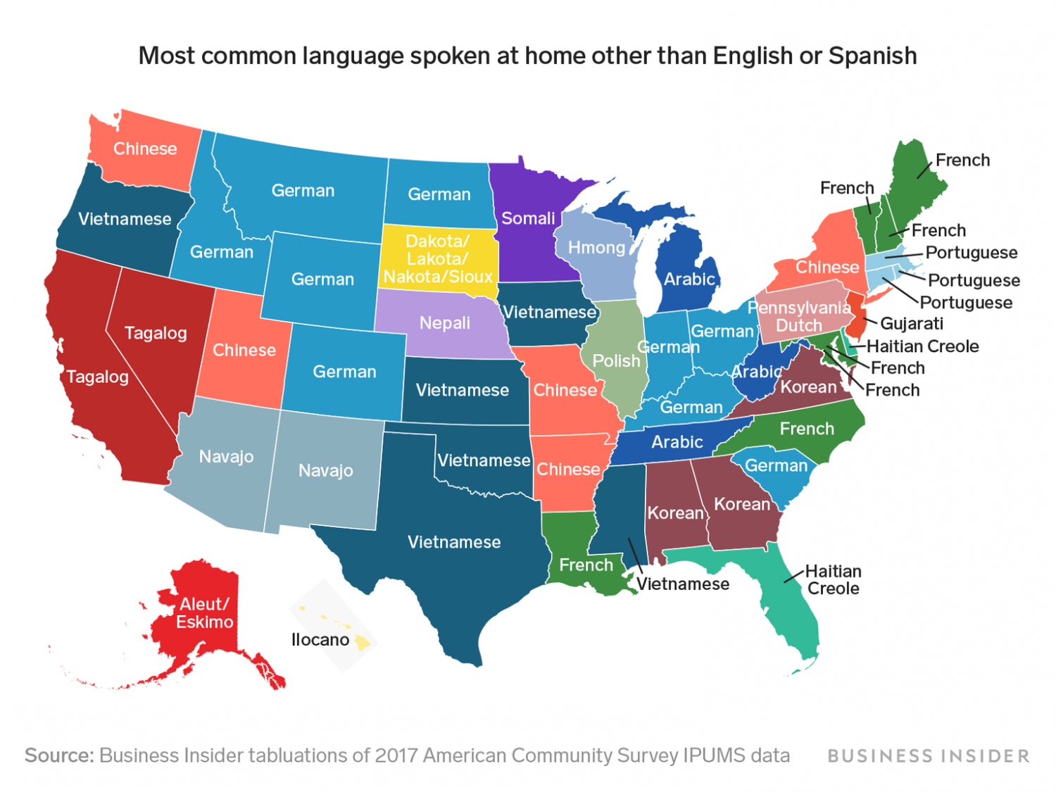
https://boostlingo.com/2019/06/27/the-top-most-common-spoken-languages-in-the-united-states-besides-english/
Mode German (9)?

Slide 15
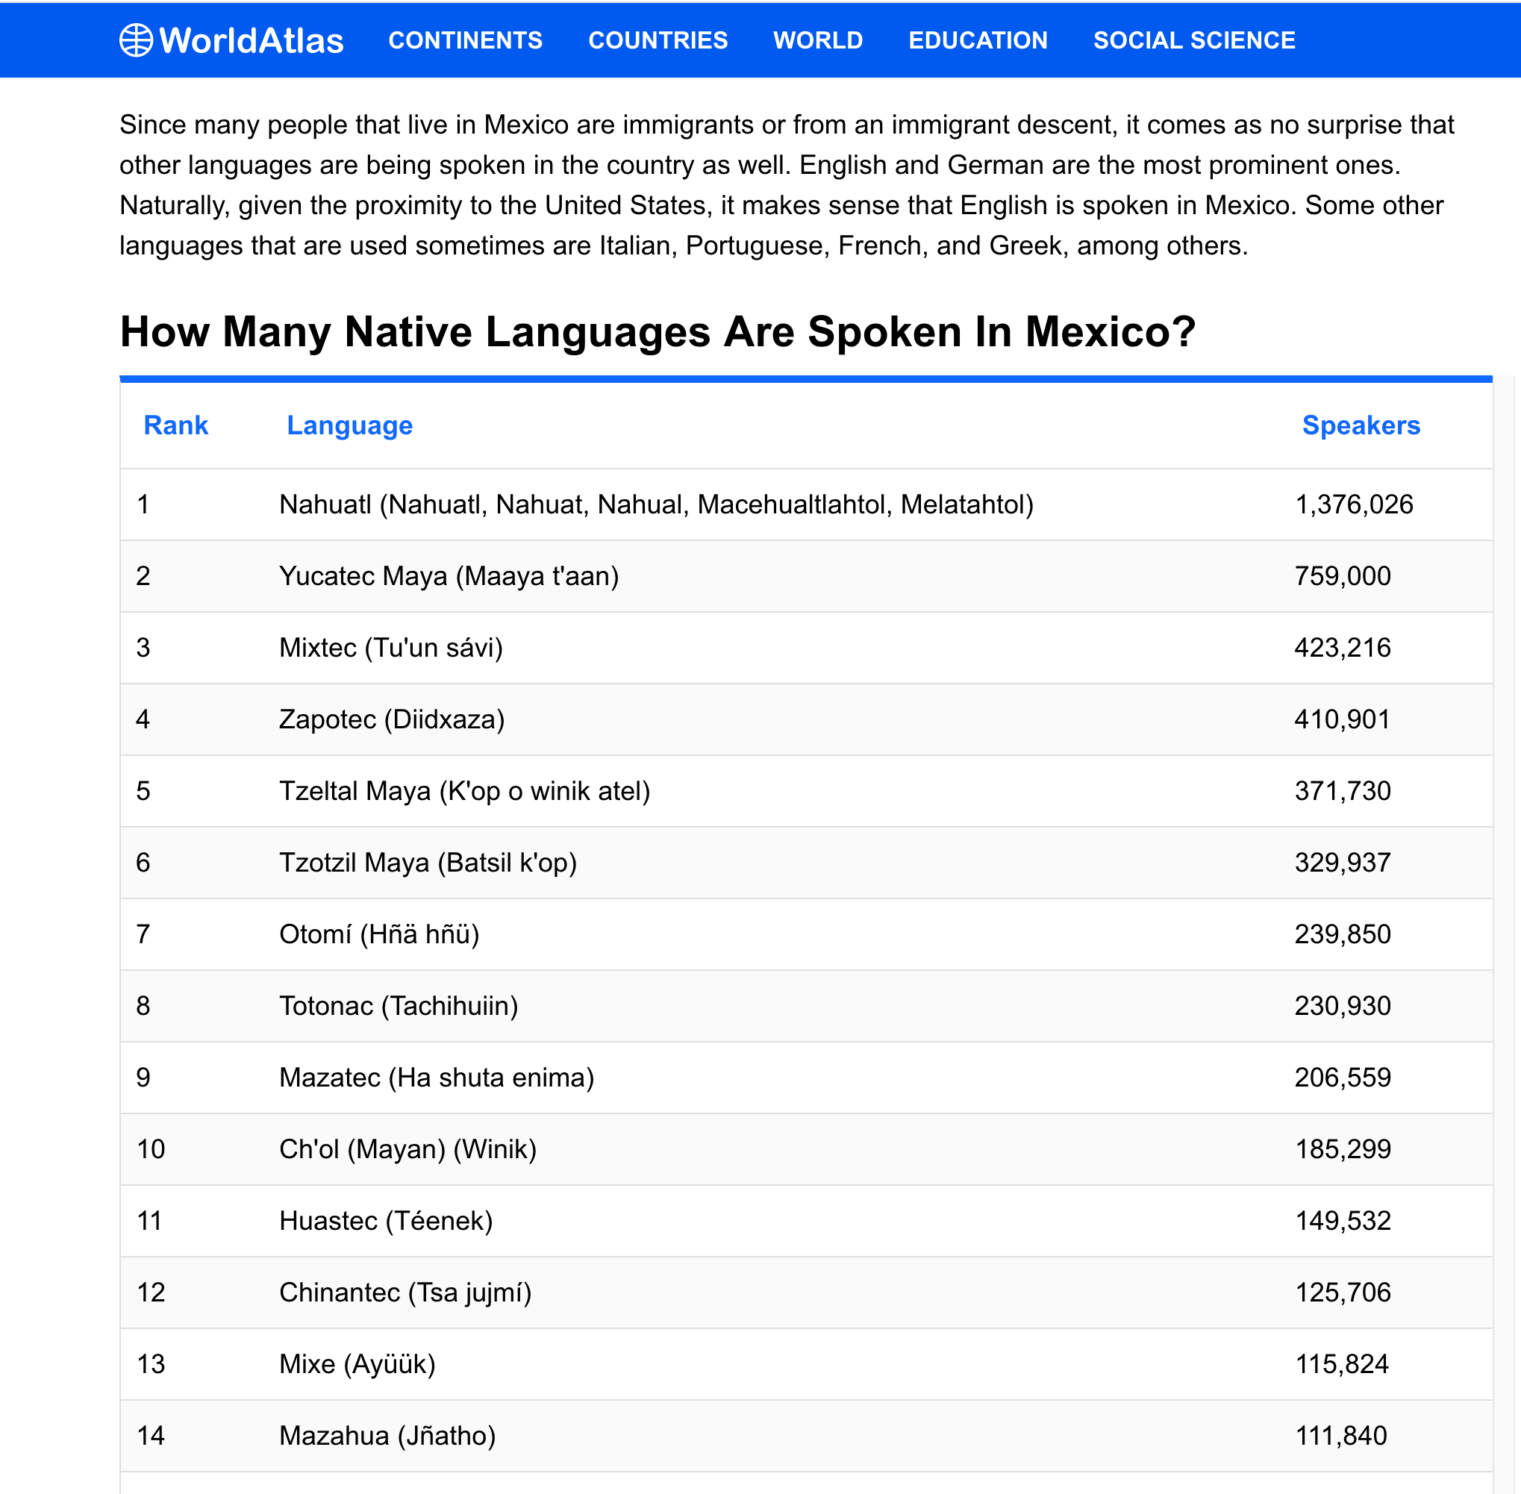

Slide 16
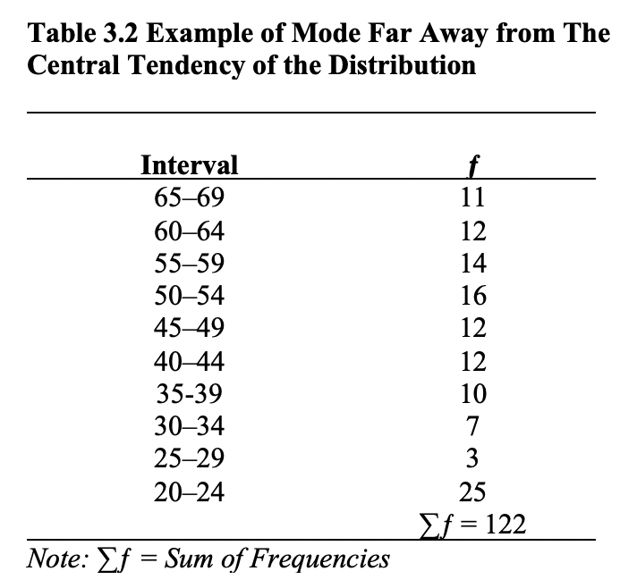
Mode very Unstable
Mode = Midpoint
Outliers
Mode = 22.5

Slide 17
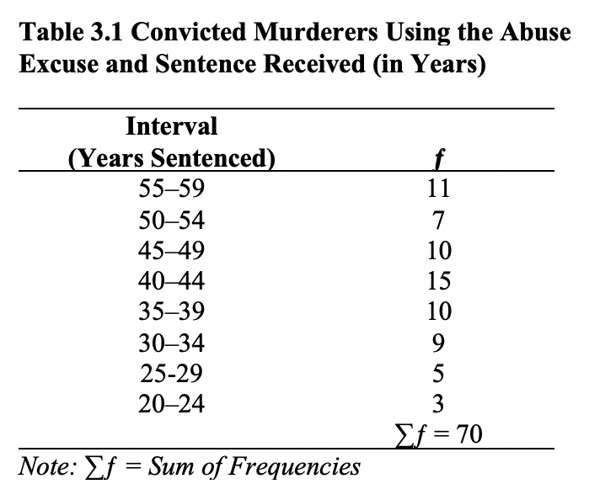
Mode = 42.5

Slide 18
Median
Middle score: Sort from lowest to highest
Number of scores + 1 and divide by 2.
5, 5, 5, 6, 6, 6, 7, 8, 8, 9, 9, 10 (12 scores + 1 = 13/2 = 6.5)
For an EVEN NUMBER of scores, the median is the average of the two middle scores.
5, 5, 5, 6, 6, 6, 7, 8, 8, 9, 9, 10 (Median: 6+7/2 = 6.5)
For ODD NUMBER of scores
5, 5, 5, 6, 6, 6, 7, 8, 8, 9, 9, 10, 11 (Median = 7)
(Or count the number of scores: 13 scores + 1 = 14/2 = 7)

Slide 19
Happiness distribution of scores
3, 6, 7, 8, 10 (n = 5) Median?
2, 3, 6, 7, 8 ,10 (n = 6) Median?
2, 3, 6, 7, 8 ,100 (n = 6) Median?
1, 2, 3, 6, 7, 8 , 10 (n = 7) Median?
0, 0, 3, 6, 7, 8 , 100 (n = 7) Median?
Median Stable or unstable?

Slide 20
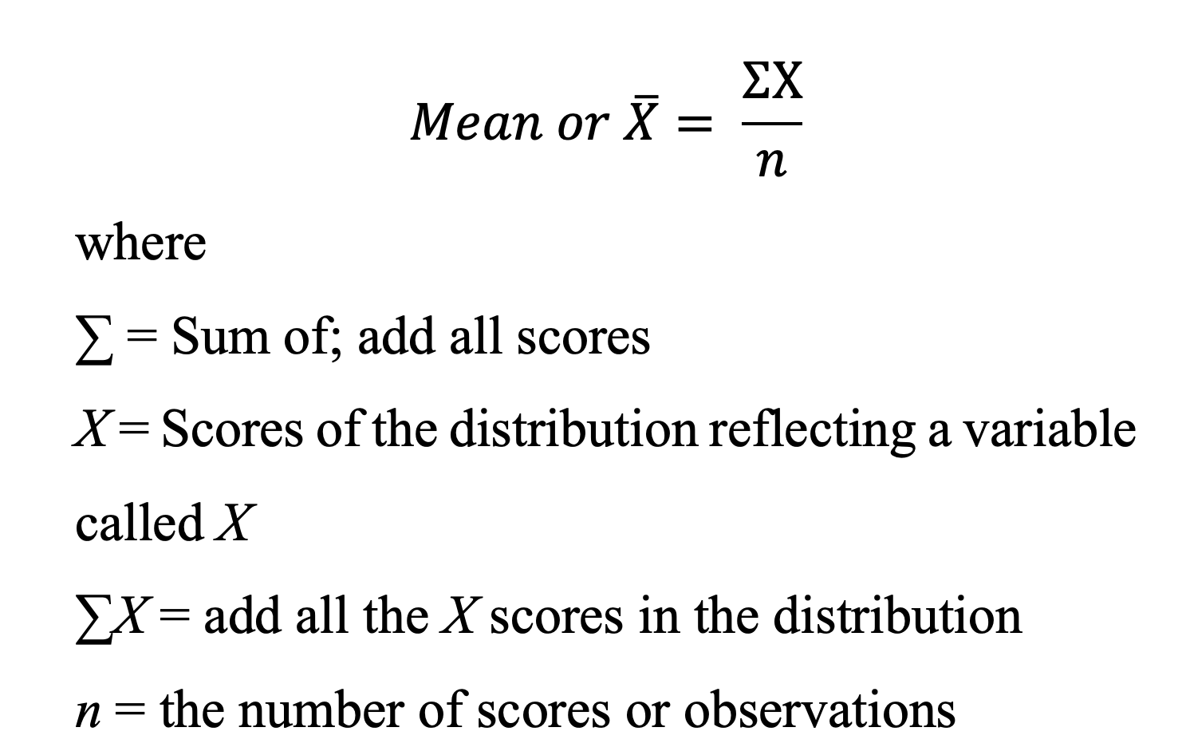
Mean
Average of a group of scores
Sum (∑) of scores divided by the number (n) of scores
Mathematical formula for figuring the mean:

Slide 21
Populations vs. Samples
Population Parameters (unknown)
µ = Population mean (Estimated from X̅)
Sample Statistics
X̅ = Sample mean

Slide 22
Computing the Mean
If the scores for a particular study were
10, 5, 9, 8, 6, 5, 9, 8, 7, 6, 5, 6
$\overline{X}$= $\frac{∑x}{n}$ = $\frac{84}{12}$ = 7

Slide 23
Mean vs. Median
Happiness scores (n = 5):
3, 6, 7, 8, 10
$\overline{X}=\frac{34}{5}=6.8$ & Median = 7
If we changed the score of 10 to a score of 60?
3, 6, 7, 8, 60
$\overline{X}=\frac{84}{5}=16.8$ & Median = 7?
Extreme scores or outliers? 60!!

Slide 24
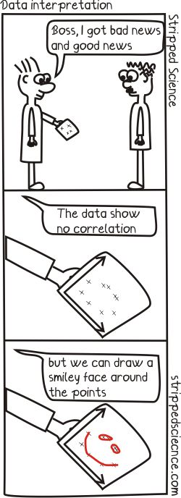
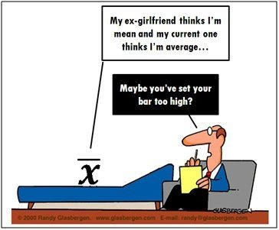

Slide 25
Comparing Representative Values
The median is better than the mean or mode as a representative value when a few extreme scores would strongly affect the mean but not the median.
An outlier is an extreme score that can make the mean unrepresentative of most of the scores.
5, 5, 5, 6, 6, 6, 7, 8, 8, 9, 9, 10, 11 (Median = 7)
5, 5, 5, 6, 6, 6, 7, 8, 8, 100, 100, 100, 1000 (Median = ?)

Slide 26
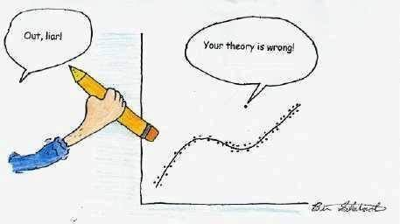
Liar-Liar-Pants on Fire!!!
Mean Sensitive to Outliers?
5,6,10,15
$\overline{X}$= $\frac{∑x}{n}$ = $\frac{36}{4}$ = 9
5,6,10,100
$\overline{X}$= $\frac{∑x}{n}$ = $\frac{121}{4}$ = 30.3

Slide 27
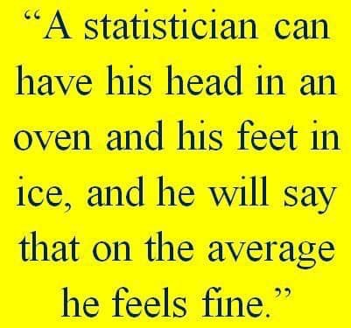

Slide 30
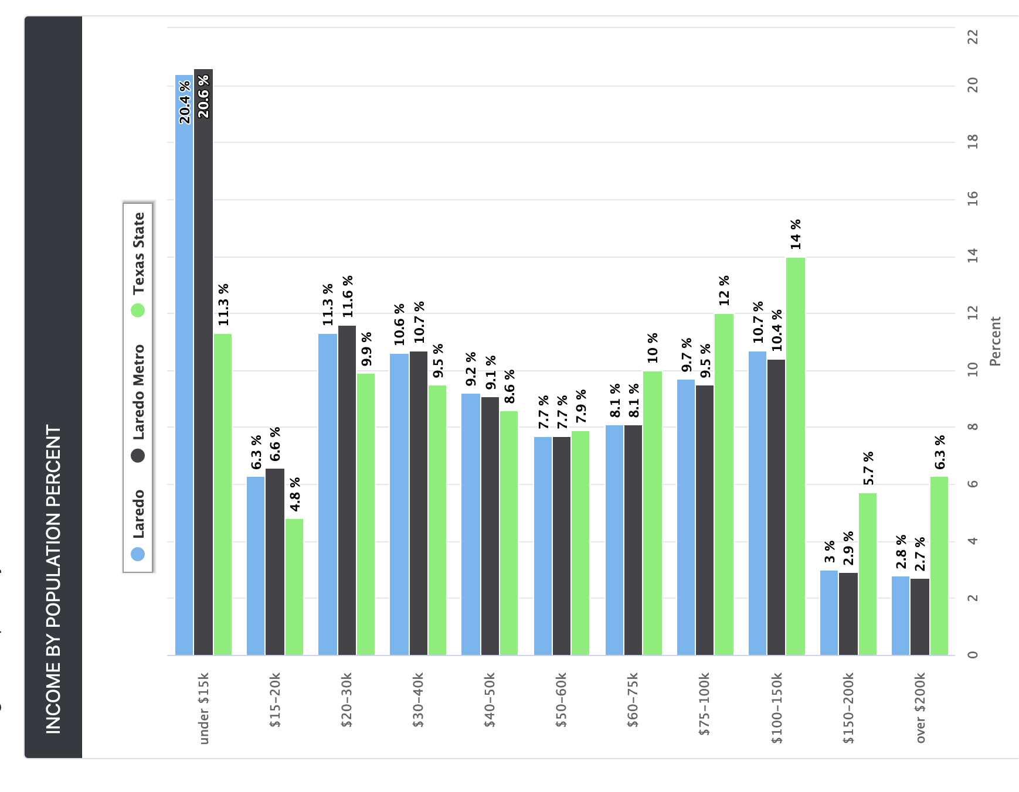

Slide 31
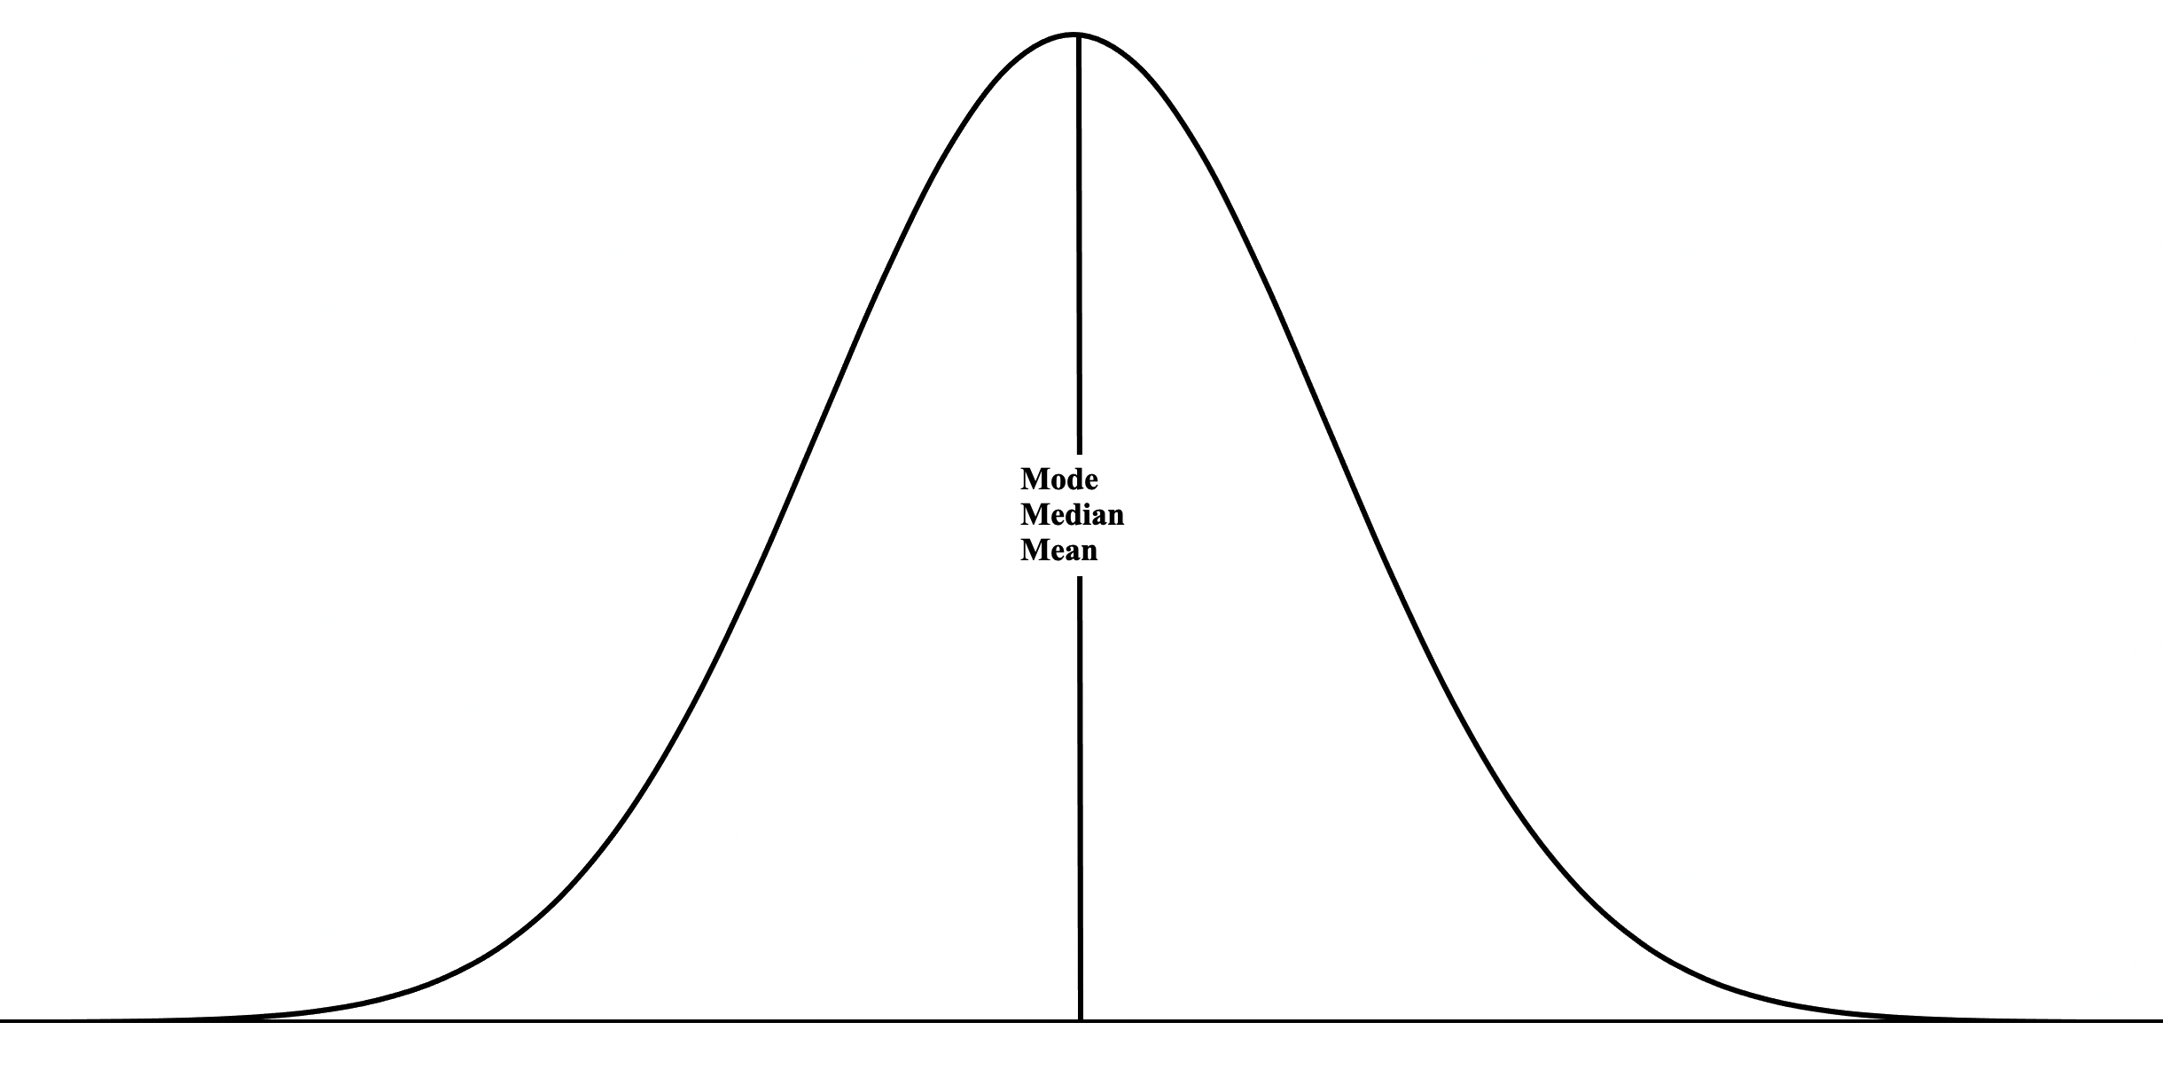

Slide 32
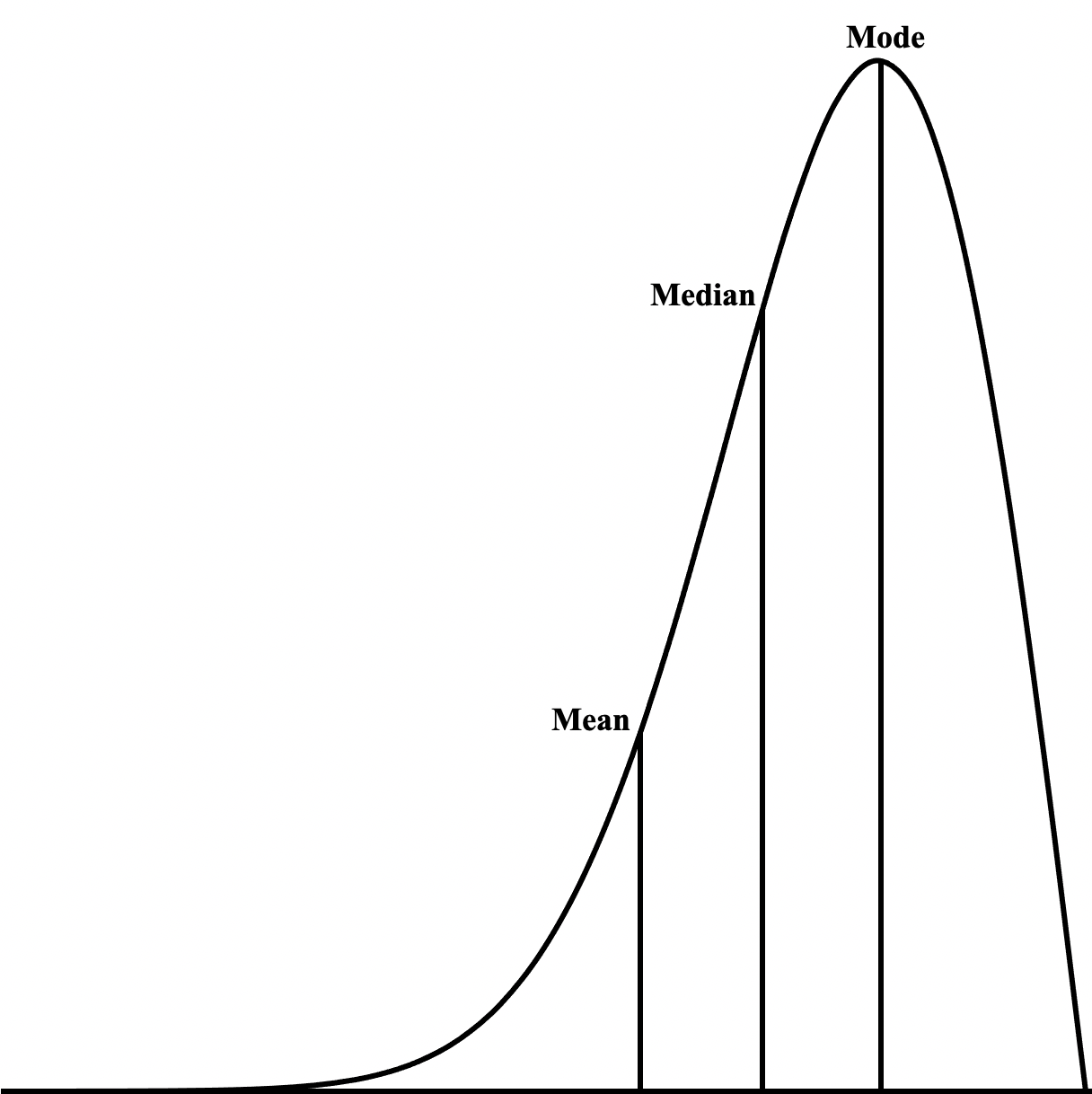
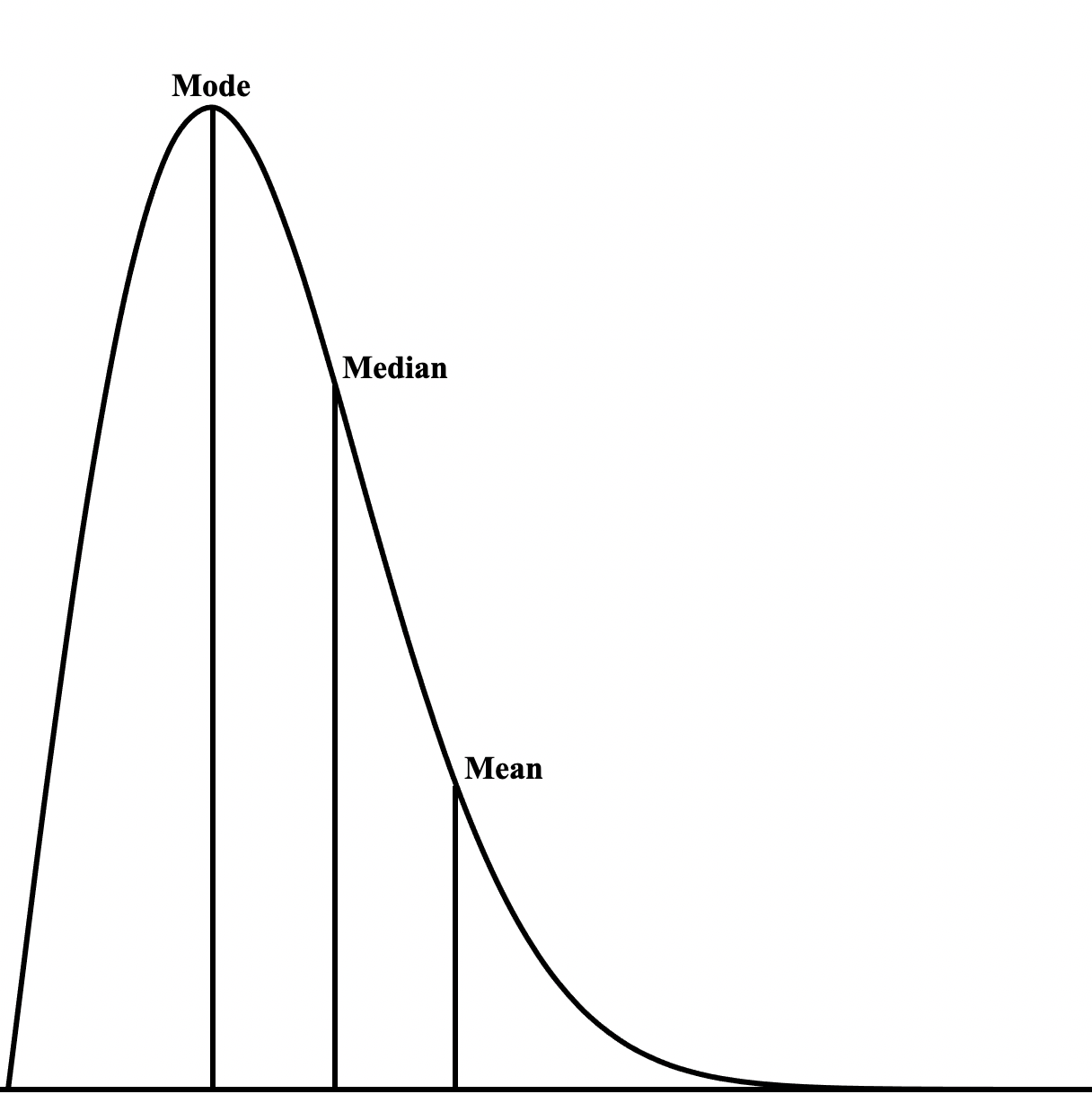

Slide 34
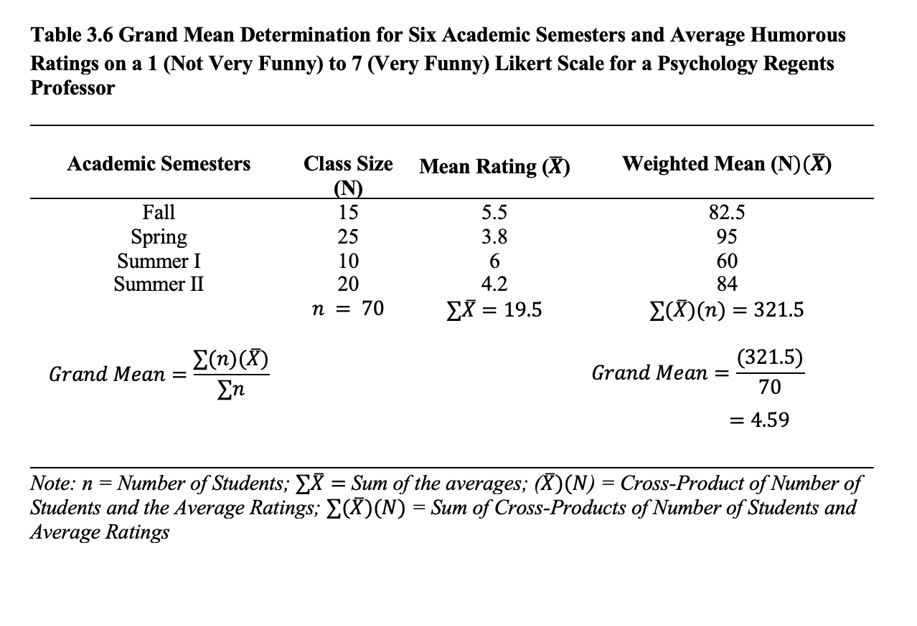

Slide 36
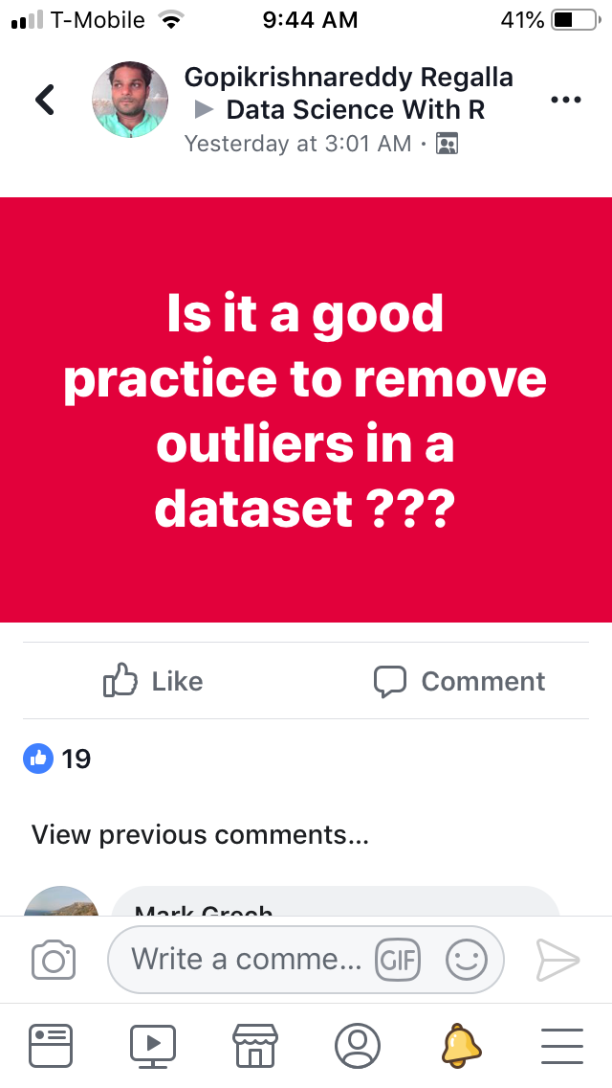

Slide 37
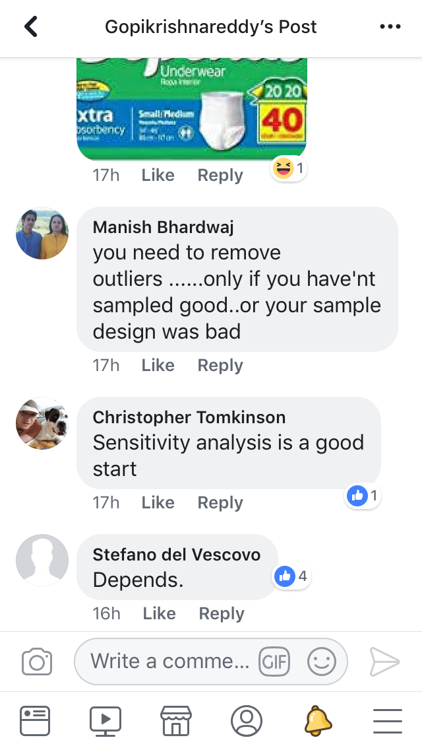
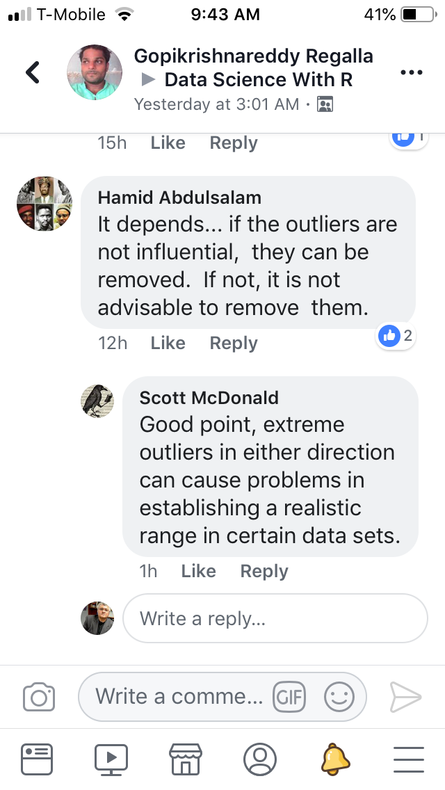
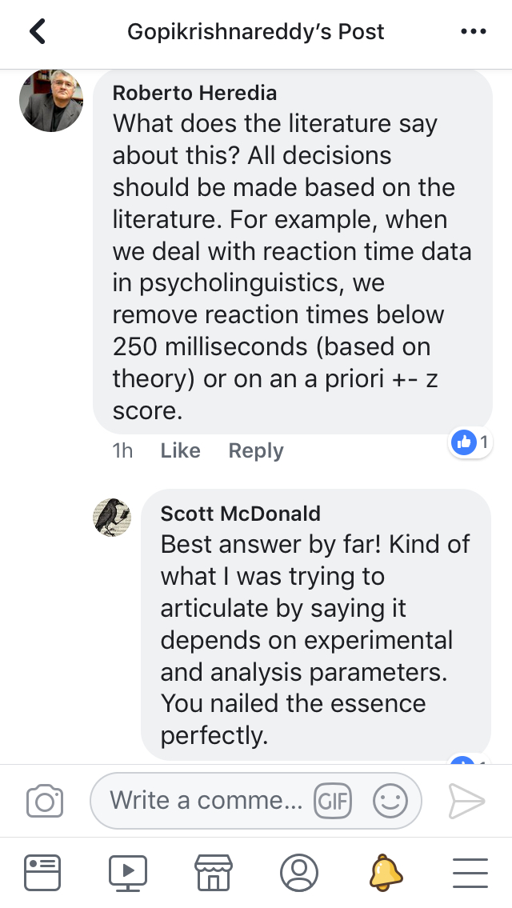

Slide 38
How Are You Doing?
Find the mean, median, and mode for the following scores:
1, 4, 3, 2, 10, 2, 1, 3, 2, 4, 3, 2, 4, 1, 3
Which one of the above scores would be considered an outlier?

Slide 40
Key Points
The mean (M = (∑X) / N) is the most commonly used way of describing the representative value of a group of scores.
The mode (most common value) and the median (middle value) are other types of representative values.
Variability refers to the spread of scores on a distribution.
Variance and standard deviation are used to describe variability.
The variance is the average of the squared deviations of each score from the mean ([∑ (X-M)²] / N).
The standard deviation is the square root of the variance(√SD²).
A Z score is the number of standard deviations that a raw score is above or below the mean (Z = (X-M) / SD).
Means and standard deviations are often reported in research articles.

