Slide 1
Inferential Statistics
Chapter 6
Inferential Statistics: Making inferences about populations based on samples

Slide 2
Chapter Outline
Hypothesis-Testing
The Core Logic of Hypothesis Testing
The Hypothesis-Testing Process

Slide 4
Hypothesis Testing
A systematic procedure for deciding whether the results of a research study (using a sample) supports a hypothesis that applies to a population (probabilistic conclusion)
Hypothesis: A predictions tested in a research study based on informal observation or theory
e.g., Concrete words are remembered better than Abstract
Theory: a set of principles that attempts to explain one or more facts, relationships, or events usually gives rise to various specific hypotheses that can be tested in research studies
e.g., Dual-coding Theory: Concrete 2 codes & Abstract 1 code

Slide 5
Hypothesis Testing
Researchers want to draw conclusions about a
particular population
e.g., Babies in general (POPULATION)
Conclusions will be based on results of studying a
sample
e.g., One baby (SAMPLE)

Slide 6
The Core Logic of Hypothesis Testing
Researchers spell out a priori what would have to happen in order to allow them to conclude that their hypothesis was supported.
They then conduct their experiment.
Then they figure the probability of getting their particular experimental result if their hypothesis were not true.
They answer the question:
What is the probability of getting our research results if the opposite of what is predicted were true?
If it is highly unlikely that we would get our research results if the opposite of what we are predicting were true:
We can reject the opposite prediction.
If we reject the opposite prediction, we can accept our prediction.

Slide 7
Hypothesis Testing Principle
Are there differences between men and women in regards to IQ tests? Make a prediction by answering question!
Research Hypothesis or Alternative Hypothesis (H_{A})
IQ_{M} ≠ IQ_{W} or IQ_{M} < IQ_{W} or IQ _{M} > IQ _{W}
H₁: Predicted Relationship between the populations
There is a difference: IV affecting the DV!

Slide 8
Hypothesis Testing Principle
Are there differences between men and women in regards to IQ tests? Make a prediction by answering question!
Null Hypothesis (H₀): IQ _{Men} = IQ _{Woman}
H₀: Relationship between populations that is the opposite
of H₁ (Scientific Hypothesis)
The opposite of what you predict
It simply says: No change, nothing happens, hence NULL

Slide 9
Hypothesis Testing
Rejecting vs. Fail to Reject the Null Hypothesis
Always test the null hypothesis: Test the opposite of what you predict.
Fail to Reject (Accept) H₀: No difference, inconclusive
Reject H₀: There is a difference, H₁ is supported
You want to always REJECT H₀

Slide 10
Example
A person says that she can identify people of above average intelligence with her eyes closed. Is this true?
STEP1. Define populations and reframe question into research and null hypothesis about populations.
Population 1: People chosen by woman with her eyes closed (THIS IS THE SAMPLE)
Population 2: People in general (Comparison Distribution, KNOWN)

Slide 11
Research Hypothesis (H₁): Those chosen are more intelligent
Population 1 > Population 2
Population 1 has a higher mean intelligence than population 2
Null Hypothesis (H₀): Those chosen are not more intelligent
Population 1 = Population 2
Population 1 does not have higher mean intelligence than population 2.

Slide 12
STEP 2. Define Characteristics of the comparison distribution
Known normal distribution with µ = 100; σ = 16

Slide 13
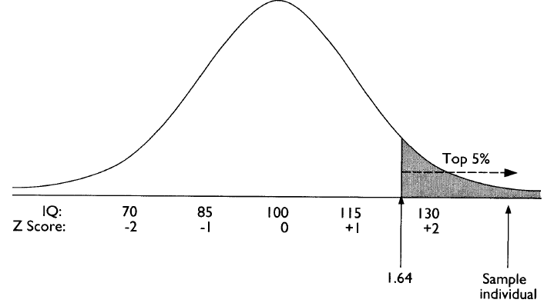
STEP 3. Determine cutoff (chosen a priori) sample scores on the comparison distribution at which the null hypothesis is rejected ( p = .05)
p < .05 or top 5% : (50% -5% = 45%) → Z = 1.64

Slide 14
STEP 3. Cutoff sample score on the comparison distribution at which the null hypothesis is rejected.
p = .05 indicates that assuming the H₀ is true there is a 5% probability of obtaining a score as extreme, or more extreme, than our study prediction.
This indicates our study prediction is unlikely when the starting assumption (H₀) is true.
If the p-value is low enough (< .05) we reject our starting assumption or the null hypothesis

Slide 15
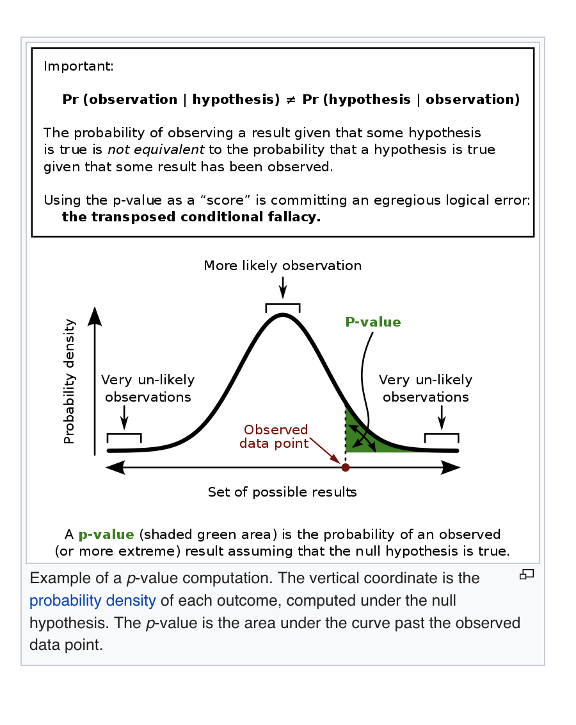
Probability and Significance
p < .05
This result is so extreme
or so unusual (top 5%) that
chance cannot explain it
Null Hypothesis Significance Testing (NHST)

Slide 16
STEP 4. Determine the score of your sample on the comparison distribution
Person selects individual with IQ score = 140
$$z=\frac{X–µ }{\text{σ}}=\frac{140 –100 }{\text{1}\text{6}}=\frac{40}{\text{1}\text{6}}=2.5$$

Slide 17
5. Compare the scores obtained in Step 3 and 4 to decide whether to reject the null hypothesis:
Score on Step 4 (Z = 2.5) is higher than score on
Step 3 (Z = 1.64)
Conclusion: Reject H₀; H₁ is supported

Slide 18
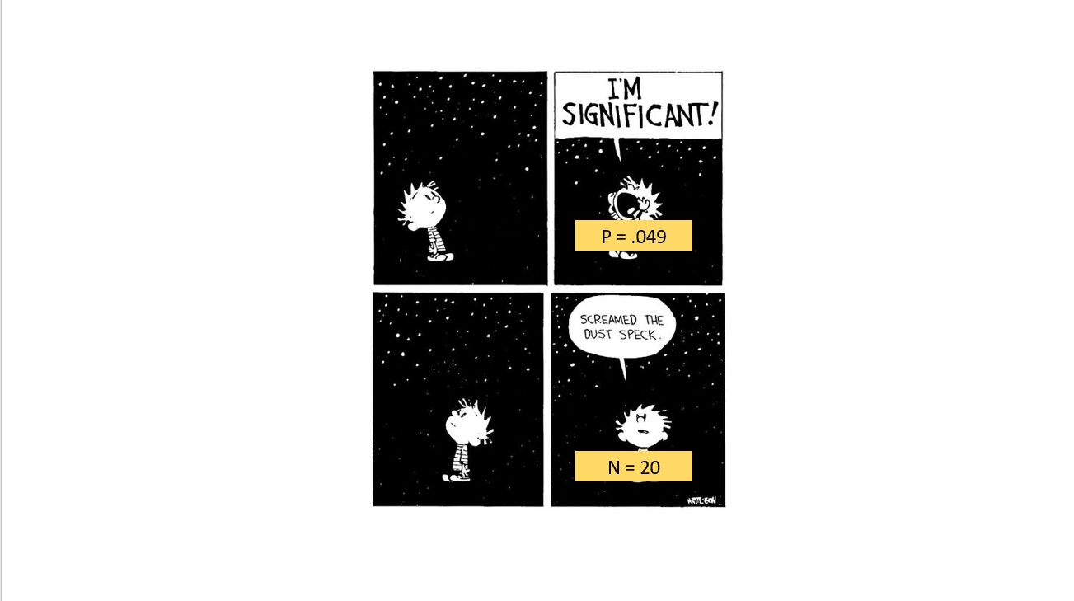

Slide 19
µ = 40, σ = 10

Slide 20
µ = 40, σ = 10
$$z=\frac{X–µ }{\text{σ}}=\frac{25 –40 }{\text{10}}=\frac{–15}{\text{1}0}= –1.5$$

Slide 21
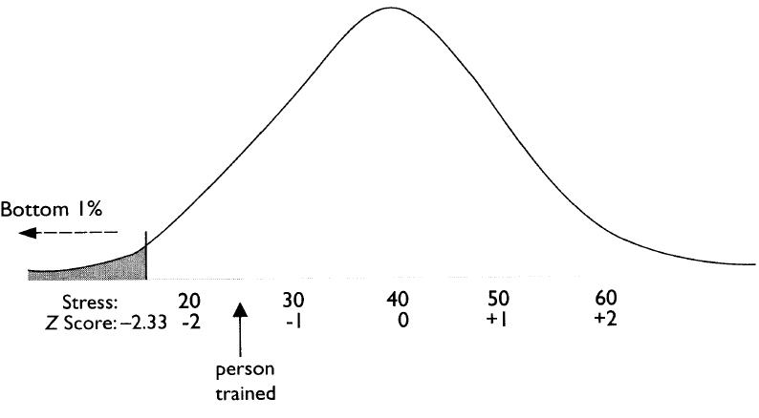

Slide 22
Implications of Rejecting or Failing to Reject the Null Hypothesis
When you reject the null hypothesis all you are saying is that your results support the research hypothesis.
The results never prove the research hypothesis or show that your hypothesis is true.
Research studies and their results are based on the probability or chance of getting your result if the null hypothesis were true.
When you fail to reject or accept the null hypothesis, you do not say that the results support the null hypothesis.
You say that the results are not statistically significant, or that the results are inconclusive.
We are basing research on probabilities, and the fact that we did not find a result in this study does not mean that the null hypothesis is true.

Slide 23
Significance Level
Criterion as % cutoff or p value
The lower the significance level, the more sure we are in rejecting H_{0:} Top .01% (p < .0001): Z score = +3.5)
The higher the significance level, less likely to deal with inconclusive results: Top 50% ( p = .5, Z = 0)
and always reject the H_{0:}

Slide 24
Significance Level
Convention in Psych: p < .01 or .05
How results are expressed:
Reject H_{o}: Results are statistically significant
Fail to reject H_{o}: Results are not statistically significant
A journal can't sensibly ignore the weight of evidence because papers that may be reporting mere noise in data (i.e., statistically non-significant results) are abundantly available but are generally uninteresting and, if misinterpreted, are misleading (Kafadar, K., 2021: Editorial: Statistical significance, p-values, and replicability. The Annals of Applied Statistics. https://doi.org/10.1214/21-AOAS1500; see also
https://imstat.org/journals-and-publications/annals-of-applied-statistics/annals-of-applied-statistics-next-issues/).

Slide 25
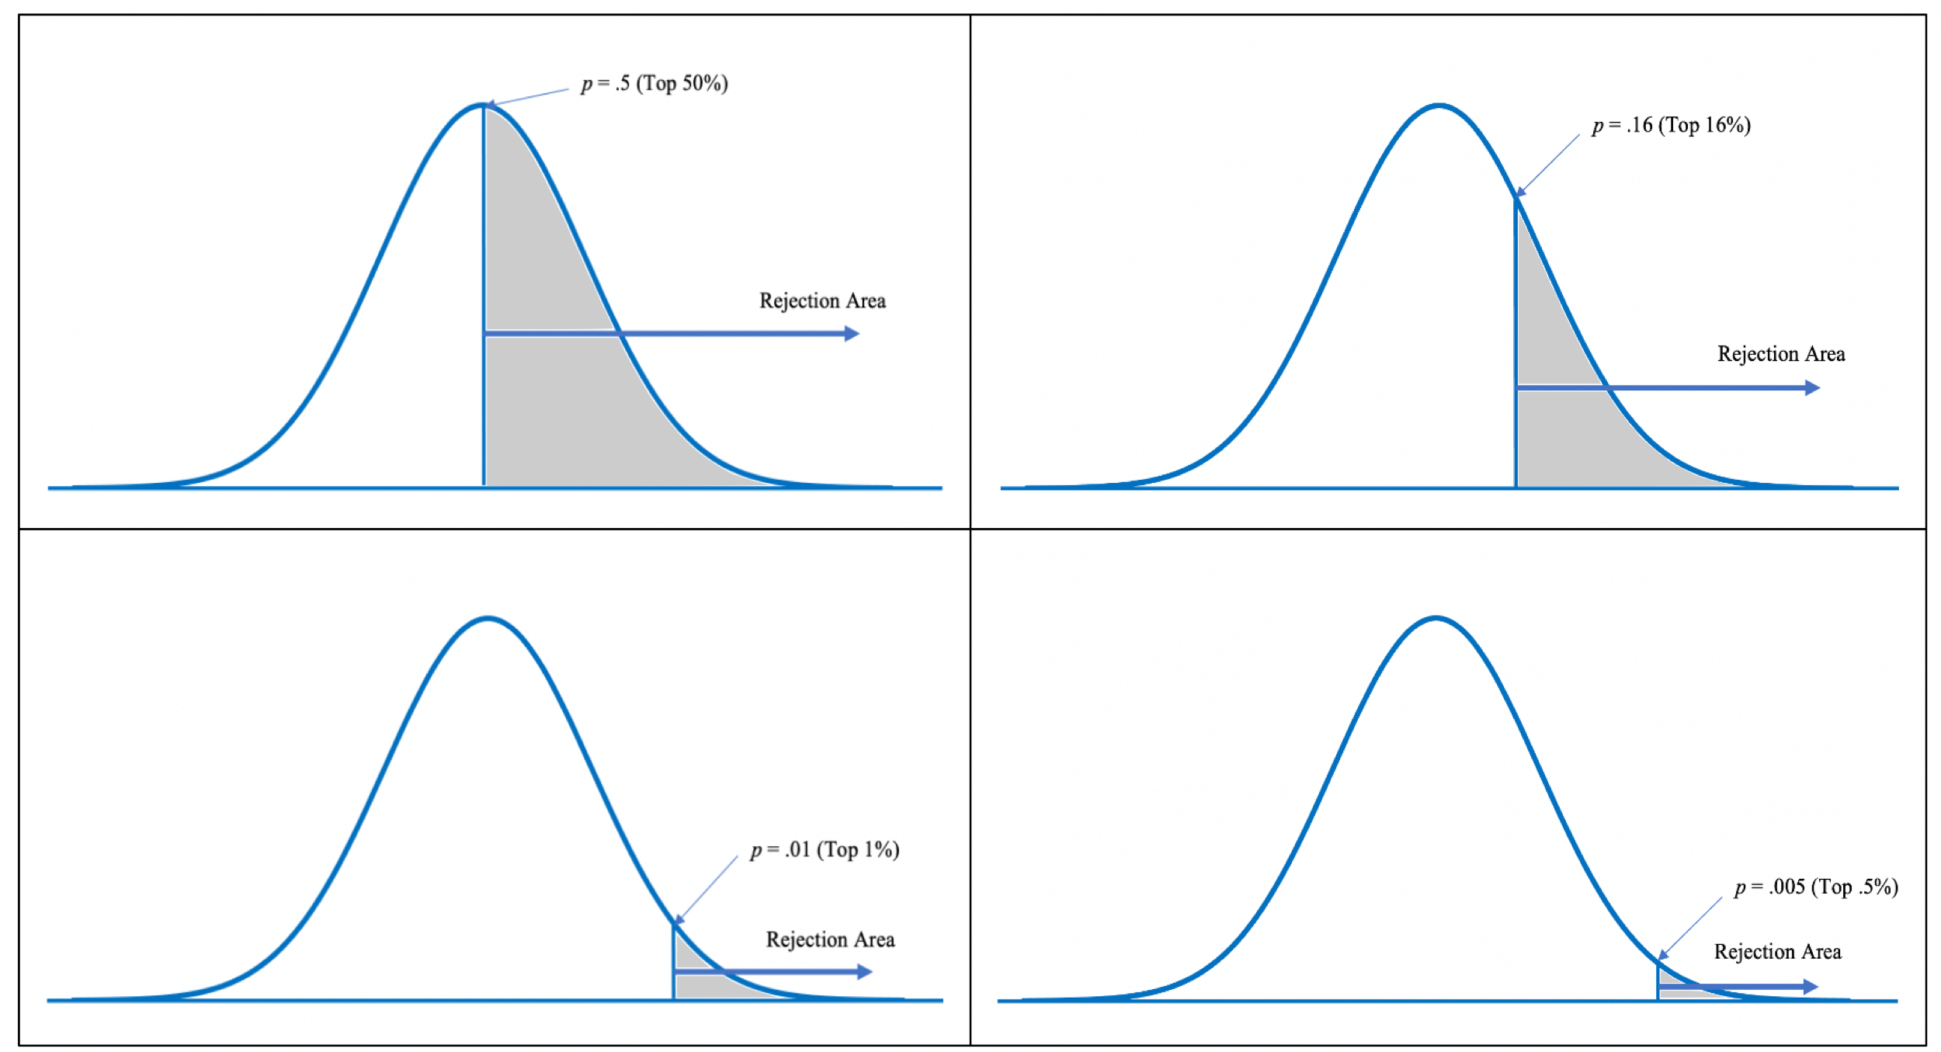

Slide 26
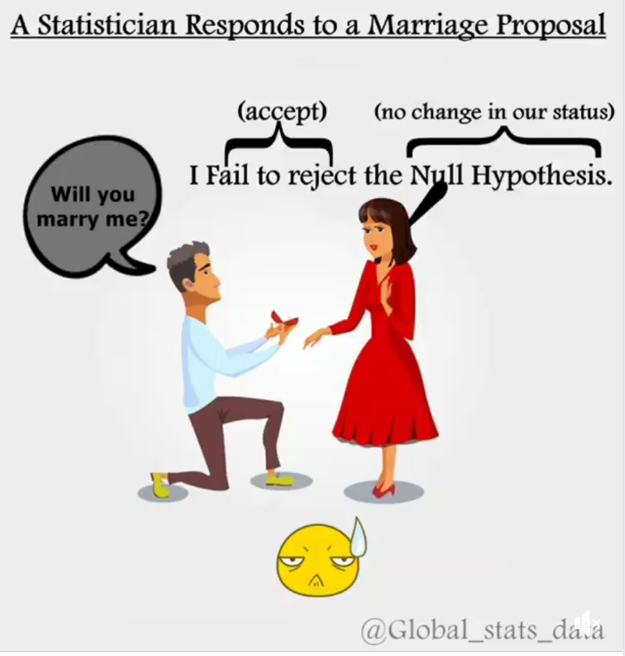

Slide 27
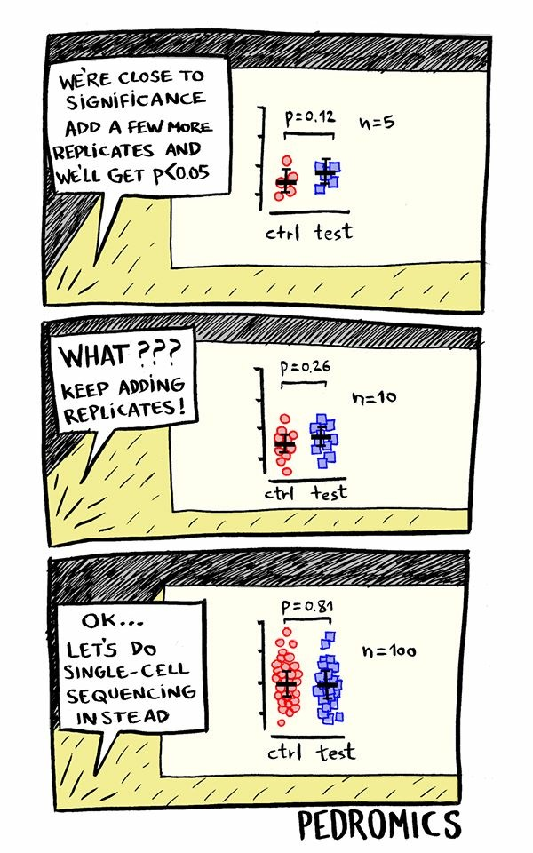

Slide 28
Key Points
Hypothesis testing considers the probability that the results of a study could have come about even if the experimental procedure had no effect. If this probability is low, the scenario of no effect is rejected and the hypothesis behind the experimental procedure is supported.
The expectation of an effect is the research hypothesis; the hypothetical situation of no effect is the null hypothesis.
When a result is so extreme that it would be very unlikely if the null hypothesis were true, the null hypothesis is rejected and the research hypothesis is supported. If the result is not that extreme, the researcher does not reject the null hypothesis and the study is inconclusive.
Behavioral and social scientists usually consider a result extreme enough if it is less likely than 5% that you would get that result if the null hypothesis was true. A significance level of 1% is also commonly used in research.
The cutoff percentage is the probability of the result being extreme in a predicted direction in a directional or one-tailed test. The cutoff percentages are the probability of the result being extreme in either direction in a nondirectional or two-tailed test.
Steps for hypothesis testing are:
Restate the question as a research hypothesis and a null hypothesis about the population.
Determine the characteristics of the comparison distribution.
Determine the cutoff sample score on the comparison distribution at which the null hypothesis should be rejected.
Determine your sample’s score on the comparison distribution.
Decide whether to reject the null hypothesis.

