Slide 1
Hypothesis Testing
Chapter 6
Inferential Statistics: Making inferences about populations based on samples

Slide 3
Chapter Outline
Hypothesis-Testing
One-Tailed and Two-Tailed Hypothesis Tests
Decision Errors

Slide 4
Decision Errors
When the right procedures lead to the wrong decisions
In spite of calculating everything correctly, conclusions drawn from hypothesis testing can still be incorrect.
This is possible because you are making decisions about populations based on information in samples.
Hypothesis testing is based on probability.

Slide 5
Hypothesis Testing Principle
A person says that she can identify people of above average intelligence with her eyes closed. Is this true?
1. Define Populations & reframe hypotheses about populations
Population 1: People chosen by woman
Population 2: People in general (Known)
H₁: µ₁ > Population µ₂
H₀: µ₁= µ₂
2. Characteristics of the comparison distribution
Known normal distribution with µ = 100; σ = 16

Slide 6
TYPE I ERROR α
3. Determine the Cutoff Sample scores on the comparison distribution (criterion) at which the null hypothesis should be rejected (p = .5)
50% probability (top 50%), Z needed is 0
A 30% Probability (top 30%)? Z = .524

Slide 7
Type I (α) Error
Rejecting the null hypothesis when the null hypothesis is true
You find an effect when in fact there is no effect.
A Type I error is a serious error as theories, research programs, treatment programs, and social programs are often based on conclusions of research studies.
The chance of making a Type I error is the same as the significance level.
If the significance level was set at p < .01, there is less than a 1% chance that you could have gotten your result if the null hypothesis were true.
Reduce chance of making a Type I error by decreasing significance level (e.g., p < .001).

Slide 8
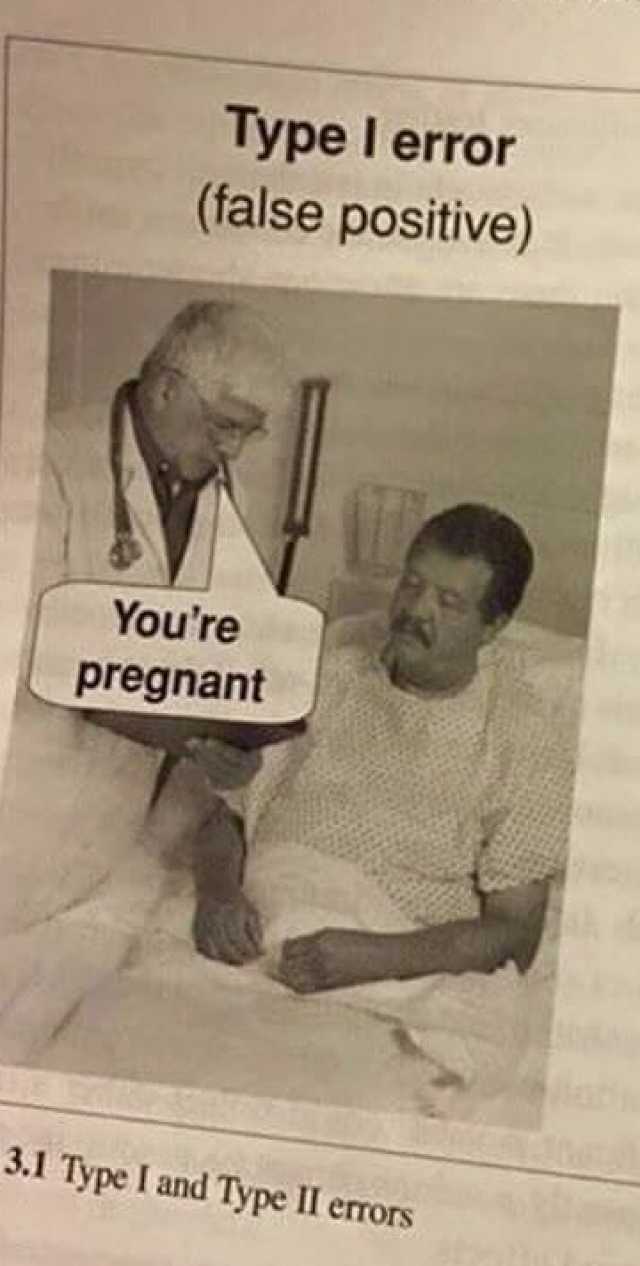
Outcomes of Hypothesis Testing
Type I error
Reject the null hypothesis when it is correct.
Saying there is a difference when there is not a difference
We are rejecting a true null hypothesis.
Accepting a research hypothesis when in fact it is not true

Slide 9
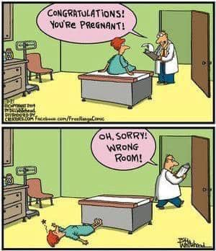

Slide 10
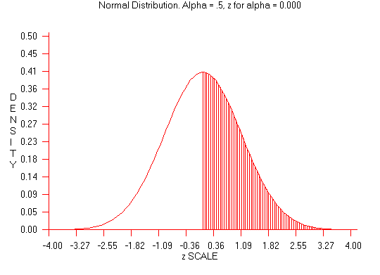
Acceptance
Area
Rejection
Area

Slide 11
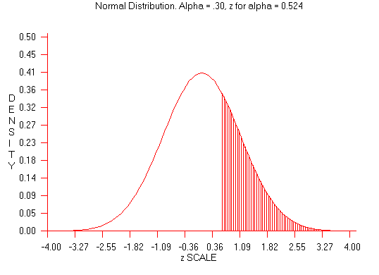
Acceptance
Area
Rejection
Area

Slide 12
Type II Error ( ß).
Not rejecting H_{O} when it is false.
Accepting H_{O} when it is false.
Saying there is not a difference when in fact there is a difference
Why?
Because the critical value (p < .001) may be too extreme or low, and maybe sample representative.
There maybe a difference but p value to low.

Slide 13
Type II Error
With a very extreme significance level, there is a greater probability that you will not reject the null hypothesis when the research hypothesis is actually true.
concluding that there is no effect when there is actually an effect
The probability of making a Type II error can be reduced by setting a very lenient significance level (e.g., p < .10).

Slide 15
Relationship Between Type I and Type II Errors
Decreasing the probability of a Type I error increases the probability of a Type II error.
The compromise is to use standard significance levels of p < .05 and p < .01.

Slide 16
Probability of making a Type I error (α)?
The p = value chosen (p < .05):
Probability of Type I error is 5 out of 100.
This is why we do not use p’s = .2 (20 out 100).
The smaller the prob of Type I Error the more we are controlling: p < .001
A p = .2 increase Type I error.

Slide 17
TYPE II ERROR β
3. Determine the Cutoff Sample scores on the comparison distribution (criterion) at which the null hypothesis should be rejected (p = .05)
p = 5 % (top 5%), Z = 1.64
p = 2.5 % (top 2.3 %), Z = 1.96
p =1 % (top 1%), Z = 2.33
How about a p < .001
or a p < .0001

Slide 18
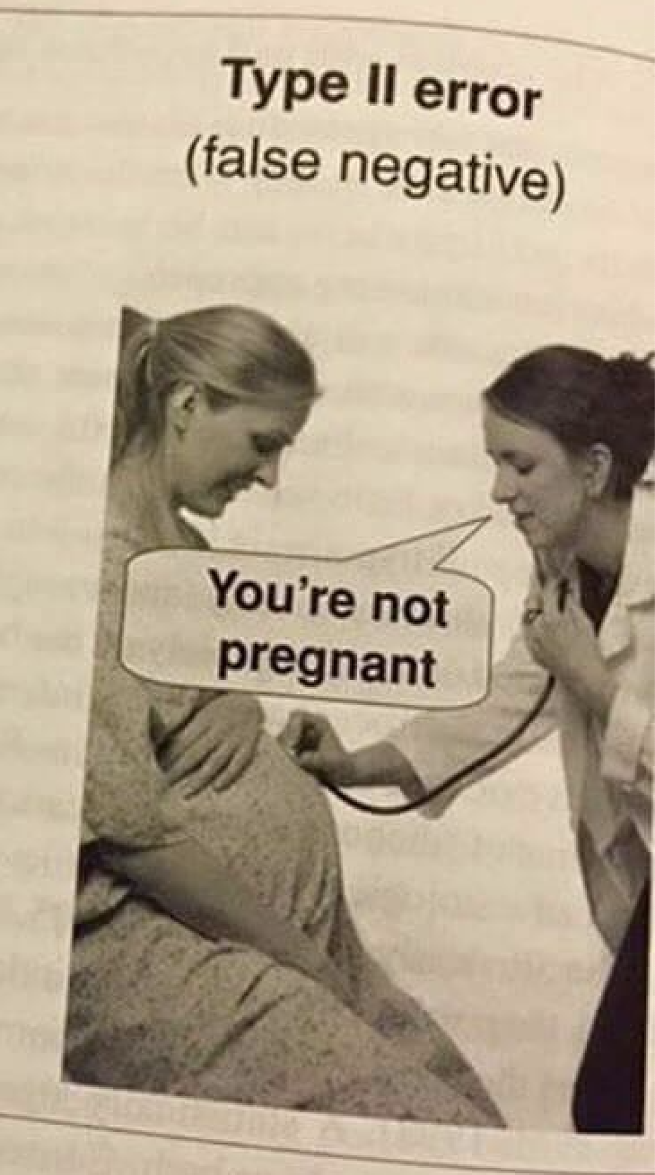
Type II (ß) Error
With a very extreme significance level: Greater probability to not reject H₀ when the H₁ is actually true.
Concluding that there is no effect when there is actually an effect
Reduce Type II error by increasing p-value (e.g., p < .10)

Slide 19
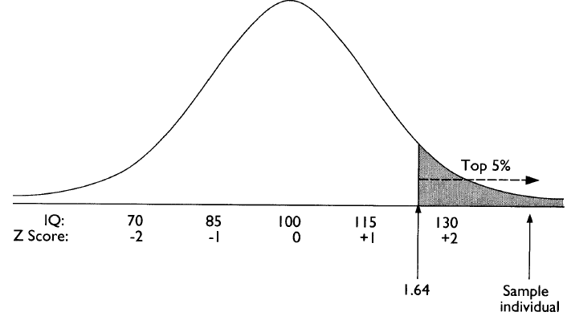

Slide 20
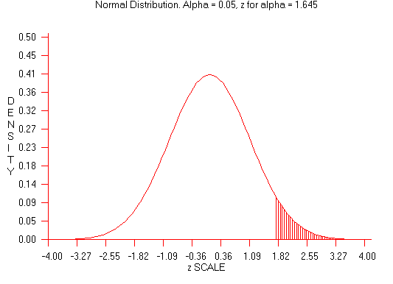
Acceptance
Area
Rejection
Area

Slide 21
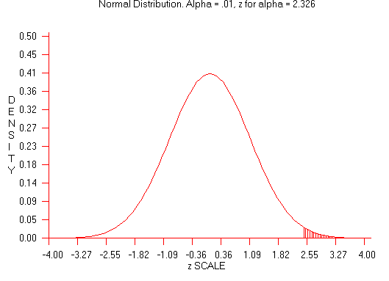
Acceptance
Area
Rejection
Area

Slide 22
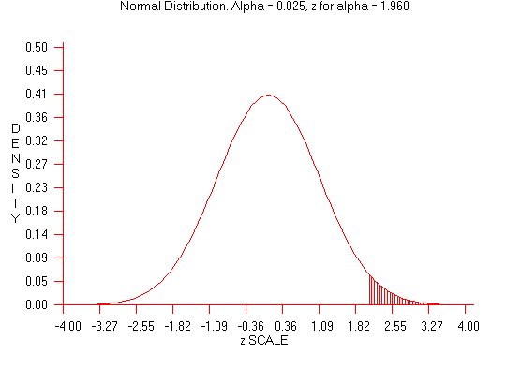
Acceptance
Area
Rejection
Area

Slide 23
Acceptance
Area
Rejection
Area

Slide 24
Acceptance
Area
Rejection
Area

Slide 25
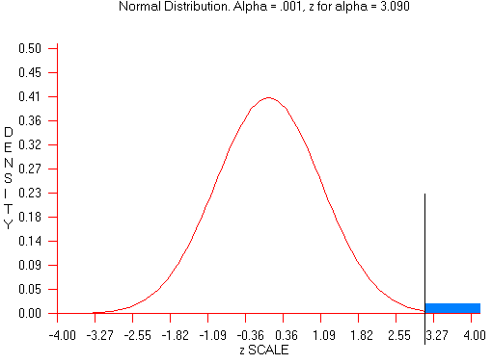
Acceptance
Area
Rejection
Area

Slide 26
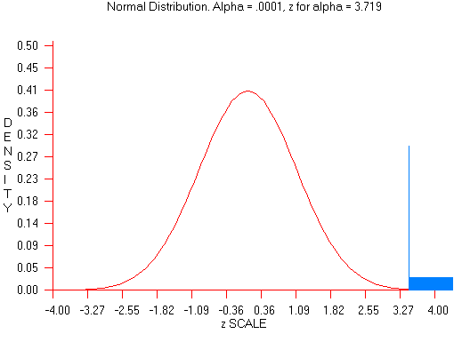
Acceptance
Area
Rejection
Area

Slide 27
Type II Error a Very High Price to Pay for
Theory building:
Sometimes we may abandon a particular good theory because of a small p value.
Practical applications of a particular treatment
Which one to use?
Control Type I error by using small p (.0001)
Control Type II error by increasing p (.2 or .3)
Use conventional values: .01 and .05.

Slide 29
Relationship Between α and β Errors
Decreasing the probability of a Type I error increases the probability of a Type II error.
The compromise is to use standard significance levels of p < .05 and p < .01.

Slide 30
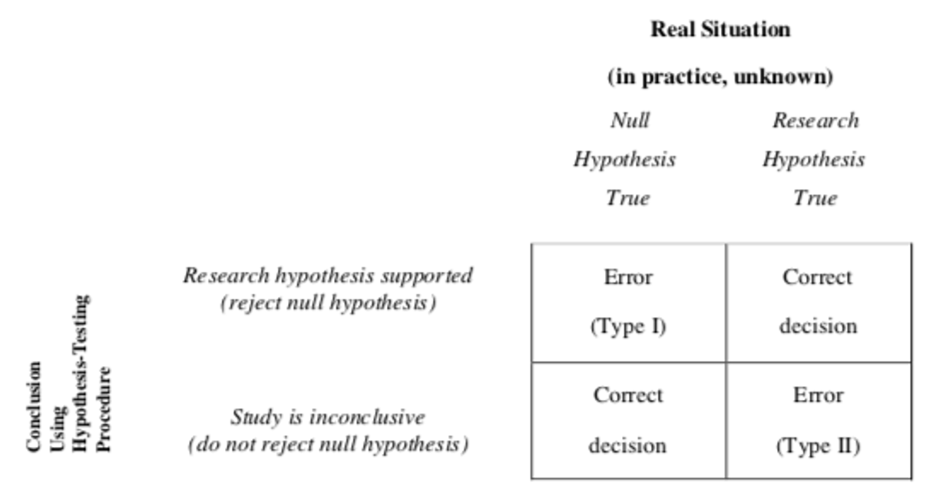

Slide 31
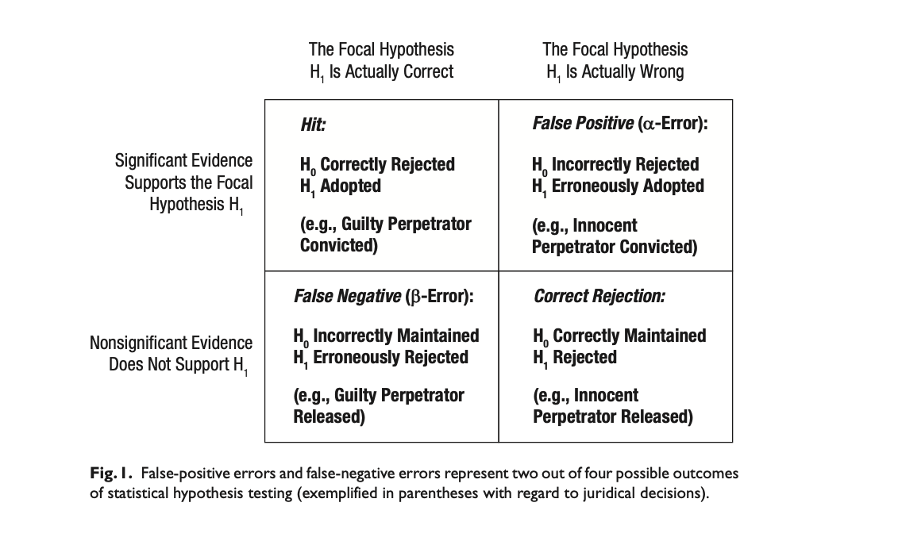

Slide 32
$µ=100,\text{σ}$ = 15
$$Z=\frac{X−µ}{\text{σ}}=\frac{140−100}{15}=2.67$$

Slide 33
One- and Two-Tailed Tests
Researcher predicts direction of H_{A} < or >
ANACIN improves memory
Experimental Group will score higher than Control group
Population 1 = group received Anacin
Population 2 = group did not receive it
H₁= Pop. 1 Remember more words than Pop. 2
H_{o}=Pop. 2 not remember more words than Pop. 1

Slide 34
One- and Two-Tailed Tests
One-Tailed Test: A directional hypothesis: it predicts a direction of result.
Also called a one-tailed test: hypothesis test looks for an extreme result at just one end (high or low end) of the curve.
Psychic (high end)
Stres-reduction-method example (low end)

Slide 35
µ = 40, σ = 10

Slide 36
µ = 40, σ = 10
$$z=\frac{X–µ }{\text{σ}}=\frac{25 –40 }{\text{10}}=\frac{–15}{\text{1}0}= –1.5$$

Slide 37
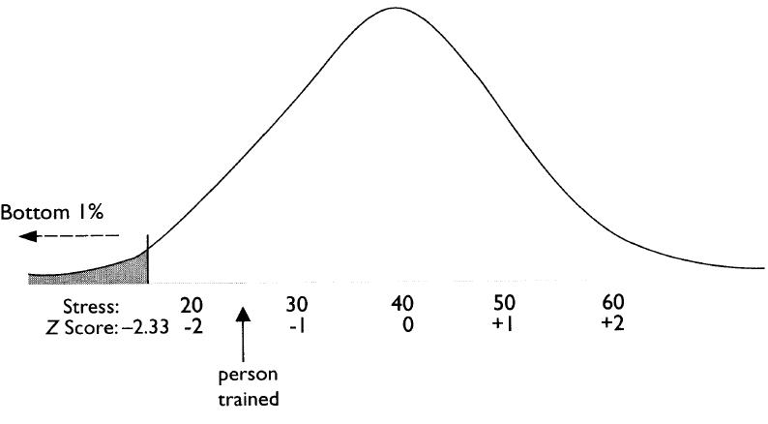

Slide 38
Two-Tailed Tests
Experimental treatment will make a difference:
Two-tailed test (non directional): Doesn't sayhow high or how low.
Extreme results: Either extreme or tail (a lot or a little sleep) would make us reject the H_{o}
Example: A polluting substance accidentally put in the water in a particular region may be suspected to affect the part of the brain that controls sleep, but it is not known whether it will increase or decrease amount of sleep.

Slide 41
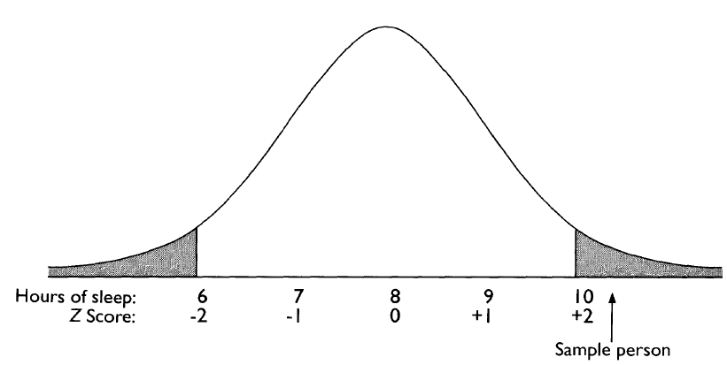

Slide 42
Non-directional hypothesis: polluting substance to affect sleep BUT no direction of effect specified.
In setting the cutoff for rejecting H₀
p < .05) value divided between the two tails
.05/2 = .025 or 2.5% at each side.
To be significant, score more extreme than if a one-tailed test

Slide 43
One-Tailed or Two-Tailed Tests
Use a one-tailed test when you have a clearly directional hypothesis (Theory Driven)
Use a two-tailed test when you have a clearly non-directional hypothesis (Don't know which way).
With a one-tailed test, if the sample score is extreme—but in the opposite direction—the null cannot be rejected.
Often researchers will use two-tailed tests even if the hypothesis is directional (As protection!)

Slide 44
When to Use One-Tailed or Two-Tailed Tests
Use a one-tailed test when you have a clearly directional hypothesis.
Use a two-tailed test when you have a clearly non-directional hypothesis.
With a one-tailed test, if the sample score is extreme—but in the opposite direction—the null cannot be rejected.
Often researchers will use two-tailed tests even if the hypothesis is directional.

Slide 45
Key Points
Hypothesis testing considers the probability that the results of a study could have come about even if the experimental procedure had no effect. If this probability is low, the scenario of no effect is rejected and the hypothesis behind the experimental procedure is supported.
The expectation of an effect is the research hypothesis; the hypothetical situation of no effect is the null hypothesis.
When a result is so extreme that it would be very unlikely if the null hypothesis were true, the null hypothesis is rejected and the research hypothesis is supported. If the result is not that extreme, the researcher does not reject the null hypothesis and the study is inconclusive.
Behavioral and social scientists usually consider a result extreme enough if it is less likely than 5% that you would get that result if the null hypothesis was true. A significance level of 1% is also commonly used in research.
The cutoff percentage is the probability of the result being extreme in a predicted direction in a directional or one-tailed test. The cutoff percentages are the probability of the result being extreme in either direction in a nondirectional or two-tailed test.
Steps for hypothesis testing are:
Restate the question as a research hypothesis and a null hypothesis about the population.
Determine the characteristics of the comparison distribution.
Determine the cutoff sample score on the comparison distribution at which the null hypothesis should be rejected.
Determine your sample’s score on the comparison distribution.
Decide whether to reject the null hypothesis.
A Type I error is when a researcher rejects the null hypothesis but the null hypothesis is actually true. A Type II error is when a researcher does not reject the null hypothesis, but the null hypothesis is actually false.
Research articles report the results of hypothesis testing by saying whether the results were significant, giving the cutoff sample score on the comparison distribution, and giving the probability level of the cutoff sample score.

