Slide 1
T-TEST FOR DEPENDENT MEANS
Chapter 8

Slide 3
Chapter Outline
The t-test for Dependent Means
Assumptions of the t-test Test for Dependent Means

Slide 4
The T-Test for Dependent Means
It is common when conducting research to have two sets of scores and not to know the mean of the population.
Repeated Measures Design
research design: person is tested more than once
Type of design: a t test for dependent means is used.
The means for each group of scores are from the same people and are dependent on each other.
A t test for dependent means is calculated the same way as a t test for a single sample; however:
Difference scores are used .
You assume that the population mean is 0.

Slide 5
t-test for Dependent Means
Within-subjects designs or (Repeated measures Designs)
Same people tested twice
Before and after (pretest-posttest)
Does therapy work in relieving depression?
Before Therapy: Measure depression levels
After Therapy: Measure depression levels again
Same subject performing two experimental conditions
S1= How fast subject can read under bright light
S1 = How fast subject can read under dim light

Slide 6
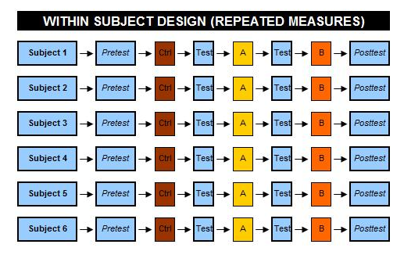

Slide 8
Matched designs
Different people are matched into pairs:
Based on IQ, social economic status and age
Is intelligence inherited?
Match design: with Identical twins
Twin one raised in wealthy household
Twin two raised in poor household
Take IQ test and compare scores
Situation treated as if both subjects are the same person tested at two different times

Slide 9
Dependent Means: interest in difference/change Scores
Score differences: After – Before (Difference score)
For each subject subtract BEFORE from AFTER score:
If before = 8 and after = 6, change = -2
If before = 39 and after = 10, change = -29
If before = 80 and after = 60, change = -20
If before = 30 and after = 40, change?
If before = 30 and after = 50, change?
If before = 30 and after = 25, change?

Slide 10
End up with one score per subject
Subject 1: before = 30 and after = 40
—> Subject 1: New score = +10
—> All calculations based on new score (+10)
For Dependent means change is most important
Population Distribution of (change) difference scores
Sample of change/difference scores
Comparison distribution: Sampling distribution of change/difference scores:
Sample variance of difference scores

Slide 11
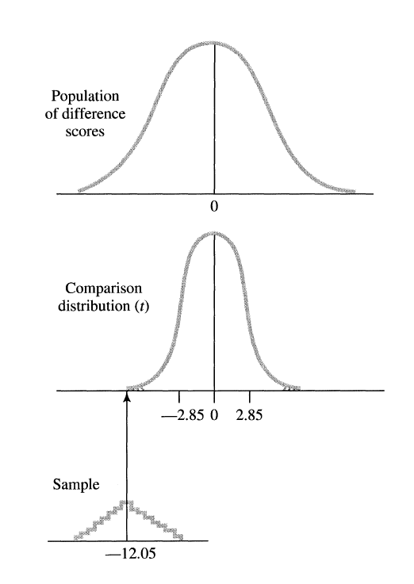
Population Distribution of difference (change) scores
Take a Sample of change scores
Sampling Distribution of Difference Scores

Slide 12
T-Test for Dependent Means
Tests hypotheses: Repeated-measures designs
Interested in a significant change/difference
Hypothesis testing:
H₀: there is no change
H_{A:} There is some change (or directional)
Convert data to change/difference scores
All computations based on change scores

Slide 13
Population of Difference Scores with a Mean of 0
Null Hypothesis in a repeated measured design
on average (if H₀ is true), there is no difference between the two groups of scores.
When working with difference scores
compare the population of difference scores from which your sample of difference scores comes (Population 1) to a population of difference scores (Population 2) with a mean of zero.
(2) Estimate S²
Sample Variance of Difference Scores = S²

Slide 14
S² of Difference Scores
Sample Variance of Difference Scores = S²
Sample Standard Deviation of Difference Scores = S
$$Estimated standard error of Difference Scores = S_{{\overline{X}}_{D}}$$
$$or Estimated standard error = S_{{\overline{X}}_{D}}= \frac{S}{\sqrt{n}}$$

Slide 15
$$t=\frac{{\overline{X}}_{D} − µ_{D}}{S_{{\overline{X}}_{D}}}$$

Slide 16
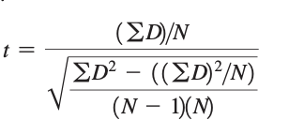

Slide 17
Assumptions for the t-test for dependent means
Pop. distribution (of change/difference scores) must be normal.
Usually not a problem
Unless reason to expect a very large discrepancy of normality
Reason to expect that the population of change scores is quite skewed and you are using a one-tailed test.

Slide 18
t-Test for Communication Quality Scores Before and After Marriage for 19 Husbands who Received No Special Communication Training

Slide 19
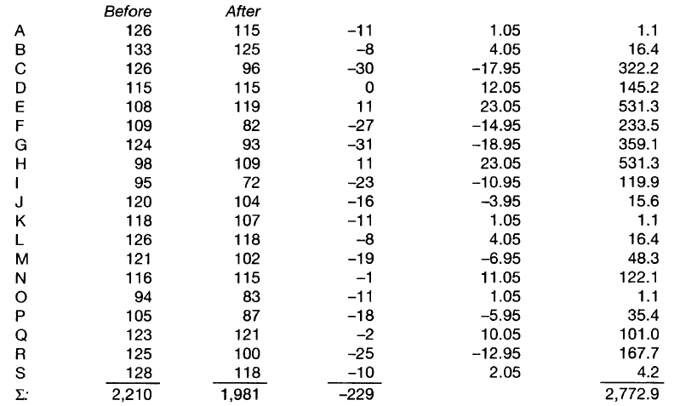
Squared Deviation
Of differences from
The mean of differences
-11-(-12.05)
Mean:
-229/19 = -12.05

Slide 20
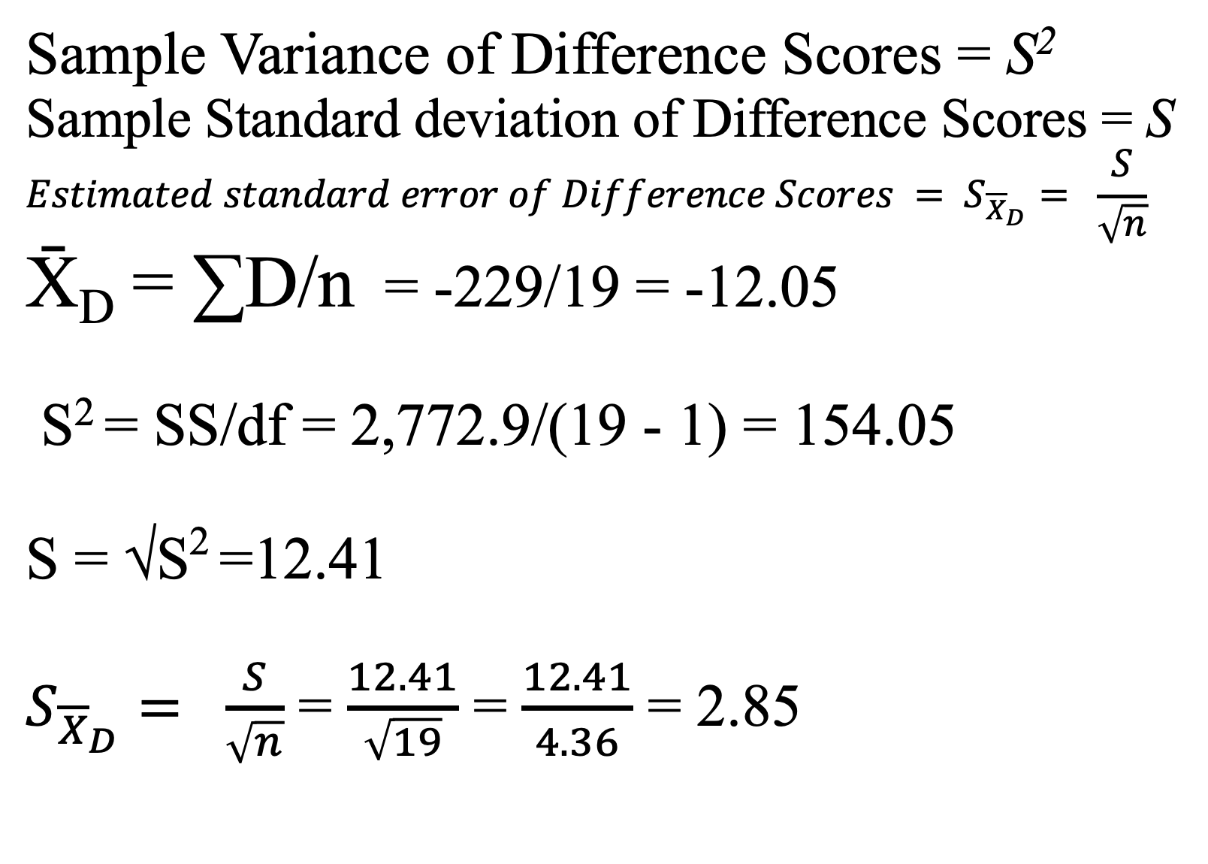

Slide 21
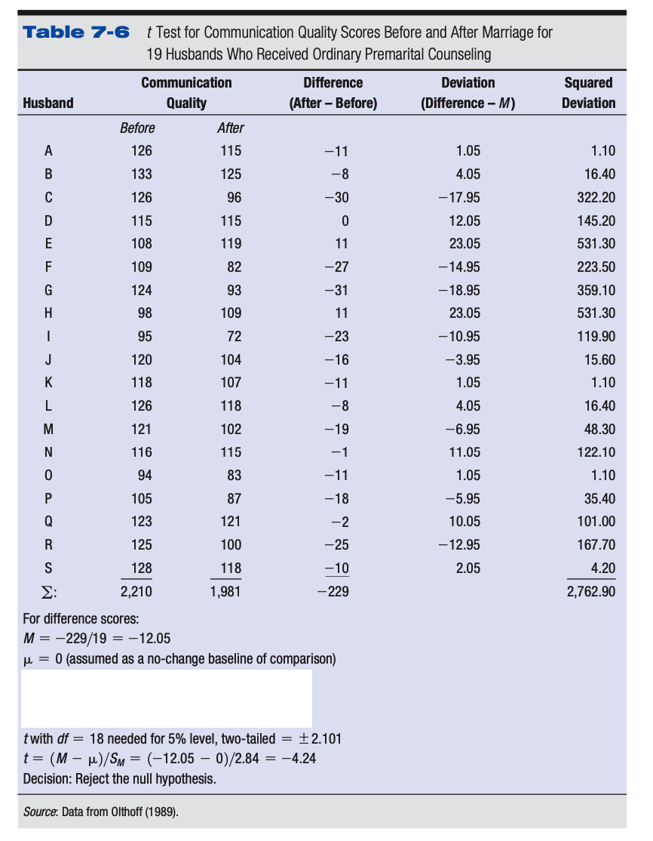

Slide 22
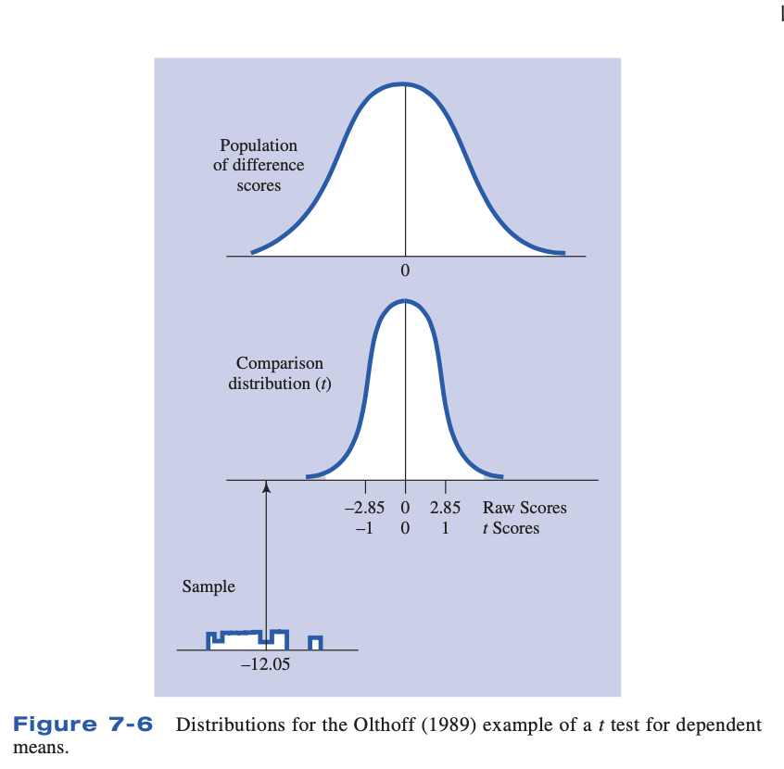

Slide 23
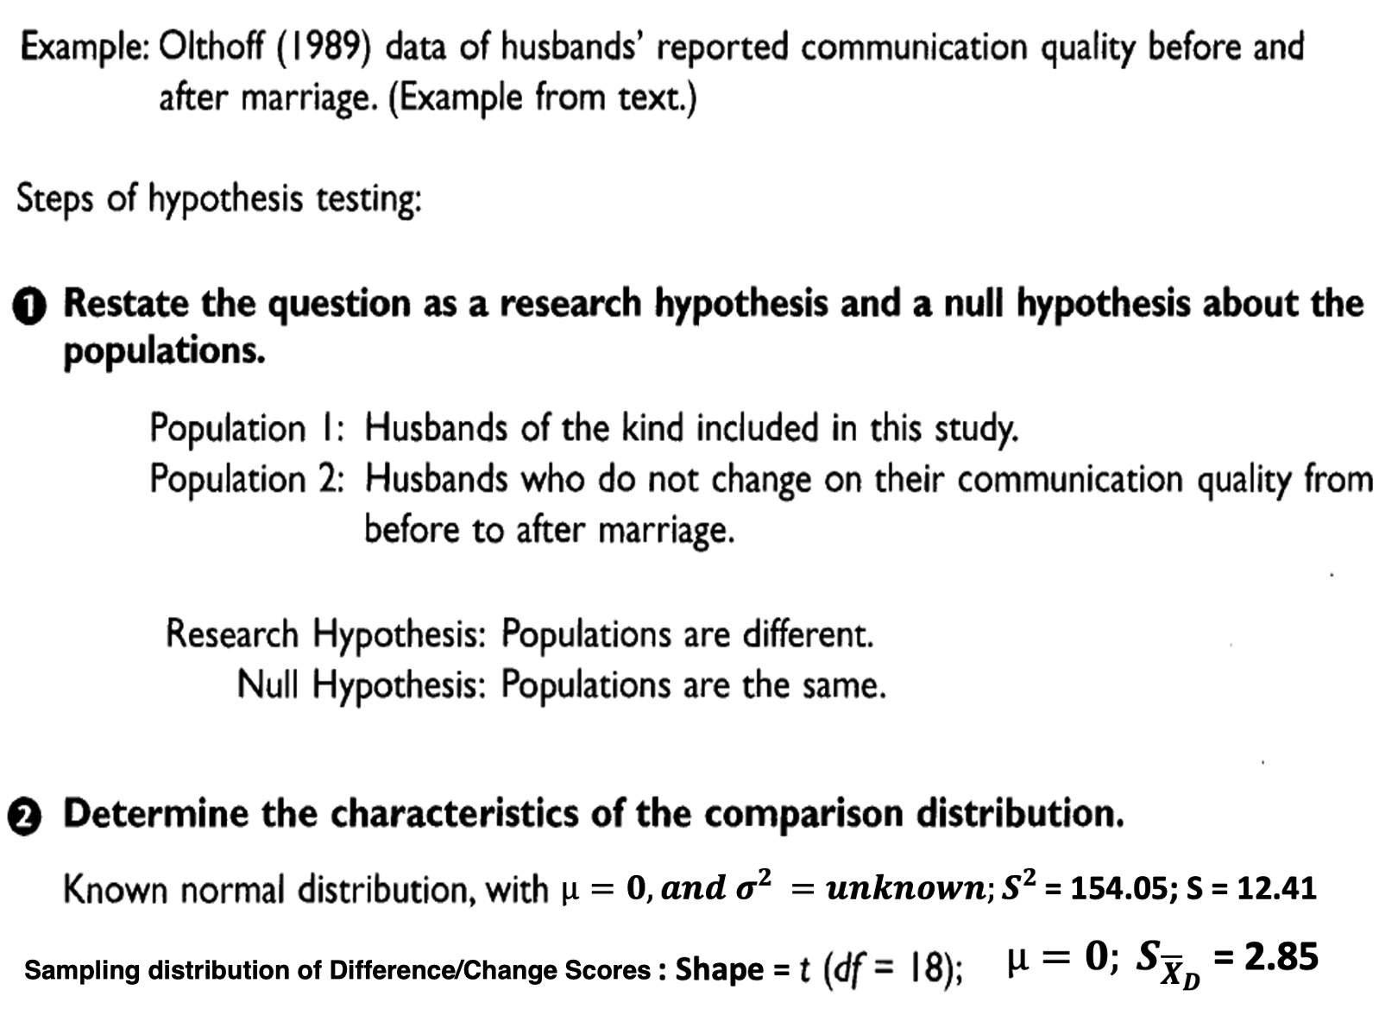

Slide 24
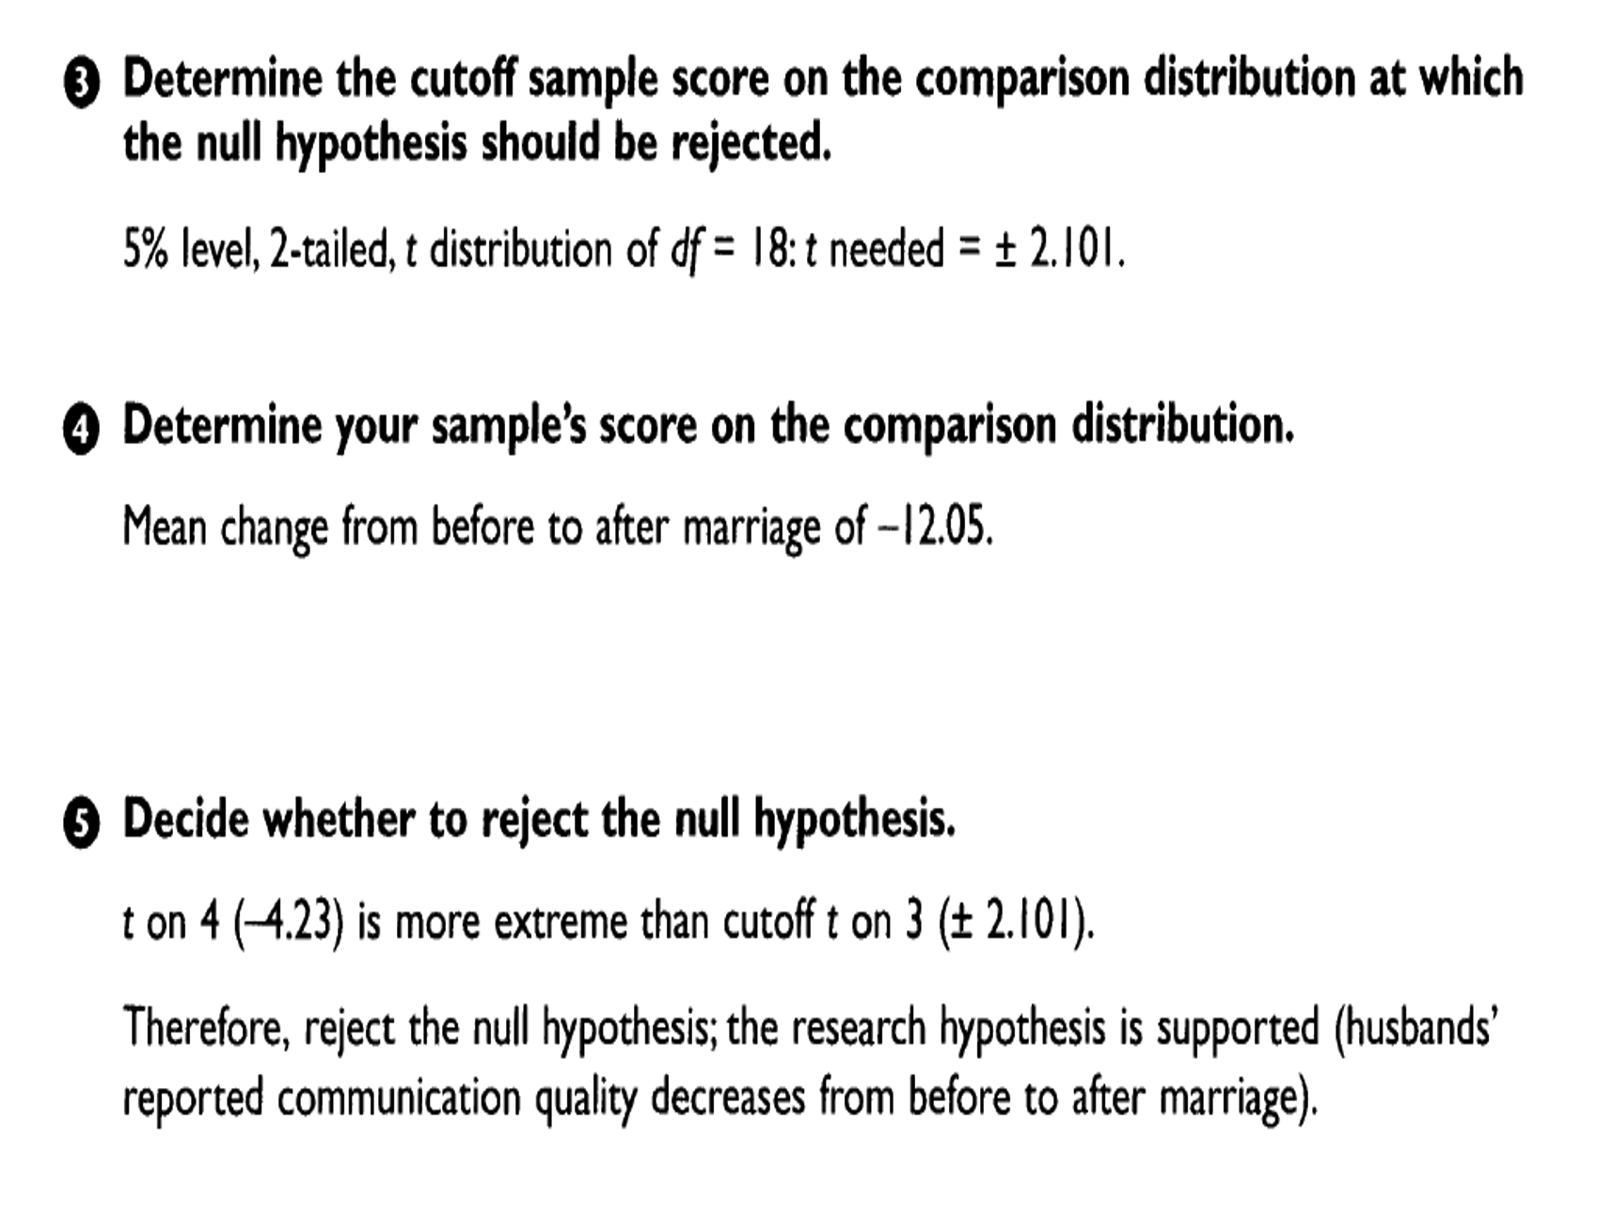
$t= \frac{{\overline{X}}_{D}− µ_{D}}{S_{{\overline{X}}_{D}}}$ = $\frac{−12. 05 − 0}{2.85}$ = – 4.23

Slide 26
Norma; $µ=0, and σ^{2 }=unknown;S^{2 }$ = 5.71; S = 2.39
Sampling Distribution of Difference/Change scores: Shape = t = (df = 108) $µ=0; S_{{\overline{X}}_{D}}$ = .23
$$S_{{\overline{X}}_{D}}= \frac{S}{\sqrt{n}}=\frac{2.39}{\sqrt{109}}= \frac{2.39}{10.4}= .23$$
$t= \frac{{\overline{X}}_{D}− µ_{D}}{S_{{\overline{X}}_{D}}}$ = $\frac{1.44 − 0}{.23}$ = 6.26

Slide 27
How Are You Doing?
What is an example of a research study for which you would need a t test for dependent means?
What is a difference score?

Slide 28
The Power of Studies Using a t Test for Dependent Means
Studies using a repeated-measures design (using difference scores) often have much larger effect sizes than studies using other research designs.
There is more power with this type of study than if the participants were divided into groups and each group was tested under each condition of the study.
The higher power is due to a smaller standard deviation that occurs in these type of studies.
The smaller variation is because you are comparing participants to themselves.

Slide 29
Key Points
When you have to estimate the population variance from scores in a sample, you will use a formula that divides the sum of square deviation scores by the degrees of freedom.
With an estimated population variance, the comparison distribution is a t distribution; it is close to normal, but varies depending on the associated degrees of freedom.
A researcher would use a t test for dependent means when there is more than one score for each participant. In this case you would use difference scores.
An assumption of the t test is that the population distribution is normal, but even if the distribution is not normal, the results are fairly accurate.
When testing hypotheses with t tests for dependent means, the mean of Population 2 is assumed to be 0.

