Slide 1
HUMAN MEMORY

Slide 2
Chapter 1
Introduction to (Human Memory) the Study of the Brain
Notes:
Change 2 Edition to 3 Edition Change title to : Introduction to the Study of the Brain

Slide 3
Memory is Critical: Do We need Memory?
Who are you?
Remember your past?
What do you do?
Where were you born?
How old are you?
Which beer is better?
Problem solving?
Remember situations?

Slide 4
Cerveza es mejor que beer

Slide 5
Priming (LEARNING!)
Exposure to a previous word/concept/picture facilitates its subsequent recognition

Slide 6
I have broken more Elton John records, he seems to have a lot of records. And I, by the way, I don’t have a musical instrument. I don’t have a guitar or an organ. No organ. Elton has an organ. And lots of other people helping. No we’ve broken a lot of records. We’ve broken virtually every record. Because you know, look I only need this space. They need much more room. For basketball, for hockey and all of the sports, they need a lot of room. We don’t need it. We have people in that space. So we break all of these records. Really we do it without like, the musical instruments. This is the only musical: the mouth. And hopefully the brain attached to the mouth. Right? The brain, more important than the mouth, is the brain. The brain is much more important.

Slide 7
The science of memory
Empirical evidence: Results of scientific research (process): Experiments!
Testable questions (Verifiable; replication)
Experiments (Data)
Goal of memory science: generalize about how memory works, BUT under controlled laboratory conditions.

Slide 8
History of Memory
Hermann Ebbinghaus (Father of Memory)
Examined the effect of retention intervals on memory.
A retention interval: time between learning and retrieving an item
Memory Savings (Method): Reduction in time required to relearn a previously mastered list.
Study a list of 10 words = 10 minutes to master it.
Relearn the list of 10 words = 5 minutes to relearn it
Savings = 5 minutes
Overlearning: Studying after material has been learned.
Spacing Effect: Spacing (spreading) your study over time

Slide 9
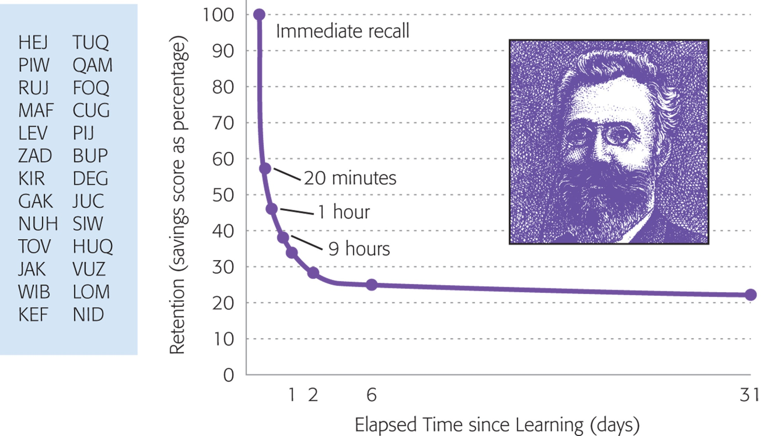
FORGETTING CURVE

Slide 10
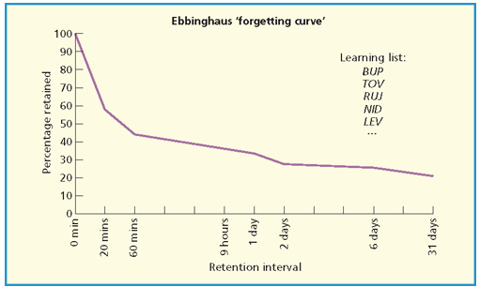
The forgetting curve that Ebbinghaus obtained when he plotted the results of one of his forgetting experiments. His finding, that information loss is very rapid at first and then levels off, holds true for many types of learned materials. Data from Ebbinghaus (1913).

Slide 11
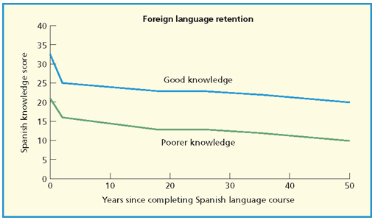
People who learned Spanish in college showed rapid forgetting over the first 3 or 4 years, followed by remarkably little forgetting over the next 30 years (Bahrick, 1984). Those who had a good knowledge (upper line, in blue) continued to have a clear advantage, even 50 years later. Data from Bahrick (1984).

Slide 12
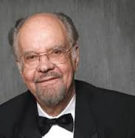
History of Memory
Endel Tulving
Encoding specificity principle; retrieval should match encoding.
Episodic/semantic distinction in memory; multiple memory systems.

Slide 13
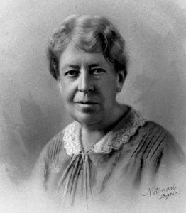
History of memory
Mary Calkins
Paired-associate learning.
Learn words linked together “rainbow–cathedral,” “captain–carbon.”
Recency effect: immediate recall (that is, when the test occurs right after learning), items which were most recently learned are remembered better than items from the middle of the list.

Slide 14
History: Memory and Behaviorism
Behaviorism. Only study directly observable behavior.
Classical conditioning: An Association between a stimulus (RING BELL) and an outcome (GETTING FOOD)
Organism demonstrates response (e.g., salivating); organism has learned the association between the stimulus and the outcome.
Operant conditioning: organism learns (IS IN CONTROL) to emit responses (e.g., pressing a bar), in response to a stimulus, to achieve desirable outcomes (getting food) or avoiding undesirable outcomes (getting electric shock).
Stimulus Response
WHAT HAPPENS IN THE MIDDLE? A BLACK BOX? PROCESSING?

Slide 15
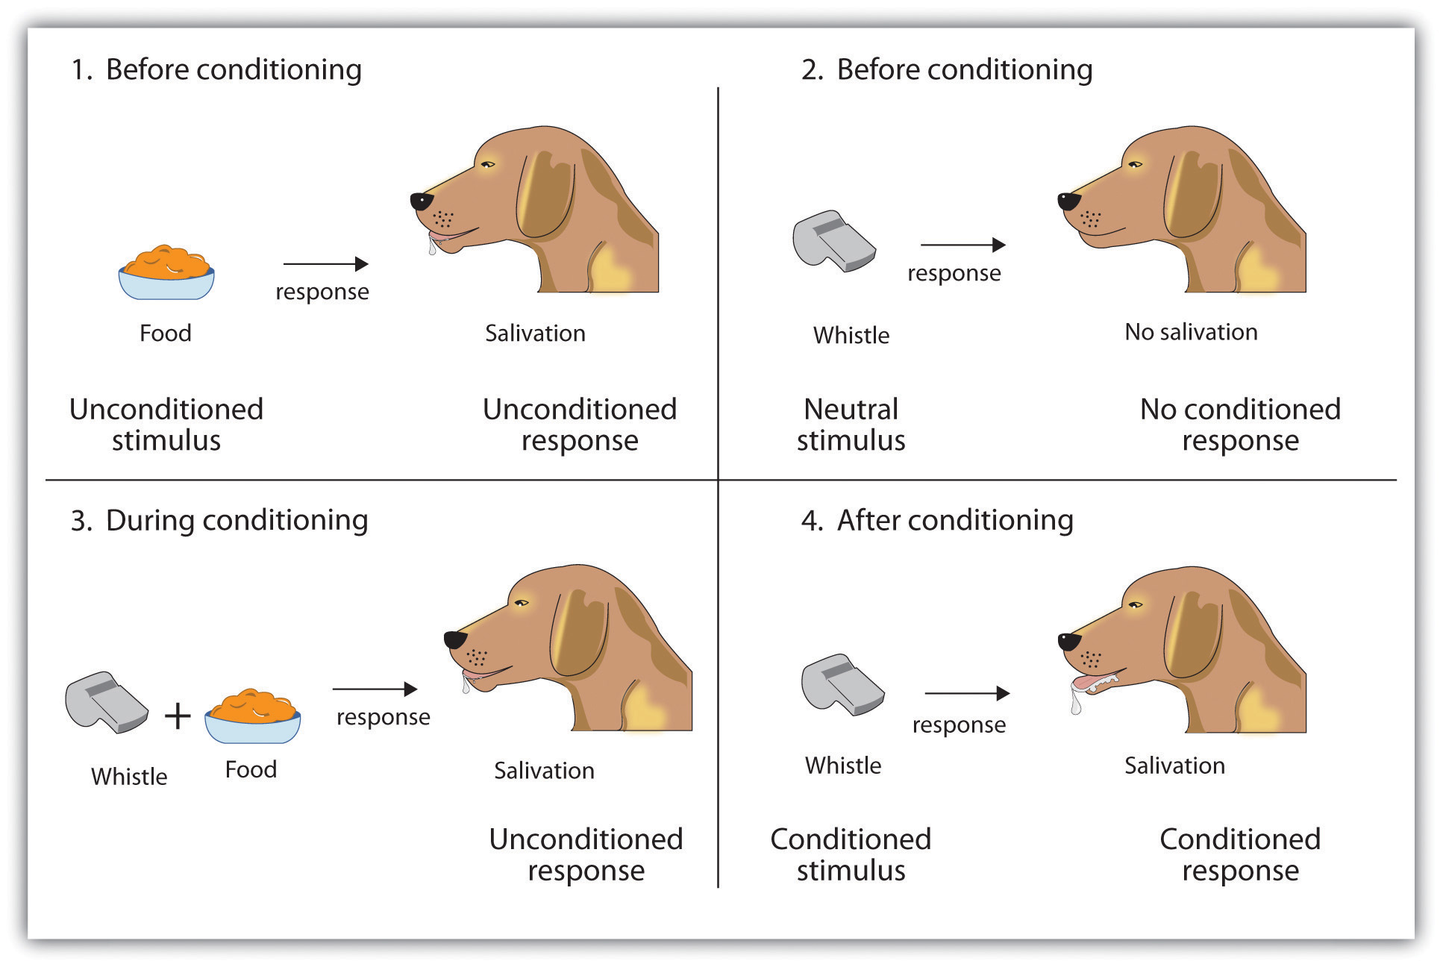
http://images.flatworldknowledge.com/stangor/stangor-fig07_003.jpg

Slide 16
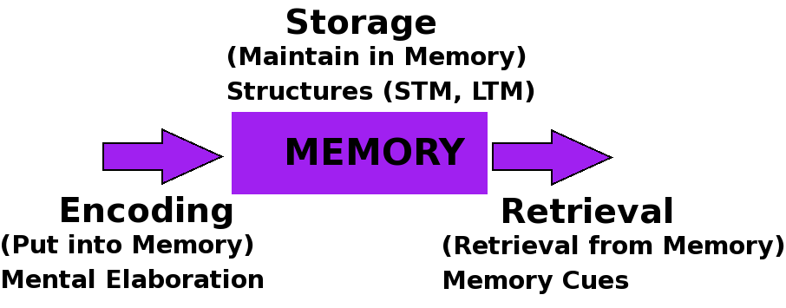
A NEW FORMULATION OF S-R?

Slide 17
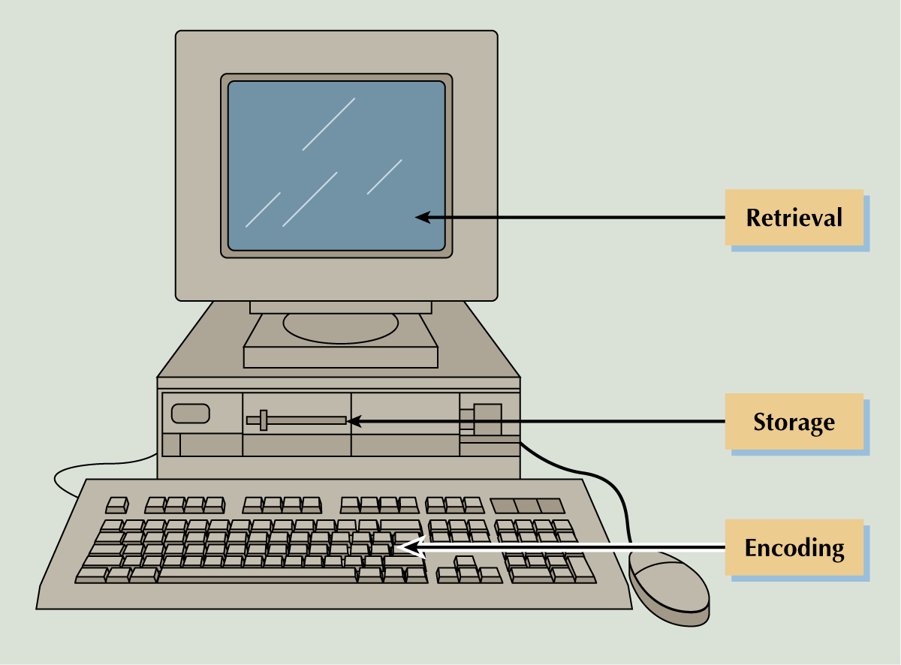
History of Memory
www.dmacc.edu/instructors/blmoses/powerpoints/Huffman%20Chap%207%20PP.ppt
Cognitive psychology: Emphasizes hidden mental processes/representations.
Computer metaphor and the flow of information (informations moves and transforms overtime).
Cognitive neuroscience: The role of the brain in producing cognition.
Information-processing approach to memory: Information flows from the environment through sensory storage and short-term storage to long-term memory.

Slide 18
Information Processing Approach
Basic assumptions
Processing broken down into stages (Reductionism: Isolate processes)
HOW MANY HANDS DID ARISTOTLE HAVE?
Stage 1: Access LTM, who, what is this?
Stage 2: Retrieve—Greek and human, Man
Stage 3: Answer—two hands!

Slide 19
What is Memory?
Not at unitary System
Episodic (Autobiographical, Who am I?)
(Space & Time)
Apple mentioned in class yesterday?
Semantic (Who was the 1st US President?)
Is apple a fruit?
Procedural (Automatic, Driving Car)
Working memory (Pink Elephants?)

Slide 20
Three Aspects of Memory

Slide 21
Memory measures
Recall: the person must generate the target memory.
Recognition: matching one’s memory to presented choices.
Implicit tests: draw on non-conscious processes
Source judgments: where information was learned from.
Metamemory judgments: our knowledge and awareness of memory.

Slide 22
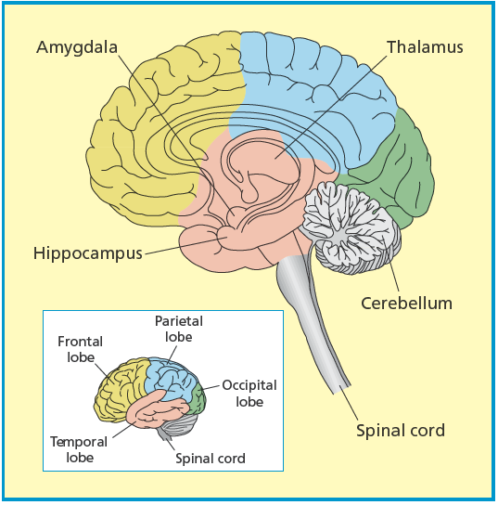
The human brain, showing those areas particularly related to memory.

Slide 23
Memory Measures
Neuropsychology: correlating brain damage with behavioral deficits in memory.
Animal models: studying animal memory as a model of human memory.
Cognitive neuroscience: using neuroimaging techniques to correlate brain processes with cognitive processes.

Slide 24
Cognitive Neuroscience Methods
Neuroimaging: Techniques to make “brain-maps” (visually examine) and assign functions to particular regions of the brain
EEG (Electroencephalography): Measures the electrical output of the brain EEG provides an excellent way of measuring the changes at the millisecond level that happen in the brain as a person engages in a memory task. EEG can be averaged to create ERP (kinds of waves)
MEG (magnetoencephalography): A magnetic sensor detects the small magnetic fields that are produced by the electrical activity in the brain. Similar to EEG, Produces better spatial maps than EEG
PET (Positron emission tomography): measures blood flow in the brain using radioactive chemicals. Radioactive chemical carried by blood stream. Areas where there is more blood more cognitive activity. X-ray like cameral measures radioactivity. PET is very good at making spatial maps of the brain and pinpointing where in the brain activity is taking place.

Slide 28
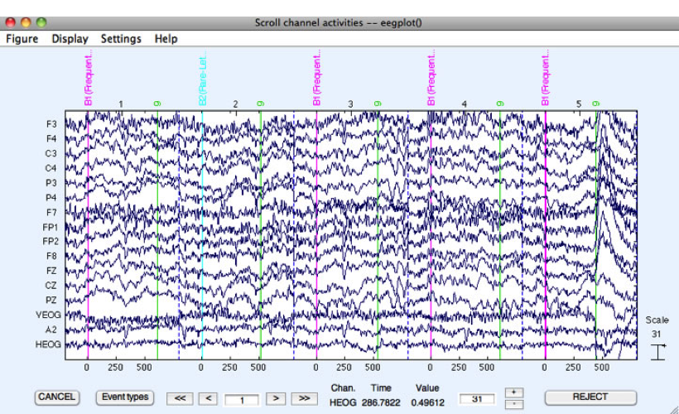

Slide 29
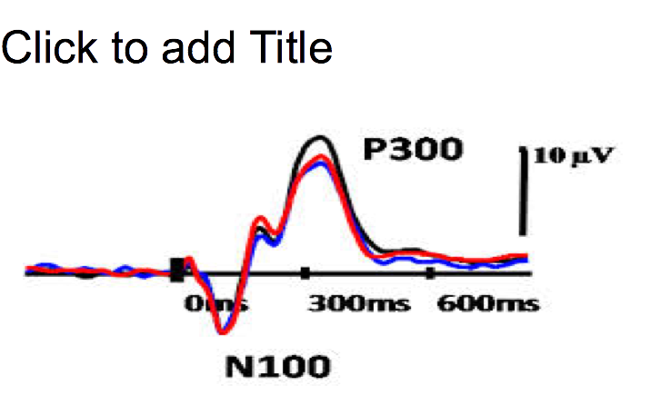

Slide 30
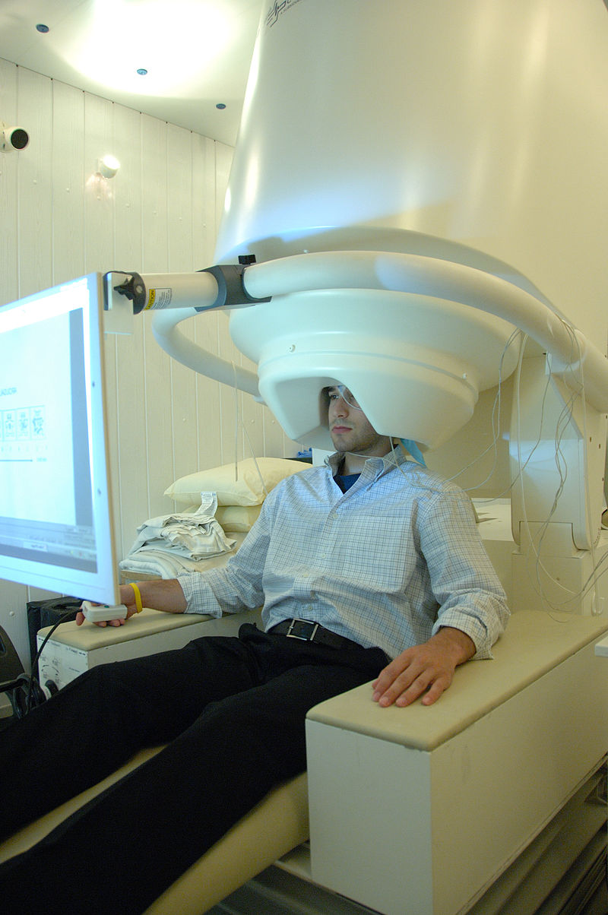

Slide 31
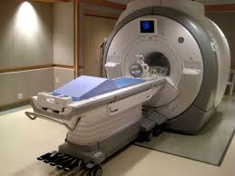
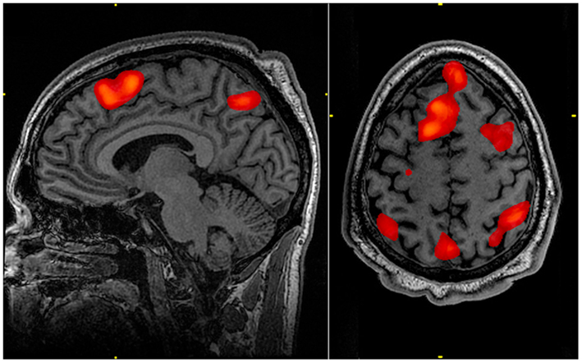
Cognitive Neuroscience Methods
Neuroimaging: Techniques to make “brain-maps” (visually examine) and assign functions to particular regions of the brain
fMRI (functional magnetic resonance imagery):
Participants place in magnetic fields that align the molecules on the brain. As blood flows into different areas of the brain, the molecule's organization is disrupted
FMRI traces oxygen molecule in the blood measuring which areas are more active. It can take a picture every .5 seconds, it allows to both determine where in the brain a particular memory function is taking place and how it changes over time (It's slower than EEG/MEG)

