Slide 1
Chapter 2
Memory and the Brain

Slide 2
What’s a Brain?
A complex assortment of separate areas and regions, each of which has its own unique function:
  The Accidental Mind (Linden, 2008): The brain is a "cobbled (Patched)-together mess." Impressive in function, sure. But in its design the brain is "quirky, inefficient and bizarre ... a weird agglomeration of ad hoc solutions that have accumulated throughout millions of years of evolutionary history," he argues in his new book:
http://www.sharonlbegley.com/the-human-brain-marvel-or-mess

Slide 3
What’s a Brain?
Just as the mouse brain is a lizard brain "with some extra stuff thrown on top," the human brain is essentially a mouse brain with extra toppings.
Neurons have hardly changed from those of prehistoric jellyfish. "Slow, leaky, unreliable," …. they tend to drop the ball: at connections between neurons, signals have a 70 percent chance of sputtering out. To make sure enough signals do get through, the brain needs to be massively interconnected, its 100 billion neurons forming an estimated 500 trillion synapses.
The brain is like an iPod built around an eight-track cassette player.

Slide 4
What’s a Brain?
A complex assortment of separate areas and regions, each of which has its own unique function:
  The Accidental Mind (Linden, 2008) The brain is a cobbled-together mess." Impressive in function, sure. But in its design the brain is quirky, inefficient and bizarre ... a weird agglomeration of ad hoc solutions that have accumulated throughout millions of years of evolutionary history.

Slide 5
What’s a Brain?
A complex assortment of separate areas and regions, each of which has its own unique function:
  Prefrontal Region: Planning, thinking, monitoring
  Occipital: Vision
  Temporal Lobe: Language, memory
  Parietal Lobe: Directs attention

Slide 6
Structures of the Human Brain
Notes:
Somatosensory Cortex: touch, attention
Temporal cortex= auditory, sound processing
Prefrontal: Most involved in memories, starting the conscious process of remembering

Slide 7
The Search for Engram
Are there specific areas of the brain that store specific memories?
  Engram: Physical unit of storage of a memory
  Engram for APPLE? No evidence (Lashley, 1950)
  Memories distributed throughout the brain:
    Grandma memory: image visual cortex; voice-auditory
BUT Quiroga et al. (2005): found cells in the temporal lobe responding to specific memories (“Halle Barry” &” Harrison Ford” Areas)
Notes:
Notice that this has been a continues issue throughout time..
What do you make of Quiroga's et al's? There is actually some other research that one would argue supports their results.. .but often times you have to go back to the methodology and wonder what fMRI studies really show

Slide 8
Structures of the Human Brain
Left Hemisphere: Language & interaction of language and memory
Right Hemisphere: Spatial cognition (understand space around us) and music
  Less hemispheric functional specialization in higher cognition (Dundas et al., 2012)
Cerebral Cortex
  Gray matter (Top layer): Language, memory, problem solving, emotion, music
Sub-Cortex & Sub-Cortex (subcortical): Evolutionary “old areas”, life regulating functions (heartbeat, breathing)
Notes:
Cerebral Cortex: frontal
Sub-cortex... specialized functions that are not unique to human!

Slide 9
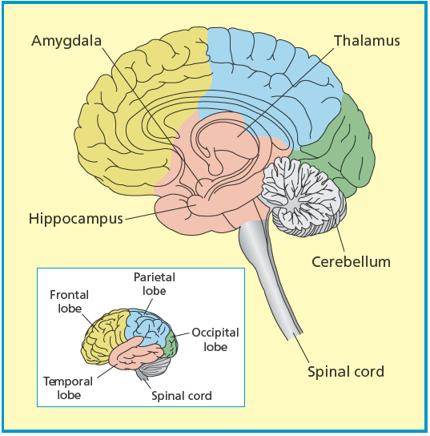
Structures of the Human Brain
Memory Areas of the Brain
Hippocampus: Encodes new memories both conscious and unconscious.
-Damage to the hippocampus can cause amnesia (Part of the limbic system)
Amygdala: Connects features of memory with aspects of emotion; highly connected to the hippocampus and with the hypothalamus.
-

Slide 10
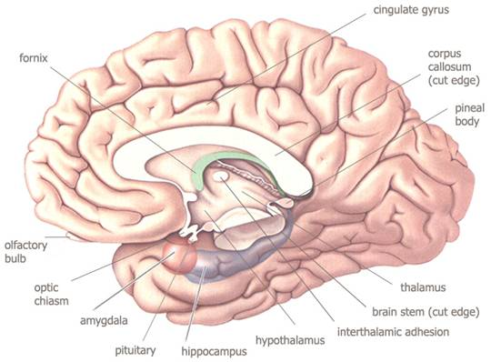
http://www.marketoracle.co.uk/images/dorn_4_11_07c.jpg
Connects Features
of memory with
Aspects of emotion
(e.g., fear)
encodes new
memories
both conscious &
Unconscious
Associated with Basic
Emotions
The Limbic System: Brain structures, located beneath the cerebral cortex: Hypothalamus, Hippocampus, Amygdala. Functions as an important area for both memory and emotion.

Slide 11
http://www.marketoracle.co.uk/images/dorn_4_11_07c.jpg
Serves as a routing
Center connecting
Disparate parts of the
Brain
Associated with Basic
Emotions
The Diencephalon: Includes the structure known as the thalamus and the hypothalamus. Includes connections between the medial temporal lobes and the hippocampus with the prefrontal lobes.

Slide 12
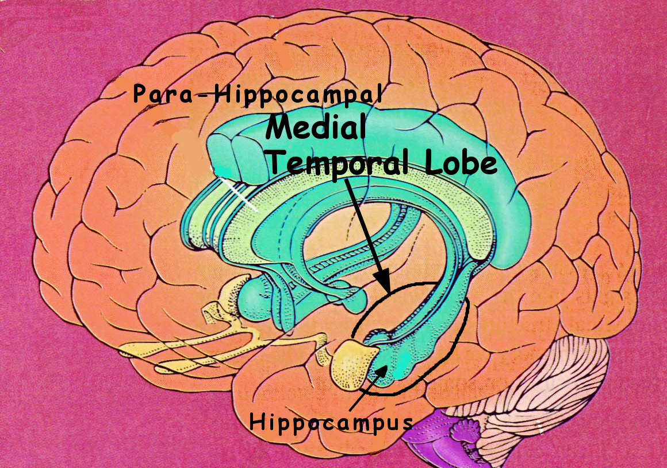
http://neuro.questionsthatmatter.info/placebo_depression/hippocampus&%20medial%20temporal.png
Structure of the Human Brain
Medial temporal cortex:
Like the hippocampus,
involved in the encoding of
Information into memory
But not in the actual storage
or representation of that
information.
Pre-frontal areas of the frontal lobe: Involved in the regulation of memory; initiating retrieval, source monitoring, and metamemory (awareness of our own memory) are functions of pre-frontal lobes.
Notes:
Medial temporal cortex:
In humans: Left temporal lobe more involved in processing verbal information
Right temporal lobe: more involved in processing spatial information...
Other areas of the temporal lobe include language and auditory processing, and interpreting and labeling visual images.

Slide 13
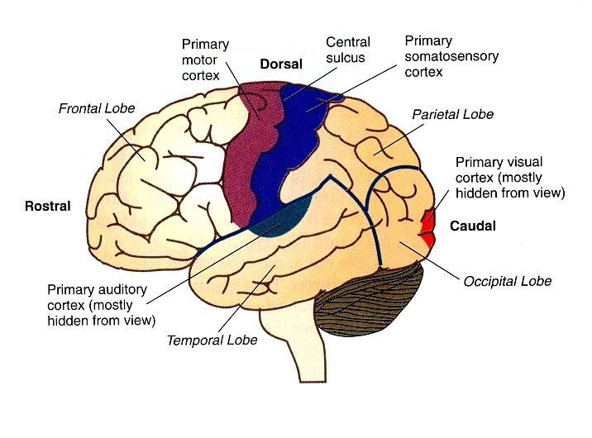
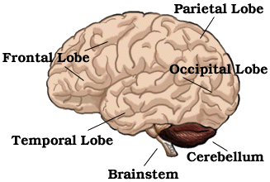
Structures of the Human Brain
Lobes of Cerebral Cortex:
Occipital: Vision, visual image
Parietal: Somatosensory perception (senses of touch: touch, pain, heat, cold, pressure), attention
Temporal:Audition, language, memory
Frontal: Higher emotion, decision-making, metacognition, memory (initiate conscious retrieval), source monitoring

Slide 14
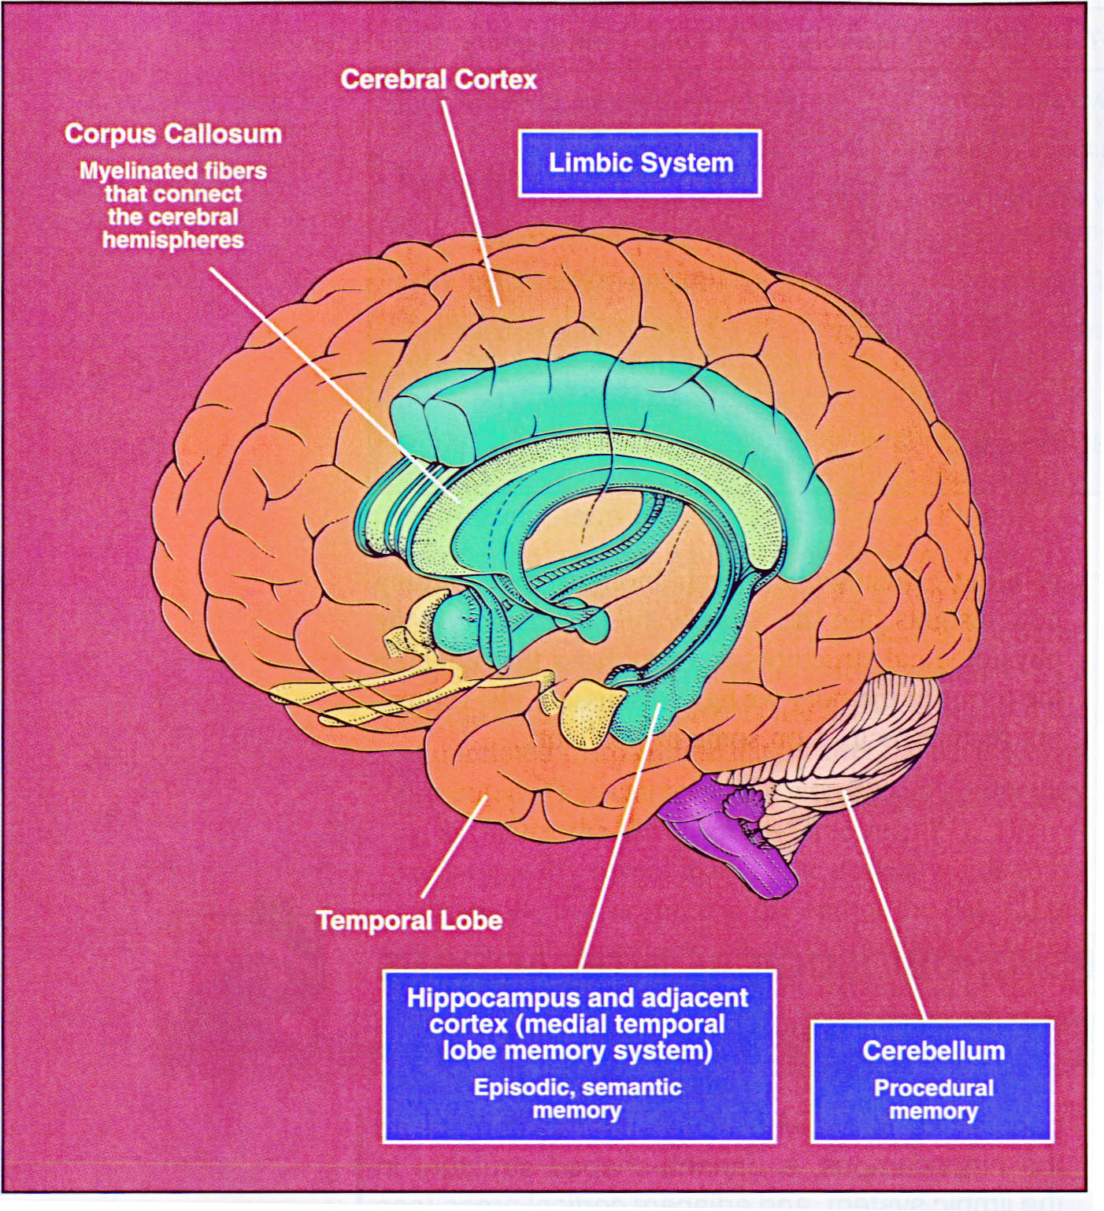
http://www.nada.kth.se/~asa/bilder/MTL.jpg

Slide 15
Structures of the Human Brain
Notes:
Somatosensory Cortex: touch, attention
Temporal cortex= auditory, sound processing
Prefrontal: Most involved in memories, starting the conscious process of remembering

Slide 16
Neuroimaging
Neuroimaging: Techniques to make “brain-maps” (visually examine) and assign functions to particular regions of the brain
Demonstrate which regions of the brain are working (more active) during a particular memory or cognitive task (Correlate cognition and behavior to active brain).
Notes:
EEG: Electroencephalography
MEG: Magnetoencephalography
PET: Positron emision tomography
FMRI: functional magnetic resonance imaging

Slide 17
Neuroimaging
Goals of Neuroimaging:
  Determine where in the brain a particular process is occurring, and create a map or localize the particular process in the brain
  To determine the flow of activity in the brain over time (e.g., ERP). Very accurate timing
    Take pictures of the brain in quick succession to determine the time course of a language or memory process as it unfolds!
    Need Psychological science.... to interpret!

Slide 18
Neuroimaging
Electroencephalography (EEG): As electrical activity moves from one area of the brain to another, it can be measured as distinct “waves” of electrical activity (Ag Electrodes).
Measures the electrical output of the brain and provides an excellent way of measuring the changes at the millisecond level that happen in the brain as a person engages in a memory task.
Event-Related Potential (ERP)
  Averages EEG waves in response to the onset of a stimulus. Distinct items produce a specific positive spike in the ERP at
  .3 sec (300 milliseconds) after the stimulus is presented.
  N400 component associated with meaning
  P300: ERP Component elicited in the process of decision making. Reflects processes involved in stimulus evaluation or categorization.
Notes:
EEG is based on the fact that neurons conduct electricity and this electrical conduction can be measured by electrodes.
N400 It is a negative-going deflection that peaks around 400 milliseconds post-stimulus onset, although it can extend from 250-500 ms, and is typically maximal over centro-parietal electrode sites. The N400 is part of the normal brain response to words and other meaningful (or potentially meaningful) stimuli, including visual and auditory words, sign language signs, pictures, faces, environmental sounds, and smells

Slide 19
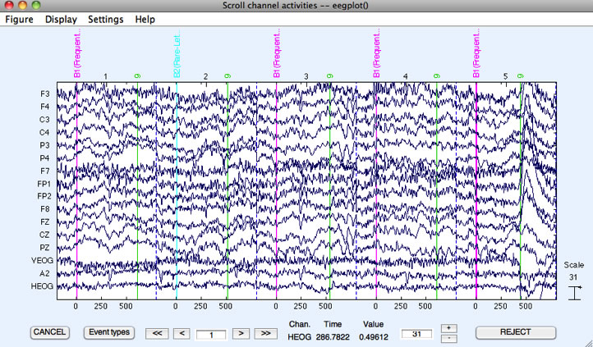

Slide 20
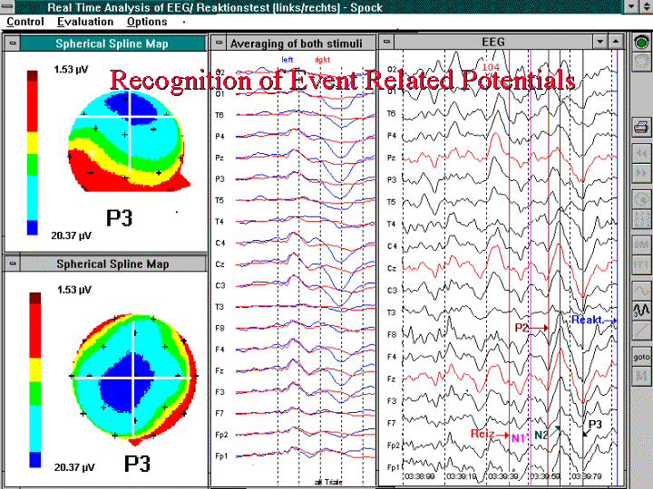

Slide 21
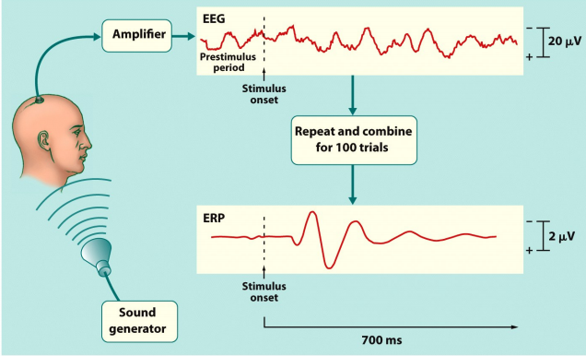

Slide 22
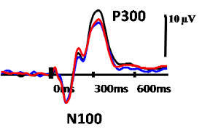

Slide 23
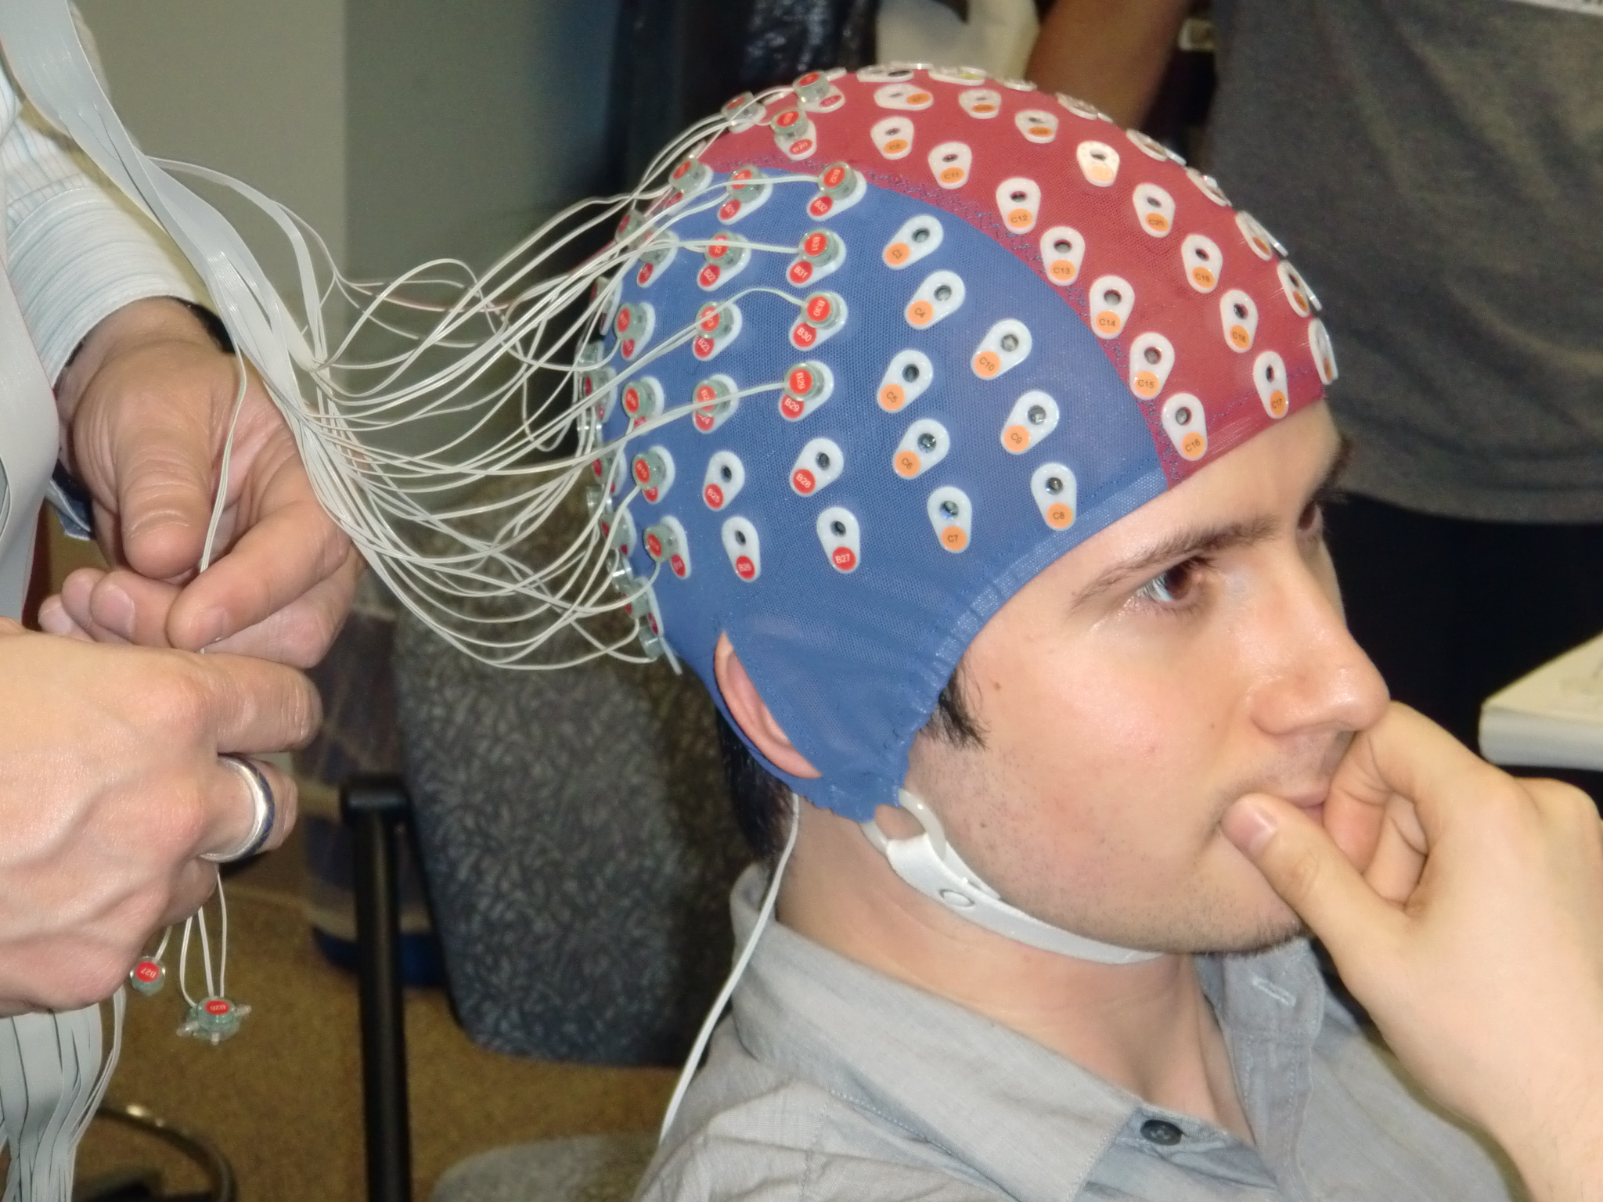

Slide 24
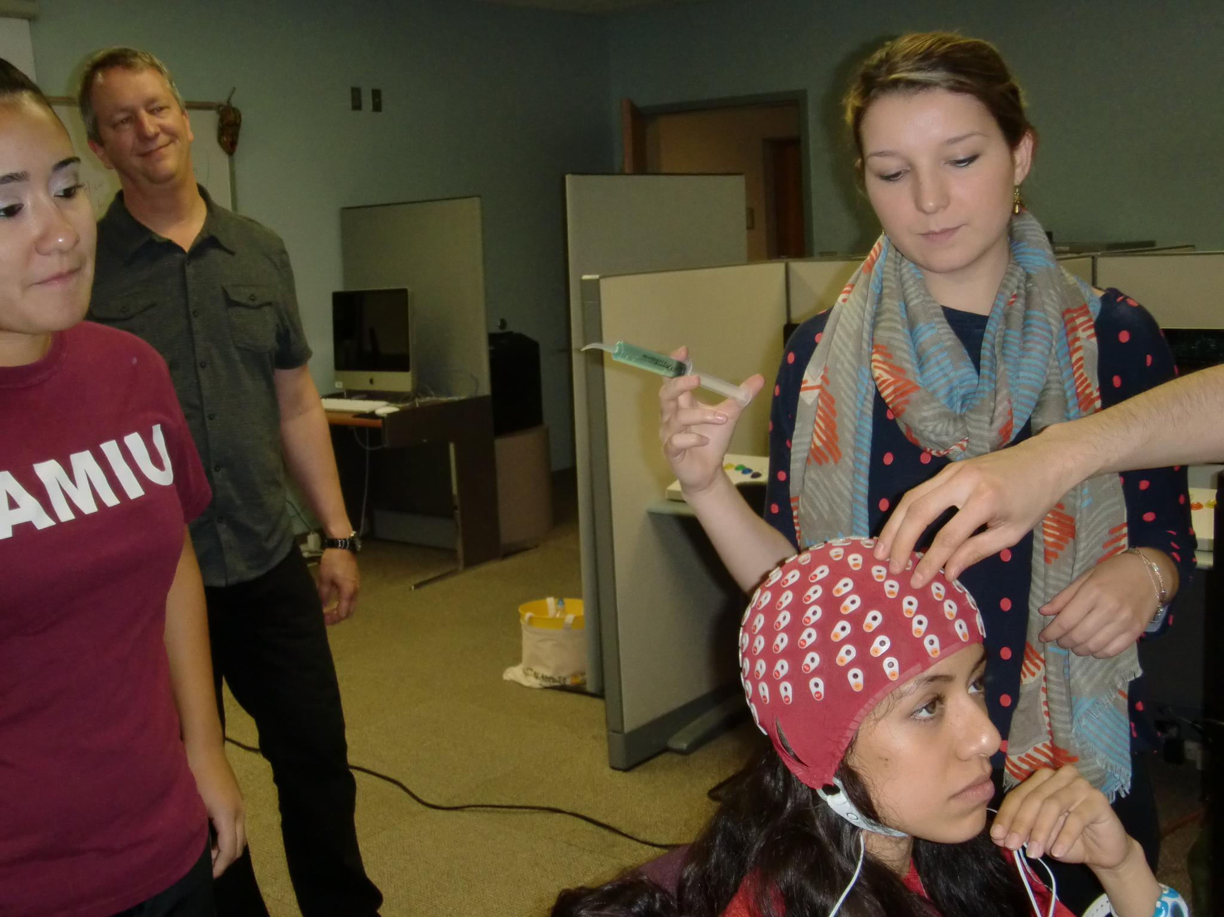

Slide 25
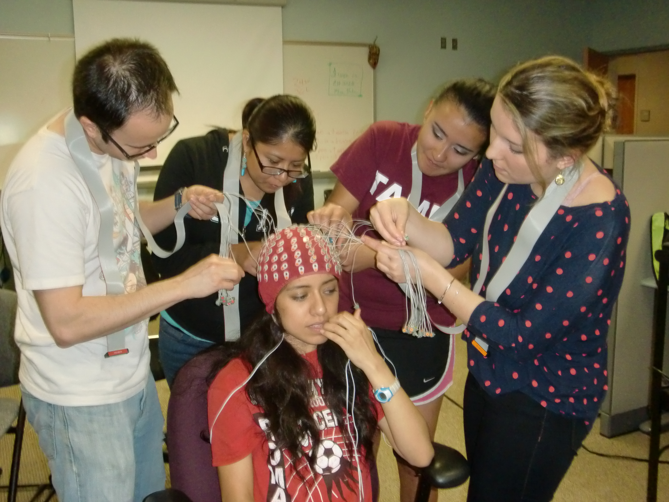

Slide 26
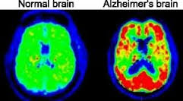
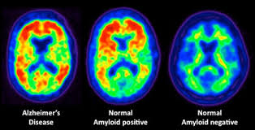
PET (Positron emission tomography):
  Measures blood flow in the brain using radioactive (injected) chemicals (tracer).
  Radioactive chemical carried by blood stream.
  Areas where there is more blood more cognitive activity. X-ray like cameral measures radioactivity.
  Very good at making spatial maps of the brain and pinpointing where in the brain activity is taking place.
  PET is based on a simple assumption that areas of the brain that are being used will require more blood.

Slide 27
Cognitive Neuroscience Methods
(functional)Magnetic Resonance Imaging (MRI/fMRI )
  Participants place in magnetic fields that align the molecules on the brain.
  As blood flows into different areas of the brain, the molecule's organization is disrupted
  Works because different molecules in the brain react differently when placed in an extremely strong magnetic field
  fMRI traces oxygen molecule in the blood measuring which areas are more active. It allows to both determine where in the brain a particular memory function is taking place and how it changes over time (It's slower than EEG/MEG)
  fMRIs offer much great spatial resolution of where events take place in the brain than any other neuroimaging technique. fMRI can rescan the brain every .3 second.

Slide 28
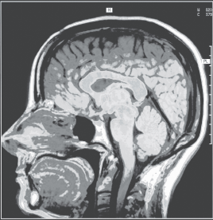
Neuroimaging

Slide 29
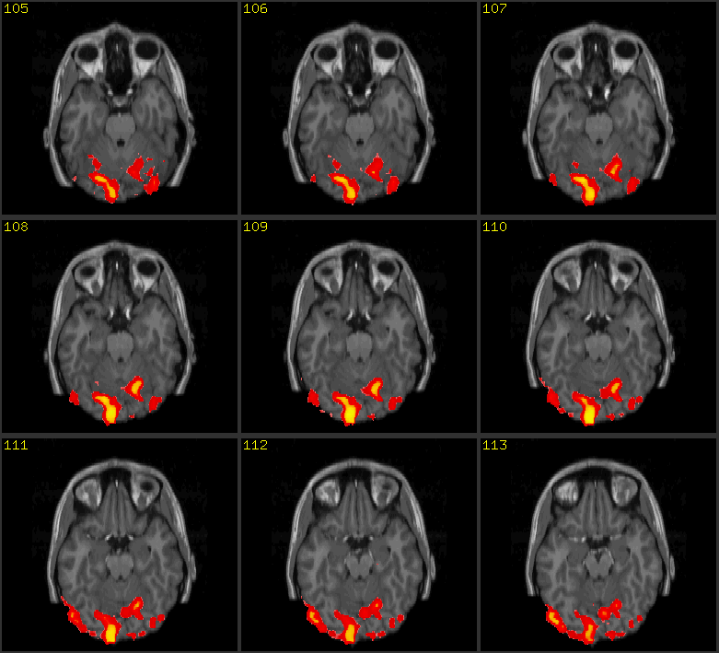

Slide 30
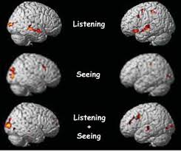

Slide 31
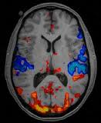

Slide 32
Neuroimaging
Koshino et al. (2008) interested in differences in working memory (WM) for faces in autistic individuals (deficits remembering faces): Visual or WM?
Perceptual (difficult seeing faces) vs. WM?
    If perceptual: less activation in occipital
    If memory: less activation in pre-frontal
  Using fMRI, Results:
    autistic individuals showed lower levels of activation in areas of the left prefrontal lobe (known to be involved in WM).

Slide 33
Amnesia
Memory Deficits and Amnesia
-Oldest methodology
Establish connection between memory and brain
Examine the relationship of deficits in cognition & behavior behavior with the locus of damage with the person's brain
Localize functions of different areas of brain (Milner 1966)
-Psychological interest
What it can tell us about structures (LTM, STM) & processes
Support Psychological theories
Craziest True Stories of How Brain Damage Changed People

Slide 34
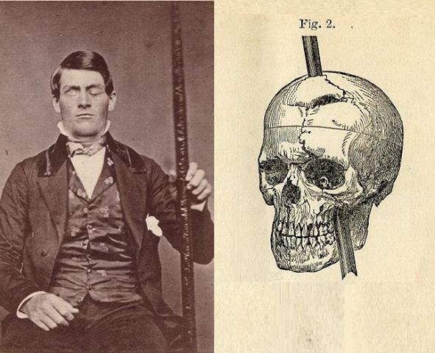
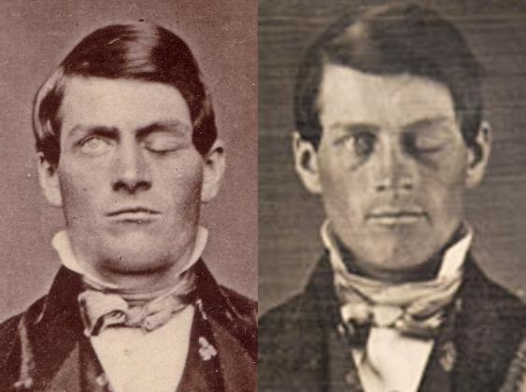
Amnesia
Memory Deficits and Amnesia
--Phineas Gage (1848): Railroad worker
Dynamite blast shot metal rod through frontal lobe
Accident changed his cognitive and emotional abilities
-Personality changes,
Significant because it set stage for Neuropsychology

Slide 35
Amnesia
HM 27 year man: Underwent experimental surgery for epilepsy.
-Part of medial temporal lobe & hippocampi removed
-Suffered from strong anterograde amnesia.
- Couldn’t learn new facts
-Suffered some relatively mild retrograde amnesia
-His memory studied extensively for the next 50 years
-HM passed away in 2008 at the age of 82.
- Episodic memory: Inability to encode new events
-Working memory & procedural learning intact.

Slide 36
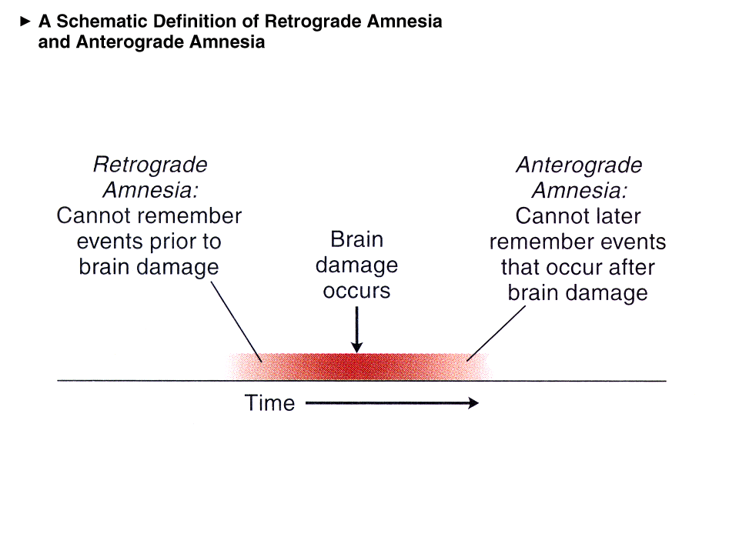
Types of Amnesia
www.psy.fsu.edu/faculty/glendenning/13amnesia.ppt
Anterograde: Problem encoding, storing or retrieving information that can be used in the future.
Capacity for new learning greatly impaired
Typically, ability to recall past events intact.
Retrograde Amnesia: Loss of access to events happening in the past (before onset of disease.

Slide 37
Anterograde Amnesia
Classic Case:
Preserved intellect
Impairment in capacity for episodic learning/memory
Tested visually, and by recall or recognition
Causes:
Associated with bilateral damage to temporal lobes, and Hippocampus
Alcoholic Korsakoff syndrome
Prolonged anoxia: Decrease in oxygen levels to brain
Encephalitis due to brain infection

Slide 38
Semantic Memory Deficits
Forgetting the word RED
Forget the meaning of the word CAT or LEMON
Funnel (1995) asked Mrs. P a retired math teacher:
Funnel: What is a kitten?
Mrs. P: What on earth is a kitten?
Funnel: Does a mouse have a beak?
Mrs. P: If I knew what a beak was, I could tell you.

Slide 39
Semantic Memory Deficits Cont.
Clive Wearing (Wilson & Wearing, 1995)
Problem distinguishing between HONEY, JAM, MARMALADE
Clive Wearing ate lemon including the peel mistakenly for another fruit
These evidence support the view that memories are stored throughout the brain as a network
Collins & Loftus (1975) network model
Damage to one NODE will eliminate that concept

Slide 40
Structures of the Human Brain
Notes:
Somatosensory Cortex: touch, attention
Temporal cortex= auditory, sound processing
Prefrontal: Most involved in memories, starting the conscious process of remembering

Slide 41
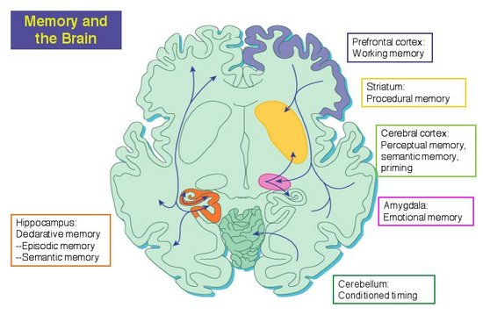
http://quantumphysicsofbeliefs.com/wp-content/uploads/2014/05/BrainMemory01.jpg

Slide 42
The human brain, showing those areas particularly related to memory.

Slide 43
Neuroimaging
Neuroimaging is the technology that allows us to create images that demonstrate which regions of the brain are working during a particular memory or cognitive task.
  EEG, MEG, PET, and fMRI

Slide 44
Neuroimaging
EEG (electroencephalography)
  As electrical activity moves from one area of the brain to another, it can be measured as distinct “waves” of electrical activity.
Event-related potential (ERP)
  Averages EEG waves in response to the onset of a stimulus. Distinct items produce a specific positive spike in the ERP at .3 sec. after the stimulus is presented.

Slide 45
Neuroimaging
MEG (magnetoencephalography)
  Allows researchers to measure brain activity by detecting magnetic fields that the brain produces.
Transcranial magnetic stimulation (TMS)
  A magnetic charge is applied via the skull to a particular area of the brain. The TMS pulse can temporarily disrupt activity in that region of the brain.

Slide 46
Neuroimaging
PET technology allows scientists to get a detailed image of a living human brain without having to damage any living tissue.
  It does involve, however, injecting a small amount of a radioactive substance into a person’s blood, which doe have potentially negative effects.
  PET is based on a simple assumption, and that is that areas of the brain that are being used will require more blood.

Slide 47
Neuroimaging
MRI works because different molecules in the brain react differently when placed in an extremely strong magnetic field.
  fMRIs offer much great spatial resolution of where events take place in the brain than any other neuroimaging technique. fMRI can rescan the brain every .5 second.

Slide 48
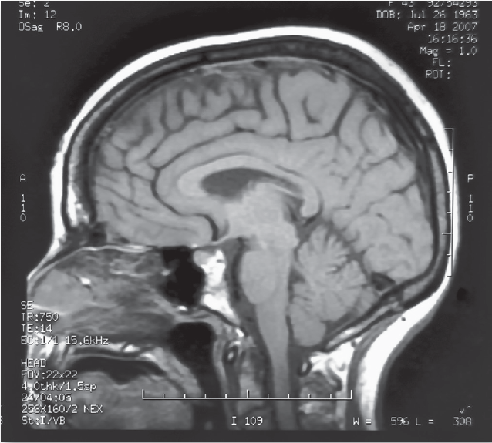
Neuroimaging

Slide 49
Neuroimaging
Koshino et al. (2008) were interested in the differences in working or short-term memory for faces in autistic individuals.
  Using fMRI, they found that, relative to the normal controls, the autistic individuals showed lower levels of activation in areas of the left prefrontal lobe, known to be involved in working memory.

Slide 50
Neuropsychology
Memory deficits and amnesia
  Anterograde amnesia: the inability to learn and remember information after a brain-damaging event.
  Retrograde amnesia: the inability to remember information learned before a brain-damaging event.

Slide 51
Chemical enhancement of the brain
Cholinergics: improve memory in early Alzheimer’s disease.
Benzodiazepines (i.e., Valium): induce mild temporary amnesia.
No known drug that selectively improves memory in normal adults.

Slide 52
Olfaction, memory, and the brain
Olfactory bulb: the primary organ in the brain for processing odors.
  Has strong connections to areas of the brain involved in emotion and in memory.
Music and memory: involves many right hemisphere processes.

