Slide 1
Autobiographical Memory
Chapter 7

Slide 2
Flash Bulb Memories
Detailed, apparently highly accurate,
highly vivid memory of a dramatic
experience
Where were you when you first heard of the 9/11 attack?
Where were you when 44th got Elected?
44th POTUS
Loma Prieta Earthquake

Slide 3
Flashbulb Memories
Flashbulb memories: Highly confident personal memories of surprising events.
--Typically on memory of public tragedies.
Defining Feature: people very confident their memories are ACCURATE EVEN when they concern features of their own whereabouts which may have little to do with the public event.

Slide 4
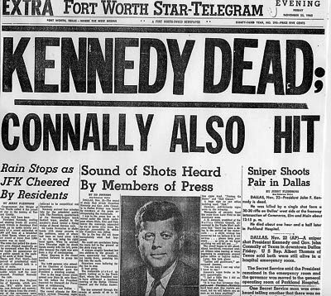
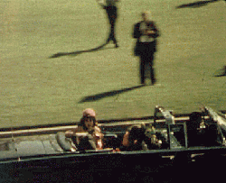
Your Parents’
Flashbulb Memories: Highly vivid, Highly Accurate
simon.lrdc.pitt.edu/~saner/psyc0421/10-ReconstructiveLTMPOST.ppt
Almost all of subjects in 1977 study remember vivid details of 1963 event

Slide 5
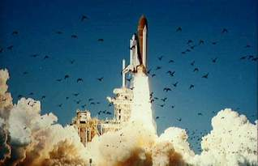
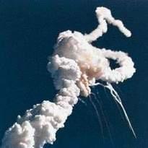
Test People Right Away
And Much Later
1986 Challenger disaster
simon.lrdc.pitt.edu/~saner/psyc0421/10-ReconstructiveLTMPOST.ppt

Slide 6
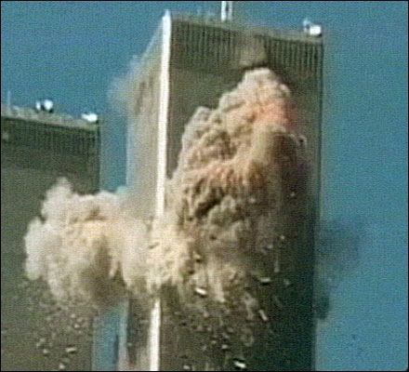
simon.lrdc.pitt.edu/~saner/psyc0421/10-ReconstructiveLTMPOST.ppt

Slide 7
September 11, 2001
Who told you about it first?
  Where were you?
  What time of day was it?
What emotion did you feel?
Did you see the video of the first plane hitting the towers that day?
How confident are you of your memories?

Slide 8
Flash Bulb Memories
Are they really “vivid photograph representations of the event in its physical context?
Do we need a “new memory mechanism” such as a the “Now print” Mechanism to explain Flash bulb memories?
Throughout time (after a year), Flash Bulb memories remembered very vividly!

Slide 9
Accuracy of Flashbulb Memories
Weaver (1993) compared an ordinary memory (interaction with classmate) and a flashbulb memory (start of first Gulf War).
Each participant gave a report after event.
3 months later, participants were asked about each event.
Results show that accuracy (correspondence with original report) was equivalent for both memories.
Confidence remained high for flashbulb memory but not for ordinary memory.

Slide 10
Accuracy of Flashbulb Memories
Talarico and Rubin (2007) compared memories of their personal whereabouts when they heard the news of 9/11 and an ordinary event around the same time.
They found that the flashbulb memories were no more accurate than the ordinary memory, BUT that vividness ratings, confidence ratings, and other subjective ratings were all higher for the flashbulb memory than for the normal memory.

Slide 11
Flashbulb Memories

Slide 12
Flashbulb Memories
Special mechanism approach: “[UNIQUE] memory mechanism (“Now print [photographical]”) to explain Flash bulb memories?
Ordinary mechanism approach. This view claims that flashbulb memories are simply normal memories but memories of emotionally charged and socially significant events.

Slide 13
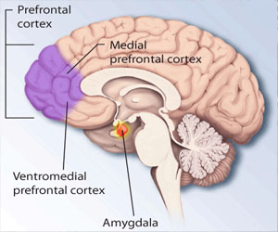
Neuroscience of Autobiographical Memory
Addis, Knapp et al. (2012; fMRI)
Brain pattern differences between different types of cues?
Participants provided with:
Specific (Lost dog last year) vs. general cues (dress)?
Using General cues:
--Lateral temporal & prefrontal lobes
(prefrontal: Memory search—Retrieval mode)
Using specific cues:
---Hippocampus, medial prefrontal region (activating the memory itself)

Slide 14
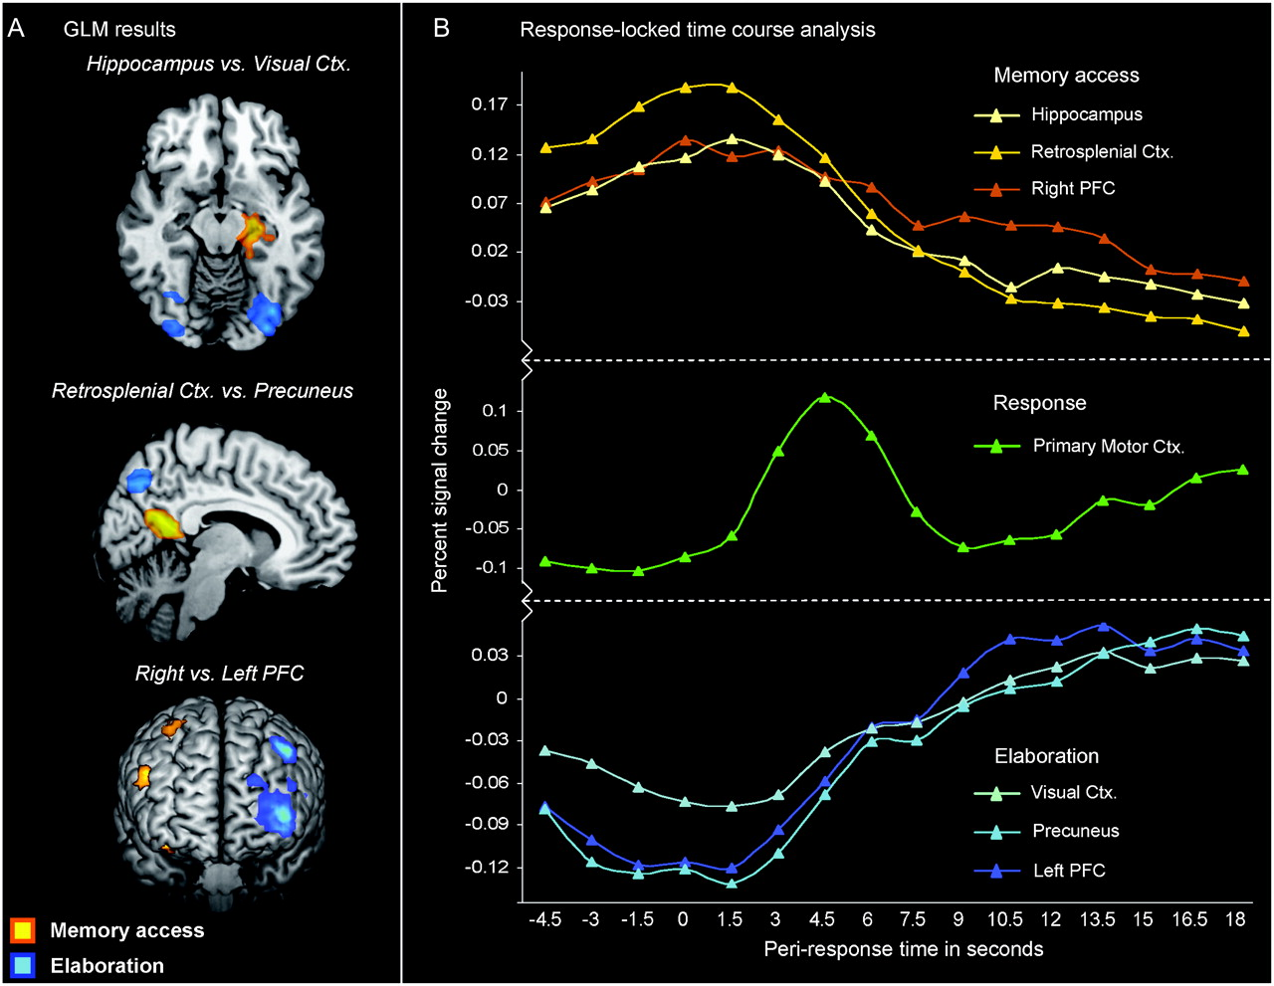
Neuroscience of Autobiographical Memory
Daselaar et al. (2008) used cue-word
-participants monitored with fMRI
Tracked time course of activation
-Think of 1st memory that came to mind:
24 secs after they had the memory in mind, asked to rate the emotion that went along with the memory & extent to which they were reliving it.
By 1.5 seconds after presentation of word:
-Medial temporal lobe: (Activating memory)
-Hippocampus (Activating memory)
-Right prefrontal cortex (memory search) were active
By 3 seconds, these areas were deactivating (see figure 7.8A)

Slide 15
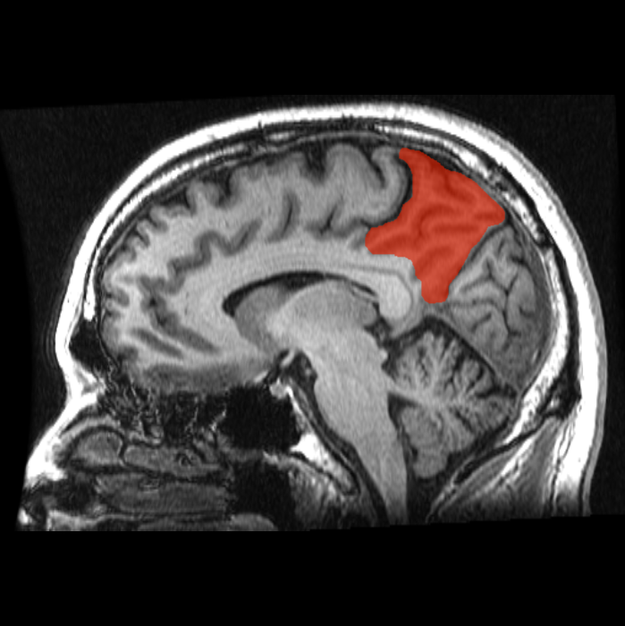
The precuneus is a part of the superior parietal lobule forward of the occipital lobe (cuneus). It is sometimes described as the medial area of the superior parietal cortex.

Slide 16
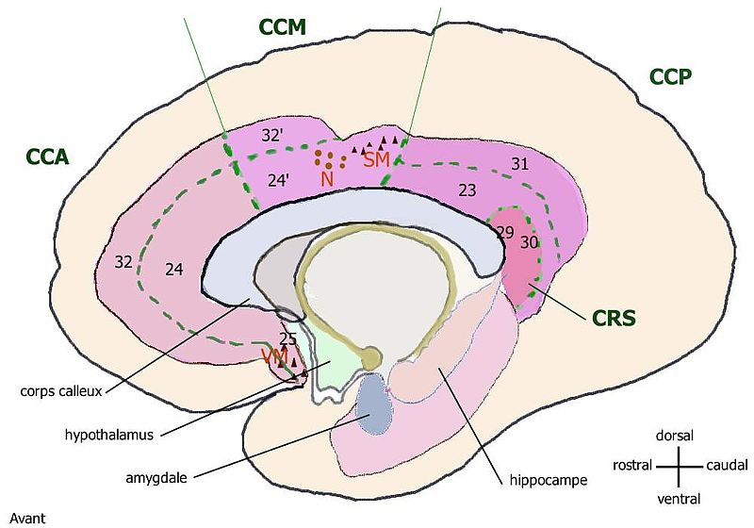
CRS cortex retrosplenial BA-29 & 30

Slide 17
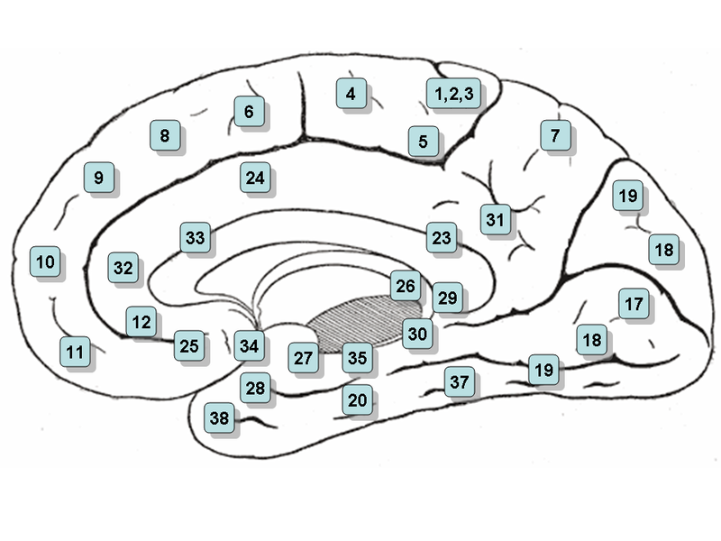
Retrospenial Cortex: Areas 29 & 30

Slide 18
Neuroscience of Autobiographical Memory
  At 3 secs after cue: occipital cortex & left PFC (verbal activity) starts occurring, & these increase until about 12 secs and then they level off. Activity remained high as long as participant remains thinking about the memory
Memories given high judgments of emotionality correlated with greater activity in the hippocampus & the amygdala in the limbic system and frontopolar areas in frontal lobe.

Slide 19
Neuroscience of Autobiographical Memory
Neural correlates of “reliving” the memory starting 12 seconds after presentation of cue:
Greater activity in the occipital cortex and prefrontal cortex activity (attention focus), especially for those memories with high “reliving” scores

Slide 20
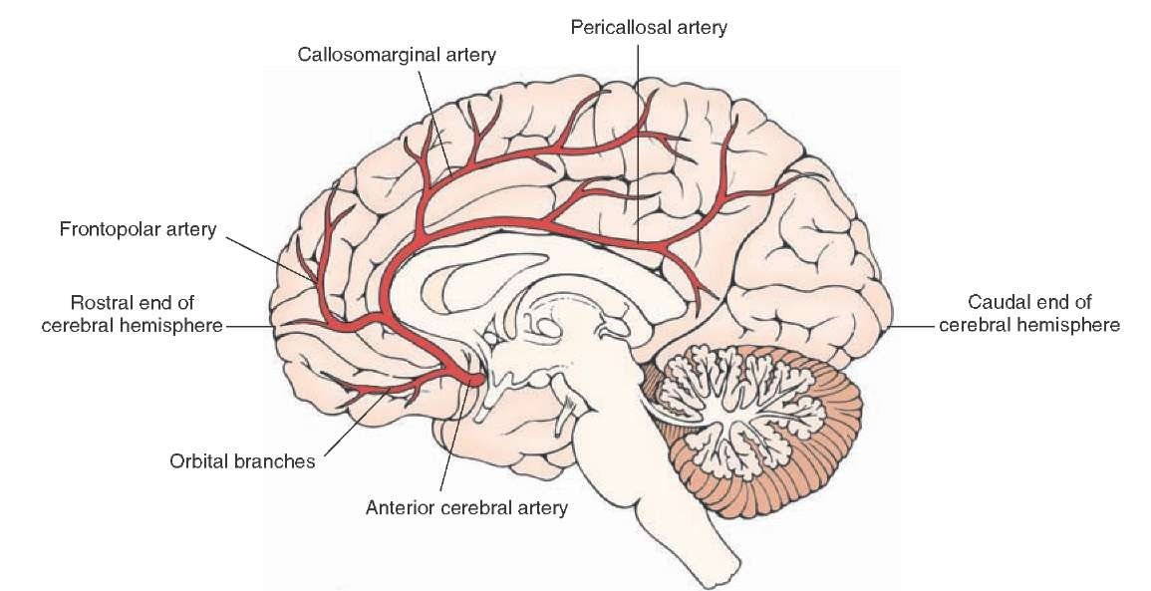

Slide 21
