Slide 1
Chapter 8
False Memory

Slide 2
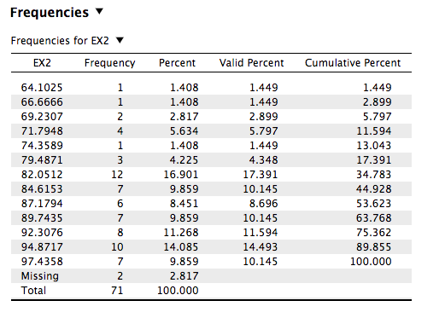

Slide 3
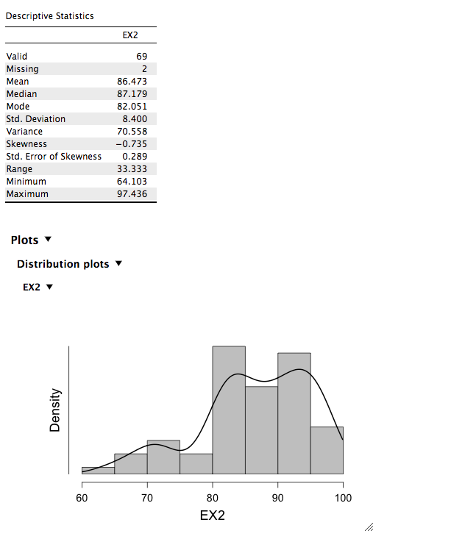

Slide 4
Presidential candidate: Mitt Romney couldn’t have remembered Detroit milestone: he wasn’t born.

Slide 5
Mistaken eye-witness testimony
The accusation of Donald Thompson
Accused of rape: He was on TV
The John Demjanuk Case
40 Holocaust survivors confirmed he was Ivan the Terrible
Susan Clancy’s abductees
Published memories about people that believed they were abducted by aliens
-Found that these people were highly suggestible

Slide 6
Recreating vs. Reconstructive
Recreate (Reproduce): Assumption that an event can be recreated. People remember event the way it happened
Reconstructive: Use of new and existing information to fill in the gaps in your recall of an experience
Using “logic” (Schema) to “remember” of fill in the gaps

Slide 7
False Memories
False memories refer to memories that people have which do not correspond to events as they actually happened.
Requirements for a False memory:
It has to feel like a memory that took place in the past: Recollection of an event!
Memory has to deviate from the event as it occurred: There is no correspondence (match between retrieval & actual event)

Slide 8
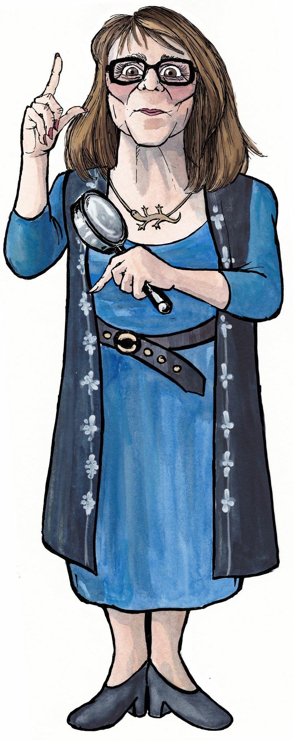
Elizabeth Loftus
False memory induction: Implantation of memories
Misinformation effect: Post event misinformation
Participants witness an event and then they receive misinformation

Slide 9
How Good is Memory Recollection
Correspondence: Memory matches actual event?
Accuracy: Memory accurately reflects actual event?
participant witnessed: deer, skunk, armadillo
participant reports: a bunch of wild animals.. Good? Accurate? Good Correspondence!
Amount: How much/detailed is the memory?
If report a bunch of wild animals?
No correspondence: if providing details about different types of birds!

Slide 10
False Memory Theories
Suggestibility: Incorporate suggestions or postevent information into one’s memory
Source Monitoring Errors: Be able to distinguish among the sources of our retrieved memories (internal or external. Real/Not real; Brian Williams)
Contextual Associations: Spreading activation (words activate related words: bread-butter-milk)
More likely with huge LISTS of words
Fuzzy-Trace Theory (AKA gist of the list): Encoding only the meaning (gist) and not the literal words.
Encode: physician, surgeon, hospital
Recall: DOCTOR, the meaning/gist of the list

Slide 11
Methods: Studying False Memories
Demonstration

Slide 12
Please study
Study the following words

Slide 13
Ready?

Slide 14
REST

Slide 15
AWAKE

Slide 16
TIRED

Slide 17
DREAM

Slide 18
AWAKE

Slide 19
NIGHT

Slide 20
BLANKET

Slide 21
DOZE

Slide 22
SLUMBER

Slide 23
SNORE

Slide 24
PILLOW

Slide 25
PEACE

Slide 26
YAWN

Slide 27
DROWSY

Slide 28
Please respond:
YES if the presented word is a word you studied
NO If the presented word was not studied

Slide 29
AWAKE

Slide 30
WHEEL

Slide 31
BLANKET

Slide 32
DESK

Slide 33
SLEEP

Slide 34
Methods: Studying False Memories
1. Deese-Roediger-McDermott procedure (DRM)
A group of words – all associated to a common, but unpresented word, are given in a free recall test (Deese,1959; Roediger & McDermott (1995).
Did you remember the word SLEEP?
In recognition, false memory to SLEEP
(NON STUDIED) if often as strong as accurate for target studied items (e.g., Blanket, doze).

Slide 35
DRM Method
Critical intrusions are the false memories created by a list in which all of the words are related or associated with the absent but suggested word.
Explanations of the DRM method
Contextual associations
Fuzzy-Trace theory

Slide 36
False Memory Induction Procedure
The experimenters ask participants about events from childhood, which never happened.
They tell the participant that they have spoken to a parent or an older sibling and received information about the childhood event. The experimenters repeatedly ask questions about the event (Remember when you spilled the punch on the wedding dress?)
Experimenters do contact a family member to confirm that a similar event did not happen to the participant.

Slide 37
False Memory Induction Procedure
Loftus and Pickrell’ (1995): Lost in the mall as a child BUT NEVER Happened. Asked participants to “imagine” being in the mall!
Most of the participants never generated false memories of being lost in the mall, but 25% remembered being lost in the mall.
Highly replicated effect (Hyman, Husband & Billings, 1995).

Slide 38
False Memory Induction Procedure
Initial interview on memory for real childhood events included a false one:
At a wedding reception when you were 5, when you ran into the table and spilled the punch bowl on the bride’s parents”.
No memory reported then, but in later interviews 20-40% or participants reported this as a memory, and up to a half of these described “clear” recollections, with incidental details.
Hyman et al. (1995)

Slide 39
False Memory Induction Procedure
Real issue with the induction of false memories:
Repeated questioning combined with the authority of a close family member
Authority: Psychotherapist
Rate of False memories relative low:
~50% for ordinary and less traumatic memories (taking a ride in a hot air balloon)
0% (being treated with an enema at Dr.’s office
Children not susceptible to implanted implausible memories (e.g., Jewish children remembering a Communion)

Slide 40
False Memory Induction Procedure
Other studies:
Children's going to doctor, and questioned after Examination with leading questions...
“He looked at your ear, didn't he?
Children Very likely to respond positively.
Results: About 37% of participants are persuaded about a (False) memory never experienced....
--Once persuaded, they even “elaborate” or describe the memory in detail (Reconstruct!)

Slide 41
False Memory Induction Procedure
Loftus argues that many of the methods used in the false memory induction procedure are similar to those used during questionable psychotherapy techniques used to help recover repressed memories.
For example, psychotherapists use: Hypnosis, guided imagery (imagining oneself in an abuse situation to see if it is real), the writing in journals, “trance writing.”
Hypnosis: Research shows that it increases number of false memories retrieved.

Slide 42
False Memory Induction Procedure
Imagination inflation: Rearchers induce false memories by simply having the participant imagine the event.
(Mazzoni & Memon, 2003)
Ask participants to imagine a plausible event (finding money on the back of a taxicab) & Implausible event (have nurse take skin sample)
One week later: Imagine events taken place when they were 6 years old.
One week later: Rate memories (no/vivid memory) Participants had a vivid memory of skin sample taken by nurse. Had memories about the taxi & Money

Slide 43
Altered Evidence
Nash, Wade, and Lindsay (2009) altered videos of participants interacting with experimenters and then showed the videotapes to participants.
Two weeks later, the participants returned for a memory test. Compared to participants who had not seen altered videotapes, those who had seen the altered videotapes had far more false memories.

Slide 44
Hypnosis and Memory
Hypnosis does increase “true memories”!
The increase in memories produced by hypnosis is dominated by false memories (Kirsch, Mazzoni, & Montgomery, 2007).
More so, the more suggestible a person is.

