Slide 1
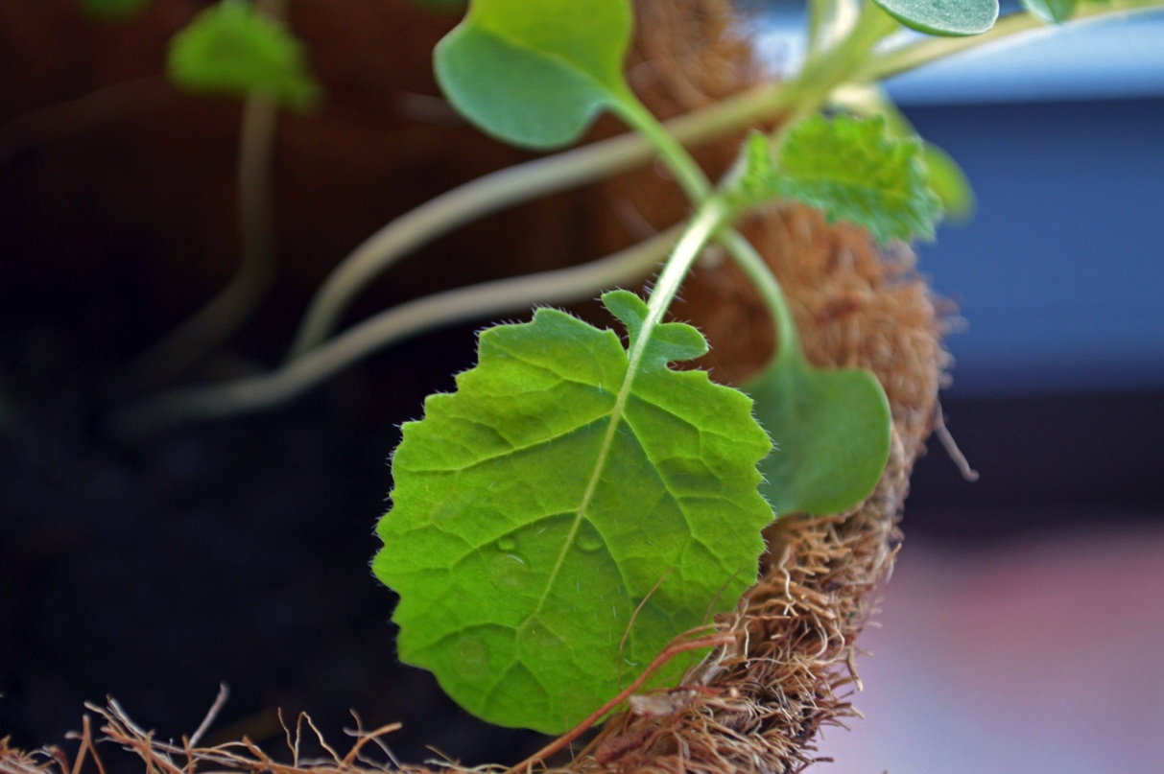
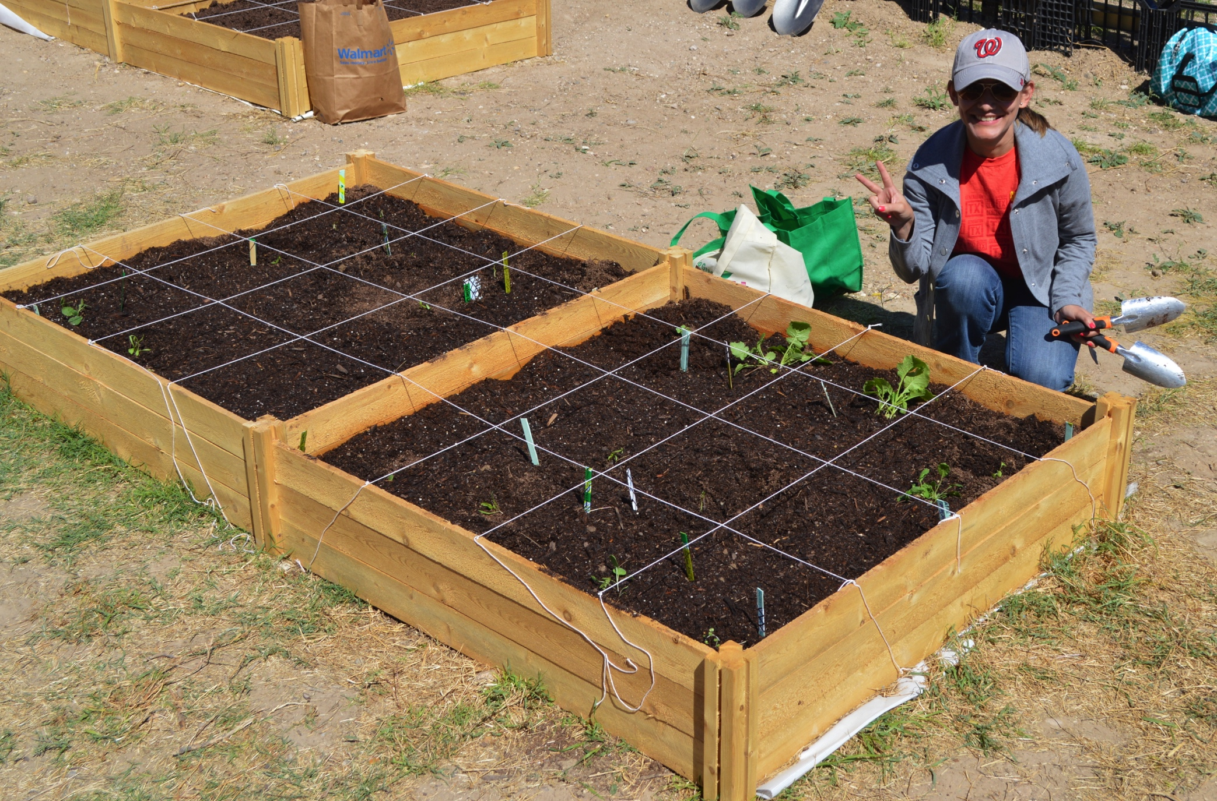
Dig’ It!
Promoting Green Spaces at TAMIU
Cihtlalli G. Perez & Dr. Marcela Uribe
UNIV 1102
(Do not forget your teammates names, course and project name)
Introduction of service project
What Did I Learn from this Service-Learning Project?
How Service Relates to Course Content?
Description of what happened during the class and service project. The project took place at (location). During x number of weeks, we did this type of service.
This is a final reflection on what you have learned from the whole experience.
What have you learned by being involved in this project/program?
Provide an example on when you had an “aha” moment and realized you have learned something different or new.
Why does this learning matter?
How do you plan on utilizing the skills you have learned beyond this course?
What has been the most exciting experience with this program?
During this project I learned that ….
In this section you have to answer how the service related to the course content. You can either choose a specific topic that you can relate your service with or several ideas that were relevant to your course.
How was your service related to your course?
How did your service help the community?
How did this project help your personal growth?
This course focused on sustainable practices, we got to learn about what sustainability is. Before, I did not really understand what sustainability was. Now I know that sustainability is finding an equilibrium between fulfilling our needs and caring about the environment. (Here you can be creative on how you see issues differently)
The experience I liked the most about this project was the presentation from the RGISC organization and the clean-up at Manadas Creek. We were able to care for the environment and invest ourselves in the process. (This is an example on how you can explain your personal experience)
What did you do as part of your service?
When did you do it?
Who did you serve?
Answer all the Wh questions you can think about. What? When? Who? Where? And How?

