Slide 1
NSF Funding Opportunities for Learning and Teaching in STEM
  Dennis Davenport
  National Science Foundation
  www.nsf.gov

Slide 2
N S F

Slide 3
N $ F

Slide 4
Not Sufficient Funds

Slide 5
N $ F

Slide 6
NSF Funding Sources
Cross-Directorate Programs
  Research in Undergraduate Institutions
  Research Opportunity Awards
Directorate for Education and Human Resources
Discipline Research Directorates

Slide 7
NSF-wide Emphasis Areas
International Polar Year
Cyberinfrastructure
Human and Social Dynamics
Cyber-enabled Discovery and Innovation
National Nanotechnology Initiative
Climate Change Science Program
http://www.nsf.gov/news/priority_areas/

Slide 8
NSF Directorate for Education and
Human Resources (EHR): Themes
Broadening Participation to Improve Workforce Development
Enriching the Education of STEM Teachers
Promoting Learning Through Research and Evaluation
Furthering Public Understanding of Science and Advancing STEM Literacy
Transforming STEM Education through Cyber-enabled Learning Strategies

Slide 9
NSF Directorate for Education and
Human Resources (EHR): Divisions
Division of Research on Learning (DRL)
- merger of Elementary, Secondary, and Informal Education
  (ESIE) and Research, Evaluation, and Communication (REC)
Division of Undergraduate Education (DUE)
Division of Human Resource Development (HRD)
Division Graduate Education (DGE)

Slide 10
Division of Research on Learning in Formal and Informal Settings (DRL): Mission
To promote innovative research, development, and evaluation of learning and teaching across all STEM disciplines by advancing cutting-edge knowledge and practices in both formal and informal learning settings.

Slide 11
DRL Programs
The Division’s programs offer a set of complementary approaches for advancing research, development, and field-based improvement strategies.
Informal Science Education (ISE)
Information Technology Experiences for Students and Teachers (ITEST)
Research and Evaluation on Education in Science and Engineering (REESE)
Discovery Research K-12 (DR-K12)

Slide 12
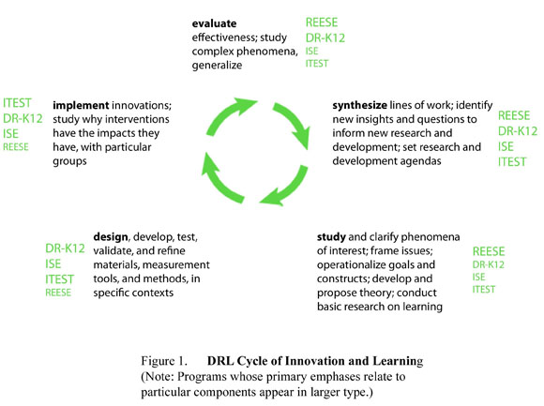
Cycle of Innovation

Slide 13
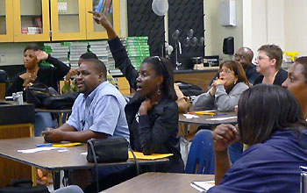
REESE Goals
The Research and Evaluation on Education in Science and Engineering (REESE) program aims at advancing research at the frontiers of STEM learning, education, and evaluation, and at providing the foundation knowledge necessary to improve STEM teaching and learning at all educational levels and in all settings.
Notes:
REESE supports basic and applied research and evaluation that enhances STEM learning and teaching.
REESE funds research projects focusing on core scientific questions about learning at all ages and in all settings.
REESE also encourages proposals concerning education research methodology and evaluation.

Slide 14
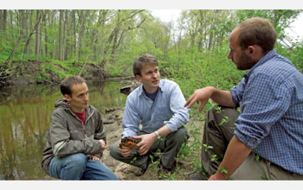
Kinds of proposals
Topical Strands
    Emerging Research
    Contextual Research
Award types
    Pathways (<$250,000)
    Knowledge diffusion (< $250,000)
    Empirical (< $1,500,000)
    Large Empirical (< $2,500,000)
Anticipated 2011 budget: $45,000,000 for new and continuing awards.

Slide 15

REESE deadlines
Next Full Proposal deadline: November 15, 2010
For further information:
    703-292-8650
    DRLREESE@nsf.gov

Slide 16
DR-K12 Goals
The DR-K12 program seeks to enable significant advances in K-12 student and teacher learning of the STEM disciplines, through research and development of innovative resources, models, and technologies for use by students, teachers, administrators and policy makers.

Slide 17
DR K-12’s Four Challenges
  Improve assessment of student knowledge and skills in order to improve instruction and learning.
  Provide all student the opportunity to learn significant STEM content.
  Enhance the ability of teachers to provide STEM education.
  Learn how effective innovations are implemented, scaled, and sustained in schools.

Slide 18
Kinds of proposals
Award types
  Full R&D projects (< $5,000,000)
  Exploratory projects (< $150,000)
  Synthesis projects (< $250,000)
  Conferences and Workshops (< $100,000)
Anticipated 2011 budget: $115,000,000 for new and continuing awards.
Notes:
Full Research and Development Projects— research, development and implementation with attention to design and evaluation
Exploratory Projects— preliminary work to clarify constructs, assemble theoretical or conceptual foundations, or perform analytic or empirical preparatory work
Synthesis Projects— synthesis of existing knowledge on a topic of critical importance
Resource Network
Conferences and Workshops—A few well-focused conferences or workshops related to the goals of the program are welcome.

Slide 19
DR-K12 Deadlines
Next full proposal deadline: January 6, 2011
Next letter of intent: November 5, 2010
For further information:
    703-292-8620
    DRLDRK12@nsf.gov

Slide 20
Division of Undergraduate Education (DUE)
Mission: To promote excellence in undergraduate science, technology, engineering, and mathematics (STEM) education for all students
Goals:
  Provide leadership
  Support curriculum development
  Prepare the workforce
  Foster connections

Slide 21
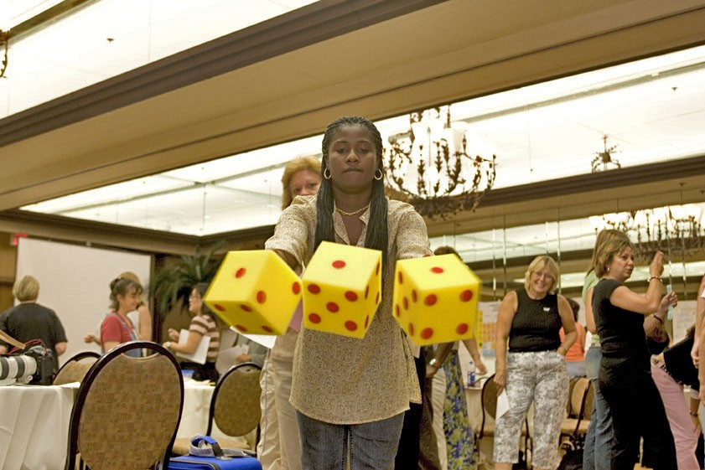
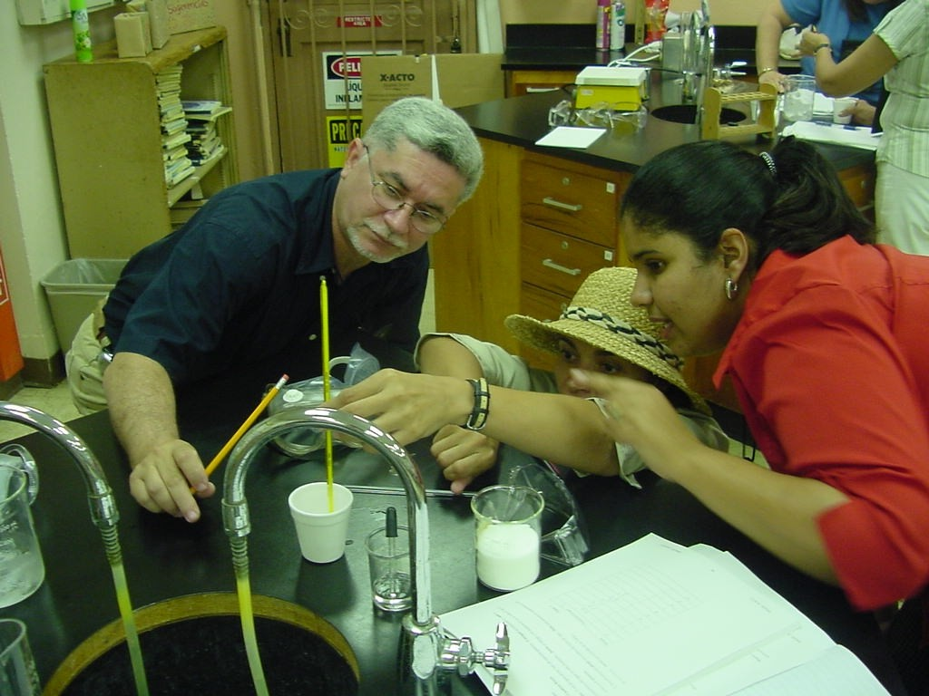
Math and Science Partnership (MSP) Program
A Research and Development Effort

Slide 22
A research & development (R&D) effort at NSF for building capacity and integrating the work of higher education with that of K-12 to strengthen and reform mathematics and science education
Launched in FY 2002 as a key facet of NCLB; reauthorized in the 2007 America COMPETES Act; additional appropriations in the 2009 ARRA Act and the FY09 budget.

Slide 23
Seeks to improve student outcomes in mathematics and science for all students, at all K-12 levels
Is a coordinated effort between NSF and ED, who together have defined the program linkages necessary to manage investment for greatest effectiveness

Slide 24
What distinguishes NSF’s MSP Program from prior efforts?
  Substantial intellectual engagement of mathematicians, scientists and engineers from higher education in improving K-12 student outcomes in mathematics and the sciences
  Breadth and depth of Partnerships – between organizations, rather than among individuals only

Slide 25
What distinguishes NSF’s MSP Program from prior efforts?
  Organizational/institutional change driven by Partnerships
  Degree to which MSP work is integrated with evidence; degree to which the work of the Partnerships is itself the work of scholars who seek evidence for what they do

Slide 26
MSP: Scope of Partnerships
  Over 900 K-12 school districts with approximately 5 million students and 147,000 teachers of K-12 mathematics and science
  Involving approximately 200 institutions of higher education – including community colleges, HBCU, HSIs and tribal colleges - with over 1200 faculty and administrators engaged
  Working with an array of corporate and business partners

Slide 27
MSP: Project types
  12 Comprehensive Partnerships – work broadly on K-12 mathematics and science
  36 Targeted Partnerships – more focused on grade span and discipline
  23 Institute Partnerships – in depth disciplinary content and leadership expertise for teachers
  49 Research, Evaluation and Technical Assistance (RETA) projects – study and support Partnerships
  19 MSP-Start Partnerships – planning activities
  6 Phase II Partnerships – focused research from established projects

Slide 28
MSP: Distinctive Features
  The role of science, engineering and mathematics faculty
  The role of partnerships
  Commitment to identified institutional change
  Emphasis on research and evidence
  A national learning community

Slide 29
MSP: Deadlines and contacts
Full proposals: (solicitation in progress)
Contacts:
  Jim Hamos: jhamos@nsf.gov
http://www.nsf.gov/funding/pgm_summ.jsp?pims_id=5756

Slide 30
Noyce Scholarship Program: Track 1
Encourage STEM disciplinary majors to pursue pre-K to 12 teaching careers
Support career changers with STEM backgrounds to pursue pre-K to 12 teaching
Recipients must teach in a “high-need” setting for two years for every one year of support
Funds provided to colleges and universities with strong teacher preparation programs to provide scholarships for prospective teachers
Scholarships based on academic merit, consideration of financial need, and increasing the participation of minority populations in the teaching

Slide 31
Noyce Scholarship Program: Track 2
NSF Teaching Fellows: STEM professionals enroll in master's degree teacher certification programs and receive academic courses, professional development, and salary supplements while fulfilling four years of teaching in a high need school district.
NSF Master Teaching Fellows: Exemplary mathematics and science teachers receive professional development and salary supplements to become Master Teachers in high need school districts.

Slide 32
Noyce Scholarship Program
Support for undergraduate students:
  must be juniors or seniors majoring in science, technology, engineering, or mathematics
  Scholarships are at least $10,000 per year for 2 years
  Students must commit to teaching in a high need school district for 2 years for each year of scholarship support
  Students failing to meet service requirement must repay scholarship

Slide 33
Noyce Scholarship Program
Support for career-changers:
  Must be STEM professional enrolled in a teacher certification program
  Stipends of at least $10,000 for one year
  Recipients must commit to two years of service as a mathematics or science teacher in a high need school district
  Recipients failing to meet service requirement must repay scholarship

Slide 34
Noyce Scholarship Program
    Award size:
      Phase 1 (new projects) – Up to $1,200,000 over 5 years
      Phase 2 (continuation) – Up to $750,000 over 5 years for scholarships/stipends; up to $150,000 for monitoring/ evaluation
      Teaching Fellowship/Master Teaching Fellowship Awards – Up to $3M over 5 years (one cohort) or over 6 years (two cohorts)
      Teaching Fellowship Planning Grants – $75,000 for one year
    50% match required for all grants except planning grants
    Available Funding in FY 2010: $54 million
    FY 2010 Deadlines:
      Letters of Intent (optional): February 2011
      Proposals: March 2011
      http://www.nsf.gov/funding/pgm_summ.jsp?pims_id=5733

Slide 35
Noyce Scholarship Program
    Anticipated number of awards in FY 2010: 35 to 46 (15-20 Phase 1, 4-6 Phase 2, 8-10 Teaching Fellowship/Master Teaching Fellowship Awards, and 8-10 Teaching Fellowship Planning Grants)
    At least 80% of funds are for scholarships

Slide 36
Noyce Scholarship Awards
Model Projects include—
Recruitment strategies
Exemplary programs leading to certification
Requirement for 2-years of service in high need school district for each year of support
Mechanism for monitoring recipients and evaluating project

Slide 37
Urban Mathematics Educator Program
Georgia State University, 0434094
Increasing the number of high quality secondary math teachers who seek jobs in urban school districts.
Graduating 40 teachers (10 per year) who commit to teach in either the Atlanta or DeKalb County School Districts
Recruiting talented math students and providing instruction to them to make a difference in student achievement.

Slide 38
Preparing Students for a New Era
Michigan State University, 0335785
Building on an all university initiative called Teachers for a New Era that creates standards for teacher preparation, prepares new courses, revises existing courses, and implements new ways of teaching and assessing students
Graduating 39 talented college students to become K-12 math or science teachers in high need schools
PI is a mathematics education faculty member

Slide 39
NSF Scholarships in Science, Technology, Engineering, and Mathematics (S-STEM)
Goal: Provide scholarships to academically talented, but financial needy, students pursuing associate, baccalaureate, or graduate degrees.
Deadlines: 08/12/2010 (letter of intent: 07/14)
http://www.nsf.gov/funding/pgm_summ.jsp?pims_id=5257

Slide 40
S-STEM
MAJOR FEATURES
  Eligible disciplines include almost all NSF supported areas (see solicitation for guidance)
  Maximum scholarships increased to $10,000 (but still based on financial need)
  Total award increased to $600,000: Based on the scholarship funds subtotal, 5% allowed for administration and 10% for student support
  Maximum of $225,000 in any one year, but can ramp up
  One proposal per constituent school or college that awards degrees (also schools within institutions)
  About $50 million available in FY 2010

Slide 41
S-STEM
Additional Program Features
  PI must be a faculty member in a STEM discipline.
  Involves cohorts of students.
  Can fund student support structures.
  Includes optional enhancements such as research opportunities, tutoring, internships, etc.
  Enrolls students full time.

Slide 42
STEP (STEM Talent Expansion Program)
Goal: to increase the number of students (U.S. citizens or permanent residents) RECEIVING associate or baccalaureate degrees in established or emerging fields within science, technology, engineering, and mathematics (STEM)
http://www.nsf.gov/pubs/2007/nsf07570/nsf07570.htm
Deadline for letters of intent (opt.): August 17, 2010
Deadline for full proposals: September 28, 2010

Slide 43
STEP
One proposal per institution
About $30 million available in FY2010
Budgetary Limitations
  $.5 M for up to 5,000 undergrad students
  $ 1 M for 5,000-15,000 undergrad students
  $2 M for >15,000 undergrad students
  20-25% addition if significant partnership with an associate degree granting inst.

Slide 44
STEP
Efforts might include:
  Bridge programs that enable additional preparation for students
  Programs that focus on the quality of student learning
    high-caliber teaching in smaller classes
    new pedagogical approaches
    training of teaching assistants
  Programs to encourage undergraduate research
  Programs that provide financial incentives to students
  Many others

Slide 45
Collaborative Research – Northwest Engineering
Talent Expansion Partnership: A Coordinated
Regional Recruitment and Retention Effort
University of Washington ($1,148,980) (0431659) &
Washington State University ($849,978) (0431556)
A collaboration of 2 universities and 4 community colleges to increase by 10% total number of students that earn an undergraduate engineering degree in next 5 years
  Increase minorities by 100%
  Increase women by 20%
Includes support services and career information
Community colleges have an on-site coordinator whose job it is to focus on supporting underrepresented students in engineering who plan to transfer.

Slide 46
ADVANCED TECHNOLOGICAL EDUCATION
Promotes improvement in the education of science and engineering technicians at the undergraduate and secondary school level and the educators who prepare them, focusing on high-technology fields that drive the nation’s economy.
ATE is in its 15th year of funding community colleges, having started with the Science and Advanced Technology Act of 1992 (SATA).
FY2010-FY2012
  Preliminary Proposals April 22, 21, and 19 respectively
  Formal Proposals October 21, 20, and 18 respectively
http://www.nsf.gov/pubs/2007/nsf07530/nsf07530.htm

Slide 47
Advanced Technological Education Program
Projects which focus on:
  Program Improvement;
  Professional Development for Educators;
  Curriculum and Educational Materials Development;
  Teacher Preparation; or
  Small Grants for Institutions New to the ATE Program.
Centers of Excellence – National, Regional, Resource
  http://www.ATECenters.org
Targeted Research on Technician Education

Slide 48
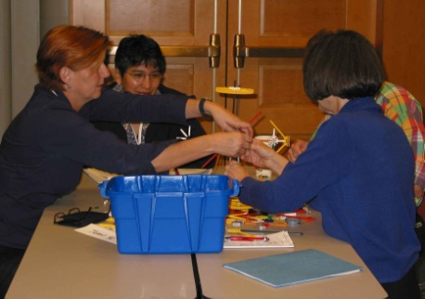
Creating Pathways for Prospective
Science and Mathematics Teachers in a Technology Enriched Environment
Antelope Valley College 0402690
Increasing the number, quality, and diversity of mathematics and science middle school teachers
Enrolling students in technology-rich classes also supported by the Mathematics Science Engineering Technology Consortium that includes 50 regional businesses, 16 school districts, and many others
Working with Cal State Bakersfield to provide pathways to baccalaureate degree
Using hands-on, inquiry based learning, field experiences, and summer institutes

Slide 49
TUES: Transforming Undergraduate Education in STEM
Provide a framework for projects to maximize their effectiveness in improving and transforming undergraduate STEM education
Increase the emphasis on projects that build on prior work and contribute to the knowledge base of STEM education research and practice
Contribute to building a community of scholars who work in related areas of education
Explicitly identify a set of measurable outcomes that will be used in the project management and evaluation

Slide 50
TUES Framework
New Learning Materials
Research on Teaching and Learning
Faculty Expertise
Assessing Learning
Implementing Innovations
Projects should address a recognized need and undertake exemplary work in at least of the above elements. Projects may take advantage of natural synergies among these elements.

Slide 51
TUES: 3 Phases to Reach Goals of the Program
Phase 1 – Exploratory Projects (May 26, 27 2011) Involve exploratory, initial investigation or adaptation in one of the five elements of the CCLI Framework.
Phase 2 – Expansion Projects (Jan. 14, 2011)
Build on smaller scale but proven innovations, refine and test innovations on diverse users
Phase 3 – Comprehensive Projects (Jan. 14, 2011) Several diverse institutions, evaluation or assessment activities–deep & broad, combine proven results and mature innovations from several component areas

Slide 52
TUES: Resource Center(s)
A new component
This is the 2nd year of competition, none funded in 2010

Slide 53
TUES: Proposal Due Dates
Due Dates: Phases 2 & 3 – January 14, 2011
Next Phase 1: (May 26, 2011)
Monitor the DUE website

Slide 54
FY2007 Phase 2 Math Awards:
Examples
Quantitative Reasoning in the Contemporary World– University of Arkansas – PI: Bernie Madison (0715039)
A Phase II Expansion of the Development of a Multidisciplinary Course on Wavelets and Applications – Univ. of St. Thomas, et al – PI: Pat Van Fleet, et al (0717622, 0717645, 0717567, 0717158)
Learning Discrete Mathematics and Computer Science via Primary Historical Sources– University of New Mexico, et al – PI: Jerry Lodder, et al (0717752, 0715392)

Slide 55
FY2008 Phase 1 Math Awards:
Examples
Development of a new calculus and differential equations sequence for undergraduate life sciences majors – Michigan State University – PI: Chichia Chiu (0736893)
Dynamic Visualization Tools for Multivariable Calculus – Monroe Community College – PI: Paul Seeburger (0736968)

Slide 56
Presidential Awards for Excellence in Science, Mathematics, and Engineering Mentoring (PAESMEM)
Full Proposal Deadline:
  October 6, 2010; first Wed. in October, annually thereafter
http://www.nsf.gov/funding/pgm_summ.jsp?pims_id=5473

Slide 57
Presidential Awards for Excellence in Science, Mathematics, and Engineering Mentoring (PAESMEM)
Identify outstanding mentoring efforts designed to enhance the participation of underrepresented groups in STEM
  Awardees are leaders in the national effort to develop the Nation's human resources in STEM
  NSF administers the program on behalf of the White House

Slide 58
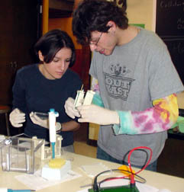
Joint Activity:
Division of Mathematical Sciences (DMS)
Division of Undergraduate Education (DUE)
Division of Environmental Biology (DEB)
Interdisciplinary Training for Undergraduates in Biological and Mathematical Sciences (UBM)

Slide 59
Interdisciplinary Training for Undergraduates
in Biological and Mathematical Sciences (UBM)
Goals:
  Enhance education of undergraduates at the intersection of the biological and mathematical sciences
  Better prepare students to pursue careers and graduate study in fields that integrate the mathematical and biological sciences
Full proposal deadline: second Thursday in February, annually thereafter

Slide 60
Interdisciplinary Training for Undergraduates
in Biological and Mathematical Sciences (UBM)
  Jointly-conducted long-term research experiences for interdisciplinary balanced teams of undergraduates from departments in the biological and mathematical sciences
  Student involvement in innovative research at the forefront of the biological and mathematical sciences
  Students pursue interdisciplinary collaborative projects under joint mentorship by faculty in both fields

Slide 61

UBM: Undergraduate Research in Metapopulation Ecology
  College of William and Mary
  Establishes an undergraduate training program in mathematical biology based on a core of 6 faculty (3 math, 3 biology)
  Uses paired undergraduate mentoring with each student being mentored by a mathematician and a biologist on a multi-year research project studying dynamics and viability of animal metapopulations
  Blends theoretical mathematical and field based biological techniques
  Develops new bio-math courses
  Hosts regional bio-math conferences
  Partners with a local community college with a focus on recruiting underrepresented minorities

Slide 62

UBM: Research-Based Interdisciplinary
Training for Mathematics and Biology Majors
  University of Vermont
  Integrates interdisciplinary courses in mathematics and biology with multi-year research projects
  Involves 8 faculty mentors from the Departments of Biology and Mathematics and Statistics
  Involves equal number of math and biology (or joint math/biology) majors working on teams with joint mentors from both departments
  Includes Calculus for Life Science Students, College Biology, Mathematical Biology and Ecology, and a Seminar series
  Provides a capstone course that ensures students have the opportunity to analyze data, prepare manuscripts, and present papers at annual symposia

Slide 63
Research Experiences for Undergraduates (REU), NSF 09-598
NSF-wide program that supports active research participation by undergraduate students
Draws on the integration of research and education to attract a diversified pool of talented students into careers in science and engineering
Projects involve students in meaningful ways in ongoing research programs or in research projects specifically designed for the REU program

Slide 64
Sites vs. Supplements
Research Experiences for Undergraduates (REU), NSF 09-598
REU Sites
REU Supplements
Group of students with group activities
Variety of research projects, maybe NSF-funded or maybe not
Choice of mentor or project
Most students not from host institution
Usually one or two students
Research within an NSF-funded research project
Position tied to particular mentor or project
Students usually from host institution

Slide 65
Research Experiences for Undergraduates (REU)
Sites
Well-defined common focus to facilitate a cohort experience for students
Significant fraction of student participants must come from outside host institution
Full proposal deadline: August 2011
Notes:
65

Slide 66
Research Experiences for Undergraduates (REU)
Supplements
Support for (usually) one or two students within an NSF-funded research project
Students usually from host institution
Request either as a supplement to an active NSF grant, or within a regular (new or renewal) research proposal
For advice, contact program officer assigned to the active NSF grant or program officer who manages the relevant research program
Not appropriate for education grants, except education research
Notes:
66

Slide 67
Division of Human Resource Development (HRD)
http://www.nsf.gov/div/index.jsp?div=HRD
Minority and Minority Serving Institution Programs:
Alliances for Graduate Education and the Professoriate Program (AGEP)
Centers of Research Excellence in Science and Technology (CREST)
Historically Black Colleges and Universities (HBCU-UP)
The Louis Stokes Alliance for Minority Participation Program (LSAMP)
Tribal Colleges and Universities Program (TCUP)

Slide 68

Division of Graduate Education
GRFP
Enriching
experiences for
individuals
SMP
Preparing
a diverse
workforce
for tomorrow
IGERT
Promoting
innovation via
interdisciplinary
collaborations
Graduate
Education
and Career
Advancement
GK-12
Creating novel
opportunities in
graduate and pre-
college education

Slide 69

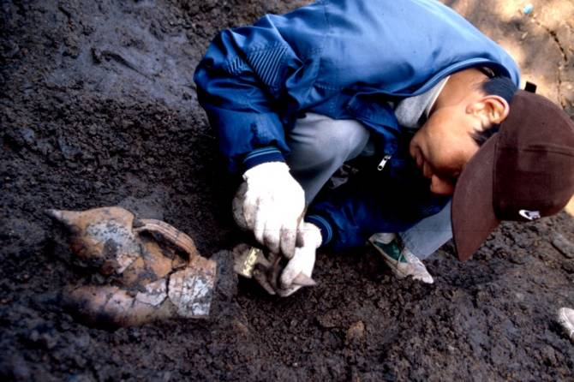
Five Year Award – $121,500
Three years of support
  $30,000 Stipend per year
  $10,500 Educational allowance to institution
Choice of project, research advisor & program
No service requirement
Portability
  Any accredited institution
  MS PhD
Notes:
69

Slide 70
GRFP General Eligibility
U.S. citizens and permanent residents
Early-career students
Pursuing research-based MS and PhD
Enrolled in accredited Institution
NSF supported fields
  Chemistry, Computer & Information Science/Engineering
  Engineering, Geosciences, Life Sciences
  Mathematical Sciences, Physics and Astronomy
  Psychology, Social Sciences
Notes:
70

Slide 71
WAYS TO PARTICIPATE
Grant Holder
  Principal Investigator
  Member of Project Team, or
  Coalition, or Advisory Board
  Test Site
User of Products
Participant in Workshops and Symposium
Reviewer of Proposals
Notes:
71

Slide 72
MyNSF
(Custom News Service)
  http://www.nsf.gov/mynsf/
  Receive notifications about new content posted on the NSF website
  Notification via email or RSS

Slide 73
Bye for Now. Hope to Hear From You Soon. NSF needs all of you. You may need NSF!!
Notes:
73

Slide 74
Information and Inquiries
DUE Coordinates
  Email undergrad@nsf.gov
  Phone 703-292-8670
  Fax 703-292-9015
http://www.nsf.gov/div/index.jsp?div=DUE
Proposal Writing Aides, e.g. Guide for Proposal Writing, Handbook for Project Evaluation
Snail mail:
  NSF, Division of Undergraduate Education, 4201 Wilson Boulevard, Room 835, Arlington, VA 22230

