Slide 1

Common Rule

Slide 2
IRB Regulation Changes - starting 1/21/2019
New exemption categories and regulatory clarifications
Continuing review no longer required for most studies
Changes in content on Informed Consent forms
Single IRB of Record – multi-site study, non-exempt, NIH funded - a single IRB reviews and approves

Slide 3
New IRB processes – starting 1/21/2019
New exemption categories added, and clarification of older categories – this will result in many projects now meeting exempt criteria
New self-determination Wufoo forms available, all investigators should start with these forms, as the long hard copy form may now not need to be submitted

Slide 4
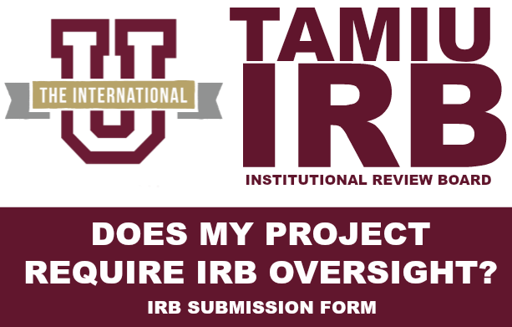
STEP 1: See new website - does your project need oversight at all or does it fit one of new categories?

Slide 5
OUTCOMES from STEP 1:
Does my project require oversight?
If answer is “no”, a determination email that project doesn’t meet regulatory requirements for oversight by IRB; or
If answer is “yes”, a determination email that project needs oversight and then you follow STEP 2 & 3 instructions
Copy of these emails also sent to IRB too.

Slide 6
Step 2: Do you have survey, interview questions, or list of topics ready to upload?
AND
Do you have information sheet, consent form or justification for waiver of documentation of informed consent ready to upload?

Slide 7
STEP 3: Does research fit exempt Category 2 – if yes, use Wufoo form if no, submit hard copy form
45 CFR 46.104(d)(2) - educational tests, surveys, interviews, public behavior – now includes identifiable results & audiovisual recordings

Slide 8
OUTCOMES from STEP 3:
Does my project meet exempt criteria?
Submission confirmation email sent to PI upon Wufoo form completion and form sent to IRB.
IRB reviews submission and sends determination email that project meets regulatory requirements for oversight, but meets one of the exempt review categories; or
C) IRB sends determination email that project needs to have a full IRB protocol form filled out and submitted for review.

Slide 9
Continuing Review Changes
Expedited protocols – Submitted after 1/21/2019
  Approved with no expiration date
  No Continuing Review paperwork to keep protocol active
No Changes - Full Review protocols – still have expiration date and must submit continuing review paperwork before expiration date
Annual status checks will continue, starting 90 days from last date checked
Completion Reports required for expedited and full protocols

Slide 10
Informed Consent – template use required
Key elements section required for consent forms longer than 6 pages
Additional statements required if identifiable private information, biospecimens, clinically relevant results or whole genome sequencing
Informed Consent templates will be posted on the IRB website and must be used starting 1/21/2019.

