Slide 1
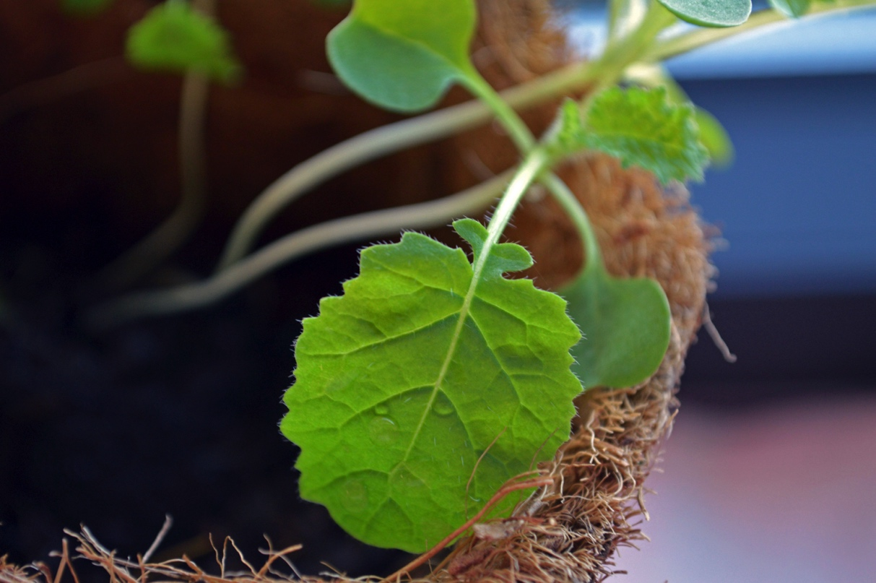
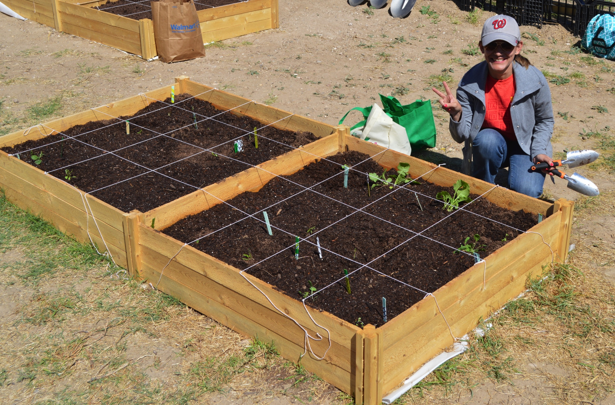

Dig’ It!
Promoting Green Spaces at TAMIU
Student Name
Class/EL Project
Introduction of service project
How EL Experience Relates to Course Content and/or Skills enhanced?
What Did I Learn from this Experiential Learning Project?
Description of what happened during the experiential learning experience. The project took place at (location). During x number of weeks. The experience involved…
In this section you have to answer how the experiential learning experience enhanced your academic learning and/or professional skills.
This is a final reflection on what you have learned from the whole experience.
What have you learned by being involved in this project/program?
Provide an example on when you had an “aha” moment and realized you have learned something different or new.
Why does this learning matter?
How do you plan on utilizing the skills you have learned beyond this course?
What has been the most exciting experience with this program?
During this project I learned that ….
You can either choose a specific topic that you can relate your service with or several ideas that were relevant to your course.
How was your experience related to your academic learning or professional skills?
How did this project help your personal growth?
Example:
This course focused on sustainable practices, we got to learn about what sustainability is. Before, I did not really understand what sustainability was. Now I know that sustainability is finding an equilibrium between fulfilling our needs and caring about the environment. (Here you can be creative on how you see issues differently)
The experience I liked the most about this project was the presentation from the RGISC organization and the clean-up at Manadas Creek. We were able to care for the environment and invest ourselves in the process. (This is an example on how you can explain your personal experience)
What did you do as part of the EL experiene?
When did you do it?
Who did you serve?
Answer all the Wh questions you can think about.
What?
When?
Who?
Where?
And How?

