Slide 1


Submit Your Next Protocol Using:
Presented by...

Slide 2
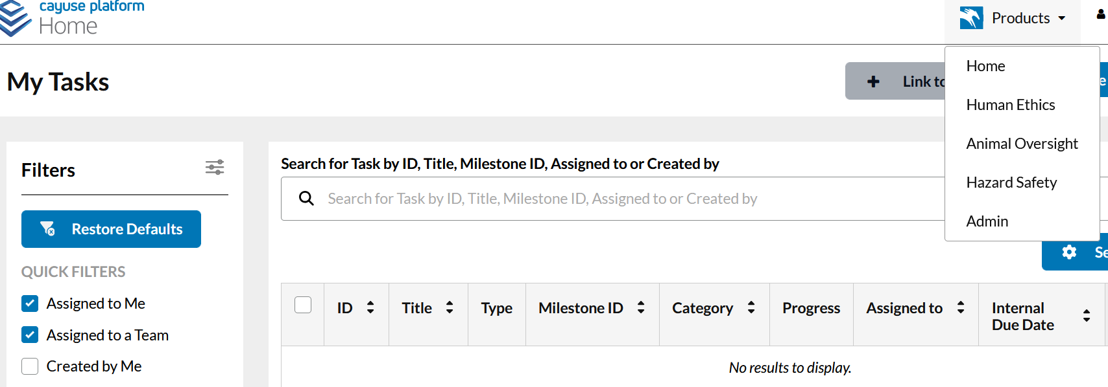
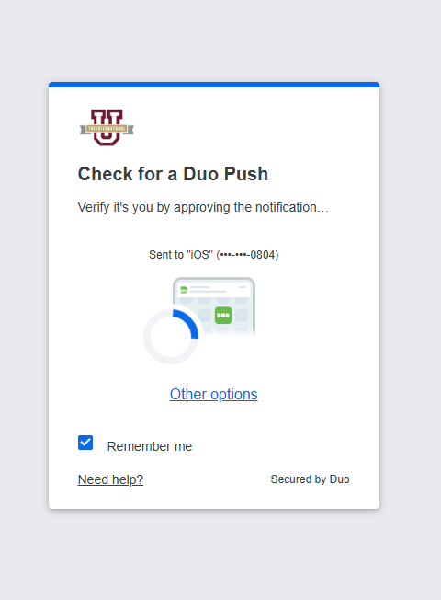
Visit tamiu.app.cayuse.com
and login using your SSO Account login
Once in, navigate to the “Products” dropdown
on the top right of the screen.
If you cannot get
access, please
email iacuc@tamiu.edu
Select the “Animal Oversight” option to continue.

Slide 3
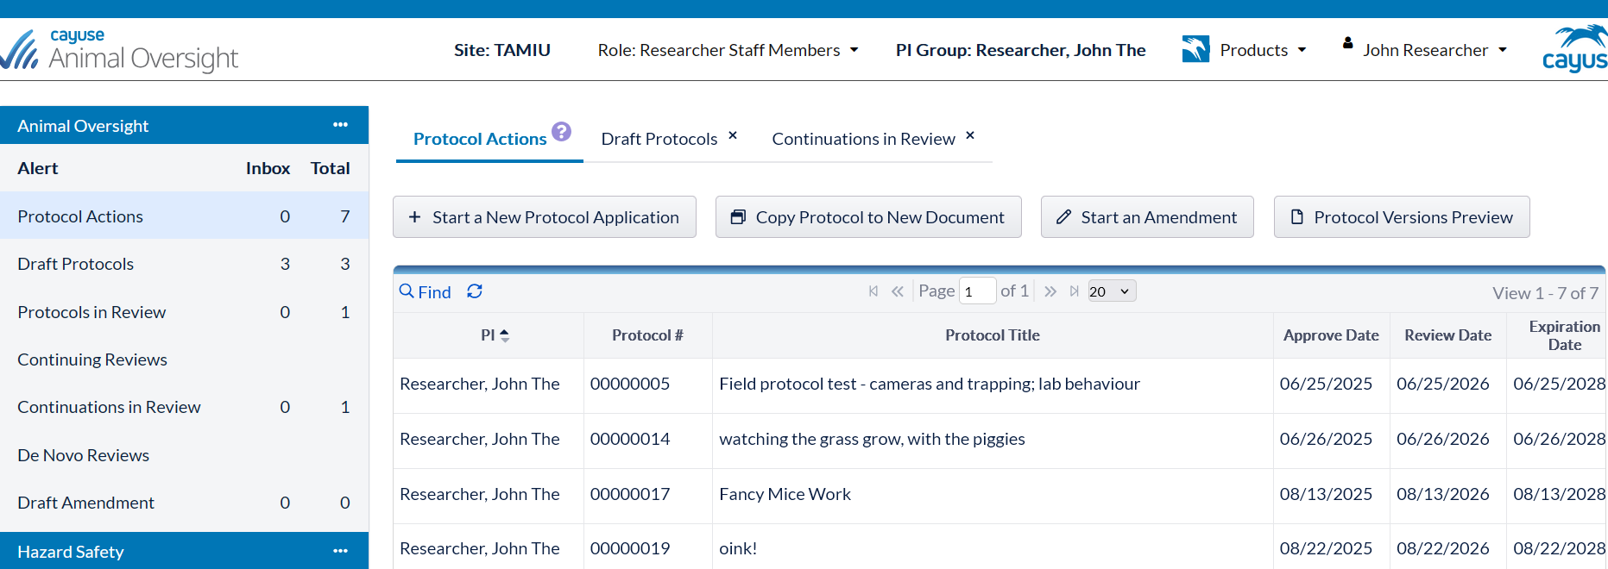

Let’s take a tour of the dashboard!
Total column = total # protocols for each type of form.
Includes approved + draft (Inbox)
Create a new protocol
Start amendment
Track the progress
of your protocols.
Inbox column = protocols with
tasks you need to do
If use human ethics or hazard safety modules, will see bar like this for each module and can click on it to easily switch between them.

Slide 4
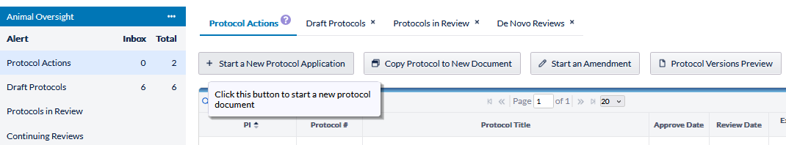
Appointments can be set up for training on how to use the CAYUSE system and/or to assist with protocol development, just contact iacuc@tamiu.edu for assistance.
Many areas of the IACUC protocol form are dictionary backed, and if you do not see the option(s) you want to use, for things like species, facility location, veterinary or experimental drugs, simply contact iacuc@tamiu.edu for assistance and your options can be easily added to the dictionaries.
You can start & stop a protocol at any point, just be sure to “save” before exiting a page.
Start a New Protocol Application
& let the research begin!

Slide 5
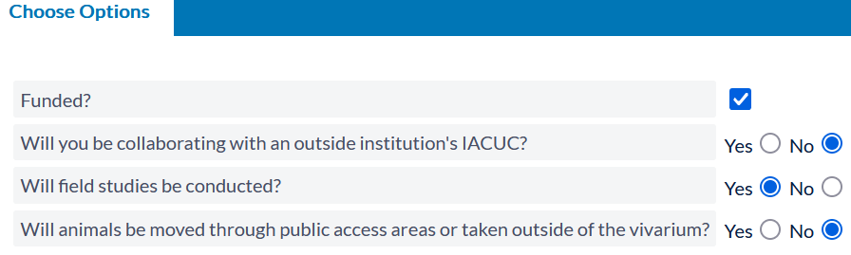
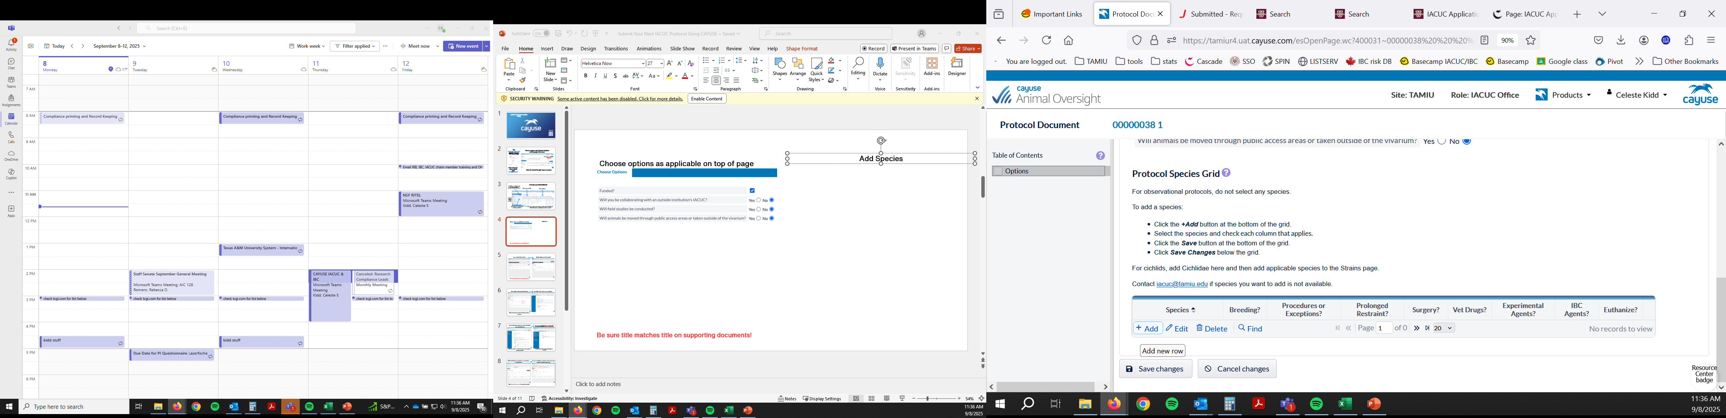
OPTIONS
Choose options as applicable on top of page
SPECIES
If doing an observational protocol, do NOT add species, just hit “save changes”
Cluetips provide extra information on a question
You can edit the selected Options at any point
to add a page or remove a page as needed
If questions, contact iacuc@tamiu.edu for assistance.

Slide 6
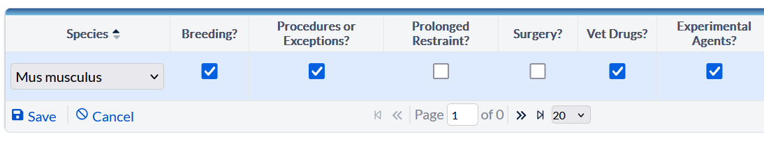
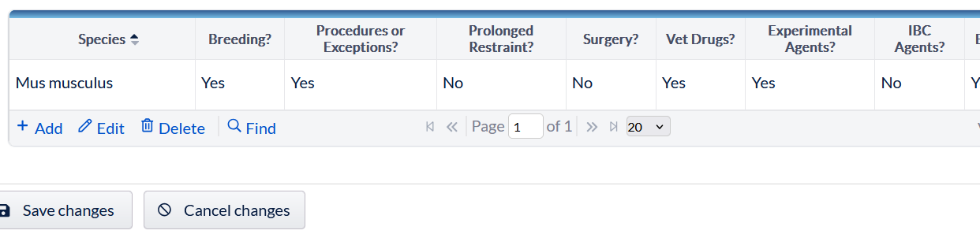
If handling/impacting animal behavior, need to Add species
Contact iacuc@tamiu.edu if need to have species added to dictionary
Select species from dropdown list, then select all applicable checkboxes for what will be done to that species on this protocol and click “save”
Repeat until all species have been added, then click “save changes”
.

Slide 7
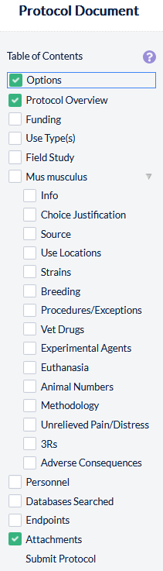
If you did NOT select “Funding” or “Field Study” on the Options page, you will not get those pages to fill out
If you did NOT add species, you will get just the Field Study page, no species pages
If you did add species, then you will have species information pages to fill out
Once a page is complete, the white box will change to a green box with checkmark.
Only after all boxes have green checkmarks can you submit the protocol.

Slide 8
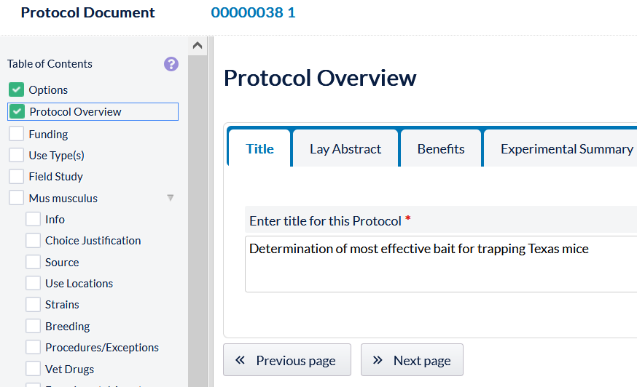
Protocol number is at the top of every page and in this screen shot, protocol number is 38, 1 is version. Whenever amendment etc. is submitted, the version number will change.
Enter Title, then
click tab at top or Next page button
to go on to next tab.
Any questions with a red asterisk must be completed or checkbox will not turning green.
If any problems or questions, contact iacuc@tamiu.edu for assistance

Slide 9
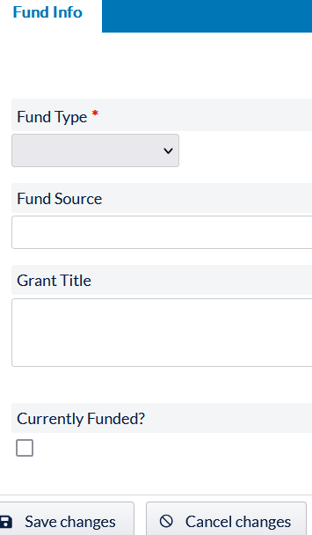
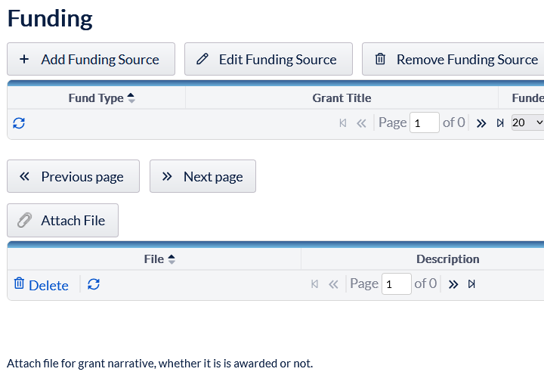
Attach File button on some pages is on the first outer page, such as shown for the Funding page below & to the right. Outer page has button & a table showing grant details put into system on the Add Funding Source page shown on right
After click Add Funding Source –
add grant details & save changes
Repeat this process until all grants have been added and upload all grant narrative documents.
Then continue answering remaining questions to complete the protocol form.

Slide 10
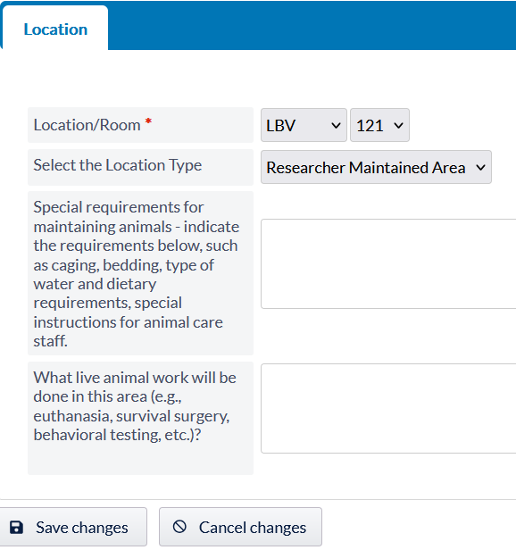
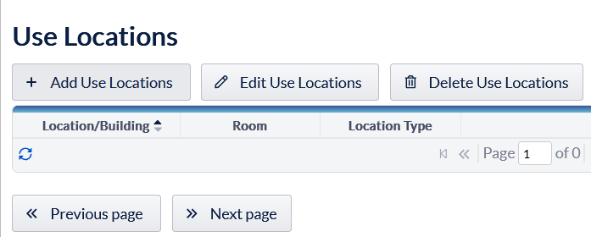
Use Locations
Click “Add Use Locations” and add all locations
to be used for this protocol
For each location – select the location and room from dropdown list & complete questions & save
If location or room is not available to select, contact iacuc@tamiu.edu for assistance.

Slide 11
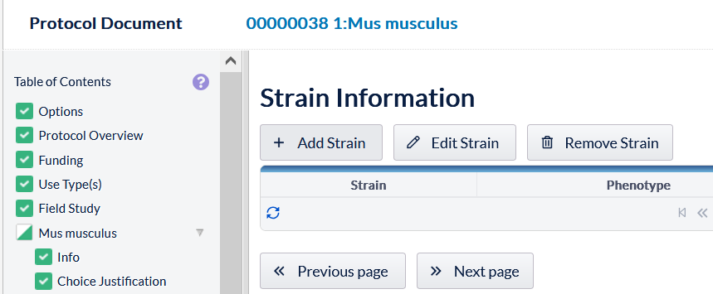
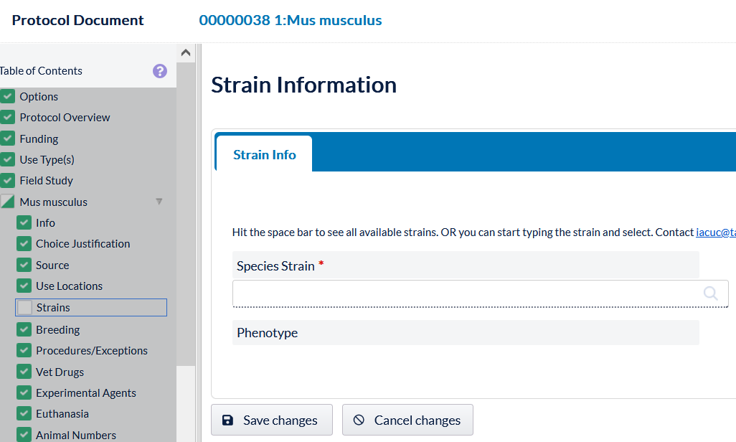
Strain Information – Click “Add Strain” and add all strains used for this protocol and save
After click Add Strain, to find target strain, either put a space in Species Strain text box & a list of all available strains for that species will be shown
or
type strain name in that field and available options will be shown
If target strain is not available to select, contact iacuc@tamiu.edu for assistance.

Slide 12
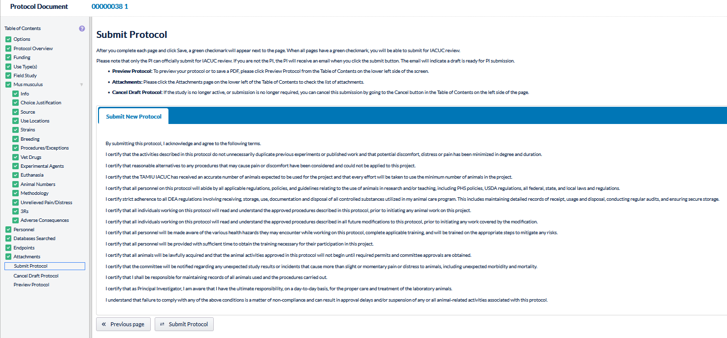
Answer all questions about your study and upload supporting documents as needed
Once all checkboxes are green, then you can submit the protocol.

Slide 13
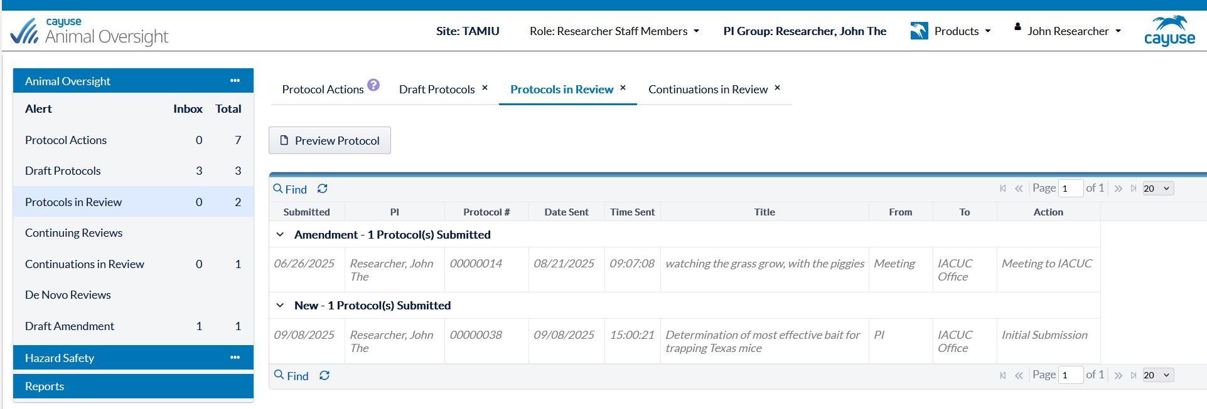
Then will see it change to be Protocol in Review, and you can monitor the progress.
Review process
IACUC Office reviews for completeness & they may send back request for revisions to PI
IACUC Chair/IACUC reviewer or agenda for next IACUC meeting
Once Office Review completed, it moves on to the

Slide 14
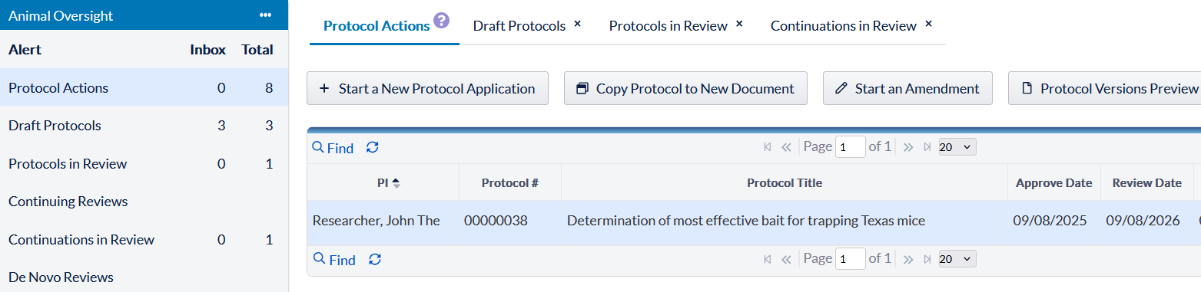
CAYUSE sends out automated emails for approval letters. Save those approval emails! PI can’t access them in the protocol system. If need approval letter again, contact iacuc@tamiu.edu for assistance.
Amendments
Only can be done to an approved protocol
1. Click on Protocol Actions to find all approved protocols
2. Use Find to be able to find & have hot link to select protocol
3. Highlight row to select which protocol to submit amendment
4. Click Start an Amendment and edit protocol as needed & submit

Slide 15
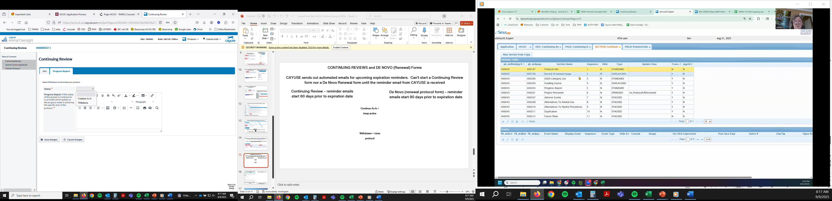
CONTINUING REVIEW Forms
CAYUSE starts sending automated Continuing Review emails starting 60 days prior to expiration date.
Can’t start a Continuing Review form until the reminder email from CAYUSE is received (i.e. no button like a new protocol)
Can only delete personnel & provide a brief progress report, all other changes must be done on the amendment form instead.
Select status requesting and fill out progress report & save
Continue As Is = keep active
Withdrawn = close protocol

Slide 16
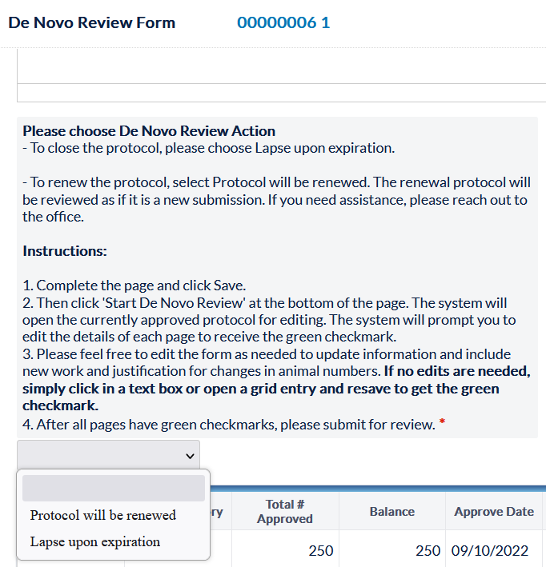
De Novo (Renewal) Forms
CAYUSE starts sending automated De Novo (Renewal) emails starting 90 days prior to expiration date.
Can’t start De Novo form until reminder email from CAYUSE is received (i.e. no button like a new protocol)
Protocols are approved for 3 years and at end of 3 years, if want to renew protocol for additional 3 years, need to submit De Novo form & it is reviewed again.
Fill out progress report, then select
“protocol will be renewed” or “lapse upon expiration” (i.e. protocol will close on expiration date) & save
NOTE: If protocol expires, there is no way to reactivate protocol, will have to copy to a new protocol form & may need be rereviewed.

Slide 17
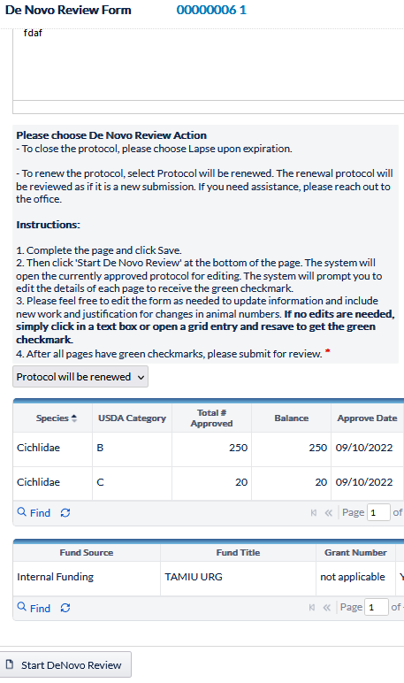
De Novo (Renewal) Forms
Once progress report & status questions answered & click save, then at bottom of page a Start DeNovo Review button appears form
Click button and this will reopen the previous approved protocol and, on each page, the investigator must review the text and make changes (if necessary), then save
Even if no changes are being made, investigator must click somewhere on the page in a textbox or radio button, and then save page before the green checkmark will appear for that page
Once all pages have been reviewed and all pages have green checkmarks, then the De Novo form can be submitted for review.

Slide 18
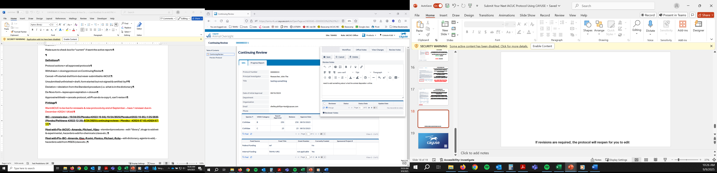
Widget identifies where edits are needed to the protocol form.
and
Also on that page, will be a popup screen with details on what needs to be edited.
If revisions are required, an automatic email will be sent to PI to notify them that edits are required & the protocol reopens for PI to make edits.
Something to edit widget

Slide 19
IMPORTANT LINKS
CAYUSE Website
https://tamiu.app.cayuse.com
TAMIU CAYUSE Help
iacuc@tamiu.edu
CAYUSE Support Site – Need to sign up to use, has helpful documents on how to use system
https://support.cayuse.com/hc/en-us
Cayuse Community Site – Need to sign up to use, can connect with other users, share best practices & give developers product enhancement ideas
https://community.cayuse.com/home

Slide 20
Happy Researching!

