Slide 1


Submit Your Next Protocol Using:
Presented by...

Slide 2
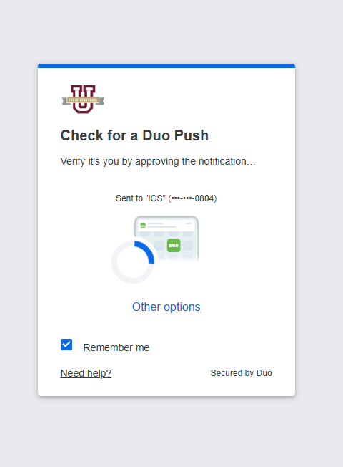
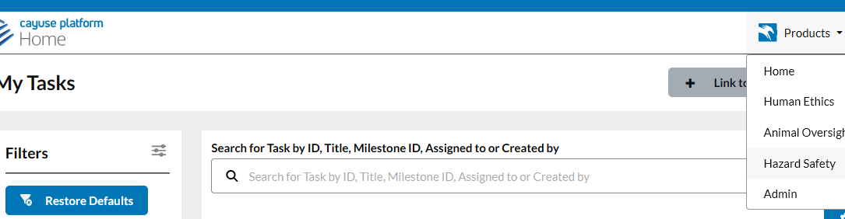
Visit tamiu.app.cayuse.com
and login using your SSO Account login
Once in, navigate to the “Products” dropdown
on the top right of the screen.
If you cannot get
access, please
email ibc@tamiu.edu
Select the “Hazard Safety” option to continue.

Slide 3
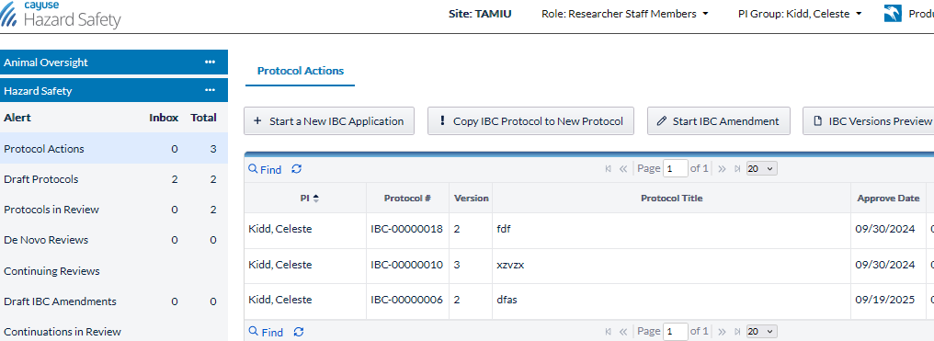

Total column = total # protocols for each type of form.
Includes approved + draft (Inbox)
Let’s take a tour of the dashboard!
If use human ethics or animal oversight modules, will see bar like this for each module and can click on it to easily switch between them.
Track progress
of your protocols
Inbox column = protocols with
tasks you need to do
Create a new protocol
Start amendment

Slide 4
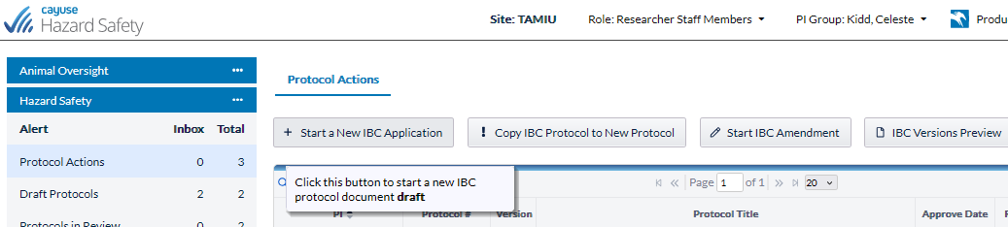
Appointments can be set up for training on how to use the CAYUSE system and/or to assist with protocol development, just contact ibc@tamiu.edu for assistance.
Many areas of the IBC protocol form are dictionary backed, and if you do not see the option(s) you want to use, for things like species, facility location, agents, simply contact ibc@tamiu.edu for assistance and your options can be easily added to the dictionaries.
You can start & stop a protocol at any point, just be sure to “save” before exiting a page.
Start a New Protocol Application
& let the research begin!

Slide 5
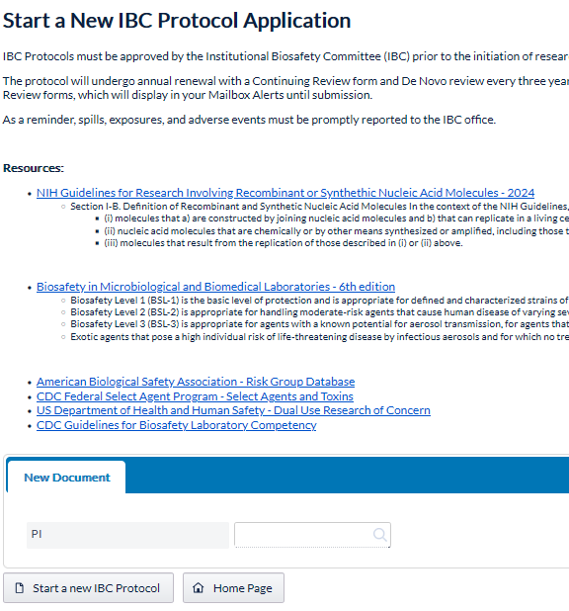
Start New IBC Protocol Application
Reference/resource materials are on this page, which are also available throughout the application and are also posted on the IBC website
Click on “start a new IBC Protocol”
If questions, contact ibc@tamiu.edu for assistance.

Slide 6
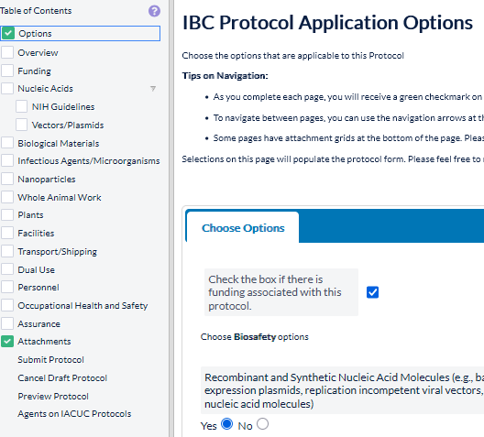
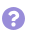
Cluetips provide extra information
on a question or section
CAYUSE has branching logic, so answers selected on the Options page will add various subpages to the protocol form. Also true for questions on pages, where depending on your response, you can get different subquestions to complete.
OPTIONS - Select all applicable options and prior to submission of protocol to IBC, you can add/delete options anytime and it will remove the subpages.
If questions,
contact ibc@tamiu.edu for assistance.

Slide 7
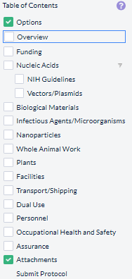
For example: If you select “Funding” or “Nanoparticles”” on the Options page, you will get those pages to fill out
If you want to remove page, just go back to “Options” and answer question on Options page differently and Save Changes, then the subpages
will also change
Once a page is complete, the white box will change to a green box with checkmark.
Only after all boxes have green checkmarks can you submit the protocol.
If questions, contact ibc@tamiu.edu for assistance.

Slide 8
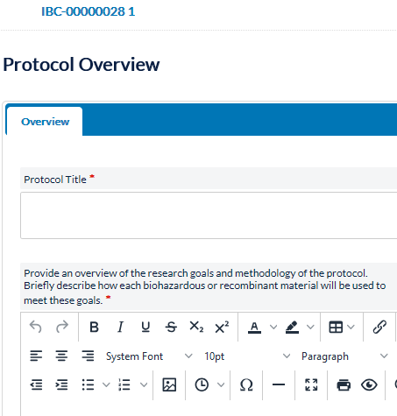
Protocol number is at the top of every page and in this screen shot,
protocol number is 28, 1 is version. Whenever amendment etc. is submitted, the version number will change.
Enter Title, then
answer remaining questions on the page and click “save changes”
Any questions with a red asterisk must be completed or you will get error & be directed to missing question, and the checkbox will not turn green
If any problems or questions,
contact ibc@tamiu.edu for assistance

Slide 9
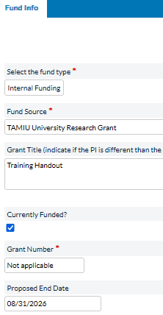
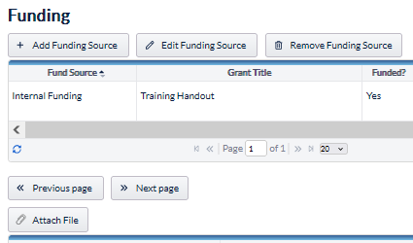
Attach File button on some pages is on the first outer page, such as shown for the Funding page below. Outer page has button & a table showing grant details that are put into system, when click on Add Funding Source, which opens up page shown on right for providing funding details
After click Add Funding Source –
add grant details & Save Changes
Repeat this process until all grants have been added and upload all grant narrative documents.

Slide 10
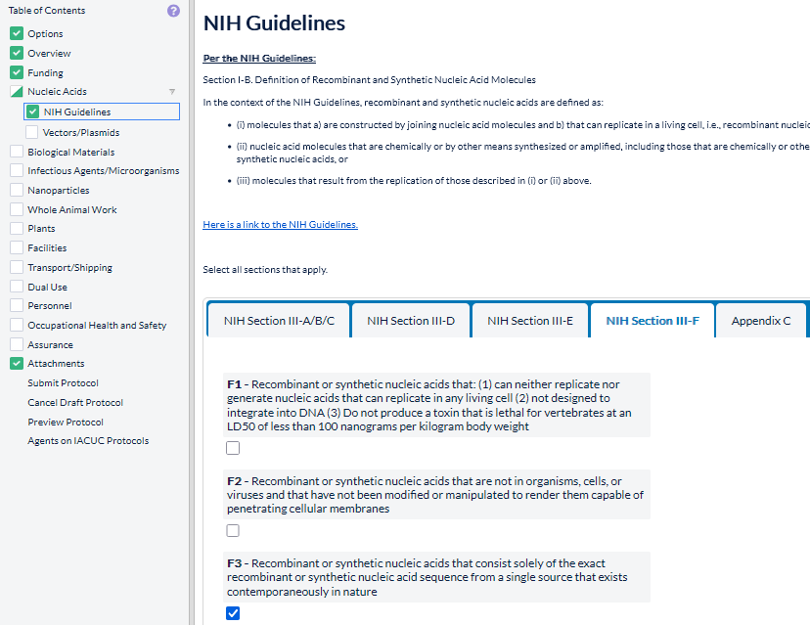
NIH Guidelines
Link to the guidelines
Select tab and items in each section as applicable
If any problems or questions, contact ibc@tamiu.edu for assistance

Slide 11
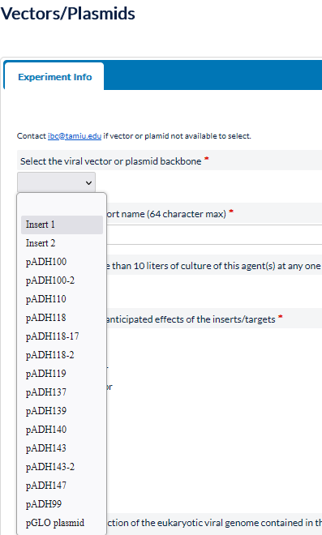
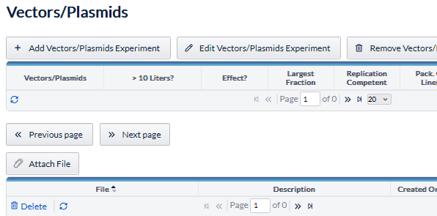
Vector/Plasmids – Click “Add Vector/Plasmids” and then select vector/plasmid from dropdown list or contact ibc@tamiu.edu to get vector/plasmid added to the dictionary.
On outer page, use Attach File button to upload documentation of BSL level (if applicable).
Repeat until all vector/plasmids to be used on protocol added, answer other questions on inner page shown on right and click Save Changes.

Slide 12

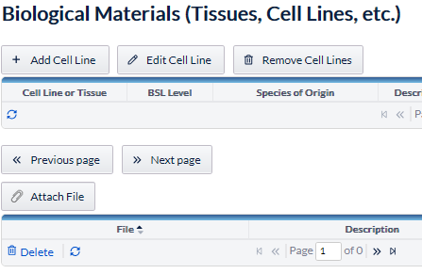
Biological Materials – Click “Add Cell Line” and then select cell line either put a space in cel line text box & a list of all available cell lines will be shown or can type category to see options.
m
On outer page, use Attach File button to upload documentation of BSL level or Experimental Details document (if not inserting that information into textbox on Cell Line Details page).
Answer other questions on inner page shown on right, and repeat until all biological materials added to protocol and click Save Changes.

Slide 13
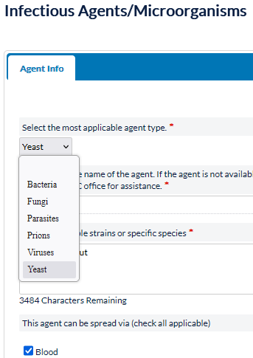
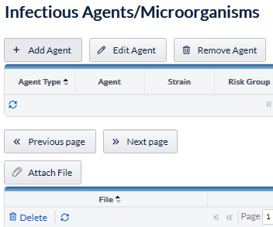
Infectious Agents/Microorganisms – Click “Add Agent” and then on Agent Info page, select agent from dropdown list or contact ibc@tamiu.edu to get agent added to the dictionary.
On outer page, use Attach File button to upload documentation of BSL level (if applicable).
Repeat until all agents to be used on protocol added, answer other questions on inner page shown on right and click Save Changes.

Slide 14
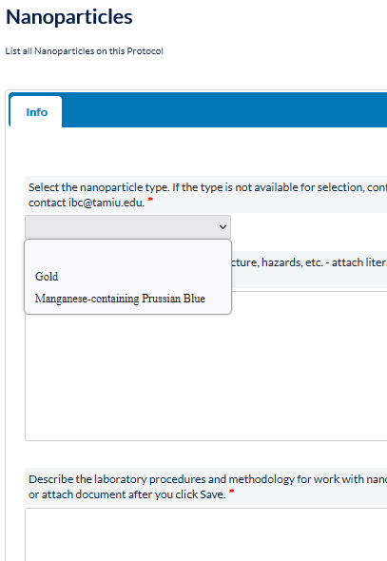
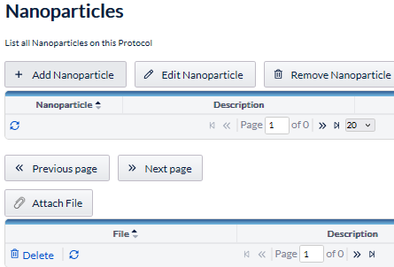
Nanoparticles – Click “Add Nanoparticle” and then on Info page, select nanoparticle from dropdown list or contact ibc@tamiu.edu to get nanoparticle added to the dictionary.
On outer page, use Attach File button to attach any supporting documents (if applicable).
Repeat until all nanoparticles to be used on protocol added, answer other questions on inner page shown on right and click Save Changes.

Slide 15
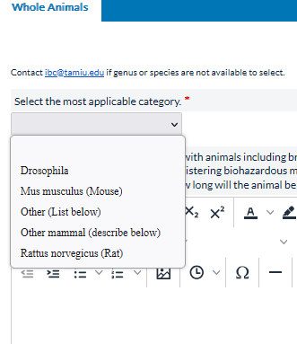
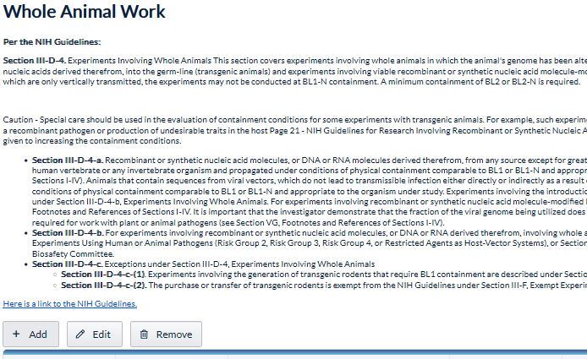
Whole Animal Work – Click “Add” and then on Whole Animals page, select animal from dropdown list or contact ibc@tamiu.edu to get animal added to the dictionary.
Repeat until all animals to be used on protocol added, answer other questions on inner page shown on right and click Save Changes.

Slide 16
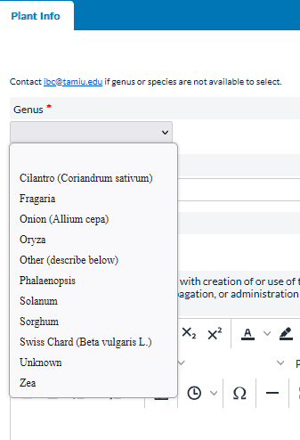
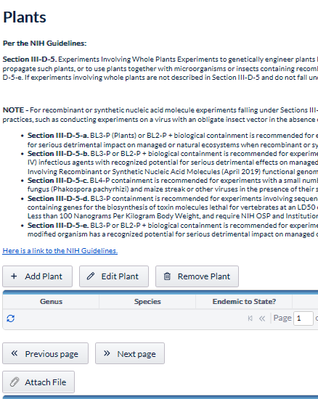
Plants – Click “Add Plant” and then on Plant Info page, select plant from dropdown list or contact ibc@tamiu.edu to get animal added to the dictionary.
Repeat until all plants to be used on protocol added, answer other questions on inner page shown on right and click Save Changes.

Slide 17
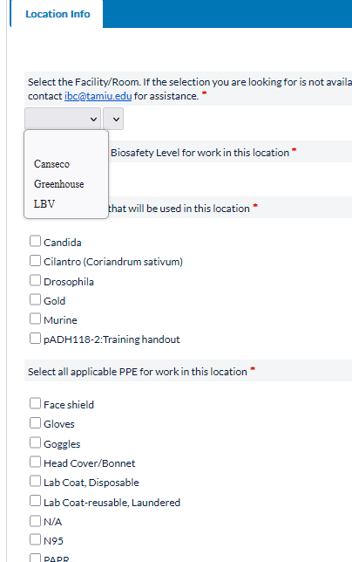
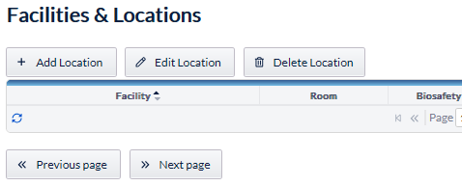
Facilities – Click “Add Location” and then on Location Info page, select location from dropdown list or contact ibc@tamiu.edu to get location added to the dictionary.
Repeat until all locations to be used on protocol added, answer other questions on inner page shown on right and click Save Changes.
If questions or problems, contact ibc@tamiu.edu for assistance.

Slide 18
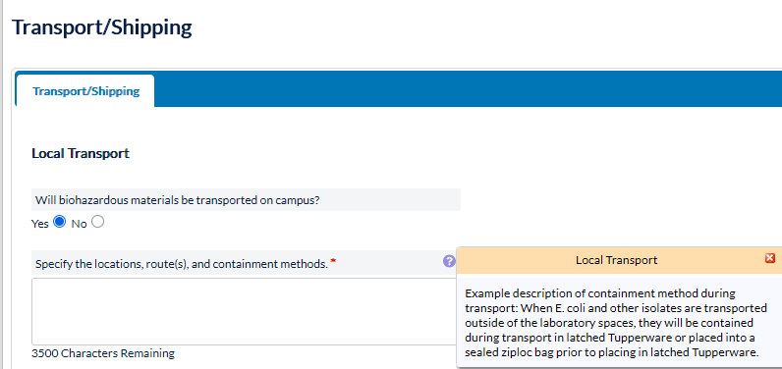
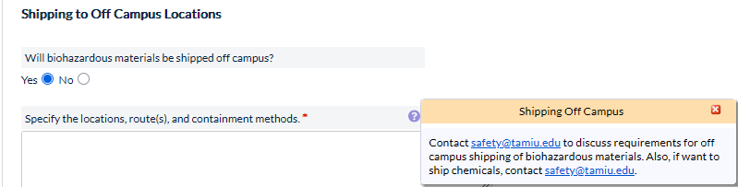
Transport/Shipping
Answer question about local transport (clue tip has example)
Answer question about off-campus shipping, and if yes, clue tip guides you to talk with safety@tamiu.edu for language to put for required shipping containment.

Slide 19
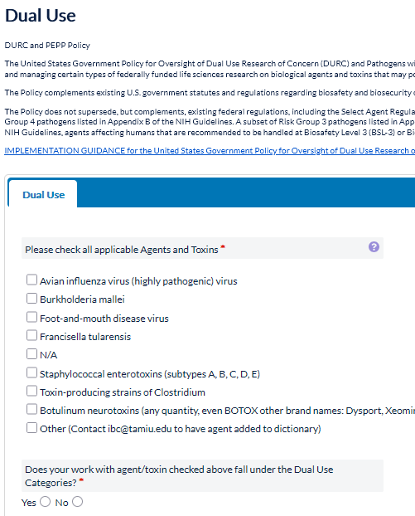
Dual Use
Reference materials are at the top of this page & clue tip has quick reference for Dual Use Categories.
Check “N/A” or check applicable agent/toxin(s)
OR
check “other” and contact ibc@tamiu.edu to get agent/toxin added to the dictionary.
Repeat until all agent/toxin(s) to be used on protocol added, answer other question about Dual Use, and click Save Changes.
If questions, contact ibc@tamiu.edu for assistance.

Slide 20
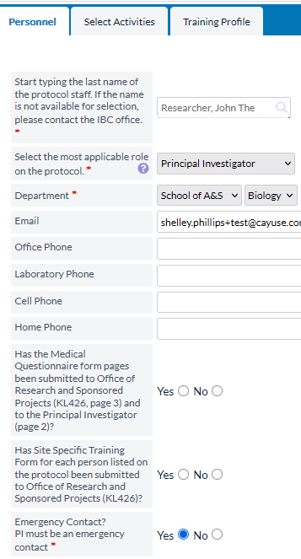
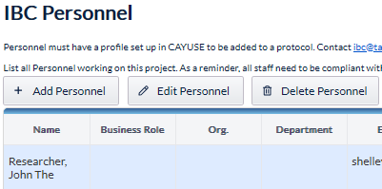
Personnel
All employees are automatically set up in the CAYUSE system. For non-employees (i.e. most students), email ibc@tamiu.edu the student ‘s name and email address to have IBC add a profile in system, then the student can be selected to be added to a protocol.
Click “Add Personnel” and then on Personnel page, type last name
in box and select person want to add, then fill information on Personnel, and Select Activities (see next slide) tabs. Training Profile tab is optional.
Note: all phone numbers are required for principal investigator and anyone who is an emergency contact.
Research staff members email will autopopulate from their profile.
Answer other questions on inner pages shown on right (on all tabs), and click Save Changes.

Slide 21
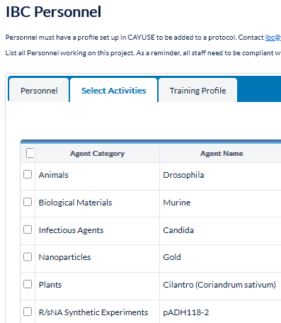
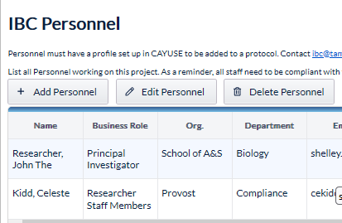
Personnel
For each individual on protocol, need to select what protocol activities they will be doing on the Select Activities tab. Selecting checkbox on top will check all boxes.
If Select Activities page not filled out when originally added personnel to protocol, click “Edit Personnel” and then “Select Activities” as shown to the right, and then click Save Changes.

Slide 22
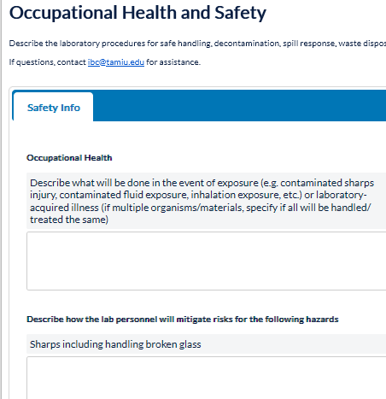
Occupational Health & Safety
Answer all questions or put N/A if question(s) don’t apply for your project.
If questions, contact safety@tamiu.edu
or
ibc@tamiu.edu for assistance.

Slide 23
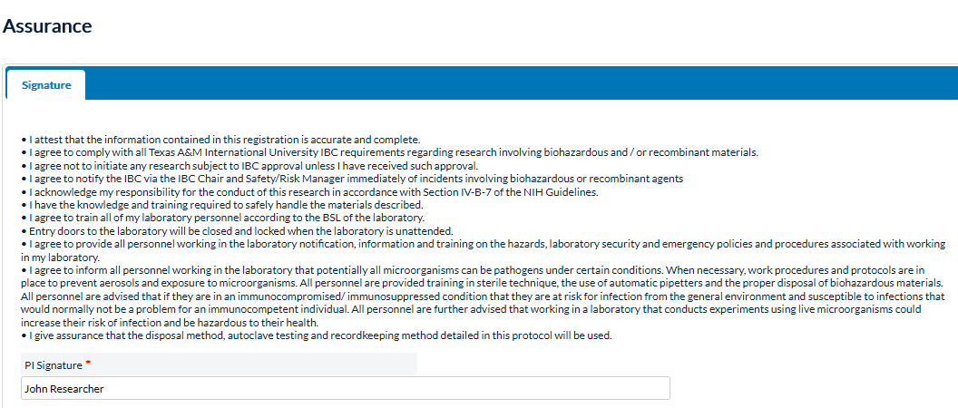
Principal Investigator reads Assurances, enters name to “sign” the protocol form, and Save Changes.

Slide 24
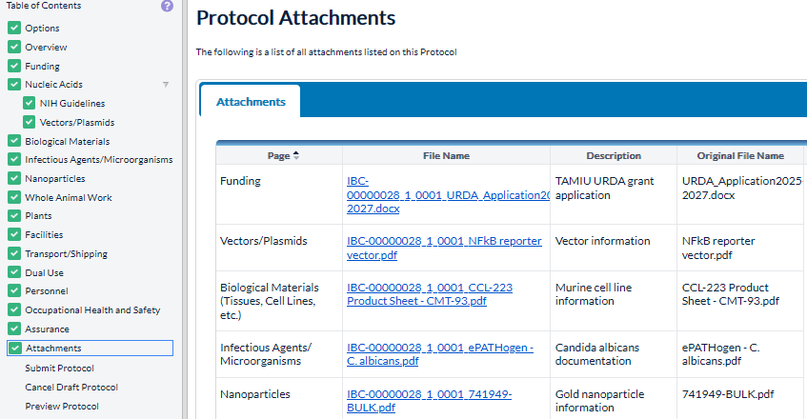
Attachments uploaded earlier in form will have a page associated with the attachment. Review and if need to attach other documents, go back to applicable earlier page, or click Attach File button on this page to upload.

Slide 25
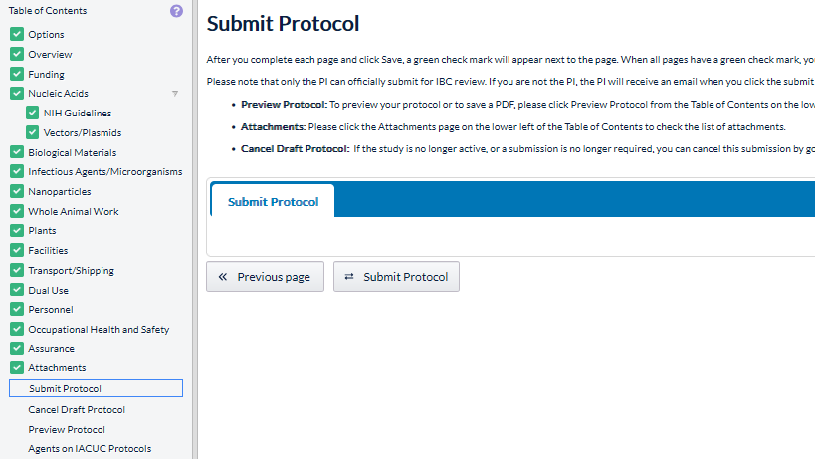
Once all checkboxes are green, then you can submit the protocol.

Slide 26
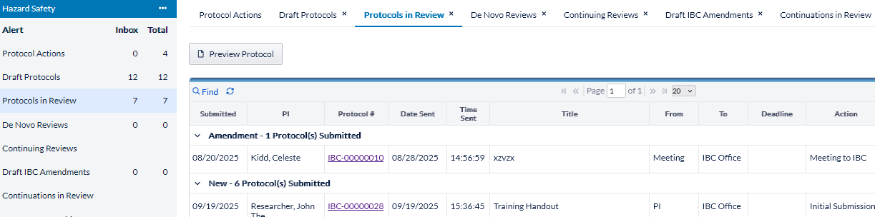
Then will see it change to be Protocol in Review, and you can monitor the progress.
Review process
IBC Office reviews for completeness & they may send back request for revisions to PI
IBC Chair/IBC reviewer or agenda for next IBC meeting
Once Office Review completed, it moves on to the

Slide 27
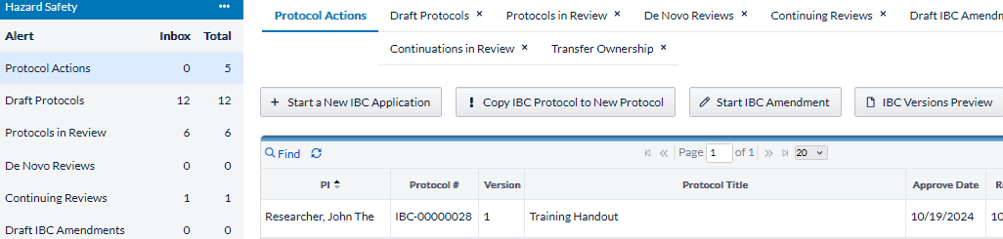
CAYUSE sends out automated emails for approval letters. Save those approval emails! PI can’t access them in the protocol system. If need approval letter again, contact ibc@tamiu.edu for assistance.
Amendments - Only can be done to an approved protocol
              1. Click on Protocol Actions to find all approved protocols
              2. Use Find to be able to find & have hot link to select protocol
              3. Highlight row to select which protocol to submit amendment
              4. Click Start an Amendment and protocol form will open up and can edit anywhere to
              make changes as needed & then submit

Slide 28
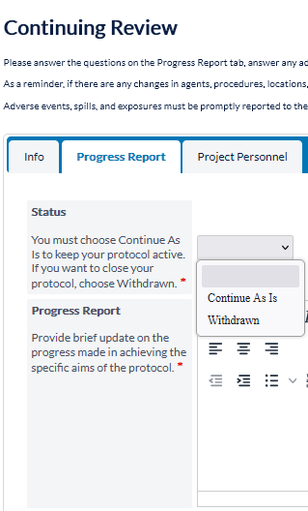
CONTINUING REVIEW Forms
CAYUSE starts sending automated Continuing Review (CR) emails starting 60 days prior to expiration date.
Can’t start a Continuing Review form until the reminder email from CAYUSE is received (i.e. no CR button to start earlier)
Select status requesting and fill out progress report & save
Continue As Is = keep active
Withdrawn = close protocol
Provide a brief progress report and can only delete personnel on this form. Any other changes must be done on the amendment form instead.

Slide 29
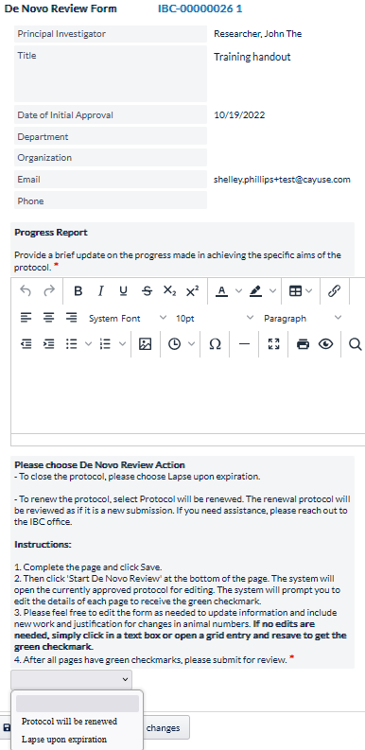
De Novo (Renewal) Forms
CAYUSE starts sending automated De Novo (Renewal) emails starting 90 days prior to expiration date.
Can’t start De Novo form until reminder email from CAYUSE is received (i.e. no De Novo button to start earlier)
Protocols are approved for 3 years and at end of 3 years, if want to renew protocol for additional 3 years, need to submit De Novo form & it is reviewed again.
Fill out progress report, then select
“protocol will be renewed” or “lapse upon expiration” (i.e. protocol will close on expiration date) & Save Changes
NOTE: If protocol expires, there is no way to reactivate protocol, will have to copy to a new protocol form & may need be rereviewed.

Slide 30
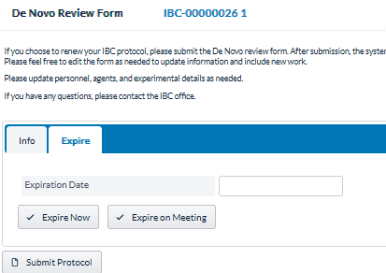
De Novo (Renewal) Forms – if closing protocol
Fill out progress report, then select if select “Lapse Upon Expiration” on the Info tab, and then go to Expire tab and select option there as well.
NOTE: If protocol expires, there is no way to reactivate protocol, will have to copy to a new protocol form & may need be rereviewed.

Slide 31
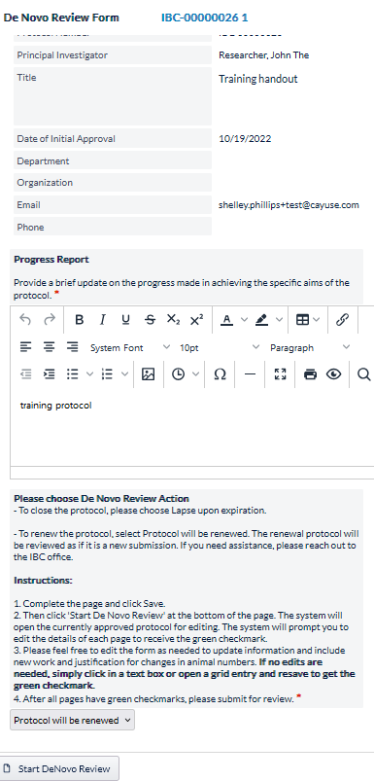
De Novo (Renewal) Forms – if renewing protocol
Once progress report & status questions answered & click save, then at bottom of page a Start DeNovo Review button appears form
Click button and this will reopen the previously approved protocol and
on each page, the investigator must review the text and make changes (if necessary), then save
Even if no changes are being made, investigator must click somewhere on the page in a textbox or radio button, and then save page before the green checkmark will appear for that page
Once all pages have been reviewed and all pages have green checkmarks, then the De Novo form can be submitted for review.

Slide 32
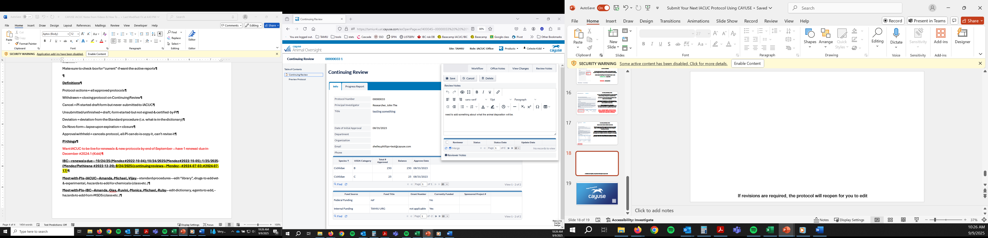
Widget identifies where edits are needed to the protocol form.
and
Also on that page, will be a popup screen with details on what needs to be edited.
If revisions are required, an automatic email will be sent to PI to notify them that edits are required & the protocol reopens for PI to make edits.
Something to edit widget

Slide 33
IMPORTANT LINKS
CAYUSE Website
https://tamiu.app.cayuse.com
TAMIU CAYUSE Help
  ibc@tamiu.edu
CAYUSE Support Site – Need to sign up to use, has helpful documents on how to use system
  https://support.cayuse.com/hc/en-us
Cayuse Community Site – Need to sign up to use, can connect with other users, share best practices & give developers product enhancement ideas
  https://community.cayuse.com/home

Slide 34
Happy Researching!

