Slide 1
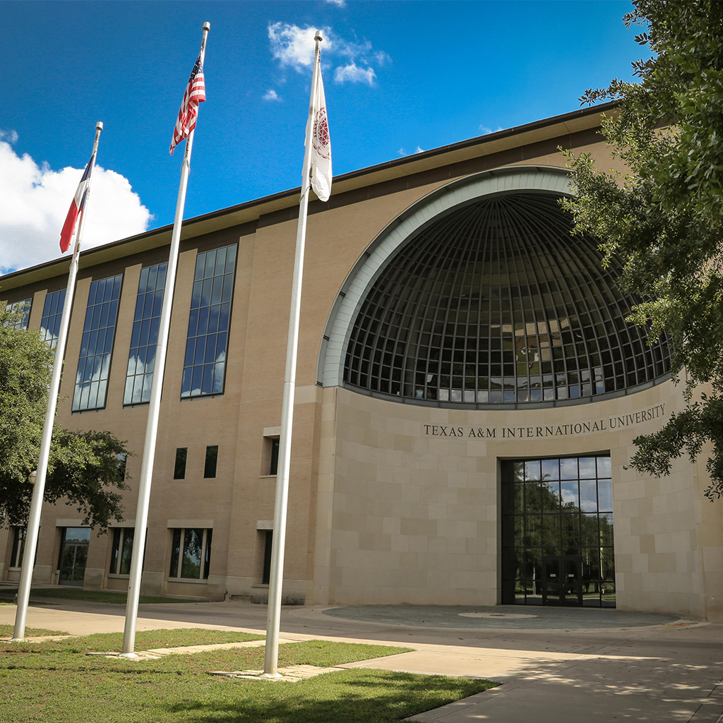
FALL ASSEMBLY
Dr. Pablo Arenaz
August 21, 2017

Slide 2
Institutional Recognition
TAMIU ranks among the best in the Country for Master’s Programs and Best Bang for the Buck by Washington Monthly’s College Guide Ranking.
TAMIU ranks 33rd among the top 100 schools nationally and the top school in Texas in Student Success as reported by Eduventures.
TAMIU ranks third among the top 10 best colleges for economic mobility and the only one in Texas as reported by Zippia.
TAMIU ranked among the Top 15 Most Affordable Bachelor’s degrees by AffordableSchools.com.

Slide 3
Institutional Recognition
TAMIU ranks eighth among Southern colleges in Washington Monthly’s 2016 Best Bang for the Buck.
TAMIU ranks sixth among 30 best Texas Universities in Financeopedia’s 2017 Review for an “…almost impossible to beat net price.”
Online College Plan ranks TAMIU 34 out of the top 50 Online Hispanic-serving Institutions.
TAMIU was recognized by LearnHowToBecome.org as one of Texas’ Best Learning Environments.
Successful Debut/Premiere of Rhapsody on the Rio Grande, a collaboration between Colin Campbell, the Laredo Philharmonic Orchestra and KLRN.

Slide 4
College Recognition
Diverse Issues in Higher Education Top Degree Producers– graduating Hispanic Undergraduate and Graduate students:
Communication Disorders ranked 2nd nationally.
Criminal Justice ranked 12th nationally.
Kinesiology ranked 17th nationally.
Teacher Education ranked 18th nationally.
Mathematics ranked 24th nationally and 18th for graduate.
Accounting ranked 26th nationally and 12th for graduate.
Biology ranked 25th nationally and 25th for graduate.

Slide 5
College Recognition
Both the MBA and the MPA Online programs were ranked 10th among the best 20 Online Colleges in Texas.
The BA in English was ranked 7th in the nation by AffordableSchools.com.
The College of Education was ranked first among schools offering bachelor’s degrees and third for master’s degrees for students looking to become Texas teachers by ToBecomeATeacher.org.
The MBA was ranked third among the top 50 affordable MBA programs according TopManagementDegree.com .

Slide 6
Faculty Recognition
Roberto Heredia was selected as Regent’s Professor.
Jerry Thompson’s book Tejano Tiger: José de los Santos Benavides and the Texas-México Borderlands, 1823-1891 was nominated for a Pulitzer Prize.
Jackie and Milton Mayfield were selected to be co-editors of the International Journal of Business Communication, a prestigious journal in Business Communication.
Stephen Meardon testified before the U.S. Trade Representative on the impact of NAFTA on the Border Region.

Slide 7
Student Recognition
The DustySWARM team placed sixth overall out of 19 teams in the second NASA Swarmathon: 3rd in technical report and 2nd High School Swarmathon Competition.
TAMIU Mariachi Internacionál took second place at a regional competition this summer in Albuquerque and was selected to perform at the 2017 Texas Music Educators Association State Convention.
TAMIU Percussion Ensemble was selected to perform at the 2017 Texas Music Educators Association State Convention.
Engineering student Michael Gutiérrez was part of a team that won the SHPE National Conference Extreme Engineering Challenge.
Oswaldo García was a Distinguished Overall Winner in the Graduate Division at the TAMUS Pathways Conference.
Luís Lascari won the prize for the best undergraduate story at the Texas Association of Creative Writing Teachers undergraduate fiction category.
.

Slide 8
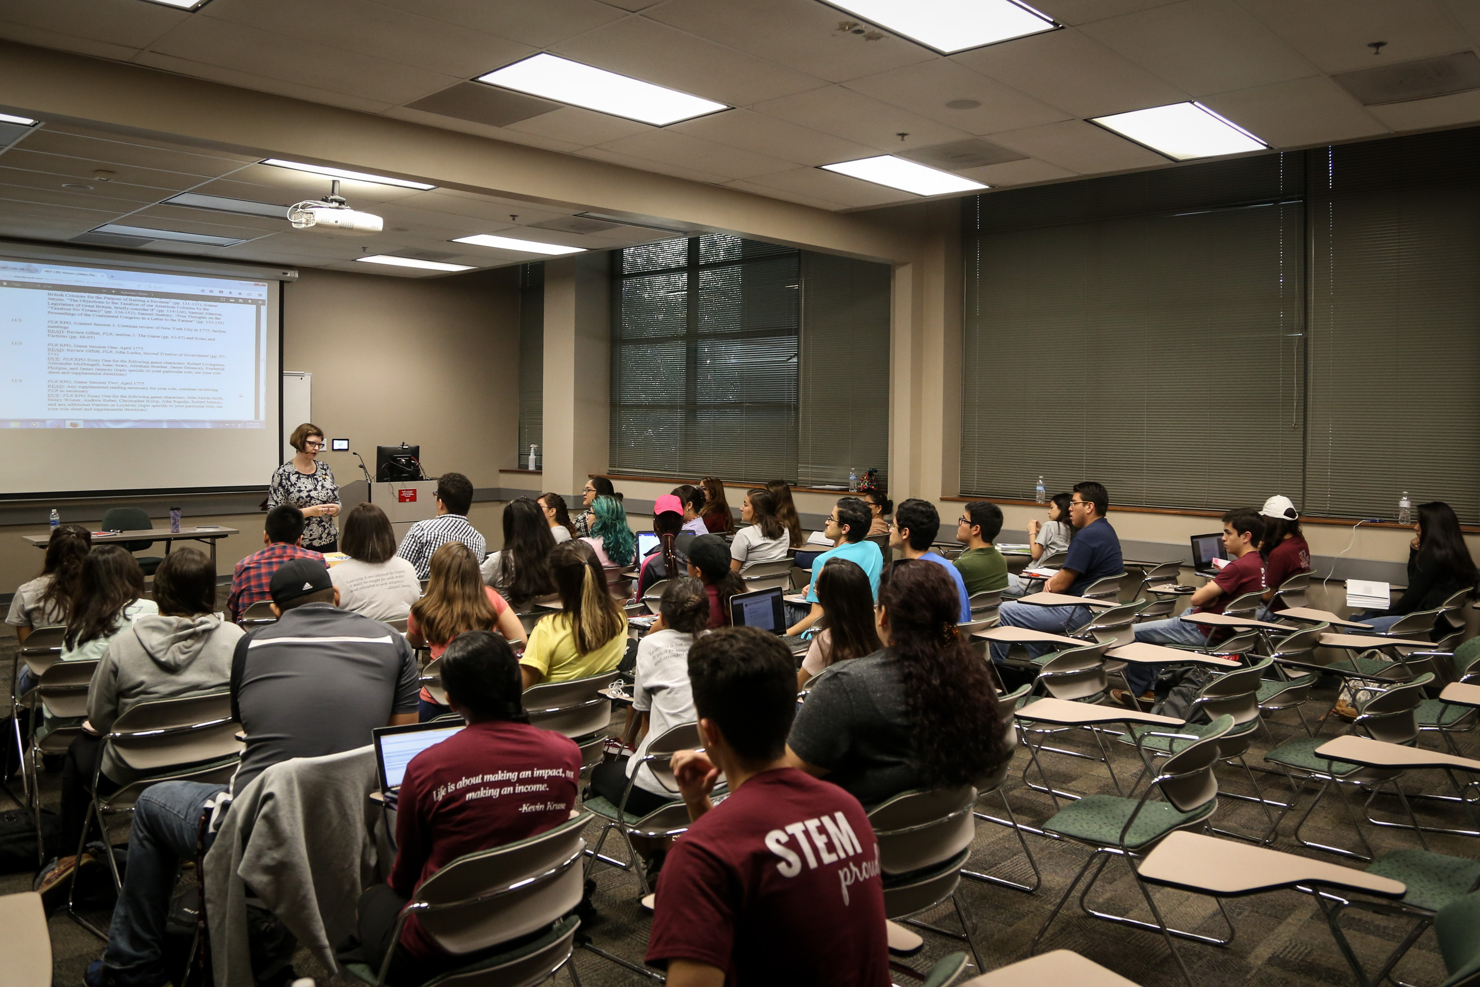
Academic Performance

Slide 9
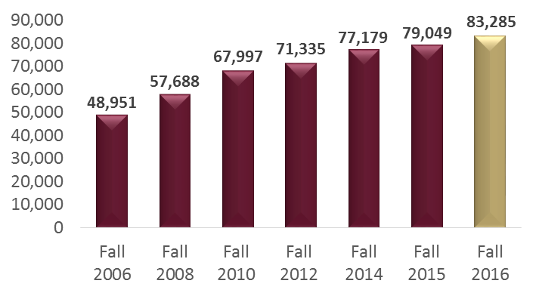
Fall Enrollment
A 51% increase in headcount since 2006

Slide 10
First-Year Persistence Rate

Slide 11
Four-Year Graduation Rate

Slide 12
Six-Year Graduation Rate

Slide 13
Persistence Rates
First-year and Six-year
 | First Year Persistence for Cohort Entering |  |  | Six Year Graduation and Persistence
 | Fall 2014 | State Avg |  | FY 2015 | State Avg
All Students | 87.2% | 86.9% |  | 62.9% | 69.9%
White | 85.7% | 89.6% |  | 55.6% | 75.6%
African-American | 0.0% | 80.3% |  | 66.7% | 53.8%
Hispanic | 87.8% | 85.5% |  | 62.4% | 65.2%

Slide 14
Degrees Awarded

Slide 15
Student to Faculty Ratio

Slide 16
Financial

Slide 17
State Appropriations Net GR (in thousands)

Slide 18
FY 18 Proposed Revenue Budget

Slide 19
FY 18 Proposed Expense Budget

Slide 20
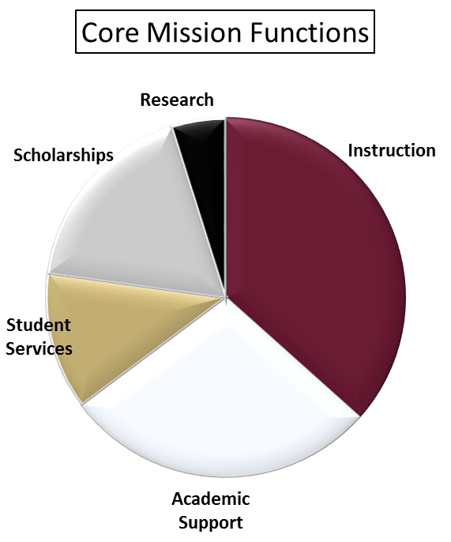
FY 18 Proposed Expense Budget

Slide 21
Administrative Costs

Slide 22
Salary Plan
(Contingent on Fall Semester Credit Hours)

Slide 23
Average Salaries

Slide 24
Tuition and Fees
Variable and Guaranteed Rates (15 SCH)

Slide 25
(in thousands)
Research Expenditures

Slide 26
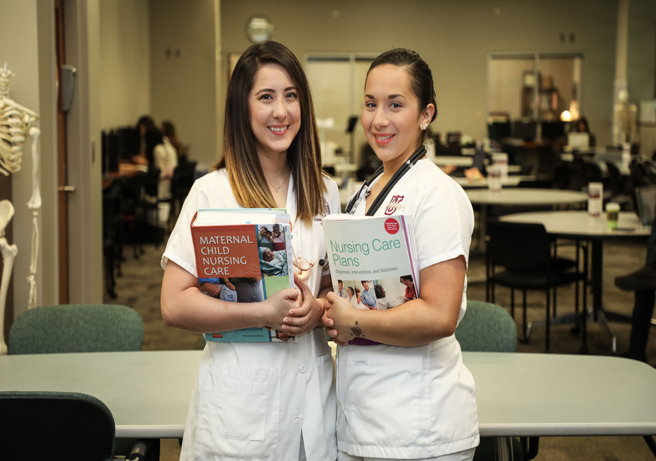
Academic Programs

Slide 27
Academic Program Successes
Nursing and Health Sciences
Admitted 120 nursing students, the largest nursing class in history.
MSN/FNP passed national certification test at 100% for second year and the BSN graduates passed at 95%.
$1.6M grant from Social Innovation fund (SIF through Methodist Healthcare Ministries).
Graduated 72 nurses, the largest class since inception of program.
Education
Will host the World Assembly of the International Council on Education for Teaching next July.
Several grant proposals from government and private foundations have been funded.
Retention rates of teachers continues to be among the highest in the State.

Slide 28
Academic Program Successes
AR Sanchez Jr. School of Business
Successful AACSB Reaccreditation.
Added new degree options in international trade and logistics to the MBA.
New Dual Master’s Degree program with Universidad Autónoma de Nuevo Leon.
IBC Speaker series again extremely successful.
Arts and Sciences
José Lozano hosted the second international communication conference, drawing participants from the United States, Mexico and Europe.
Manuel Broncano hosted the successful International American Studies Association 8th World Congress Marginalia: the Border of the Borders.
José Cardona Lopez hosted an international seminar about the Spanish American Short Novel (Nouvelle).
School of Engineering received initial accreditation from Accrediting Body for Engineering and Technology.

Slide 29
Academic Program Successes
University College
Launched 12 Signature Courses in the spring. Program was highly successful.
Established the Presidential Lecture Series which will continue into this year. One of the featured speakers this year will be Martha Nussbaum, one of the premier philosophers in the country.
Supported over 40 service-learning projects involving over 1000 students.
Established a Civic Engagement Certificate.
Saw increase in student use of both the Writing Center and the Tutoring Center. More faculty are using supplemental instruction.
Killam Library
Opened new digitization lab and have begun digitizing Special Collection material.
Expanded the Kozer collection, including personal diaries
Library usage is up significantly over last year.

Slide 30
Academic Program Successes
Graduate School
Graduate enrollment up 23% from last fall. Education has seen a 30% increase in graduate enrollment, the first increase since 2007.
Streamlined admission process.
Have become more visible in community and have improved relationships with local and regional entities.
Research and Sponsored Projects
Faculty from across the campus generated over $6.1M in grant support this past year from federal, state, local, and private sources.
Received our 6th major instrumentation grant from NSF.
Continue to be recognized as a model institution for research compliance and export control.

Slide 31
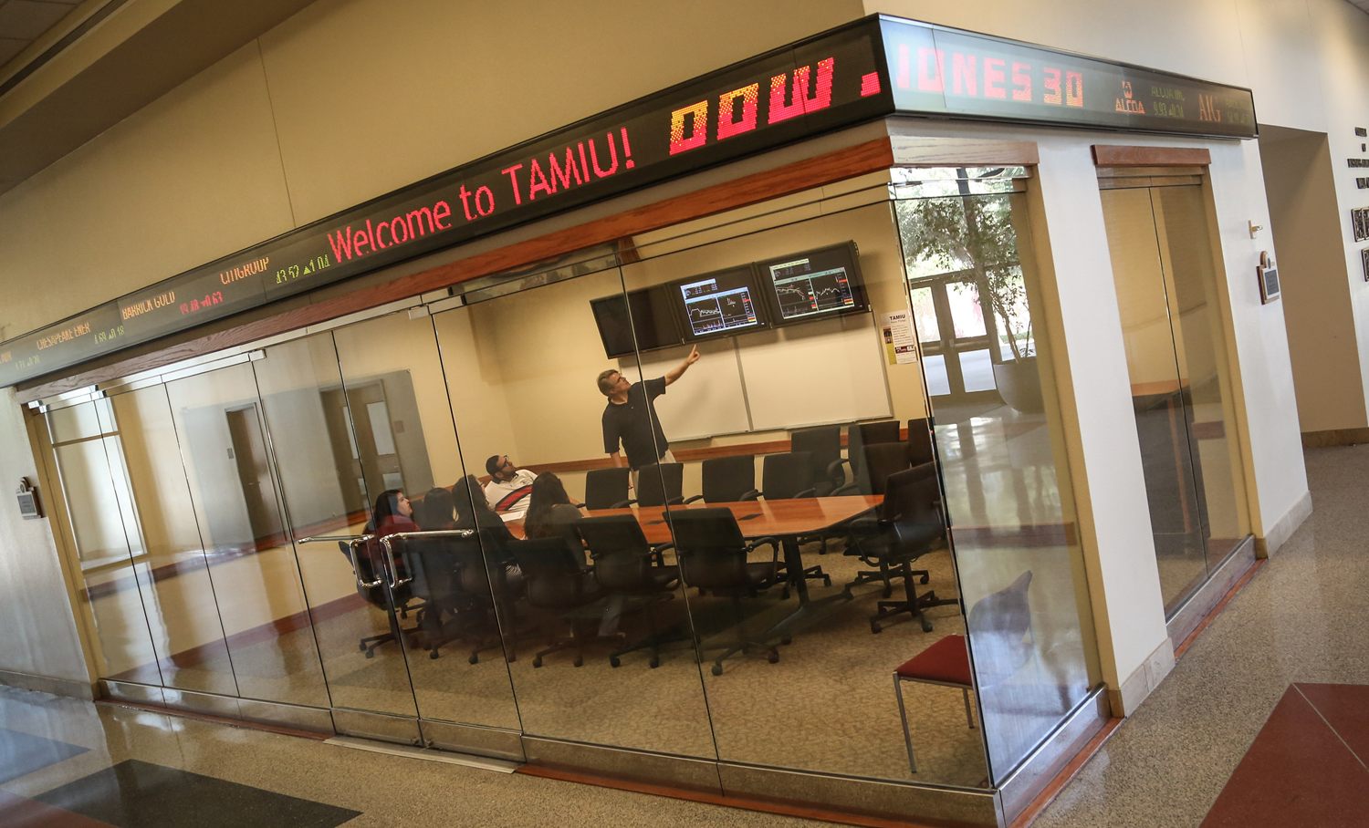
Administrative Programs

Slide 32
Administrative Program Success
Student Success
Created Presidential Scholarship and Transfer Scholarship programs which allows for automatic awarding of scholarships for academically talented students. More than 22% of our 2016 freshman class was in the top 10% and 54% in the top 25%. This puts TAMIU second in the System behind TAMU.
Increased the number of students in study abroad programs. This year we had 14 faculty-led study abroad programs with 191 students.
Received President’s Award for Community Engagement again this past year. Over 1,000 students donated over 49,000 hours in community service resulting in an in-kind investment of over $1M.
Recruited our largest freshman class of nearly 1,300.
Ad Astra was launched this past year allowing for more efficient scheduling of rooms.

Slide 33
Administrative Program Success
Athletics
Athletics recognized by NCAA for their community outreach/engagement efforts.
93 student-athletes were named to the Heartland Conference Academic Honor Roll which represents nearly 40% of athletes.
Seven teams competed in post-season play or tournaments.
Public Relations and Marketing
TAMIU's Office of Public Relations, Marketing and Information Services swept state, national and international PR competitions, earning 13 professional awards.
From the 2017 AVA Digital Awards, TAMIU earned a platinum, two gold and two honorable mentions for video entries.
TAMIU earned multiple awards, including a gold for total public relations campaign and a gold for its 2016 Annual Report the 32nd Annual Educational Advertising Awards (EAA’s).
The Public Relations Society of America (PRSA), San Antonio Chapter, awarded TAMIU the El Bronce Excellence Tactics Award for TAMIU’s 2016 Annual .
The University’s “Go Beyond” Campaign was recently showcased in the national publication, Higher Ed Marketing, which highlighted TAMIU’s marketing approach.

Slide 34
Administrative Program Success
Development
Student Philanthropy Council had another successful year. This year, they raised over $5,000.
Largest participation in the ring ceremony this past spring.
Have seen increased participation in career fairs by both students and employers.
Received a $1M endowment fro the Canseco Foundation to establish the Consuelo S. Canseco Endowment for Nursing Programs.
Finance and Administration
Groundbreaking for 118,000 sq ft new academic hall. Construction is on time and building should be ready for occupancy in fall 2019.
Completed Rec Center expansion.
Successfully implemented Campus Carry without incident.
Collaborated with the City of Laredo to host movies in the park on campus.
Successfully migrated the learning management system to Blackboard.

Slide 35
University Success
Another very productive collaboration with the Texas A&M Law School in Ft. Worth. This collaboration will continue and hopefully expand, possibly with guaranteed admission, similar to the medical school programs.
We signed a 3+3+1 agreement with the Texas A&M University School of Pharmacy, guaranteeing admission to pharmacy for TAMIU students who complete the program and meet all requirements.
Will sign an agreement in two weeks with the School of Health Professions at the University of Texas Health Science San Antonio for early admission into their graduate programs in: Physician Assistant, Occupation Therapy, Respiratory Therapy, Physical Therapy and Medical Laboratory Sciences.
Signed a MOU Haiti and the Dominican Republic to facilitate their Border Development and Modernization project. Project has the potential to engage people from across campus.
CBP Center of Excellence for Machinery will be relocated to TAMIU this Fall.

Slide 36
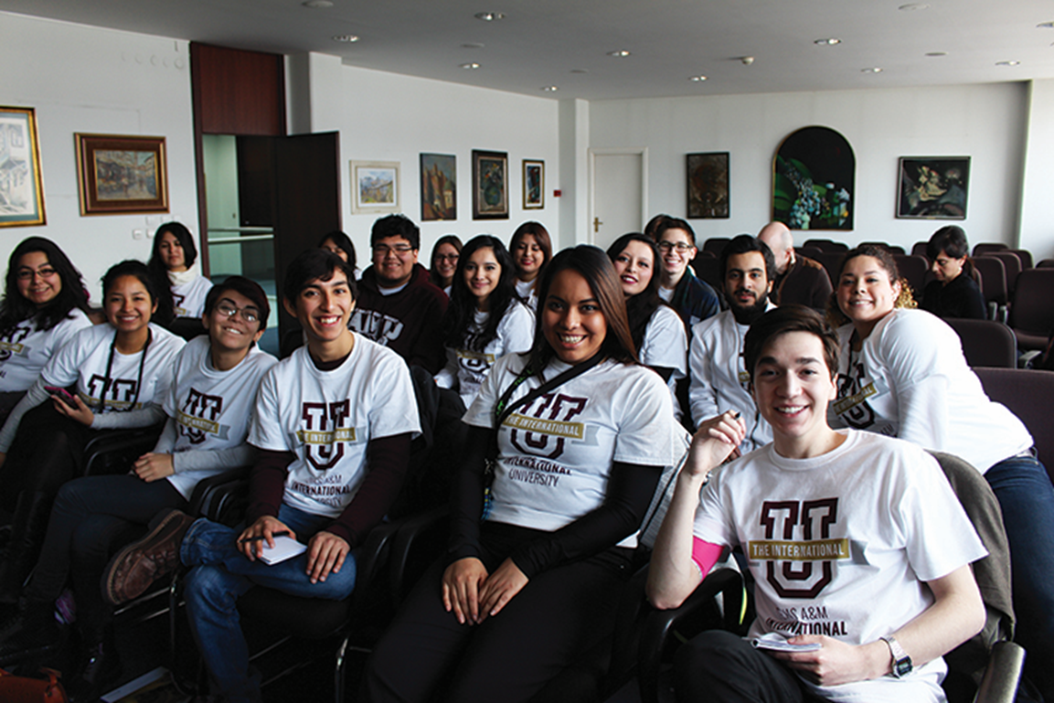
GOING BEYOND

Slide 37
Goals and Objectives: The Next 5 Years
Grow TAMIU into a comprehensive, regional University with multiple doctoral programs and a strong research portfolio.
Expand academic offerings to meet regional needs with an impact on local and regional economy.
Establish Texas A&M International University as a destination institution.

Slide 38
Goals and Objectives: The Next 5 Years
Engage students in undergraduate research experiences.
Expand regional energy, health and other research initiatives.
Increase recruitment and outreach footprint.
Increase philanthropy/donor support.

Slide 39
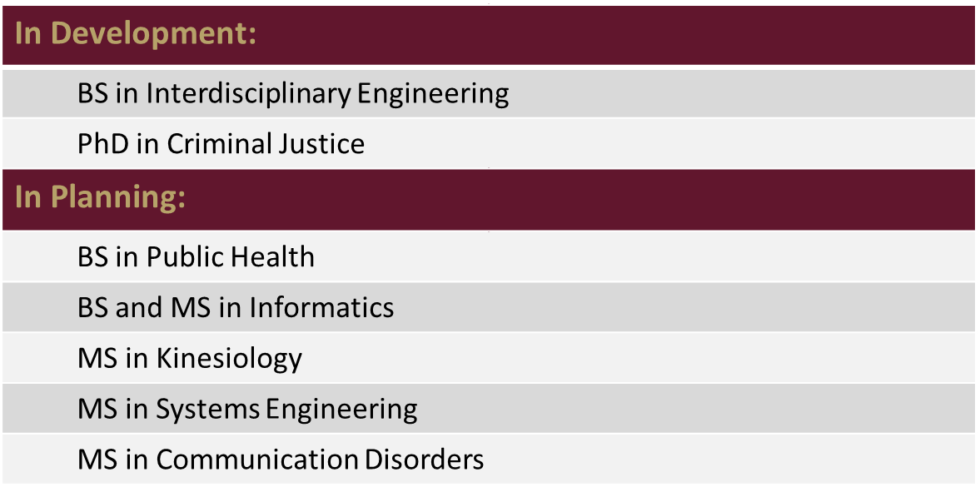
Academic Program Development

Slide 40
GOALS for 2017-2018
Develop a ROADMAP for improving four and six-year graduation rates:
Have Organized a Taskforce
Examine Course Prerequisites and Corequisites
Sequencing and Scheduling of Courses
Catalog Descriptions for Lower Division Courses to Match TCCN Descriptions
Advising and Mentoring of Undergraduate Students
Junior and Senior Year Experience
Develop Program Proposals in Interdisciplinary Engineering and PhD in Criminal Justice.

Slide 41
GOALS for 2017-2018
Integration of Computer Science across the Curriculum – Gig Economy and programming/coding.
Organize Taskforce to look at integrating entrepreneurship across the curriculum.
Create an entrepreneurship/incubator on campus.
25/50 Celebration Committee

Slide 42
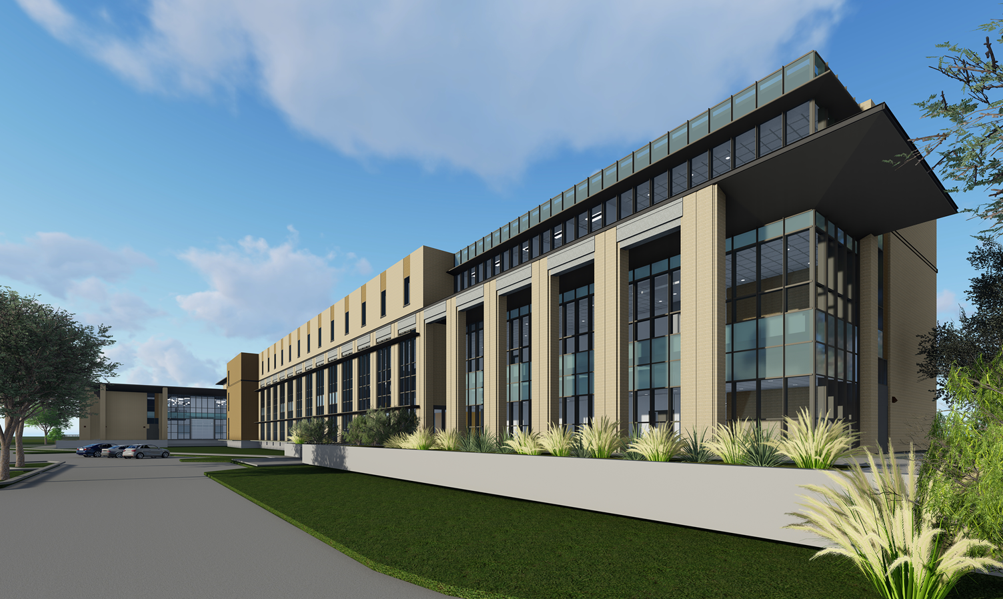
Capital Plan Update

Slide 43
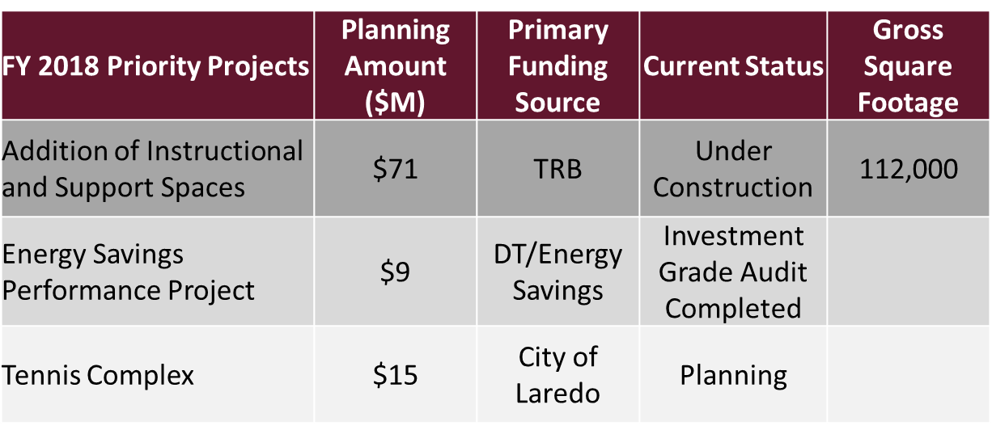
Capital Plans
Notes:
Classroom 111,000, Warehouse 11,400

Slide 44
